Slide 1

Active Learning In the Classroom
Improving Students' Engagement and Learning in Large Classes
Sridhar Iyer
sri@iitb.ac.in
IDP in Educational Technology, &
Dept of Computer Science and Engg.,
Indian Institute of Technology Bombay
SUTD, Singapore, 20 June 2016
This presentation is released under Creative Commons-Attribution 4.0 License.
You are free to use, distribute and modify it , including for commercial purposes,
provided you acknowledge the source.

Slide 2
Interdisciplinary programme in Educational Technology
Started April 2010.
Ph.D. program – Research in:
  Technology enhanced learning environments for the development of pan-domain cognitive abilities. Ex: engineering design, system-thinking, problem posing, data visualization, algorithmic thinking, spatial abilities.
  Teacher use of educational technologies and strategies.
Outreach:
  Workshops, Consultancy, Continuing Education Program.
  Pedagogies for effective use of educational technologies.
    Workshops of varying durations - 3 days to 3 weeks to 3 months.
    Face-to-face as well as distance education modes.
    4000+ teachers attended the workshop in Jan 2015, via remote classrooms.
    5500+ teachers attended MOOC on IITBombayX during Jan-Mar 2016.
  This talk is an overview of some topics from these workshops.

Slide 3
How engaged are your students?
Consider a large class. (In IITB - 111/ 112, N ~ 150; CS 101, N~250 per section)
Imagine a 90-minute class in a large auditorium with fixed seats.
Think (Individually):
  Predict the percentage of students who may be showing “engaged” behaviour (with the content of the lecture), at various instants of time.
  Draw a graph of engagement versus time. [~1 min]
Percentage of
students engaged
% e
t (Time instant of lecture)

Slide 4
How engaged are your students?
Consider a large class.
Imagine a 90-minute class in a large auditorium with fixed seats.
Think (Individually):
  Predict the percentage of students who may be showing “engaged” behaviour (with the content of the lecture), at various instants of time.
  Draw a graph of engagement versus time. [~1 min]
Pair (with your neighbour):
  Examine each other’s graphs. [~1 min]
  Together, come up with two techniques that could be used to convert your graph into something that looks like the figure shown. [~2 min]
80%
Percentage of
students engaged
% e
t (Time instant of lecture)

Slide 5
How engaged are your students?
Consider a large class. Imagine a 90-minute class in a large auditorium with fixed seats.
Think (Individually):
  Predict the percentage of students who may be showing “engaged” behaviour (with the content of the lecture), at various instants of time.
  Draw a graph of engagement versus time. [~1 min]
Pair (with your neighbour):
  Examine each other’s graphs. [~1 min]
  Together, come up with two techniques to convert your graph into something that looks like the figure. [~3 min]
Share (entire audience):
  Share pros and cons of some techniques. [~2 min each]
  Identify top three techniques that are likely to “succeed”. [~3 min]
% e
80%
t (Time instant of lecture)

Slide 6
Can we engage students by …
Telling jokes?
  - only during the joke ☺
Historical anecdotes?
  - interesting, useful - but can only be done occasionally
Giving real life context?
  - necessary, good motivation, but again, 1-2 times per topic
Showing demos, videos
  - useful but not sufficient
Asking – “do you have any doubts?”
  - necessary, might results in ‘blips’ in engagement curve
Asking a question related to the topic?
  - necessary, might results in ‘blips’ in engagement curve

Slide 7
How to maintain students’ engagement in the content?
Active learning.

Slide 8
My lectures are plenty interactive!
I often pause to ask students if they understood the material
I allow students to interrupt whenever they have doubts
I never hesitate to answer their questions
I show them demos and videos
….
Isn’t this active learning?

Slide 9
Why ‘interactive lectures’ may not be enough
Students don’t pay utmost attention throughout the lecture.
Students think that they understand because they can follow the lecture.
  - They are not confronted with their misconceptions immediately.
Difficult to ensure that all students in the class participate actively.
  Students with high motivation / achievement levels drive the pace
  Students with low achievement levels get left behind.
Students have a barrier to responding directly to the instructor.
  Shy students don’t ask questions, or give answer, even if they have one.
  Forcing all students to respond tends to be counter-productive.

Slide 10
Requirements of active learning strategies
Students go beyond listening, copying of notes, execution of prescribed procedures.
Instructor designs activities that require students to talk, write, reflect and express their thinking.
Explicitly based on theories of learning.
Evaluated repeatedly through empirical research.
D. E. Meltzer and R. K. Thornton. "Resource letter ALIP–1: active-learning instruction in physics." Am. J. Phys, 80.6 (2012): 478-496

Slide 11
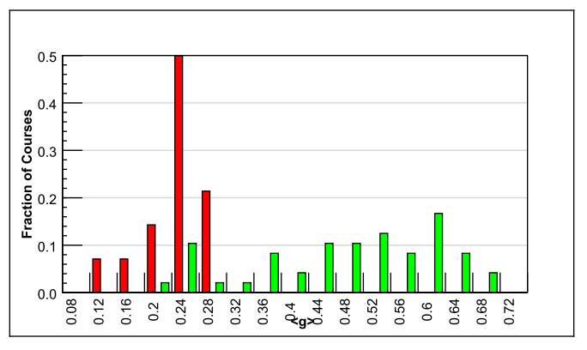
Evidence for active learning – 1
Comparative study of 62 Physics courses (1998)
6542 students
Variety of institutions: high school, college, university
Test of conceptual reasoning – Force Concept Inventory
Pre-post, semester long
Trad lecture (14)
Active learning strategies (48)
Normalized gain
<g> = ^{post-pre} ^{100-pre}
IMPLICATION
Desirable to explicitly incorporate active learning strategies in our teaching-learning.
RESULTS:
Maximum gain from lecture courses was 0.28
  - Many instructors had high scores on teaching evaluations
Gain from active-learning courses had a wide range: 0.23-0.7
  - AL courses had gains 2-3 times greater than lectures
R. Hake, “Interactive-engagement versus traditional methods: A six-thousand student survey of mechanics test data for introductory physics courses” Am. J. Phys., 66 (1998)

Slide 12
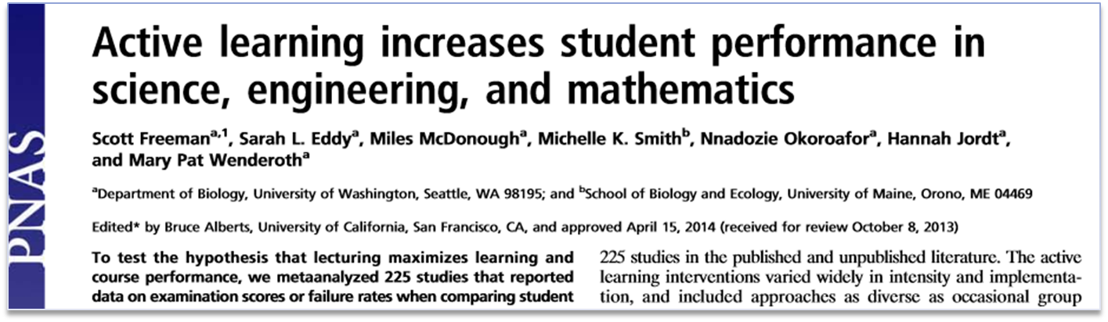
Evidence for active learning – 2
Proc. Natl. Acad. Sc, 111(23), 2014
Meta-analysis of 225 studies (2014)
Exam performance: higher by 0.47 standard deviations in active learning courses– ~ 1/2 letter grade average increase.
Failure rates : 33.8% in traditional classes vs 21.8% in active learning courses
Results hold across STEM disciplines, majors and non-majors, lower- and upper-division courses.
Effect sizes greater for concept inventories than for instructor-written exams.

Slide 13
Features of active learning strategies
Students engage in problem-solving activities during lecture.
Students work collaboratively.
Students are asked to “ﬁgure things out for themselves.”
Students are asked to express their reasoning explicitly.
Qualitative reasoning, conceptual thinking are emphasized.
Speciﬁc student ideas are elicited and addressed.
Students receive rapid feedback on their work.
Ensure (most) students participate
Target misconceptions
from ‘… think they understand’
to ‘… know whether or not understand’

Slide 14
Implementing active learning in your classes – some activities
Ask students to:
Pose problem, ask students to begin the problem solution
Ask students to complete the last 2 steps in the problem
Figure out the next step in the derivation
Devise possible reasons for an observation (shown in a video)
Predict the outcome of an program (shown in a video/ animation)
Brainstorm a list of methods to solve a design problem
Debate pros & cons of various methods

Slide 15
Important good practice –
Applicable for all active learning strategies
GET STUDENT BUY-IN.
Create it by explaining why you are doing this.
Better still demonstrate why you are doing this.
Notes:
15

Slide 16
What are some active learning strategies?
Peer-Instruction [Eric Mazur, Harvard University, early 1990s]
Think-Pair-Share [Frank Lyman, University of Maryland, early 1980s]
Team-Pair-Solo [Spencer Kagan, University of California, early 2000s]
Many others:
  Debates, Role-play, Jigsaw, problem-based learning, productive failure.

Slide 17
Peer-Instruction is a classroom active-learning strategy based on specific, well-designed questions, often of the multiple-choice type.
Notes:
17

Slide 18
Vote individually
An object floats in water but sinks in oil. When it floats in water it is exactly halfway submerged.
If we slowly pour oil on top until the oil completely covers the object, does the object:
Move up
Stay in place
Move down
?

Slide 19
Convince your neighbor
An object floats in water but sinks in oil. When it floats in water it is exactly halfway submerged.
If we slowly pour oil on top until the oil completely covers the object, does the object:
Move up
Stay in place
Move down
?

Slide 20
Converge … and vote again
An object floats in water but sinks in oil. When it floats in water it is exactly halfway submerged.
If we slowly pour oil on top until the oil completely covers the object, does the object:
Move up
Stay in place
Move down
?

Slide 21
Dissecting Peer-Instruction method
What do students do? What are the benefits?
Talk, argue, listen (sometimes), reason, draw => Actively engaged
Learn from each other, teach each other (teach<=>learn)
Those who don’t know willing to think, reason, answer
Those who do know also participate
Pre-existing thinking is elicited, confronted, resolved (How many of
you changed your answer?)
What are benefits to instructor? To the class atmosphere?
Immediate feedback to instructor
Students realize that even others are struggling
Builds a friendly, yet scientific atmosphere
Improve communication

Slide 22
More on Peer-Instruction
Overview-level (following slides)
Details (later within this presentation)
Workshop (constructors, videos)

Slide 23

Anatomy of Peer-Instruction method
Ask Question
(May vote individually)
…Lecture…
Debrief /
Class Discussion
Peer Discussion
Vote
Figure attributed to: Stephanie Chasteen and the Science Education Initiative at the University of Colorado
See also: Peer Instruction, A User’s Manual. Eric Mazur.
23
Notes:
23

Slide 24

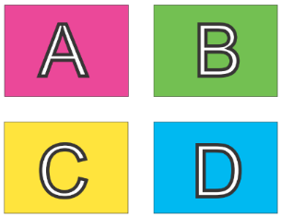
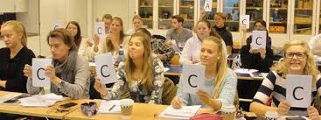

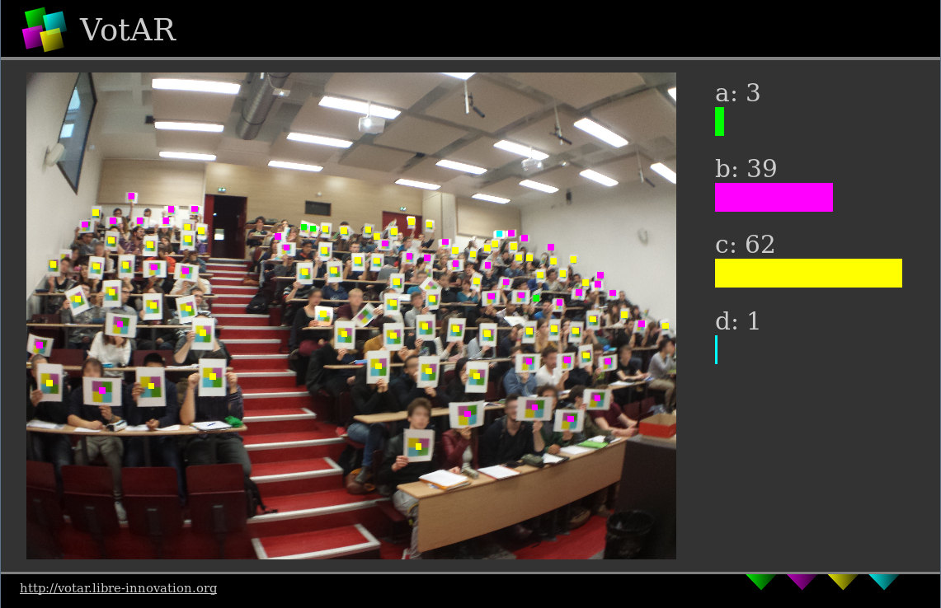
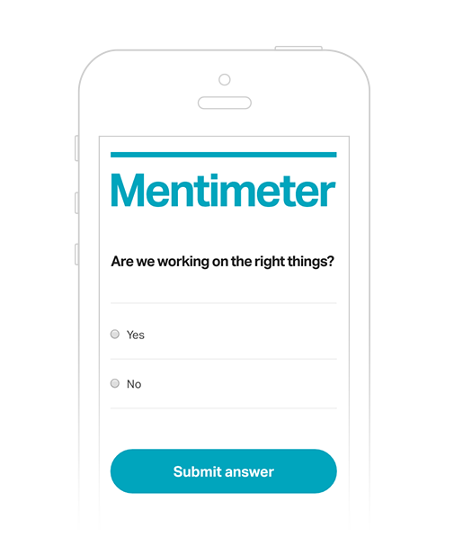



Implementation of Peer-Instruction
www.votar.libre-innovation.org
www.mentimeter.com

Slide 25
Example 1: Counting iterations
Below is the for loop for calculating the factorial of a number. How many times is this set of code executed ?
for (i = 1; i <= N; i ++) {
nFactorial = nFactorial * i;
}
1 time
N times
N -1 times
N + 1 times

Slide 26
Example 2: Predict the outcome of a program
What is the output of the code shown below?
int main() {
int a = 1; b = 2; c = 3;
int *p, *q;
p = &a; q = &b;
c = *p; p = q;
*p = 13;
cout << a << b << c;
}
a=1, b=2, c=3
a= 1, b=13, c=1
a=1, b=2, c=1

Slide 27
What makes a peer-instruction question “good”?
An effective peer-instruction question:
  Is usually conceptual (avoid long analytic computation)
  Elicits pre-existing thinking, students’ alternate conceptions
  Has believable distractors
  Asks students to predict results of experiment, or algorithm
  Makes students apply ideas in new context
  Relates different representations
  is not ambiguous
  is not leading
  is not ‘trivial’
Adapted from Clicker Resource Guide, Science Education Initiative/ CU-Boulder .
27

Slide 28
When to use PI within the learning cycle
BEFORE
Setting up instruction
(beginning of module)
DURING
Developing knowledge
(middle of module)
AFTER
Assessing learning
(end of module)
Questions to:
Motivate
Discover
Provoke thinking
Assess prior knowledge
Questions to:
Check knowledge
Application
Analysis
Evaluation
Synthesis
Elicit misconception
Questions to
Relate to big picture
Demonstrate success
Review or recap
Exit poll
Adapted from From from “iClicker” by Stephanie Chasteen and the Science Education Initiative at the University of Colorado
28
Notes:
An alternate presentation of the Question Cycle by Peter Newbury
28

Slide 29
Challenges you might face
POSSIBLE CHALLENGES | RECOMMENDED STRATEGIES
The class is too quiet. | Be patient – students’ reluctance to discuss improves after 3-4 iterations Do solo vote, allow enough time
The class is too noisy. | That’s ok, this is good noise. Most students are seen to be on task.
Some students just may not participate. | Explain why you are doing this, use challenging & interesting questions, … let them be
The class will get chaotic. How do I get students back? | Use a cue such as a bell
Notes:
29

Slide 30
Plenty of resources
Peer-instruction How-tos, workshop slides, videos, research … Carl Wieman Science Education Institute http://www.cwsei.ubc.ca/resources/clickers.htm
and host of links from within
Instructors in many disciplines have posted peer-instruction questions for their courses – physics, CS, Statistics – use Google (search with varied nomenclature – PI, clickers, PRS)
BUT …
We need to create a library of questions for our courses, report experiences in our context.
Please participate! www.et.iitb.ac.in
Notes:
30

Slide 31
What are some active learning strategies?
Peer-Instruction [Eric Mazur, Harvard University, early 1990s]
Think-Pair-Share [Frank Lyman, University of Maryland, early 1980s]
Team-Pair-Solo [Spencer Kagan, University of California, early 2000s]
Many others:
  Debates, Role-play, Jigsaw, problem-based learning, productive failure.

Slide 32
Think-Pair-Share is a classroom active-learning strategy in which students work on a problem posed by instructor,
  first individually (Think),
  then in pairs (Pair) or groups, and
  finally together with the entire class (Share).
Notes:
32

Slide 33
Recall the activity - How engaged are your students?
Consider a large class. Imagine a 90-minute class in a large auditorium with fixed seats.
Think (Individually):
  Predict the percentage of students who may be showing “engaged” behaviour (with the content of the lecture), at various instants of time.
  Draw a graph of engagement versus time. [~1 min]
Pair (with your neighbour):
  Examine each other’s graphs. [~1 min]
  Together, come up with two techniques to convert your graph into something that looks like the figure. [~3 min]
Share (entire audience):
  Share pros and cons of some techniques. [~2 min each]
  Identify top three techniques that are likely to “succeed”. [~3 min]
% e
80%
t (Time instant of lecture)

Slide 34
Dissecting Think-Pair-Share method
What do students do? What are the benefits?
Talk, argue, listen (sometimes), reason, draw => Actively engaged
Learn from each other, teach each other (teach<=>learn)
Those who don’t know and those who do know also participate
Students can tackle large and ill-structured problems
What are benefits to instructor? To the class atmosphere?
Immediate feedback to instructor
Builds a friendly, yet scientific atmosphere
Improves ability to consider multiple points of view
Includes all students in the teaching-learning process

Slide 35
More on Think-Pair-Share
Overview-level (following slides)
Details (later within this presentation)
Workshop (constructors, videos)

Slide 36
TPS: Definition
T (Think): Teacher asks a specific question about the topic. Students "think" about what they know or have learned, and come up with their own individual answer to the question. [Takes 1-3 Minutes].
P (Pair): Teacher asks another question, related to the previous one, that is suitable to deepen the students’ understanding of the topic. Each student is paired with another student. They share their thinking with each other and proceed with the task. [Takes 5-10 Minutes].
S (Share): Students share their thinking (or solution) with the entire class. Teacher moderates the discussion and highlights important points. [Takes 10-20 minutes].

Slide 37
Think-Pair-Share – Example – Design a solution
“Design a taxi scheduling service for an airport as follows:
When a driver arrives, his ID is entered in an array
When a customer arrives the earliest waiting driver is assigned
Think: What structures and variables are required?
Pair: Come up with the pseudo-code for the functions that are required.
Share: : Follow instructor led discussion of your solutions and others.
Question from CS101, Spring 2014

Slide 38
TPS in CS 101: Example (conceptual)
“Consider an unsorted array of N elements”.
Think: Write the pseudo code for sorting the array.
  Students do: Write down answer the given question.
  Instructor does: Encourages students to write, instead of working mentally.
Pair: Discuss your answer with your neighbor, do pros and cons analysis of your algorithms.
  Students do: (i) Identify parts of the answer that they have missed out. (ii) Discuss which answer is better; do pros-cons analysis if there are multiple solutions.
  Instructor does: (i) Walks around the class to get a feel of student solutions. (ii) Gives comments where necessary, to ensure that discussion is on-track.
Share: Participate in discussion of your solution and others.
  Students do: (i) Share their own solution. (ii) Critique other’s solutions.
  Instructor does: Discusses (i) What are all the essential parts in the answer? (ii) Pros-cons of various solutions given by students.
This TPS activity led to a discussion of various sorting algorithms.

Slide 39
Active learning in IITB courses – Research results

Slide 40
Research studies on active learning techniques
 | COURSE | ACTIVE LEARNING STRATEGY | RESULT
CS101 | Computer programming 2013 & -14 (N=450, each) | Think-Pair-Share, Peer Instruction A. Kothiyal, R Majumdar, SM and S Iyer. “Effect of Think-Pair-Share in a large CS1 class: 83% sustained engagement” ACM International Computing Education Research, San Diego, 2013 | 83% students engaged (observation protocol) Higher learning than lecture (controlled expt) High student perception (survey, course eval)
EE 590 | Foundations of projects 2014 | GPGP – Guided Problem-solving and Group Programming A Anand, A Kothiyal, B Rajendran and SM. Guided Problem Solving and Group Programming: A Technology-Enhanced Teaching-Learning Strategy for Engineering Problem Solving. IEEE International Conference T4E 2014, Kollam. | Significant pre-post gain on problem-solving skills; High perception of learning
EE 746 | Neuromorphic engg 2013 | Delayed Guidance – in-class ill-structured problem solving A Kothiyal, B Rajendran and SM. Delayed Guidance: A teaching-learning strategy to develop ill-structured problem solving skills in engineering. LaTiCE 2015, Taipei | Higher problem solving skills compared to traditional methods (controlled expt); Wider range of problem solving heuristics
CS 213 | Data structures and algos. 2014 | Think-Pair-Share D Reddy, S Mishra, G Ramakrishnan and SM. Thinking, Pairing, and Sharing to improve learning and engagement in a Data Structures and Algorithms (DSA) class. LaTiCE 2015, Taipei | Relative gain twice for TPS topic than traditionally taught topic Majority students wanted more TPS topics
CS 716 | Computer networks 2009, -10, -11 | Analogical problem solving, TPS, PI S Iyer and SM. “Demystifying networking: teaching non-majors via analogical problem-solving”. ACM Symposium on Computer Science Education (SIGCSE 2013), Denver, USA, March 2013. | Students able to apply concepts from real life to solve networking problems in new unseen topic

Slide 41
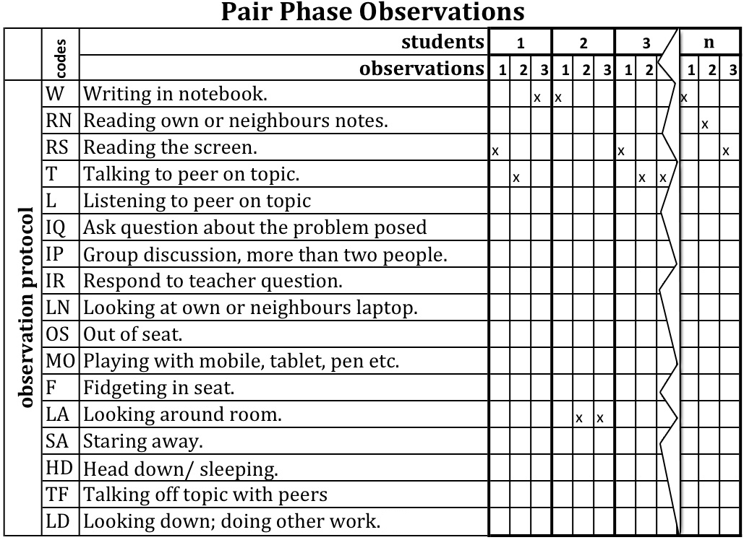
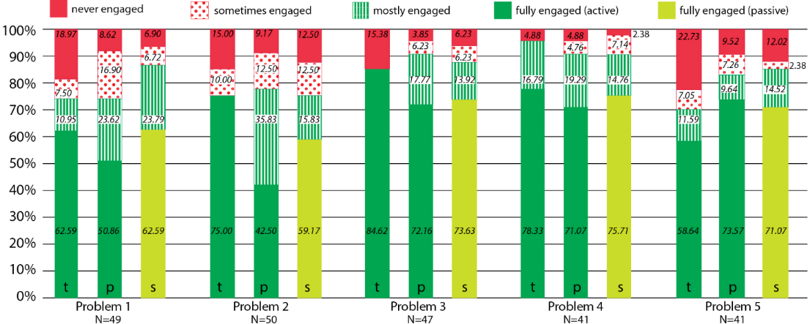
Measuring student engagement and learning - CS101
Observation Protocol
Overall engagement across T, P, S (N=228). Av. = 83%
Experimental group Mean (N-250) | Control group Mean (N=169) | p
1.91 (1.65) | 0.88 (1.3) | 0.001**
Learning – problem solving test, 2 groups
Scores of TPS group higher than control group
A.Kothiyal, R. Majumdar, S. Murthy and S. Iyer, “Effect of Think-Pair-Share in a large CS1 class: 83% sustained engagement” ACM International Computing Education Research (ICER) Workshop, San Diego, 2013
A. Kothiyal, S. Murthy and S. Iyer, “Think-Pair-Share in a large CS1 class: Does learning really happen?” ACM Innovations and Technology in Computer Science Education (ITiCSE) , Uppsala, 2014

Slide 42
Summary of TPS setup guidelines
Download the TPS-activity-constructor resource sheet from:
  Download from www.et.iitb.ac.in/resources
Three points to keep in mind:
  Ensure that there is a clear ‘deliverable’ for each phase. This drives the action in that phase.
  Ensure that the phases are logically connected. They should use the output of one phase in next.
  Ensure that there is sufficient time for each phase.
  Too little → Frustration; Too much → Boredom.
  Move on when 80% of the class has finished.

Slide 43
Closing – Fostering active-learning in your class
Think (Individually):
Choose a topic that you are about to teach. Come up with one activity that you will implement in class that requires students to talk, write, reflect and express their thinking. (~3 min).
Pair (with your neighbor):
Examine your neighbor’s activity. Does it ensure that majority of students are actively engaged - beyond listening, copying of notes?
If not, what modifications do you suggest? (~5 min).
Share (with everyone):
Your topic and strategy. (~10 min).
43
Notes:
43

Slide 44
Peer-Instruction Details

Slide 45
Anatomy of Peer-Instruction method
Ask Question
(May vote individually)
…Lecture…
Debrief /
Class Discussion
Peer Discussion
Vote
Figure attributed to: Stephanie Chasteen and the Science Education Initiative at the University of Colorado
See also: Peer Instruction, A User’s Manual. Eric Mazur.
45
Notes:
45

Slide 46
Implementation of Peer-Instruction
www.votar.libre-innovation.org
www.mentimeter.com

Slide 47
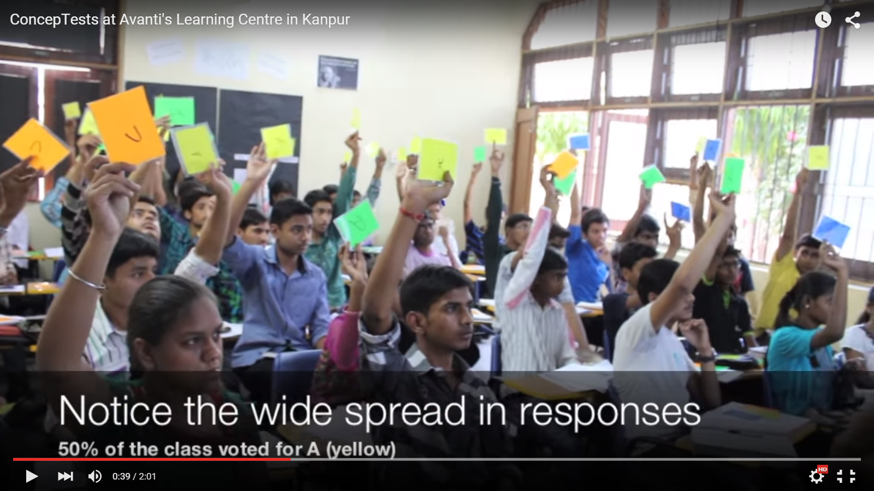
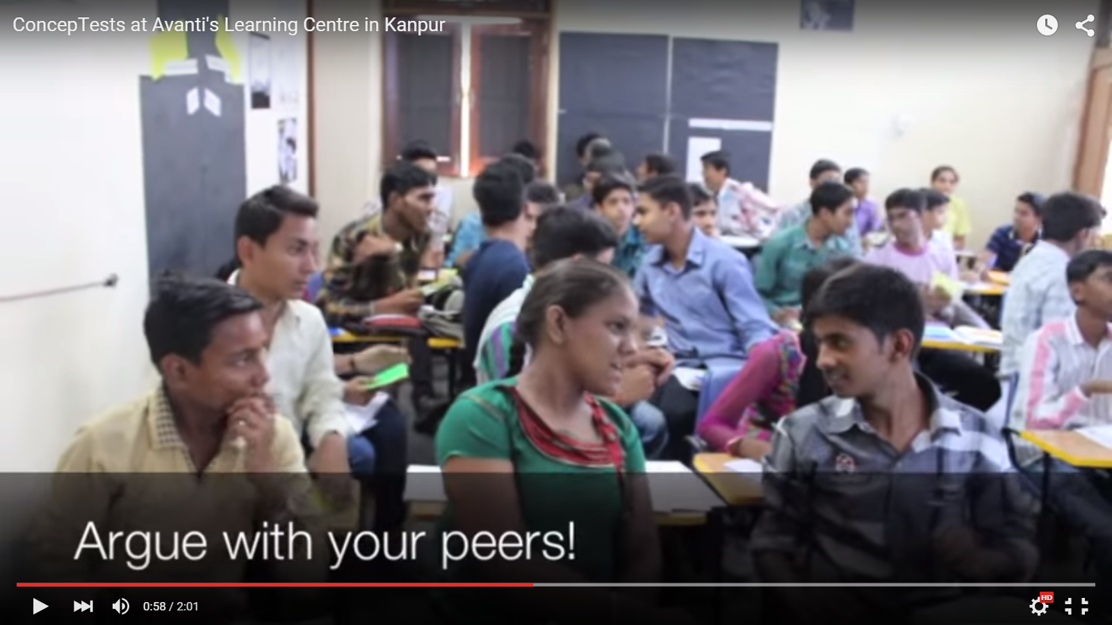
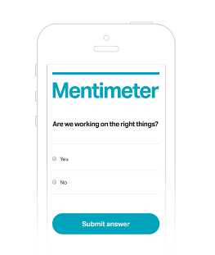

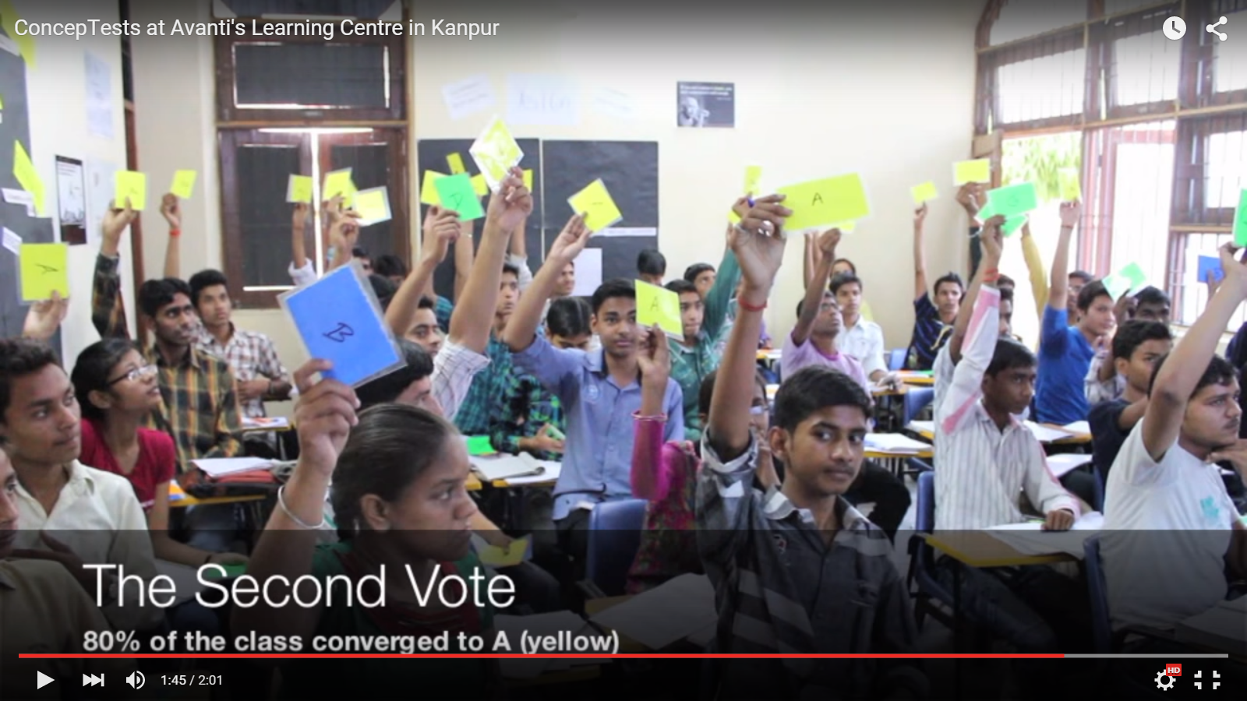
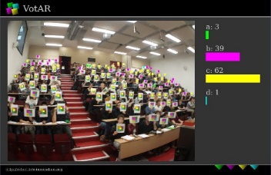
Implementation of Peer-Instruction

Slide 48
Example – Conceptual reasoning
A parallel plate capacitor is charged to a total charge Q and then the battery is removed. A dielectric slab is inserted between the plates.
What happens to the energy stored in the capacitor?
Increases
Decreases
Stays the same
I need more info to answer
Goal – to get students to reason verbally and conceptually.

Slide 49
Example- “no single right answer”
A block m sits on a rough inclined surface, attached with a spring (extended) to a fixed point at the other end. As the block moves up the incline a small distance, how many forces are exerted on the block?
One force
Two forces
Three forces
Four forces
Five forces
More than five forces
Impossible to determine
None of the above
Good question to get students to model a physical system
From ‘Example Questions’ ppt, Stephanie Chasteen / Science Education Initiative/ CU-Boulder . Original credit Bill Gerace, U. Mass Amherst

Slide 50

Example - Predict the outcome (of an expt, video)
A helium balloon is attached to a string tied to the bottom of a cart on wheels. The sides of the cart are encased in clear plastic. A person will abruptly push the cart to the
left. Will the balloon move?
  Yes, to the left
  Yes, to the right
  No
Let students vote, only then show movie
http://paer.rutgers.edu/pt3/experiment.php?topicid=13&exptid=121
Goal – to get students to make predictions based on learnt theory, discuss reasoning in wrap-up
(this expt is counter-intuitive)

Slide 51
Example – Reasoning with representations
Which circuit will satisfy the given input-output relationship?
Goal – to get students to reason diagrammatically
1.
2.
3.
4.

Slide 52
Why Peer-Instruction
Notes:
52

Slide 53
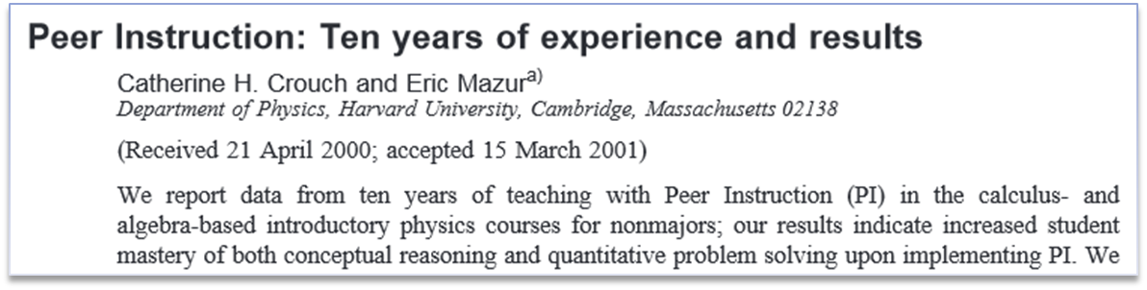
Research on Peer Instruction
300+ studies in various domains – Physics, CS, EE, psychology, political science, …
Meta-analyses
Several measures:
  - conceptual understanding, problem solving, attendance, motivation, learning from peers, student perceptions of

Slide 54
PI one of the most widely researched* strategies
(* This is good because …)
Extent of research
  300+ research articles
  Physics, biology, chemistry maths, CS, engineering, psychology, medicine & nursing …
  Many controlled studies using standardized tests
Courses using peer instruction outperform traditional lecture courses on a common test
Students can better answer a question on their own, after peer instruction discussion, (especially difficult questions) – study with 16 pairs of isomorphic questions Smith et al, Science 2009
Research on student perception says: clickers help students show up for class, feel part of class community, make their voice heard, hold them accountable …

Slide 55
Writing effective Peer-Instruction questions
Notes:
55

Slide 56
Example 1: Counting iterations
Below is the for loop for calculating the factorial of a number. How many times is this set of code executed ?
for (i = 1; i <= N; i ++) {
nFactorial = nFactorial * i;
}
1 time
N times
N -1 times
N + 1 times

Slide 57
Example 2: Predict the outcome of a program
What is the output of the code shown below?
int main() {
int a = 1; b = 2; c = 3;
int *p, *q;
p = &a; q = &b;
c = *p; p = q;
*p = 13;
cout << a << b << c;
}
a=1, b=2, c=3
a= 1, b=13, c=1
a=1, b=2, c=1

Slide 58
Example 3: What does this code do?
main () {
int vn=9, va[vn];
for (int i = 0; i < vn; i++) va[i] = i * (vn – 1 –i);
for (int i = 0; i < vn; i++) cout << va[i] << “,”;
cout << endl;
}
What does this code do?
Calculates values of array va[]
Prints the values of first vn elements of va
Initializes the array va and prints it
Finds maximum element in the array

Slide 59
Example 4: What will happen if …. ?
Consider the function and main program shown below.
void fun (int& x) { x = 5; }
int main () {
int a = 3;
fun(a);
cout << a << endl;
}
What will happen if we change the function call from
fun (int& x) to fun (int x) ?
No change in the output
Program will not compile
a = 5 will be printed
a = 3 will be printed

Slide 60
Example 5: Debug
int val = 5;
switch (val) {
case 5: cout << “five ”;
break;
case 4: cout << “four ”;
break;
default: cout << “default”;
break;
}
What will happen if we forget to include ‘break’ statement?
Compiler error
It will print only five
It will print five four
It will print five four default

Slide 61
What makes a peer-instruction question “good”?
An effective peer-instruction question:
  Is usually conceptual (avoid long analytic computation)
  Elicits pre-existing thinking, students’ alternate conceptions
  Has believable distractors
  Asks students to predict results of experiment, or algorithm
  Makes students apply ideas in new context
  Relates different representations
  is not ambiguous
  is not leading
  is not ‘trivial’
Adapted from Clicker Resource Guide, Science Education Initiative/ CU-Boulder .
61

Slide 62
What makes a good Peer-Instruction question?
clarity | Students should waste no effort trying to figure out what’s being asked.
context | The topic of the question should be relevant to the class.
connection to learning goals | Does the question make students do the right thing to demonstrate they grasp the concept.
distractors | i) Must be plausible. ii) “Wrong” choices should tell you something about students’ thinking.
difficulty | Check that the question is not too trivial or too hard (note – there exists a theory for this)
stimulates thoughtful discussion | The question should engage students and spark thoughtful discussions. Is there potential for you to be “agile”?
Adapted from “Writing Questions” by Stephanie Chasteen and the Science Education Initiative at the University of Colorado
Notes:
Courtesy of Cynthia Heiner and Peter Newbury
You may then show a series of questions to participants and ask them to consider these aspects: clarity, context, connection, distractors, difficulty, and discussion
62

Slide 63
Activity – write your own question
Choose a topic in an Intro-to-programming course.
Write 3 peer-instruction question in that topic.
Make sure you include the choices too ~ 3 to 5.
Recall – An effective PI question :
  Elicits pre-existing thinking, students’ misconceptions
  Has believable distractors
  Asks students to predict results of a program or algorithm
  Makes students apply ideas in new context
  Relates different representations
Avoid
  Long calculations
  Trivial questions

Slide 64
When to use Peer-instruction questions
Notes:
64

Slide 65
Questions within the learning cycle
BEFORE
Setting up instruction
(beginning of module)
Questions to:
Motivate
Discover
Provoke thinking
Assess prior knowledge
Notes:
An alternate presentation of the Question Cycle by Peter Newbury
65

Slide 66
Questions within the learning cycle
BEFORE
Setting up instruction
(beginning of module)
DURING
Developing knowledge
(middle of module)
Questions to:
Motivate
Discover
Provoke thinking
Assess prior knowledge
Questions to:
Check knowledge
Application
Analysis
Evaluation
Synthesis
Elicit misconception
Notes:
An alternate presentation of the Question Cycle by Peter Newbury
66

Slide 67
Questions within the learning cycle
BEFORE
Setting up instruction
(beginning of module)
DURING
Developing knowledge
(middle of module)
AFTER
Assessing learning
(end of module)
Questions to:
Motivate
Discover
Provoke thinking
Assess prior knowledge
Questions to:
Check knowledge
Application
Analysis
Evaluation
Synthesis
Elicit misconception
Questions to
Relate to big picture
Demonstrate success
Review or recap
Exit poll
Adapted from From from “iClicker” by Stephanie Chasteen and the Science Education Initiative at the University of Colorado
67
Notes:
An alternate presentation of the Question Cycle by Peter Newbury
67

Slide 68
Challenges and Best Practices
Notes:
68

Slide 69
Challenges you might face
POSSIBLE CHALLENGES | RECOMMENDED STRATEGIES
The class is too quiet.
The class is too noisy.
Notes:
69

Slide 70
Challenges you might face
POSSIBLE CHALLENGES | RECOMMENDED STRATEGIES
The class is too quiet. | Be patient – students’ reluctance to discuss improves after 3-4 iterations Do solo vote, allow enough time
The class is too noisy.
Notes:
70

Slide 71
Challenges you might face
POSSIBLE CHALLENGES | RECOMMENDED STRATEGIES
The class is too quiet. | Be patient – students’ reluctance to discuss improves after 3-4 iterations Do solo vote, allow enough time
The class is too noisy. | That’s ok, this is good noise. Most students are seen to be on task.
Notes:
71

Slide 72
Challenges you might face
POSSIBLE CHALLENGES | RECOMMENDED STRATEGIES
The class is too quiet. | Be patient – students’ reluctance to discuss improves after 3-4 iterations Do solo vote, allow enough time
The class is too noisy. | That’s ok, this is good noise. Most students are seen to be on task.
Some students just may not participate. | Explain why you are doing this, use challenging & interesting questions, … let them be
Notes:
72

Slide 73
Challenges you might face
POSSIBLE CHALLENGES | RECOMMENDED STRATEGIES
The class is too quiet. | Be patient – students’ reluctance to discuss improves after 3-4 iterations Do solo vote, allow enough time
The class is too noisy. | That’s ok, this is good noise. Most students are seen to be on task.
Some students just may not participate. | Explain why you are doing this, use challenging & interesting questions, … let them be
The class will get chaotic. How do I get students back? | Use a cue such as a bell
Notes:
73

Slide 74
Best Practices
On Writing Questions
Recommended – questions requiring conceptual reasoning (verbal, logical, diagrammatic)
Avoid – questions involving number crunching (but can use PI to precede a numerical problem, for ex … )
Recommend – Mix it up.
  WHY: different pedagogical goals : bringing out a misconception, predicting an outcome, recall point from last class
  WHAT: different types of questions: survey, representations, reasoning, Y/N
  WHEN: at a variety of points during class (beginning / middle / end)
Avoid - questions that can be answered by memorization (unless that’s your goal, then use sparingly).
Notes:
74

Slide 75
Best Practices
On Facilitating Peer-Instruction
DON’T SKIP ON PEER DISCUSSION (if single vote, only after group talk)
FOCUS ON REASONING NOT ON RIGHT ANSWER.
  Withhold judgment. Do not give ‘rapid rewards’ (nodding in assent)
  Discuss reasons for right and wrong answers
  Ask multiple students to give answers.
TIME. Recommended 2-5 minutes per question.
FREQUENCY. Recommended – a “few” per class, 2-4.
CREDIT. Do not assign heavy credit for right / wrong answers. Some instructors (with clickers) assign a “whiff” of credit for participation.
I like to circulate, listen to student reasoning, give individual attention
Notes:
75

Slide 76
Plenty of resources
Peer-instruction How-tos, workshop slides, videos, research … Carl Wieman Science Education Institute http://www.cwsei.ubc.ca/resources/clickers.htm
and host of links from within
Instructors in many disciplines have posted peer-instruction questions for their courses – physics, CS, Statistics – use Google (search with varied nomenclature – PI, clickers, PRS)
BUT …
We need to create a library of questions for our courses, report experiences in our context.
Please participate! www.et.iitb.ac.in
Notes:
76

Slide 77
Think-Pair-Share Details

Slide 78
Clicker Question
Consider a large class. Ex: CS1 to 450 first year undergraduate students, across various engineering disciplines.
Imagine a 90-minute class in a traditional lecture mode in a large auditorium with fixed seats (Oh yes, we still have many of those).
30 minutes into the class, you take a snapshot of the students.
Predict the percentage of students who may be showing “engaged behavior” (with the content of the lecture).
A. 0-20 % | B. 21-40 % | C. 41-60 % | D. 61-80 % | E. 81-100 %
Do: Voting – Peer-Discussion – Vote again

Slide 79
Think-Pair-Share Activity
Consider the same scenario as in the previous slide - large class, 90-minute traditional lecture, auditorium seating.
Think (Individually):
  Predict the percentage of “engaged” students at various instants of time. Draw a graph of engagement versus time. [~1 Minute]

Slide 80
Think-Pair-Share Activity
Consider the same scenario as in the previous slide - large class, 90-minute traditional lecture, auditorium seating.
Think (Individually):
  Predict the percentage of “engaged” students at various instants of time. Draw a graph of engagement versus time. [~1 Minute]
Pair (with your neighbor):
  Examine each other’s graphs. Converge on a single graph. [~2 Minutes]
  List three techniques that could be used to convert your graph into something that looks like the figure shown. [~3 Minutes]
0.8
% e
t

Slide 81
Think-Pair-Share Activity
Consider the same scenario as in the previous slide - large class, 90-minute traditional lecture, auditorium seating.
Think (Individually):
  Predict the percentage of “engaged” students at various instants of time. Draw a graph of engagement versus time. [~1 Minute]
Pair (with your neighbor):
  Examine each other’s graphs. Converge on a single graph. [~2 Minutes]
  List three techniques that could be used to convert your graph into something that looks like the figure shown. [~3 Minutes]
Share (entire class):
  Create a combined list of techniques. [~3 Minutes]
  Discuss pros and cons of each technique. [~2 Minutes each]
  Identify top three techniques that are likely to “succeed”. [~3 Minutes]
0.8
% e
t

Slide 82
Think-Pair-Share (TPS)
What is TPS? - Illustrated through an activity on an earlier slide.
  Definition follows on a later slide (boring).
Why TPS?
  Well known challenges to teaching-learning in large classes – more easy for students to tune out and get distracted into using their mobiles, talking, or other off-task activities.
  Active learning techniques that engage the entire class are required.
  There is research on various aspects of peer-discussion technique.
  Not so much is known about TPS.
  Later discussion: When to use peer-discussion and when to use TPS.

Slide 83
TPS: Definition
T (Think): Teacher asks a specific question about the topic. Students "think" about what they know or have learned, and come up with their own individual answer to the question. [Takes 1-3 Minutes].
P (Pair): Teacher asks another question, related to the previous one, that is suitable to deepen the students’ understanding of the topic. Each student is paired with another student. They share their thinking with each other and proceed with the task. [Takes 5-10 Minutes].
S (Share): Students share their thinking (or solution) with the entire class. Teacher moderates the discussion and highlights important points. [Takes 10-20 minutes].

Slide 84
Think-Pair-Share – Example
A student was sampling a sinusoid with frequency fm=10kHz with a sampling frequency fs=30kHz. Later she added one more sinusoid of frequency fm=20kHz to the original.
Think: Will she be able to analyze the signal properly? Why / why not?
Pair: Together with your neighbor: i) Do you agree with neighbor’s answer? ii) Come up with possible rectifications the above student could make.
Share: Participate in discussion of your solution and others.
Question adapted from Prof V M Gadre and Abhinav Anand

Slide 85
TPS: Example
Consider the TPS activity shown below:
Write a program to find the smallest and largest element in a given array
Think: Write the pseudo-code individually. [5 min]
Pair: Write the c++ code with a partner. [10 min]
Share: Compare with demo-array.cpp. [5 min]
Discussion: Why is this a “good” TPS activity?
*
Notes:
*

Slide 86
TPS in CS 101: Example 1 (conceptual)
“Consider an unsorted array of N elements”.
Think: Write the pseudo code for sorting the array.
  Students do: Write down answer the given question.
  Instructor does: Encourages students to write, instead of working mentally.
Pair: Discuss your answer with your neighbor, do pros and cons analysis of your algorithms.
  Students do: (i) Identify parts of the answer that they have missed out. (ii) Discuss which answer is better; do pros-cons analysis if there are multiple solutions.
  Instructor does: (i) Walks around the class to get a feel of student solutions. (ii) Gives comments where necessary, to ensure that discussion is on-track.
Share: Participate in discussion of your solution and others.
  Students do: (i) Share their own solution. (ii) Critique other’s solutions.
  Instructor does: Discusses (i) What are all the essential parts in the answer? (ii) Pros-cons of various solutions given by students.
This TPS activity led to a discussion of various sorting algorithms.

Slide 87
TPS in CS 101: Example 2 (detailing)
Learning outcome
  “Students should be able to write programs for given task (using threads in Scratch)”.
Problem statement
  “Recall the drag-and-drop game demo that we saw in the last class. You and your neighbor have to now create this game. One of you has to write the script (code) for the 'trashcan' object (sprite) while the other writes the script for the 'falling trash' sprite.”
Think (3 minutes)
  Individually, students wrote the pseudo-code for their chosen sprite.
Pair (5 minutes)
  Along with their neighbor, each student wrote the code to interface his/her sprite with its counterpart written by the neighboring student.
Share (8-10 minutes)
  Instructor elicited responses from a few pairs and discussed their solution details. Pairs that had used different approaches from the ones discussed were encouraged to speak. Instructor summarized some solution approaches and their pros and cons.

Slide 88
TPS in CS 101: Example 3 (Multiple solutions)
Suppose you have to write a Taxi Service program. When a driver arrives, his ID is entered in an array driverID (if the array has space). When a customer arrives the earliest waiting driver (if any) in driverID is assigned to the customer.
Think: What struct and variables are required?
Pair: Discuss the pseudo-code for the functions that are required.
Share: Compare with demo18-queue.cpp

Slide 89
Activity - Write a TPS question
Suppose you want to create a TPS activity that should lead students towards:
Write a program to manage the contacts data on a phone.
Group work (in pairs):
What will you specify as the actions to be done in each phase of the TPS activity?
Notes:
*

Slide 90
TPS in CS 101: Example 4 (design)
Write a program to manage your ‘Contacts’ information.
  You need to store the following information about each contact – Name, Phone number, Email id.
  You need to provide functions to – Input, Lookup, Update and Delete – information.
Think: How will you store the information? Write the C++ class declarations for the data structures.
Pair: Discuss with your neighbor’s answer and agree on the class declarations. Together, write the code for the functions.
Share: Participate in discussion of your solutions and others.

Slide 91
Summary of TPS setup guidelines
Download the TPS-activity-constructor resource sheet from:
  Download from www.et.iitb.ac.in/resources
Three points to keep in mind:
  Ensure that there is a clear ‘deliverable’ for each phase. This drives the action in that phase.
  Ensure that the phases are logically connected. They should use the output of one phase in next.
  Ensure that there is sufficient time for each phase.
  Too little → Frustration; Too much → Boredom.
  Move on when 80% of the class has finished.

Slide 92
Experiments with TPS in CS 101
(Details)

Slide 93
Goals
Instructional Goals: standard CS 101 context
  Students should be able to read code, trace code, write code.
  Students should be able to demonstrate conceptual understanding.
  And (since multiple valid solutions may exist), students should be able to analyze the pros and cons of various solutions.
Pedagogical Goals:
  Incorporate active learning techniques a large classroom setting - keep students engaged with the content, with the instructor and with each other - through Writing, Talking, Reflecting.
  Encourage a student to come up with his/her idea of the solution first.
  Get students to work with each other for detailing, so that they do not feel daunted by the task.
Our chosen technique – TPS.
Research Goal: Quantify the engagement & learning due to TPS.

Slide 94
How we implemented TPS
Think:
  The instructor posed a question like predict the output or write the pseudo-code.
  The students worked individually on the task.
  About two minutes.
Pair:
  The instructor gave a task related to the Think phase, such as check your neighbor’s solution, or work with your neighbor to write the detailed code for the given problem.
  The students worked with one of their neighbor’s to complete the task
  Three to five minutes.
Share:
  The instructor facilitated a class-wide discussion related to the tasks in the Think and Pair phases.
  Students participated in the discussion to verify their solution, propose alternate solutions, and discuss ‘what-if’ scenarios.
  Open ended, lasting from three to fifteen minutes depending on the intensity of the discussion.

Slide 95
Did TPS work in CS101? - Overview
We measured student engagement and learning:
  Observed a total of 13 TPS activities across the semester.
  Performed 2-group experiment to measure learning with and without TPS.
Engagement results
  83% of students on average mostly or fully engaged.
  Students self-perception of engagement matches our measurements.
Learning results
  Experimental group (which learned a concept via a TPS-activity) performed significantly better (with a moderate to high effect size) than the control group (which learned the same concept from an interactive lecture).
  Students self-perception of learning due to TPS is high (>70% agreement).
A.Kothiyal, R. Majumdar, S. Murthy and S. Iyer, “Effect of Think-Pair-Share in a large CS1 class: 83% sustained engagement” ACM International Computing Education Research (ICER) Workshop, San Diego, 2013
A. Kothiyal, S. Murthy and S. Iyer, “Think-Pair-Share in a large CS1 class: Does learning really happen?” ACM Innovations and Technology in Computer Science Education (ITiCSE) , Uppsala, 2014

Slide 96
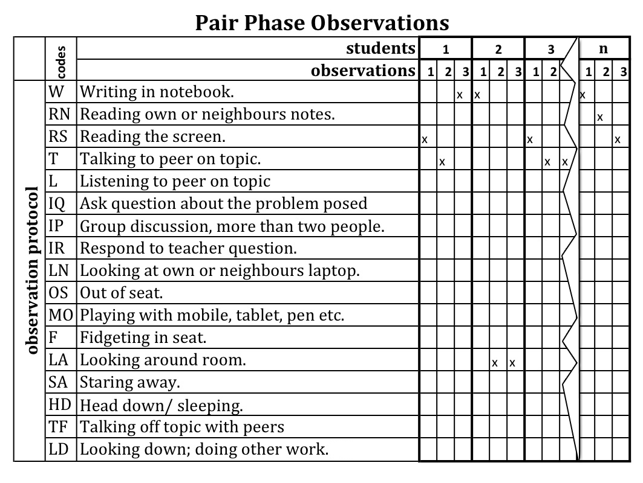
How did we measure engagement? - Observation Protocol

Slide 97
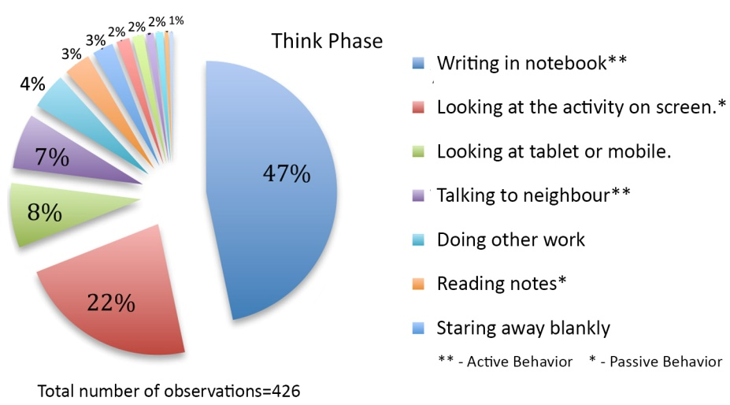
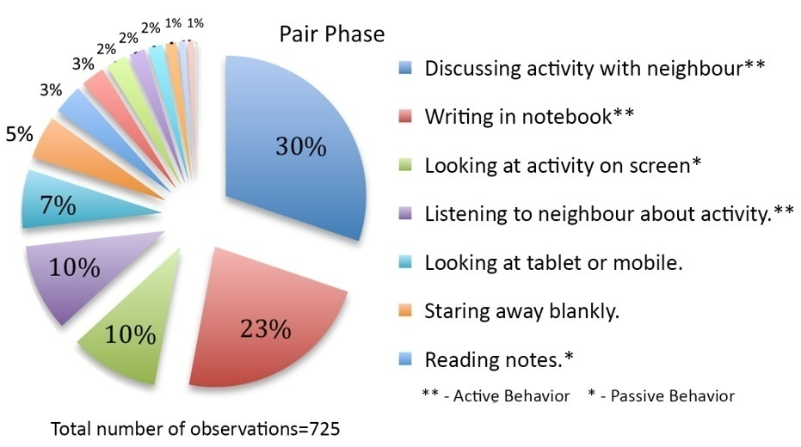
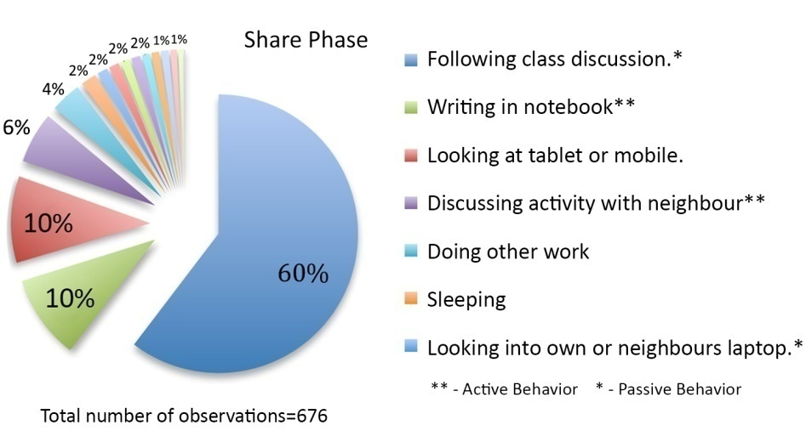
Frequencies of behaviours in each phase

Slide 98
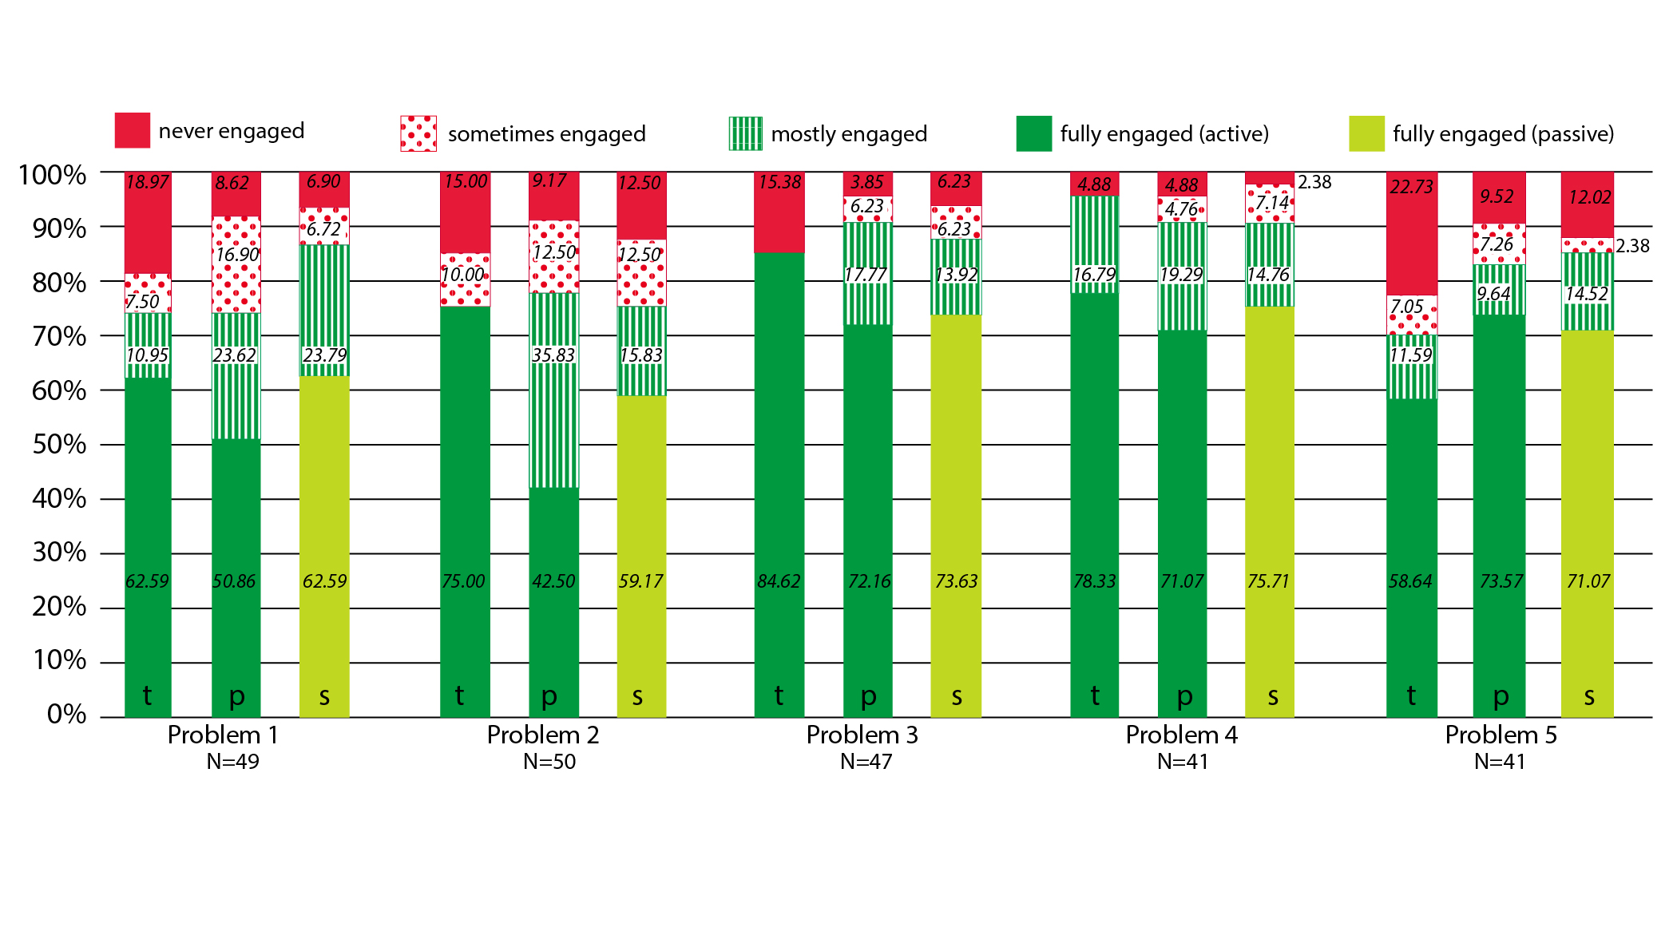
Average classroom engagement levels

Slide 99
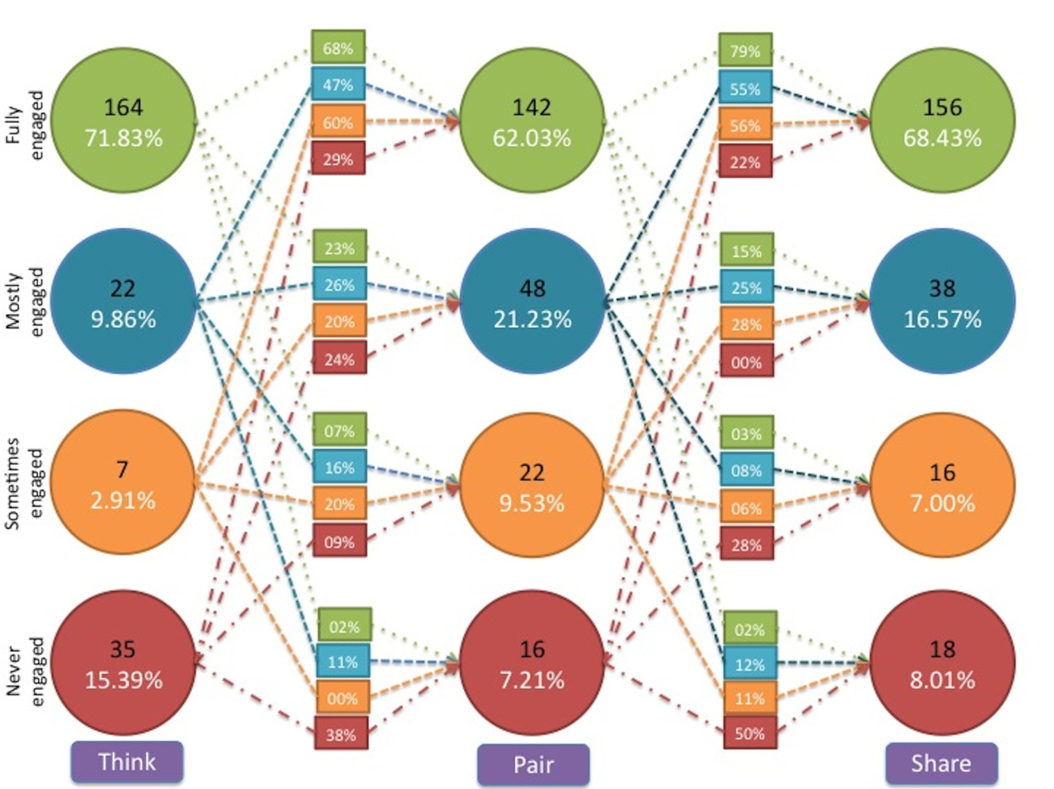
Student behaviour transition model

Slide 100
How did we triangulate? - engagement survey
Measured self-reported student engagement during the TPS activities.
Two questions on a 5 point Likert scale:
  How frequently did you write the solution to the problem given by the instructor during the think phase?
  How frequently did you discuss your solution with your partner during the pair phase?

Slide 101
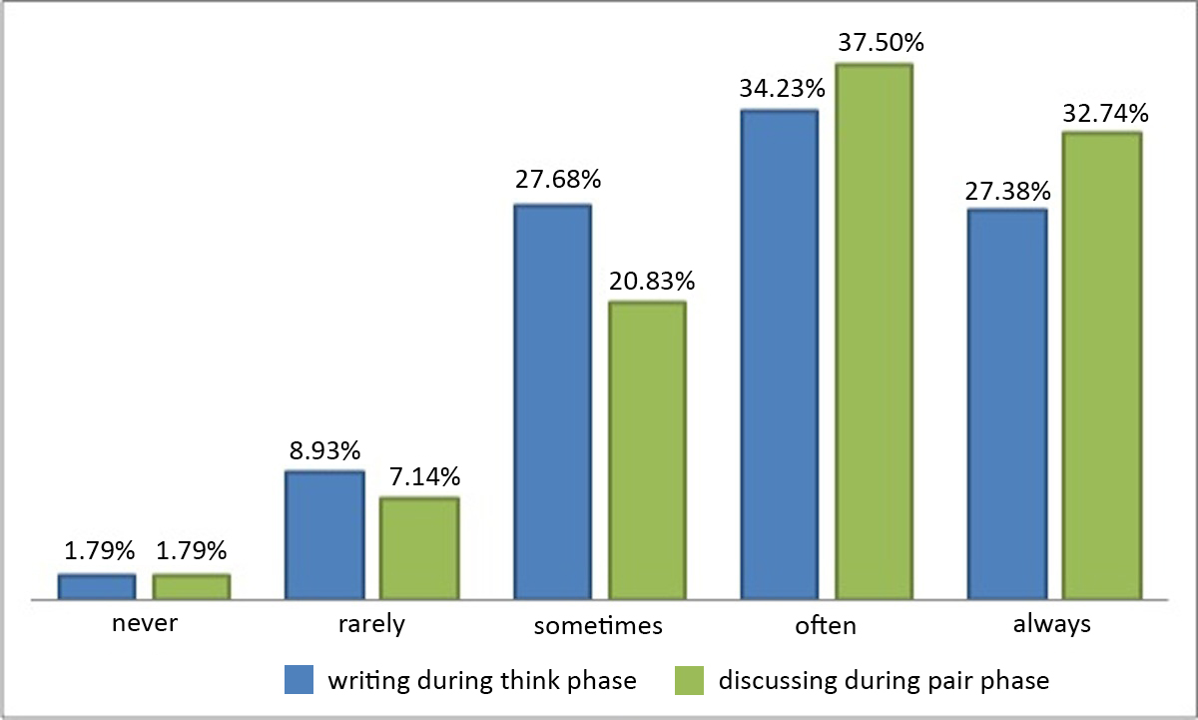
Survey questions - responses

Slide 102
Summary of TPS for engagement
RQ1: What behaviors do students engage in during TPS in a large class?
  Range of behaviors are displayed (see pie charts).
  Predominantly follows expectations of desirable behavior in each phase.
RQ2: How much student engagement occurs during TPS acitivity?
  70% to 95% of students are engaged, averaging out to 83% (see bar charts).
  Observations and self-reported engagement triangulate well.
RQ3: How does the engagement change as the TPS progresses?
  Student who is fully engaged in the think phase is likely remain engaged with probability 0.68 (see state-transition diagram).
  Significant probabilities (0.47, 0.6) that students from lower engagement states in think phase will move to higher engagement states in pair phase.

Slide 103
TPS and learning
Two-group, quasi-experimental study:
  One section was the experimental group (263 students), which received a TPS treatment, and the other was control group (184 students), which received a regular interactive lecture. Same instructor for both groups.
Topic: CPU execution sequence of multiple threads.
  Concept is new to both novices and advanced learners, so their prior knowledge does not play a role.
TPS Treatment:
  Think: Write one possible interleaved execution sequence.
  Pair: Check your neighbors’ solution. If it is the same as yours, come up with a second possible interleaved execution sequence.
  Share: Identify differences in your solution with one given by the Instructor.
Post-test:
  Problem on thread interleaving, similar to the one discussed. Included as the last part of Quiz1 – in the class following the above activity.
A. Kothiyal, S. Murthy and S. Iyer, “Think-Pair-Share in a large CS1 class: Does learning really happen?” ACM Innovations and Technology in Computer Science Education (ITiCSE) , Uppsala, 2014

Slide 104
TPS and learning: Research Questions
RQ1: Do TPS activities lead to increased conceptual understanding and application of CS1 concepts?
  Answered through: 2 group quasi-experimental study.
RQ2: What are the students’ perceptions of learning with TPS?
  Answered through: Focus group interviews.
RQ3: What are the instructor’s perceptions of teaching with TPS?
  Answered through: Instructor class logs.

Slide 105
RQ1: Learning outcome measurement
Two-group, pre-post quasi-experimental study.
Sample – Course had 2 sections and same instructor for both.
  One section was the experimental group (263 students), which received a TPS treatment, and the other was control group (184 students), which received a regular interactive lecture.
  Equivalence established on the basis of a pre-test of 5 questions on the pre-requisites. Mann Whitney U test showed no significant difference.
Treatment: Topic - CPU execution sequence of multiple threads.
  Concept is new to both novices and advanced learners, so their prior knowledge does not play a role.
  Instructor first explained the concept of multiple threads and thread synchronization via an interactive lecture. Next the instructor presented a problem on interleaving of threads.
  Control group: instructor explained the solution as a worked example
  Experimental group: problem was presented as a TPS activity

Slide 106
RQ1: Problem given during treatment
Thread A When Run flag clicked, Say “Thread A start”; Repeat 2 times ● Move 10 steps; Say “Thread A done” | Thread B When Run flag clicked Say “Thread B start”; Turn 90 degrees; Broadcast “event”; Say “Thread B done”; | Thread C When I receive “event”, Glide to (0,0).
Assume that: (i) 'When' and 'Say' statements result in 2 assembly instructions, (ii) Loop initialization, increment and condition check, each results in 1 assembly instruction, and (iii) all other statements result in 3 assembly instructions. Also assume that: (a) all assembly instructions are atomic and take the same amount of time, (b) CPU time-slice is sufficient for 3 assembly instructions. What are the possible interleaved execution sequences?”
TPS Treatment:
  Think: Write one possible interleaved execution sequence.
  Pair: Check your neighbors’ solution. If it is the same as yours, come up with a second possible interleaved execution sequence.
  Share: Identify differences in your solution with one given by the Instructor.

Slide 107
RQ1: Post-test results
Post-test was one question on thread interleaving similar to the problem discussed during treatment.
It was included as the last part of the quiz that students took in the class following the above problem-solving activity.
The post-test question was graded out of a maximum score of 4.
250 students in the experimental group and 169 students in the control group took the post test.
Used Mann-Whitney U-test to compare means of the two groups.
Cohen’s effect size (d = .67) suggests a moderate to high significance
Post-test scores
Experimental Mean (SD) | Control Mean (SD) | p-value | Difference
1.91 (1.65) | 0.88 (1.38) | 0.00 | Significant at p<0.05

Slide 108
RQ1: Stratified Analysis (Expt group)
61% of high achievers in pre-test continued to be high in post-test.
Significant percentage of medium (37%) and low achievers (30%) move into a higher achievement category.

Slide 109
RQ1: Stratified Analysis (Control group)
Only 21% of high achievers in pre-test continued to be high achievers in post-test. 79% of high achievers moved into low or medium achievement.

Slide 110
RQ1: Confirmation
Experimental study was conducted in one topic.
For all other topics, both groups were taught using interactive lectures interspersed with TPS.
No significant difference between the groups when both learnt via the same method. This result continued to hold for all exam problems throughout the semester.
These results indicate that it was the introduction of the TPS activity which caused the significant difference between the post test scores of the two groups.

Slide 111
RQ2: Student perceptions of TPS
Likert Scale – 336 responses received.
4 focus group interviews of 30 minutes duration, with 8-10 students in each group. Audio recorded, transcribed and analyzed using the content analysis technique.
Likert scale survey | Agree (%) | Neutral (%) | Disagree (%)
Thinking about the problem and writing the solution during the think phase helped me learn CS1 concepts. | 72 | 21 | 7
Discussing my solution with my partner during the pair phase helped me learn CS1 concepts. | 67 | 24 | 9
Listening to other students' solutions and discussion during the share phase helped me learn CS1 concepts. | 73 | 21 | 6
I would not have learned as much from the lecture if there had been no think-pair-share activities. | 58 | 29 | 13

Slide 112
RQ2: Confirmation
“The think and pair parts were equally important. Unless we think on our own, we won’t get to know at what level we are. When we were made to think on certain questions we realize that these are some places we get stuck. We discuss those things with our partner, we realize that he overcame this problem in a certain manner and then we may come up with better solutions. So that’s a way of learning.”
“In a class of 240 you can come with 4 or 5 different solutions. […] In that half an hour [of TPS] we are able to learn five methods of solving a problem and pros and cons of each method. That’s more that you can learn in an hour.”

Slide 113
RQ3: Instructor perceptions
Instructor maintained detailed logs of the class.
External observer, who attended all classes, maintained notes of classroom observations.
TPS is useful to address the challenges of students tuning out, getting distracted or going off-task.
  When specific deliverables were given in each stage of the activities, students were on-task.
  There is increased participation by everyone, not just the vocal students. Since everyone has worked on the problems, everyone has something to contribute and so gets involved.
TPS works even in large classes.
  The Share phase can become a bottleneck, but many solutions turn out to be similar and so only the first instance of each type of solution needed to be discussed.

Slide 114
Snippets from cs 101 course evaluation
“Think-Pair-Share activity proved useful in clearing the doubts and building confidence in the course.”
“The think-pair exercises were nice. They stimulated our thinking process.”
“He came up with very innovative exercises such as Think-Pair-Share which further improved our understanding of the course.”
“Think, Pair, Share was a good idea, but sometimes it was more than needed. Anyhow, overall it was good.”
“Used Think Pair Share very effectively. This involved everyone. However, pace was often slow.”
“His methods were innovative but I couldn`t connect to.”

Slide 115
Summary of findings
Engagement:
  70% to 95% of students are engaged, averaging out to 83%
  Observations triangulate well with self-reported engagement.
  Student who is fully engaged in the think phase is likely remain engaged with probability 0.68 (see state-transition diagram).
  Significant probabilities (0.47, 0.6) that students from lower engagement states in think phase will move to higher engagement states in pair phase.
Learning:
  Group which learned a concept via a TPS-activity performed significantly better (with a moderate to high effect size) than the group which learned the same concept from an interactive lecture.
  Significant majority of students approved of a TPS-based classroom environment, and felt that they would not have been able to learn CS1 as well had they not performed the TPS activities.

Slide 116
Summary of TPS setup guidelines
Download the TPS-activity-constructor resource sheet from:
  Download from www.et.iitb.ac.in/resources
Three points to keep in mind:
  Ensure that there is a clear ‘deliverable’ for each phase. This drives the action in that phase.
  Ensure that the phases are logically connected. They should use the output of one phase in next.
  Ensure that there is sufficient time for each phase.
  Too little → Frustration; Too much → Boredom.
  Move on when 80% of the class has finished.

