Slide 1
The Dataflow Model: A Practical Approach to Balancing Correctness, Latency, and Cost in Massive-Scale, Unbounded, Out-of-Order Data Processing, VLDB 2015
Slides prepared by Samkit

Slide 2
What is Dataflow Model ?
Enables Massive-scale, unbounded, out-of-order stream processing
Provides unified model for both batch processing and stream processing
Makes it easy to select different trade-offs of completeness, cost and latency
Open Source SDK for building parallelized pipelines
Available as fully managed service on Google Cloud Plateform

Slide 3
Outline for Rest of the Talk
MillWheel Overview
FlumeJava Overview
Motivating Use-cases
Dataflow Basics
Data Representation and Transformation
Windowing
Triggering and watermark
Refinements
Examples

Slide 4
MillWheel Overview
Framework for building low-latency data processing applications
Provides programming model that can be used to build complex stream processing applications without distributed system expertise
Guarantees exactly once processing
Uses checkpointing and persistent storage to provide fault-tolerance

Slide 5
FlumeJava Overview
A Java library for developing efficient data processing parallel pipelines of MapReduces
Provide abstraction over different data representations and execution strategies in the form of parallel collections and their operations
Supports deferred evaluation of pipeline operations
Transforms user constructed modular FlumeJava code into excution plan which can be executed efficiently

Slide 6
Motivating Use-cases
Advertisement Billing Pipeline inside Google
Requires complete data, latency and cost can be higher
Live Cost Estimate Pipeline
Approximate results at low latency can work, low cost is necessary
Abuse Detection Pipeline
Requires low latency, can work with incomplete data
Abuse Detection Backfill Pipeline to pick appropriate detection algorithm
Low latency and low cost are required, partial incomplete data can work

Slide 7
DataFlow Model Basics
Separates the logical notion of data processing from the underlying physical implementation
What Results are being computed
Where in event time they are being computed
When in processing time they are materialized
How earlier results relate to later refinements

Slide 8
DataFlow Basics
Separates the logical notion of data processing from the underlying physical implementation
What Results are being computed
Data Reprentation and Transformation
Where in event time they are being computed
Windowing
When in processing time they are materialized
Watermarks and Triggering
How earlier results relate to later refinements
Refinements

Slide 9
Data Representation and Transformation
Provides logical view of data as immutable collection of same-typed elements
PCollection<T>, PCollectionTuple, PCollectionList
Each element has unique timestamp
Data goes through pipeline, a directed graph of transformation
Core Transformations:ParDo(), GroupByKey(), Combine(), Flatten()
Composite Transformation: Join(), Count()
Custom transformations can be used

Slide 10
Core Transformations
ParDo ( doFn<T, F>() )
Supports elementwise computation over an input PCollection<T>
DoFn<T, S>, a function object defining how to map each element in input T to zero or more elements in output
Should be pure functions of their Input
Can be used to express both map and reduce parts of MapReduce
groupByKey()
Similar to shuffle step in MapReduce
Allows specifying a sorting order for the collection of values for each key

Slide 11
Core Transformations
flatten()
Takes a list of PCollection<T> and combines them into single PCollection<T>
combine()
Combines input collection of values into a single output value

Slide 12
Example
Pipline pipeline = Pipline.create(options);
pipeline.apply(TextIO.Read.from(options.getInput()))
.apply(ParDo.of(new function1())
.apply(Count.perElement())
.apply(ParDo.of(new function2())
.apply(new Format())
.apply(TextIO.Write.to(options.getOutput()));
pipeline.run();

Slide 13
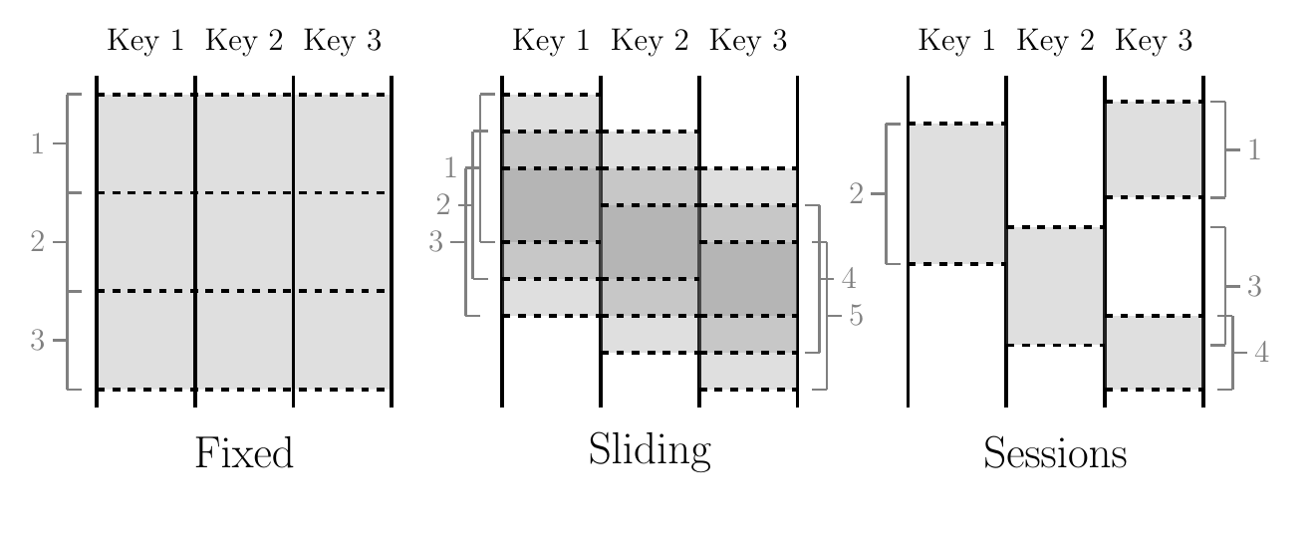
Windowing

Slide 14
Windowing

Slide 15
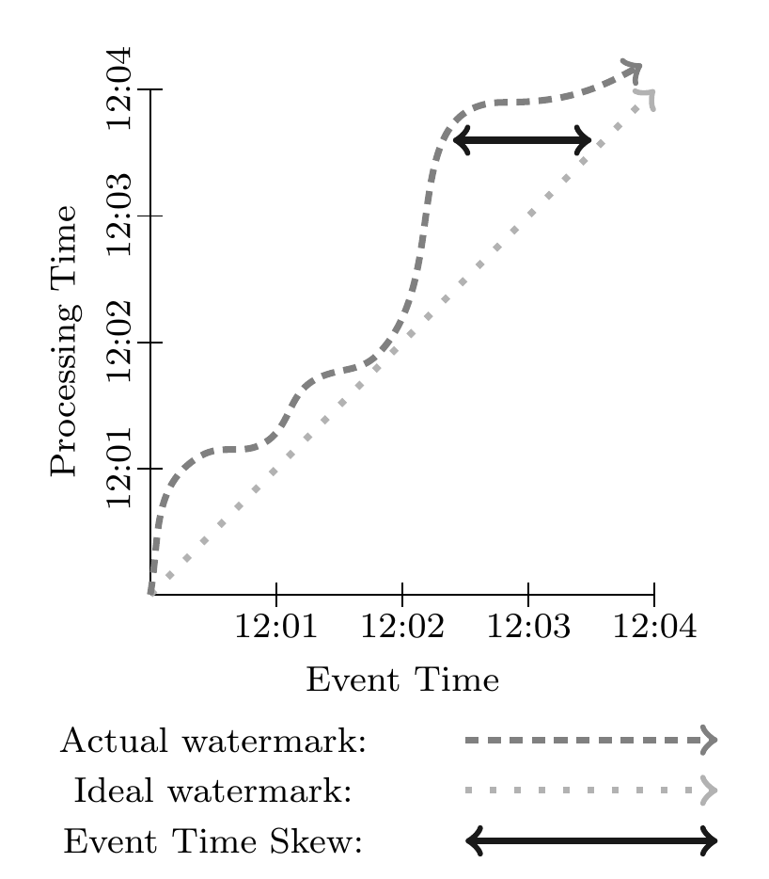
Watermark
f(S) -> E
S = a point in stream processing time
E = the point in event time up to which input data is complete as of S
Provides global time progress metric
Problems with watermark:
Sometimes too fast
Sometimes too slow

Slide 16
Triggering and Watermark
Triggers control when results are emitted
Triggers can be used
At Completion estimates
At points in processing time
In Response to data arrival
Can be used with loops, sequences and other constructs
Users can define their own triggers utilizing these primitives

Slide 17
Triggering

Slide 18
Content Refinements
How should outputs per window accumulate?
Firing | Elements | Discarding | Accumulating | Accumulating and Retracting
Speculative | 3 | 3 | 3 | 3
Watermark | 5, 1 | 6 | 9 | 9, -3
Late | 2 | 2 | 11 | 11, -9
Total Observations | 11 | 11 | 23 | 11

Slide 19
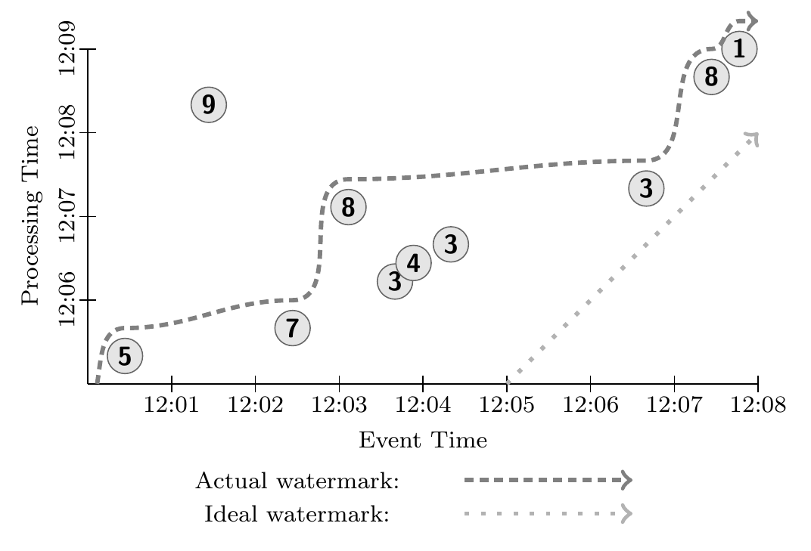
Different combinations of What Where When and How
Example Input

Slide 20
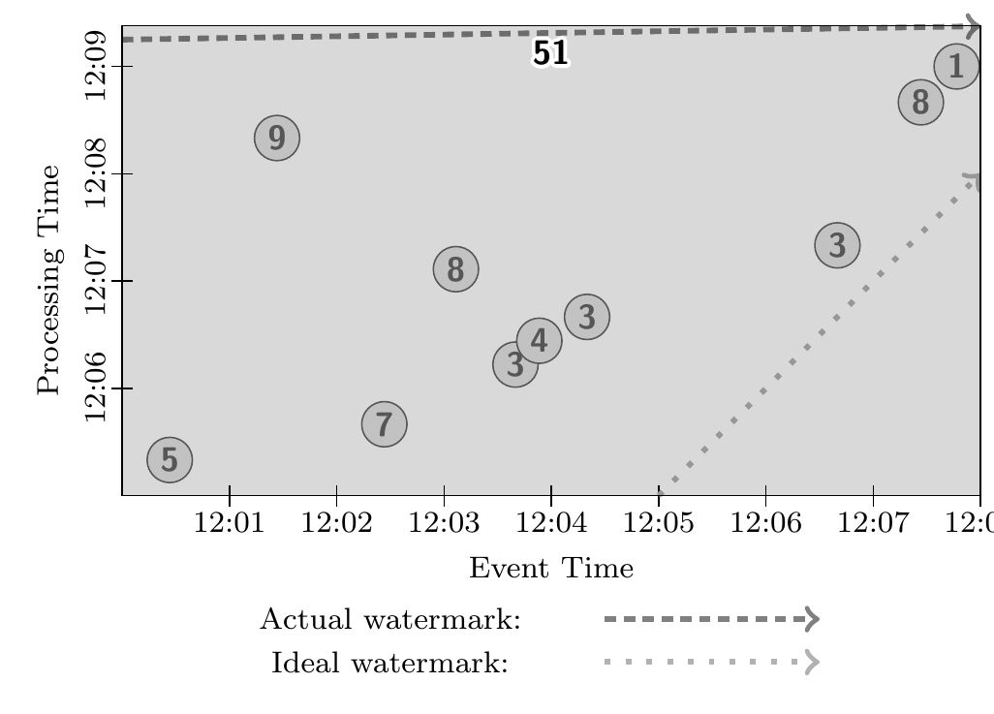
Classic Batch Execution

Slide 21
GlobalWindows, AtPeriod, Accumulating
FixedWindows, Batch

Slide 22
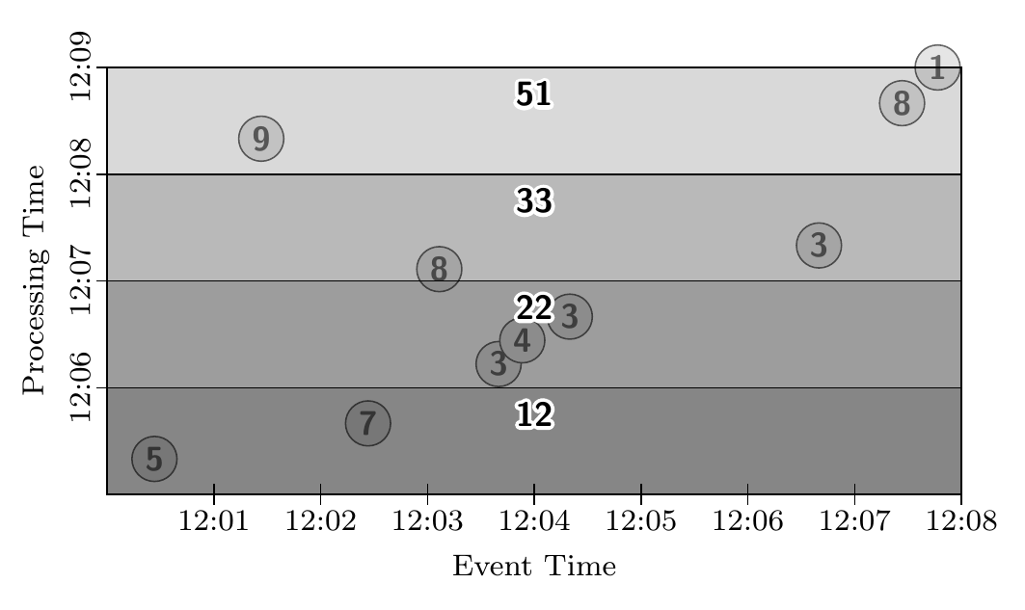
GlobalWindows, AtPeriod, Accumulating
FixedWindows, Batch

Slide 23
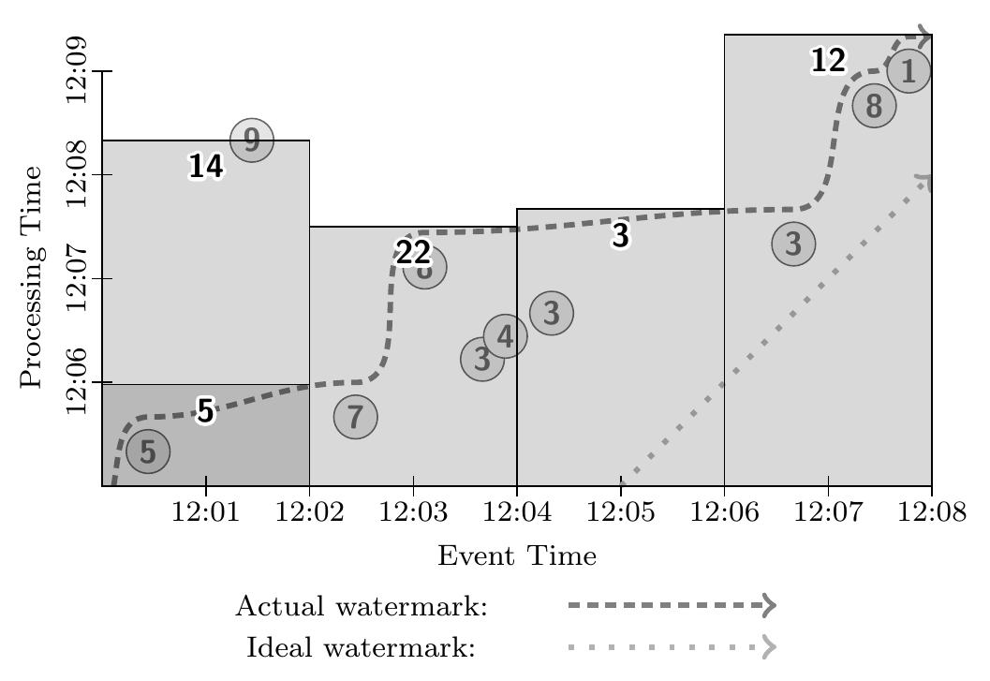
FixedWindows, Streaming

Slide 24
FixedWindows, Streaming, Partial

Slide 25
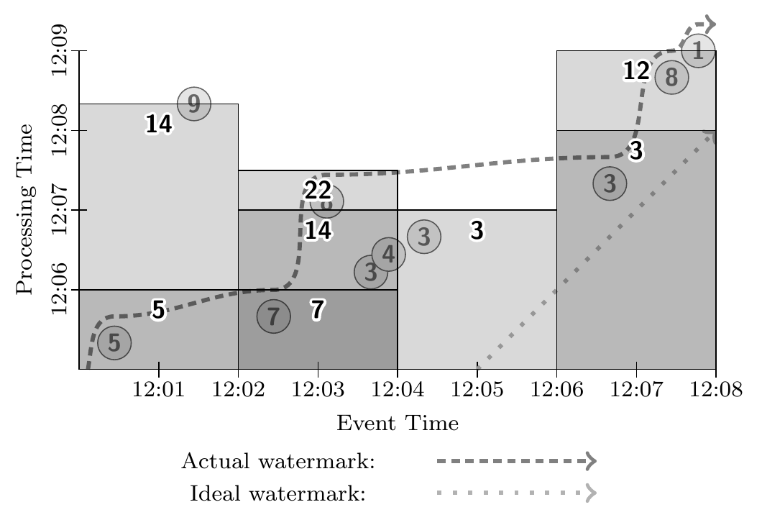
FixedWindows, Streaming, Partial

Slide 26
Sessions, Retracting

Slide 27
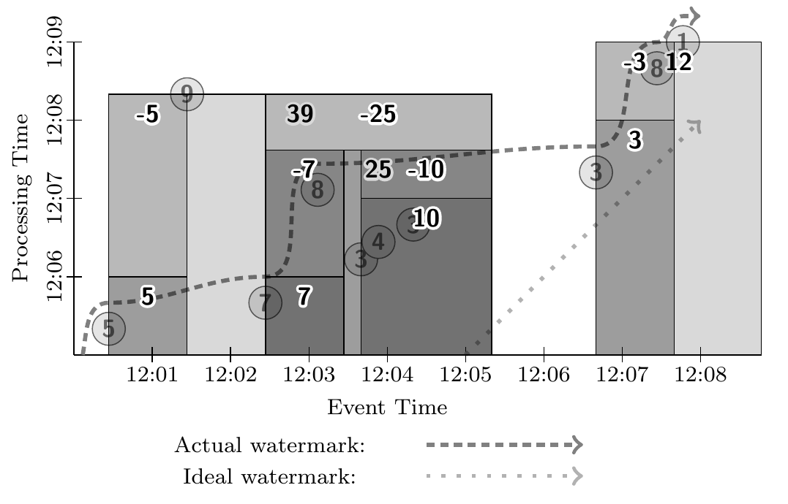
Sessions, Retracting

Slide 28
Thank You

