Slide 1
RDF-3X: a RISC style Engine for RDF

Slide 2
Semantic Web
A set of standards and best practices for sharing data and the semantics of that data over the web for use by applications
The RDF data model
The SPARQL query language
The RDF Schema providing basic elements for description of ontologies, otherwise called RDF vocabularies, intended to structure RDF resources.
The best practices recommend
The use of URIs to name things
The use of standards such as RDF and SPARQL

Slide 3
Motivation
RDF(Resource Description Framework ) is schema-free structured information.
Increasingly popular in context of
Knowledge bases
Semantic Web
Life-Sciences and Online communities.
Managing large-scale RDF data includes challenges for Storage layout, indexing and querying.

Slide 4
Introduction to RDF
Standard model for data interchange on the Web.
Allows structured and semi-structured data to be mixed, exposed, and shared.
Conceptually a labeled graph
Linking structure forms a directed labeled graph where the edges represent the named link between two resources that are represented by the graph nodes.
Graph is stored as collection of facts. Each edge represents a fact (triple in RDF notation)
Triples have the form (subject; predicate; object)

Slide 5
RDF Triples
In RDF every data item is represented using a triple
(subject, predicate, object) aka (subject, property, value)
For example, information about the movie “Sweeney Todd” may be 'triplified' as:
(id1, hasT itle, ”Sweeney T odd”),
(id1, producedInY ear, ”2007”),
(id1, directedBy, ”T im Burton”),
(id1, hasCasting, id2),
(id2, RoleName, ”Sweeney T odd”),
(id2, Actor, id11),
(id1, hasCasting, id3),
(id3, RoleName, ”Mrs. Lovett”),
(id3, Actor, id12),
(id11, hasName, ”Johnny Depp”),
(id12, hasName, ”Helena Bonham Carter”)

Slide 6
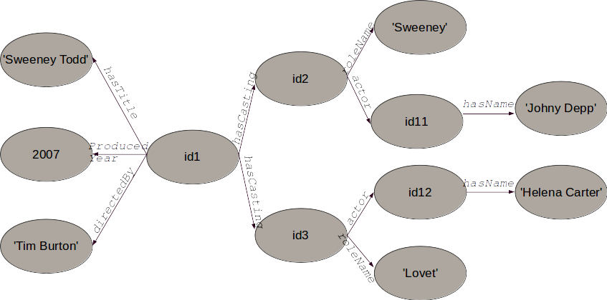
RDF – Graph based data model

Slide 7
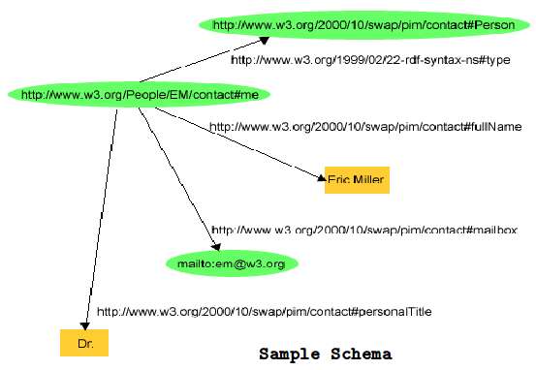
RDF as labeled graph
Extends the linking structure of the Web by using URIs(Uniform Resource Identifiers) for relationship
Subjects and predicates are identified by URI values
Schema language is RDFS ( RDF Schema)
Eg of RDF triplets in this case:
<http://www.w3.org/People/EM/contact#me >,
<http://www.w3.org/2000/10/swap/pim/contact#fullName >,
“Eric Miller”
Another example:
<http://www.w3.org/People/EM/contact#me >,
<http://www.w3.org/1999/02/22-rdf-syntax-ns#type >,
<http://www.w3.org/2000/10/swap/pim/contact#Person >

Slide 8
Introduction - SPARQL
SPARQL is used to query over RDF data
Official standard query language for querying RDF repositories
SPARQL queries are basically pattern matching queries on triples from the RDF data graph

Slide 9
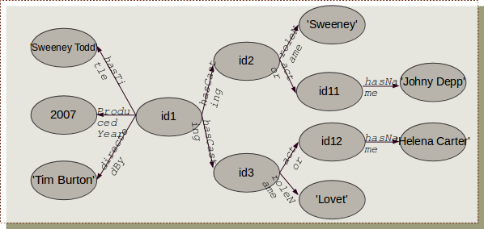
SPARQL Query Examples-1
Select all the movie titles (assume that predicate <hasTitle> implies movie titles)
SELECT ?title
WHERE{ ?x <hasTitle> ?title }

Slide 10
SPARQL Query Examples-2
Select the director of the movie 'Sweeney Todd'
SELECT ?directorName
WHERE{ ?movieId <hasTitle> “Sweeney Todd”.
?movieId <directedBy> ?directorName}

Slide 11
SPARQL Query Examples-3
Select all the roles and the actors who have acted those roles
SELECT (?role AS ?RoleName) (?name AS ?ActorName)
WHERE{ ?roleId <roleName> ?role.
?roleId <actor> ?actorId.
?actorId <hasName> ?name }

Slide 12
SPARQL Syntax
PREFIX foo: <...>
PREFIX rdf: <...>
SELECT [DISCTINCT | REDUCED] ?variable1 ?variable2 ...
WHERE {
pattern1. pattern2. ...}
ORDER BY
LIMIT
OFFSET
Each pattern consists of S, P, O and each of these may be either a variable or a literal
A dot(.) corresponds to join/conjunction; UNION keyword is used for disjunctions
ORDER BY keyword :orders the result
DISTINCT keyword : removes duplicates from the result
REDUCED keyword : may but need not remove duplicates
PREFIX clause for Namespace Prefixes

Slide 13
Motivation and Problem
Managing large-scale RDF data involves technical challenges:
Physical database design is difficult because of the absence of a global schema
Since everything is a triple instead of an entity with a lot of attributes, queries involve many, many joins.
RDF data is fine-grained and meant for on-the-fly applications; this calls for appropriate choice of query processing and optimization algorithms
Statistics gathering for join-order and execution-plan optimization is not very obvious
RDF stores data as graph rather than tree structure used by XML

Slide 14
Solution
RDF-3X (RDF Triple eXpress)
RDF-3X engine is an implementation of SPARQL that achieves excellent performance through RISC-style architecture, puristic data structures and operations
Key Features:
Physical design is workload independent. With exhaustive compressed indexes, it eliminates need for physical-design tuning
Query processor rely mostly on merge joins over sorted index lists
Query optimizer focuses on join order in generating the execution plan; dynamic programming for plan enumeration
Cost model is based on RDF-specific statistics synopsis

Slide 15
Storage and Indexing

Slide 16
RDF Data Storage
There are three approaches followed by various implementations:
Giant Triple Table method
Property Table method
Cluster Property Table method

Slide 17
Giant Triple Table method
Subject | Predicate | Object
id1 | hasTitle | “SweenyTodd”
id1 | producedYear | 2007
id1 | directedBy | “Tim Burton”
id1 | hasCasting | id2
id1 | hasCasting | id3
id2 | roleName | “Sweeny Todd”
id3 | roleName | “Lovet”
id2 | actor | id11
id3 | actor | id12
id11 | hasName | “Johny Depp”
id12 | hasName | “Helena Carter”
All triples are stored in a single, giant
triple table with generic attributes
subject, predicate, object
RDF-3X follows this approach

Slide 18
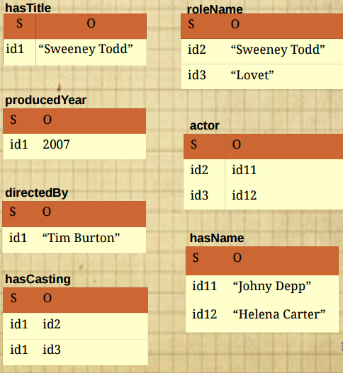
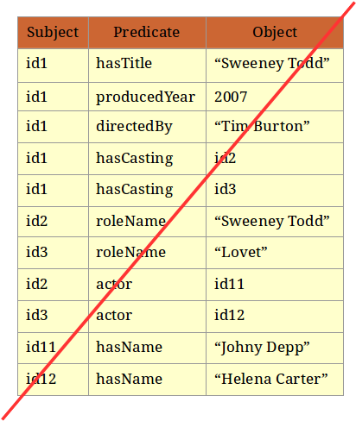
Property Table method

Slide 19
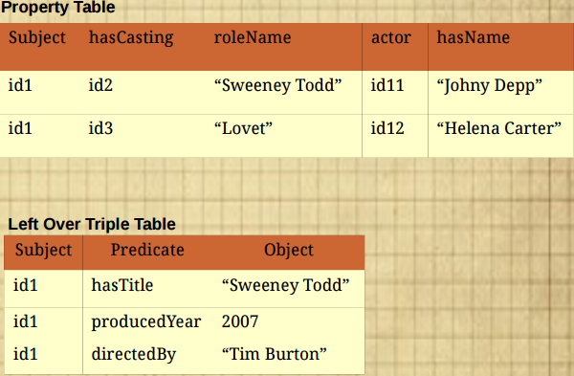
Cluster-Property Table method

Slide 20
Triple Store and Mapping Dictionary
RDF-3X uses giant triple table approach
Drawback – literals can be very large and may contain lot of redundancy
Solution used by RDF-3X:
Use dictionary compression: Mapping Dictionary
Compresses the triple store
Fast query processing
Store all the triples in a clustered B+-tree
Triples are sorted lexicographically
Eases SPARQL range queries

Slide 21
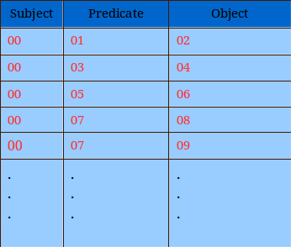
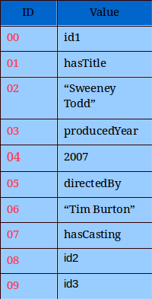
Mapping Dictionary
Used to map literals to a corresponding id
This compresses the triple store
Simplifies query processing allowing for fast, simple RISC style operators
Incurs a minor cost of additional dictionary indices

Slide 22
Compressed Indexes
When literals are prefixes and variables are suffixes in the pattern, the query acts like a range query; suffices to have single index-range-scan
For example: (literal1, literal2, ?x)
To guarantee that queries with all possible patterns are answered in a single index scan, RDF-3X maintain all six possible permutations of subject(S), predicate(P) and object(O), in six separate indices
SPO, SOP, OSP, OPS, PSO, POS
Triples in the index are sorted lexicographically
Are directly stored in the leaf pages of the clustered B+-tree
This ordering causes neighboring triples to be very similar
Hence compression of triples is possible: instead of storing full triples RDF-3X stores only the changes between the triples

Slide 23
Sort Orders
6 possible orderings, store all of them (SPO, SOP, OSP, OPS, PSO, POS)
Will make merge joins very convenient
Each SPARQL triple pattern can be answered by a single range scan
Eg: If we need to know all actors of a film, the subject (“Film object”) and predicate (<hasActor>) remain the same. So, we use the index on sort order “SPO”
On the other hand, if we need to find all movies in which an actor has acted, the object (“Actor”) and predicate (<hasActor>) remain the same. So, the index on sort order “OPS” would be more suitable

Slide 24
Compressed Triple Structure
Compression of triples is the difference in their id values (delta encoding)
Triples are sorted lexicographically which allows SPARQL pattern matching into range scans
Structure of byte-level compressed triple is
Header byte denotes number of bytes used by the three values (5*5*5=125 size combinations)
Gap bit is used when only value3 changes and delta is less than 128 (that fits in header)

Slide 25
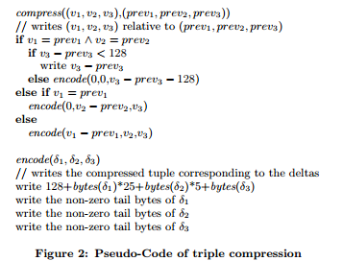
Triple Compression Algorithm

Slide 26
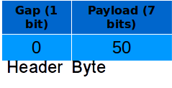
Compressing Triple Example-1
Example1: Suppose the first triple is (10,20,1123) and the next triple is (10,20,1173).
v1 = prev1 and v2 = prev2
Also, v3 - prev3 < 128
Hence, the delta entry would be 1173-1123 = 50 in the header record
Hence, the size of this tuple is only 1 byte; gap bit set to 0

Slide 27
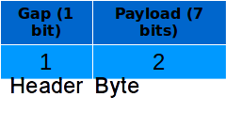
Compressing Triple Example-2
Example2: Suppose the first triple is (10,20,1000), second triple is (10,20,1500)
v1 = prev1 and v2 = prev2; but (1500-1000) = 500 !< 128
Function call: encode (0,0,372)
Header will contain 128 + 0 + 0 + 2 = 130
δ1 has 0 non-zero bytes, δ2 has 0 non-zero byte, δ3 has 2 non-zero bytes
Hence, the overall size of the tuple will be 3 bytes

Slide 28
Aggregated Indices
For many SPARQL queries indexing partial triples rather than full triples would be sufficient
SELECT ?a ?c WHERE { ?a ?b ?c}
Aggregated Indices:
Two-value indices: Each of the possible pairs out of a triple (SP, PS, SO, OS, PO, OP) and the number of occurences of each pair in in the full set of triples
One-value indices: Three one valued indices, (S/P/O, count) are stored

Slide 29
RDF-3X Indexing Summary – 3 Types of Indices
Six triple indexes: SPO, PSO, SOP, OSP, POS, OPS
Six two valued aggregated indices and their count: SP, PS, PO, OP, SO, OS
Three one valued aggregate indices and the respective counts
Experimentally total size of all indexes is less than original data

Slide 30
Query Processing and Optimization

Slide 31
Translating SPARQL Queries
Step1: Convert the SPARQL query into a query graph representation, interpreted as relational tuple calculus expression
Step2: Conjunctions are parsed and expanded into a set of triple patterns
Step3: Literals are mapped to ids through dictionary lookup
Step4: Multiple query patterns are computed by joining individual triple patterns
Step5: If distinct results are to be obtained, duplicates are removed from the result
Step6: The result contains ids now; dictionary lookup is performed to get back the actual string equivalents

Slide 32
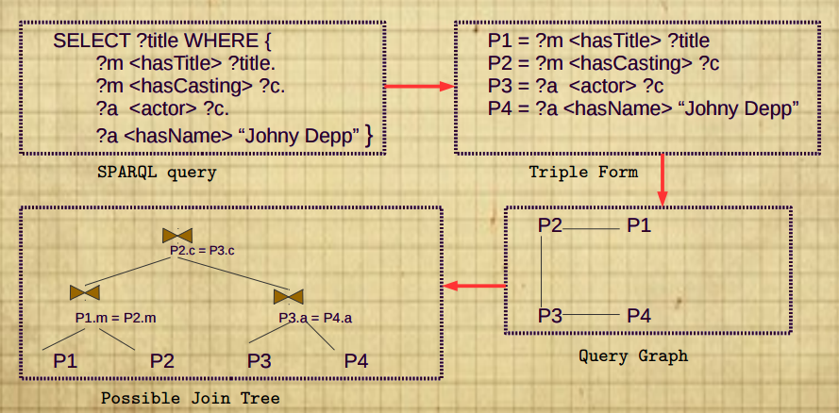
SPARQL Query Graph
Each triple pattern corresponds to one node in the query graph
An edge between two nodes is a common query variable

Slide 33
Optimizing Join Ordering
SPARQL query execution demands join queries which can be really complex:
SPARQL queries contain star-shaped subqueries connected by long paths and hence strategies to handle bushy join trees are required
Since large number of joins are common in SPARQL queries, fast plan enumeration and cost optimization are required
RDF-3X uses decision cost based dynamic programming approach for optimizing join orderings

Slide 34
DP Based Join Optimization
RDF-3X uses bottom-up dynamic programming approach
Takes a connected query graph as input and outputs an optimal bushy join tree
Enumerates DP table with the initial set of triples efficiently and correctly
Unused(unbound) variables are projected away by using aggregated index
The plans that are costlier and equivalent to other plans are pruned
Sometimes plans are retained even if they are costlier based on order optimization
The larger optimal plan is generated by joining optimal solutions to smaller problems that are adjacent in the query graph
FILTER predicates are placed greedily.

Slide 35
Selectivity Estimates
Identification of lowest-cost execution plan hugely relies on the estimated cardinalities and selectivities
A bit different from standard join ordering:
One big "relation", no schema
Selectivity estimates are hard
Standard single attribute synopses are not very useful:
Only three attributes and one big relation;
But (?a, ?b, ”Mumbai”) and (?a, ?b, ”1974-05-30”) produces vastly different values for ?a and ?b
Two kinds of statistics are maintained by RDF-3X
Selectivity Histograms
Frequent Join Paths

Slide 36
Selectivity Histograms
Generic but assumes predicates are independent
Aggregates indexes until they fit into one page
Merge smallest buckets(equi-depth)
For each bucket compute statistics
6 indexes, pick the best for each triple pattern
Assumes uniformity and independence, but works quite well

Slide 37
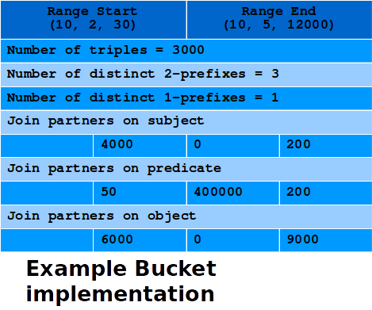
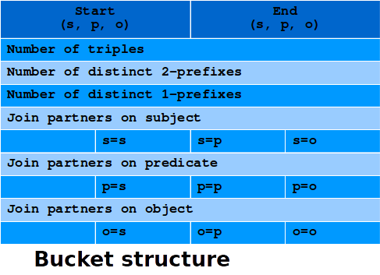
Selectivity Histograms
Query optimizer uses aggregated indexes for calculations based on triple cardinalities
For estimating join selectivity, histogram buckets with additional information are maintained, as follows

Slide 38
Frequent Paths
Correlated predicates appear in SPARQL queries in two ways:
Stars of triple patterns: a number of triple patterns with different predicates sharing the same subject
SELECT r1, rn WHERE{ (r1 p1 r2). (r1 p2 r3). ... (r1 pn rn)}
Chains of triple patterns: a number of triple patterns where object of the first pattern is subject of the second pattern
SELECT r1, rn+1 WHERE{ (r1 p1 r2). (r2 p2 r3). ... (rn pn rn+1)}
Most frequent paths(ie., the paths with the largest cardinalities) are computed, the result cardinalities are materialised along with the path description p1, p2, ... pn

Slide 39
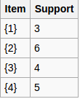
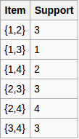
Apriori Algorithm
Apriori is used to determine the frequent itemsets in a database ( frequent itemset mining).
Let us say that an itemset is frequent if it appears in at least 3 transactions of the database: the value 3 is the support threshold.

Slide 40
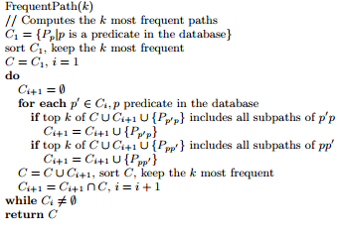
Frequent Path Mining Algorithm

Slide 41
Estimates for Composite Queries
Combining histogram with frequent path statistics
Long join chain decomposed to subchains of maximal length
For exampleconsider a query like: ?x1 a1 v1. ?x1 p1 ?x2. ?x2 p2 ?x3. ?x3 p3 ?x4. ?x4 a4 v4. ?x4 p4 ?x5. ?x5 p5 ?x6. ?x6 a6 v6
For subchains p1-p2-p3 and p4-p5 , selectivity estimation is done using frequency path and for selections histograms are used
In absence of any other statistics, assume the above two estimators as probabilistically independent - use product formula with per-chain and per-selection statistics as factors

Slide 42
Evaluation
RDF-3X is compared with:
MonetDB (column store approach)
PostgreSQL (triple store approach)
Three different data sets:
Yago, Wikipedia-based ontology: 1.8GB
LibraryThing : 3.1
Barton library data : 4.1GB

Slide 43
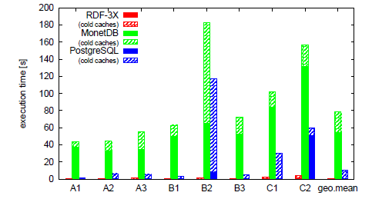
Evaluation - Yago
sample query(B2) : select ?n1 ?n2 where { ?p1 <isCalled> ?n1.
?p1 <bornInLocation> ?city. ?p1 <isMarriedTo> ?p2.
?p2 <isCalled> ?n2. ?p2 <bornInLocation> ?city }

Slide 44
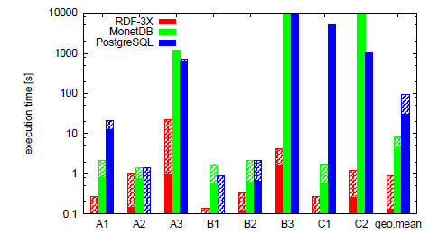
Evaluation - LibraryThing
sample query(B3): select distinct ?u where { ?u [] ?b1.
?u [] ?b2.?u [] ?b3.?b1 [] <german> .?b2 [] <french> .
?b3 [] <english>}

Slide 45
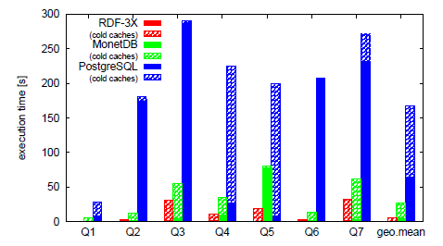
Evaluation - Barton Dataset
sample query (Q5) select ?a ?c where
{ ?a <origin> <marcorg/DLC>. ?a <records> ?b.
?b <type >?c. filter (?c != <Text>) }

Slide 46
Conclusion
RDF-3X is a fast and flexible RDF/SPARQL engine
Exhaustive but very space-efficient triple indexes
Avoids physical design tuning, generic storage
Fast runtime system, query optimization has a huge impact

Slide 47
Thanks

