Slide 1
Monitoring streams: a new class of data management applications
D. Carney et al.
Includes slides by:
YongChul Kwon (http://goo.gl/8K7Qa)
Jong-Won Roh (http://goo.gl/Fzc3e) Joydip Datta
Debarghya Majumdar
Le Xu
Presented by: J. Rashmitha Reddy
Under the guidance of: Prof. S. Sudarshan
Advanced Database Management System

Slide 2
Introduction Scenario
2
User ID and Status
RPM, temperature, pressure, oil status, …
RFID tagged
Components
Armed various sensors
Brightness Sensor
Pressure Sensor

Slide 3
Introduction
Human-Active, DBMS-Passive(HADP) Model:
  Traditional DBMSs have assumed that the DBMS is a passive repository storing a large collection of data elements and humans initiate queries and transactions on this repository
  They have assumed that the current state of the data is the only thing that is important.
  DBMSs assume that data elements are synchronized and that queries have exact answers.

Slide 4
Introduction
DBMS-Active, Human-Passive(DAHP) Model:
  The role of DBMS is to alert humans when abnormal activity is detected.
  Monitoring applications require data management that extends over some history of values reported in a stream
  Stream data is often lost, stale, or intentionally omitted for processing reasons.
  Real-time requirements

Slide 5
Scenario Summary
Data Streams rather than Static Data
Paradigm shift from HADP to DAHP
Can traditional databases be used to handle this kind of scenarios?
NO!

Slide 6
Monitoring Applications
Concept
  Monitor continuous data streams, detect abnormal activity, and alert users those situations
Data Stream
  Continuous
  Unbounded
  Rapid
  May contain missing, out of order values
Occurs in a variety of modern applications

Slide 7
Examples of Monitoring Applications
Patient monitoring
Aircraft Safety monitoring
Stock monitoring
Intrusion detection systems

Slide 8
Examples of Monitoring Applications
Monitoring the ups and downs of various stock prices in a Stock Broker Firm
  Process streams of stock tickers from various sources
Monitoring the health and location of soldiers in a warzone
  Process streams of data coming from sensors attached to the soldiers
  Some data items may be missing
  Alerts the control room in case of health hazards
Monitor the location of borrowed equipments
  Process streams of data coming from RFID sensors
  Alerts when some items goes missing

Slide 9
Motivation
Monitoring applications are difficult to implement in the traditional DBMS
Traditional DBMS | Needs of Monitoring applications
One time query: Evaluated once on a fixed dataset | Queries once registered continuously act on incoming flow of tuples (like a filter)
Stores only the current state of the data | Applications need some history of the data (time series data)
Triggers secondary features; often not scalable | Triggers are one of the central features. Must be scalable
Does not require real time service | Real time service is required
Data items assumed to be accurate | Data may be incomplete, lost, stale or intentionally dropped

Slide 10

Aurora
This paper describes a new prototype system, Aurora, which is designed to better support monitoring applications
  Stream data
  Continuous Queries
  Historical Data requirements
  Imprecise data
  Real-time requirement

Slide 11
Outline
Aurora
  System Model of Aurora
  Operators in Aurora
  Aurora Query Model
  Aurora System Architecture
  Optimization
  Real Time Operation
Conclusion

Slide 12
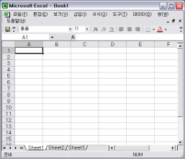
Aurora Overall System Model
12
User application
QoS spec
Query spec
Aurora
System
Historical
Storage
External
data source
Operator
boxes
data flow
(collection of stream)
Query spec
Application
administrator

Slide 13
Example
Suppose, in a hospital, continuous stream of doctor’s position, patient’s health, position etc. is monitored
Patients
Filter
(disease=heart)
Nearby doctors who can work
on a heart patient
Join
Doctors
Join condition:
|Patient.location – doctor.location| < θ

Slide 14
System Model
Basic job of Aurora
To process incoming streams in the way defined by an application administrator.
Fundamentally, it is a dataflow system
Tuples flow through a loop-free, directed graph of processing operations (i.e., boxes).

Slide 15
Representation of Stream
Aurora stream tuple: (TS=ts, A₁=v₁, A₂=v₂ .. A_{n}=v_{n})
TS (Timestamp) information specifies its time of origin within the Aurora network and is used for QoS calculations.
A stream is an append-only sequence of tuples with uniform type (schema)

Slide 16
Order-agnostic operators
Filter: screens tuples based on input predicate
  Like select in usual DBMS
  Syntax:
  Filter(P₁,…….P_{m})(S)
Map is a generalized projection operator
Union: merge two or more streams with common schema into a single output stream.
  Union(S₁,……S_{n}) such that S₁,……S_{n} are streams with common schema
Note:
  Operators like Join, however can not be calculated over unbounded streams
  Those operations are defined in windows over the input stream (described in next slide)

Slide 17
Operators in Aurora
Order-agnostic
operators that can always process tuples in the order in which they arrive.
Order-sensitive
operators that can only be guaranteed to execute with finite buffer space and in finite time if they can assume some ordering over their input streams(some bounded disorder can be tolerated).

Slide 18
Example
Consider the following query
  Compute the maximum price of a stock per hour

Slide 19
Concept of Windowing
Monitoring Systems often applies operations on a window
  Operations (e.g. Join) can not be applied over infinite length streams
  Window marks a finite length part of the stream
  Now we can apply operations on windows
Window advancement
  Slide: perform rolling computations (e.g. max stock price in last one hour)
  Tumble: Consecutive windows has no tuple in common (e.g. hourly max stock price)
  Latch: Like tumble but may have internal state (e.g. Max stock price in life time)

Slide 20
Order Specification in Aurora
Till now we assumed ordering on Timestamp
  Aurora allows ordering on any attribute
  Allows relaxed specification of orders
Order syntax O = Order(on A, Slack n, Group By B₁, …, B_{m} )
  Ordering on attribute A
  n: how many out of order tuples are accounted for
  n=0 means every out of order tuple will be ignored
  B₁ ,B₂ ..B_{m} are attributes that partitions the stream
“A tuple is out of order by n w.r.t A in S” if there are more than n tuple preceding t in S such that u.A > t.A

Slide 21
Order-Sensitive Operations
Aggregate: Applies aggregate function on windows over input stream
  Syntax:
  Aggregate(F, Assuming O, Size s, Advance i) (S)
Join: Binary join operation on windows of two input streams
  Syntax: Join(P, Size s, Left Assuming O₁, Right Assuming O₂)(S1,S2)
Note: For now, we assume all tuples are ordered by timestamp

Slide 22
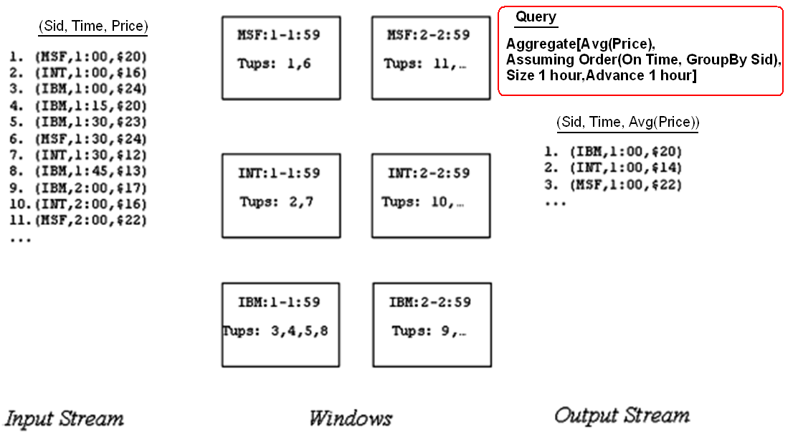
Aggregate Example

Slide 23
Blocking
Waiting for lost or late tuples to arrive in order to finish window calculations.
But, streaming applications have real-time requirements.
Therefore, it is essential to ‘timeout’, even at the expense of accuracy.
Aggregate(F, Assuming O, Size s, Advance i, Timeout t) (S)

Slide 24
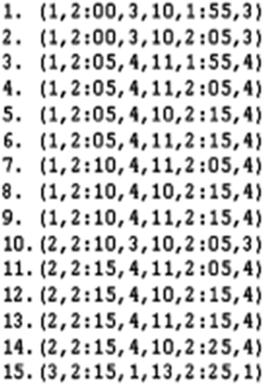
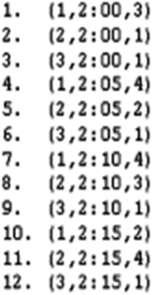
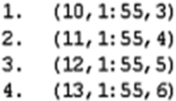
Join Example
Join( x.pos = y.pos, size = 10 min, X ordered in time,
Y ordered in time) ( X,Y )
X(id, time, pos)
Y(id, time, pos)

Slide 25
Aurora Query Model
Three types of queries
  Continuous queries: Continuously monitors input stream
  Views: Queries yet not connected to application endpoint
  Ad-hoc queries: On demand query; may access predefined history

Slide 26
Aurora Query Model (cntd.)
Continuous queries: Continuously monitors input stream
QoS spec
data input
b1
b2
b3
app
continuous query
Connection
Point
Persistence spec:
“Keep 2 hr”
Picture Courtesy: Reference [2]

Slide 27
Connection Points
Supports dynamic modification to the network (say for ad-hoc queries)
Stores historical data (Application administrator specifies duration)
    Persistent Storage – retains data items beyond their storage by a particular box.

Slide 28
Connection Point Management
Historical data of a predefined duration is stored at the connection points to support ad-hoc query
Historical tuples are stored in a B-Tree on storage key
  Default storage key is timestamp
B-Tree insert is done in batches
Old enough tuples are deleted by periodic traversals

Slide 29
Aurora Query model: Views
QoS spec
data input
b1
b2
b3
app
continuous query
Connection
point
b4
QoS spec
b5
b6
view
Picture Courtesy: Reference [2]

Slide 30
Views
No application connected to the end point
May still have QoS specifications to indicate the importance of the view
Applications can connect to the end of the path at any time
Values may be materialized which is under the control of the scheduler

Slide 31
Aurora Query model: Ad-hoc queries
QoS spec
data input
b1
b2
b3
app
continuous query
Connection
point
b4
QoS spec
b5
b6
view
ad-hoc query
b7
b8
b9
app
QoS spec
Picture Courtesy: Reference [2]

Slide 32
Ad-hoc queries
Can be attached to a connection point at any time
Gets all the historical data stored at the connection point
Also access new data items coming in
Acts as a continuous query until explicitly disconnected by the application

Slide 33
Aurora Optimization
Dynamic Continuous Query Optimization
Ad-hoc query optimization

Slide 34
Optimization
Optimization issues
  Large no. of small box operations
  Dependencies among Box operations
  High Data rates
  Architecture changes to the system

Slide 35
Continuous Query Optimization
The un-optimized network starts executing... optimizations are done on the go
Statistics are gathered during execution
  Cost and Selectivity of a box
The network is optimized at run time
Can not pause the whole network and optimize
Optimizers selects a sub-network, holds all incoming flow, flushes the items inside and then optimizes
Output may see some hiccups only

Slide 36
Optimization
Courtesy: Slides by Yong Chul Kwon
Aggregate
Join
Map
Filter
pull data
Hold
Union
Continuous query
Filter
Hold
Ad hoc query
Filter
BSort
Map
Static storage
Aggregate
Join

Slide 37
Continuous Query Optimization
Local tactics applied to the sub-network
  Inserting projections: Attributes not required are projected out at the earliest
  Combining Boxes:
    Boxes are pair-wise examined to see if they can be combined
    Combining reduces box execution overhead
    Normal relational query optimization can be applied on combined box
    Example: filter and map operator, two filters into one etc
  Re-ordering boxes: cntd to next slide

Slide 38
Reordering Boxes
Each Aurora box has cost and selectivity associated with them
Suppose there are two boxes b_{i} and b_{j} connected to each other.
Let,
C(b_{i}) = cost of executing b_{i} for one tuple
S(bi) = selectivity of b_{i}
C(b_{j}) = cost of executing b_{j} for one tuple
S(b_{j}) = selectivity of b_{j}
Case 1:
Case 2:
b_{i}
b_{j}
b_{j}
b_{i}
Overall Cost = C(b_{i}) + C(b_{j}) * S(b_{i})
Overall Cost = C(b_{j}) + C(b_{i}) * S(b_{j})
Whichever arrangement has smaller overall cost is preferred
Iteratively reorder boxes until no more reorder is possible

Slide 39
Optimizing Ad-hoc queries
Two separate copies sub-networks for the ad-hoc query is created
  COPY#1: works on historical data
  COPY#2: works on current data
COPY#1 is run first and utilizes the B-Tree structure of historical data for optimization
  Index look-up for filter, appropriate join algorithms
COPY#2 is optimized as before

Slide 40
Aurora Runtime
inputs
outputs
Storage Manager
Router
Q₁
Scheduler
σ
μ
Q₂
Output
Data
Stream
Q_{m}
Buffer manager
Catalog
Box Processors
Persistent Store
Q₁
Load
Shedder
QoS
Monitor
Q₂
Q_{n}
Picture Courtesy: Reference [2]

Slide 41
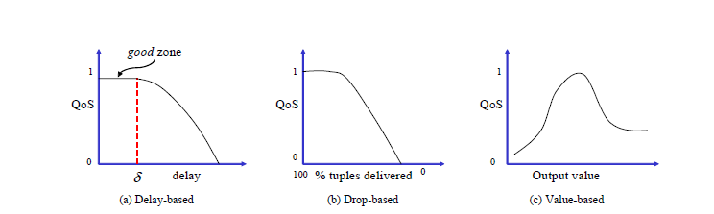
QoS specifications
Done by administrator
A multi dimensional function specified as a set of 2D functions
Picture Courtesy: Reference [2]

Slide 42
QoS Specification
Response Time
  Output tuples should be produced in timely fashion, as otherwise QoS/utility will degrade as delay get longer
Tuple Drops
  How utility is affected with tuple drops
Values produced
  Not all values are equally important

Slide 43
Aurora Storage Management (ASM)
  Two kinds of storage requirements
    Manages queues and buffers for tuples being passed from one box to another
    Manages storage at connection points

Slide 44
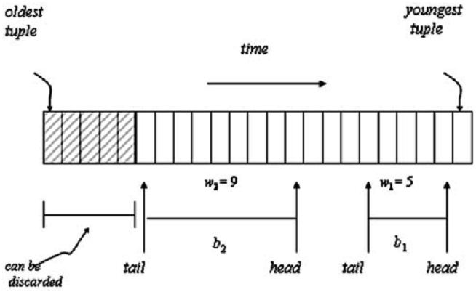
Queue Management
Head: oldest tuple that this box has not processed
Tail: Oldest tuple that this box still needs
b₁
b₀
b₂
Output Queue of b₀:
b₁ & b₂ share the same output queue of b₀
Only the tuples older than the oldest tail pointer (tail of b₂ in this case) can be discarded
Picture Courtesy: Reference [2]

Slide 45
Storing of Queues
Disk storage is divided into fixed length blocks (the length is tunable)
  Typical size is 128KB
Initially each queue is allocated one block
Block is used as a circular buffer
At each overflow queue size is doubled

Slide 46
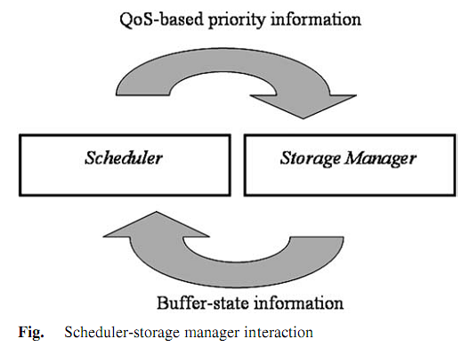
Scheduler-Storage Manager Interaction

Slide 47
Swap policy for Queue blocks
Idea: Make sure the queue for the box that will be scheduled soon is in memory
The scheduler and ASM share a table having a row per box
  Scheduler updates current box priority + isRunning flag
  ASM updates fraction of the queue that is in memory
ASM uses (1) for paging:
  Lowest priority block is evicted
  Block for which box is not running is replaced by a higher priority block
  Can also consider multi-block read/write
Scheduler uses (2) for fixing priorities
Picture Courtesy: Reference [2]

Slide 48
Real Time Scheduling(RTS)
Scheduler selects which box to execute next
Scheduling decision depends upon QoS information
End to End processing cost should also be considered
Aurora scheduling considers both

Slide 49
RTS by Optimizing overall processing cost
Non Linearity: Output rate is not always proportional to input rate
Intrabox nonlinearity
  Cost of processing decrease if many tuples are processed at once
    The number of box call decreases
    Scope of optimization on call for multiple tuples

Slide 50
RTS by Optimizing overall processing cost(contd.)
Interbox nonlinearity
  The tuples which will be operated should be in main memory avoiding disk I/O
  B2 should be scheduled right after B1 to bypass storage manager
Batching of multiple input to a box is train scheduling
Pushing a tuple train through multiple box is superbox scheduling
B1
B2
B3

Slide 51
RTS by Optimizing QoS: Priority Assignment
Latency = Processing delay + waiting delay
Train scheduling considers the Processing Delay
Waiting delay is function of scheduling
Give priority to tuple while scheduling to improve QoS
Two approaches to assign priority
  a state-based approach
  feedback-based approach

Slide 52
Different priority assignment approach
State-based approach
  assigns priorities to outputs based on their expected utility
  How much QoS is sacrificed if execution is deferred
  Selects the output with max utility
Feedback-based approach
  Increase priority of application which are not doing well
  Decrease priority of application in good zone

Slide 53
Putting it all together
Aurora uses heuristics to simultaneously address real-time requirements and cost reduction
  First, assigns priorities to select individual outputs
  Then, explores opportunities for constructing and processing tuple trains.

Slide 54
Scheduler Performance
The network contained 40 boxes
It was run against a simulated input of 50,000 tuples.
Running a scheduler that uses both superbox and tuple train scheduling, they were able to process about 3200 boxes per second, which produced about 830 tuples per second at the outputs.

Slide 55
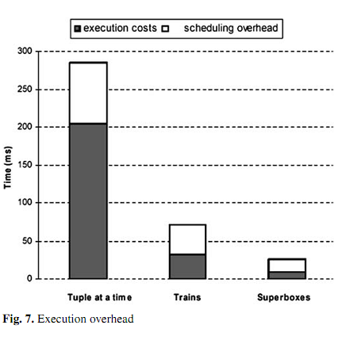
Scheduler Performance
Picture Courtesy: Reference [2]

Slide 56
Load Shedding
Systems have a limit to how much fast data can be processed
Load shedding discards some data so the system can flow
Drop box are used to discard data
Different from networking load shedding
  Data has semantic value
  QoS can be used to find the best stream to drop

Slide 57
Detecting Load Shedding: Static Analysis
When input date rate is higher than processing speed queue will overflow
Condition for overload
  C X H < min_cap
    C=capacity of Aurora system
    H=Headroom factor, % of sys resources that can be used at a steady state
    min_cap=minimum aggregate computational capacity required
min_cap is calculated using input data rate and selectivity of the operator

Slide 58
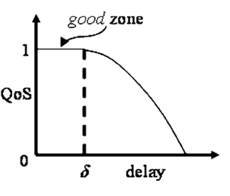
Detecting Load Shedding: Dynamic Analysis
The system have sufficient resource but low QoS
Uses delay based QoS information to detect load
If enough output is outside of good zone it indicates overload
Picture Courtesy: Reference [2]

Slide 59
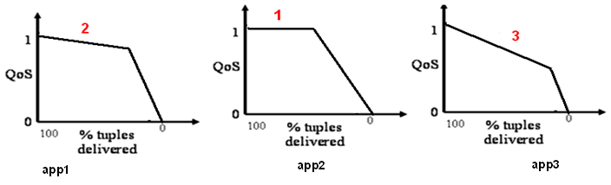
Static Load Shedding by dropping tuples
Considers the drop based Qos graph
Step1: Finds the output and amount of tuple drop which would results in minimum overall QoS drop
Step 2: Insert drop box in appropriate place and drop tuples randomly
Step3: Re-calculate the amount of system resources. If System resource is not sufficient repeat the process

Slide 60
Placement of Drop box
Move the drop-box as close to the data source or connection point
  Drop the overhead as early as possible
Drop Box
Operator
app1
app2
Too much load

Slide 61
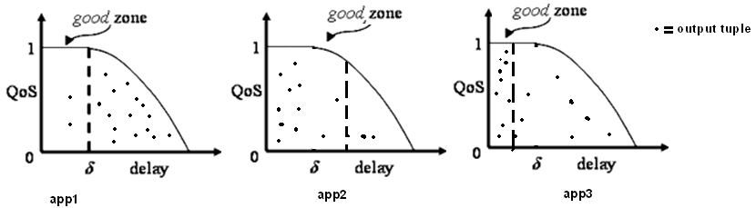
Dynamic Load Shedding by dropping tuples
Delay based Qos graph is considered
Selects output which has Qos lower than the threshold specified in the graph(not in good zone)
Insert drop box close to the source of the data or connection point
Repeat the process until the latency goal are met

Slide 62
Semantic Load shedding by filtering tuples
Previous method drops packet randomly at strategic point
Some tuple may be more important than other
Consult value based QoS information before dropping a tuple

Slide 63
Semantic Load shedding example
Load shedding based on condition
  Most critical patients get treated first
  Filter added before the Join
Patients
Drop barely
Injured tuples
Join
Doctors who can work
on a patient
Doctors
Too much Load

Slide 64
Conclusion
Aurora is a Data Stream Management System for Monitoring Systems. It provides:
  Continuous and Ad-hoc Queries on Data streams
  Historical Data of a predefined duration is stored
  Box and arrow style query specification
  Real-time requirement is supported by Dynamic Load-shedding
Aurora runs on Single Computer
  Borealis^{[3]} is a distributed data stream management system

Slide 65
Parallel Streaming – Apache Storm
Apache Storm is a free and open source distributed real-time computation system.
Storm makes it easy to reliably process unbounded streams of data, doing for real-time processing what Hadoop did for batch processing

Slide 66
Storm Components
A topology is a graph of computation.
  Each node in a topology contains processing logic.
  Links between nodes indicate how data should be passed around between nodes.
Spout
  Sources of data for the topology
  E.g.: Kafka, Twitter etc.
Bolt
  Logical processing units.
  Filtering, Aggregation, Join etc.

Slide 67
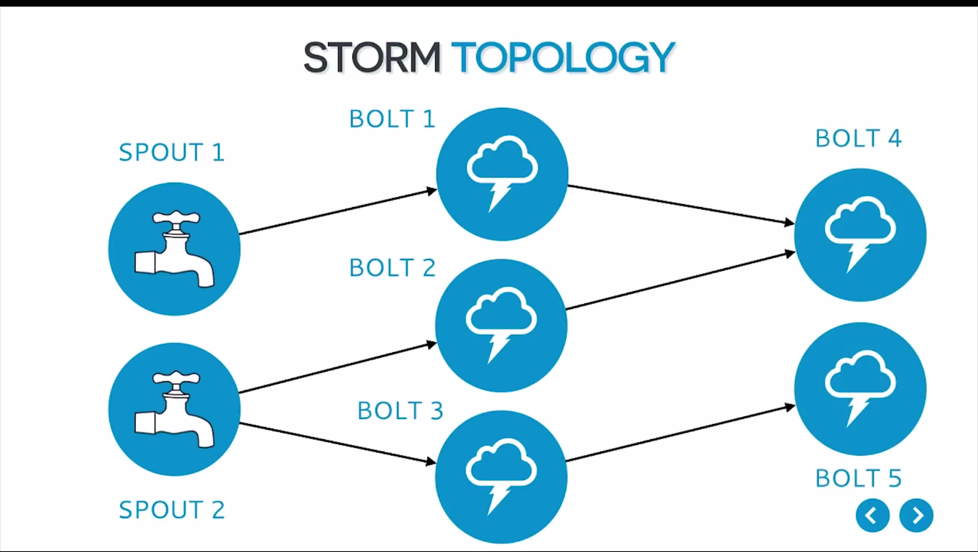
Example: Storm Topology
A topology is a graph of stream transformations where each node is a spout or bolt. Edges in the graph indicate which bolts are subscribing to which streams. When a spout or bolt emits a tuple to a stream, it sends the tuple to every bolt that subscribed to that stream.

Slide 68
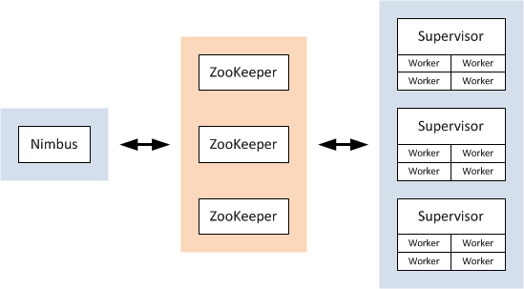
Components of a storm cluster
The master node runs a daemon called "Nimbus“. Nimbus is responsible for distributing code around the cluster, assigning tasks to machines, and monitoring for failures.
Each worker node runs a daemon called the "Supervisor". The supervisor listens for work assigned to its machine and starts and stops worker processes as necessary based on what Nimbus has assigned to it..

Slide 69
Components of Apache Storm
The actual work is done on worker nodes.
Each worker node runs one or more worker processes.
Each worker process runs a JVM, in which it runs one or more executors(threads). Executors are made of one or more tasks.
A task is an instance of a spout or a bolt. It performs the actual data processing

Slide 70
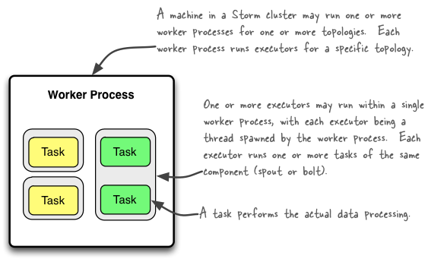
Understanding the Parallelism of a Storm Topology

Slide 71
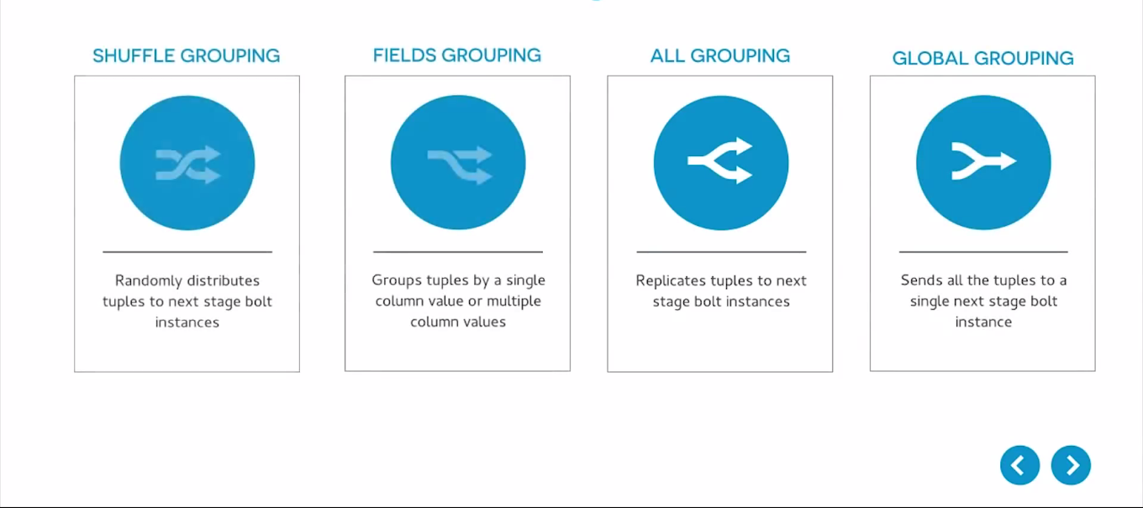
Storm Groupings
A stream grouping tells a topology how to send tuples between two components.

Slide 72
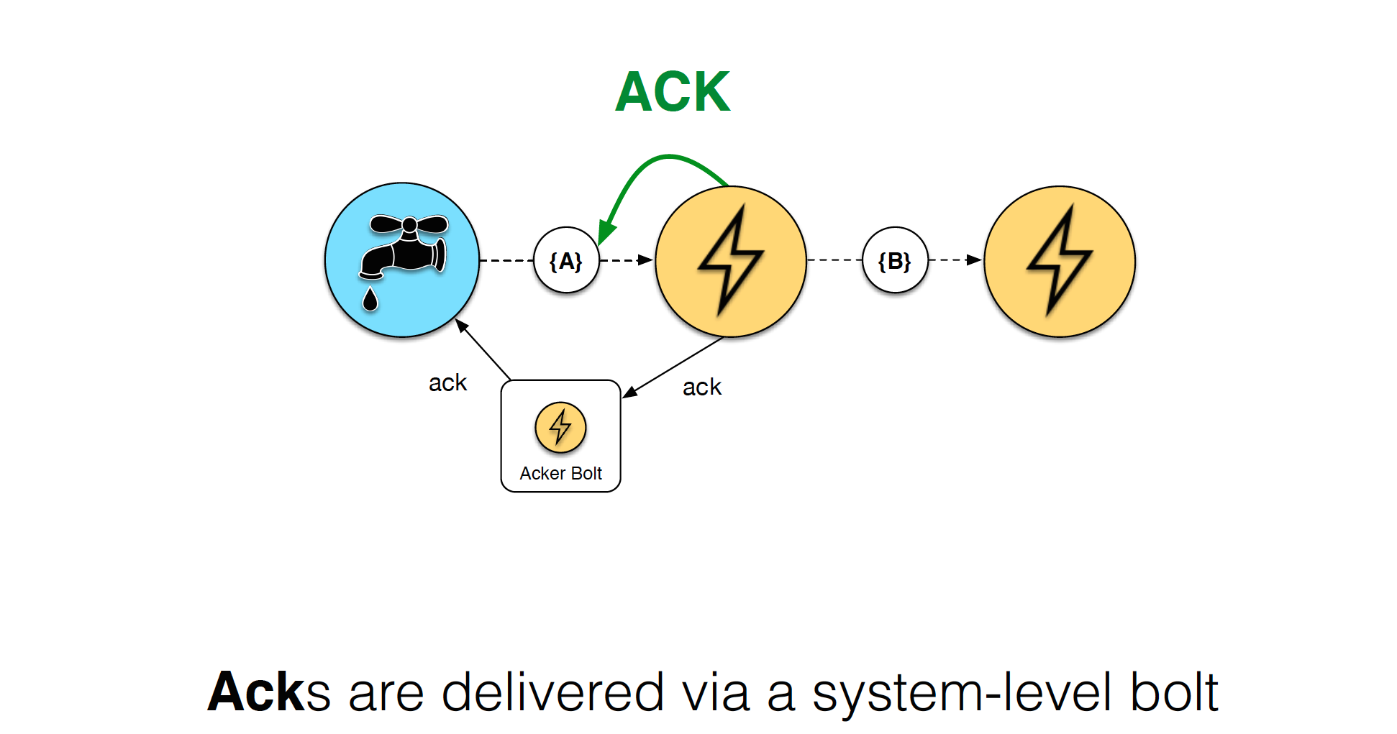
Reliable Processing

Slide 73
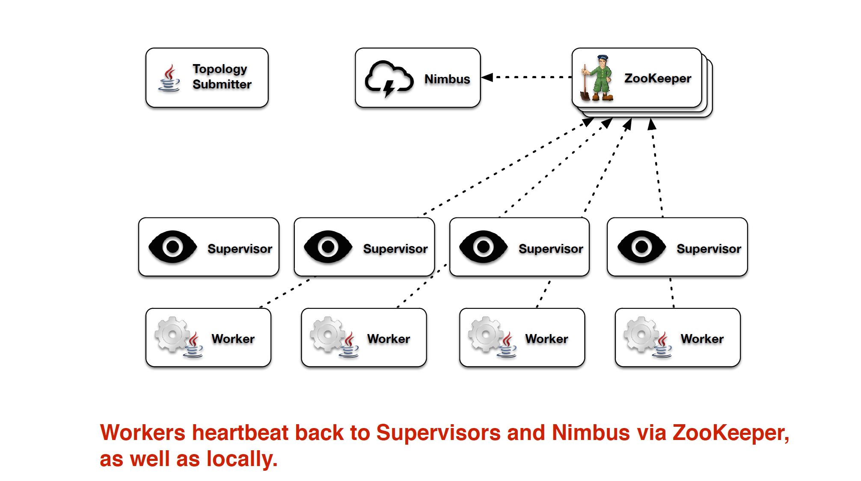
Fault Tolerance

Slide 74
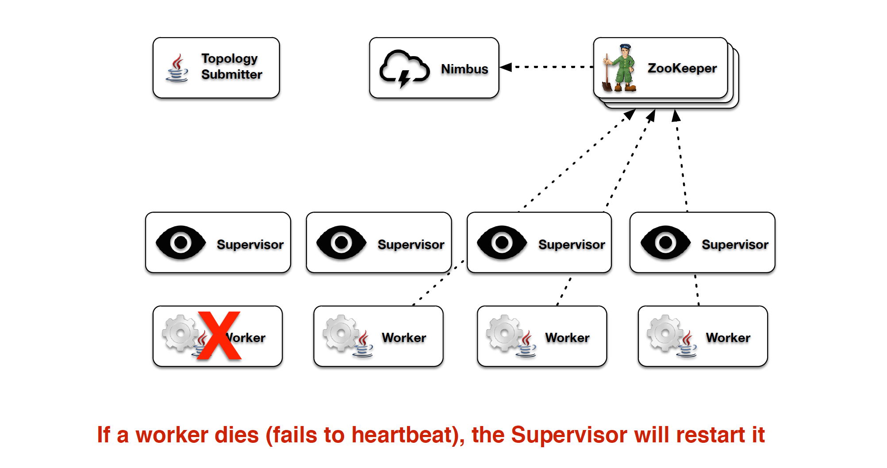
Fault Tolerance

Slide 75
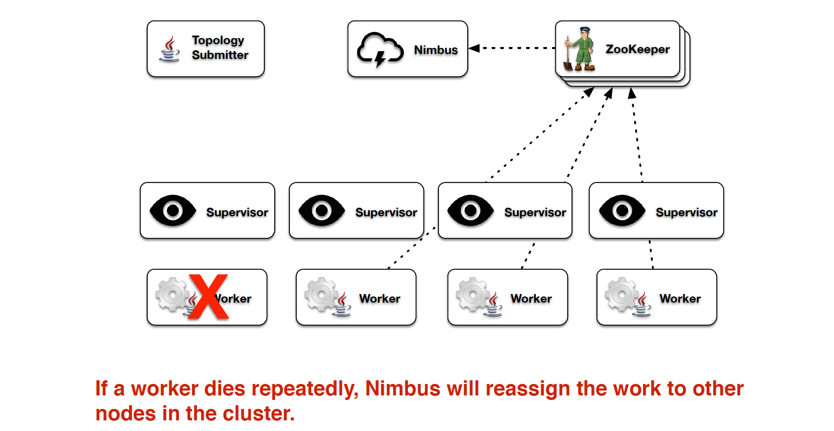
Fault Tolerance

Slide 76
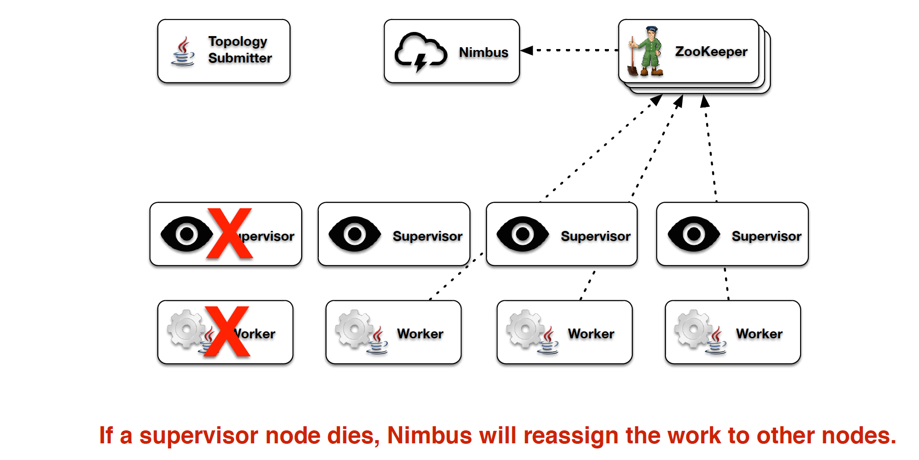
Fault Tolerance

Slide 77
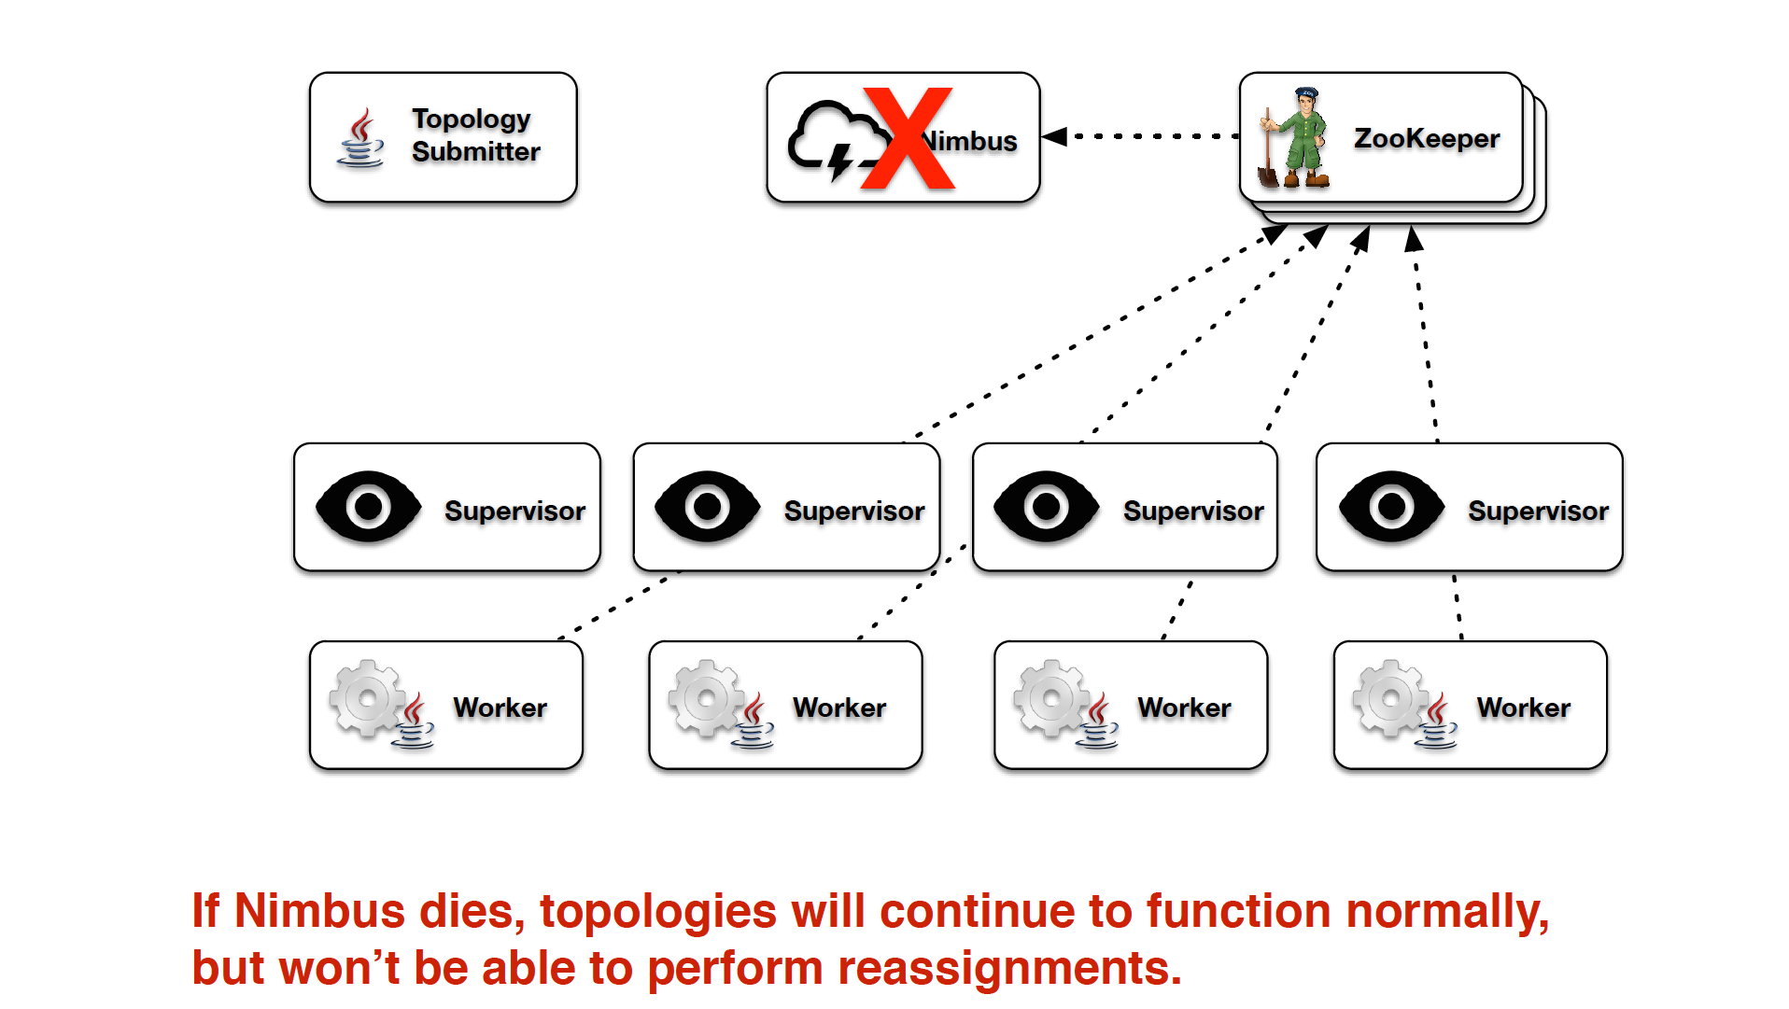
Fault Tolerance

Slide 78
References
[1]
D. Carney et al., “Monitoring streams: a new class of data management applications,” Proceedings of the 28th international conference on Very Large Data Bases, p. 215–226, 2002.
[2]
D. J. Abadi et al., “Aurora: a new model and architecture for data stream management,” The VLDB Journal The International Journal on Very Large Data Bases, vol. 12, no. 2, pp. 120-139, 2003.
[3]
storm.apache.org

Slide 79
Thank You!
Picture Courtesy: Good Financial Cents http://goo.gl/MaQC0

Slide 80
BSort
BSort is an approximate sort operator of the form
Bsort(Assuming O)(S)
where, O = Order(On A, Slack n, GroupBy B₁, …, B_{m})
A buffer of size n+1 is kept
At each stage the min value in buffer is output
Gives correct sorting only if no tuple is out of order by n in S

Slide 81
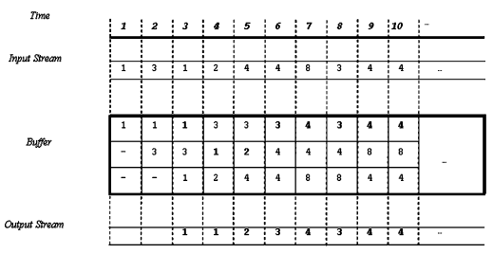
BSort Example
Suppose tuples in a stream have A values: 1,3,1,2,4,4,8,3,4,4 and Slack=2

Slide 82
Aggregate
Aggregate applies “window functions” to sliding windows over its input stream.
Output form

Slide 83
Aggregate Example
To compute an hourly average price (Price) per stock (Sid) over a stream that is known to be ordered by the time the quote was issued (Time).
  Input tuple Schema (Sid, Time, Price)
  Output tuples schema (Sid, Time, Avg(Price))

Slide 84
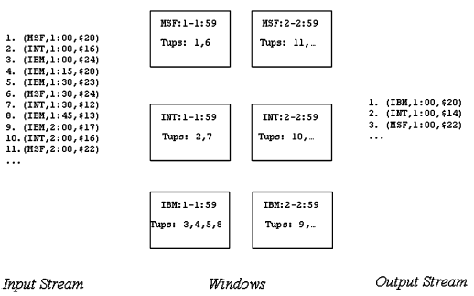
Aggregate Example Contd.

Slide 85
Join
Join is a binary join operator that takes the form
The QoS timestamp is the minimum timestamp of t and u
Join (P, Size 10 min, Assuming Left O, Assuming Right O)(X,Y )

Slide 86
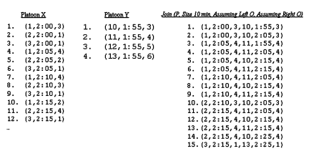
Join example

Slide 87
Resample
Resample can be used to align pairs of streams.
Output such that

Slide 88
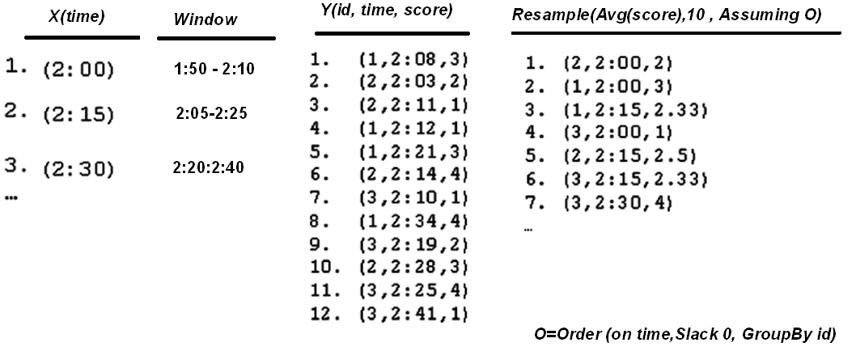
Resample example
The output tuples are emitted in the order in which their computations conclude

Slide 89
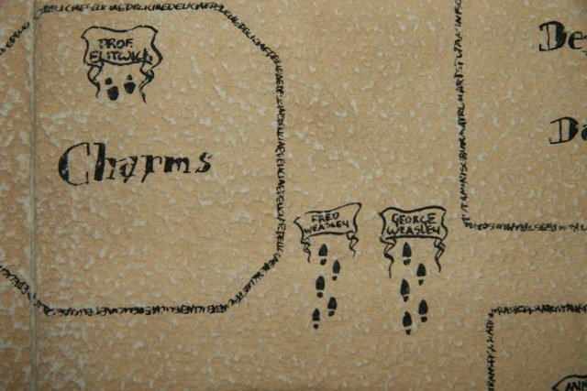
Semantic Load shedding example
Hospital - Network
  Stream of free doctors locations
  Stream of untreated patients locations, their condition (dyeing, critical, injured, barely injured)
  Output: match a patient with doctors within a certain distance
Patients
Join
Doctors who can work
on a patient
Doctors

Slide 90
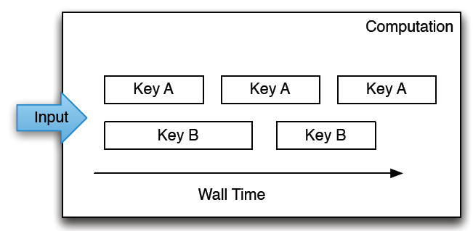
Parallel Streaming
  Processing is serialized per-key, but can be parallelized over distinct keys.
  Per-key processing is serialized over time, such that only one record can be processed for a given key at once. Multiple keys can be run in parallel.

