Slide 1
Keyword Searching and Browsing in Databases using BANKS
S. Sudarshan, Soumen Chakrabarti, Gaurav Bhalotia,
Charuta Nakhe, and Arvind Hulgeri
-Presented by
Aarti Sharma(173053001)

Slide 2
Outline
Motivation and Graph Data Model
Query/Answer models
Tree answer model
Graph Search Algorithms
Backward Expanding Search(in BANKS)
Browsing
Conclusions
Limitations and LaterWork
Conclusion
Limitations and Later Work

Slide 3
Keyword Search on Semi-Structured Data
Keyword search of documents on the Web has been enormously successful
Simple and intuitive, no need to learn any query language
Database querying using keywords is desirable
SQL is not appropriate for casual users
Form interfaces cumbersome:
Require separate form for each type of query – confusing for casual users of Web information systems
Not suitable for ad hoc queries

Slide 4
Keyword Search on Semi-Structured Data
Much data is resident in databases
Organizational, government, scientific, medical data, bibliographic database
Deep web
Goal: querying of data from multiple data sources, with different data models
Often with no schema or partially defined schema
Without having a detailed knowledge of query languages

Slide 5
Keyword Search on Semi-Structured Data
Many websites provide forms to carry out limited types of queries which is laborious and confusing
Another approach is to export data from databases to web pages
-> results in duplication
-> overhead of updation

Slide 6
Graph Data Model
Lowest common denominator across many data models
Relational
node = tuple, edge = foreign key
XML
Node = element, edge = containment/idref/keyref
HTML
node = page, edge = hyperlink
Knowledge representation
node = entity, edge = relationship
Network data
e.g. social networks, communication networks

Slide 7
Graph Data Model (Cont)
Nodes can have
labels
E.g. relation name, or XML tag
textual or structured (attribute-value) data
Edges can have labels

Slide 8
Keyword Search on Structured/Semi-Structured Data
Key differences from IR/Web Search:
Normalization (implicit/explicit) splits related data across multiple tuples
To answer a keyword query we need to find a (closely) connected set of entities (via relationships) that together match all given keywords
soumen crawling or soumen byron
BANKS: Keyword search…
Focused Crawling …
paper
writes
Sudarshan
Soumen C.
Byron Dom
author

Slide 9
Answer Example
Query: sudarshan roy
paper
Information node :
MultiQuery Optimization
writes
writes
author
author
S. Sudarshan
Prasan Roy
Note: Edge from Paper to Writes is a backward edge and is denoted by blue color

Slide 10
Outline
Motivation and Graph Data Model
Query/Answer models
Tree answer model
Graph Search Algorithms
Backward Expanding Search
Browsing
Conclusions
Limitations and LaterWork
Conclusions
Limitations and Later Work

Slide 11
Query/Answer Models
Basic query model:
Keywords match node text/labels
Can extend query model with attribute specification, path specifications
e.g. paper(year < 2005, title:xquery),
Alternative answer models
tree connecting nodes matching query keywords
nodes in proximity to (near) query keywords

Slide 12
Tree Answer Model
Answer: Rooted, directed tree connecting keyword nodes (can relax it according to query)
In general, a Steiner tree
Multiple answers possible
Answer relevance computed from
answer edge score(inverse effect with edge weights) combined with
answer node score
paper
Focused Crawling
writes
writes
author
author
Soumen C.
Byron Dom
Eg. “Soumen Byron”

Slide 13
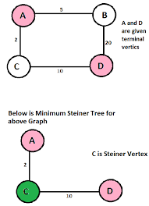
Steiner Trees
Steiner Tree(named after Jacob Steiner) is a tree in a graph which spans a given subset of vertices (terminals) with the minimum total edge weight
The tree may contain vertices that are not terminal vertices
Minimum Steiner tree used in network design and wiring layout problems.

Slide 14
Example
ChakrabortySD98 | Mining Surprising Patterns | .........
Paper tuple
SoumenC | ChakrabortySD98
SunitaS | ChakrabortySD98
Writes tuple
SoumenC | Soumen Chakraborty
SunitaS | Sunita Sarawagi
Author tuple

Slide 15
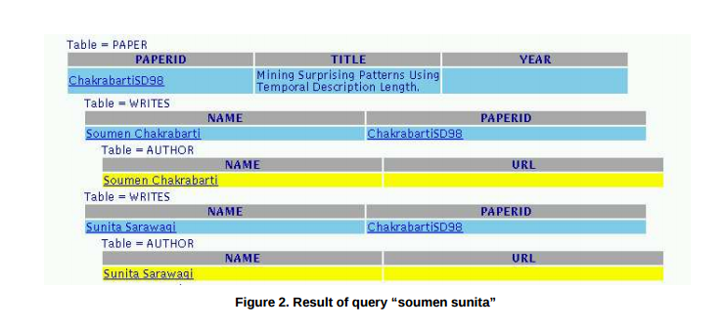

Slide 16
Answer Ranking
Naïve model: answers ranked by number of edges
Problem:
Some tuples are connected to many other tuples
E.g. highly cited papers, popular web sites
Highly connected tuples create misleading shortcuts
E.g. every student would be closely linked with every other student via the department/university
Solution: use directed edges with edge weights
Define different forward and backward edge weights
Forward edges: In the direction of the foreign key reference (e.g. paper to author path)
allow answer tree to have backward edge u→v if original graph has v→u, but at higher cost

Slide 17
Edge Weight Model
Weight of forward edge based on schema
e.g. citation link weights > writes link weights
Reflects the strength of proximity
By default set to 1
Create extra backward edges v→u for each edge u→v present in data
Backward Edge weight proportional to #edges pointing to v (indegree of v)
If both forward and backward edge exists from a node v to a node u, then weight should be minimum of the two.
Overall Answer-tree Edge Score E_{A} = 1/ (Σ edge weights)
Higher score ➔ better result (higher proximity)
Notes:
“cites” link weights > “writes” link weights
changed to
“cites” link weight greater than “writes” link weight

Slide 18
Edge Weight
Example:
Backward edge
3
Forward-edge
R[i]
1
3
R[j]
1
Q[v]
3
R[k]
1
Primary-Key
Foreign-Key
R[i]:
Aarti | CSE | ....
Q[v]:
CSE | ....

Slide 19
Tree Edge Score
Problem: Some backward edges have unduly large weights
Scale backward edge weights by using log(1+raw-edge-weight)
Overall tree edge score
Escore=1/(1+Σ_{e} Escore(e))

Slide 20
Node Weight
Node prestige based on indegree
More incoming edges → higher prestige
Set node weight = in-degree
Problem: Nodes with many in-edges result in skewed answers
Subdue extreme node weights by using log(1+in-degree)
(Implemented in later paper) PageRank style transfer of prestige
Node weight: function of node prestige

Slide 21
Answer Tree Node Score
Normalized node score
Nscore(v) = N(v)/Nmax
or = log(1+N(v)/Nmax)
Answer-tree Node score N_{A} = root node weight + Σ leaf node weights
Node scores of intermediate nodes not included to avoid meaningless inclusion of high prestige nodes into an answer tree

Slide 22
Combining Scores
Overall score of answer tree A
combine tree edge and node scores
Final query result will be shown sorted in the decreasing order of overall tree relevance score.
Top k results will be shown
Problem: how to combine two independent metrics: node weight and edge weight
Normalize each to 0-1
Combine using weighting factor λ
Additive: (1- λ) E + λ N
Multiplicative: E N^{λ}
Performance study to compare alternatives and to find reasonable values for λ

Slide 23
Outline
Motivation and Graph Data Model
Query/Answer models
Tree answer model
Graph Search Algorithms
Backward Expanding Search
Browsing
Conclusions
Limitations and Later Work

Slide 24
Finding Answer Trees
Backward Expanding Search Algorithm (Bhalotia et al, ICDE02):
Intuition: find vertices from which a forward path exists to at least one node from each Si.
Run concurrent single source shortest path algorithm from each node matching a keyword
Create an iterator for each node matching a keyword
Traverse the graph edges in reverse direction
Output next nearest node on each get-next() call
Do best-first search across iterators
Output an answer when its root has been reached from each keyword
Answer heap to collect and output results in score order

Slide 25
Backward Expanding Search
Query: soumen byron
paper
Focused Crawling
writes
authors
Soumen C.
Byron Dom

Slide 26
Finding Answer Tress
For each vertex visited, maintain a nodelist v.Li for each search term ti.
Update the ith nodelist when the search starting from a vertex reaches the vertex v.
The new result trees produced correspond to the nodelists : {u × π_{i ≠ j}v.Li}

Slide 27
Example
X
Searched Keyword: “Aarti Anshi Pooja”
v.L1={}
v.L1={S1}
S1 X {v.L2 , v.L3}
v.L2={}
v.L2={S2}
v.L3={}
v.L3={S3,S4}
Leaf nodes: <S1,S2,S3>
<S1,S2,S4>
Dept :
CSE | ..... | ....
v
Student :
34 | Aarti | CSE
46 | Pooja | CSE
S1
S3
25 | Anshi | CSE
47 | Pooja | CSE
S2
S4

Slide 28
Result Ordering
Answer trees may not be generated in relevance order
Solution:
Best-first search across all iterators, based on path length
Output answers to a buffer
Eliminate duplicates: Isomorphic Trees
Output highest ranked answer from buffer to user when buffer is full

Slide 29
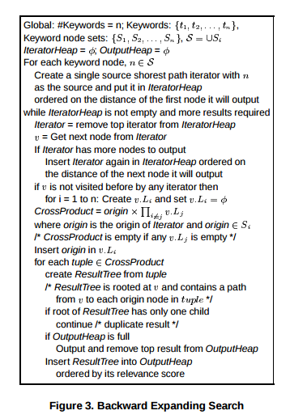

Slide 30
Performance
Anectodes
For query “Mohan” on DBLP database, C.Mohan, Mohan Ahuja, Mohan Kamat were the top responses
Due to prestige conferred by writes relation, has many tuples for these authors
Query “computer engineering” on IITB ETD database returned the Computer Science and Engineering department with a higher relevance than other node types (e.g. thesis nodes) containing these keywords
the larger number of references to the department gave it a higher node weight

Slide 31
Performance
Space and Time
For bibliographic database with 100K nodes and 300K edges, memory utilization was 120MB
Graph takes initially 2 min to load, with most time spent in Java structure creation
After that queries take few seconds
Feasible to use for moderately large databases with proper Java/C implementation

Slide 32
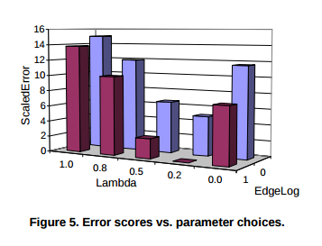
Performance
Effects of Parameters

Slide 33
The BANKS System
User
HTTP
BANKS
JDBC
Database
Web Server + Servlets
Available on the web, with DBLP, IMDB and IITB ETD data
http://www.cse.iitb.ac.in/banks/
No programming needed for customization
Minimal preprocessing to create indices and give weights to links
Provides keyword search coupled with extensive browsing features
Schema browsing + data browsing
Hyperlinks are automatically added to all displayed results
Browsing data by grouping and creating crosstabs
Graphical display of data: bar charts, pie charts, etc

Slide 34
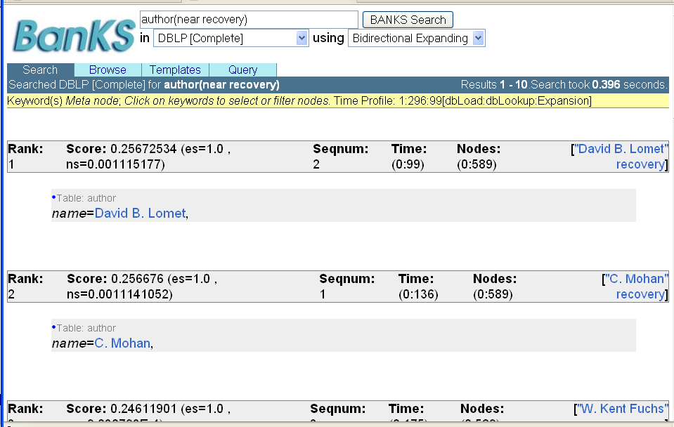
Screenshot
author (near recovery)

Slide 35
Browsing
Generates browsable views of database relations and query results
Every displayed foreign key attribute value becomes hyperlink to the referenced tuple
Each table display comes with different tools :
Columns can be projected away
Selections can be imposed
For Foreign key columns, clicking on “join” results in the referenced table being joined in
Results can be grouped by on a column

Slide 36
Conclusions
BANKS system
provides an integrated browsing and keyword querying system for relational databases
allows users with no knowledge of database system or schema to query and browse relational database with ease

Slide 37
Backward Exp. Search Limitations & Later Work (not in ICDE 2012 paper)
Backward search can perform poorly if some keyword match many nodes, or some has very large degree.
Reason: Too many iterators (one per keyword node)
Solution: single iterator per keyword (SI-Bkwd search)
tracks shortest path from node to keyword
Changes answer set slightly
Different justifications for same root may be lost
Not a big problem in practice
Backward search may explore one keyword more than another due to its prioritization, delaying answer generation
Solution: Balanced Backward Search performs one exploration step for a keyword, then moves to next keyword in round-robin fashion
Shown to return results faster

Slide 38
Basic Idea about Information Retrieval
Information retrieval (IR) systems use a simpler data model than database systems
Information organized as a collection of documents
Documents are unstructured, no schema
Information retrieval locates relevant documents, on the basis of user input such as keywords
e.g., find documents containing the words “database systems”
Web search engines are the most familiar example of IR systems

Slide 39
Keyword Search
Information-retrieval systems typically allow query expressions formed using keywords and the logical connectives and, or, and not
Ands are implicit, even if not explicitly specified
Ranking of documents on the basis of estimated relevance to a query is critical
Relevance ranking is based on factors such as
Term frequency
Frequency of occurrence of query keyword in document
Inverse document frequency
How many documents the query keyword occurs in
Fewer ➔ give more importance to keyword
Hyperlinks to documents
More links to a document ➔ document is more important

Slide 40
Term Frequency and Inverse Document Frequency
TF-IDF (Term frequency/Inverse Document frequency) ranking:
Let n(d) = number of terms in the document d
n(d, t) = number of occurrences of term t in the document d.
Relevance of a document d to a term t
TF (d, t) = log 1 + n(d, t)
n(d)
The log factor is to avoid excessive weight to frequent terms
TF definition usually extended to give more weight to title and words at beginning of document
IDF(t) = 1/ n(t), where n(t) denotes the number of documents (among those indexed by the system) that contain the term t
Relevance of document d to query Q
r (d, Q) = ∑ TF (d, t) * IDF(t)
t∈Q
Proximity: if keywords in query occur close together in the document, the document has higher importance than if they occur far apart

Slide 41
What is PageRank?
PageRank (PR) is an algorithm used by Google Search to rank websites in their search engine results
PageRank is a way of measuring the importance of website pages
PageRank works by counting the number and quality of links to a page to determine a rough estimate of how important the website is
Assuming that more important websites are likely to receive more links from other websites
The numerical weight that it assigns to any given element E is referred to as the PageRank of E and denoted by PR(E)

Slide 42
Page Ranking Algorithm
PR(A) = (1-d) + d (PR(T1)/C(T1) + ...+PR(Tn)/C(Tn))
where:
PR(A) is the PageRank of page A,
PR(Ti) is the PageRank of pages Ti which link to page A,
C(Ti) is the number of outbound links on page Ti d is a damping factor which can be set between 0 and 1.
PR can be computed iteratively by giving initial value to PR.

Slide 43
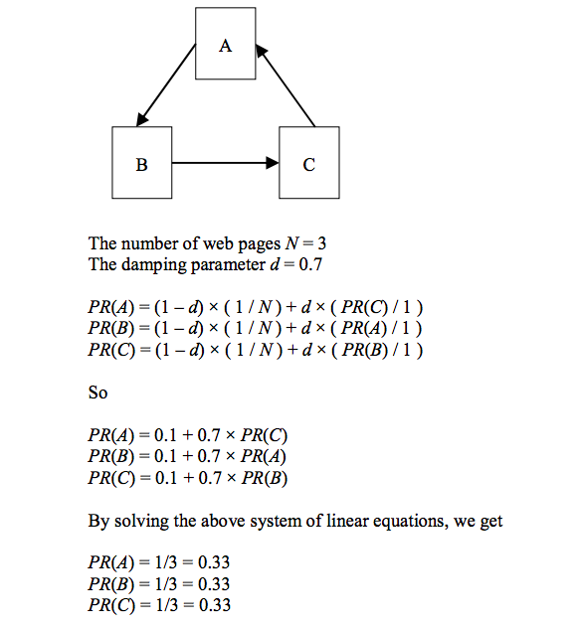
PageRank Example

Slide 44
References
https://en.wikipedia.org/wiki/Steiner_tree_problem
http://homepage.divms.uiowa.edu/~hzhang/c145/notes/chap22.pdf
https://www.cse.iitb.ac.in/~sudarsha/db-book/slide-dir/ch19.pdf
http://codex.cs.yale.edu/avi/db-book/db6/slide-dir/index.html
https://en.wikipedia.org/wiki/PageRank
http://www.dcs.bbk.ac.uk/~dell/teaching/ir/examples/pr_example.pdf

Slide 45
Thanks!

