Slide 1
Building Confidence Shweta Agrawal IIT Madras

Slide 2
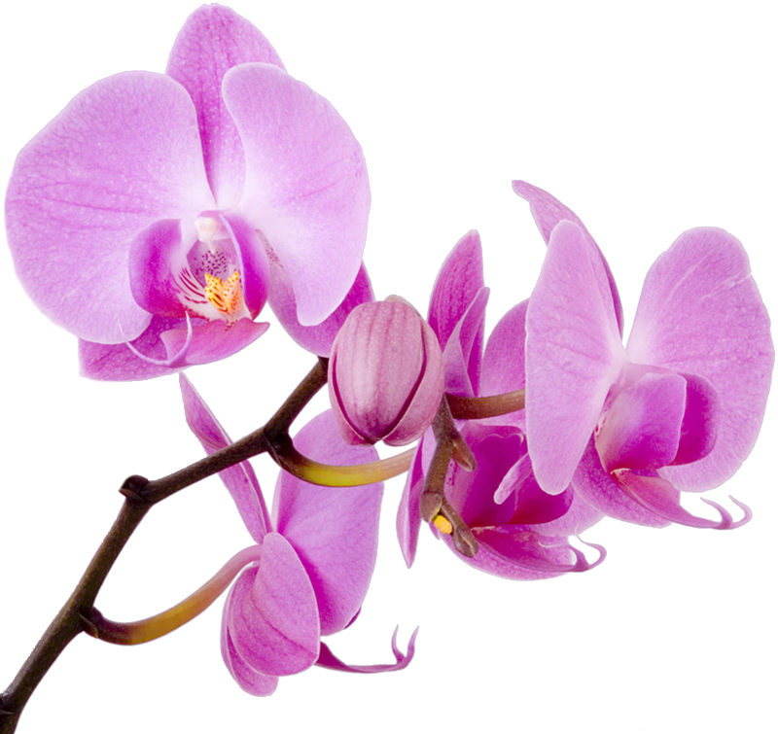
Confidence
Merriam Webster: Confidence is a feeling or consciousness of one's powers or of reliance on one's circumstances

Slide 3
Confidence
Merriam Webster: Confidence is a feeling or consciousness of one's powers or of reliance on one's circumstances

Slide 4
Some data
In 2013, the gender pay gap in India was estimated to be 24.81%.
A report by World Economic Forum highlights that in the corporate sector in India, a woman is paid only 1/3rd what a man in the same position is paid.
Representation of women in work force constitutes only 1/4th total strength

Slide 5
Science and scientists are objective

Slide 6
Science and scientists are objective Study 1
Trix and Psenka (2003) analyzed 312 letters of recommendation for 103 successful applicants for faculty positions in a large medical school.
They found that letters for women were shorter than letters for men, which meant that fewer of the women's credentials were being described.
Results of their study show that women are – unintentionally – discriminated against.

Slide 7
Science and scientists are objective Study 2
Research from Yale had scientists presented with application materials from a student applying for a lab manager position and who intended to go on to graduate school.
Half the scientists were given the application with a male name attached, and half were given the exact same application with a female name attached.
Results found that the “female” applicants were rated significantly lower than the “males” in competence, hireability, and whether the scientist would be willing to mentor the student.
The scientists also offered lower starting salaries to the “female” applicants: $26,507.94 compared to $30,238.10.

Slide 8
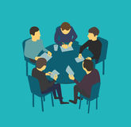
Science and scientists are objective Study 3: Head of the Table Exp (Porter and Geis)
College students saw a slide of 5 people seated around a table. The group was described as working together on a project. Two people sat at each side and one person sat at the head of the table.
Some students saw group all male, others all female, and yet others mixed, i.e. both males and females.
Students were asked to say who was the leader of the group.
In same-sex groups, students consistently identified the man or woman sitting at the head of the table as the leader.

Slide 9
In mixed-sex groups, if a man was at the head of the table, students saw him as the leader.
But if a woman was at the head, students labeled her as the leader about half the time and labeled a man seated elsewhere at the table as the leader about equally often.
Women are less likely to obtain the automatic deference that marks leadership conferred to men.
A woman has to work harder to demonstrate that her apparent position of leadership is a real position of leadership.

Slide 10
Science and scientists are objective Study 4
One early study evaluated postdoctoral fellowship applications in the biomedical sciences and found that the women had to be 2.5 times more productive than the men in order to be rated equally scientifically competent by the senior scientists evaluating their applications.
The authors concluded, “Our study strongly suggests that peer reviewers cannot judge scientific merit independent of gender. The peer reviewers over-estimated male achievements and/or underestimated female performance.”
The study finds that “gender discrimination of the magnitude we have observed… could entirely account for the lower success rate of female as compared with male researchers in attaining high academic rank.”

Slide 11
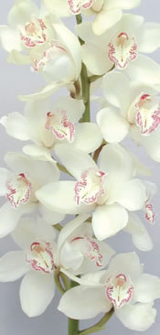
Whenever the subject of women in science comes up, there are people fiercely committed to the idea that sexism does not exist. They will point to everything and anything else to explain differences while becoming angry and condescending if you even suggest that discrimination could be a factor. But these people are wrong. This data shows they are wrong.
[Article in Scientific American about Yale study]

Slide 12
Scientists are supposed to be objective, able to evaluate data and results without being swayed by emotions or biases. This is a fundamental tenet of science. What this extensive literature shows is, in fact, scientists are people, subject to the same cultural norms and beliefs as the rest of society.
[Prof. Alison Coil, UCSD]

Slide 13
Women can’t do math
Women are good at rote learning not reasoning
It is not feminine to argue
Why would Google pay so much to hire a woman whose just going to go on maternity leave
I saw a very beautiful woman on our floor today and I wondered, what she is doing on the science floor?
Your paper has better chances since it will get sympathy, being an all woman paper
Yes, you have many good papers at good venues but they are all with other people. How do we know what you have done?
To be popular women just need to be glamorous and stupid
If you study so much, who will marry you?
Its normal that people prefer male children because they look after their parents, while women leave home

Slide 14
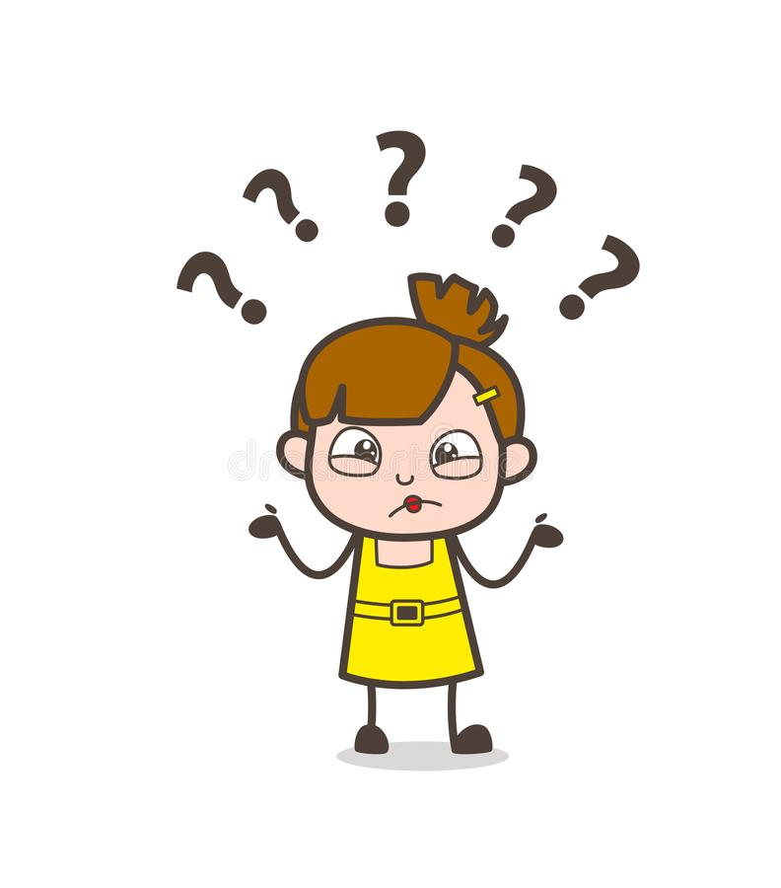
Why am I telling you this?
A girl receives literally thousands of suggestions over time that tell her where her place is… in the best case, she notices and rebels, in the much more common case, she internalizes it and does not fight to reach her potential.
If a man speaks up in disagreement, it is seen as leadership/courage. If a woman speaks up in disagreement, it is seen as aggression/rudeness.
Most women in science suffer from Imposter Syndrome: A psychological pattern in which an individual doubts their accomplishments, and has a persistent internalized fear of being exposed as a "fraud". Despite external evidence of their competence, those experiencing this phenomenon remain convinced that they are frauds, and do not deserve all they have achieved.

Slide 15
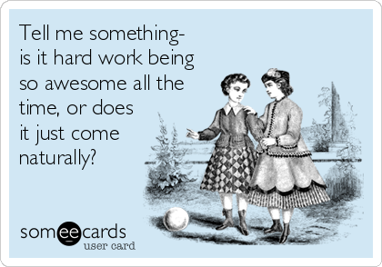
Then, confidence?
If despite so much conditioning, negative feedback from society etc, we still came so far, then ….
Are we not awesome by definition ☺ ?

Slide 16
Personal
I realized the error I had always made was in waiting for other people to tell me how good I was.
At some point, it occurred to me ….
Errr…. Why do I care exactly? ;-)
No one else is in a position to tell me how to feel about myself! Confidence, for me, was just taking back ownership of my own sense of self worth. I decided to be it, and I was.
Do not pay attention to what others think of you! Just feel confident, for no reason other than that you are you.

Slide 17
Calling It Out
Calling out thoughtless remarks is often unpleasant, and can lead to strained relationships.
Most of the time, no one noticed but you. Almost all the time, no guy thinks its his problem. This discourages women further from saying anything.
No community is in isolation from society, and if we do not notice these things, do not have conscious, intelligent responses to them and do not actively seek to correct them, we become automatic, unconscious transmitters of the same repressive ideas.
When we do not call out these ideas, we perpetrate them. When the majority perpetrates the same ideas, we continue to maintain status quo.

Slide 18
Actually No. Use your judgement.
Guard your creative energy. Channelize it to fruitful pursuits like research, friendships, hobbies. Staying happy and being creative is your first business.
Put your head down and work. Over time, success will come. The detractors will anyway be silenced.
Confidence is not aggression. Often causes more harm than good.

