Slide 1
Paper Reading and Writing
Dr. Padmaja Joshi
Associate Director
C-DAC Mumbai

Slide 2
Reading
Journal Papers
Conference Papers
Books
Reports

Slide 3
Reading Abstract and Conclusion
‘Understanding through referred literature
Understanding Results

Slide 4
White Paper
Survey Paper
Concept Paper
Experience Paper
Research
Paper

Slide 5
What is required?
Concept/ Contribution
Motivation / Need
Literature survey
Completeness of the concept
Empirical validation
Conclusion

Slide 6
Identification of the uniqueness in contribution
Explain what the problem statement is or what is addressed in the paper
What is the motivation of choosing the statement
Originality
Explain in your own words rather than copy paste
Maintaining the flow while writing
Bring completeness

Slide 7
Structure
Title & Authors
Abstract
Introduction
Background
Literature Survey
Approach/ concept
Concept Detailing
Experimentation
Analysis
Conclusion
References

Slide 8
Process
Decide the problem statement
Create Outline
Do identify the work done in the domain- include papers, thesis, reports, patents
Bring out the concept well with the necessary background
Test and provide mathematical or empirical support through validations

Slide 9
Abstract Introduction & Conclusion

Slide 10
ABSTRACT
Gist of the paper
Shortest
CONCLUSION
Conclusions extracted from the work, experimentation analysis
Do not conclude something that is not proven in your paper
Should cover all points discussed in the paper

Slide 11
Literature Survey
Relevance to the topic
Comparison with your concept
How different is your concept
Base paper details if extended further

Slide 12
CloneCloud
OOD Metric Suite
Concept Lattice
Property 9
Extending App Memory

Slide 13
References
Standard for mentioning references
Journal:
[].Author(s), year published, Article Title, Journal Name, Volume(Issue), pp. doi#
Book:
[].Author(s).Publication year . Article, Edition, Place of Publication:Publisher, Extent, Notes

Slide 14
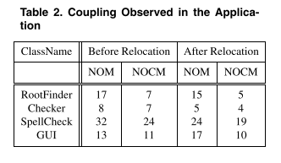
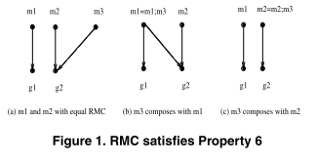
Figures and Tables
Every figure, table should be numbered.
Every Figure, Table should be referred.

Slide 15
Should Not be Ignored
Grammatical Errors
Spelling Mistakes
Incomplete Sentences
Unreferenced Figures/ Tables
Orphan Sentence, Paragraph, Section Heading
Uncited Copy-Paste
Incorrect citations

Slide 16
THANK YOU

