Slide 1
MTech vs PhD
Shruti Kunde
TCS Research, Mumbai

Slide 2
Agenda
What does a PhD / Masters Program mean?
Why a PhD ?
When a PhD vs Masters ?
What after PhD / Masters ?

Slide 3
What is a PhD ?
A graduate degree that requires a significant amount of time.
MTech ?
A graduate degree that requires a significantly lesser amount of time compared to a PhD.

Slide 4
Imagine a circle that contains all of human knowledge
http://matt.might.net/articles/phd-school-in-pictures/

Slide 5
By the time you finish elementary school you know a little
http://matt.might.net/articles/phd-school-in-pictures/

Slide 6
By the time you finish high school, you know a bit more
http://matt.might.net/articles/phd-school-in-pictures/

Slide 7
With a bachelor’s degree, you gain some specialty
http://matt.might.net/articles/phd-school-in-pictures/

Slide 8
A master’s degree deepens that specialty
http://matt.might.net/articles/phd-school-in-pictures/

Slide 9
Reading research papers takes you to the edge of human knowledge
http://matt.might.net/articles/phd-school-in-pictures/

Slide 10
Once you are at the boundary, you focus!
http://matt.might.net/articles/phd-school-in-pictures/

Slide 11
You push at the boundary for a few years, until the boundary gives away
http://matt.might.net/articles/phd-school-in-pictures/

Slide 12
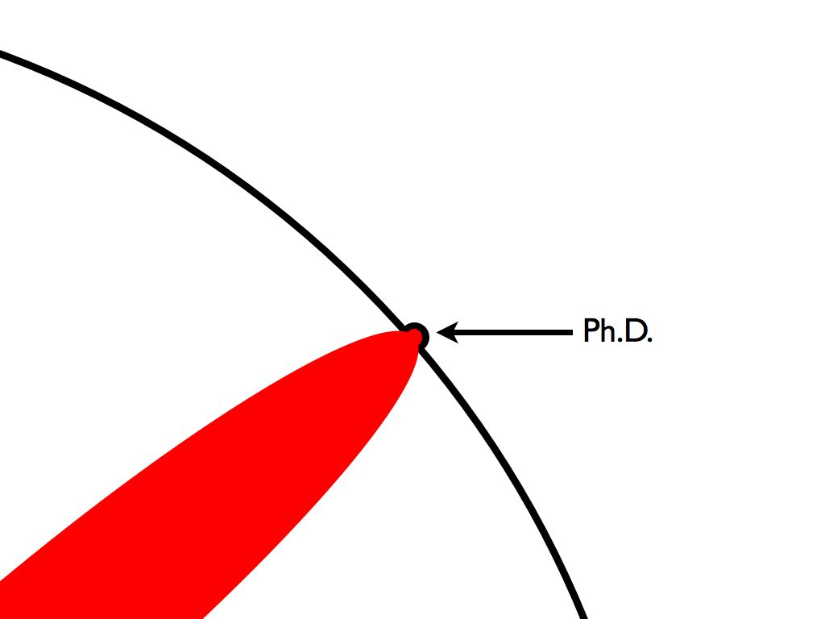
And the dent that you’ve made, is the PhD
http://matt.might.net/articles/phd-school-in-pictures/

Slide 13
Of course, the world looks different to you now.
http://matt.might.net/articles/phd-school-in-pictures/

Slide 14
But don’t forget the big picture.
http://matt.might.net/articles/phd-school-in-pictures/

Slide 15
PhD
Extending this boundary of human knowledge gives you a number of other skills apart from the knowledge gained

Slide 16
MTech vs PhD
Ability to work independently
Ideas must originate from degree holder
Degree not conferred till candidate is able to prove to experts
Critical Thought
Extending state of the art cannot be achieved without understanding the current state

Slide 17
MTech vs PhD
Perseverance
Journey for getting the degree is long and arduous.
Meaningfully extend the boundary of human knowledge.
Ability to work with poorly defined goals
May not have a clear goal
May not have well defined tasks on a day to day basis.

Slide 18
Mtech vs PhD
Cogency
Science is as much an act of persuasion as it is an act of discovery.
Ability to clearly and forcefully articulate ideas
Persuade experts that you have made a legitimate and meaningful contribution
Capability of writing compelling abstracts and introductions, motivating a particular problem

Slide 19
What after ?
A masters degree equips you to come up with designs for complex engineering problems and potentially lead software engineering teams.
A PhD degree equips you to do original research and potentially lead R&D teams.

Slide 20
When ?
PhD
Immediately after a Master’s
Master’s degree with work experience
Immediately after a Bachelor’s
Bachelor’s degree with work experience
Mtech
Immediately after a Bachelor’s
Bachelor’s degree with work experience

Slide 21
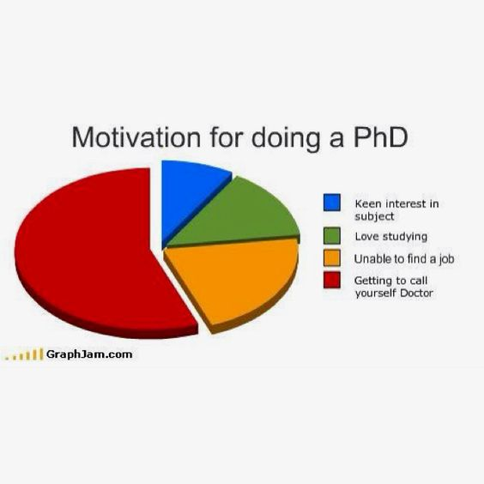
Why PhD ?

Slide 22
Thank you!
Shruti.kunde@tcs.com

