Slide 1
Lazy set and Linearizability WITH HINDSIGHT BY- AYUSH SHARMA(203050029) AVIRAL SINGH(203050119)

Slide 2
Plan
Introduction to lazy set.
The new algorithm.
Some terminologies.
Hindsight lemma.
Linearizability proof by hindsight.

Slide 3
Lazy list
Coarse-grained locking
Lock coupling

Slide 4
Coarse grained locking
Uses a single lock

Slide 5
Lock coupling
Its is also known as hand-over-hand locking.
Lock for every entry before releasing its predecessor lock.

Slide 11
Some assumptions for our new algorithm
Represent set as a sorted linked list.
We use optimistic approach:- while searching without acquiring any locks.
Advantage of optimistic approach.

Slide 12
Lock freedom vs wait freedom
LOCK FREEDOM | WAIT FREEDOM
1. SOME THREAD IS DOING PROGRESS. | 1. SOME THREAD PROVIDED WITH A TIME SLICE WILL SATISFY PROGRESS AND EVENTUALY COMPLETE.
2. IT MAY TAKE INFINITE AMOUNT OF OPEATION THEORITICALLY. | 2. NUMBER OF STEPS IS FINITE THEORITICALLY.
3. BUT IN PRACTISE , IT TKES A SHORT AMOUNT OF OPERATIONS. | 3. BUT IN PRACTISE IT TAKES A LARGE AMOUNT OF OPERATIONS.

Slide 13
linearizability
It’s a standard correctness conditions for concurrent data structures.
What is linearization point?
All function call have a linearization point at some instant between their invocation and response.
SINGLE OPERATION WHEN THE METHOD CALL “TAKES EFFECT”

Slide 14
The new algorithm
We represent the concurrent linked list implementation in the context of a list based set object.
Set provides three methods:-
Remove method
ADD method
Contains method

Slide 16
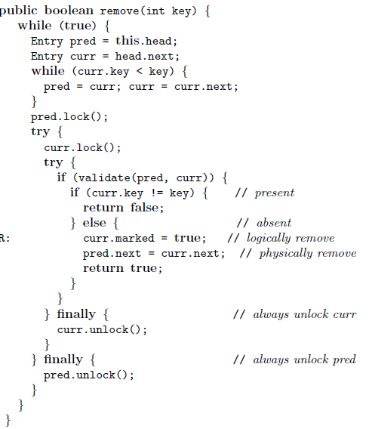
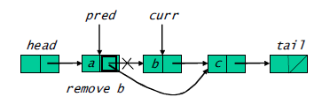
Remove method

Slide 17
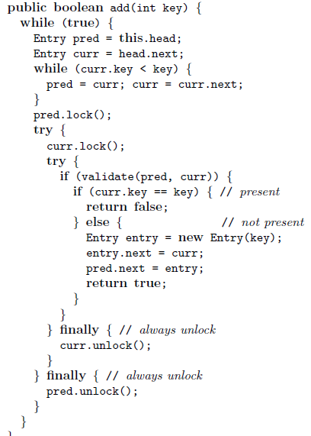
Add method

Slide 18
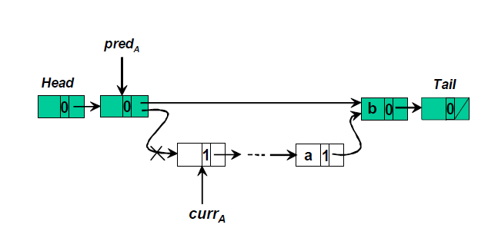
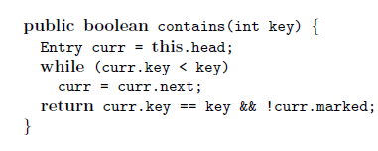
Contains method

Slide 19
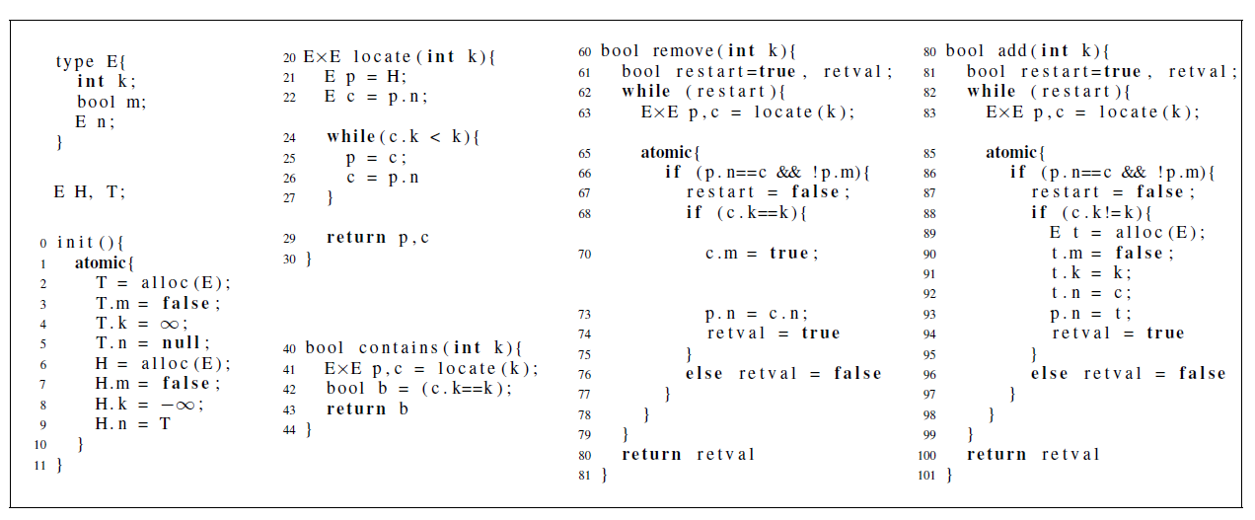
Linearizability WITH HindSight
Replace lock with atomic block.
Such that in atomic block either whole block will run or nothing.

Slide 20
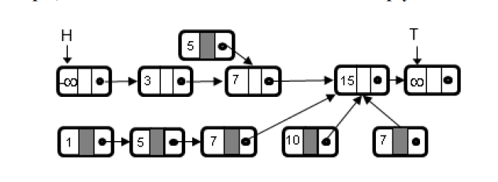
Sample Set
Node 5 is deleted, and the gray part tells that node 5 is logically deleted and by removing the link it is also physically removed.

Slide 21
Some terminology
Backbone Node:- A node is backbone node in state  if it is reachable from head node.
Backbone link:- A link u.n → v in  is a backbone link in  if u is backbone node in .
Transition:- A transition →<t,k>’ represents the fact that the source memory state  can be transformed into the target memory ’ by thread t executing computation step k.
Trace(π):-Is the sequence of states that occurs during π.

Slide 22
Hindsight lemma
The hindsight says that in every execution which satisfy the integrity shape properties, if the link u.n→v is reachable from head node at a state , and the link v.n→w with v in common is a link in a latter state ’, then there is some state occurring between  and ’ in which the later link v.n→w is reachable from head node.

Slide 23
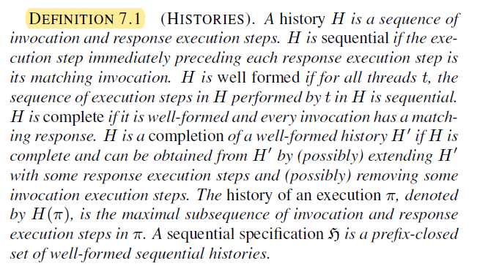
Some important definitions.

Slide 24
Linearizability in terms of history
A concurrent object is linearizable with respect to a sequencial specification if for every execution π of the concurrent object, the interaction between the threads and the concurrent object in π can be explained by a sequencial history Hs.
In Hs, every thread performs the same sequence of invocations and responses as in H(π) and the real time precedence order between non overlapping operations in π is preserved in Hs.

Slide 25
Proving Linearizability with hindsight
IDEA:- The idea behind the hindsight lemma to define a function f which maps every operation t of π to a state which occurs in π between t’s invocation and response.
We construct a sequential history Hs using an auxiliary function f and show that H(π) is linearizable with respect to Hs.

Slide 26
Proving Linearizability with hindsight
We now define function f and use it to construct a complete sequential history Hs which contains the same execution steps as H.
F is defined as follows:-
An add and remove operation t is associated with the source state of the transition in which t executes its atomic section.
A contains operation t is associated with the last state occurring at or before the last crossing state in the traversal trail tail of t in which (last) crossed link is a backbone link.
Hs is obtained by reordering the operations according to the partial order induced by f.
Every operation starts with an invocation and does not execute any step after it responds. Thus, by construction of f, if the response of t1 precedes the invocation of t2 in H then f(t1) < f(t2) and thus t1 also precedes t2 in Hs.
By construction of Hs, it contains same execution steps in H’ which is completion of H(π). It follows that H(π) is linearizable with respect to Hs.

Slide 27
THANK you

