Slide 1
Machine Translation for Related Languages
Anoop Kunchukuttan
Microsoft AI and Research
Center for Indian Language Technology
Indian Institute of Technology Bombay
Microsoft Academic Accelerator (AXLE), 15th May 2018

Slide 2
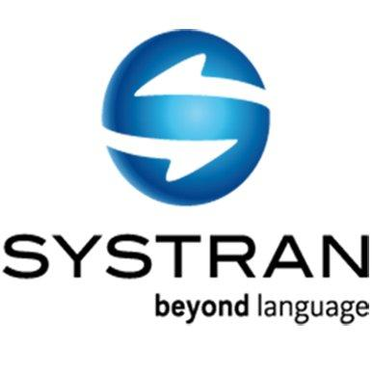
What is Machine Translation?
Automatic conversion of text/speech from one natural language to another
Be the change you want to see in the world
वह परिवर्तन बनो जो संसार में देखना चाहते हो

Slide 3
Related Languages
Related by Genealogy
Related by Contact
Language Families
Dravidian, Indo-European, Turkic
(Jones, Rasmus, Verner, 18th & 19th centuries, Raymond ed. (2005))
Linguistic Areas
Indian Subcontinent, Standard Average European
(Trubetzkoy, 1923)
Related languages may not belong to the same language family!
Notes:
Greenberg, Joseph H. (ed.) (1963) Universals of Language. Cambridge, Mass.: MIT Press.

Slide 4
Key Similarities between related languages
भारताच्या स्वातंत्र्यदिनानिमित्त अमेरिकेतील लॉस एन्जल्स शहरात कार्यक्रम आयोजित करण्यात आला
bhAratAcyA svAta.ntryadinAnimitta ameriketIla lOsa enjalsa shaharAta kAryakrama Ayojita karaNyAta AlA
Marathi
भारता च्या स्वातंत्र्य दिना निमित्त अमेरिके तील लॉस एन्जल्स शहरा त कार्यक्रम आयोजित करण्यात आला
bhAratA cyA svAta.ntrya dinA nimitta amerike tIla lOsa enjalsa shaharA ta kAryakrama Ayojita karaNyAta AlA
Marathi segmented
भारत के स्वतंत्रता दिवस के अवसर पर अमरीका के लॉस एन्जल्स शहर में कार्यक्रम आयोजित किया गया
bhArata ke svata.ntratA divasa ke avasara para amarIkA ke losa enjalsa shahara me.n kAryakrama Ayojita kiyA gayA
Hindi
Lexical: share significant vocabulary (cognates & loanwords)
Morphological: correspondence between suffixes/post-positions
Syntactic: share the same basic word order
Notes:
Make the highlighted areas in square for better alignment

Slide 5
Why are we interested in such related languages?

Slide 6
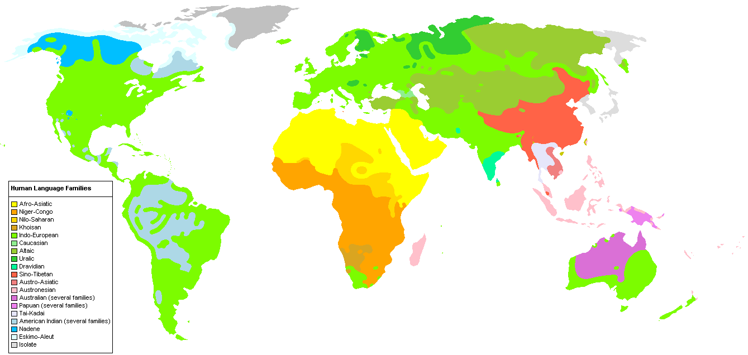
Source: Wikipedia
These related languages are generally geographically contiguous

Slide 7
Balkans
Indian Subcontinent
Indian Subcontinent
Nigeria
South East Asia
Source: Wikipedia
These related languages are generally geographically contiguous
Notes:
Trubetzkoy,
Emenau, 1956

Slide 8
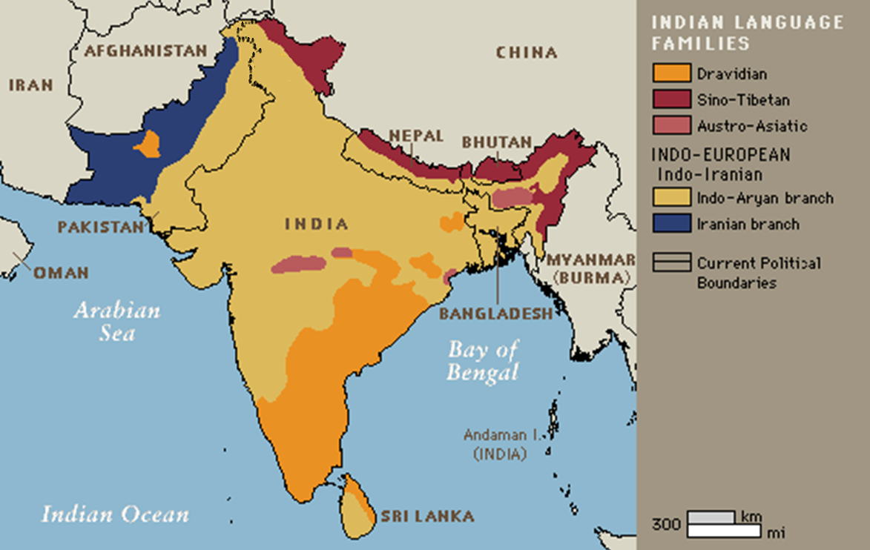
Source: Quora
5 language families (+ 2 to 3 on the Andaman & Nicobar Islands)
22 scheduled languages
11 languages with more than 25 million speakers
Highly multilingual country
Notes:
Correct map boundaries

Slide 9
Naturally, lot of communication between such languages
(government, social, business needs)
Most translation requirements also involves related languages
Between related languages
Hindi-Malayalam
Marathi-Bengali
Czech-Slovak
Related languages ⇐⇒ Link languages
Kannada,Gujarati ⇒ English
English ⇒ Tamil,Telugu
We want to be able to handle a large number of such languages
e.g. 30+ languages with a speaker population of 1 million + in the Indian subcontinent

Slide 10
Is vanilla Statistical Machine Translation not sufficient?

Slide 11
Parallel Corpus
A boy is sitting in the kitchen | एक लडका रसोई मे़ बैठा है
A boy is playing tennis | एक लडका टेनिस खेल रहा है
A boy is sitting on a round table | एक लडका एक गोल मेज पर बैठा है
Some men are watching tennis | कुछ आदमी टेनिस देख रहे है
A girl is holding a black book | एक लडकी ने एक काली किताब पकडी है
Two men are watching a movie | दो आदमी चलचित्र देख रहे है
A woman is reading a book | एक औरत एक किताब पढ रही है
A woman is sitting in a red car | एक औरत एक काले कार मे बैठा है
Machine Learning
* Learn word/phrase alignments
* Learning to reorder
Let’s begin with a simplified view of Statistical Machine Translation (SMT)!!

Slide 12
Co-occurrence is the dominant learning signal
Makes SMT language independent
Hence very popular
Over-reliance on co-occurrence alone increases parallel corpus requirements
Problem is grave for agglutinative languages
e.g. Marathi, Dravidian languages
घरासमोरचा ➔ घर + समोर + चा
Language-specific learning signals are ignored

Slide 13
Aren’t “language independent” Statistical/Neural Machine Translation methods sufficient?
Implicit assumptions increase need for:
(1) Parallel Corpora (2) Linguistic Resources (3) Language specific processing
‘Limited language independence’ can be achieved between some languages if we can make assumptions that hold across all these languages
Related languages can serve as a good level of abstraction to utilize linguistic regularities:
Reduce parallel corpora
Reduce linguistic resource requirements
Better Generalization

Slide 14
Utilizing Lexical Similarity for Subword-level translation
Kunchukuttan & Bhattacharyya, EMNLP (2016)
Kunchukuttan & Bhattacharyya, SCLeM (2017)

Slide 15
Lexically Similar Languages (Many words having similar form and meaning)
Cognates
Loan Words
Named Entities
Fixed Expressions/Idioms
a common etymological origin
do not change across languages
roTI (hi) | roTlA (pa) | bread
bhai (hi) | bhAU (mr) | brother
mu.mbaI (hi) | mu.mbaI (pa) | mu.mbaI (pa)
keral (hi) | k.eraLA (ml) | keraL (mr)
borrowed without translation
MWE with non-compositional semantics
matsya (sa) | matsyalu (te) | fish
pazha.m (ta) | phala (hi) | fruit
dAla me.n kuCha kAlA honA | (hi) | Something fishy
dALa mA kAIka kALu hovu | (gu)

Slide 16
Why do we use word-level translation?
MT learns mappings between meaning bearing linguistic units ➔ Words and Morphemes
Why? ⇒ Fundamental principle of linguistics
Arbitrariness of a word’s form and meaning (Saussure, 1916)
Is the mapping between forms of similar words across languages arbitrary?
Probably true in the most general case
Not true for related languages due to lexical similarity
Utilize lexical similarity between related languages: Sub-word level transformations

Slide 17
Related Work
Transliterate unknown words [Durrani, etal. (2010), Nakov & Tiedemann (2012)]
(a) Primarily used to handle proper nouns (b) Limited use of lexical similarity
स्वातंत्र्य → स्वतंत्रता
Translation of shared lexically similar words can be seen as kind of transliteration
Is there a better translation unit?
Character Level Translation
Limited context of character level representation
Character n-gram ⇒ increase in data sparsity
[Vilar, etal. (2007), Tiedemann (2009)]
Limited benefit ….
… just for closely related languages
Macedonian - Bulgarian, Hindi-Punjabi, etc.

Slide 18
Orthographic Syllable
(Kunchukuttan & Bhattacharyya, EMNLP 2016)
(CONSONANT)➕ VOWEL
Examples: ca, cae, coo, cra, की (kI), प्रे (pre)
अभिमान ➔ अ भि मा न
Pseudo-Syllable
True Syllable ⇒ Onset, Nucleus and Coda
Orthographic Syllable ⇒ Onset, Nucleus
Generalization of akshara, the fundamental organizing principle of Indian scripts
Linguistically motivated, variable length unit
Number of syllables in a language is finite
Used successfully in transliteration

Slide 19
Byte Pair Encoded (BPE) Unit
(Kunchukuttan & Bhattacharyya, SCLeM 2017)
There may be frequent subsequences in text other than syllables
Herdan-Heap Law ⇒ Syllables are not sufficient
These subsequences may not be valid linguistic units
But they represent statistically important patterns in text
How do we identify such frequent patterns?
Byte Pair Encoding (Sennrich et al, 2016), Wordpieces ( Wu et al, 2016), Huffman encoding based units (Chitnis & DeNero, 2015)

Slide 20
Byte Pair Encoded (BPE) Unit
Byte Pair Encoding is a compression technique (Gage, 1994)
Number of BPE merge operations=3
Vocab: A B C D E F
P₁=AD
P₂=EE
P₃=P₁D
Words to encode
Iterations
BADD
FAD
FEEDE
ADDEEF
BADD
FAD
FEEDE
ADDEEF
BP₁D
FP₁
FEEDE
P₁DEEF
BP₁D
FP₁
FP₂DE
P₁DP₂F
BP₃
FP₁
FP₂DE
P₃P₂F
1
2
3
4
Data-dependent segmentation
Inspired from compression theory
MDL Principle (Rissansen, 1978) ⇒ Select segmentation which maximizes data likelihood

Slide 21
Example of various translation units
Notes:
Add BPE example

Slide 22
Typical SMT Pipeline
Word-aligned Corpus
Phrase-table
Parallel Corpus
Word Alignment
Phrase Extraction
Tuning
Model parameters
Decoder
Target Monolingual Corpus
Language Modelling
Target
LM
Source sentence
Target sentence

Slide 23
Adapting SMT for subword-level translation
Tune at the word-level (Tiedemann, 2012)
Word-aligned Corpus
Phrase-table
Parallel Corpus
Word Alignment
Phrase Extraction
Tuning
Decode using cube-pruning & smaller beam size for improved performance (Kunchukuttan & Bhattacharyya, VarDial 2016)
Model parameters
Decoder
Target Monolingual Corpus
Language Modelling
Target
LM
Source sentence
Target sentence
Use higher order language models (Vilar et al., 2007)
रा जू _ , _ घ र _ के _बा ह र _ म त _ जा ओ _ .
राजू , घर के बाहर मत जाओ .

Slide 24
Comparison of subword level units
 | OS | BPE
Unit | pseudo-syllable | frequent char sequence
Motivation | Linguistic ⇒ approximate syllable | Statistical ⇒ Minimum Description Length
Length | Variable length | Variable length
Vocab size | Some mutiple of |char_set| | Some mutiple of |char_set|
OOV | Few | No
Extraction | Rule-based | Data-oriented
Script | Should use vowels | Any

Slide 25
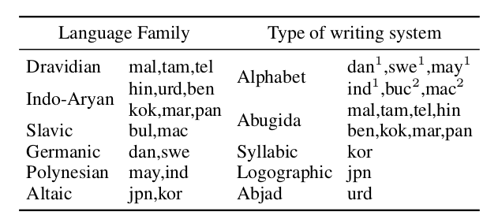
Experiments: Language Pairs & Datasets
have vowels
1: Latin
2: Cyrillic
doesn’t have vowels
6 language groups, 17 languages, 5 types of writing systems, 11 writing systems
Datasets: ILCI corpus (for Indian languages, ~50k), OPUS corpus (non-Indic languages, ~150k)

Slide 26
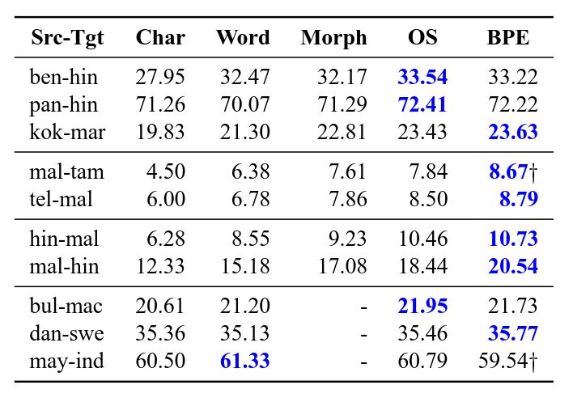
Results for languages using abugida and alphabetic scripts
Substantial improvement over char-level model (27% & 32% for OS and BPE resp.)
Char-level model is competitive only when languages are very closely related
else even word outperforms char
Significant improvement over word and morph level baselines (11-14% and 5-10% resp)
Improvement even when languages don't belong to same family (contact exists)
More beneficial when languages are morphologically rich
BPE slightly better than OS (2.5%)
not statistically significant

Slide 27
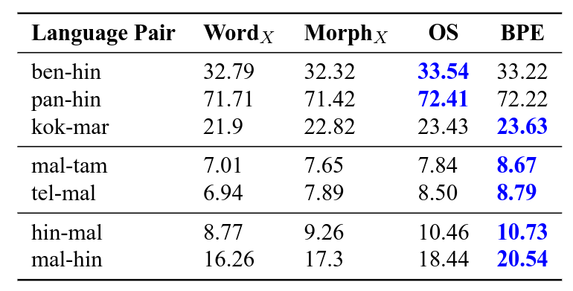
Comparison with post-processing using transliteration
Significant improvement over strong baselines: Word_{X} (10%) & Morph_{X} (5%)

Slide 28
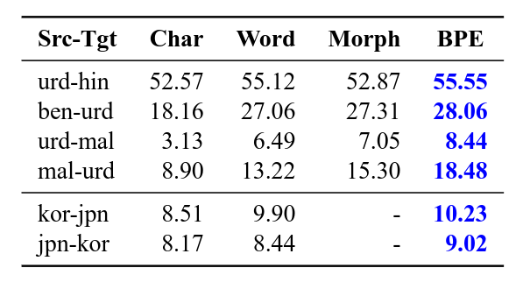
Results for languages using non-vowel scripts
Orthographic syllables cannot be used
BPE units outperform both word and morph units. Over word based:
18% improvement for Urdu pairs
6% improvement for kor-jpn pairs
More improvement when morphologically rich languages are involved
BPE works well for non-vowel scripts also

Slide 29
Some Illustrations from Hindi-Malayalam translation
 | English | Hindi | Malayalam
Translates cognates | time | samaya | samaya.m
Translates non-cognates | door | darvAzA | vatila
Translates morphological suffixes | ago | pahale | munpe
False friends can cause problems | chintA | worry | thought

Slide 30
Why do OS and BPE outperform other units?
Reduction in vocabulary size
Addresses Data Sparsity
Ability to learn Diverse Lexical Mappings
Judicious use of Lexical Similarity

Slide 31
Judicious use of Lexical Similarity
Pearson’s correlation coefficient between translation accuracy & lexical similarity (sentence level using LCSR)
Morph and Word doesn’t sufficiently utilize lexical similarity
Word level is least correlated
Morph level output is less correlated than BPE or OS
Character level performance highly correlated with lexical similarity
Little context for translation ⇒ learns character transliterations
OS & BPE strike a balance between using lexical similarity and word-level information

Slide 32
Utilizing Lexical Similarity between related, low resource languages for Pivot based SMT
Kunchukuttan et al., IJCNLP (2017)

Slide 33
Utilizing Lexical Similarity for Pivot-based SMT
Parallel corpus with pivot language
Telugu
Telugu
No parallel corpus between related languages
Tamil
Malayalam
Malayalam
Related languages ⇒ Use subword level translation units
Translation through intermediate language ⇒ Use Pivot based SMT methods
Our work brings together these two strands of research
Notes:
Between related languages
Lingua Franca → set of related languages
Set of related languages → related languages

Slide 34
Related Work
Subword level translation: Used character, OS, BPE as basic translation units
Pivot Translation (Adri‘a De Gispert, 2006; Utiyama & Isahara, 2007; Wu & Wang, 2007) :
Synthetic corpus, Transfer/pipelining, Triangulation
Subword level translation + Pivot Translation

Slide 35
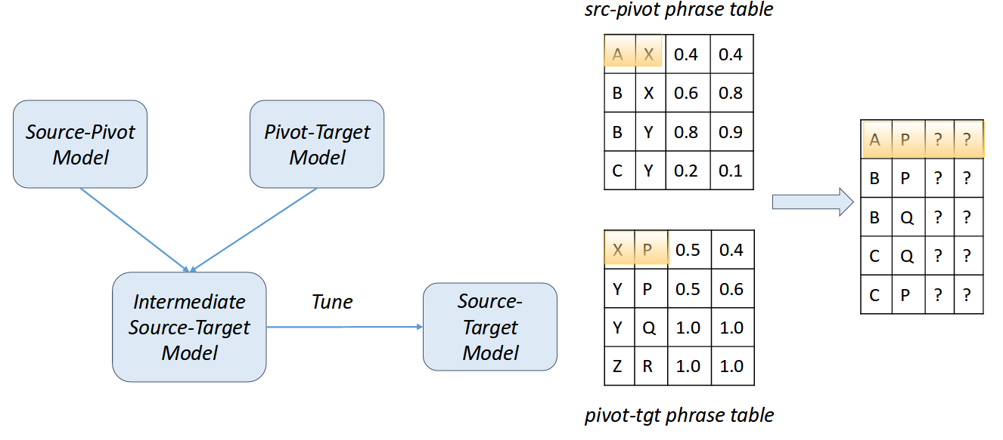
Triangulation of Pivot Tables (Utiyama & Isahara,2007; Wu & Wang, 2007)
Pivot related to source & target ⇒ subword level

Slide 36
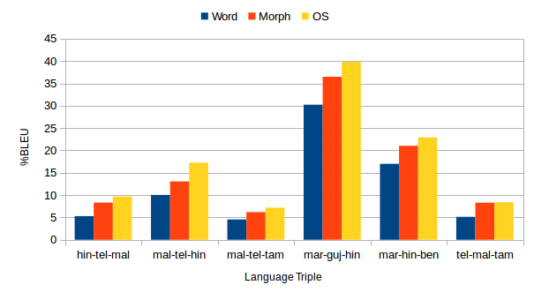
Comparison of translation units for pivot SMT
OS level pivot system outperforms other units
~60% improvement over word level
~15% improvement over morph level
Why is OS level pivot better?
Better direct source-pivot & pivot-target translation systems
Indo-Aryan
Triangulation at OS level faces lesser data sparsity
Indo-Aryan ⇆ Dravidian
Dravidian

Slide 37
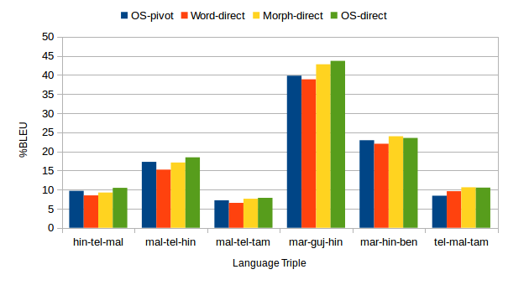
Comparison of OS level pivot with direct models
Better than word level direct model
(~5% improvement)
Competitive with direct morph and OS level models (~95 and 90% respectively of the direct system scores)
OS level system is competitive with the best word and morph level direct systems

Slide 38
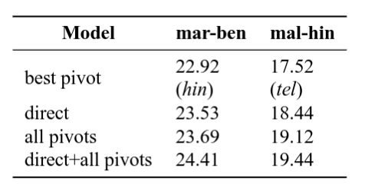
Can multiple pivot languages do better?
Combining multiple pivot systems can outperform direct systems also
This cannot be achieved with word/morph level pivoting
Pivots used for ...
mar-ben: guj, pan, hin
mal-hin : tel, mar, guj
Linear Interpolation with equal weights used to combine phrase tables
Notes:
How to explain this multiple pivot languages?
How do multiple pivot languages help?

Slide 39
Multilingual Neural Machine Translation
Notes:
Neural Machine Translation

Slide 40
Embed - Encode - Attend - Decode Paradigm
(Bahdanau et al, 2015)
Attention Network
Decoder
Annotation Vector
o₁
o₂
o₃
o₄
s₀
s₁
s₂
s₃
Encoder
मैंने
किताब
पढ़
ली
Embedding
e₁
e₂
e₃
e₄
I
read
the
book

Slide 41
Multilingual Neural Translation
(Firat et al., 2016; Johnson et al., 2017)
Encoder₁
Hindi
Decoder₁
English
Shared Attention Mechanism
Encoder₂
Bengali
Decoder₂
German
Encoder₃
Telugu
Translate unseen language pairs ➔ Zeroshot Translation
Notes:
Multilingual Neural Translation – Firat et al

Slide 42
Shared Encoder
(Zoph et al., 2016; Nguyen et al., 2017; Lee et al., 2017)
Hindi
Shared Attention Mechanism
?
Shared
Encoder
Decoder
English
Bengali
Telugu

Slide 43
Shared Encoder
(Zoph et al., 2016; Nguyen et al., 2017; Lee et al., 2017)
Hindi
Shared Attention Mechanism
Shared Embeddings & Vocabularies
Shared
Encoder
Decoder
English
Bengali
Telugu

Slide 44
Shared Encoder
(Gu et al., 2018)
Hindi
E₁
Shared Attention Mechanism
Map Embeddings
Shared
Encoder
Decoder
English
Bengali
E₂
E₃
Telugu

Slide 45
Shared Encoder with Adversarial Training
(Joty et al., 2017)
Hindi
E₁
Shared Attention Mechanism
Map Embeddings
Shared
Encoder
Decoder
English
Bengali
E₂
Generate embeddings which the language discriminator cannot distinguish
E₃
Telugu
Language Discriminator
Keep improving the discriminator such that it is difficult to fool it

Slide 46
Training Multilingual NMT systems
C₁’
C₁
C₂
C₁’
C₂’
Method 1
C₂’
Train
Sample from Parallel Corpora
Combine Parallel Corpora
C₁
C₂
Model for C₂
Model tuned for C₁
Method 2
Train
Finetune
Notes:
Finetuning Method

Slide 47
Learning Multilingual mappings/embeddings
Hindi
The key to multilingual learning
Text Classification (sentiment analysis, Question matching)
Sequence Tagging (POS, NER, etc.)
Sequence to Sequence Learning (Machine Translation, Transliteration, etc)
E₁
Map Embeddings
Bengali
E₂
E₃
Telugu
Offline Mapping of embeddings
e₂ = A₂₁e₁
Joint training for multilingual embeddings
A₁e₁=A₂e₂
Needs parallel corpora or bilingual dictionaries
Tutorial on Multilingual Multimodal Language Processing Using Neural Networks at NAACL 2016, Mitesh Khapra & Sarath Chandar

Slide 48
Summary and Future Directions
Related Languages serve as an important level of abstraction for building MT systems
Utilizing lexical similarity can reduce parallel corpus requirements
Combining lexical similarity and multilingual learning can provide significant improvements in translation quality
Advances in Transfer Learning and Adversarial Learning are interesting direction for improving multilingual learning
Learning good multilingual embeddings efficiently can help make NLP applications multilingual

Slide 49
Thank you!
Multilingual data, code for Indian languages
http://www.cfilt.iitb.ac.in
https://www.cse.iitb.ac.in/~anoopk
Work with Prof. Pushpak Bhattacharyya, Prof. Mitesh Khapra, Abhijit Mishra, Ratish Puduppully, Rajen Chatterjee, Ritesh Shah, Maulik Shah, Pradyot Prakash, Gurneet Singh, Raj Dabre, Rohit More
Notes:
Bilingual Mappings

Slide 50
References
Abbi, A. (2012). Languages of india and india and as a linguistic area. http://www.andamanese.net/LanguagesofIndiaandIndiaasalinguisticarea.pdf. Retrieved November 15, 2015.
Bahdanau, D., Cho, K., & Bengio, Y. (2014). Neural machine translation by jointly learning to align and translate. ICLR 2015.
Caruana, R. (1997). Multitask learning. Machine learning.
De Saussure, F. (1916). Course in general linguistics. Columbia University Press.
Dong, D., Wu, H., He, W., Yu, D., and Wang, H. (2015). Multi-task learning for multiple language translation. In Annual Meeting of the Association for Computational Linguistics.
Durrani, N., Sajjad, H., Fraser, A., and Schmid, H. (2010). Hindi-to-urdu machine translation through transliteration. In Proceedings of the 48th Annual Meeting of the Association for Computational Linguistics.
Emeneau, M. B. (1956). India as a Lingustic area. Language.
Finch, A., Liu, L., Wang, X., and Sumita, E. (2015). Neural network transduction models in transliteration generation. In Proceedings of the Fifth Named Entities Workshop (NEWS).
Firat, O., Cho, K., and Bengio, Y. (2016). Multi-way, multilingual neural machine translation with a shared attention mechanism. In Conference of the North American Chapter of the Association for Computational Linguistics.
Gillick, D., Brunk, C., Vinyals, O., and Subramanya, A. (2016). Multilingual language processing from bytes. NAACL.
Gispert, A. D. and Marino, J. B. (2006). Catalan-english statistical machine translation without parallel corpus: bridging through spanish. In In Proc. of 5th International Conference on Language Resources and Evaluation (LREC).
Gordon, R. G., Grimes, B. F., et al. (2005). Ethnologue: Languages of the world, volume 15. SIL International Dallas, TX.
Gu, J., Hassan, H., Devlin, J., & Li, V. O. (2018). Universal neural machine translation for extremely low resource languages. NAACL.
Jha, G. N. (2012). The TDIL program and the Indian Language Corpora Initiative. In Language Resources and Evaluation Conference.
Johnson, M., Schuster, M., Le, Q. V., Krikun, M., Wu, Y., Chen, Z., Thorat, N., Viégas, F., Wattenberg, M., Corrado, G., et al. (2016). Google’s multilingual neural machine translation system: Enabling zero-shot translation. arXiv preprint arXiv:1611.04558.
Joty, S., Nakov, P., Màrquez, L., & Jaradat, I. (2017). Cross-language Learning with Adversarial Neural Networks: Application to Community Question Answering. CoNLL.

Slide 51
References
Kunchukuttan, A., & Bhattacharyya, P. (2016). Orthographic syllable as basic unit for smt between related languages. EMNLP.
Kunchukuttan, A., & Bhattacharyya, P. (2016). Faster decoding for subword level Phrase-based SMT between related languages. VarDIAL.
Kunchukuttan, A., & Bhattacharyya, P. (2017). Learning variable length units for SMT between related languages via Byte Pair Encoding. SCLeM.
Kunchukuttan, A., Shah, M., Prakash, P., & Bhattacharyya, P. (2017). Utilizing Lexical Similarity between Related, Low-resource Languages for Pivot-based SMT. IJCNLP.
Lee, J., Cho, K., and Hofmann, T. (2017). Fully Character-Level Neural Machine Translation without Explicit Segmentation. Transactions of the Association for Computational Linguistics.
Nakov, P. and Tiedemann, J. (2012). Combining word-level and character-level models for machine translation between closely-related languages. In Proceedings of the 50th Annual Meeting of the Association for Computational Linguistics: Short Papers-Volume 2.
Nguyen, T. Q., & Chiang, D. (2017). Transfer Learning across Low-Resource, Related Languages for Neural Machine Translation. IJCNLP.
Sennrich, R., Haddow, B., and Birch, A. (2016). Neural machine translation of rare words with subword units. In ACL.
Subbārāo, K. V. (2012). South Asian languages: A syntactic typology. Cambridge University Press.
Tiedemann, J. (2009a). Character-based PBSMT for closely related languages. In Proceedings of the 13th Conference of the European Association for Machine Translation (EAMT 2009).
Tiedemann, J. (2009b). News from OPUS-A collection of multilingual parallel corpora with tools and interfaces. In Recent Advances in Natural Language Processing.
Tiedemann, J. and Nakov, P. (2013). Analyzing the use of character-level translation with sparse and noisy datasets. In Recent Advances in Natural Language Processing.
Trubetzkoy, N. (1928). Proposition 16. In Actes du premier congres international des linguistes à La Haye.
Utiyama, M. and Isahara, H. (2007). A comparison of pivot methods for phrase-based statistical machine translation. In HLT-NAACL, pages 484–491.
Vilar, D., Peter, J.-T., and Ney, H. (2007). Can we translate letters? In Proceedings of the Second Workshop on Statistical Machine Translation.
Vrandečić, D. and Krötzsch, M. (2014). Wikidata: a free collaborative knowledgebase. Communications of the ACM.

Slide 52
References
Wu, H. and Wang, H. (2007). Pivot language approach for phrase-based statistical machine translation. Machine Translation, 21(3):165–181.
Wu, Y., Schuster, M., Chen, Z., Le, Q. V., and Norouzi, M. (2016). Google’s neural machine translation system: Bridging the gap between human and machine translation. ArXiv e-prints: abs/1609.08144.
Yang, Z., Salakhutdinov, R., and Cohen, W. (2016). Multi-task cross-lingual sequence tagging from scratch. arXiv preprint arXiv:1603.06270.
Zoph, B., Yuret, D., May, J., & Knight, K. (2016). Transfer learning for low-resource neural machine translation. EMNLP.

Slide 53
Extra Slides

Slide 54
Building a subword level translation system
Pre-processing:
Segment the corpus
Use higher order language models (Vilar et al., 2007)
Tune at the word-level (Tiedemann, 2012)
Decode using cube-pruning & smaller beam size for improved performance
(Kunchukuttan & Bhattacharyya, VarDial 2016)
De-segment translation output
रा जू _ , _ घ र _ के _बा ह र _ म त _ जा ओ _ .
राजू , घर के बाहर मत जाओ .

Slide 55
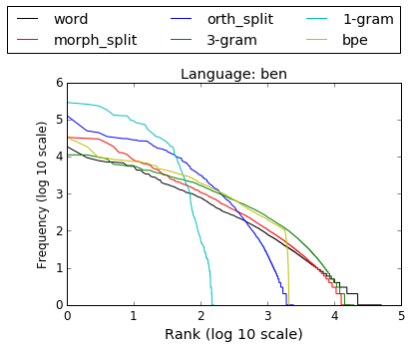
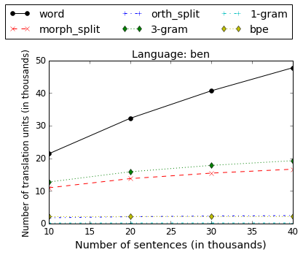
Zipf’s Law
Herdan-Heap Law
Character 1-gram and OS don’t follow a “strong” Zipf’s Law
Character 1-gram, OS and BPE don’t follow a Herdan-Heap Law
Note: BPE vocab size is fixed
Manning et al (2008)

Slide 56
Address Data Sparsity
Ability to learn Diverse Lexical Mappings
Reduction in vocabulary size
Explain improvement compared with word and morph units
Using BPE, different types of translation units can be learnt
The vocabulary size can be chosen as per the corpus size
Non-linguistic mappings as well

Slide 57
Additional Observations for Subword Translation
Just a small vocabulary needed for translation
Improving decoding speed: use a small beam size
Particularly beneficial for more synthetic languages
Robust to domain changes & works with small parallel corpora

Slide 58
Additional Findings for Pivot+Subword
These results also hold for:
Transfer-based Pivot SMT
BPE translation units
We see improvements in cross-domain translation also using subword units
Pivot language closer to the target seems to be better
(suggested by Paul et al (2013) )

Slide 59
Shared Decoder
English
Hindi
Shared Attention Mechanism
Shared Embeddings & Vocabularies
Shared
Encoder
Decoder
Bengali
Telugu
German
Shared Embeddings for the target languages
Single Output layer
Target language is indicated by a special lang-id token in the input sequence

