Slide 1
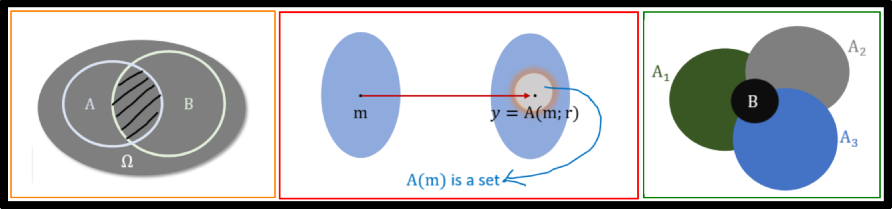
CS409m: Introduction to Cryptography
Lecture 02 (01/Aug/25)
Instructor: Chethan Kamath
(Slides: Sruthi Sekar)

Slide 2
Announcements
Administrivia...
Venue change: CC103 to CC101
Join WhatsApp group (link shared on Moodle)
TA session: Fridays, 19:30-21:00, CC101
Coursework
  Hands-on Exercise 0 uploaded on Moodle
  Assignment 1 will be uploaded today on webpage/Moodle
    Ungraded, but you will get some questions in the quiz!

Slide 3
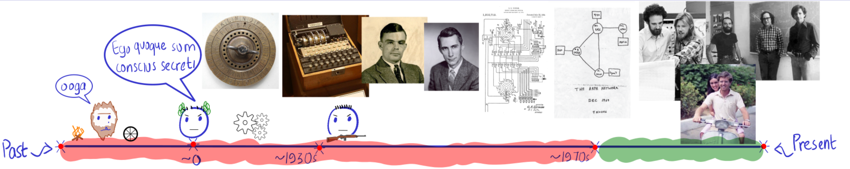
Recall from Last Lecture
Classical vs modern cryptography
Guiding principles for modern cryptography:
  Formally define threat model M: identify security goal and adversary's capabilities
  Construct scheme
  Provide rigorous security proof
    Rely on precise, well-studied assumption
Classical ciphers: shift cipher, substitution cipher, polyalphabetic shift cipher
Saw why these are considered insecure by modern standards
  The ciphertext leaks some information about the message

Slide 4

Plans for Today's Lecture
Randomized Algorithms
Basic Theory
  Definition and Background
  Law of Total Probability, Conditional Probability, Expectation and Variance
Concentration Inequalities
  Union Bound, Markov’s inequality, Chebyshev’s inequality, Chernoff bounds
Misc

Slide 5
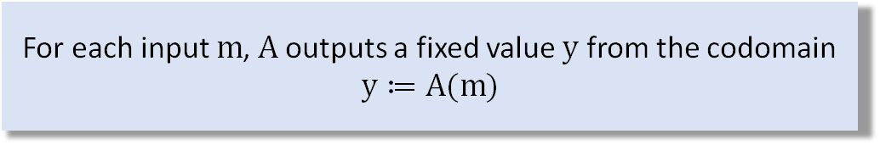
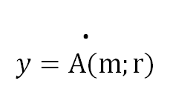

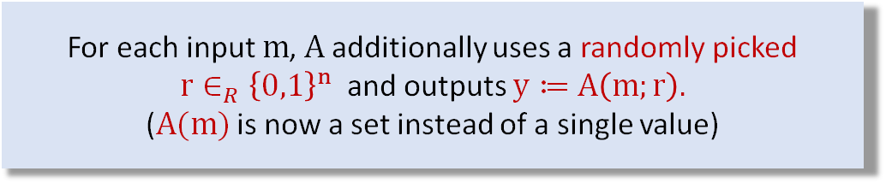
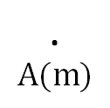


Motivation: Randomized Algorithms
Deterministic Algorithm
For each input $m$, $A$ outputs a fixed value $y$ from the codomain
$$y≔A(m)$$
.
$$m$$
.
$$A(m)$$
Randomized Algorithm
For each input $m$, $A$ additionally uses a randomly picked
$r∈_{R}{\left\{0,1\right\}}^{n}$ and outputs $y≔A\left(m;r\right).$
($A(m)$ is now a set instead of a single value)
.
$$m$$
.
$$y=A(m;r)$$
Why?
Randomized algorithms can be faster than deterministic ones
In cryptography, randomization will be necessary for security
  Key generation and encryption will be randomized
$A(m)$ is a set

Slide 6
BASIC THEORY

Slide 7

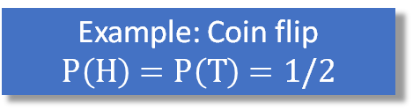
Definition and Background
$Ω$: finite set of possible outcomes, called sample space of the experiment
Example: Coin flip
$$Ω=\{H,T\}$$
Definition 1
A probability distribution over $Ω$ is a function $P: Ω →ℝ_{≥0}$ such that $Σ_{x∈Ω}P\left(x\right)=1$.
(sum of all $p_{i}^{′}s$ over all possible outcomes in $Ω$ is 1)
Example: Coin flip
$$P\left(H\right)=P\left(T\right)=1/2$$
Definition 2
An event is any subset $A⊆Ω.$ The probability of an event $A$ is $\underset{P}{Pr}\left[A\right]=Σ_{x∈A}P\left(x\right)$.
Definition 3
Two events $A$ and $B$ are said to be independent if $\operatorname{Pr}\left[A∩B\right]=Pr\left[A\right].Pr⁡[B].$

Slide 8

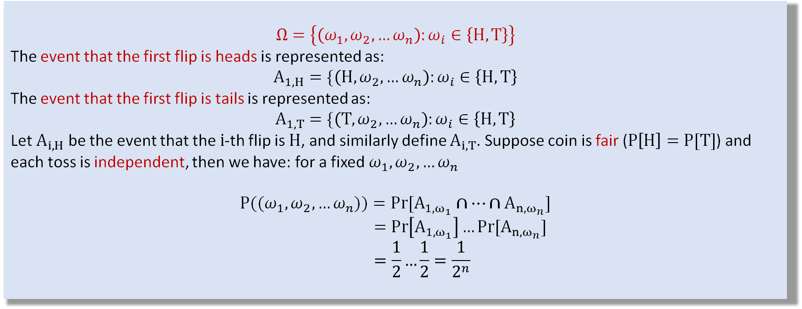
Examples
Example 1: Tossing a coin $n$ times
$$Ω=\left\{\left(ω_{1},ω_{2},…ω_{n}\right):ω_{i}∈\left\{H,T\right\}\right\}$$
The event that the first flip is heads is represented as:
$$A_{1,H}=\{\left(H,ω_{2},…ω_{n}\right):ω_{i}∈\left\{H,T\right\}$$
The event that the first flip is tails is represented as:
$$A_{1,T}=\{\left(T,ω_{2},…ω_{n}\right):ω_{i}∈\left\{H,T\right\}$$
Let $A_{i,H}$ be the event that the $i$-th flip is $H$, and similarly define $A_{i,T}$. Suppose coin is fair ($P\left[H\right]=P[T]$) and each toss is independent, then we have: for a fixed $ω_{1},ω_{2},…ω_{n}$
$$P({(ω}_{1},ω_{2},…ω_{n}))=Pr⁡[A_{1,ω_{1}}∩…∩A_{n,ω_{n}}]$$
$$=\operatorname{Pr}\left[A_{1,ω_{1}}\right]…Pr[A_{n,ω_{n}}]$$
$$=\frac{1}{2}…\frac{1}{2}=\frac{1}{2^{n}}$$
(by independence)
(by fairness)

Slide 9
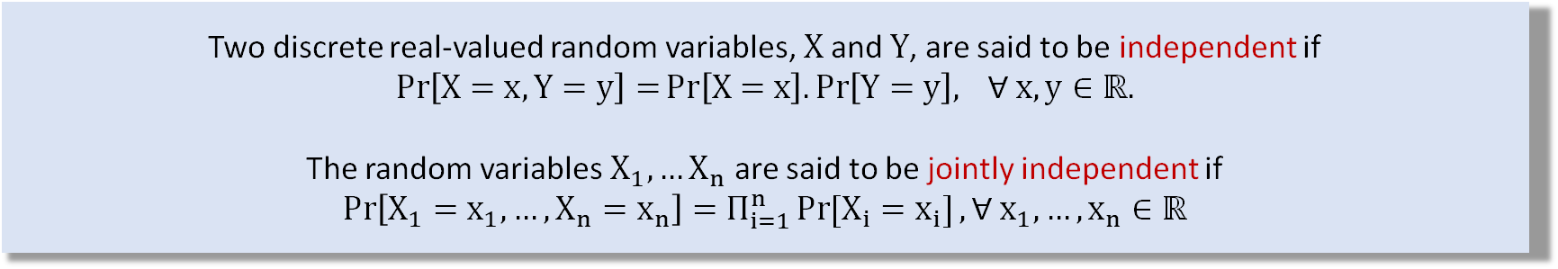
Definition and Background
Definition 4
A (real-valued) random variable is a function $X: Ω →ℝ$. In Example 1, the number of heads is a random variable represented by the function $X\left(\left(ω_{1},ω_{2},…ω_{n}\right)\right)=Σ_{i=1}^{n}ω_{i}$.
Definition 5
Two discrete real-valued random variables, $X$ and $Y$, are said to be independent if
$$\operatorname{Pr}\left[X=x,Y=y\right]=Pr\left[X=x\right].\operatorname{Pr}\left[Y=y\right], ∀ x,y∈ℝ.$$
The random variables $X_{1},…X_{n}$ are said to be jointly independent if
$$\operatorname{Pr}\left[X_{1}=x_{1},…,X_{n}=x_{n}\right]=Π_{i=1}^{n}\operatorname{Pr}{[X_{i}=x_{i}]},∀{ x}_{1},…,x_{n}∈ℝ$$

Slide 10
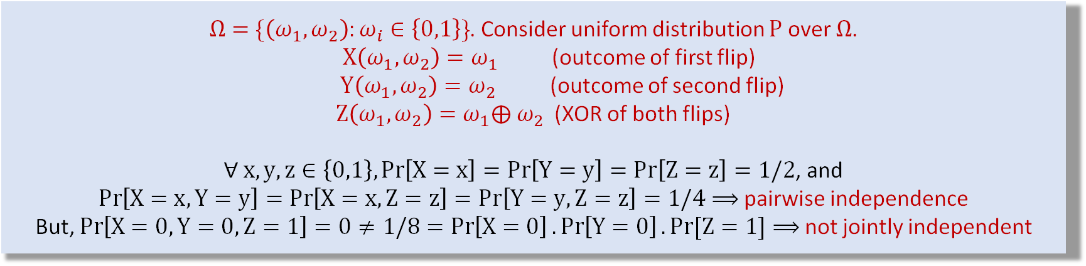

Examples
Example 2: Jointly independent random variables
$$X_{i}=\left\{\begin{aligned}1, if i^{th}coin lands H \\ 0, if i^{th}coin lands T\end{aligned}\right.$$
The random variables $X_{1},…X_{n}$ are jointly independent.
Example 3: Pairwise Independent but not jointly independent random variables
$Ω=\{\left(ω_{1},ω_{2}\right):ω_{i}∈\left\{0,1\right\}\}$. Consider uniform distribution $P$ over $Ω$.
$X\left(ω_{1},ω_{2}\right)=ω_{1}$ (outcome of first flip)
$Y\left(ω_{1},ω_{2}\right)=ω_{2}$ (outcome of second flip)
$Z\left(ω_{1},ω_{2}\right)=ω_{1}⨁{ ω}_{2}$ (XOR of both flips)
$∀ x,y,z∈\left\{0,1\right\},\operatorname{Pr}\left[X=x\right]=\operatorname{Pr}\left[Y=y\right]=Pr\left[Z=z\right]=1/2$, and
$\operatorname{Pr}\left[X=x,Y=y\right]=\operatorname{Pr}\left[X=x,Z=z\right]=Pr\left[Y=y,Z=z\right]=1/4$ $⟹$ pairwise independence
But, $\operatorname{Pr}\left[X=0,Y=0,Z=1\right]=0≠1/8=\operatorname{Pr}\left[X=0\right].\operatorname{Pr}\left[Y=0\right].Pr⁡[Z=1]$ $⟹$ not jointly independent

Slide 11


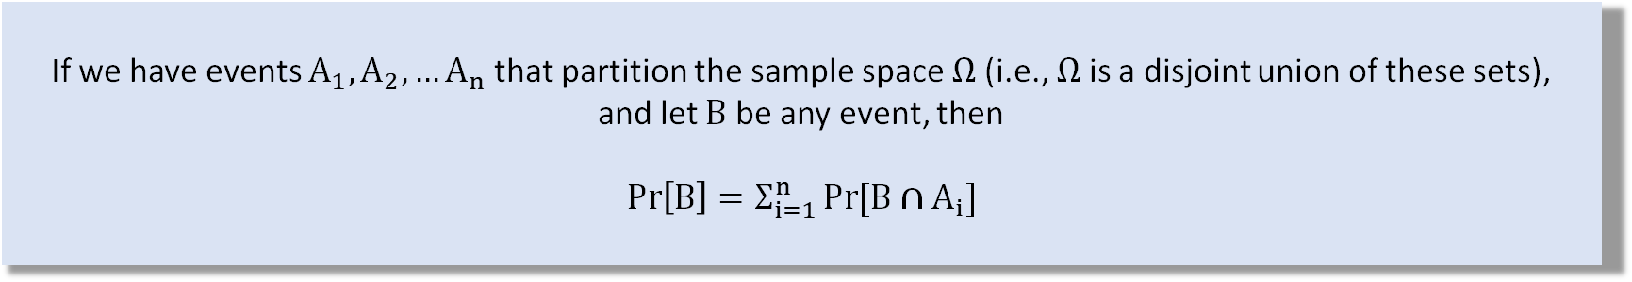



Law of Total Probability
If we have events $A_{1},A_{2},…A_{n}$ that partition the sample space $Ω$ (i.e., $Ω$ is a disjoint union of these sets),
and let $B$ be any event, then
$$\operatorname{Pr}\left[B\right]=Σ_{i=1}^{n}\operatorname{Pr}{[B∩A_{i}]}$$
EXAMPLE:
$$A_{2}$$
$$A_{1}$$
$$Ω=A_{1}⊔A_{2}⊔A_{3}$$
$$B$$
$$A_{3}$$

Slide 12



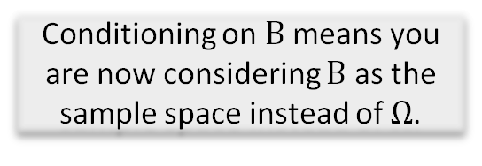






Conditional Probability
Definition 6
Probability of an event $A$ conditioned on event $B$ (with $Pr⁡[B]≠0)$) is defined as
$$\operatorname{Pr}\left[A | B\right]=\frac{\operatorname{Pr}\left[A∩B\right]}{\operatorname{Pr}\left[B\right]}$$
Conditioning on $B$ means you are now considering $B$ as the sample space instead of $Ω$.
Bayes’ Rule
$$\operatorname{Pr}\left[A | B\right]=\frac{\operatorname{Pr}\left[B|A\right]\operatorname{Pr}{[A]}}{\operatorname{Pr}\left[B\right]}$$
$$A$$
$$B$$
Chain Rule
$$\operatorname{Pr}{[A_{1}∩A_{2}∩…∩A_{n}]}=\operatorname{Pr}\left[A_{1}\right]Pr⁡[A_{2}|A_{1}]…Pr⁡[A_{n}|A_{1}∩A_{2}∩…∩A_{n−1}]$$
$$Ω$$

Slide 13



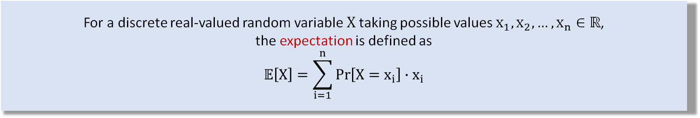
Expectation
Definition 7
For a discrete real-valued random variable $X$ taking possible values $x_{1},x_{2},…,x_{n}∈ℝ$,
the expectation is defined as
$$𝔼\left[X\right]=\sum_{i=1}^{n}{\operatorname{Pr}\left[X=x_{i}\right]}∙x_{i}$$
“average” value that X will take
Example 4: Expectation of a coin toss
$$X=\left\{\begin{aligned}1, if a fair coin lands H \\ 0, otherwise \end{aligned}\right.$$
$$𝔼\left[X\right]=\frac{1}{2}∙1+\frac{1}{2}∙0=\frac{1}{2}$$

Slide 14

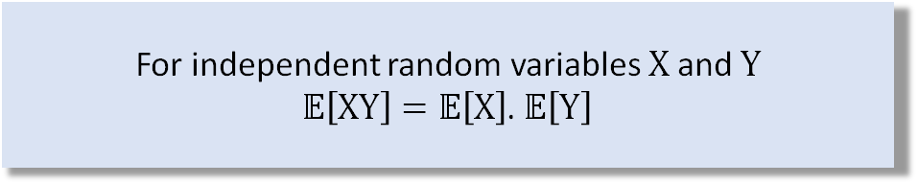
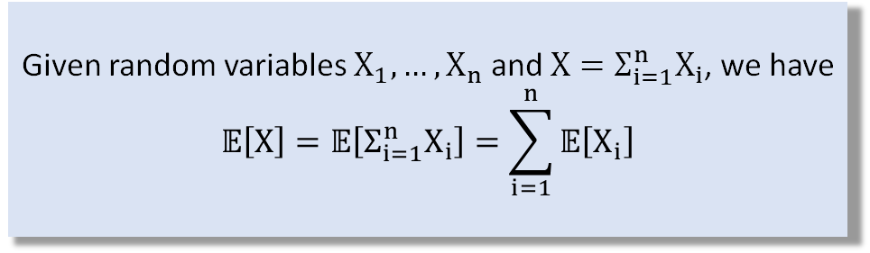
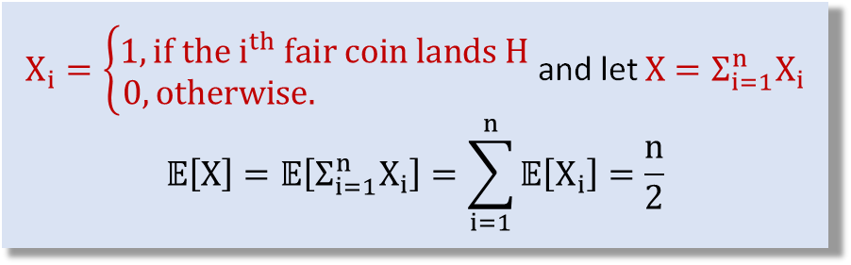
Properties of Expectation
Linearity of Expectation
Example 4: Coin tosses
Given random variables $X_{1},…,X_{n}$ and $X=Σ_{i=1}^{n}X_{i}$, we have
$$𝔼\left[X\right]=𝔼\left[Σ_{i=1}^{n}X_{i}\right]=\sum_{i=1}^{n}{𝔼\left[X_{i}\right]}$$
$X_{i}=\left\{\begin{aligned}1, if the i^{th} fair coin lands H \\ 0, otherwise. \end{aligned}\right.$ and let $X=Σ_{i=1}^{n}X_{i}$
$$𝔼\left[X\right]=𝔼\left[Σ_{i=1}^{n}X_{i}\right]=\sum_{i=1}^{n}{𝔼\left[X_{i}\right]}=\frac{n}{2}$$
**Holds even if the $X_{i}^{′}s$ are not independent!
HW: Prove this by expanding the right side of the equation and using the independence.
Multiplicativity of Expectation under independence
For independent random variables $X$ and $Y$
$𝔼\left[XY\right]=𝔼\left[X\right]$. $𝔼\left[Y\right]$

Slide 15
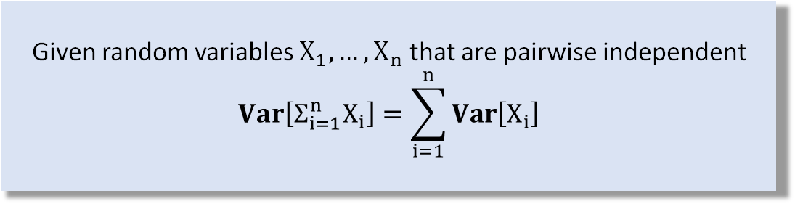
Variance
Definition 8
For a discrete real-valued random variable $X$ the variance is defined as
$$Var\left[X\right]=𝔼\left[{\left(X−𝔼\left[X\right]\right)}^{2}\right]=𝔼\left[X^{2}\right]−𝔼{\left[X\right]}^{2}$$
Variance measures how far the random variable deviates from its expectation
Linearity of variance under pairwise independence
HW: Prove this using properties of expectation!
Given random variables $X_{1},…,X_{n}$ that are pairwise independent
$$Var\left[Σ_{i=1}^{n}X_{i}\right]=\sum_{i=1}^{n}{Var\left[X_{i}\right]}$$

Slide 16
CONCENTRATION INEQUALITIES

Slide 17
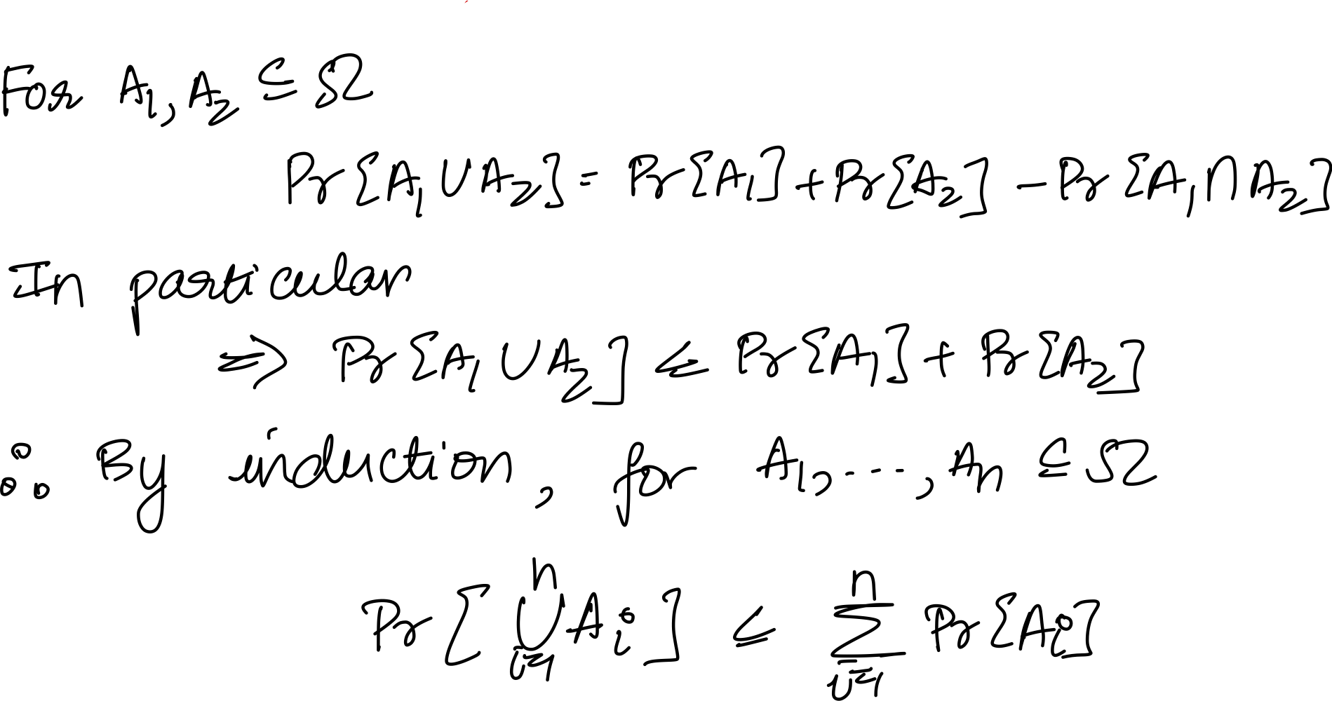




Union Bound
For events $A_{1},A_{2},…A_{n}⊆$ $Ω$,
$$\operatorname{Pr}\left[\bigcup_{i=1}^{n}{A_{i}}\right]≤\sum_{i=1}^{n}{\operatorname{Pr}{[A_{i}]}}$$
$$A_{1}$$
Proof
$$A_{1}∩A_{2}$$
$$A_{2}$$
Inclusion-exclusion
Principle

Slide 18
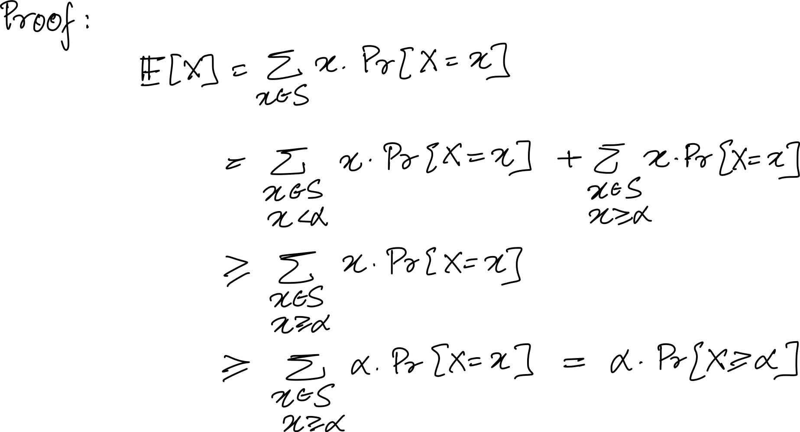
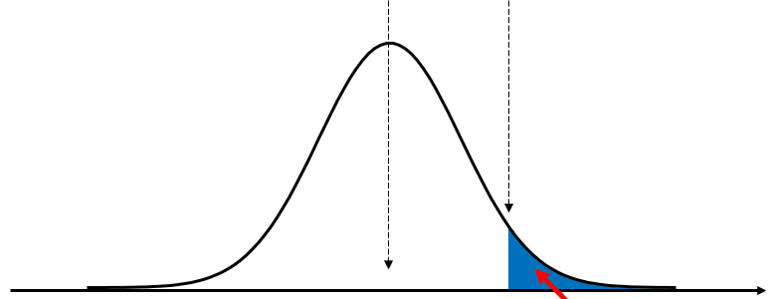





Markov’s Inequality
For a discrete random variable $X$ taking non-negative values in the set $S$, and for any $α>0$,
$$Pr\left[X≥α\right]≤\frac{𝔼\left[X\right]}{α}$$
$$𝔼[X]$$
$$α$$
$$0$$
$$x$$
$$Pr[X≥α]⁡$$

Slide 19
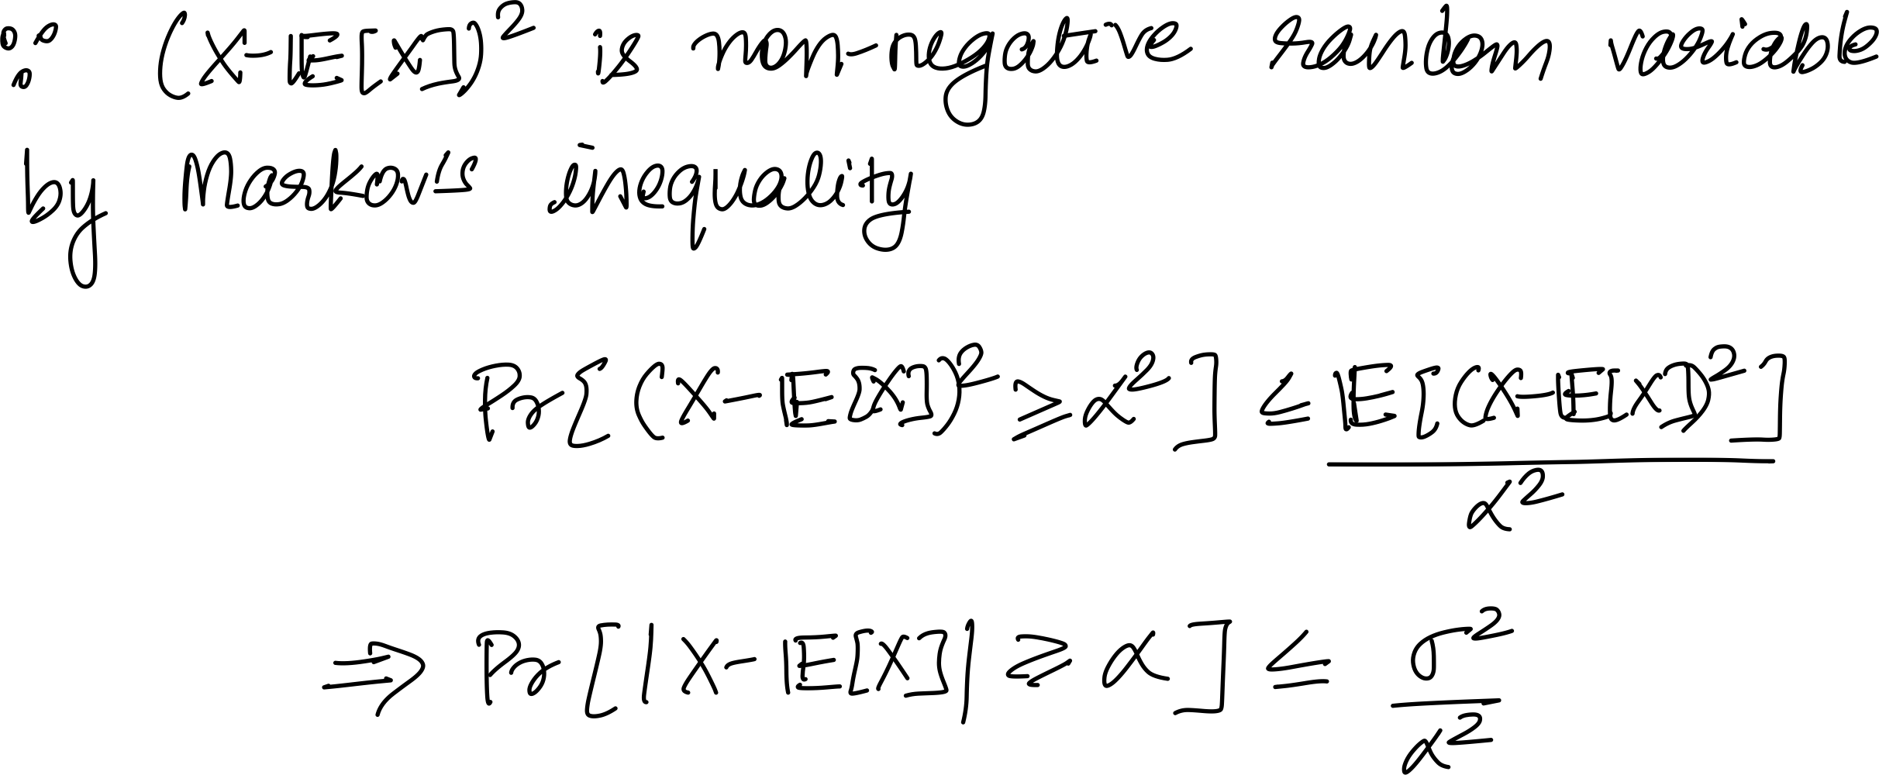
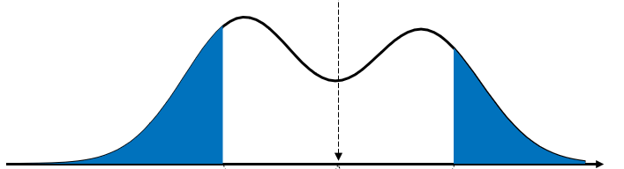





Chebyshev’s Inequality
For a discrete random variable $X$ with variance $σ^{2}>0$, and for all real $α>0$
$$Pr\left[|X−𝔼\left[X\right]|≥α\right]≤\frac{σ^{2}}{α^{2}}$$
$$𝔼[X]$$
$$0$$
$$x$$
$$α$$
$$α$$
$$\operatorname{Pr}{[\left|X−𝔼\left[X\right]\right|≥α]}$$

Slide 20
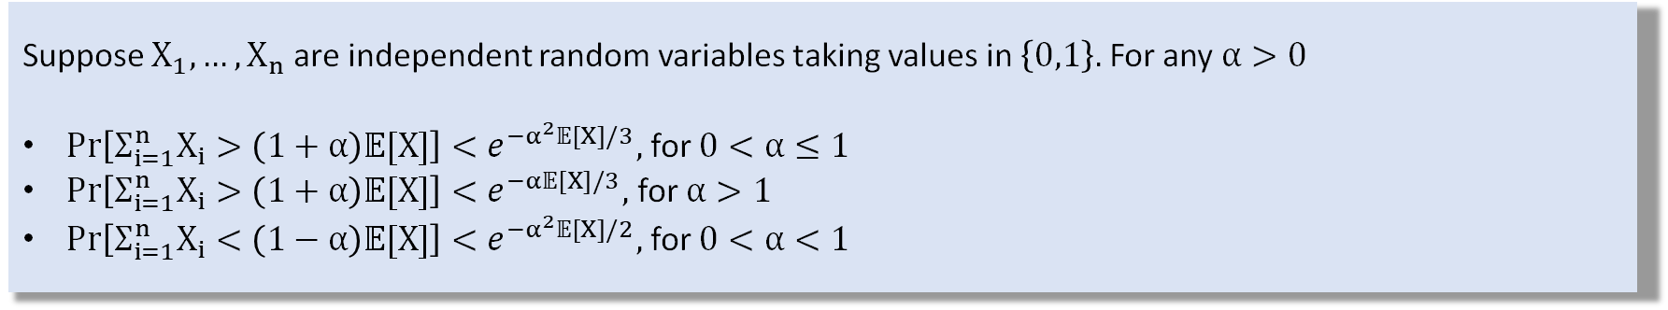
Chernoff Bounds
Suppose $X_{1},…,X_{n}$ are independent random variables taking values in $\left\{0,1\right\}.$ For any $α>0$
$Pr\left[Σ_{i=1}^{n}X_{i}>\left(1+α\right)𝔼[X]\right]<e^{−α^{2}𝔼[X]/3},$ for $0<α≤1$
$Pr\left[Σ_{i=1}^{n}X_{i}>\left(1+α\right)𝔼[X]\right]<e^{−α𝔼[X]/3},$ for $α>1$
$Pr\left[Σ_{i=1}^{n}X_{i}<\left(1−α\right)𝔼[X]\right]<e^{−α^{2}𝔼[X]/2},$ for $0<α<1$
Tighter bounds making use of joint independence!

Slide 21
MISC
(We'll need these later.)

Slide 22



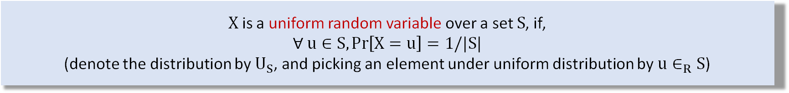



Uniform Random Variable
Definition 9
$X$ is a uniform random variable over a set $S$, if,
$∀ u∈S,\operatorname{Pr}\left[X=u\right]=1/|S|$
(denote the distribution by $U_{S}$, and picking an element under uniform distribution by $u∈_{R}S$)
.
.
.
$$1/n$$
.
.
.
$$S=\{u_{1},u_{2},…,u_{n}\}$$
$$u_{1}$$
$$u_{2}$$
$$…$$
$$u_{n}$$

Slide 23
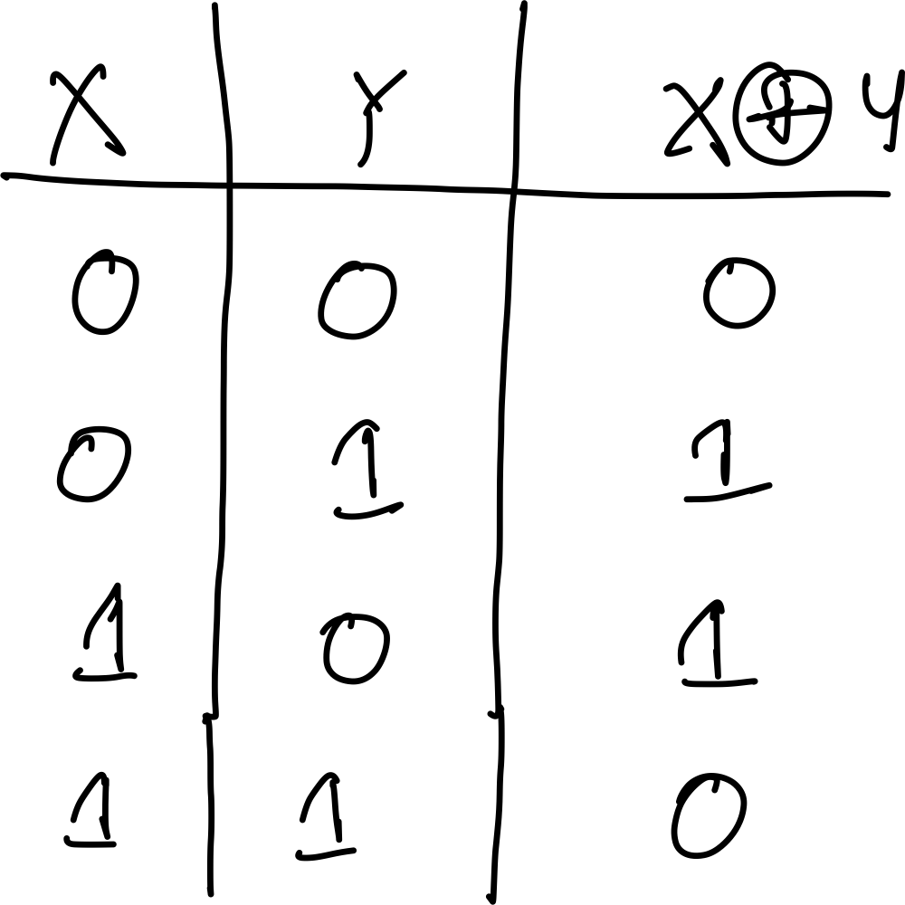
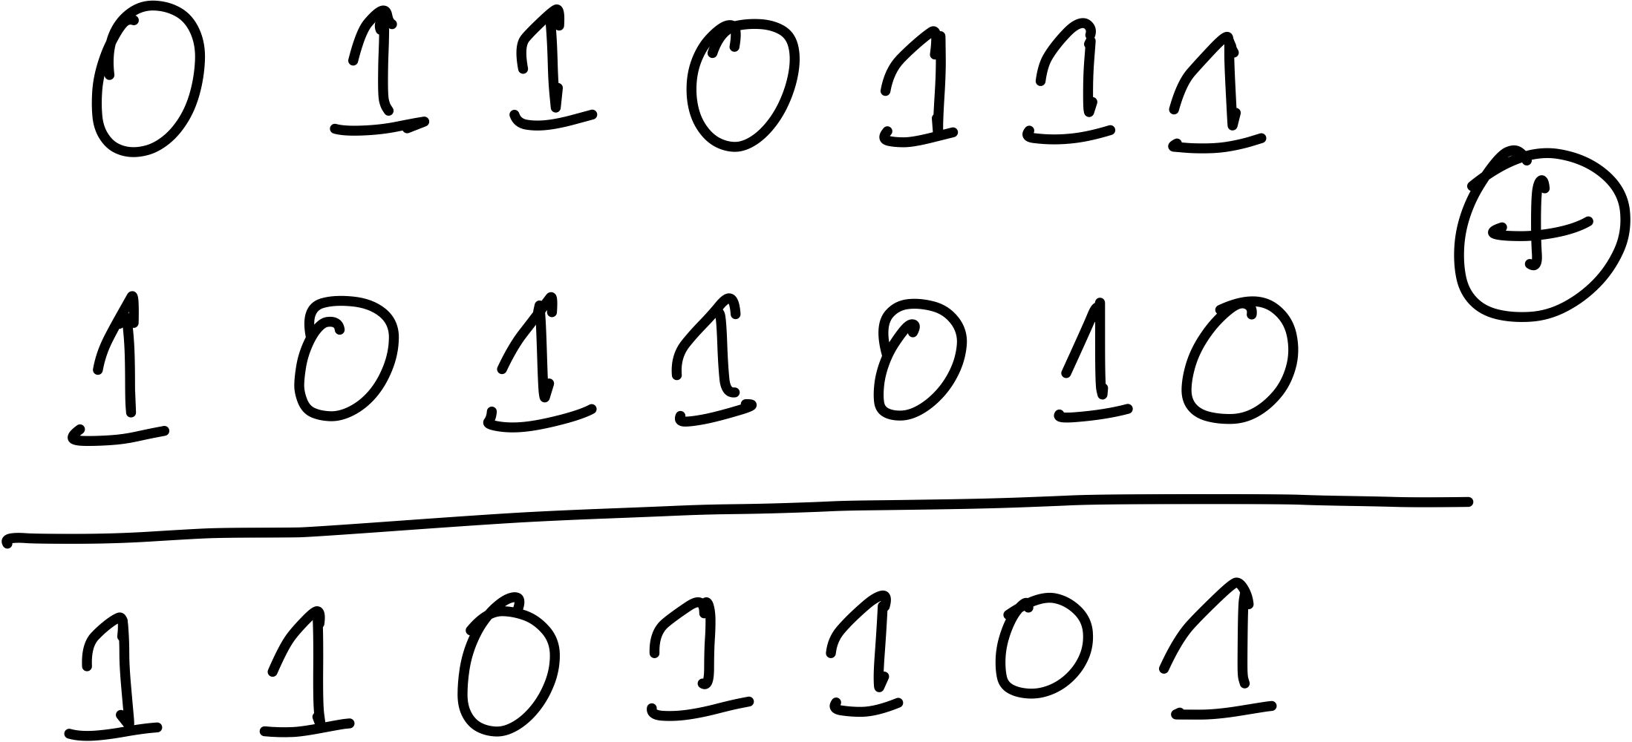
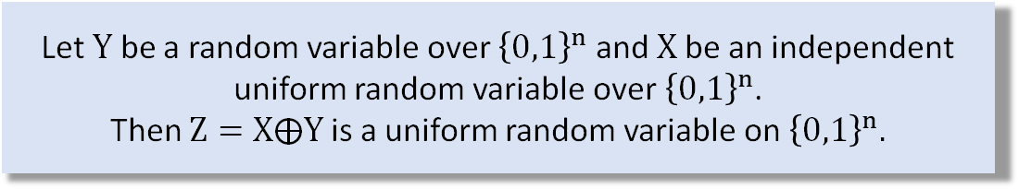
XOR and its Properties
XOR of two strings in ${\left\{0,1\right\}}^{n}$ is their bit-wise addition modulo $2$.
Theorem 1
Let $Y$ be a random variable over ${\left\{0,1\right\}}^{n}$ and $X$ be an independent uniform random variable over ${\left\{0,1\right\}}^{n}$.
Then $Z=X⨁Y$ is a uniform random variable on ${\left\{0,1\right\}}^{n}.$
XOR of bits
HW: Prove this
(Hint: use induction)
Example

Slide 24
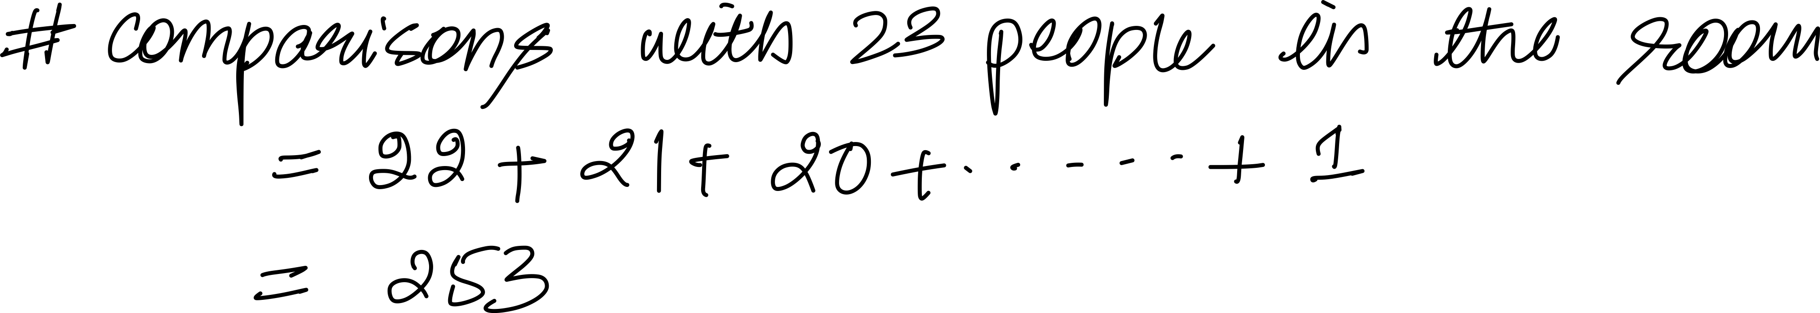
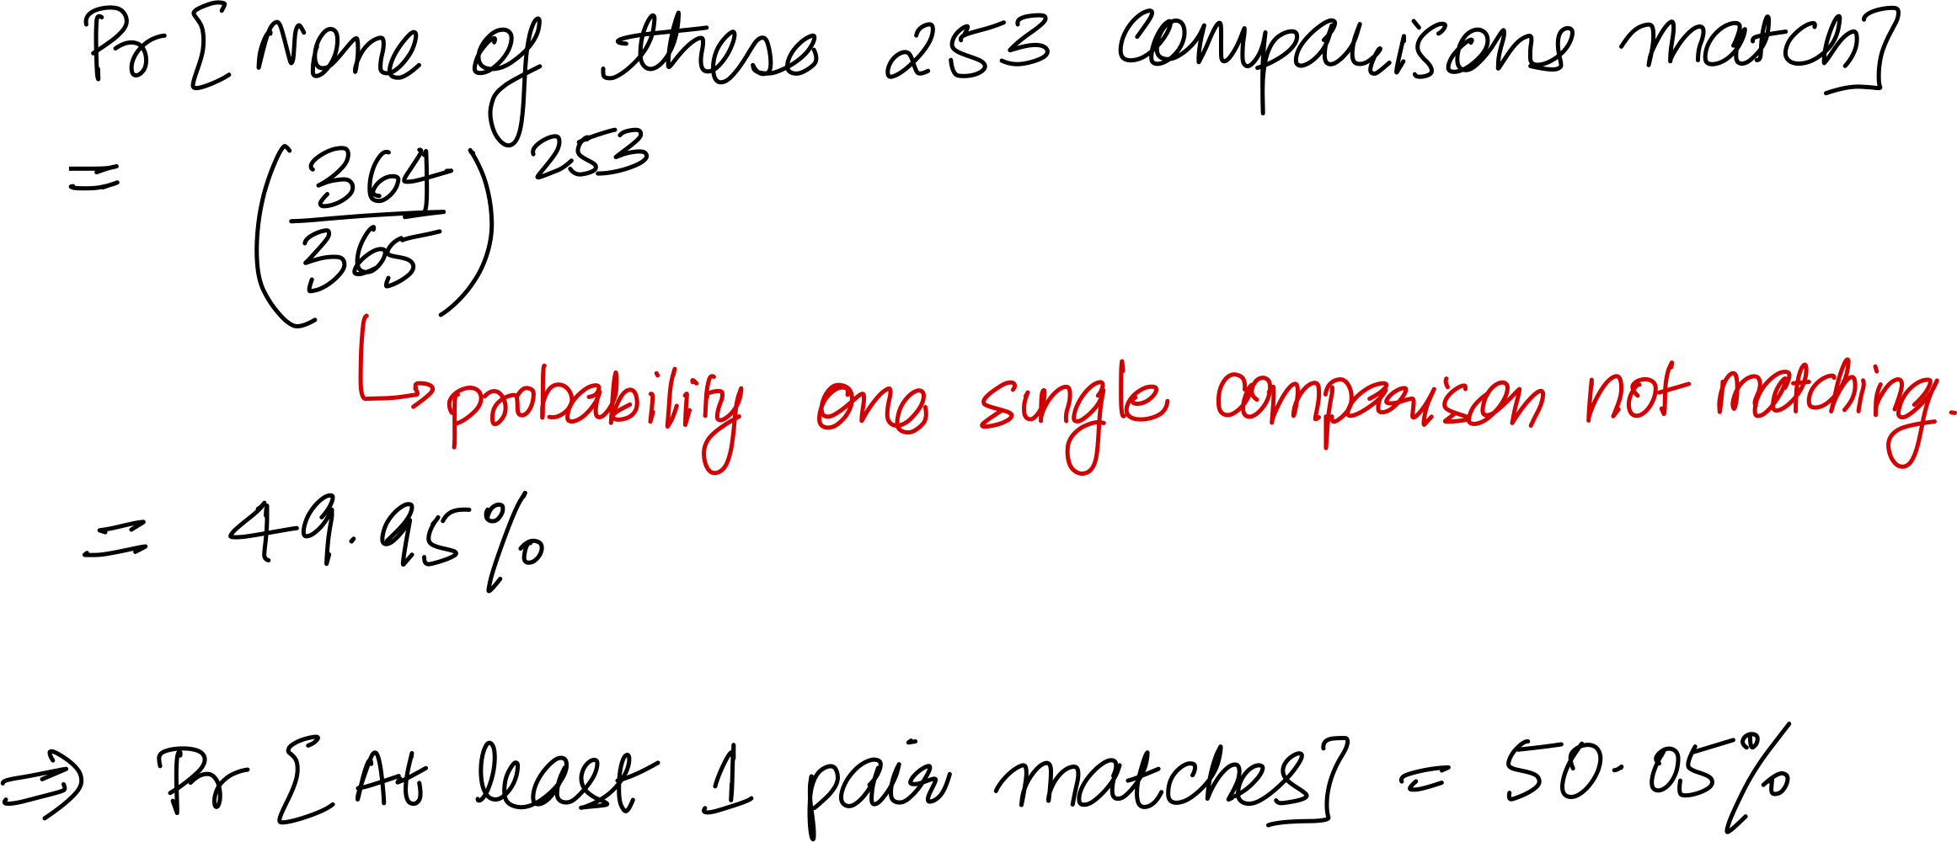
Birthday Paradox
Let $q$ birthdays be $y_{1},y_{2},…{,y}_{q}$ chosen uniformly at random from $\{1,2,…,365\}$
*assuming non-leap year and that birthdays are uniform and independent
Problem: Find minimal $q$ such that $coll\left(q,365\right)=Pr\left[∃ i≠j s.t. y_{i}=y_{j}\right]≥1/2$
23
INTUITION:
HW: Solve for q by using the same argument with unknown q

Slide 25
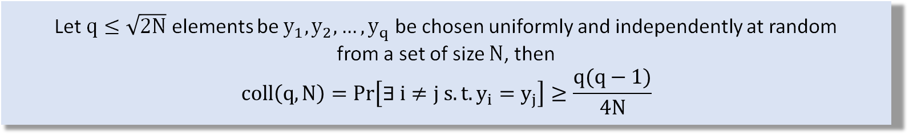

Birthday Paradox, Generalized
Theorem 2
Let $q$ elements be $y_{1},y_{2},…{,y}_{q}$ be chosen uniformly and independently at random
from a set of size $N$, then
$$coll\left(q,N\right)=Pr\left[∃ i≠j s.t. y_{i}=y_{j}\right]≤\frac{q^{2}}{2N}$$
Assignment Problems
Theorem 3
Let $q≤\sqrt{2N}$ elements be $y_{1},y_{2},…{,y}_{q}$ be chosen uniformly and independently at random
from a set of size $N$, then
$$coll\left(q,N\right)=Pr\left[∃ i≠j s.t. y_{i}=y_{j}\right]≥\frac{q(q−1)}{4N}$$

Slide 26
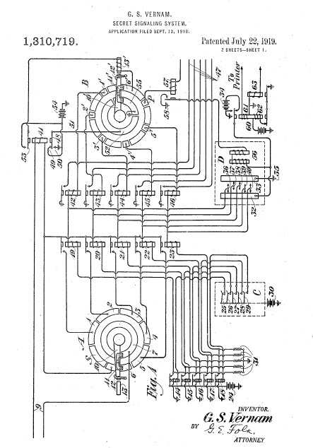
Next Lecture
Perfect security for shared-key/symmetric encryption
Example: one-time pad or Vernam cipher
Limitations of perfect security and some attacks
Thank you!

