Slide 1
Coordinated Scheduling of TCEDs under
Peak Power Constraint
Gopinath Karmakar¹, A. Kabra¹ and Krithi Ramamritham²
¹Bhabha Atomic Research Centre, India
²Indian Institute of Technology Bombay, India

Slide 2
TCEDs:Thermostatically Controlled Electrical Devices
Exhibits Periodic ON-OFF Operation
Maintains Temp within [T^{U}, T^{L}]
Contributes to a substantial fraction of building loads

Slide 3
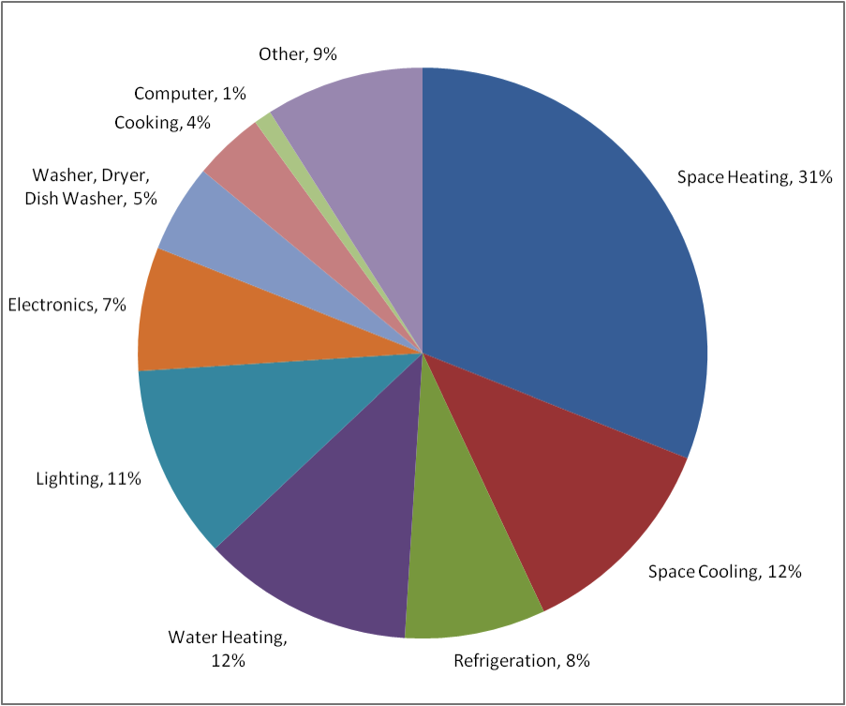
TCEDs: Thermostatically Controlled Electrical Devices
Residential Energy Usage
Source: National Academy of Sciences (2006)

Slide 4
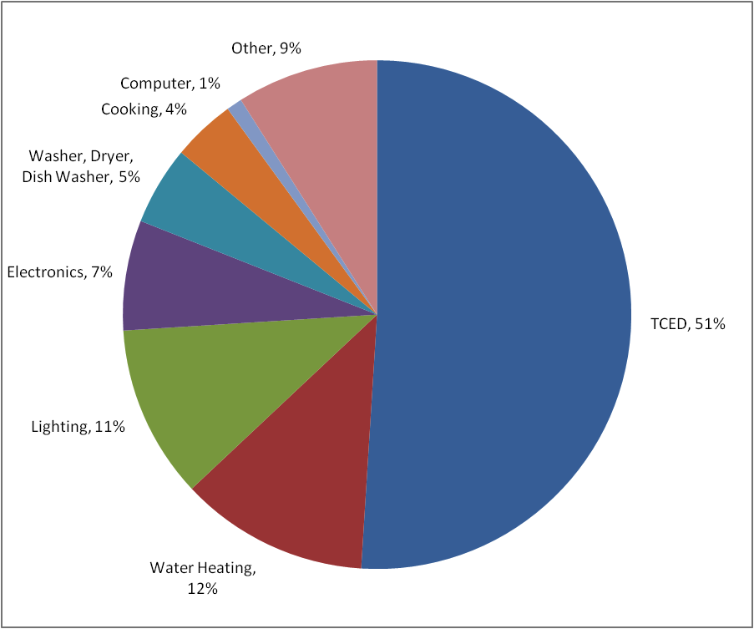
TCEDs: Thermostatically Controlled Electrical Devices
Residential Energy Usage
Source: National Academy of Sciences (2006)

Slide 5
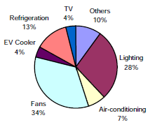
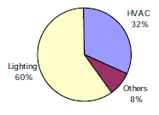
TCEDs: Thermostatically Controlled Electrical Devices
Residential Building Sector
Commercial Building Sector
Source: (CMIE 2001)

Slide 6
Peak Demand Reduction
Power
AC2
AC2
AC2
AC1
AC1
AC1
Time
But, Comfort-Band Must be maintained
Power
AC1
AC2
AC1
AC2
AC1
AC2
Time

Slide 7
Why worry about
Reduction in Peak Demand?
Lesser investment on reserve power generation. Has an implication on base electricity price.
Improves grid stability.
Improves quality of service (fewer occurrences of load-shedding, brownouts and blackouts).
Dynamic electricity pricing depending on the pattern of peak demand to be met by the grid.
Solution: Co-ordinated Scheduling

Slide 8
TCED Characteristics
Time (min.)

Slide 9
TCED Operation as Real-Time Task
Ci
Pi
Time (min.)

Slide 10
(Un)Suitability of Existing RT Scheduling Policies
Existing policies (RM, EDF, LSF) considers a task schedulable, if it receives C_{i} unit of time every P_{i} .
When a task receives C_{i} unit of processor time within P_{i} , is not a concern.
For a TCE device,
The parameters C_{i} (power-on duration) and P_{i} are dynamic.
It is important when a TCED receives power (resource), because it affects environmental parameter under control.
Therefore, Scheduling algorithms from real-time domain are not suitable for TCEDs.

Slide 11
TCED Characteristics
Preempted
Time (min.)

Slide 12
TCED Characteristics
CB Violated!
Preempted
Time (min.)

Slide 13
TCED Characteristics
CB Violated!
Preempted

Slide 14
Constraints in Scheduling of TCED
Number of devices (m out of n) that can run at a time is governed by
Where, and = Peak Demand Limit
A device should be scheduled (switched ON/OFF) in such a way that

Slide 15
Constraints in Scheduling of TCED (Contd …)
Mandatory Restart-Delay (~3 min.) for compressor driven TCEDs like AC & Refrigerators.
Demands Minimum switching
  To avoid additional power consumption due to high starting current on every switching-ON.
  For better equipment life.

Slide 16
Thermal Comfort-Band Maintenance (TCBM) Algorithm
At any point of time allow only m ACs (constrained by peak-demand) to run.
Switch ON an AC if
  its zone temperature T_{i} ≥T^{U}
Switch OFF an AC if
  its zone temperature T_{i} ≤ T^{L} Or,
  some other AC is required to be switched ON.

Slide 17
TCED Characteristics
Time (min.)

Slide 18
Feasibility Criterion
The temperatures in the zones will eventually fall from the ambient temperature T_{a} to T^{L} and it will be maintained within [T^{U},T^{L}], if
Where, i) the sum on the left is calculated from the first m ACs arranged in increasing order of their slopes and ii) the sum on the right is calculated from the first n-m ACs arranged in decreasing order of their slopes

Slide 19
Simulation and Results
Simulation Study
Based on the thermal characteristics generated by curve-fitting using empirical data
The electrical load consists of 5 ACs. (n = 5)
Peak demand limit allows only 3 ACs to run at a time. (m = 3)
Desired comfort-band = [26⁰, 23⁰].

Slide 20
Candidate scheduling algorithms for comparison
Global EDF (gEDF)
LSF
Value-Based

Slide 21
Operation of 2 ACs with Different Scheduling Policies (gEDF)
^{Comfort-band not maintained}
^{Unnecessary switching of TCED.}

Slide 22
Operation of 2 ACs with Different Scheduling Policies (LSF)
Unnecessary and large number of switching.

Slide 23
Operation of 2 ACs with Different Scheduling Policies (ValueBased)
Unnecessary and very large number of switching.

Slide 24
Operation of 2 ACs with Different Scheduling Policies (TCBM)
Maintains Comfort-Band
Switching of TCED occurs only when necessary.

Slide 25
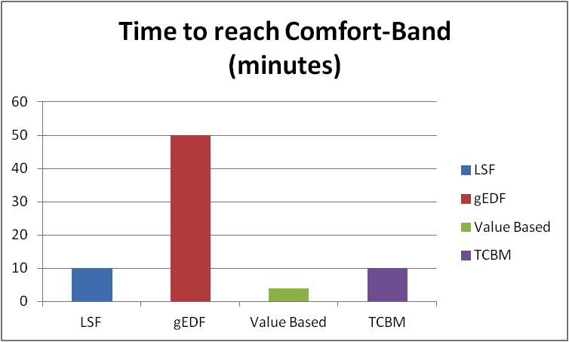
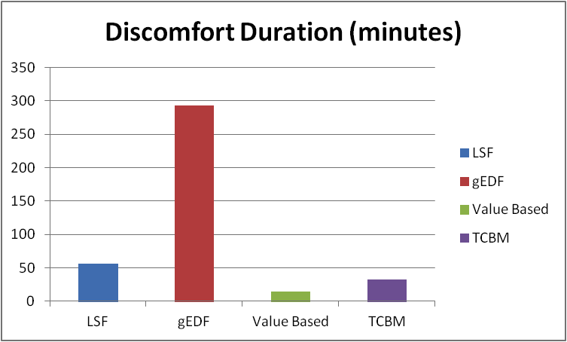
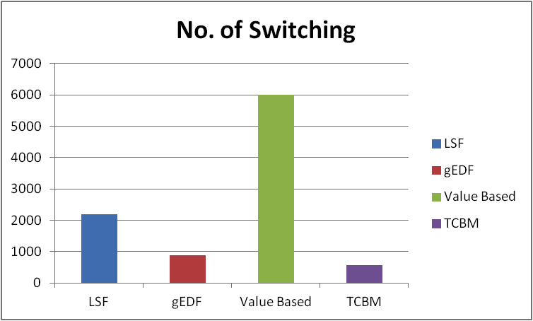
Simulation Results

Slide 26
Prototype Experiment
2 ACs are controlled.
Comfort-Band = [26⁰C, 23⁰C]
Peak demand constraint allows only 1 AC to run at a time.

Slide 27
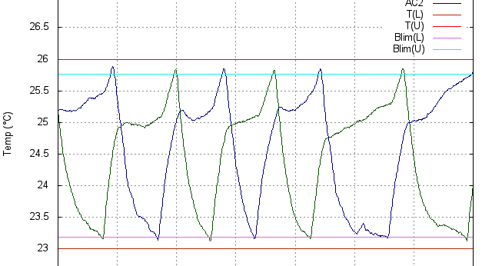
Prototype Experiment with 2 ACs

Slide 28
Adaptive Demand-Response Control and
Energy-Aware TCBM

Slide 29
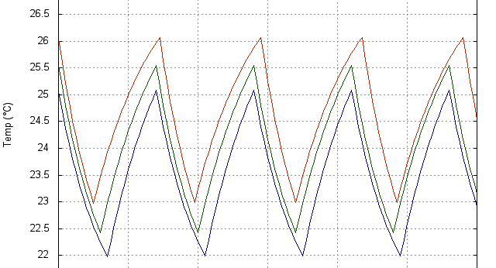
Effect of Varying Comfort-Band (Equal CB)
The OFF-time duration increases with shifting the CB up.

Slide 30
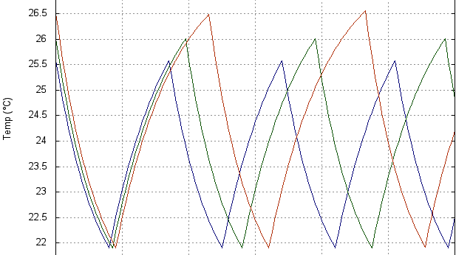
Effect of Varying Comfort-Band (Varying T^{U})
The OFF-time duration increases by shifting the upper-limit T^{U} of the CB.

Slide 31
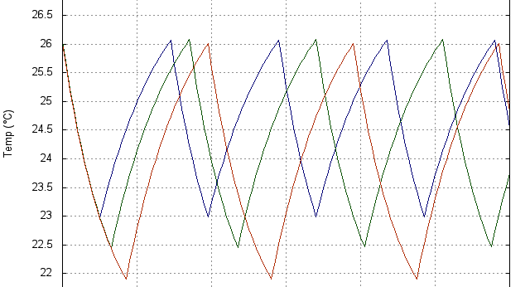
Effect of Varying Comfort-Band (Varying T^{L})
The ON-time duration increases with shifting the lower limit T^{L} of the CB

Slide 32
On-line Adaptive Control using TCBM
Feasibility condition can be improved by
shifting comfort-band up (say from [23⁰C,25⁰C] to [24⁰C,26⁰C]), or
shifting up the upper limit of comfort-band (say from 25⁰C to 26⁰C).
Comfort-band can be adjusted dynamically peak-demand constraint.

Slide 33
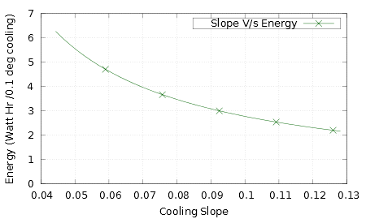
Energy Consumption Vs Cooling Slope
Temperature Profile of an AC
Cooling Slope
Energy Consumption

Slide 34
Energy Consumption Vs Cooling Slopes

Slide 35
Thermal Characteristics of an AC (near linear operating zone)
Time (Sec.)

Slide 36
Simulation and Results
Cumulative ON-time (3 ACs)= 205.7 min in 120 min duration
CB = [25.5⁰C, 22.5⁰C]
Time (Min.)

Slide 37
Thermal Characteristics of an AC (near linear operating zone)
Time (Sec.)

Slide 38
Simulation and Results
Cumulative ON-time (3 ACs)= 329.0 min in 120 min duration
CB[T^{U}, T^{L}] = [24.5⁰C, 21.5⁰C]
Time (Min.)

Slide 39
AC ON-time for Different CB
Duration: 120 min.
Peak Demand Constraint: permits m=3 ACs to run at a time
Comfort-Band (CB) | Cumulative ON-time (min.)
25.5⁰C - 22.5⁰C | 205.7
24.5⁰C - 21.5⁰C | 329.0
Energy-Saving 37%

Slide 40
Summary
Feasibility analysis technique for maintenance of thermal comfort-band.
TCBM algorithm has superior performance characteristics.
Prototype implementation of TCBM shows peak-demand reduction.
TCBM is amenable to adaptive demand-response.
Significant reduction in energy consumption by shifting the CB just by 1⁰C.

Slide 41
Thank You!
Questions are Welcome

Slide 42
Additional Slides

Slide 43
Implementation - I
One Wire Protocol
DS18B20 Temperature sensors
Arduino Board
AC1
AC2
AC3
AC4
Stage1 Relay
Stage2 Relay
5V voltage+
High/low for
each of the ACs
230 V for
ACs to work

Slide 44
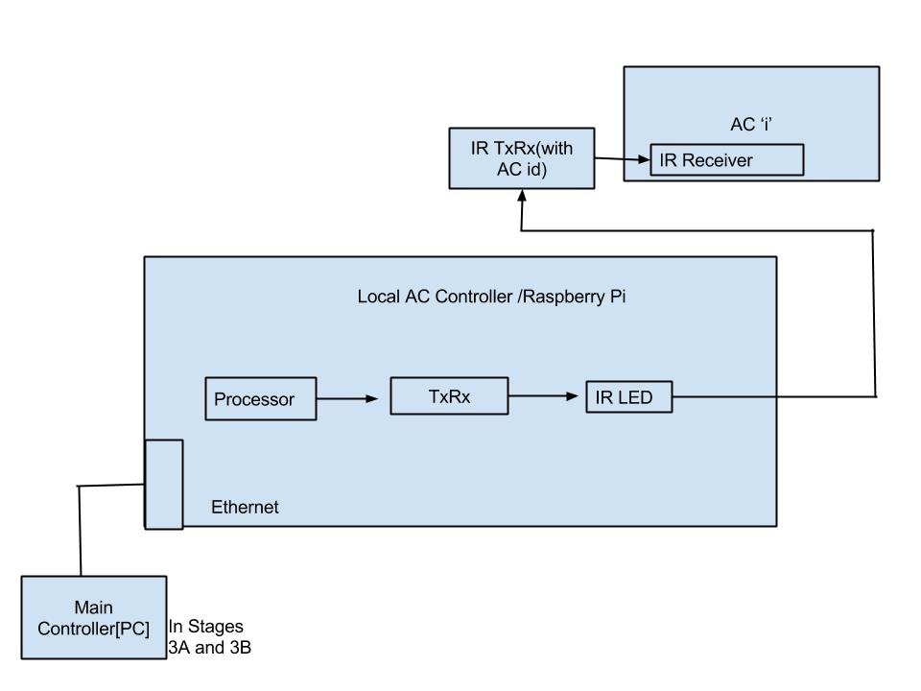
Implementation - II

Slide 45
Thermal Characteristics of an AC
Time (Sec.)

Slide 46
Summary of Performance of Different Scheduling Policies

