Slide 1
Natural Language Processing
Assignment
Group Members:
Soumyajit De
Naveen Bansal
Sanobar Nishat

Slide 2
Outline
POS tagging
Tag wise accuracy
Graph- tag wise accuracy
Precision recall f-score
Improvements In POS tagging
Implementation of tri-gram
POS tagging with smoothing
Tag wise accuracy
Improved precision, recall and f-score
Next word prediction
Model #1
Model #2
Implementation method and details
Scoring ratio
perplexity ratio
NLTK
Yago
    Different examples by using yago
Parsing
    Different examples
    conclusions

Slide 3
POS Tagging

Slide 4
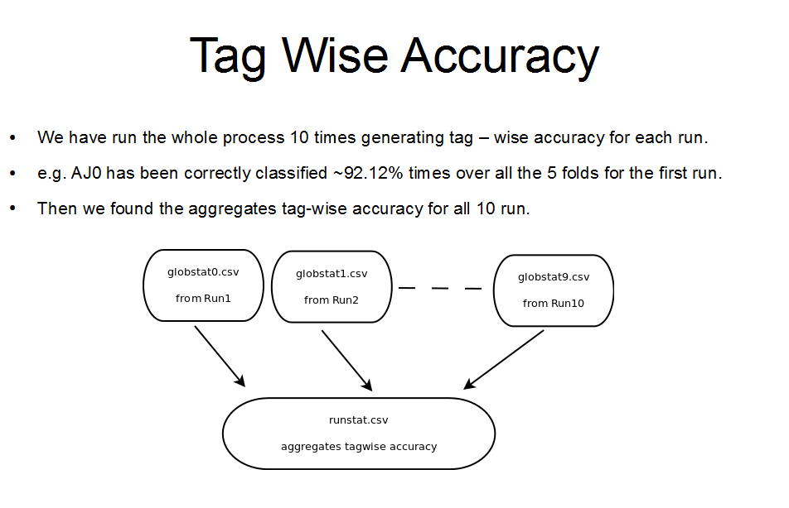

Slide 5
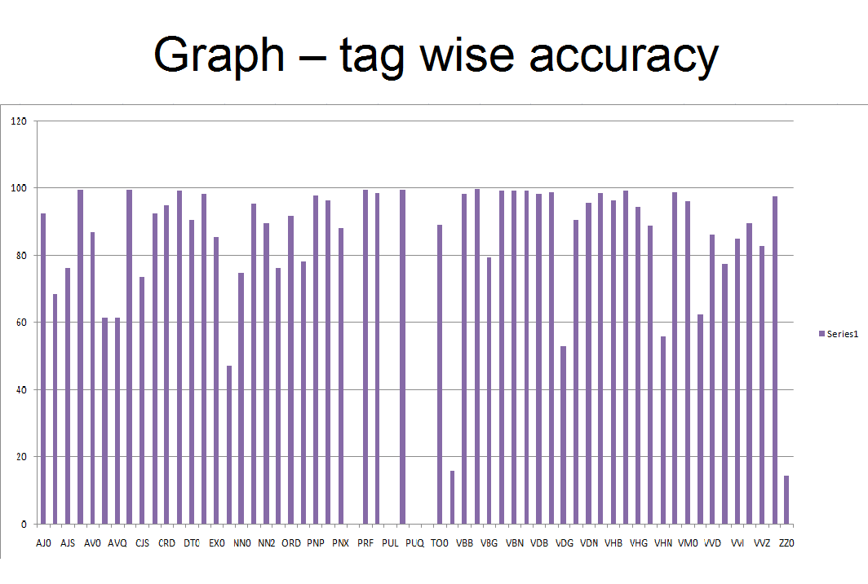
Outline

Slide 6
Precision, Recall, F-Score
Precision = 0.92
Recall = 1
F-score = 0.958

Slide 7
Improvements in
POS tagger

Slide 8
Improvement in POS Tagger
Implementation of trigram
* issues (sparcity – solution smoothing)?
* results – increases overall accuracy upto 94%

Slide 9
Improvement in POS Tagger (cont..)
Implementation of smoothing Technique
* Linear Interpolation Technique
* Formula:
i.e.
* Finding value of lambda

Slide 10
POS tagging Accuracy with smoothing

Slide 11
Precision : tp/(tp+fp) = 0.9415
Recall: tp/(tp+fn) = 1
F-score: 2.precision.recall/(precision + recall)
= 0.97

Slide 12
Tag wise accuracy

Slide 13
Tag wise accuracy (cont..)

Slide 14
Further improvements in POS tagging
by handling unknown words

Slide 15
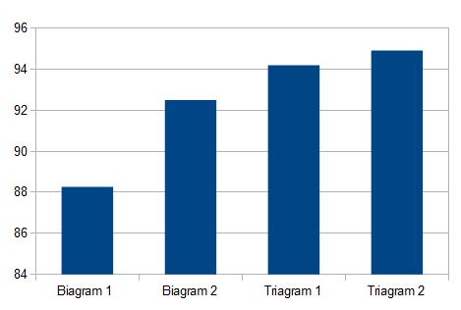
Precision score (accuracy in %age)

Slide 16
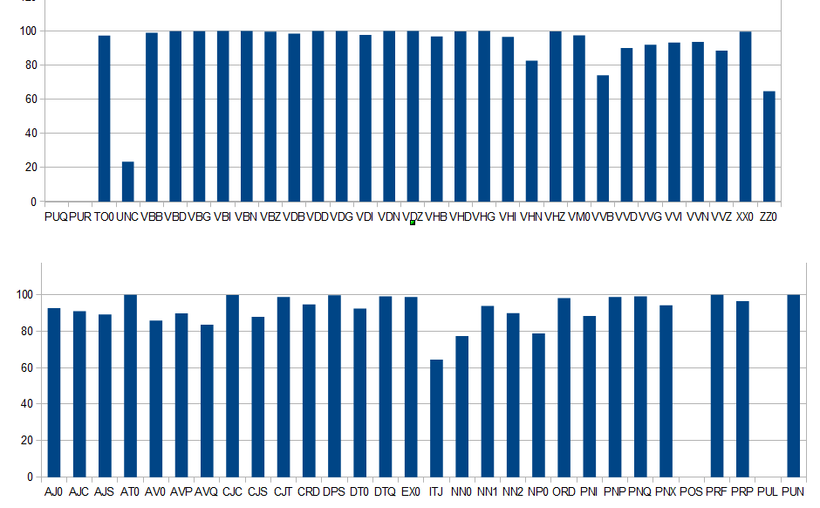
Tag wise accuracy

Slide 17
Error Analysis
VVB - finite base form of lexical verbs (e.g. forget, send, live, return)
Count: 9916
Confused with | counts | Reason
VVI (infinitive form of lexical verbs (e.g. forget, send, live, return)) | 1201 | VVB is used to tagged the word that has the same form as the infinitive without “to” for all persons. E.g. He has to show Show me
VVD (The past tense form of lexical verbs (e.g. forgot, sent, lived, returned)) | 145 | The base form and past tense form of many verbs are same. So domination of emission probability of such word caused VVB wrongly tagged as VVD. And effect of transition probability might got have lower influence.
NN1 | 303 | Words with similar base form gets confuse with common noun. e.g. The seasonally adjusted total regarded as… Total has been tagged as VVB and NN1

Slide 18
Error Analysis
ZZ0 - Alphabetical symbols (e.g. A, a, B, b, c, d) (Accuracy - 63%)
Count: 337
Confused with | counts | Reason
AT0 (Article e.g. the, a, an, no) | 98 | Emission probability of “a” as AT0 is much higher compare to ZZ0. Hence AT0 dominates while tagging “a”
CRD (Cardinal number e.g. one, 3, fifty-five, 3609) | 16 | Because of the assumption of bigram/trigram Transition probability.

Slide 19
Error Analysis
ITJ - Interjection (Accuracy - 65%)
Count: 177
Reason: ITJ Tag appeared so less number of times, that it didn't miss classified that much, but yet its percentage is so low
Confused with | counts | Reason
AT0 (Article (e.g. the, a, an, no)) | 26 | “No“ is used as ITJ and article in the corpus. So confusion is due to the higher emission probability of word with AT0
NN1 (Singular common noun) | 14 | “Bravo” is tagged as NN1 and ITJ in corpus

Slide 20
Error Analysis
UNC - Unclassified items (Accuracy - 23%)
Count: 756
Confused with | counts | Reason
AT0 (Article (e.g. the, a, an, no)) | 69 | Because of the domination of transition probability UNC is wrongly tagged
NN1 (Singular common noun) | 224 | Because of the domination of transition probability UNC is wrongly tagged
NP0 (Proper noun (e.g. London, Michael, Mars, IBM)) | 132 | New word with begin capital letter is tagged as NP0, since mostly the UNC words are not repeating among different corpus.

Slide 21
Next word prediction

Slide 22

Model # 1
When only previous word is given
Example: He likes -------

Slide 23
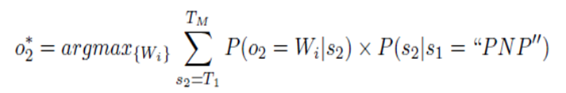
Model # 2
When previous Tag & previous word are known.
Example: He_PP0 likes_VB0 --------
Previous Work

Slide 24
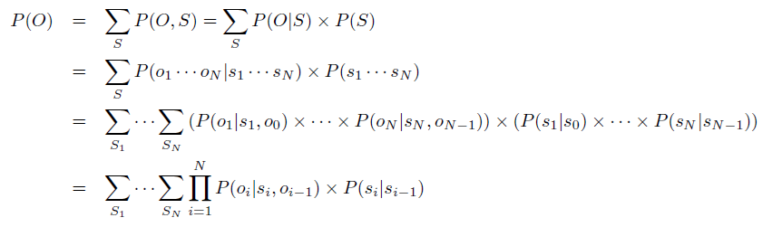

Model # 2 (cont..)
Current Work

Slide 25
Evaluation Method
Scoring Method
Divide the testing corpus into bigram
Match the testing corpus 2nd word of bigram with predicted word of each model
Increment the score if match found
The final evaluation is the ratio of the two scores of each model i.e. model1/model2
If ratio > 1 => model 1 is performing better and vice-verca.

Slide 26
Implementation Detail
Look Up Table
Previous Word | Next Predicted Word (Model 1) | Next Predicted Word (Model 2)
I | see | see
he | looks | goes
: : | : : | : :
Look up is used in predicting the next word

Slide 27
Scoring Ratio

Slide 28
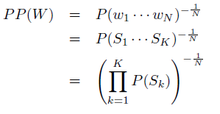
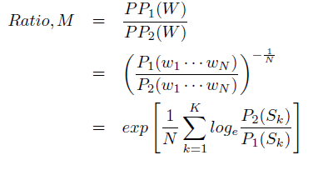
Perplexity:
Comparison:

Slide 29
Perplexity Ratio

Slide 30
Remarks
Model 2 is performing poorer than model 1 because of words are sparse among tags.

Slide 31
Further Experiments

Slide 32
Score (ratio) of word-prediction

Slide 33
Perplexity (ratio) of word-prediction

Slide 34
Remarks
Perplexity is found to be decreasing in this model.
Overall score has been increased.

Slide 35
Yago

Slide 36
Example #1
Query : Amitabh and Sachin
wikicategory_Living_people -- <type> -- Amitabh_Bachchan -- <givenNameOf> -- Amitabh
wikicategory_Living_people -- <type> -- Sachin_Tendulkar -- <givenNameOf> -- Sachin
ANOTHER-PATH
wikicategory_Padma_Shri_recipients -- <type> -- Amitabh_Bachchan -- <givenNameOf> -- Amitabh
wikicategory_Padma_Shri_recipients -- <type> -- Sachin_Tendulkar -- <givenNameOf> -- Sachin

Slide 37
Example#2
Query : India and Pakistan
PATH
wikicategory_WTO_member_economies -- <type> -- India
wikicategory_WTO_member_economies -- <type> -- Pakistan
ANOTHER-PATH
wikicategory_English-speaking_countries_and_territories -- <type> -- India
wikicategory_English-speaking_countries_and_territories -- <type> -- Pakistan
ANOTHER-PATH
Operation_Meghdoot -- <participatedIn> -- India
Operation_Meghdoot -- <participatedIn> -- Pakistan

Slide 38
ANOTHER-PATH
Operation_Trident_(Indo-Pakistani_War) -- <participatedIn> -- India
Operation_Trident_(Indo-Pakistani_War) -- <participatedIn> -- Pakistan
ANOTHER-PATH
Siachen_conflict -- <participatedIn> -- India
Siachen_conflict -- <participatedIn> -- Pakistan
ANOTHER-PATH
wikicategory_Asian_countries -- <type> -- India
wikicategory_Asian_countries -- <type> -- Pakistan

Slide 39
ANOTHER-PATH
Capture_of_Kishangarh_Fort -- <participatedIn> -- India
Capture_of_Kishangarh_Fort -- <participatedIn> -- Pakistan
ANOTHER-PATH
wikicategory_South_Asian_countries -- <type> -- India
wikicategory_South_Asian_countries -- <type> -- Pakistan
ANOTHER-PATH
Operation_Enduring_Freedom -- <participatedIn> -- India
Operation_Enduring_Freedom -- <participatedIn> -- Pakistan
ANOTHER-PATH
wordnet_region_108630039 -- <type> -- India
wordnet_region_108630039 -- <type> -- Pakistan

Slide 40
Example #3
Query: Tom and Jerry
wikicategory_Living_people -- <type> -- Tom_Green -- <givenNameOf> -- Tom
wikicategory_Living_people -- <type> -- Jerry_Brown -- <givenNameOf> -- Jerry

Slide 41
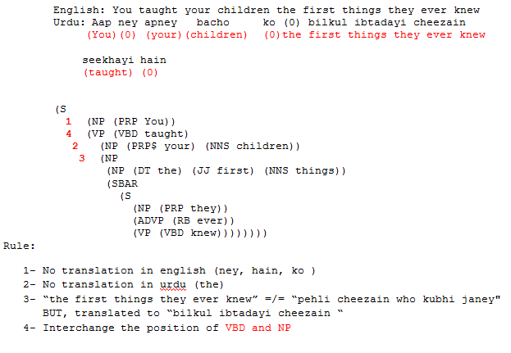
Parsing
Example#1:

Slide 42
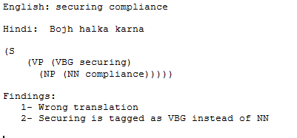
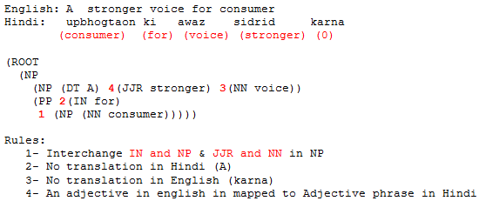
Example#2
Example#3

Slide 43
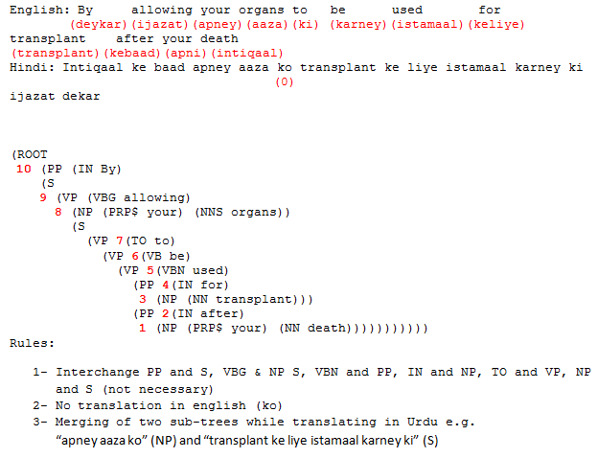
Example#4

Slide 44
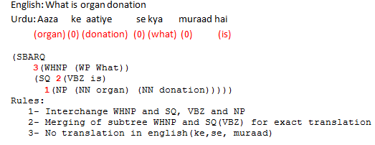
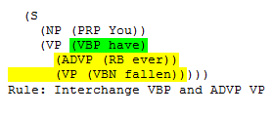
Example#5
Example#6

Slide 45
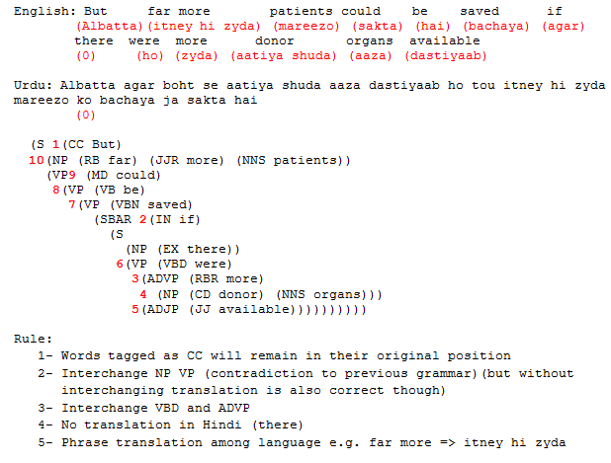
Example#7

Slide 46
Conclusion
VBZ always comes at the end of the parse tree in Hindi and Urdu.
The structure in Hindi and Urdu is always expand or reset to NP VB
e.g. S=> NP VP (no change) OR VP => VBZ NP (interchange)
3. For exact translation in Hindi and Urdu, merging of sub-tree in English is sometimes required
One word to multiple words mapping is common while translating from English to Hindi/Urdu
e.g. donar => aatiya shuda OR have => rakhta hai
Phrase to phrase translation is sometimes required, so chunking is required
e.g. hand in hand => choli daman ka saath (Urdu) => sath sath hain (Hindi)
DT NN or DT NP doesn’t interchange
In example#7: correct translation won’t require merging of two sub-trees MD and VP e.g. could be => jasakta hai

Slide 47
NLTK Toolkit
NLTK is a suite of open source Python modules
Components of NLTK : Code, Corpora >30 annotated data sets
corpus readers
tokenizers
stemmers
taggers
parsers
wordnet
semantic interpretation

Slide 48
A* - Heuristic
Fixed : (Min cost)* No. of Hops
^
$
Selected Route

