Slide 1
Automatic Detection of Spamming and Phishing
Kallol Dey
Rahul Mitra
Shubham Gautam

Slide 2
Trivial Definition. | Spamming and Phishing.
What is Spam ?
According to wikipedia …
Email spam, also known as junk email or unsolicited bulk email (UBE),is a subset of electronic spam involving nearly identical messages sent to numerous recipients by email. Clicking on links in spam email may send users to phishing web sites or sites that are hosting malware.
What is Phishing?
According to wikipedia ….
Phishing is the act of attempting to acquire information such as usernames, passwords, and credit card details (and sometimes, indirectly, money) by masquerading as a trustworthy entity in an electronic communication.

Slide 3
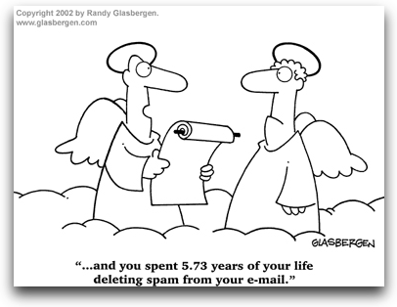
Why We Need To Know This. | Motivations Behind.
Phishing attacks in the United States caused $3.2 billion loss in 2007, with about 3.6 million victims falling for the attacks, a huge increase from the 2.3 million the year before.
Q1 2012 summary for Spam emails :
In Q1 of 2012, the share of spam in mail traffic was down 3 percentage points compared to the previous quarter, averaging 76.6%.Asia (44%) and Latin America (21%) remain the most prominent sources of spam.
The proportion of emails with malicious attachments grew by 0.1 percentage points compared to Q4 2011 and averaged 3.3%The share of phishing emails averaged 0.02% of all mail traffic.
Natural Language and ML based approach will be useful for automatic detection of spam and phishing attack. So the motivation behind today’s talk is to describe some novel ideas related to this.

Slide 4
Outline Of Today’s Talk. | Spamming and Phishing.
Difference between spamming and phishing
Automatic Spam Detection Techniques
Automatic Phishing Detection Techniques
Reference
Literature Reference
Website Reference
Phish-Net [ML , IR , NLP ]
CANTINA +
Using Language Model.
Maximum Entropy Model
Conclusion of Spamming Detection
Conclusion of Phishing Detection
Combination of LM features with pre-computed content and link features.

Slide 5
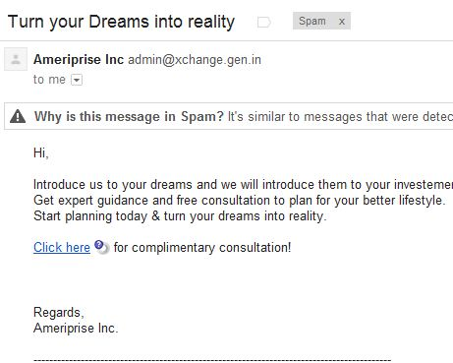
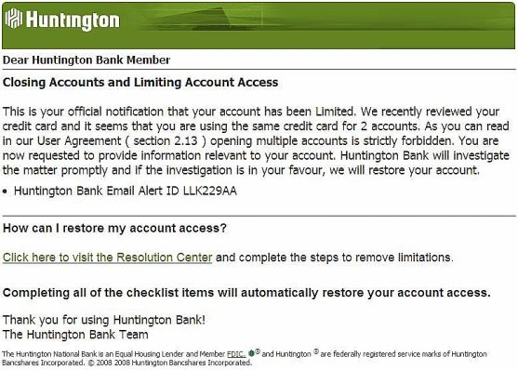
Difference | Spamming and Phishing.
Spamming
Phishing
Spamming is when a cyber criminal sends emails designed to make a victim spend money on counterfeit or fake goods.
Irritating if consider not harmful all the time.
Phishing attacks are designed to steal a person’s login and password details so that the cyber criminal can assume control of the victim’s social network, email and online bank accounts.
More harmful.

Slide 6
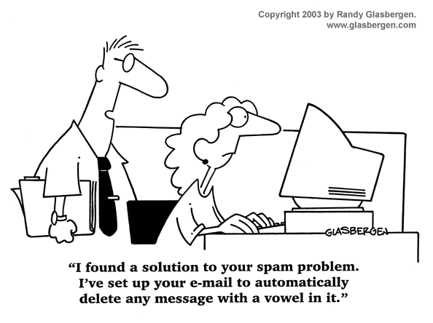
Available Way outs. | Spamming Detection.
Two classes of methods have been shown to be useful for classifying e-mail messages. The rule based method uses a set of heuristic rules to classify e-mail messages while the statistical based approach models the difference of messages statistically, usually under a machine learning framework.
Rule based approach is fruitful when all classes are static, and their components are easily separated according to some features.(However this is not the case most of the time.)
Generally speaking, the statistical based methods are found to outperform the rule based method .
A hybrid approach, utilizing a Maximum Entropy Model is used in a junk mail filtering task.[2]
Detecting comment spamming using Language Model.
LM with pre-computed link features.

Slide 7
Types Of Spam | Spamming Detection.
There are broadly two types of Spam based on which classification techniques are devised:-
Linked Spam
Content Spam

Slide 8
Linked Spam | Spamming Detection.
Link Based Spam detection techniques detects Links Spam which are defined as links between pages that are present for reasons other than merit. Link Spam takes advantage of link-based ranking algorithms, which gives websites higher rankings the more other highly ranked websites link to it.
Common way of creating Link Spam are:
Link farms: which are tightly-knit communities of pages referencing each other.
Hidden links: Putting hyper links where visitors will not see them to increase link popularity. Highlighted link text can help rank a web page higher for matching that phrase.
Sybil attack: A Sybil attack is the forging of multiple identities for malicious intent. A Spammer may create multiple web sites at different domain names that all link to each other, such as fake blogs.

Slide 9
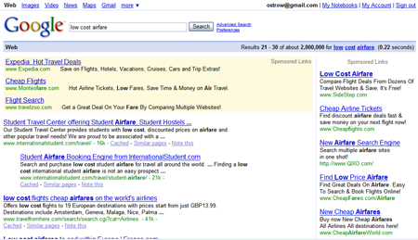
Examples of Linked Spam | Spamming Detection.
The following figure shows the search results when “low cost airfare” is searched.

Slide 10
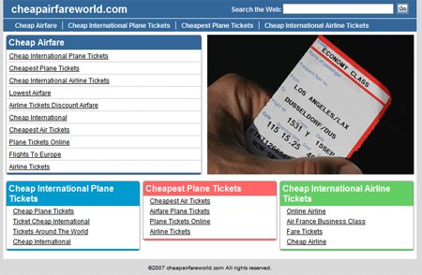
Examples of Linked Spam | Spamming Detection.
CheapAirfareWorld.com comes under page 3 of results under sponsored links.

Slide 11
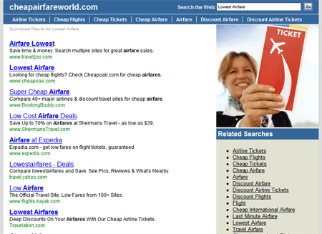
Examples of Linked Spam | Spamming Detection.
Now if lowest Air fare linked is clicked then a page opens which consists of sponsored links to highly ranked web pages.

Slide 12
Content Spam | Spamming Detection.
These techniques involve altering the logical view that a search engine has over the page's contents. They all aim at manipulate techniques of information retrieval on text collections.
Some techniques of creating Content Spam are:
Keyword stuffing: involves the calculated placement of keywords within a page to raise the keyword count, variety, and density of the page.
Meta-tag stuffing: involves repeating keywords in the Meta tags, and using meta keywords that are unrelated to the site's content.
Hidden or invisible text: Unrelated hidden text is disguised by making it the same color as the background.
Article spinning: involves rewriting existing articles, as opposed to merely scraping content from other sites

Slide 13
Content Spam Keyword Stuffing | Spamming Detection.
Here is web page which has been banned by google for Spamming. Figure below shows a part of page having a small text area which does show anything unusual .

Slide 14
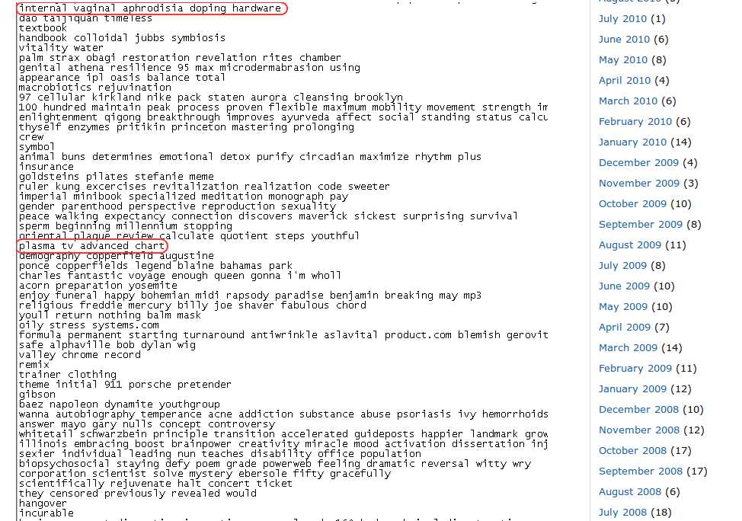
Content Spam Keyword Stuffing | Spamming Detection.
However if we inspect the html code the following comes up which are nothing but popular keywords.

Slide 15
Comment Spam | Spamming Detection.
Comment Spam are special kind of link Spam originating from comments and responses added to web pages which support dynamic user editing.
Comment Spamming can be done very easily by the spammer and also enjoy the high ranks the blogs they linked to.

Slide 16
Broad Methodology in Detecting Comment Spam | Spamming Detection.
Here we examine the language models Posts, Comments and the links in the comments.
Here its expected that the language models of the original post and the spammed comments and spam links would be different.
As opposed to detection through difference in langauage models, detection of Spam through detection of Keyword and Regular Expression suffers from the following disadvantages:
Updating training data continuously
Large training data

Slide 17
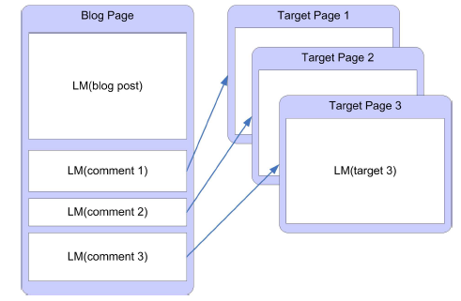
Language Model For Text Comparison. | Spamming Detection.
Language Model : probability distribution over strings, indicating the likely hood of observing this strings in the language.
So different texts can be compared by formulating their individual language model and comparing those distribution using the well known KL Divergence method.
Therefore here for the original post there is a LM and for each subsequent comments we have at most two LM one for the comment text and one for the linked page in the comment (if any).

Slide 18
Language Model For Text Comparison. | Spamming Detection.
To account for Data Sparsity in small text's LM Interpolated Aggregate Smoothing is done on probabilities of words in the LM.
Finally, the KL Divergence between the 2 LMs is given by :
KL(θi || θj) = ∑_{w} p(w|θi)log( p(w|θi) / p(w|θj) )
where p(w|θi) is probability in observing the word in distribution θi.

Slide 19
Comparing Language Models | Spamming Detection.
Let θp and θc be the model for post and comment respectively.
The probabilities of words are estimated from this model and then are smoothed by using a general probability model of words on the Internet.
The probability distributions θp and θc created using Maximum Likelyhood over the texts available.
p(w0-n|θp) = λp(w0-n|θp) + (1-λ)p(w0-n|θinternet)‏
Since the model is taken in this approach is a unigram model
so,
p(w_{0-n}|θp) = π p(w_{i}|θp), similarly we can compute the probabilities for θc.

Slide 20
Example of KL Divergence giving similarity measure between Language Models | Spamming Detection.
KLD(Free Ring tones || Free Ring tones for Your Mobile Phone from PremieRingtones.com) = 0.25
KLD(Best UK Reviews || Findabmw.co.uk – BMW Information Resource) = 3.86
So, we can see that in the first two language models there is very less disagreement between each other hence the lower divergence value.

Slide 21
Spam classification | Spamming Detection.
Step 1: Calculate KL Divergence for all Comments in a POST.
These divergence values can be seen as drawn from a probability distribution which is a mixture of Gaussains. i.e. Gaussian with the lowest mean represents the language model closest to that of the original POST.
In this approach it is assumed that the KL- Divergence values are drawn from 2 such Gaussian distributions, one for Spam and another for not Spam.
Step 2: To estimate the parameters of the Gaussian distributions EM is used.
Step 3: Finally a comment is classified as Spam if its probability is more in the Spam distribution than in the non-Spam distribution. This can be easily achieved by a vertical separator between the distributions as shown in figure below.
By changing the value of the threshold no. false negatives and false positives can be controlled
Mixture of Gaussains
Two different Component Gaussian,
red being non Spam

Slide 22
Results | Spamming Detection.
This model for Spam detection was tested on 50 Blog posts containing 1024 comments.
68% if the comments were found to be link Spam and so randomly 68% was labeled as Spam and that was taken as the baseline.

Slide 23
Language Model For Text Comparison. Limitations of this model. | Spamming Detection.
Sometimes Spammers can even fake the language model of the posts by copying phrases from the posts in the comments. This may lead to mis-classification of the comments.
However this can also provide an opportunity for search engines which has connectivity server to detect such Spam sites which is linked to different blogs (to increase page ranks ) which has completely different language models.
Also another limitations is the misclassification of valid comments which uses a different set of vocabulary from the one used in the original post.

Slide 24
Language Model For Text Comparison. Model Expansion and Future Work . | Spamming Detection.
Requirement for expansion of this model is that many times blog comments are very short and this causes sparse language models. So to enrich the language models one way is to follow the links in comments and posts and their contents recursively up to a certain depth but here a trade-off has to be made between topic drift and richer language models.

Slide 25
General Spam Detection based on the previous approach | Spamming Detection.
The previous approach can be used to improve classification rate of General Spam Links and Pages.
Here an extension of the basic approach is used to analyze several sources of information extracted from each web page.
The different sources of information are:
From source:
anchor text , Surrounding anchor text, Url terms
From Target:
Title, Page Content, Meta Tags
using these sources of information new features are extracted that will be used for classification of Spam

Slide 26
Method | Spamming Detection.
Here the classifier used to classify Spam pages is a cost sensitive decision tree with bagging being used to increase accuracy. Here while training a cost 0 is set to right classification. Also for Spam pages misclassified as normal the cost set is R times higher than the cost set normal pages misclassified as Spam.
As this approach tries to combine Language models with the existing information to generate better features, the baseline measure considered for this approach is the measure obtained by precomputed content and link features.
The performance measure adopted for comparison are True positive, False positive rate and F-measure
As with previous approach KL Divergence is used to determine the similarity between the 2 language models.

Slide 27
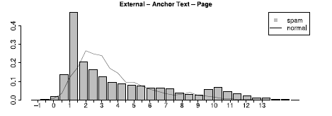
Description of the new Features | Spamming Detection.
New features are derived from the difference in language model of source information and target pages information.
These features are:
Anchor Text – Target Content : A great divergence between this text and content of linked page shows clear evidence of Spam.
Figure showing KL Divergence Between Anchor Text and Target Content.

Slide 28
Description of the new Features | Spamming Detection.
From the previous graph we can see alone anchor text does not provide distinguishing value eg. From a link having “click me ” there is no way to distinguish between normal and spam. The surrounding anchor text provides much more information and richer language model.
We can see that the Spam curve is displaced more towards higher KL divergence value.
Figure showing KL Divergence
between Surrounding Anchor
Text and Target Content.

Slide 29
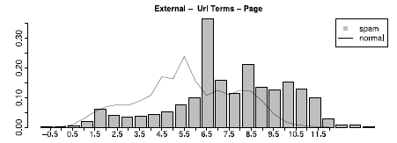
URL Terms. | Spamming Detection.
Url Terms – Target Content: The Url terms are mainly protocol,domain,path and file. The language model from these terms can be used to detect Spam techniques. eg. www.domain.com/big-money-youtube-free-download-poker-online.html and it is linked to an online music store so then it can be said that this link is Spam.
So 60% (by analyzing several urls )of the terms are used to calculate the KL Divergence between url terms and target content.
The figure clearly shows difference between normal and Spam histograms.
Figure shows KL divergence
between Url terms and Target
Contents

Slide 30
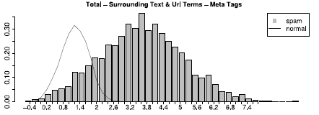
FEATURES. | Spamming Detection.
Other features are: Anchor Text – Title, Surrounding Anchor Text – Title, Url-Terms Title.
Another important source of information of a web page are its Meta Tags: These are mainly used by search engine optimizations and attributes like 'Description' and 'keywords' which is used to in this approach to build a virtual document.
Now combining sources of information from the source page to create richer language model and computing its divergence with meta tags gives a better probability distribution of a page being Spam.
Figure shows the probability
distribution of Spam and normal
With KL divergence of combination
Surrounding Text and Url Terms
with meta tags.

Slide 31
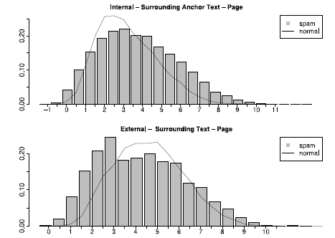
Different Types of Links. | Spamming Detection.
So far it was assumed irrespective of the type of links the distribution of normal and Spam over Divergence measure would be the same but in reality its not. This is due to fact that search engines considers relationship (ratio) among internal and external links to compute Page Ranks. So spammers accordingly use this information to spam their links accordingly. This is also justified from the following figures.
Top Figure shows distribution
of Spam and normal for anchor
Text – Content for internal links
and bottom shows for external
Links.

Slide 32
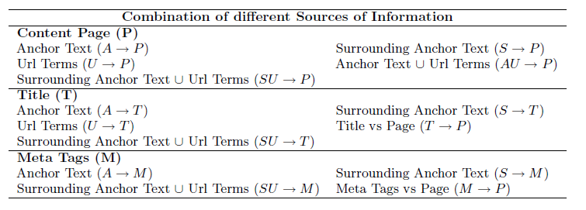
Results and Conclusion. | Spamming Detection.
For classification of Spam by combining language models with precomputed features 42 precomputed features were along with 14 language model features.
Above figure shows the 14 different features obtained from language models of various sources of information. Also out of the 42 precomputed features 14 were for internal links, 14 were for external links, 14 for both internal and external links.

Slide 33
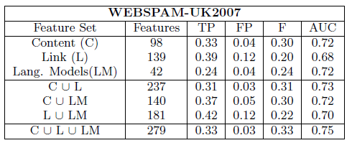
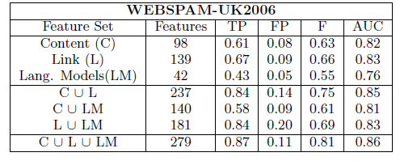
Results and Conclusion. | Spamming Detection.
This classifier was tested for Web Spam UK 2006 and 2007 data and the following figure shows the results.
So we can conclude that LM features alone does not give better results than as content or link features due to the fact that the number of features in LM is much less. Here we see in both the cases that F-score and the classification accuracy increases when all the features ( i.e LM ) are combined.

Slide 34
Maximum Entropy Model. | Spamming Detection.
The goal of the ME principle is that, given a set of features, a set of functions f1 : : : fm (measuring the contribution of each feature to the model) and a set of constrains, we have to find the probability distribution that satisfies the constrains and minimizes the relative entropy .In general, a conditional Maximum Entropy model is an exponential (log-linear) model has the form:
where p(a|b) denotes the probability of predicting an outcome a in the given context b with constraint or "feature" functions f_{j} (a ,b).
Here k is the number of features and is a normalization factor to ensure that ∑_{a} P(a|b)=1
The parameters α^{j} can be derived from an iterative algorithm called Generalized Iterative Scaling. ^{[extra slide ]}
What about f_{j}(a,b) ? Feature function of every selected feature.
b =message
a={Spam ,Legitimate}

Slide 35
Maximum Entropy Model. Feature Selection Techniques. | Spamming Detection.
The Χ² test is used to find the feature selection from the corpus :
All features will have context predicates in the form:
cp_{f} (b) = true if message b contains feature f =false , otherwise .
A is the no of times feature f and category c co-occur.
B is the number of times of f occurs without c.
C is the number of times c occurs without f.
D is the number of times neither c or f occurs and
N is the total number of documents (messages).

Slide 36
Maximum Entropy Model. Feature Selection Techniques. | Spamming Detection.
Therefore all features have the form:
f(a,b)= 1 if cp_{f} (b) true
=0 otherwise
where cp is the contextual predicate which maps a pair of outcome a and context b to {true,false}.
Here a is the possible category {SPAM , LEGITIMATE} of message b
Feature Selection :
Term Feature
“FREE!!”
“Click Here …”
“WIN $*** ”
Domain Specific Feature
use “Dear User” as user name ,
All Caps in subject (some of us use !!)
relying command to load outside URL )
In this way we know which features are really need to give importance..

Slide 37
Available Way Outs. | Phishing Detection.
Several Possible Solution using Natural Language Techniques and ML techniques.
Here we described the followings :
Schemes based on Information Retrieval
Machine learning based techniques
String, pattern and visual matching based detection schemes
CANTINA +

Slide 38
What is Phish Net ? | Phishing Detection.
It operates between a user’s mail transfer agent (MTA) and mail user agent (MUA) and processes each arriving email for phishing attacks even before reaching the inbox.
It uses the information present in the email header, text in the email body and the links embedded in the email.
It is our objective to maximize the distance between the user and the phisher - clicking a malicious link puts the user closer to the threat.

Slide 39
Information Retrieval based Approach | Phishing Detection.
TF-IDF (Term Frequency-Inverse Document Frequency):
* Its a weight used to determine the importance of a word to a document in a collection of documents.
* The importance of a word increases proportionally to the number of times a word appears in the document (term frequency) and is inversely proportional to the document frequency of the word in the collection.

Slide 40
Machine Learning based Technique 1 of 3. | Phishing Detection.
Dynamic Markov Chains
The idea here is to model the “language” of each class of messages. For each class a probabilistic automaton is learned that allows, for a new message, to output a probability with which the message belongs to that class.

Slide 41
Machine Learning based Technique 2 of 3. | Phishing Detection.
Dynamic Markov Chains
Let the sequence of bits (b1 , . . . , bn ) be the representation of an email.
Let M be a model for the sequence of bits (b1 , . . . , bn ), which predicts the probability p(bi |b1 , . . . , bi−1 , M ) that bit bi = 1 given the sequence of previous bits b1 , . . . , bi−1 .
Then the average log-likelihood of the email for the model is :

Slide 42
Machine Learning based Technique. 3 of 3. | Phishing Detection.
Dynamic Markov Chain
Assume that we have estimated a model Mc for each of the classes ham, spam and phishing. The class c for which log p(b1 , . . . , bn |Mc ) is maximal is the most likely class of the email x. Therefore the classification of x can be formulated based on the maximal log-likelihood for all classes C as:

Slide 43
Approach to Email text processing via NLP | Phishing Detection.
Lexical Analysis
Part-of-speech Tagging
Named Entity Recognition
Normalization of words to lower case
Stemming and Stopword Removal
Semantic NLP techniques, viz., Word-Sense Disambiguation

Slide 44
Phishing Detection Algorithm | Phishing Detection.
Text Analysis
Header Analysis
Link Analysis

Slide 45
Phishing Detection Algorithm | Phishing Detection.
Text Analysis:
Text Score
Context Score

Slide 46
Phishing Detection Algorithm Text Analysis | Phishing Detection.
Textscore
Let V = {click, follow, visit, go, update, apply, submit, confirm, cancel, dispute, enroll}
SA = Synset({here, there, herein, therein, hereto, thereto, hither, thither, hitherto, thitherto})
U = {now, nowadays, present, today, instantly, straightaway, straight, directly, once, forthwith, urgently, desperately, immediately, within, inside, soon, shortly, presently, before, ahead, front}
D = {above, below, under, lower, upper, in, on, into, between, besides, succeeding, trailing, beginning, end, this, that, right, left, east, north, west, south}

Slide 47
Phishing Detection Algorithm Text Analysis | Phishing Detection.
Consider a phishing email in which the bad link appears in the top right-hand corner of the email and the email (among other things) directs the reader to “click the link above.”
The score of verb v is given by :
score(v) = {1 + x(l + a)}/2^{L}
x = 1 if the sentence containing v also contains either a word from SA ∪ D, and, either a link or the word “url,” “link,” or “links” appears in the same sentence; otherwise, x = 0.
l = no. of links
a = 1 if there is a word from U or a mention of money in the sentence containing v, otherwise a = 0.
l = level of the verb
Textscore(e) = Max{score(v) | v ∈ e}

Slide 48
Phishing Detection Algorithm Text Analysis | Phishing Detection.
Context Score
ev = email vector
ec = corresponding vector for each email in the context
we perform similarity computation between ev and ec.
Similarity(ev, ec) = cosine θ
Contextscore(ev) = max_{ec∈C} Similarity(ev, ec)‏

Slide 49
Phishing Detection Algorithm Text Analysis | Phishing Detection.
Final-text-score(e)‏
The combination of Textscore(e) and Contextscore(e) is done logically to yield Final-text-score(e)‏

Slide 50
Phishing Detection Algorithm Header Analysis | Phishing Detection.
First, the user is asked to input his/her other email addresses that forward emails to this current email address and this information is stored.
Phase 1 - Extracting the data
We extract the FROM and DELIVERED-TO fields from the header. Then, we extract the RECEIVED FROM field(s).

Slide 51
Phishing Detection Algorithm Header Analysis | Phishing Detection.
Header Analysis:
Phase 2 - Verifying the data
If the first Received From field has the same domain name as the FROM FIELD or LOCALHOST or ANY FORWARDING EMAIL ACCOUNT, then the email is legitimate. (score = 0)‏
Otherwise, if the first Received From field has the same domain name as the user’s current email account’s domain name, then we look at the next received from field.
Otherwise, we mark the email as phishing. (score = 1)‏

Slide 52
Phishing Detection Algorithm Link Analysis. | Phishing Detection.
In this classifier, our objective is to determine whether the URLs present in the email point to the legitimate website that the text in the body of the email claims.
We extract all domains from the links in the email in an array.
The linkAnalysis() classifier assigns an email a score of 1 for phishing and 0 for legitimate.

Slide 53
Phishing Detection Algorithm Combining Scores of the Three Classifiers | Phishing Detection.
If combined score of the three classifiers (header, link and text) is ≥ 2 EMAIL PHISHING.
Otherwise Legitimate.

Slide 54
Phishing Detection Algorithm Combining Scores of the Three Classifiers | Phishing Detection.
Input: SMTP server name, user name, password
Output: Label for each email: Phishing or Legitimate
Fetch email from SMTP server
if (new email downloaded) then
foreach email e do
header h = extractHeader();
if (h indicates that e is HTML encoded) then
decodedEmail dE=HTMLDecode(e);
end
parsedEmail pE = emailParser(dE);
headerScore = headerAnalysis(header);
linkScore = linkAnalysis(links);
textScore = textAnalysis(text);
cs = combineScore(headerScore, linkScore, textScore);
if cs ≥ 2 then
Output Label: Phishing
end
else
Output Label: Legitimate
end
end
end

Slide 55
Phishing Detection Algorithm CANTINA + | Phishing Detection.
The layered system of CANTINA+ consists of 3 major modules.
HASH-BASED NEAR-DUPLICATE PAGE REMOVAL
High similarity among phishing web pages
SHA1 hash algorithm is used
LOGIN FORM DETECTION
FORM tags INPUT tags, and login keywords such as password, PIN
Application of NLP
FEATURE-RICH MACHINE LEARNING FRAMEWORK
15 highly expressive features
SVM, Logistic Regression etc. ML algorithms are used

Slide 56
Phishing Detection Algorithm CANTINA + : Features | Phishing Detection.
Embedded domain: This feature examines the presence of dot separated domain/hostname patterns such as www.ebay.com
IP address.
No of Dots in address
Bad forms in html
Bad action fields
Age of Domain
Page in top search results
Etc ….

Slide 57
Phishing Detection Algorithm CANTINA + | Phishing Detection.
A1) 15 feature values are extracted from each instance in the training corpus;
A2) the feature values are organized in proper format and
forwarded to the machine learning engine;
A3) classifiers are built for phish detection. In the testing stage
B1) the hash-based filter examines whether or not the incoming page is a nearduplicate of known phish based on comparing SHA1 hashes;
B2) if no hash match is found, the login form detector is called, which directly classifies the webpage as legitimate if no login form is identified;
B3) the webpage is sent to the feature extractor when a login form is detected;
B4)the pre-trained learning models run on the features and predict a class label for the webpage.

Slide 58
Phishing. | Conclusion.
CANTINA + is good but depend on some condition like if a phishing page has more no of appearance in search engine then the features of CANTINA+ may not select it as phishing page.
Phish Net gives an accuracy of 97 % with very low false positive.

Slide 59
Literature Reference. | Spamming and Phishing
Statistical NLP by Manning ,Schuetze.
CANTINA+: A Feature-rich Machine Learning Framework for Detecting Phishing Web Sites.
New Filtering Approaches for Phishing Email by Fraunhofer IAIS, K.U. Leuven
Detecting Phishing Emails the Natural Language Way by Rakesh Verma, Narasimha Shashidhar, and Nabil Hossain ESORICS 2012, Heidelberg.
Filtering Junk Mail with A Maximum Entropy Model by ZHANG Le and YAO Tian-shun , ICCPOL 2003 ,China.
Fighting Unicode-Obfuscated Spam by Changwei Liu Sid Stamm
Link-Based Characterization and Detection of Web Spam Luca Becchetti, Carlos Castillo, Debora Donato, Stefano Leonardi, Università di Roma "La Sapienza", and Ricardo Baeza-Yates, Yahoo! Research Barcelona on AIRWEB ,2006.
Web Spam Identification through LM analysis by Juan Martinez-Romo and Lourdes Araujo. AIRWEB 2009 Madrid Spain.
Blocking blog spam with LM model disagreement by Gilad Mishne & et al. AIRWEB 2005 ,Chiba ,Japan.
Detecting Nepotistic Links by LM model disagreement by Andras A Benczur et al. WWW 2006 , Edinburg h, Scotland.

Slide 60
Website Reference. | Spamming and Phishing
http://en.wikipedia.org/wiki/Email_spam
http://en.wikipedia.org/wiki/Phishing
http://prettygoodplan.com/wp-content/uploads/2011/04/website_development_program.jpg
http://www.washingtonpost.com/blogs/ezra-klein/files/2012/08/Spam2_2.jpg

Slide 61
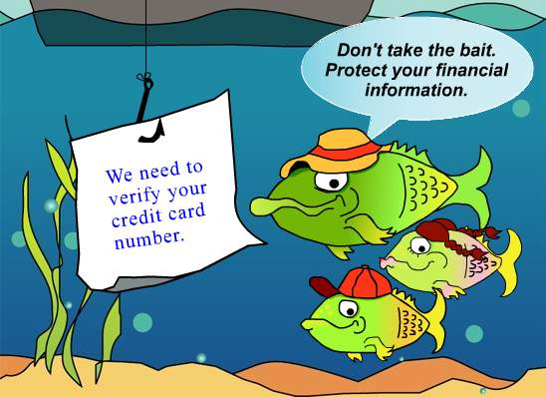
Thank You. | Caution : Don’t be victim of Phishing.

Slide 62
EXTRA SLIDES !!!

Slide 63
EXTRA SLIDE. | GIS 1.

Slide 64
EXTRA SLIDE. | GIS 2.

Slide 65
EXTRA SLIDE. | CHI .

