Slide 1
Neurolinguistics
Tarun Gujjula
Varun Suprashanth
Asok Ramachandran
Under Guidance of Dr. Pushpak Bhattacharya

Slide 2
Outline
What is Neurolinguistics ?
Motivation
Areas of the Brain
Neurobiology of Language
Cognitive Linguistics
Conclusion

Slide 3
What is Neurolinguistics?
Neurolinguistics is the study of the neural mechanisms in the human brain that control the comprehension, production, and acquisition of language. As an interdisciplinary field, neurolinguistics draws methodolgy and theory from fields such as neuroscience, linguistics, cognitive science, neurobiology, communication disorders, neuropsychology and computer science.

Slide 4
Motivation
“If one were to rank a list of civilization's greatest and most elusive intellectual challenges, the problem of "decoding" ourselves -- understanding the inner workings of our minds and our brains, and how the architecture of these elements is encoded in our genome -- would surely be at the top.“
– Yarden Katz while interviewing Noam Chomsky

Slide 5
Motivation
The main aim of the ongoing research in both NLP and AI, if it could be put in simple terms, is to try and emulate the human brain.
It comes as no surprise why. In a world increasingly being based on one model or the other, the grey matter between our ears serves as the best model anyone can ask for.

Slide 6

Motivation

Slide 7
Motivation
This picture is taken from the movie 2001 : A Space Odyssey. The two men are inside an onboard ejection capsule to talk without the spaceship’s rogue computer (the red dot outside the window) listening.
But sadly for them, the computer could lip read!!
And this is something the author Arthur C. Clarke
came up way back in 1968.

Slide 8
Motivation
Although the idea seems a bit far fetched now (lip reading computers! seriously!) we are not far from Mr. Clarkes vision if not for 2001 atleast 2012.
Products like SIRI and Watson are pushing the boundaries of Artificial Intelligence and in turn Language Processing every day.
In this seminar we shall study how our brain processes language, how should we go about studying that and maybe using the results even find out if HAL is actually possible or not.

Slide 9
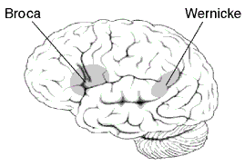
Areas of the Brain

Slide 10
Areas of the Brain
Broca’s Area : Broca’s area is the part of the
brain mainly linked with speech production.
Although initially only linked with production
recent research has also revealed that this area
might also play an important role in
understanding language as well.

Slide 11
Areas of the Brain
Wernicke’s Area : is the part of the brain which is primarily associated with the written and spoken language.
Both Broca’s Area and Wernicke’s Area play an important role in understanding the inner functions of a brain.

Slide 12
Neurobiology of Language
The most common method to study the brain
has been to surprise it in various ways.
Mismatch Negativity(MMN) is a very useful tool used widely to gauge this in many branches of neuroscience and psychology.
The brain produces different electrical signals for different stimuli. These electrical signals are tracked from the aforementioned areas to find the and understand the different responses.

Slide 13
Neurobiology of Language
The MMN is a response to a deviant within a sequence of otherwise regular stimuli. Thus, in an experimental setting, it is produced when stimuli are presented in a many-to-one ratio. For example, in a sequence of sounds s ssssssdssssdsss..., the d is the deviant or oddball stimulus, and will elicit an MMN response.
The mismatch negativity occurs even if the subject is not consciously paying attention to the stimuli. Processing of sensory stimulus features is essential for humans in determining their responses and actions.

Slide 14
Neurobiology of Language

Slide 15
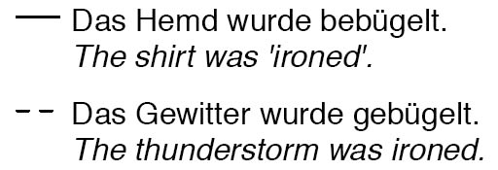
Neurobiology of Language
The brain responds to implausibility in a robust manner.
The undotted curve is for the first sentence whereas the dotted one is for the second.

Slide 16
Neurobiology of Language
The spike in the electric discharge is due to the absurdity of the sentence.
Although gramatically correct the human brain recognises that the sentence is flawed which might be quite a task to replicate with a computer.

Slide 17
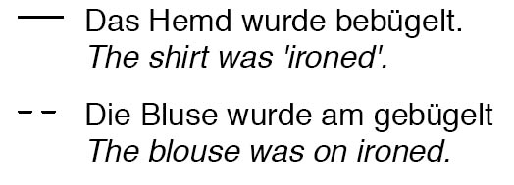
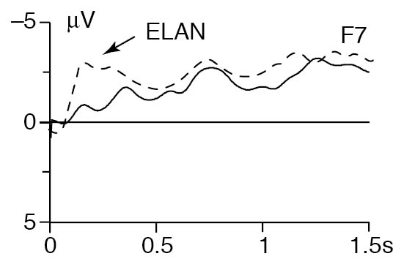
Neurobiology of Language
Gramatically incorrect
sentences prompt a
robust response from
our brains.

Slide 18
Cognitive Linguistics
Cognition : The mental action or process of acquiring knowledge through thought, experience and senses.
Cognitive linguistics is an emerging discipline that studies the cognitive properties of natural languages and the cognitive models of languages in cognitive computing and computational intelligence.

Slide 19
Cognitive Linguistics
Cognitive Linguistics is a very volatile topic and often times only loosely based on objective proof.
This is not due to the lack of effort but rather a lack of a knowledge of all the parameters involved.
When it comes to dealing with the grey matter, scientists are literally in the grey area.

Slide 20
Cognitive Linguistics - Representation
Before we go into recent schools of thought on Cognitive Linguistics we would like to dwell for a small amount of time on the formal frameworks involved in studying cognitive linguistics.
The mathematical models can be divided into three hierarchical structures:
Formal methods to describe natural languages at a very abstract level.
Formal models on lexical and syntactical structures of languages.

Slide 21
Cognitive Linguistics - Representation
3. Models to develop general patterns of sentence
structures and the detective grammar of a
language in a rigorous approach.
Since the last two models have been discussed in class in one way or an other and due to the scope of the seminar we will stick with the first model to just give an oversight.
Reference for further reading : Towards a Formal Framework of Cognitive Linguistics by Yingxu Wang and Robert C. Berwick .

Slide 22
Cognitive Linguistics - Representation
A formal model of a general language such as English can be described as an abstract language using denotational mathematics [Wang, 2008a, 2011].
Based on the general abstract language model, the structural models of natural languages can be created at the lexis, phrase, clause, sentence, paragraph, and article levels from the bottom up.

Slide 23
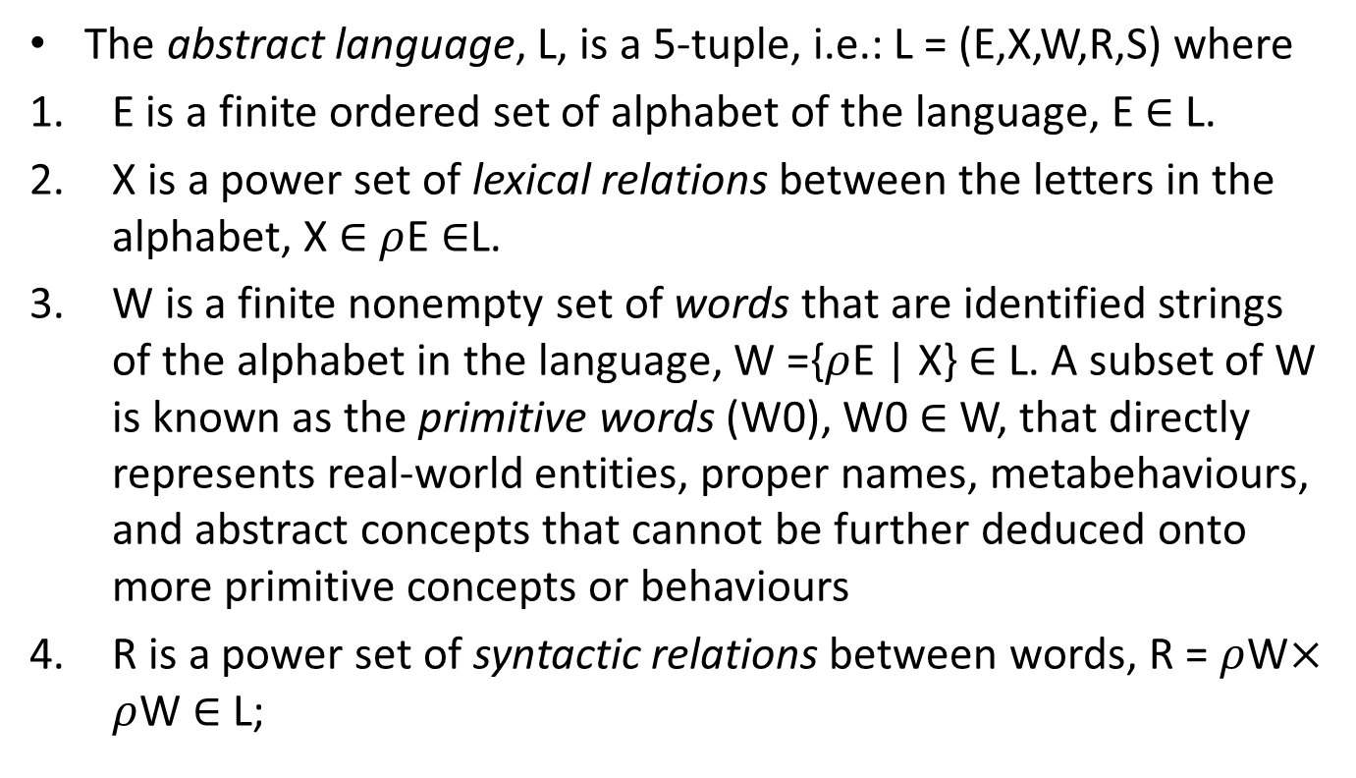
Cognitive Linguistics - Representation
The abstract language, L, is a 5-tuple, i.e.: L = (E,X,W,R,S) where
E is a finite ordered set of alphabet of the language, E $∈$ L.
X is a power set of lexical relations between the letters in the alphabet, X $∈$ $ρ$E $∈$L.
W is a finite nonempty set of words that are identified strings of the alphabet in the language, W ={$ρ$E | X} $∈$ L. A subset of W is known as the primitive words (W0), W0 $∈$ W, that directly represents real-world entities, proper names, metabehaviours, and abstract concepts that cannot be further deduced onto more primitive concepts or behaviours
R is a power set of syntactic relations between words, R = $ρ$W$×$ $ρ$W $∈$ L;

Slide 24
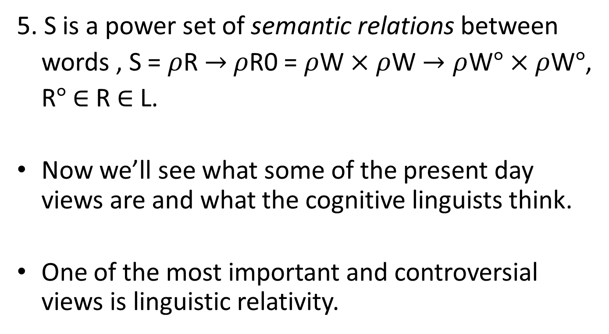
Cognitive Linguistics - Representation
5. S is a power set of semantic relations between
words , S = $ρ$R $→$ $ρ$R0 = $ρ$W $×$ $ρ$W $→ρ$W$°$ $×ρ$W$°$,
R$°$ $∈$ R $∈$ L.
Now we’ll see what some of the present day views are and what the cognitive linguists think.
One of the most important and controversial views is linguistic relativity.

Slide 25
Cognitive Linguistics - Representation
The lexes are a category of syntactic units that represent the six basic parts of speech. The modifiers are a category of syntactic units that that refines and restricts the semantics of words. The phrases are a category of syntactic units that compose multiple words into a complex unit.
Definition: The set of lexical elements E of a sentence S in language L can be classified into the categories of lexes (L’), modifiers (M), and phrases (P).

Slide 26
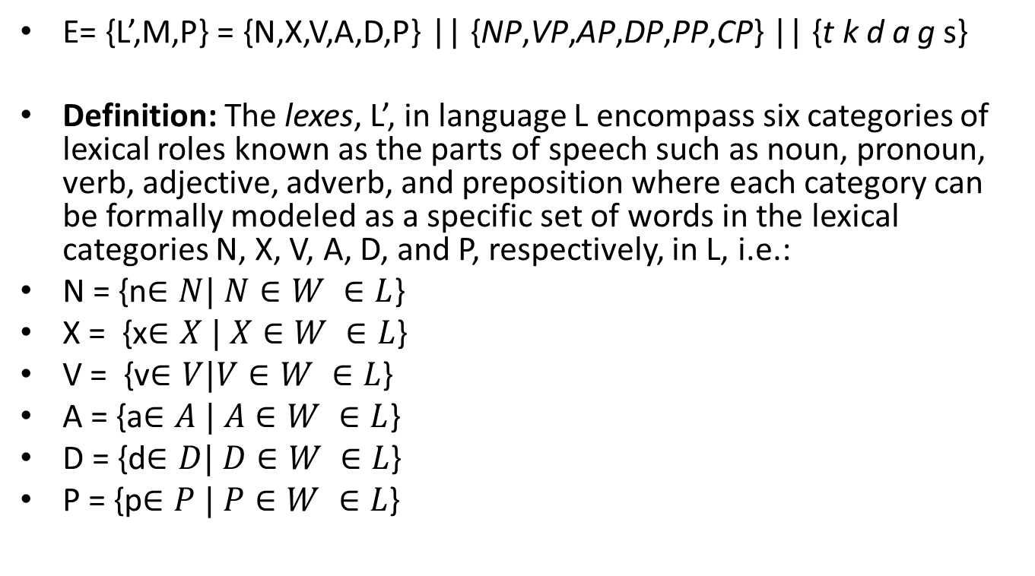
Cognitive Linguistics - Representation
E= {L’,M,P} = {N,X,V,A,D,P} || {NP,VP,AP,DP,PP,CP} || {t k d a g s}
Definition: The lexes, L’, in language L encompass six categories of lexical roles known as the parts of speech such as noun, pronoun, verb, adjective, adverb, and preposition where each category can be formally modeled as a specific set of words in the lexical categories N, X, V, A, D, and P, respectively, in L, i.e.:
N = {n$∈N| N∈W ∈L$}
X = {x$∈X | X∈W ∈L$}
V = {v$∈V|V∈W ∈L$}
A = {a$∈A | A∈W ∈L$}
D = {d$∈D| D∈W ∈L$}
P = {p$∈P | P∈W ∈L$}

Slide 27
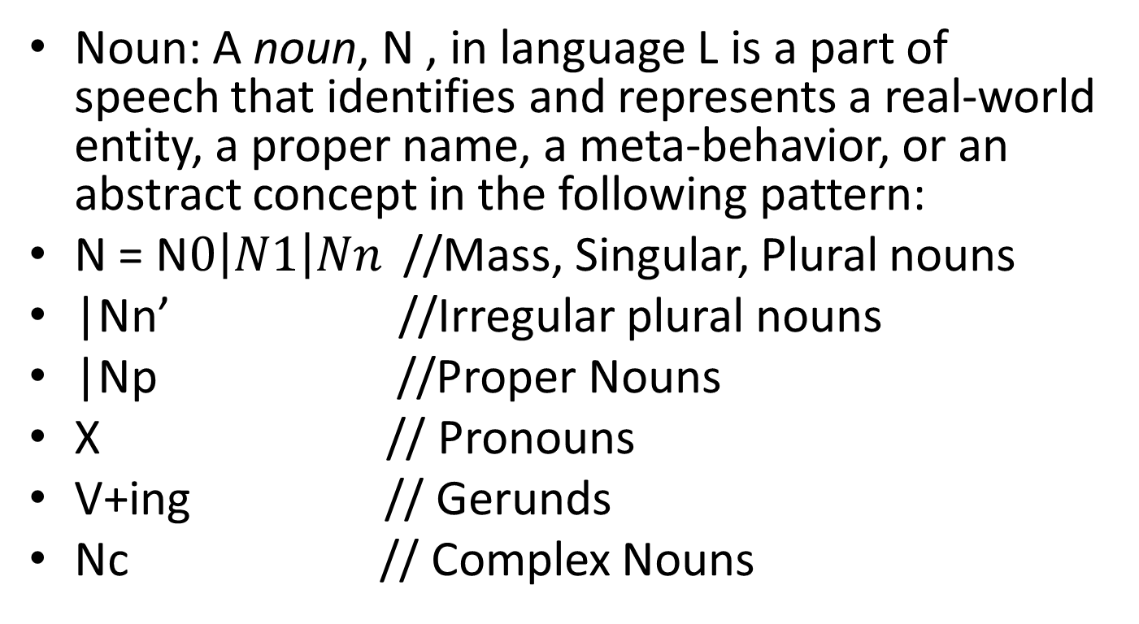
Cognitive Linguistics - Representation
Noun: A noun, N , in language L is a part of speech that identifies and represents a real-world entity, a proper name, a meta-behavior, or an abstract concept in the following pattern:
N = N$0\left|N1\right|Nn$ //Mass, Singular, Plural nouns
|Nn’ //Irregular plural nouns
|Np //Proper Nouns
X // Pronouns
V+ing // Gerunds
Nc // Complex Nouns

Slide 28
Cognitive Linguistics - Representation
Pronouns: A pronoun, X , in language L is a part of speech that is used to represent or indicate a personal, impersonal, and proper noun in nine categories in the following pattern:
X=X01 | X0n // Impersonal, single/plural
| X11 | X1n //First person, single/plural
| X21 | X2n //Second person, single/plural
| X31m | X3nm //Third person (male), single/plural
| X31f | X3nf //Third person (female), single/plural
| Xp // General person
| Xi1 | Xin //Indefinitive, single/plural
| Xth1 | Xthn // Demonstrative, single/plural
| Xwh // Interrogative

Slide 29
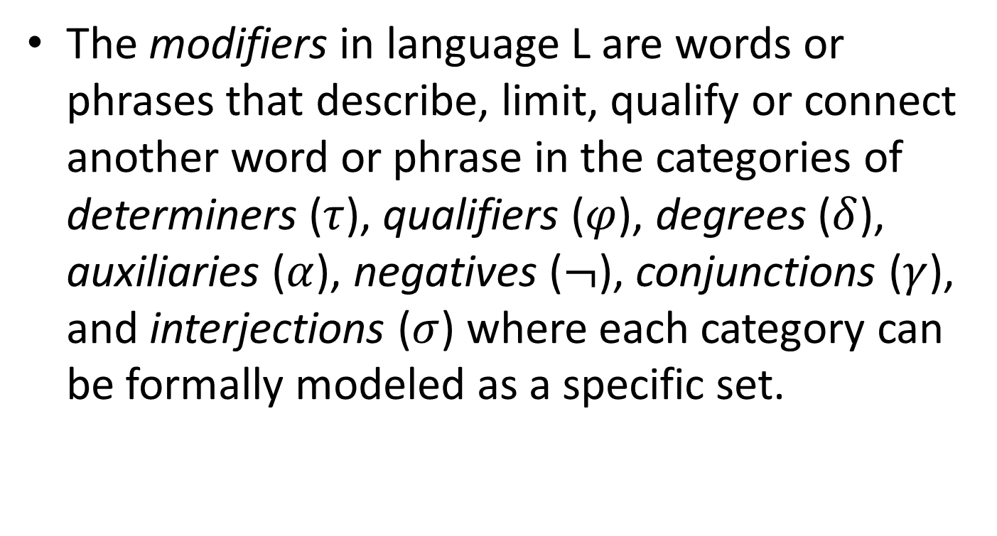
Cognitive Linguistics - Representation
The modifiers in language L are words or phrases that describe, limit, qualify or connect another word or phrase in the categories of determiners ($τ$), qualifiers ($φ$), degrees ($δ$), auxiliaries ($α$), negatives ($¬$), conjunctions ($γ$), and interjections ($σ$) where each category can be formally modeled as a specific set.

Slide 30
Cognitive Linguistics - Representation
A phrase in L is a combination of multiple words that forms an element of sentence in the categories of noun phrase (NP), verb phrase (VP), adjective phrase (AP), adverb phrase (DP), proposition phrase (PP), and complement phrase (PP) where each category of the phrases can be formally modeled as a specific set in L.

Slide 31
Cognitive Linguistics – Theories
The principle of linguistic relativity holds that the structure of a language affects the ways in which its speakers conceptualize their world, i.e. their world view, or otherwise influences their cognitive processes.
Popularly known as the Sapir–Whorf hypothesis, the principle is often defined as having two versions:
(i) the strong version that language determines thought and that linguistic categories limit and determine cognitive categories and

Slide 32
Cognitive Linguistics - Theories
(ii) the weak version that linguistic categories and usage influence thought and certain kinds of non-linguistic behaviour.
Eg: There is a language Guugu Yimithirr (spoken by an indigenous group in Queensland, Australia) which does not use “left”,“right”,“behind” or “in front of” to describe positions.Instead, Guugu Yimithirr speakers use cardinal directions (north, south, east, and west) to describe the relationships between things.

Slide 33
Cognitive Linguistics - Theories
Where an English speaker may say, “To get to the bathroom, go to the end of the hallway and turn left. It’s the second door on the right,” a Guugu Yimithirr speaker would say, “Go to the end of the hallway and turn north. It’s the second door on the west side.”
As Guy Deutscher explains in his book Through the Language Glass, the small change in vocabulary may have an immense influence in your attitude towards the world.

Slide 34
Cognitive Linguistics - Theories
For example, those who follow analytic philosophy from Ludwig Wittgenstein might accept the proposition that, as Wittgenstein said in the Tractatus Logico-Philosophicus
"The limits of my language mean the limits of my world." (proposition 5.6)
"The subject does not belong to the world, but it is a limit of the world." (proposition 5.632)

Slide 35
Cognitive Linguistics - Theories
"About what one can not speak, one must remain silent." (proposition 7).
That is, the words we possess determine the things that we can know. If we have an experience, we are confined not just in our communication of it, but also in our knowledge of it, by the words we possess.

Slide 36
Cognitive Linguistics - Theories
Another interesting theory is another one of Noam Chomsky’s brain child .
Cognitive approaches to grammar are theories of grammar that relate grammar to mental processes and structures in human cognition.
While Chomsky's theories of generative grammar are the most influential in most areas of linguistics, other theories also deal with the cognitive aspects of grammar.

Slide 37
Cognitive Linguistics - Theories
The approach of Noam Chomsky and his fellow generative grammarians is that of an autonomous mental faculty that it is governed by mental processes operating on mental representations of different kinds of symbols that apply only within this faculty.
i.e they believe that there is an area in our brain which is solely responsible for using generative grammatical rules to decode a language.

Slide 38
Cognitive Linguistics - Theories
Another interesting phenomenon is linguistic ‘déjà vu’.
Eg : Suddenly noticing stuff you’ve never noticed before. If you learn a new word you suddenly notice it more frequently than you did before.

Slide 39
Cognitive Linguistics - Theories
People attribute this fact to déjà vu which is more because of a lag in the processing of the brain than anything.
A possible explanation is that when a person hears a word with a context attached with it registers better in our memory. Therefore although we might have heard the word before many times it did not register a strong enough mark on our brain.

Slide 40
Conclusion
To recap we have seen in this seminar ways to represent language, how our brain might store language and subsequently process it.
We looked thorough three theories presently doing the rounds of Cognitive Linguistics and studied them superficially.
And to conclude although the waters of cognitive linguistics maybe deep and murky they give us enough to work on. Work is being done to make the boundaries and rules concerning our subconscious more concrete and rigid. Although this might be too far ahead but HAL looks certainly doable based on the Hachido robots. A distant one but a possibility certainly.

Slide 41
References
http://en.wikipedia.org/wiki/
http://www.petemandik.com/philosophy/papers/brookmandik.pdf
Lee, Penny (1996). "The Logic and Development of the Linguistic Relativity Principle". The Whorf Theory Complex: A Critical Reconstruction. John Benjamins Publishing. p. 84.ISBN 978-1556196195.
Introductory Lectures on Neurolinguistics from the Psychology Department New York University. (2010 Fall)
Towards a Formal Framework of Cognitive Linguistics(2012), Yingxu Wang and Robert C. Berwick , International Institute of Cognitive Informatics and Cognitive Computing (IICICC).

