Slide 1
Where the computers and Arts meet
Artificial Poetry
By
Biplab Ch Das
Ravi Kumar

Slide 2
The plan
Creativity and the stages of creative process
Computational Creativity
Artificial Poetry
Types of artificial poetry
Poetry using bigram and wordnet
Some demonstrations in between

Slide 3
Why motivated?
Computers can do many things that human beings can do. Some times better.
Try this:
1231467284678*3632778937982793987/7237378
Computers are put in “Technology ” and the “science “ category.
All the arts are by human.
So why should the computers be behind.

Slide 4
What is creativity?
Creativity refers to the invention or origination of any new thing (a product, solution, artwork, literary work, joke, etc.) that has value. "New" may refer to the individual creator or the society or domain within which novelty occurs. "Valuable", similarly, may be defined in a variety of ways.
-wikipedia

Slide 5
The Five stages of creativity:
Possibility:
You might have some interesting starter ideas, but really, you probably have nothing.
“Here’s a cool idea. Here’s another one. And another. Man, I’m pretty good.”
Doubt:
As you begin to look at your ideas more closely, you realize, um… they’re actually not that great. Doubt sets in and uncertainty set in. You might become defensive, and start questioning the process, and yourself.

Slide 6
3. Agony
The most grueling of all steps in the creative process, this stage is a red-blooded struggle. Nothing seems to work. Your co-workers get stressed by the perceived lack of progress.
4. Epiphany
You’ve done it! You’ve just invented a big, new idea. With a burst of energy and relief, your breakthrough has happened.
5. Finesse
Now you’re crafting the raw idea to be more strategic and purposeful. Your skill and training really begins to shine through, as you sharpen and reﬁne your concept into the best possible execution.

Slide 7
Computational Creativity
Computational creativity (also known as artificial creativity, mechanical creativity or creative computation) is a multidisciplinary Endeavour that is located at the intersection of the fields of artificial intelligence, cognitive psychology, philosophy, and the arts.
-Wikipedia

Slide 8
Goals of Computational Creativity
To construct program capable of human level creativity
to better understand human creativity and to formulate an algorithmic perspective on creative behavior in humans
to design programs that can enhance human creativity without necessarily being creative themselves

Slide 9
Types of creativity
Music
Its about creating music using computers.
EMI is a good example.
It extends to Experiments in Musical Intelligence.
It was developed by David cope and generates classical music.

Slide 10
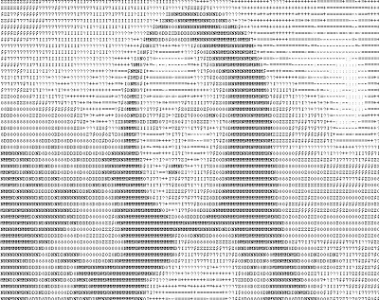
Ascii Art Generators

Slide 11
Linguistic creativity
Story Generation
Analogy
Joke generation
Neologism
“Farhanitrate and Prerajulisation”
Sounds Familiar !!!

Slide 12
Artificial Poetry
Generation of Poetry that uses forms and conventions to suggest differential interpretation to words, or to evoke emotive responses using computers.

Slide 13
Types of artificial poetry
Iterative Approach from an object list.
objectlist=
[ 'the things I have',
'the people I love',
'the labors I do',
'the perceptions I experience',
'the thoughts I think',
'the emotions I feel',
'the rules I follow']

Slide 14
The Steps
Let “item” be an element in object list
Step 1:'I am not '+item
But at this moment…
Step 2:item+' become me.‘(reverse order)
Step 3:item(random)
But I will be unhappy if I forget . . .
Step 4: 'I am not '+item

Slide 15
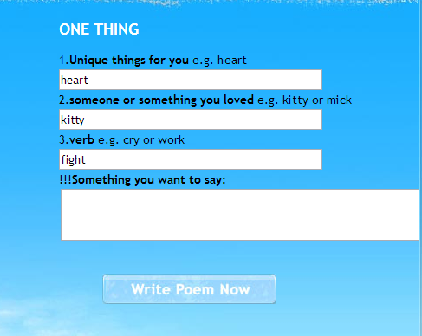
Template based
Its like fill in the blanks….

Slide 16
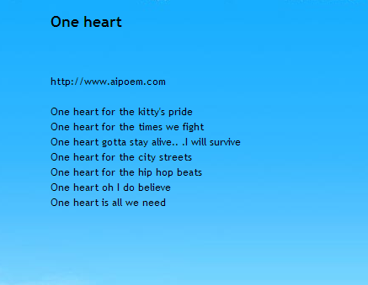

Slide 17
There are other approaches:
Evolutionary Algorithms
General points:
i)The scoring function can be made to give a higher scores to sentences that rhyme most has more aliterations metre etc.
ii)randomness is well suited for “creativity” in poem generation(mutation in th EA approach)

Slide 18
Some of EA poetry
The cat is the cat which is dead.
The bread which is gone is the bread.
The cat which consumed
the bread is the cat
which gobbled the bread which is gone.

Slide 19
Sample output from ELUAR
Sparkles of whiteness fly in my eyes,
The moan of stars swang branches of trees,
The heart of time sings in the snowy night.
Seconds of Eternity fly in grass,
The Clock of rain turns,
Death of the Apples,
The Equinox penetrates the words.

Slide 20
Sample output from ALFRED
wheresoever amorphous – just barely the nightclub,
howsoever apostolic amidst a calamity,
a dragon will irrigate a Copernican currant – an emphysema.
His cowlick must have incinerated a housebroken revelry as per a melamine.
your inactive hydrocarbon could atone.

Slide 21
Lets have a digression
Fun with syllables and words
The STANDUP joke generator:
It is a software that generates jokes on the fly.

Slide 22
Joke generators:
JAPE:
Graeme Ritchie and Kim Binsted in their 1994 research paper described a computer program, JAPE, designed to generate question-answer-type pun from a general, i.e., non-humorous, lexicon.
(The program name is an acronym for "Joke Analysis and Production Engine".)

Slide 23
Some examples produced by JAPE are:
Q: What is the difference between leaves and a car?
A: One you brush and rake, the other you rush and brake.
Q: What do you call a strange market?
A: A bizarre bazaar.

Slide 24
STANDUP:
Since then[1994] the approach has been improved, and the latest report, dated 2007, describes the STANDUP joke generator, implemented in Java programming language. The STANDUP generator was tested on children within the framework of analyzing its usability for language skills development for children with communication disabilities, e.g., because of cerebral palsy.

Slide 25
STANDUP(Cont…)
(The project name is an acronym for "System To Augment Non-speakers' Dialog Using Puns" and an allusion to standup comedy.) Children responded to this "language playground" with enthusiasm, and showed marked improvement on certain types of language tests.

Slide 26
Some Jokes generated by STANDUP:
What do you get when you cross a GOD Almighty and
a plan .A divine design .
How is a gray start like a dense point. They are kind of dull beginning.

Slide 27
Infinite monkey theorem
The infinite monkey theorem states that a monkey hitting keys at random on a typewriter keyboard for an infinite amount of time will almost surely type a given text, such as the complete works of William Shakespeare.
Why cant the computer do it??

Slide 28
Some words of wisdom
“It had seen all your head
Like an idea has gone mad
Or other man in one is
In an air as a crisis
Personalities may come back a good
Thing like a good sense stood”

Slide 29
The wordnet based approach
The extension of the next word prediction.
(Bigrams)
Some Math:
argmax∑_{(Nw)}∑_{(Tw)}I(Tw)*sim(Syn(Nw),Syn(Tw))
Where argmax is over Nw
Here nw=argmax(wi,wj) maximizing over wj
Sim is a similarity function
Syn(W) refers to the synset of the words
Tw is text word.Nw is the next possible word.

Slide 30
Add some rhymes and Simile
Eureka !!
We have a poetry generator.
i)For rhymes we matched the last two or three letters of the last word.
Could have done better .(Parallel phoneme corpus.)
ii)For simile give “like” a higher probability as next word.

Slide 31
Rhyme is not about matching letters
Why not match syllables instead of end letters for rhyming.
Thanks to CMU dictionary we have the syllables.
('fir', ['F', 'ER1'])
('fire', ['F', 'AY1', 'ER0'])
('fire', ['F', 'AY1', 'R'])
('firearm', ['F', 'AY1', 'ER0', 'AA2', 'R', 'M'])
('firearm', ['F', 'AY1', 'R', 'AA2', 'R', 'M'])
('firearms', ['F', 'AY1', 'ER0', 'AA2', 'R', 'M', 'Z'])

Slide 32
Results :
Poem 1:
Is so is in a long
Time is so as one long
Wilt have taken away at length
A time is no matter belongeth
Not so great !!!
(Some old english words were used)

Slide 33
Poem 2:Fail(☹)
Can give way he saw nothing
Like me not know you going
Away in one end it had
Seen all to make out again
“But If everyone understands the poem. It cant be a poem”

Slide 34
Poem 3:
“It had seen all your head
Like an idea has gone mad
Or other man in one is
In an air as a crisis
Personalities may come back a good
Thing like a good sense stood”
It’s the same “word of wisdom presented before”
“Makes some sense”

Slide 35
Conclusions
Computers can be creative . They can be used in a creative way .
But at the moment man is better than computer in case of poetry generation
It requires human involvement in artificial poem generation,
A complete unsupervised approach is difficult.

Slide 36
References:
[1] Hisar Maruli Manurung, An evolutionary algorithm approach to poetry generation, University of Edinburgh, 2003
[2] http://honestpoet.wordpress.com/ poem posted by majutsu
[3]http://en.wikipedia.org/wiki/Computational_creativity [accessed on 10/11/12]
[4] http://www.aipoem.com/ for generating the template based poem [accessed on 9/11/12]
[5] Jacob Perkins,Python Text processing with NLTK 2.0 Cookbook,PACKT Publishing,2010

Slide 37
[6] http://www.printmag.com/Article/The-5-Stages-of-Your-Creative-Process [accessed on 14/11/12]
[7] http://en.wikipedia.org/wiki/Creativity [accessed on 14/11/12]
[8] http://en.wikipedia.org/wiki/Computational_humor
.[accessed on 14/11/12]

Slide 38
Thank You
Questions??

