Slide 1
ADMM and DSO

Slide 2
Pre-requisites for ADMM
Dual Ascent
Dual decomposition
Augmented Lagrangian

Slide 3
Dual Ascent
Constraint convex optimization of the form:
Lagrangian:
Dual function:
Issue:
Slow convergence
No distributedness.
Notes:
Q: Why dual ascent is slow?

Slide 4
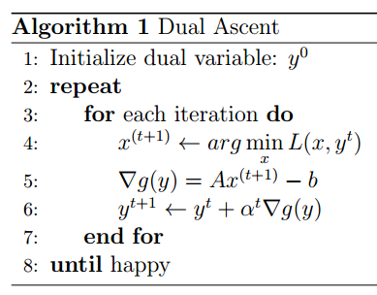

Slide 5
Dual decomposition
Same constraint convex optimization problem but separable.
Lagrangian:
Parallelization is possible.
Issue:
Still slow convergence.
Notes:
If we map to machine learning algorithm then, its clear that dual decomposition actually does feature splitting.
A_i x_i = column space of A(remember). If someone argues why for “Y” update we need to gather, then ans is : actually not for “Y” we are gathering, Here in this L(x,y) we need y^T A_i x_i . So we need to supply Y to all nodes.

Slide 6
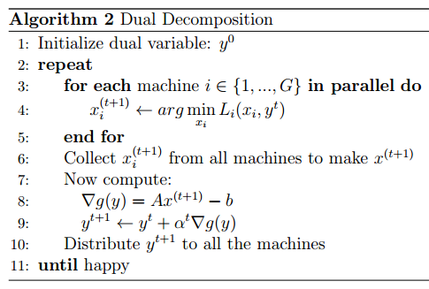
xi updates of t+1 iteration are send to a central hub which calculates y(t+1) and then again propagates it to different machines.

Slide 7
Augmented Lagrangian method
Constraint convex optimization : Updated objective function
So the Lagrangian would look like:
Updates would look like:
Issue:
Due to this new term we lost decomposability but improved convergence.

Slide 8
ADMM (Alternating Direction Method of multipliers)
Standard ADMM
Scaled ADMM

Slide 9
Standard ADMM
Constraint convex optimization :
Augmented Lagrangian:
AL updates would be like:
Notes:
Because of the updates in alternating fashion of x and z, it is called as ADMM. “f” and “g” should be closed , proper , real-valued convex functions. Saddle point should exist and strong duality should hold.

Slide 10
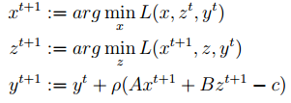
Standard ADMM
Blend of dual decomposition and augmented Lagrangian method(AL).
ADMM updates would be:
Notes:
Because of the updates in alternating fashion of x and z, it is called as ADMM. “f” and “g” should be closed , proper , real-valued convex functions. Saddle point should exist and strong duality should hold.

Slide 11
Scaled ADMM
Scale the dual variable: u=y/ρ
The standard ADMM updates would look like:
The formulas are shorter in this version.
This version is widely used.

Slide 12
Least square problem
Consider the method of least-square where we minimize the sum of square of errors for regression purpose:
For standard ADMM to work, we will reformulate the problem as:

Slide 13
DSO (Distributed Stochastic Optimization)

Slide 14
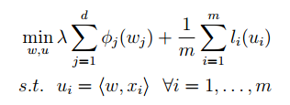
Regularized Risk Minimization
RRM :
Introducing constraints:
Notes:
Here at this stage we can apply ADMM too, but let’s go for SGD formulation.

Slide 15
Lagrangian
Lagrangian:
Fenchel-Legendre conjugate :
Lagrangian can be rewritten as:

Slide 16
DSO
Again rewriting the previous equation but only for non-zero features.
Now applying stochastic gradient descent for w and ascent for α :
Note that we can parallelize this stochastic optimization algorithm.

Slide 17
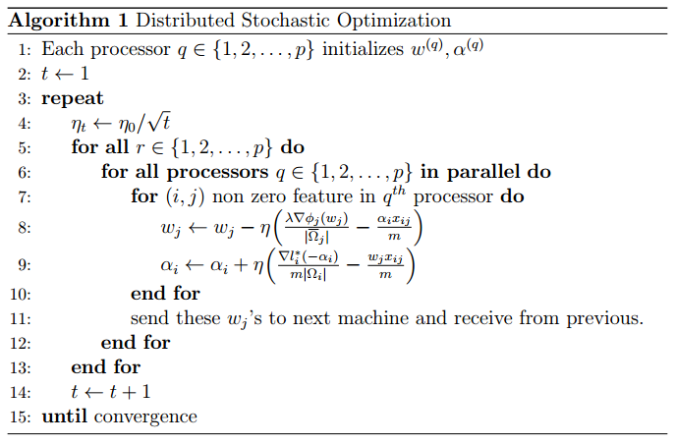

Slide 18
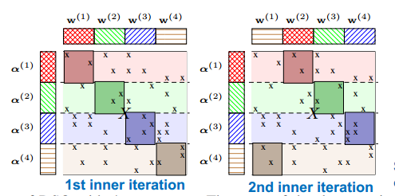
Working of DSO

Slide 19
Thank-you ☺

