Slide 1
Foundations of Machine Learning (CS725)
Autumn 2011
Instructor: Prof. Ganesh Ramakrishnan
TAs: Ajay Nagesh, Amrita Saha, Kedharnath Narahari

Slide 2
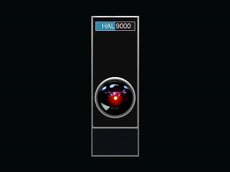
The grand goal
From the movie 2001: A Space Odyssey (1968)

Slide 3
Outline
Introduction to Machine Learning
  What is machine learning?
  Why machine learning
  How machine learning relates to other fields
Real world applications
Machine Learning : Models and methods
  Supervised
  Unsupervised
  Semi-supervised
  Active learning
Course Information
  Tools and software
  Pre-requisites

Slide 4
Introduction to
Machine Learning

Slide 5
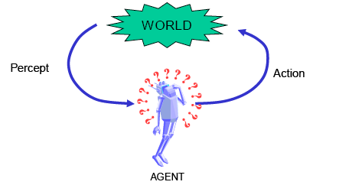
Intelligence
Ability for abstract thought, understanding, communication, reasoning, planning, emotional intelligence, problem solving, learning
The ability to learn and/or adapt is generally considered a hallmark of intelligence

Slide 6
Learning and Machine Learning
``Learning denotes changes in the system that are adaptive in the sense that they enable the system to do the task(s) drawn from the same population more efficiently and more effectively the next time.''--Herbert Simon
Machine Learning is concerned with the development of algorithms and techniques that allow computers to learn.

Slide 7
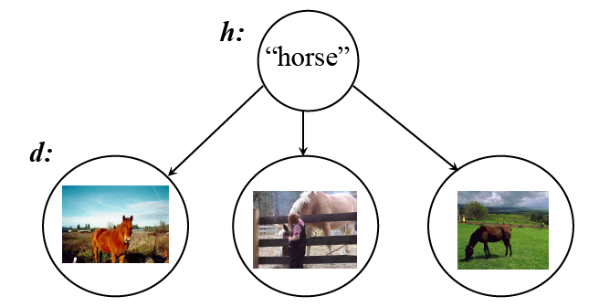
Machine Learning
“Machine learning studies the process of constructing abstractions (features, concepts, functions, relations and ways of acting) automatically from data.”

Slide 8
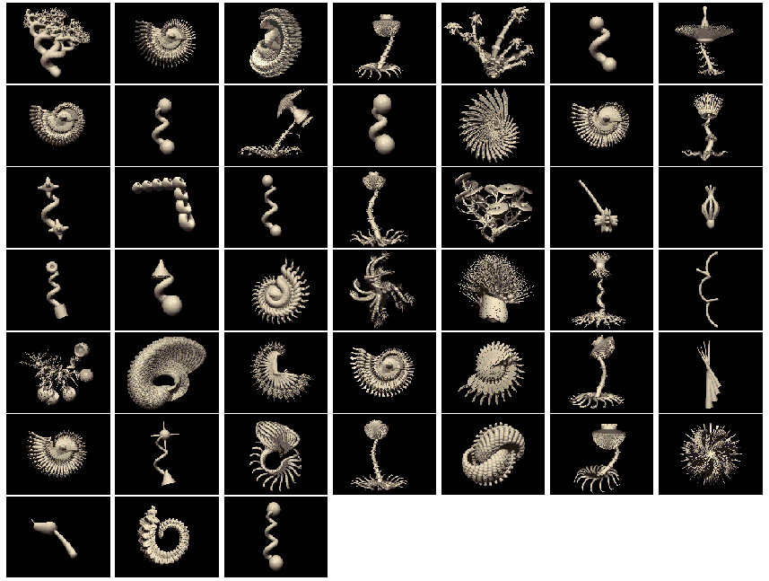
E.g.: Learning concepts and words
“tufa”
“tufa”
“tufa”
Can you pick out the tufas?
Source: Josh Tenenbaum

Slide 9
Why Machine Learning ?
Human expertise does not exist (e.g. Martian exploration)
Humans cannot explain their expertise or reduce it to a rule set, or their explanation is incomplete and needs tuning (e.g. speech recognition)
Situation changing in time (e.g. spam/junk email)
Humans are expensive to train up (e.g. zipcode recognition)
There are large amounts of data (e.g. discover astronomical objects)

Slide 10
Applications of
Machine Learning

Slide 11
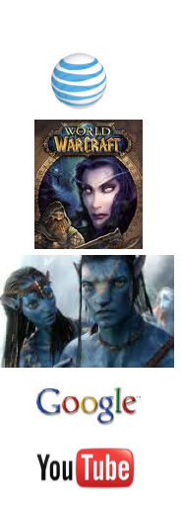
Data Data Everywhere …
Library of Congress text database of ~20 TB
AT&T 323 TB, 1.9 trillion phone call records.
World of Warcraft utilizes 1.3 PB of storage to maintain its game.
Avatar movie reported to have taken over 1 PB of local storage at WetaDigital for the rendering of the 3D CGI effects.
Google processes ~24 PB of data per day.
YouTube: 24 hours of video uploaded every minute. More video is uploaded in 60 days than all 3 major US networks created in 60 years. According to Cisco, internet video will generate over 18 EB of traffic per month in 2013.

Slide 12
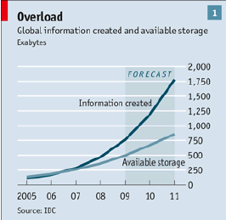
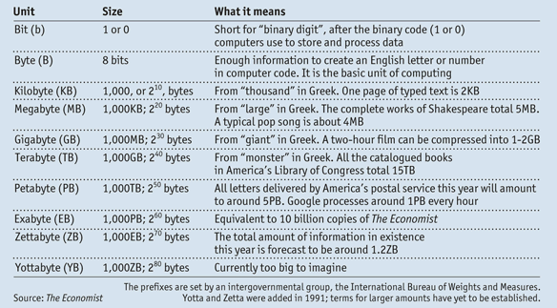
Information Overload

Slide 13

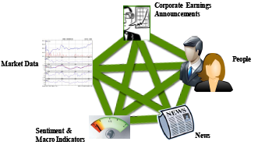


Machine Learning to the rescue
Machine Learning is one of the front-line technologies to handle Information Overload
Business
  Mining correlations, trends, spatio-temporal predictions.
  Efficient supply chain management.
  Opinion mining and sentiment analysis.
  Recommender systems.

Slide 14
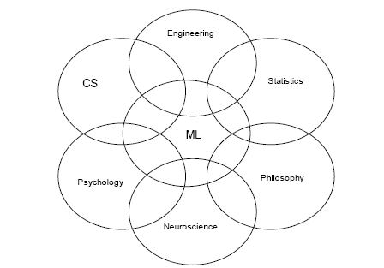
Fields related to Machine Learning

Slide 15
Fields related to Machine Learning
Artificial Intelligence: computational intelligence
Data Mining: searching through large volumes of data
Neural Networks: neural/brain inspired methods
Signal Processing: signals, video, speech, image
Pattern Recognition: labeling data
Robotics: building autonomous robots

Slide 16
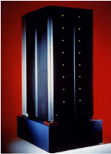
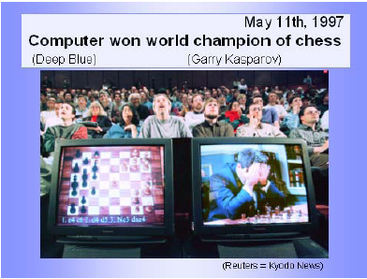

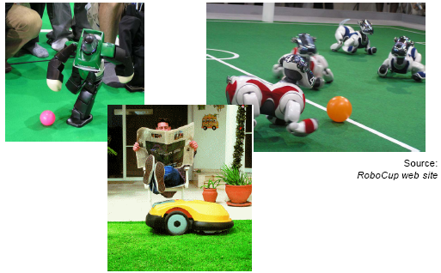
Application of Machine Learning
Deep Blue
and the chess
Challenge
RoboCup
Online Poker

Slide 17
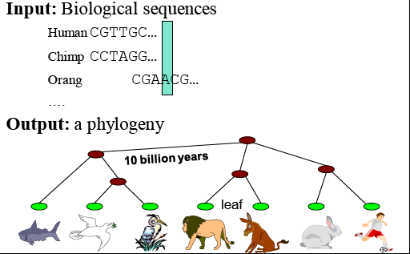
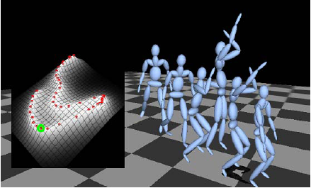
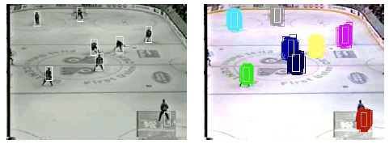
Application of Machine Learning
Computation Biology (Structure learning)
Animation and Control
Tracking and activity recognition

Slide 18
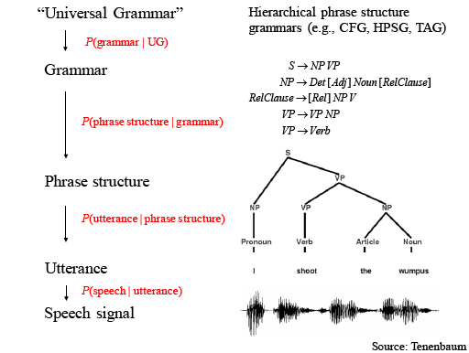
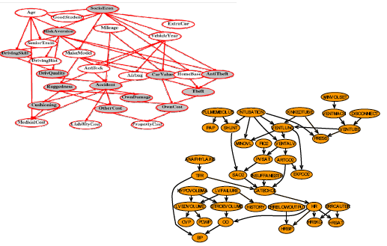
Application of Machine Learning
Application in speech and Natural Language processing
Probabilistic Context Free Grammars
Graphical Models
Social network graph analysis, causality analysis

Slide 19
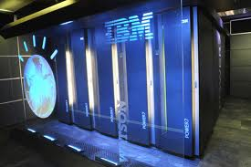
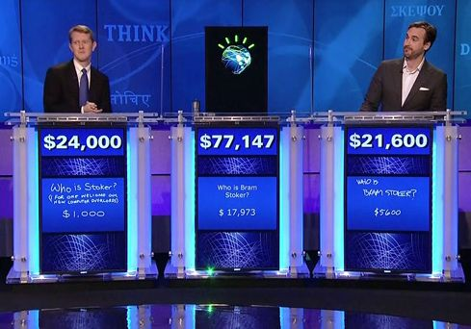
Deep Q and A: IBM Watson
Deep Question and Answering : Jeopardy challenge
Watson emerged winner when pitted against all time best rated players in the history of Jeopardy
Source: IBM Research

Slide 20
Machine Learning
Models and Methods

Slide 21
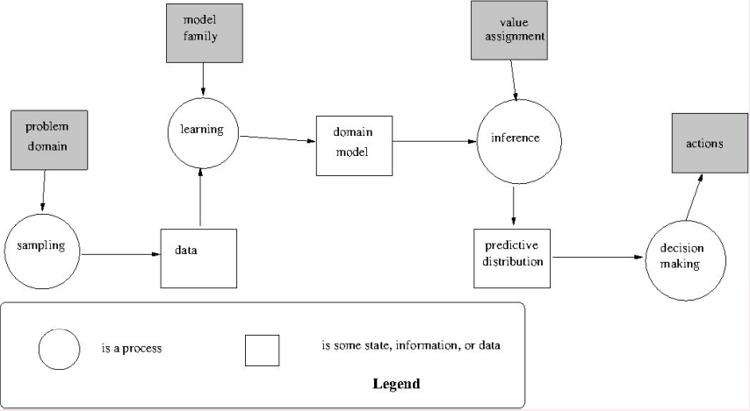
Machine Learning Process
How to do the learning actually?

Slide 22
Learning (Formally)
Task
  To apply some machine learning method to the data obtained from a given domain (Training Data)
  The domain has some characteristics, which we are trying to learn (Model)
Objective
  To minimise the error in prediction
Types of Learning
  Supervised Learning
  Unsupervised Learning
  Semi-Supervised Learning
  Active Learning

Slide 23
Supervised Learning
Classification / Regression problem
Where some samples of data (Training data) with the correct class labels are provided.
  i.e. Some correspondence between input (X) & output (Y) given
Using knowledge from training data, the classifier/ regressor model is learnt
  i.e. Learn some function f : f(X) = Y
f may be probabilistic/deterministic
Learning the model ≡ Fitting the parameters of model to minimise prediction error
Model can then be tested on test-data

Slide 24
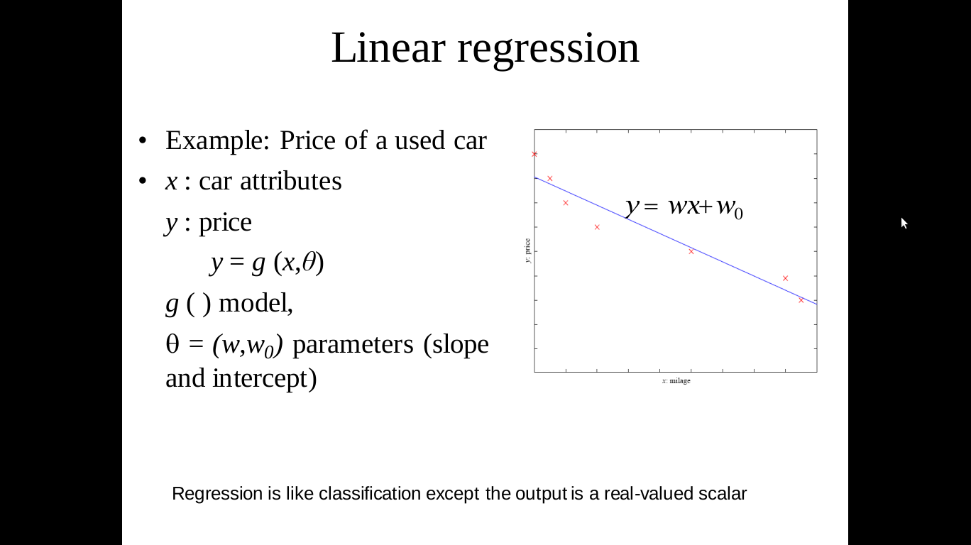
Regression
Linear regression
Uses
    Stock Prediction
    Outlier detection

Slide 25
Regression

Slide 26
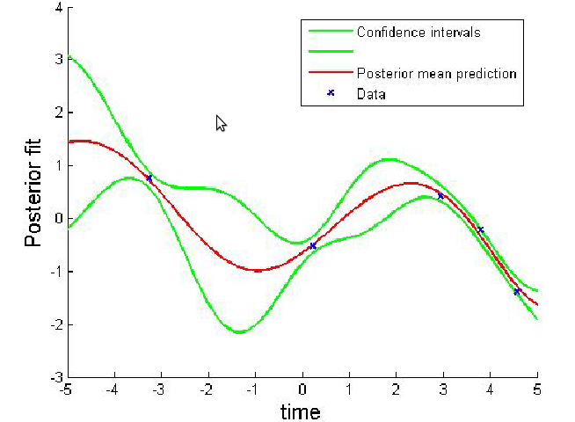
Regression
Non Linear regression

Slide 27
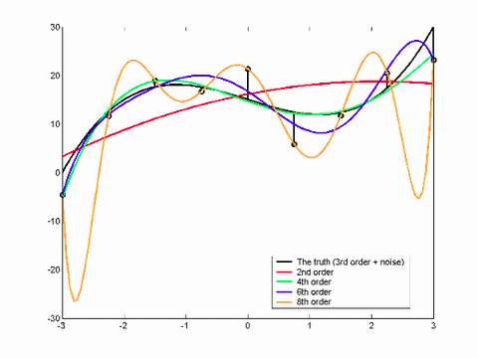
All models are not good
Constrain the parameters

Slide 28
Classification

Slide 29
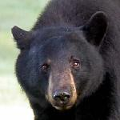
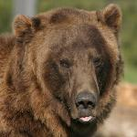
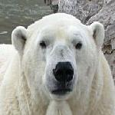
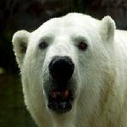
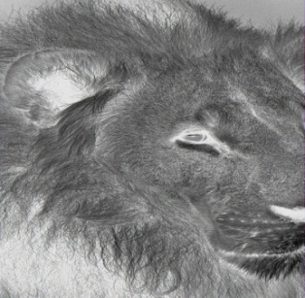

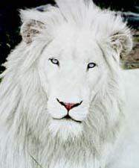
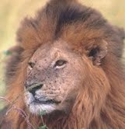
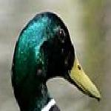


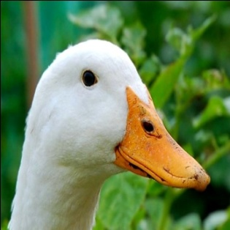
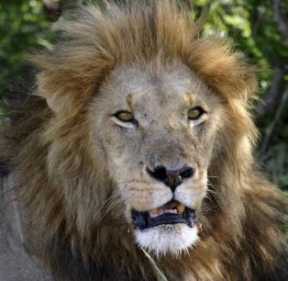
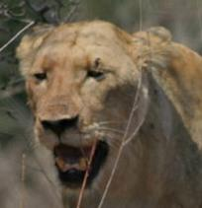
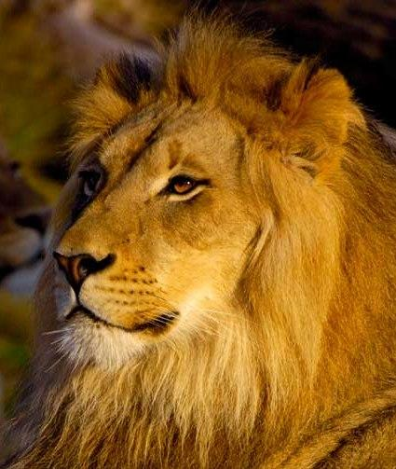
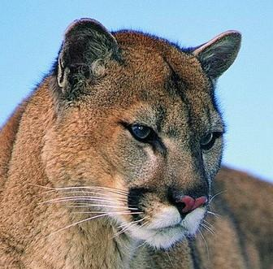
Supervised Classification example
f1
f2
f3
f4
Class label
d1
BearHead
???
d2
DuckHead
d3
LionHead
Source: LHI Animal Faces Dataset

Slide 30
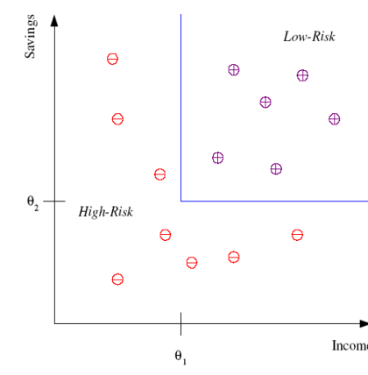
Classification
Example:
  Credit Scoring
Goal:
  Differentiating between high-risk and low-risk customers based on their income and savings
Discriminant:
  IF income > θ₁ AND savings > θ₂ THEN low-risk ELSE high-risk
Discriminant is called 'hypothesis'
Input attribute space is called 'Feature Space'
Here Input data is 2-dimensional and the output is binary

Slide 31
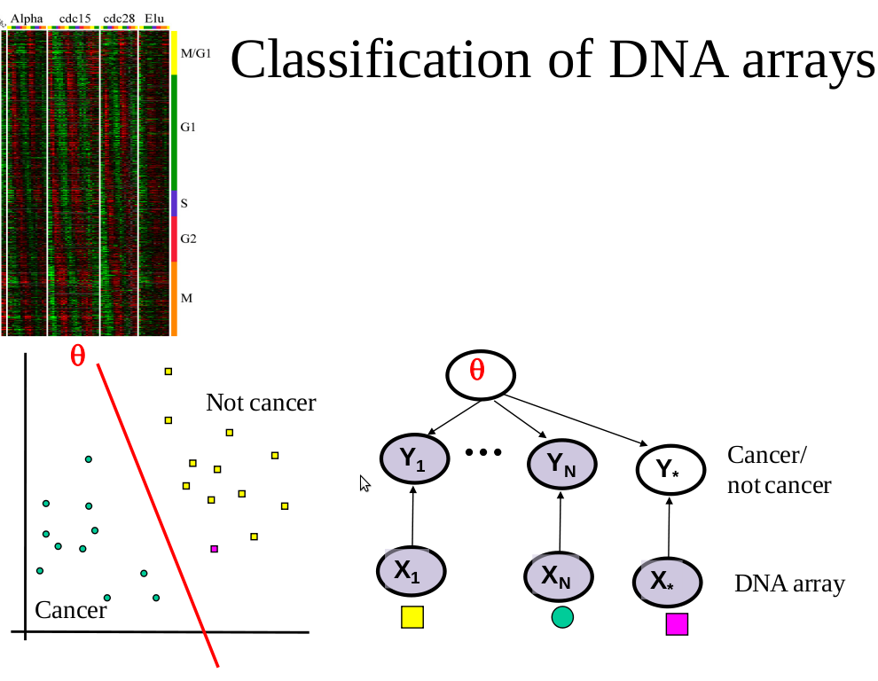
Other applications

Slide 32
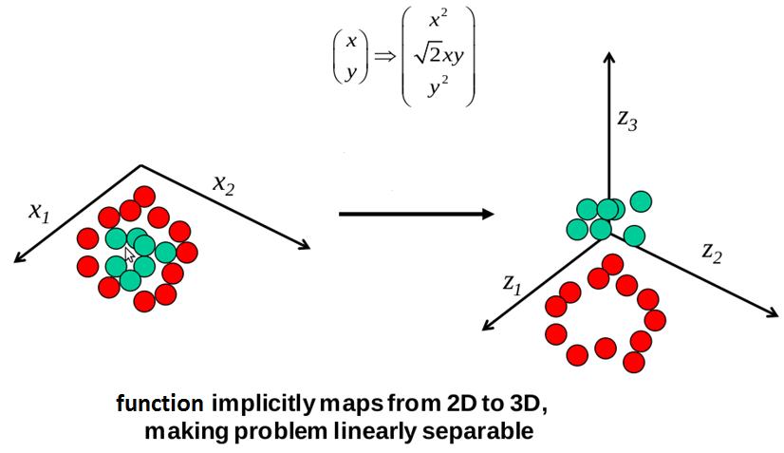
Building non-linear classifiers
Curse of dimensionality

Slide 33
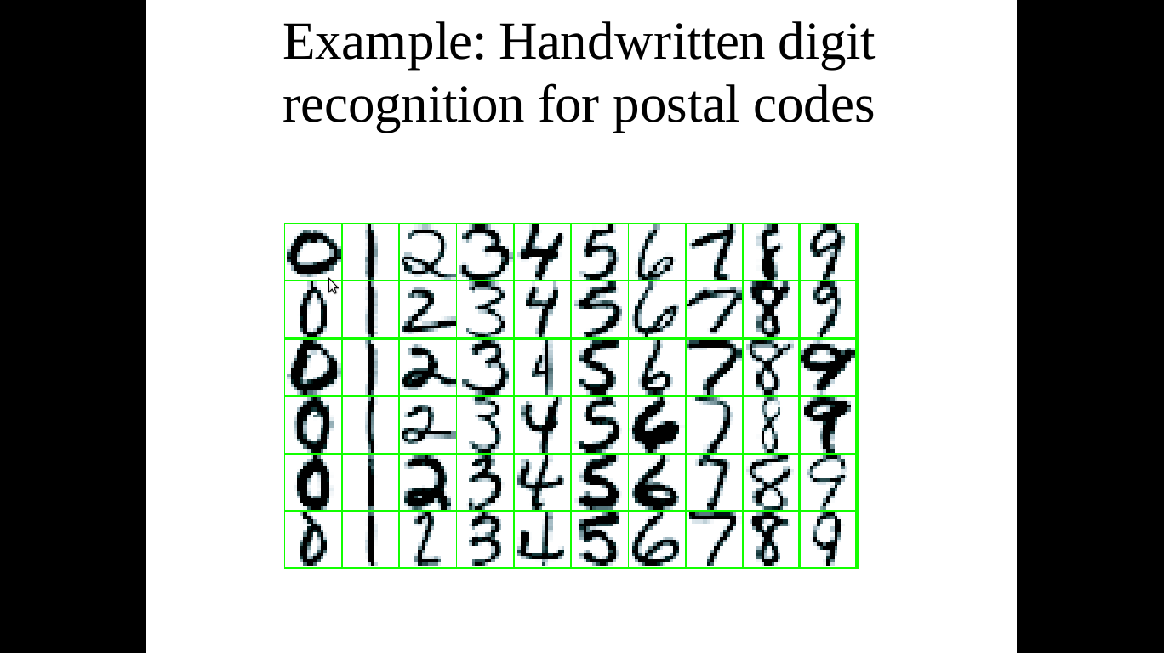
Application

Slide 34
What is the right hypothesis?

Slide 35
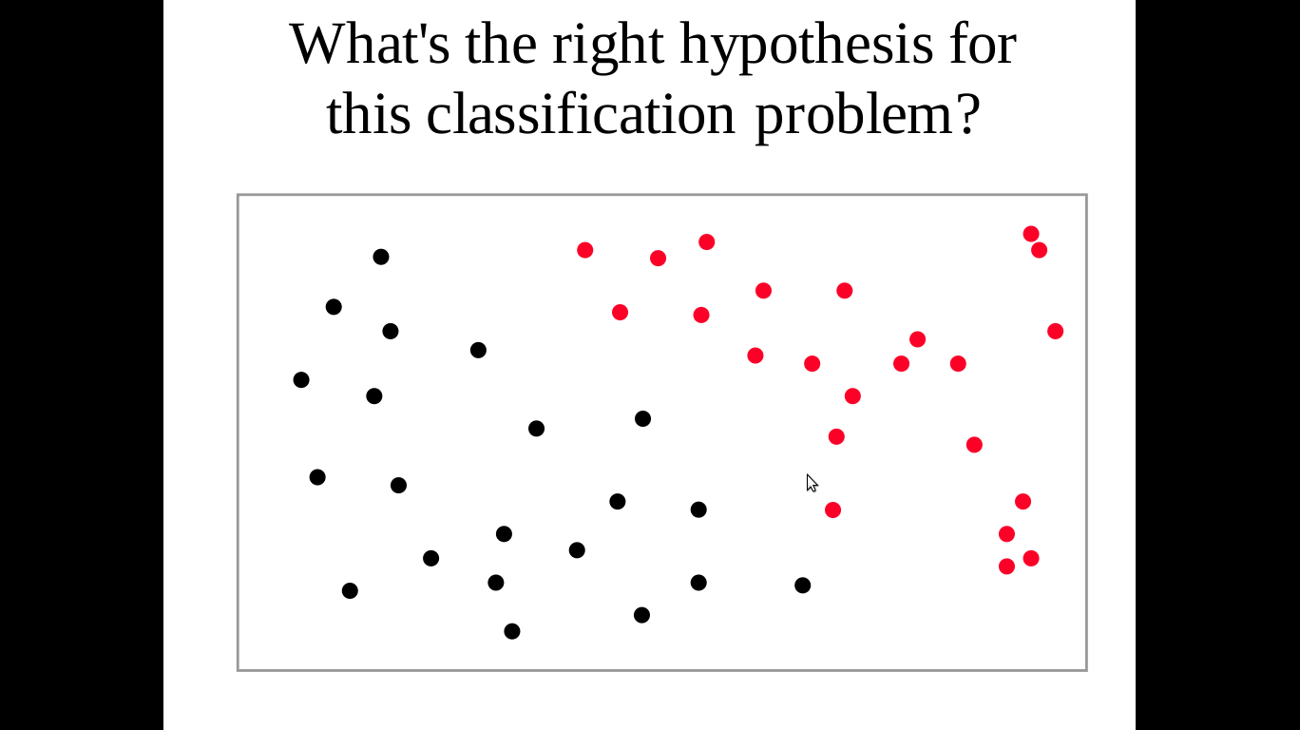
What is the right hypothesis for this classification problem

Slide 36
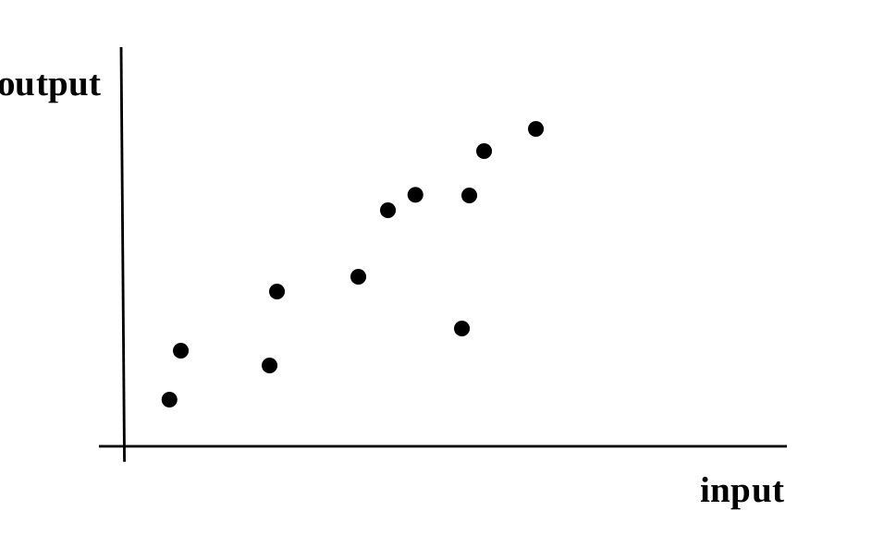
What is the right hypothesis for this regression problem

Slide 37
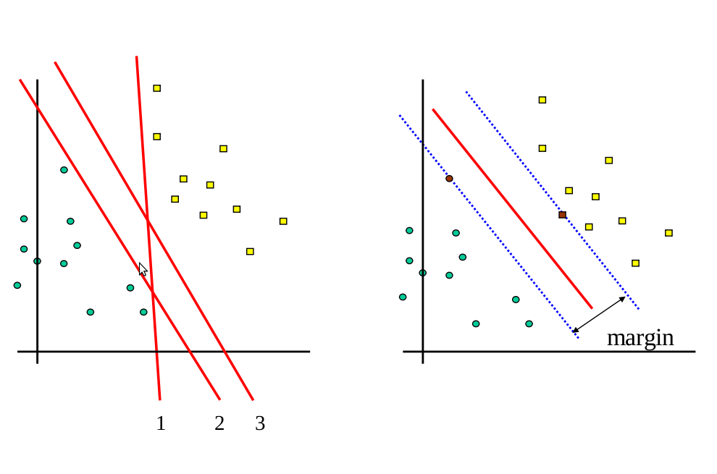
Which linear hypothesis is better
Max – Margin Classifier

Slide 38
Other considerations
Feature extraction: which are the good features that characterise the data
Model selection: picking the right model using some scoring/fitting function:
  It is important not only to provide a good predictor, but also to assess accurately how “good” the model is on unseen test data
  So a good performance estimator is needed to rank the model
Model averaging: Instead of picking a single model, it might be better to do a weighted average over the best-fit models

Slide 39
Which hypothesis is better?
Unless you know something about the distribution of problems your learning algorithm will encounter, any hypothesis that agrees with all your data is as good as any other.
You have to make assumptions about the underlying features.
Hence learning is inductive, not deductive.

Slide 40
Unsupervised Learning
Labels may be too expensive to generate or may be completely unknown
There is lots of training data but with no class labels assigned to it

Slide 41
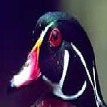

???
Source: LHI Animal Faces Dataset

Slide 42
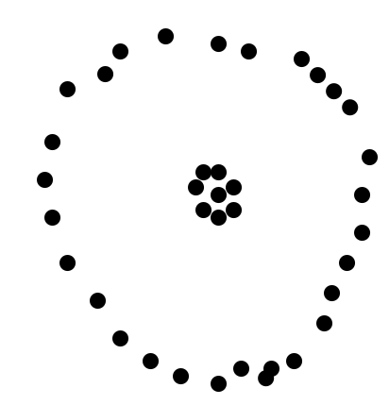
Unsupervised Learning
For example clustering
Clustering –
  grouping similar objects
Similar in which way?

Slide 43
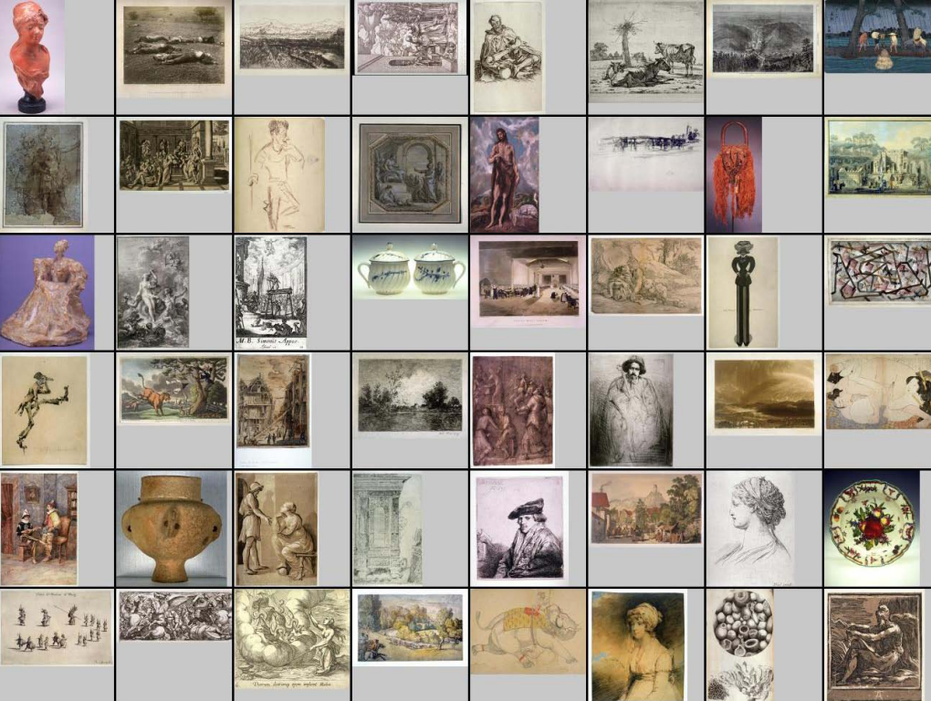
Clustering

Slide 44
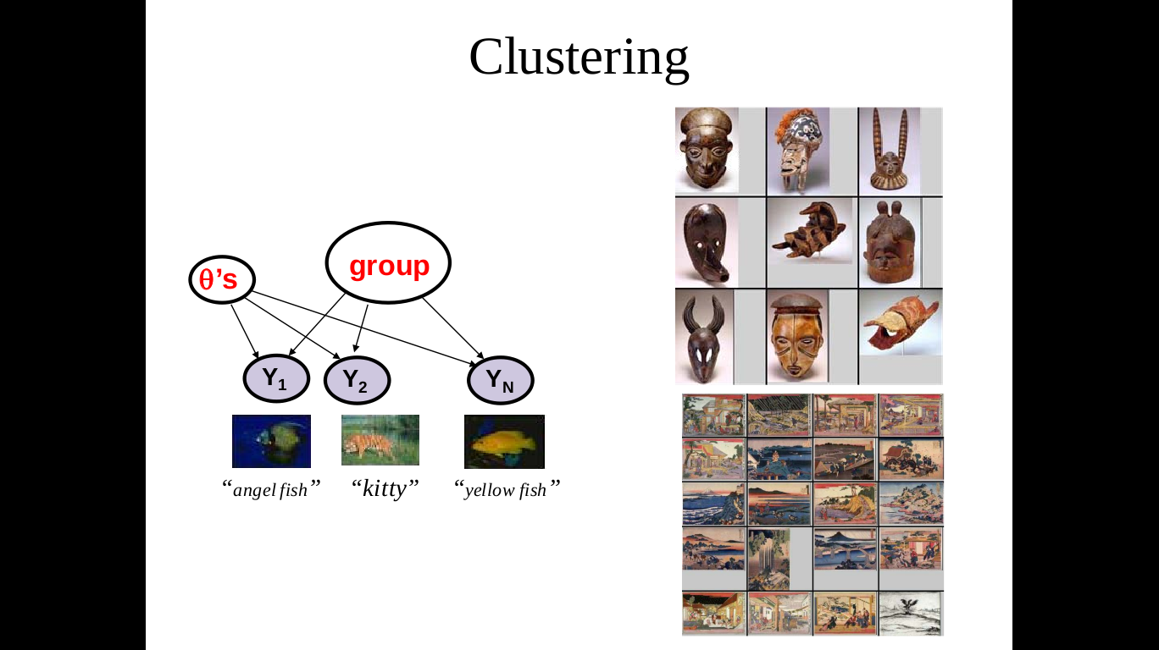

Slide 45
Clustering Problems
How to tell which type of clustering is desirable?

Slide 46
Semi-Supervised Learning
Supervised learning + Additional unlabeled data
Unsupervised learning + Additional labeled data
Learning Algorithm:
  Start from the labeled data to build an initial classifier
  Use the unlabeled data to enhance the model
Some Techniques:
  Co-Training: two or more learners can be trained using an independent set of different features
  Or to model joint probability distribution of the features and labels

Slide 47
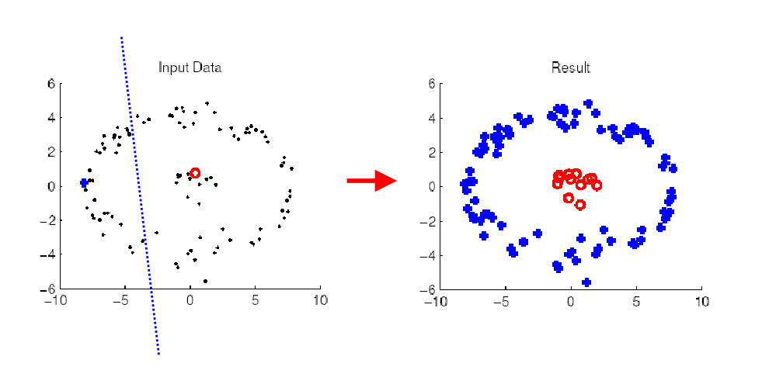
Example
ideally...

Slide 48
Active Learning
Unlabeled data is easy to obtain; but labels may be very expensive
For e.g. Speech recognizer
Active Learning
  Initially all data labels are hidden
  There is some charge for revealing every label
Active Learner will interactively query the user for labels
By intelligent querying, a lot less number of labels will be required than in usual supervised training
But a bad algorithm might focus on unimportant or invalid examples

Slide 49
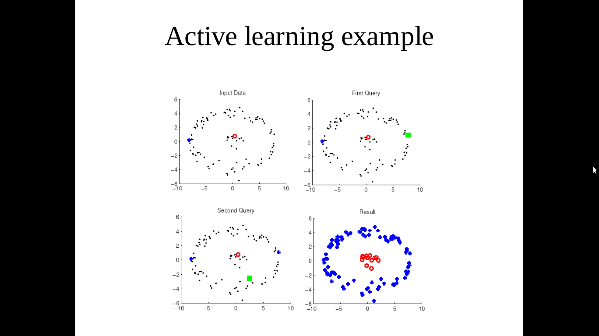
Active Learning: Example
Ideally,

Slide 50
Active Learning: Example
Suppose data lies on a real line and the classifier discriminant looks like
  H= {h_{w}}: h_{w}(x) = 1 if x > w, 0 otherwise
Theoretically we can prove that if the actual data distribution P can be classified using some hypothesis h_{w} in H
  Then to get a classifier with error 'e', we just need O(1/e) random labeled samples from P
Now labels are sequences of 0s and 1s
Goal is to discover the pt 'w' where transition occurs
Find that using binary search
So only log (1/e) samples queried
Exponential improvement in terms of number of samples required

Slide 51
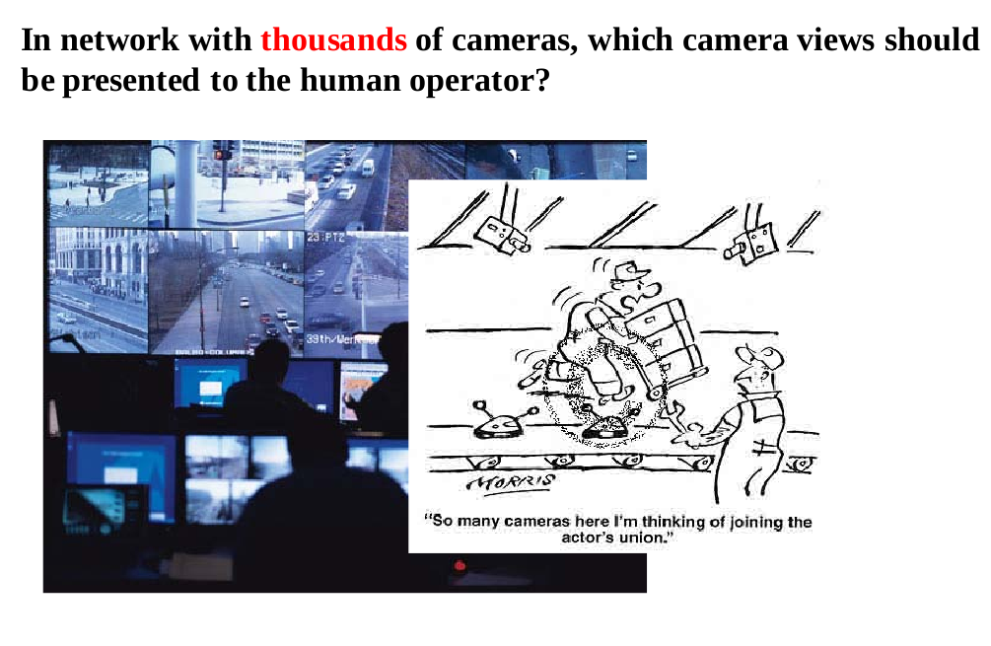
Active Learning and survelliance

Slide 52

Active Learning and sensor networks

Slide 53
How learning happens
Human | Machine
Memorize | k-Nearest Neighbours, Case/Example-based learning
Observe someone else, then repeat | Supervised Learning, Learning by Demonstration
Keep trying until it works (riding a bike) | Reinforcement Learning
20 Questions | Active Learning
Pattern matching (faces, voices, languages) | Pattern Recognition
Guess that current trend will continue (stock market, real estate prices) | Regression

Slide 54
Course Information

Slide 55
Tools and Resources
Weka: http://www.cs.waikato.ac.nz/ml/weka
Scilab: http://www.scilab.org/
R-software: http://www.r-project.org/
RapidMiner: http://rapid-i.com/content/view/181/190/
Orange: http://orange.biolab.si/
KNIME: http://www.knime.org/
SVM Light: http://svmlight.joachims.org
ShogunToolbox: http://www.shogun-toolbox.org/
Elefant: http://elefant.developer.nicta.com.au
Google prediction API: http://code.google.com/apis/predict/

Slide 56
Course Info
Pre-requisites for course
  Probability & Statistics
  Basics of convex optimization
  Basics of linear algebra
Online Materials
  Online class-notes : http://www.cse.iitb.ac.in/~cs725/notes/classNotes/
    Username: cs717
    Password: cs717_student
  Andrew Ng. Notes http://www.stanford.edu/class/cs229/materials.html and video lecture series http://videolectures.net/andrew_ng/
Main Text Book: Pattern Recognition and Machine Learning – Christopher Bishop
Reference: Hastie, Tibshirani, Friedman The elements of Statistical Learning Springer Verlag

