Slide 1
Deep Learning and Optimization,
With Applications to Speech Recognition
Tara N. Sainath
June 15, 2015

Slide 2
Acknowledgements
Google
  Michiel Bacchiani
  Hasim Sak
  Andrew Senior
IBM
  Brian Kingsbury
  George Saon
Microsoft
  Li Deng
  Frank Seide
  Dong Yu
Notes:
Need some more slides on why we care about this architecture

Slide 3
Outline
Why Neural Networks
Training Neural Networks
Making Neural Networks Work for Speech Recognition
Optimization challenges: Training time
Optimization challenges: New architectures

Slide 4
Pattern Recognition System
The goal of any pattern recognition system is to
  determine an appropriate feature representation
  classify these features effectively
“bat”
Feature
Extractor
Classifier

Slide 5
Example from Speech Recognition
For example, in speech recognition, we first create features by hand
Then we build a discriminative classifier (Gaussian Mixture Model) to distinguish between classes
Features are not directly designed for classification objective
“bat”
Classifier
Feature
Extractor

Slide 6
End-to-End Recognition System
Black box which takes simple features + labels does the feature extraction jointly with the classification
Features are trained to the classification objective
Big non-linear system trained to map from simple features to labels
“bat”
Classifier
Feature
Extractor

Slide 7
Intuition Behind Deep Neural Networks
Each block produces a higher level feature representation and better classifier than its input
By combining simple building blocks, we can design more and more complex, non-linear systems
“bat”
Reduce signal
variance
Class discrimination
characteristics
Notes:
We want to see that early layers capture generalized concepts about the input
(for example in imagse, detecting edges), or in speech mapping speech from different speakers from the same space into a canonical space and remove invariance in the input signal. This is exactly how humans process speech

Slide 8
Representation at Each Stage
Within each building block, we want the following properties:
  Create a higher level representation of input
  Better separate input into classes
  Can be combined with previous layers
  Can be trained jointly with other layers
Using a mathematical model of a biological neuron is an appropriate choice

Slide 9
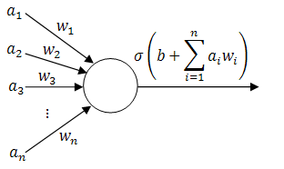
Neurons
A neuron takes a weighted sum of inputs a and feeds the result through an activation function σ
Output of the activation function produces decision boundary which can be used in classification

Slide 10
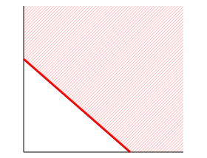
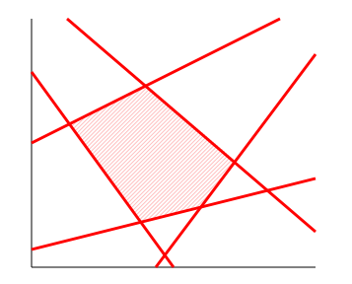
Combining Neurons
Each neuron splits the feature space with a hyperplane
1-layer of trainable weights cannot handle XOR
2-layers of trainable weights gives a convex polygon region

Slide 11
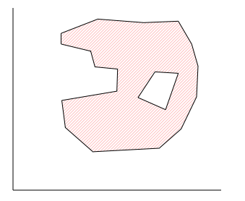
Combining Neurons
3 layers of trainable weights gives a composition of polygons: convex regions
More layers can handle more complicated spaces – but require more parameters

Slide 12
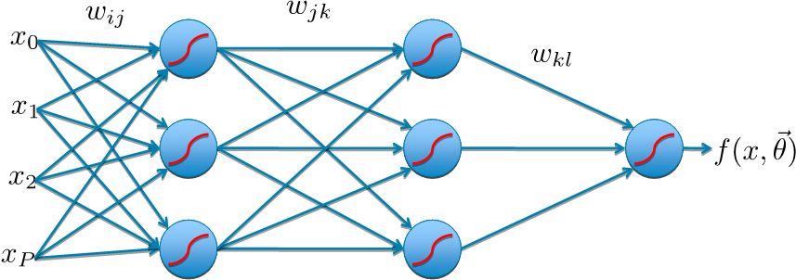
Multi-Layer Neural Network
Each simple building block is a connection of neurons which produces a higher-order, more complex representation of the input
Neurons in one layer are connected to neurons in the next layer
“bat”

Slide 13
Outline
Why Neural Networks
Training Neural Networks
Making Neural Networks Work for Speech Recognition
Optimization challenges: Training time
Optimization challenges: New architectures

Slide 14
Training Neural Networks
Most common approach to train neural networks is via stochastic gradient descent
  Propagate input forward
  Compute gradient of objective function
  Propagate error gradient backwards

Slide 15
Feed-Forward Networks
Predictions are fed forward through the network to classify

Slide 16
Feed-Forward Networks
Predictions are fed forward through the network to classify

Slide 17
Feed-Forward Networks
Predictions are fed forward through the network to classify

Slide 18
Feed-Forward Networks
Predictions are fed forward through the network to classify

Slide 19
Feed-Forward Networks
Predictions are fed forward through the network to classify

Slide 20
Feed-Forward Networks
Predictions are fed forward through the network to classify
f(x,θ)

Slide 21
Define Objective Function
Error
ref=y
For regression problems, sum-of-squared error is used
For classification problems, cross-entropy is used

Slide 22
Error Backpropagation
Introduce variables over the neural network
Notes:
\vec{\theta}=\{w_{ij}, w_{jk}, w_{kl}\}

Slide 23
Error Backpropagation
Introduce variables over the neural network
  Define a to be the input of each non-linearity
  Define z to be the output of each non-linearity
Notes:
\vec{\theta}=\{w_{ij}, w_{jk}, w_{kl}\}

Slide 24
Error Backpropagation
Notes:
\vec{\theta}=\{w_{ij}, w_{jk}, w_{kl}\}

Slide 25
Error Backpropagation
Training: Take the gradient of the last component and iterate backwards
Notes:
\vec{\theta}=\{w_{ij}, w_{jk}, w_{kl}\}

Slide 26
Error Backpropagation
Empirical Risk Function
n is number of training points
Composition of weights + nonlinearity
creates a nonconvex objective function

Slide 27
Error Backpropagation
Compute the gradient with respect to objective function and propagate the gradient backwards to update each layer
Stochastic Gradient Descent (SGD) is the most popular optimization strategy
Notes:
\frac{\partial R}{\partial w_{jk}}=\frac{1}{N}\sum_n\left[\sum_l\delta_l w_{kl}g'(a_{k,n})\right]\left[z_{j,n}\right]\\

Slide 28
Outline
Why Neural Networks
Training Neural Networks
Making Neural Networks Work for Speech Recognition
Optimization challenges: Training time
Optimization challenges: New architectures

Slide 29
Acoustic Modeling for Speech Recognition
Speech recognition problem characterized as follows:
Acoustic modeling is the process of modeling a set of sub-word units which make up words
Acoustic realization of a phoneme depends strongly on context
We model sub-word units as triphones (context-dependent states)

Slide 30
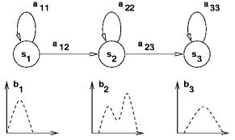
Acoustic Modeling for Speech Recognition
Each sub-word unit is modeled by a 3-state Hidden Markov Model
5 years ago, a popular acoustic modeling technique is to model the output distribution in each state by Gaussian Mixture Models (GMM)
Neural Networks (alternatively called Multi Layer Perceptrons – MLPs) can also be used for acoustic modeling

Slide 31
Neural Network Acoustic Models
Final non-linearity is represented by softmax
Each class c_{i} will be the same sub-word units we build GMMs for
W₀₁
W₁₂
W₁₂
a₀
s o f t
m a x
p(c₀|x)
a₁
p(c₁|x)
a₂
p(c₂|x)

Slide 32
Neural Network Acoustic Models
Neural networks are trained to minimize cross-entropy objective function (i.e. frame error rate)
NN gives posterior p(c_{i}|x) so divide by class prior to get likelihood
NN likelihood replaces GMM likelihood as output distribution in HMM

Slide 33
Early Performance of Neural Networks
Previous LVCSR performance with MLPs
  shallow network (3 layers), small output targets (46) - [Zhu et al, ICSLP 2004]
  On a Switchboard telephony task, gains with MLPs only observed when combined with baseline
Training neural networks is difficult!
  Objective function is non-convex
  Training is done SGD serially one one machine, can be slow on CPUs
These difficulties pose challenges to have deep networks with many output targets
Method | WER
Baseline GMM/HMM | 30.8
+ MLP | 28.6

Slide 34
Making DNNs Successful for Acoustic Modeling
3 advances made DNNs successful for acoustic modeling
  Pre-training
  Improved Hardware with GPUs
  Sequence training [B. Kingsbury et al, Interspeech 2012]
This encouraged
  Deeper networks
  Networks with more output targets (i.e., classes)

Slide 35
(1) Pre-Training via Unsupervised Learning
The goal of unsupervised learning is to put the weights in a good initial space to encourage deeper and larger networks during superivsed fine-tuning
Unsupervised learning systems can be designed using the encoder-decoder paradigm
  Encoder: transform input v into code representation h
  Decoder: reconstructs input from the code by minimizing reconstruction error
Encoder-decoder paradigm learns weights such that the code captures higher-order relevant information from input signal, these weights are used to initialize network for fine-tuning
Unsupervised learning
  Restricted Boltzmann Machine (RBM) [Hinton – Toronto]
  Sparse Encoding Symmetric Machine (SESM) [Lecun – NYU]
  De-noising Auto-Encoder [Bengio – Montreal]
h
W
v
6/14/15

Slide 36
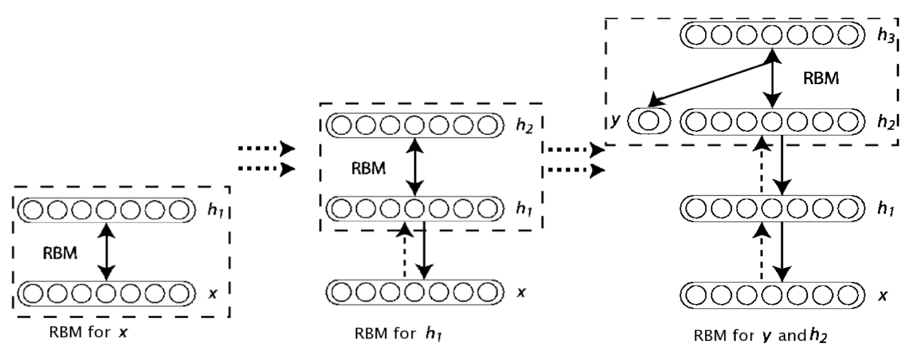
Greedy Layer-wise Pre-training
First train a layer of features that receive input directly from the speech features
Then treat the activations of the trained features as if they were speech features and learn features of features in a second hidden layer.
After pre-training is done, use weights and train network using cross-entropy objective
Notes:
Deep belief nets are learned one layer at a time by treating the values of the latent variables in one layer, when they are being inferred from data, as the data for training the next layer. This efficient, greedy learning can be followed by, or combined with, other learning procedures that fine-tune all of the weights to improve the generative or discriminative performance of the whole network
finetuning: 20 epochs for backprop, we look at the train set and the def set

Slide 37
(2) GPU training
DNN training is slow is due to the large number of dense matrix multiplications and large amount of training data
GPUs help SGD DNN training by parallelizing this matrix multiplication over thousands of cores
GPU training can achieve over a 9x speedup with a K20x speedup to a compared to a 8-core CPU
Method | WER (50-hr BN) | Training Time (hrs)
SGD (CPU) | 17.8 | 35
SGD (GPU) – K20x | 17.8 | 3.8

Slide 38
Results with PT+CE: Deepness
WER
Experimentally, we see that network depth improves WER
Generally 6-7 hidden layers is used for speech tasks

Slide 39
Results with PT+CE: Increased Output Targets
We know with GMM/HMMs, increasing the number of context-dependent states (i.e., classes) improves performance
In the past, MLPs typically trained with small number of outputs
  increasing output targets becomes a harder optimization problem and does not always improve WER
  increases parameters → increases training time
With DNNs, pre-training putting weights in better space, and thus we can increase output targets effectively
Number of Targets | WER
384 | 21.3
512 | 20.8
1024 | 19.4
2,220 | 18.5

Slide 40
DNN Acoustic Modeling Results
DNNs provide between a 8-25% relative improvement in word error rate over GMM/HMM systems across a variety of tasks and languages
Results confirmed by many, many research labs
 | 300 hour SWB Conversational Telephony | 400 hour Broadcast News | 2000 hour Voice Search
GMM/HMM | 14.3 | 16.5 | 16.0
DNN | 12.2 | 15.2 | 12.2
% Relative Improvement | 14.7 | 7.9 | 23.8
Notes:
Include we don’t have any fancy feature engineering in this

Slide 41
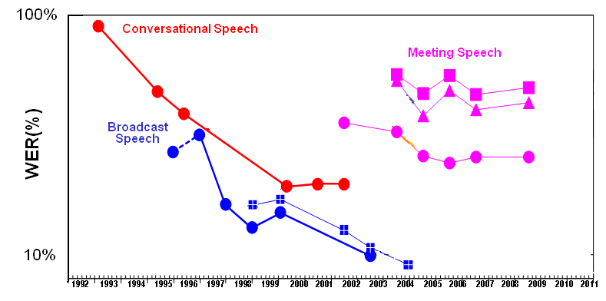
Historical Performance in Speech Recognition
Few techniques we explore consistently show gains of this magnitude
Performance with
Deep Neural Networks

Slide 42
Outline
Why Neural Networks
Training Neural Networks
Making Neural Networks Work for Speech Recognition
Optimization challenges: Training time
Optimization challenges: New architectures

Slide 43
The Revolution
The 2007 launch of smartphones (iPhone and Android) was a revolution and dramatically changed the status of speech processing
Google’s current suite of mobile applications is launched in 48 languages and processes about a decade of speech each day

Slide 44

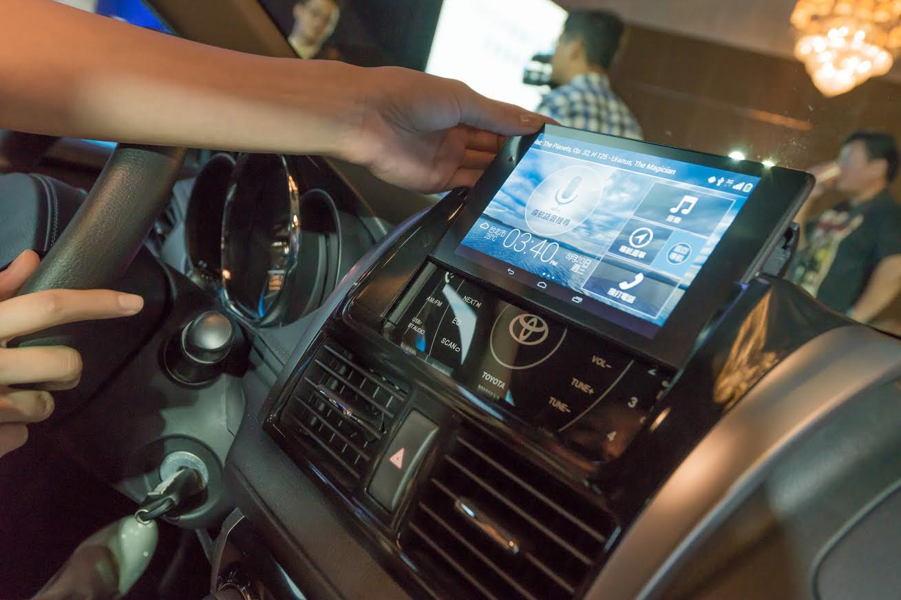
Mobile Speech Will Grow
Speech becomes the primary input modality
Training data will continue to grow
With this, we need efficient algorithms to train these networks

Slide 45


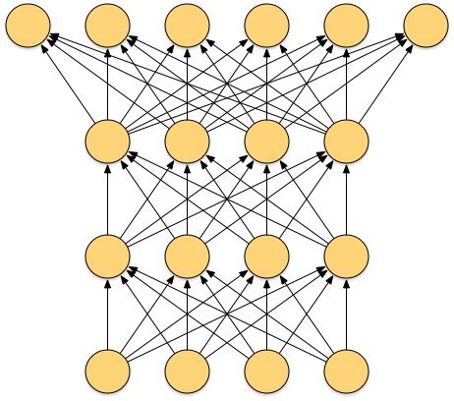

Stochastic Gradient Descent

Slide 46
GPU training
DNN training is slow is due to the large number of dense matrix multiplications and large amount of training data
GPUs help SGD DNN training by parallelizing this matrix multiplication over thousands of cores
GPU training can achieve over a 9x speedup with a K20x speedup to a compared to a 8-core CPU
In reality applications of speech, text and NLP thousands of hours of labeled training data, even more unlabeled data
It is critical for DNN success to speed up training
Method | WER (50-hr BN) | Training Time (hrs)
SGD (CPU) | 17.8 | 35
SGD (GPU) – K20x | 17.8 | 3.8

Slide 47
Approaches to Speed up DNN Training
Parallel SGD on GPUs [Microsoft]
Asynchronous SGD [Google]
Hessian-free training on Blue Gene [IBM]

Slide 48
(1) Parallel SGD
ground truth
BP steps:
  forward propagation
  error back propagation
  model update
P{s|v²}
e²
softmax(.)
. (W²)^{T},+a² . v¹
.W²
v² = E{h¹|v¹}
e¹
σ(.) σ’(.)
. (W¹)^{T},+a¹ . v¹
.W¹
v¹ = E{h⁰|v¹}
e⁰
σ(.) σ’(.)
^{. (}W⁰), + a⁰ . v⁰
v⁰ = obs
Notes:
28

Slide 49
Parallel SGD
BP steps:
  forward propagation
  error back propagation
  model update
  To improve efficiency of data parallelism, reduce how much data gets exchanged by quantizing sub-gradients to one bit/value
  Key trick is to keep quantization error from one mini-batch and add it to the next
GPU 1
GPU 2
GPU 3
P{s|v²}
e²
P{s|v²}
e²
P{s|v²}
e²
softmax(.)
. W^{T}, + a . v
.W
softmax(.)
. W^{T}, + a . v
.W
softmax(.)
. W^{T}, + a . v
.W
ΔW² Δa²
ΔW² Δa²
v² = E{h¹|v¹}
e¹
σ(.) σ’(.)
. (W¹)^{T},+a¹ . v⁰
.W¹
σ(.) σ’(.)
. (W¹)^{T},+a¹ . v⁰
.W¹
σ(.) σ’(.)
. (W¹)^{T},+a¹ . v⁰
.W¹
ΔW¹
Δa¹
ΔW¹
Δa¹
v¹ = E{h⁰|v¹}
e⁰
σ(.) σ’(.)
. W^{T}, + a . v
σ(.) σ’(.)
. W^{T}, + a . v
σ(.) σ’(.)
. W^{T}, + a . v
ΔW⁰
Δa⁰
ΔW⁰
Δa⁰
1/3
1/3
1/3
v⁰ = obs
Notes:
28

Slide 50
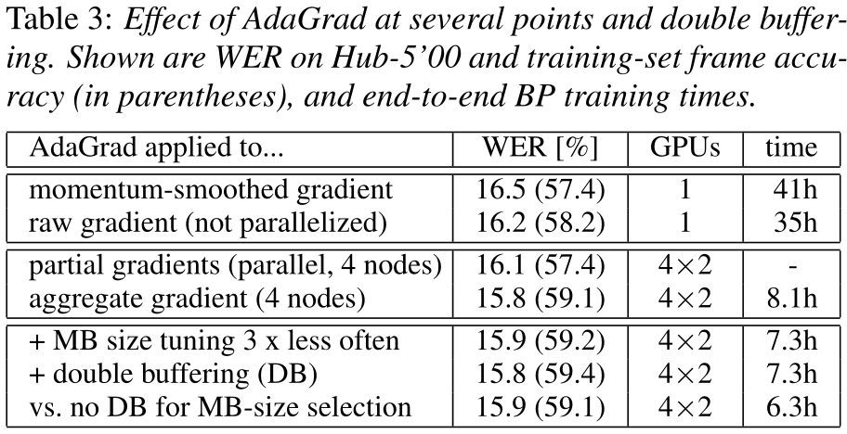
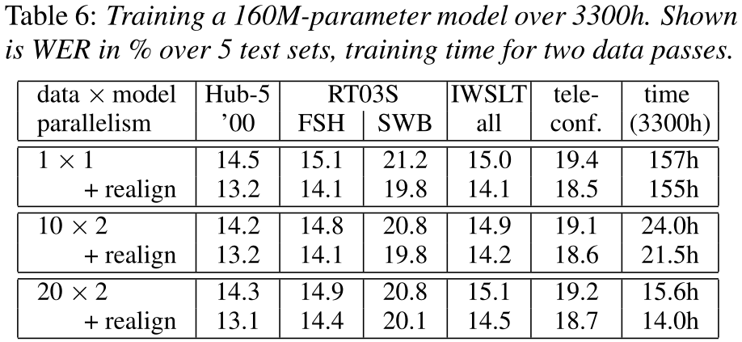
Results
[F. Seide et al, Interspeech 2014]
SWBD 309h (46M): total reduction from 41 to 6.3h → 6.5 x (8-GPU server)
3300h S2S/MAVIS model (160M): 312 to 45.5h → 6.9 x (20 GPUs GCD)

Slide 51

(2) Asynchronous SGD - DistBelief Parallel Trainer
Data

Slide 52
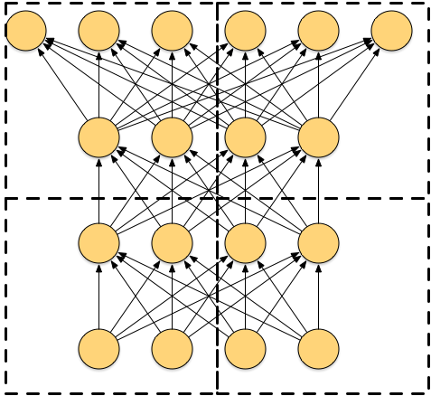
Asynchronous SGD - DistBelief Parallel Trainer
Data

Slide 53
Asynchronous SGD - DistBelief Parallel Trainer
Data
Data
Data

Slide 54
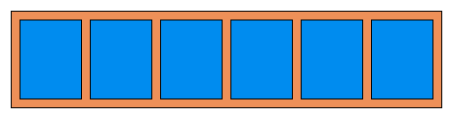
Asynchronous SGD - DistBelief Parallel Trainer
Parameter Server
Data
Data
Data

Slide 55
Asynchronous SGD - DistBelief Parallel Trainer
Parameter Server
Data
Data
Data

Slide 56
Asynchronous SGD - DistBelief Parallel Trainer
Parameter Server
Data
Data
Data

Slide 57
Asynchronous SGD - DistBelief Parallel Trainer
Parameter Server
Data
Data
Data

Slide 58
ASGD Training Time
[J. Dean et al, NIPS 2012]
Task | Model Type | WER | Training Size (hours) | GPU Training Time (hours /epoch) | Hidden Layers | Number of States
Voice Search | GMM | 16.0 | 5780 | 321 | 4x2560 | 7969
 | DNN | 12.2
You Tube | GMM | 52.3 | 1400 | 55 | 4x2560 | 17552
 | DNN | 46.2
DistBelief CPU training allows speed ups of 70 times over a single CPU and 5 times over a GPU.
Train a 85M parameter system on 2,000 hours, 10 epochs in about 10 days.

Slide 59
(3) 2nd Order Optimization via Hessian-free
[B. Kingsbury et al,
Interspeech 2012]
Distributed optimization techniques, such as 2nd order methods, use large data batches for gradient and curvature information, which can be parallelized across machines
Minimize the following objective function
Find the best search direction d_{n}
Update parameters
Iterate

Slide 60
Hessian-free Training
Data
Data
Data

Slide 61
Hessian-free Training
Master
Data
Data
Data

Slide 62
Hessian-free Training
Master
Data
Data
Data

Slide 63
Hessian-free Training
Master
Data
Data
Data

Slide 64
Hessian-free Training
Master
Data
Data
Data

Slide 65
Further Speedups with Blue Gene/Q
A major problem with parallel architectures is communication bottlenecks between workers
Having a specialized hardware/software architecture to minimize these bottlenecks is critical
The Blue Gene/Q architecture is perfect for 2nd order parallel HF training
  Massively parallel architecture with thousands of cores
  Minimal communication cost between processors

Slide 66
Overall Speedups with BG/Q – 300 hrs SWB
[T. N. Sainath et al,
Interspeech 2014]
Experiments run on two BG/Q rack (2,048 nodes, 16 cores/node, 4 threads/core)
On 300-hr SWB, BG/Q is
  4x faster for CE compared to SGD GPU
  10x faster for ST compared to SGD GPU
  No loss in WER compared to HF CPU
Algorithm | Cross-Entropy (CE) |  | Sequence Training (ST)
 | Time (hrs) | WER | Time (hrs) | WER
HF CPU | - | - | - | 12.4
SGD GPU | 121.5 | 14.1 | 47.6 | 12.7
HF BG/Q | 28.0 | 14.1 | 4.6 | 12.4
Speedup | 4 | - | 10.3
Notes:
Table needed from Interspeech paper

Slide 67
Overall Speedups with BG/Q – 400 hrs BN
On 400 hours BN with 2 racks, HF BG/Q shows
  3x faster for CE compared to SGD GPU
  11.6x faster for ST compared to SGD GPU
  No loss in WER compared to HF CPU
A specialized architecture such as BG/Q makes HF the fastest approach for CE and Sequence training
Hardware | Cross-Entropy |  | Sequence Training
 | Time (hrs) | WER | Time (hrs) | WER
HF CPU | - | - | - | 15.1
SGD GPU | 77.9 | 16.5 | 42.1 | 15.8
BG/Q | 21.7 | 16.5 | 3.6 | 15.1
Speedup | 3 | - | 11.6
Notes:
Table needed from Interspeech paper

Slide 68
Outline
Why Neural Networks
Training Neural Networks
Making Neural Networks Work for Speech Recognition
Optimization challenges: Training time
Optimization challenges: New architectures

Slide 69
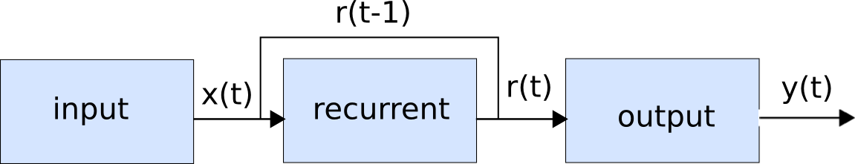
(1) Recurrent Neural Networks
Activation from previous time step is fed as input to network at current time step
Recurrent layer encodes “state” and can encode long-term temporal information
RNNs good at modeling non-linear temporal sequence data [Robinson, 1993]

Slide 70

Training RNNs
An RNN can be made to look like a feed forward network by unrolling the RNN through time
During training, activations are forward propagated for a fixed time-step T
Gradients are computed and then backpropagated to start (backpropagation through time)

Slide 71
Backpropagation Through Time

Slide 72
RNN Architectures
[G. Saon et al, Interspeech 2014]
Explore using RNNs for temporal modeling and
DNNs for depth in a unified framework
RNN is unfolded for 6 time steps
RNN can achieve a 4% relative improvement over DNN
Model | WER
RNN – unfolded 6 | 13.5
RNN – unfolded 11 | 13.8
Model | SWB-300
Baseline GMM/HMM | 14.5
DNN | 12.5
RNN | 12.0

Slide 73
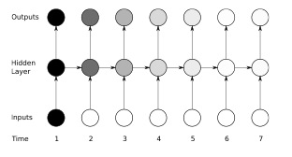
(2) Long Short-Term Memory RNNs
Modeling long-term dependencies with RNNs is difficult due to vanishing gradient problem
This limits modeling capability of RNNs to small time steps (5-10)
LSTMs were developed to address these issues [Hochreiter and Schmidhuber, 1997]
Notes:
The shading of the nodes in the unfolded network indicates their sensitivity to the inputs at time one (the darker the shade, the greater the sensitivity). The sensitivity decays over time as new inputs overwrite the activations of the hidden layer, and the network ‘forgets’ the first inputs.

Slide 74
LSTM architecture
Memory cells store temporal state of network
Multiplicative gates control information flow
  Input gate: controls flow of input activations into cell
  Output gate: controls output flow of cell activations
  Forget gate: Process continuous input streams
These gates allow LSTM to store and access long-term information
Notes:
The LSTM architecture consists of a set of recurrently connected subnets, known as memory blocks. These blocks can be thought of as a differentiable version of the memory chips in a digital computer. Each block contains one or more self-connected memory cells and three multiplicative units—the input, output and forget gates—that provide continuous analogues of write, read and reset operations for the cells.
The multiplicative gates allow LSTM memory cells to store and access in- formation over long periods of time, thereby mitigating the vanishing gradient problem. For example, as long as the input gate remains closed (i.e. has an activation near 0), the activation of the cell will not be overwritten by the new inputs arriving in the network, and can therefore be made available to the net much later in the sequence, by opening the output gate. The preservation over time of gradient information by LSTM is illustrated in Figure 4.4.

Slide 75
Preserving Gradient Information with LSTMs
Memory cell remembers first input as long as the forget gate is open and then input gate is closed
Output Gate
Forget Gate
Input Gate

Slide 76
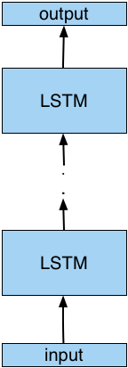
LSTM Results
[H. Sak et al, Interspeech 2014]
Explore LSTMs on 2,000 Voice Search Task
LSTM gives a 10% relative improvement over the DNN
Optimization challenges:
  LSTM is unrolled for 20 time steps
  Performance seems to saturate after 2 LSTM layers
Model Training | WER-DNN | WER-LSTM
Cross-Entropy | 11.1 | 10.0
Sequence | 10.0 | 8.9
Number of Layers | WER, CE
1 | 11.3
2 | 10.7
3 | 10.7

Slide 77
(3) CLDNN
[T.N. Sainath et al,
ICASSP 2015]
We combine convolutional neural networks, LSTMs and deep neural networks in a unified framework (CLDNN)
Architecture uses 1 CNN, 3 LSTM and 1 DNN layer
CLDNNs give an 8% relative improvement over LSTMs
Optimization Challenges:
  Increasing number of layers saturates performance
  Can only unroll LSTM for 20 time steps
Method | WER – Seq
LSTM | 8.9
CLDNN | 8.2

Slide 78
Conclusions
DNN performance
  Pre-training strategies and GPUs
  This encouraged deeper networks with more output targets
Training improvements
  Parallel GPU training via 1-bit GPU
  Asynchronous SGD via CPUs
  2nd order Hessian-free via Blue Gene
Architecture challenges
  LSTMs and their variants are popular but still have optimization issues
  Can only unroll for limited time steps
  Can only make the architectures so deep

Slide 79
References – Neural Network Architectures
G. Hinton, L. Deng, D. Yu, G. Dahl, A. Mohamed, N. Jaitly, A. Senior, V. Vanhoucke, P. Nguyen, T. N. Sainath, and B. Kingsbury, “Deep Neural Networks for Acoustic Modeling in Speech Recognition,” IEEE Signal Processing Magazine, vol. 29, no. 6, pp. 82–97, 2012.
T. N. Sainath, B. Kingsbury, G. Saon, H. Soltau, A. Mohamed, G. Dahl and B. Ramabhadran, "Deep Convolutional Neural Networks for Large-Scale Speech Tasks,” in Elsevier, Special Issue in Deep Learning, November 2014.
H. Soltau, G. Saon and T.N. Sainath, “Joint Training of Convolutional and Non-Convolutional Neural Networks,” in Proc. ICASSP, 2014.
H. Sak, A. Senior, and F. Beaufays, “Long Short-Term Memory Recurrent Neural Network Architectures for Large Scale Acoustic Modeling,” in Proc. Interspeech, 2014.
T. N. Sainath, O. Vinyals, A. Senior and H. Sak, “Convolutional, Long Short-Term Memory, Fully Connected Deep Neural Networks ” in Proc. ICASSP, 2015.

Slide 80
References – Training Improvements
  Jeff Dean, Greg Corrado, Rajat Monga, Kai Chen, Matthieu Devin, Quoc Le, Mark Mao, Marc’Aurelio Ranzato, Antrew Senior, Paul Tucker, Ke Yang, Andrew Ng Large Scale Distributed Deep Networks. NIPS 2012.
  B. Kingsbury, T. N. Sainath, and H. Soltau, "Scalable Minimum Bayes Risk Training of Deep Neural Network Acoustic Models Using Distributed Hessian-free Optimization,” in Proc. Interspeech, 2012.
  G. Saon and H. Soltau, “A comparison of Two Optimization Techniques for Sequence Training of Deep Neural Networks,” in Proc. ICASSP 2014.
  T. N. Sainath, I. Chung, B. Ramabhadran, M. Picheny, J. Gunnels, B. Kingsbury, G. Saon, V. Austel, U. Chaudhri, “Parllel Deep Neural Network Training for LVCSR using Blue Gene/Q,” in Proc. Interspeech, September 2014.
  F. Seide, H. Fu, J. Droppo, G. Li and D. Yu, “1-Bit Stochastic Gradient Descent and Application to Data-Parallel Distributed Training of Speech DNNs,” in Interspeech 2014.

Slide 81
Backup Slides

Slide 82
(1) Error Backpropagation
Introduce variables over the neural network
Notes:
\vec{\theta}=\{w_{ij}, w_{jk}, w_{kl}\}

Slide 83
Error Backpropagation
Introduce variables over the neural network
  Define a to be the input of each non-linearity
  Define z to be the output of each non-linearity
Notes:
\vec{\theta}=\{w_{ij}, w_{jk}, w_{kl}\}

Slide 84
Error Backpropagation
Notes:
\vec{\theta}=\{w_{ij}, w_{jk}, w_{kl}\}

Slide 85
Error Backpropagation
Training: Take the gradient of the last component and iterate backwards
Notes:
\vec{\theta}=\{w_{ij}, w_{jk}, w_{kl}\}

Slide 86
Error Backpropagation
Empirical Risk Function
n is number of training points

Slide 87
Error Backpropagation
Optimize last layer weights w_{kl}
Calculus chain rule
Notes:
\frac{\partial R}{\partial w_{kl}}=\frac{1}{N}\sum_n\left[\frac{\partial L_n}{\partial a_{l,n}}\right]\left[\frac{\partial a_{l,n}}{\partial w_{kl}}\right]

Slide 88
Error Backpropagation
Optimize last layer weights w_{kl}
Calculus chain rule

Slide 89
Error Backpropagation
Optimize last layer weights w_{kl}
Calculus chain rule

Slide 90
Error Backpropagation
Optimize last layer weights w_{kl}
Calculus chain rule

Slide 91
Error Backpropagation
Optimize last layer weights w_{kl}
Calculus chain rule

Slide 92
Error Backpropagation
Optimize last hidden weights w_{jk}
Notes:
\frac{\partial R}{\partial w_{kl}}=\frac{1}{N}\sum_n\left[\frac{\partial \frac{1}{2}(y_n-g(a_{l,n}))^2}{\partial a_{l,n}}\right]\left[\frac{\partial z_{k,n}w_{kl}}{\partial w_{kl}}\right]&=&\sum_n\left[-(y_n-z_{l,n})g'(a_{l,n})\right]z_{k,n}\\&=&\sum_n\delta_nz_{k,n}

Slide 93
Error Backpropagation
Optimize last hidden weights w_{jk}
Multivariate chain rule
Notes:
\frac{\partial R}{\partial w_{kl}}=\frac{1}{N}\sum_n\left[\frac{\partial \frac{1}{2}(y_n-g(a_{l,n}))^2}{\partial a_{l,n}}\right]\left[\frac{\partial z_{k,n}w_{kl}}{\partial w_{kl}}\right]&=&\sum_n\left[-(y_n-z_{l,n})g'(a_{l,n})\right]z_{k,n}\\&=&\sum_n\delta_nz_{k,n}

Slide 94
Error Backpropagation
Optimize last hidden weights w_{jk}
Multivariate chain rule
Notes:
\frac{\partial R}{\partial w_{kl}}=\frac{1}{N}\sum_n\left[\frac{\partial \frac{1}{2}(y_n-g(a_{l,n}))^2}{\partial a_{l,n}}\right]\left[\frac{\partial z_{k,n}w_{kl}}{\partial w_{kl}}\right]&=&\sum_n\left[-(y_n-z_{l,n})g'(a_{l,n})\right]z_{k,n}\\&=&\sum_n\delta_nz_{k,n}

Slide 95
Error Backpropagation
Optimize last hidden weights w_{jk}
Multivariate chain rule
Notes:
\frac{\partial R}{\partial w_{kl}}=\frac{1}{N}\sum_n\left[\frac{\partial \frac{1}{2}(y_n-g(a_{l,n}))^2}{\partial a_{l,n}}\right]\left[\frac{\partial z_{k,n}w_{kl}}{\partial w_{kl}}\right]&=&\sum_n\left[-(y_n-z_{l,n})g'(a_{l,n})\right]z_{k,n}\\&=&\sum_n\delta_nz_{k,n}

Slide 96
Error Backpropagation
Optimize last hidden weights w_{jk}
Multivariate chain rule
Notes:
\frac{\partial R}{\partial w_{jk}}=\frac{1}{N}\sum_n\left[\sum_l\delta_l w_{kl}g'(a_{k,n})\right]\left[z_{j,n}\right]\\

Slide 97
Error Backpropagation
Repeat for all previous layers
Notes:
\frac{\partial R}{\partial w_{ij}}&=&\frac{1}{N}\sum_n\left[\frac{\partial L_n}{\partial a_{j,n}}\right]\left[\frac{\partial a_{j,n}}{\partial w_{ij}}\right]=\frac{1}{N}\sum_n\left[ \sum_k\delta_{k,n}w_{jk}g'(a_{j,n}) \right]z_{i,n} =\frac{1}{N} \sum_n\delta_{j,n}z_{i,n}

Slide 98
Error Backpropagation
Now that we have well defined gradients for each parameter,
update using Gradient Descent
Notes:
\frac{\partial R}{\partial w_{jk}}=\frac{1}{N}\sum_n\left[\sum_l\delta_l w_{kl}g'(a_{k,n})\right]\left[z_{j,n}\right]\\

Slide 99
Error Back-propagation
Error backprop unravels the multivariate chain rule and solves the gradient for each layer separately.
The error δ is backpropagated along the network from one layer to the next

Slide 100
(2) Pre-Training via Unsupervised Learning
The goal of unsupervised learning is to put the weights in a good initial space to encourage deeper and larger networks during fine-tuning
Unsupervised learning systems can be designed using the encoder-decoder paradigm
  Encoder: transform input v into code representation h
  Decoder: reconstructs input from the code by minimizing reconstruction error
Encoder-decoder paradigm learns weights such that the code captures higher-order relevant information from input signal, these weights are used to initialize network for fine-tuning
Unsupervised learning
  Restricted Boltzmann Machine (RBM) [Hinton – Toronto]
  Sparse Encoding Symmetric Machine (SESM) [Lecun – NYU]
  De-noising Auto-Encoder [Bengio – Montreal]
h
W
v
6/14/15

Slide 101
Restricted Boltzmann Machines
Consider a one layer RBM
  Weights are fully connected between hidden and visible units
  No connections between hidden units
Hidden units are conditionally independent given the visible states.
Relationship between v and h for Bernoulli-Bernoulli RBMs given as:
hidden
j
i
visible
6/14/15

Slide 102
The Energy of Joint Configuration
Each possible joint configuration of the visible and hidden units (ignoring biases) has an energy
The energy of a joint configuration of the visible and hidden units determines its probability:
hidden
j
w_{ij}
i
Visible

Slide 103
Using energies to define probabilities
The probability of a joint configuration over both v and h depends on the energy E of that joint configuration compared with the energy of all other joint configurations.
The probability of a configuration of the visible units is the sum of the probabilities of all the joint configurations that contain it.
partition function

Slide 104
How to maximize p(v)
Goal of supervised fine-tuning is to maximize log p(class|v)
It follows that the goal of unsupervised learning is to maximize log p(v)
Define free-energy as
Gradient given as
Positive phase term
easy to compute directly
Negative phase term difficult
to analytically compute

Slide 105
Computing Derivative of Negative Phase
Negative phase term can be represented as , the expectation over all possible configurations of the input (under the distribution formed by the model), which is difficult to estimate analytically
Estimate the expectation using a fixed number of model samples
Obtain samples of p(v) using Gibbs sampling

Slide 106
Sampling in an RBM
j
j
j
j
a fantasy
i
i
i
i
t = 0 t = 1 t = 2 t = infinity
In the RBM structure, v and h are conditionally independent
To obtain samples of p(v,h):
  Start with a training vector on the visible units.
  Sample hidden units given fixed visible units
  Then sample visible units given fixed hidden units

Slide 107
Contrastive Divergence
Start with a training vector on the visible units.
Update all the hidden units in parallel
Update the all the visible units in parallel to get a “reconstruction”.
Update the hidden units again.
j
j
i
i
t = 0 t = 1
data
reconstruction
With contrastive divergence, just one step of Gibbs sampling is run
While this approximates -log p(v), it seems to work well in practice (Carreira-Perpinan & Hinton, 2005).

Slide 108
Constructing Deep Belief Networks
First train a layer of features that receive input directly from the speech features
Then treat the activations of the trained features as if they were speech features and learn features of features in a second hidden layer.
Why greedy?
  It can be proved that each time we add another layer of features we improve a variational lower bound on the log probability of the training data.
  Simplicity of training
Notes:
Deep belief nets are learned one layer at a time by treating the values of the latent variables in one layer, when they are being inferred from data, as the data for training the next layer. This efficient, greedy learning can be followed by, or combined with, other learning procedures that fine-tune all of the weights to improve the generative or discriminative performance of the whole network
finetuning: 20 epochs for backprop, we look at the train set and the def set

