Slide 1
Provable Non-convex Optimization for ML
Prateek Jain
Microsoft Research India
http://research.microsoft.com/en-us/people/prajain/

Slide 2
Overview
High-dimensional Machine Learning
  Many many parameters
  Impose structural assumptions
Requires solving non-convex optimization
  In general NP-hard
  No provable generic optimization tools

Slide 3

Overview
Most popular approach: convex relaxation
  Solvable in poly-time
  Guarantees under certain assumptions
  Slow in practice
Theoretically Provable Algorithms
For High-d ML Problems
Practical Algorithms
For High-d ML Problems
Theoretically Provable Algorithms
For High-d ML Problems
Practical Algorithms
For High-d ML Problems

Slide 4
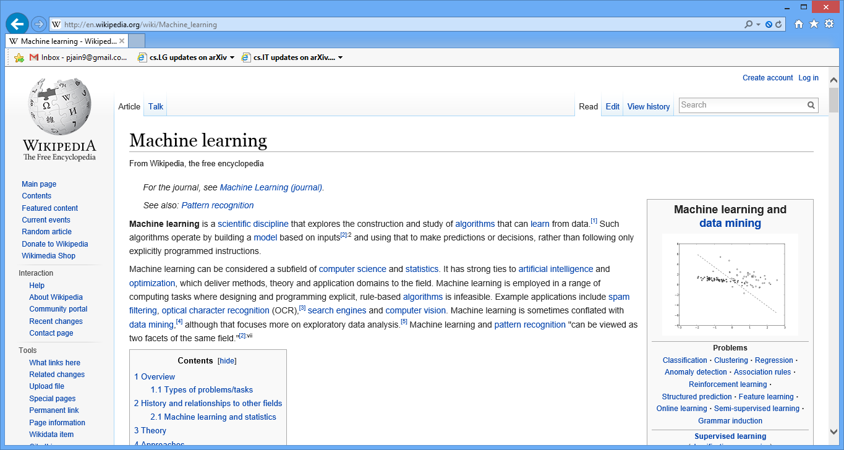

Learning in Large No. of Dimensions
(
)
f
{Learning, Optimization}
0 | 3 | 0 | … | … | … | … | ... | 0 | 9
1 | 0 | … | … | 2
$$d$$

Slide 5
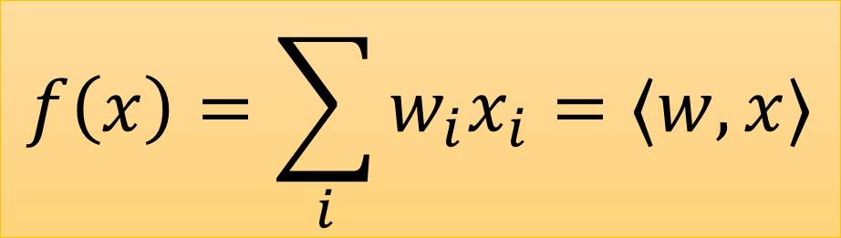
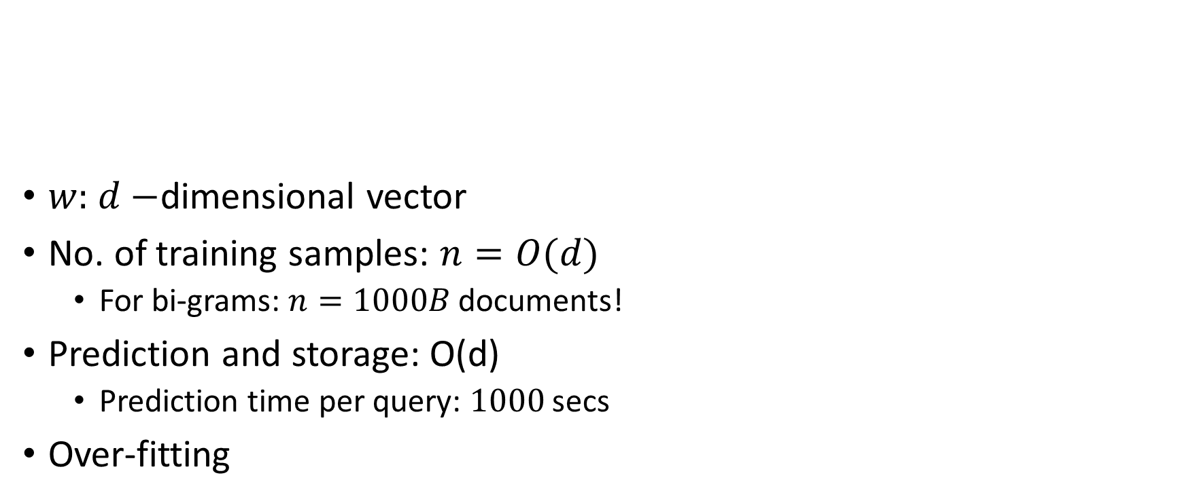
Linear Model
$$f\left(x\right)=\sum_{i}{w_{i}x_{i}}=〈w, x〉$$
$w:$ $d−$dimensional vector
No. of training samples: $n=O(d)$
  For bi-grams: $n=1000B$ documents!
Prediction and storage: O(d)
  Prediction time per query: $1000$ secs
Over-fitting
0 | 3 | 0 | … | … | … | … | ... | 0 | 9
0 | 3 | 0 | … | … | … | … | ... | 0 | 9 | … | … | … | … | 22 | 1

Slide 6
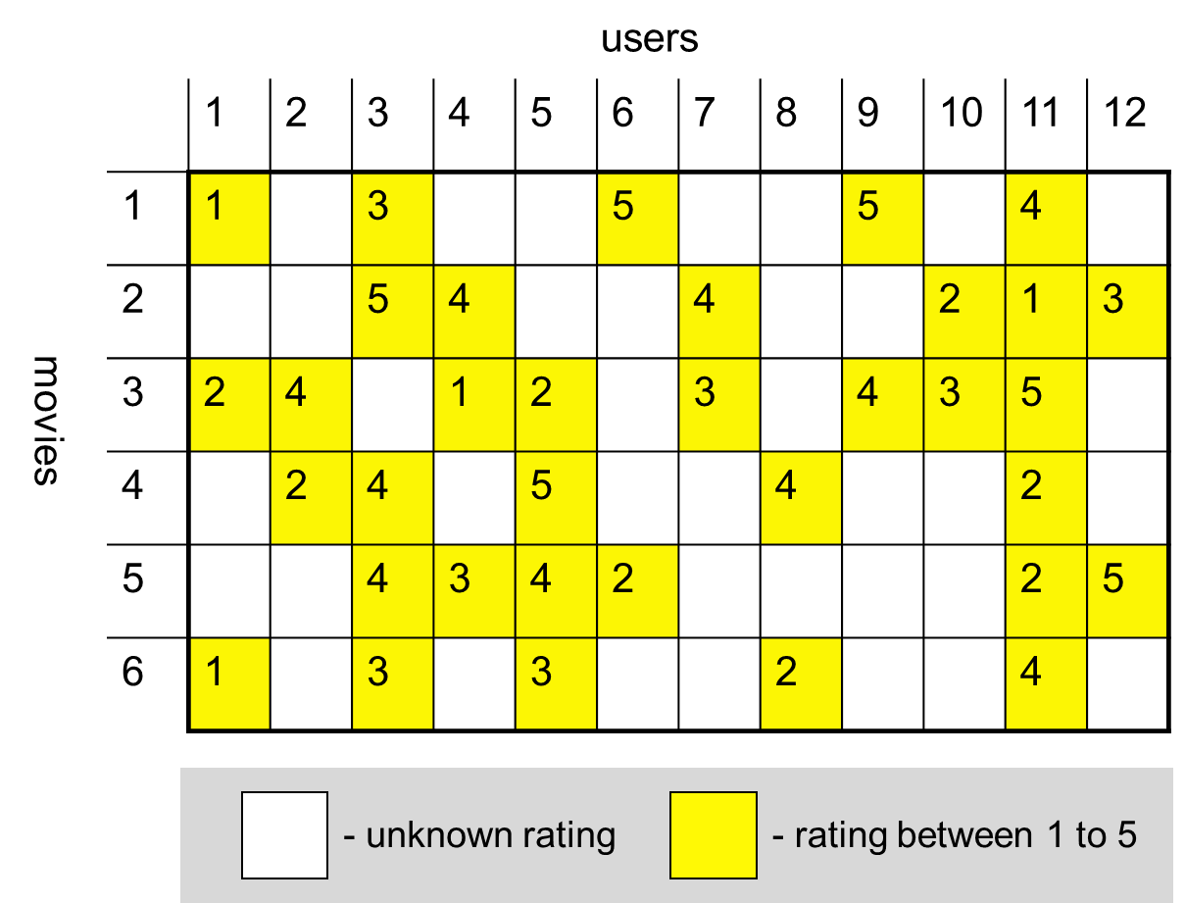
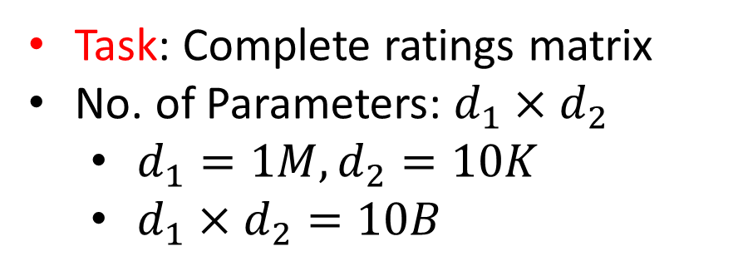
Another Example: Low-rank Matrix Completion
Task: Complete ratings matrix
No. of Parameters: $d_{1}×d_{2}$
  $d_{1}=1M, d_{2}=10K$
  $d_{1}×d_{2}=10B$

Slide 7
Key Issues
Large no. of training samples required
Large training time
Large storage and prediction time

Slide 8
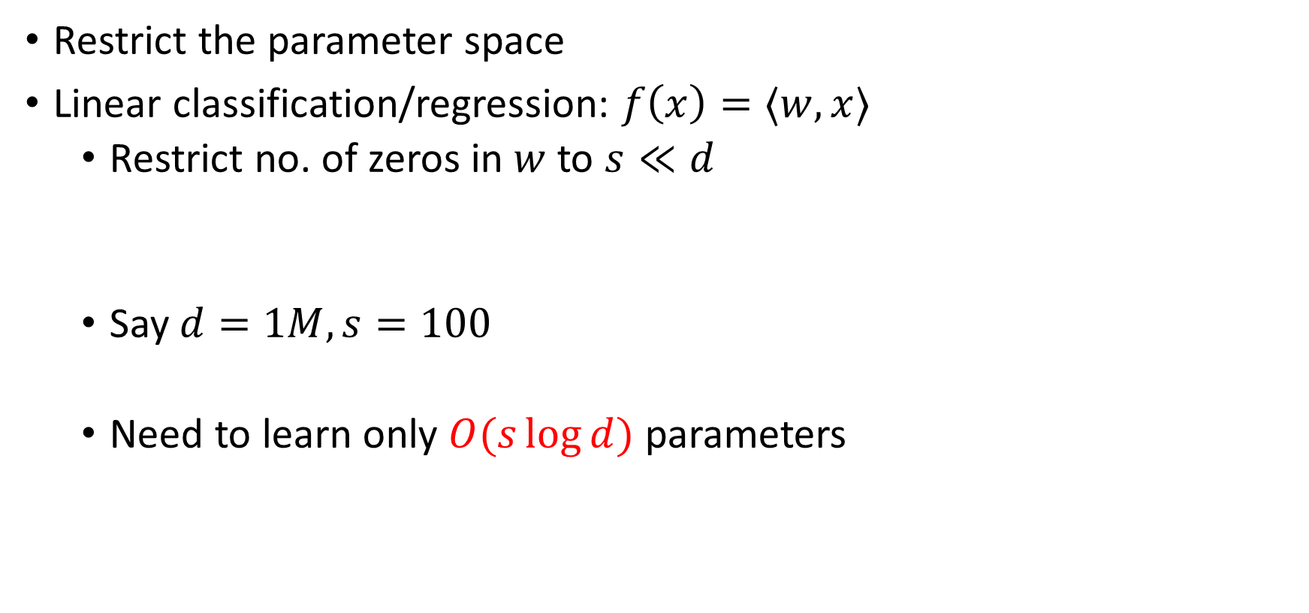
Learning with Structure
Restrict the parameter space
Linear classification/regression: $f\left(x\right)=〈w, x〉$
  Restrict no. of zeros in $w$ to $s≪d$
  Say $d=1M, s=100$
  Need to learn only $O(s\log{d})$ parameters
0 | 3 | 0 | 0 | 1 | 0 | 0 | 0 | 0 | 9

Slide 9








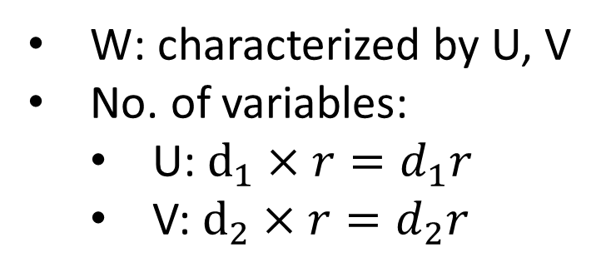


Learning with Structure contd…
Matrix completion:
$$r$$
$$r$$
$$≅$$
$$×$$
$$W$$
$$≅$$
$$U$$
$$×$$
$$V^{T}$$
W: characterized by U, V
No. of variables:
  U: $d_{1}×r=d_{1}r$
  V: $d_{2}×r=d_{2}r$
$$d_{2}$$

Slide 10



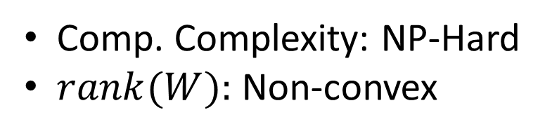
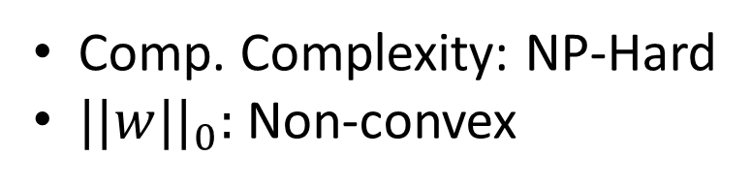
Learning with structure
Data Fidelity Function
Linear classification/regression
  $C=\{w, ||w||_{0}≤s\}$
  $s\log{d}≪d$
Matrix completion
  $C=\{W, rank\left(W\right)≤r\}$
  $r(d_{1}+d_{2})≪d_{1}d_{2}$
$$\min_{w}{L(w)} \\ s.t. w∈C$$
Comp. Complexity: NP-Hard
$||w||_{0}:$Non-convex
Comp. Complexity: NP-Hard
$rank(W):$ Non-convex

Slide 11
Non-convexity of Sparse Vector Set
1
0
0
0
1
0
0.5
0.5
0
0.5
+ 0.5
=

Slide 12
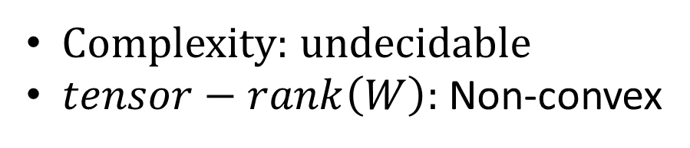
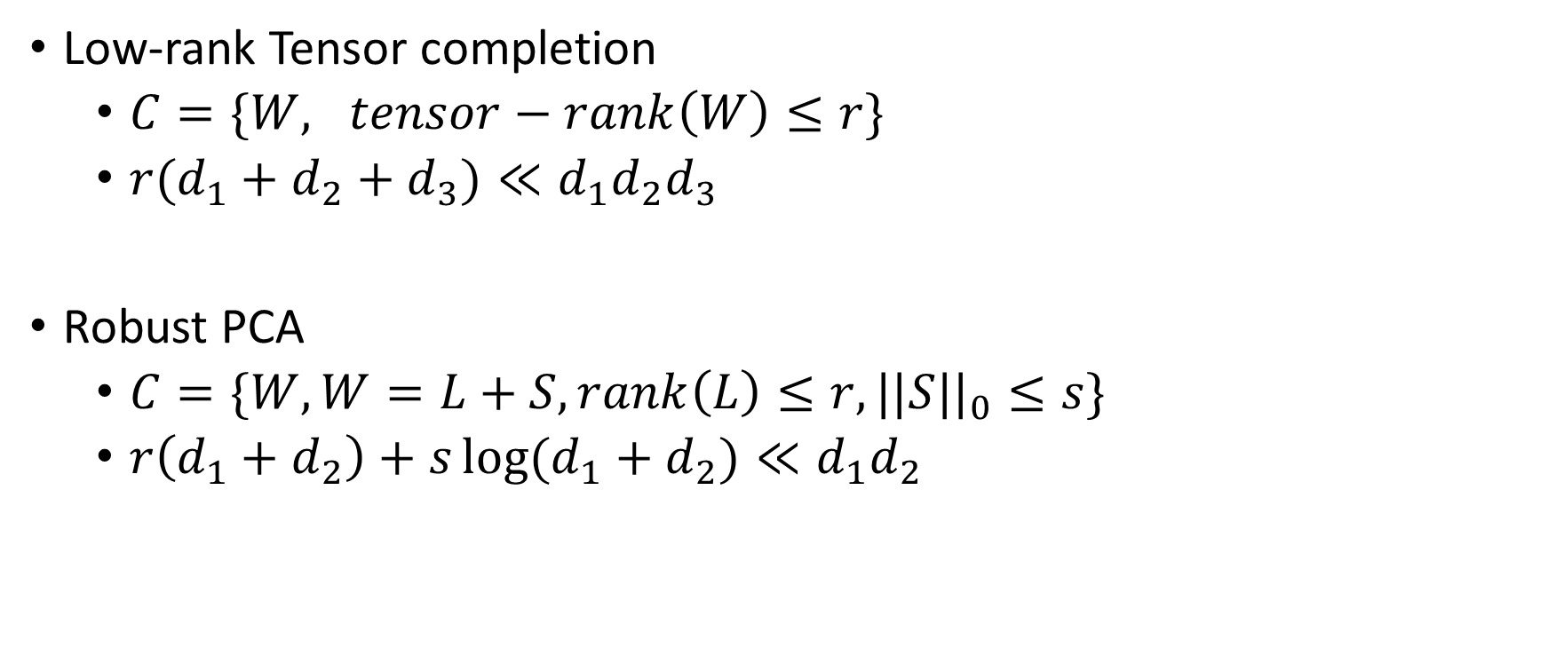
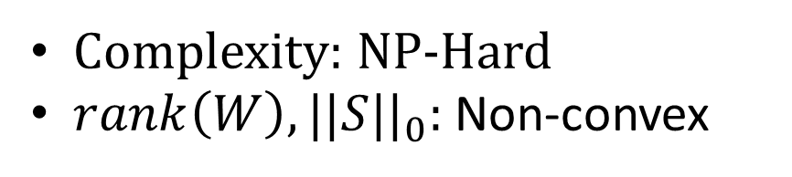
Other Examples
Complexity: undecidable
$tensor−rank\left(W\right):$Non-convex
Low-rank Tensor completion
  $C=\{W, tensor−rank\left(W\right)≤r\}$
  $r(d_{1}+d_{2}+d_{3})≪d_{1}d_{2}d_{3}$
Robust PCA
  $C=\{W, W=L+S, rank\left(L\right)≤r, ||S||_{0}≤s\}$
  $r\left(d_{1}+d_{2}\right)+s\log{(d_{1}+d_{2})}≪d_{1}d_{2}$
Complexity: NP-Hard
$rank\left(W\right), ||S||_{0}:$ Non-convex

Slide 13





Convex Relaxations
Linear classification/regression
  $C=\{w, ||w||_{0}≤s\}$
  $||w||_{1}≤\sum_{i}{w_{i}}$
Matrix completion
  $C=\{W, rank\left(W\right)≤r\}$
  $||W||_{∗}≤\sum_{i}{σ_{i}}, W=UΣV^{T}$
  $$\tilde{C}=\{w, ||w||_{1}≤λ(s)\}$$
  $$\tilde{C}=\{W, ||W||_{∗}≤λ\left(r\right)\}$$

Slide 14


Convex Relaxations Contd…
Low-rank Tensor completion
  $C=\{W, tensor−rank\left(W\right)≤r\}$
Robust PCA
  $C=\{W, W=L+S, rank\left(L\right)≤r, ||S||_{0}≤s\}$
  $$\tilde{C}=\{W, |{\left|W|\right|}_{∗}≤λ\left(r\right)\}$$
  $$\tilde{C}=\{W, W=L+S, ||L||_{∗}≤λ\left(r\right), ||S||_{1}≤λ\left(s\right)\}$$

Slide 15
Convex Relaxation
Advantage:
  Convex optimization: Polynomial time
  Generic tools available for optimization
  Systematic analysis
Disadvantage:
  Optimizes over a much bigger set
  Not scalable to large problems

Slide 16
This tutorial’s focus
Don’t Relax!
Advantage: scalability
Disadvantage: optimization and its analysis is much harder
  Local minima problems
Two approaches:
  Projected gradient descent
  Alternating minimization

Slide 17
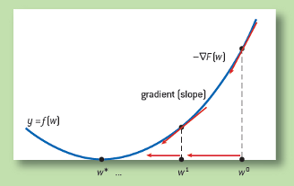

Approach 1: Projected Gradient Descent
$$\min_{w}{L\left(w\right)} \\ s.t. w∈C$$
$w_{t+1}=w_{t}−∂_{w_{t}}L(w_{t})$
$w_{t+1}=P_{C}(w_{t+1})$

Slide 18
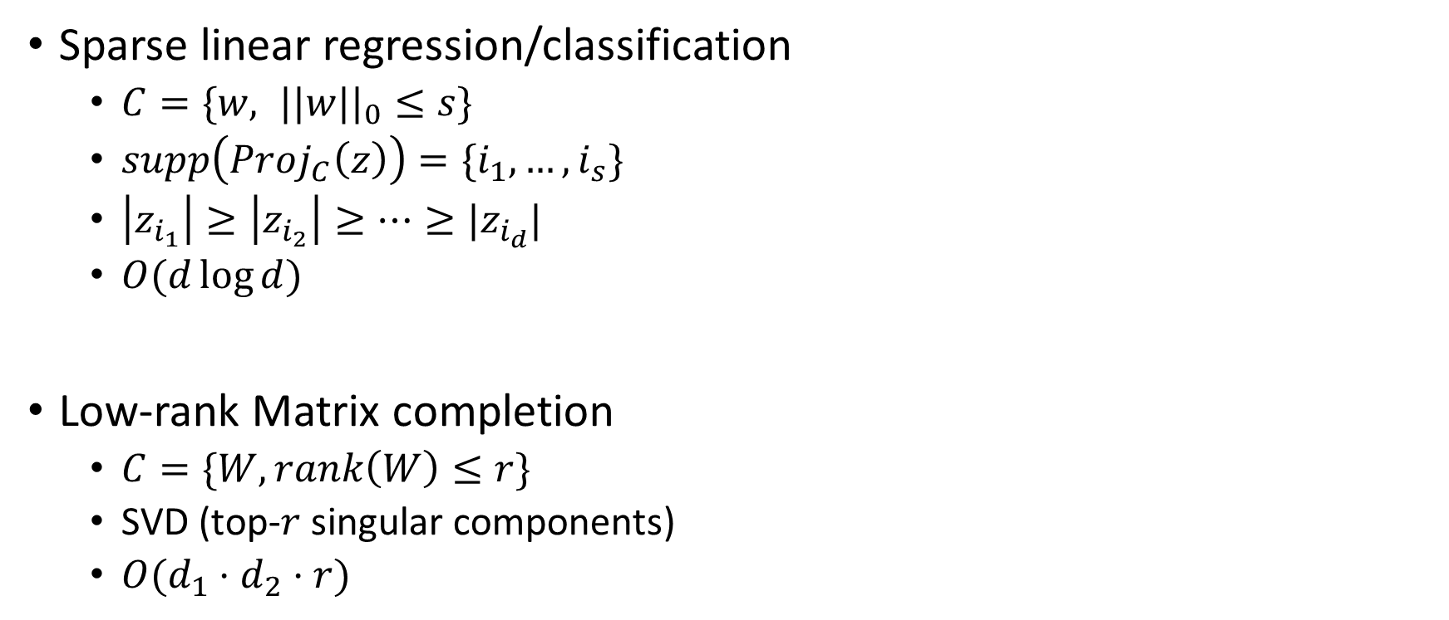
Efficient Projection
Sparse linear regression/classification
  $C=\{w, ||w||_{0}≤s\}$
  $supp\left(Proj_{C}\left(z\right)\right)=\{i_{1},…,i_{s}\}$
  $\left|z_{i_{1}}\right|≥\left|z_{i_{2}}\right|≥…≥|z_{i_{d}}|$
  $O(d\log{d})$
Low-rank Matrix completion
  $C=\{W, rank\left(W\right)≤r\}$
  SVD (top-$r$ singular components)
  $O(d_{1}⋅d_{2}⋅r)$

Slide 19
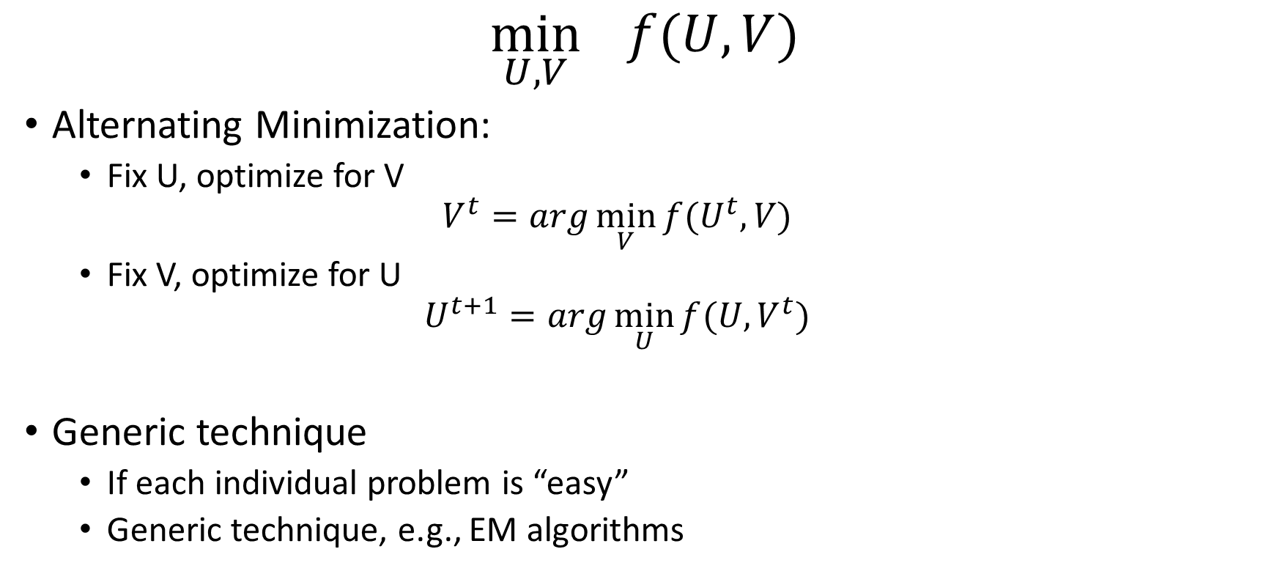
Approach 2: Alternating Minimization
$$\min_{U, V}{f(U, V)}$$
Alternating Minimization:
  Fix U, optimize for V
  $$V^{t}=arg\min_{V}{f(U^{t}, V)}$$
  Fix V, optimize for U
  $$U^{t+1}=arg\min_{U}{f(U, V^{t})}$$
Generic technique
  If each individual problem is “easy”
  Generic technique, e.g., EM algorithms

Slide 20
Results for Several Problems
Sparse regression [Jain et al.’14, Garg and Khandekar’09]
  Sparsity
Robust Regression [Bhatia et al.’15]
  Sparsity+output sparsity
Dictionary Learning [Agarwal et al.’14]
  Matrix Factorization + Sparsity
Phase Sensing [Netrapalli et al.’13]
  System of Quadratic Equations
Vector-value Regression [Jain & Tewari’15]
  Sparsity+positive definite matrix

Slide 21
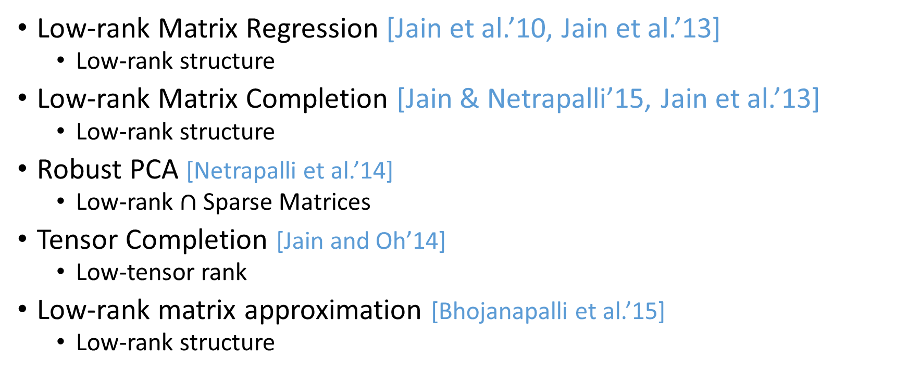
Results Contd…
Low-rank Matrix Regression [Jain et al.’10, Jain et al.’13]
  Low-rank structure
Low-rank Matrix Completion [Jain & Netrapalli’15, Jain et al.’13]
  Low-rank structure
Robust PCA [Netrapalli et al.’14]
  Low-rank $∩$ Sparse Matrices
Tensor Completion [Jain and Oh’14]
  Low-tensor rank
Low-rank matrix approximation [Bhojanapalli et al.’15]
  Low-rank structure

Slide 22
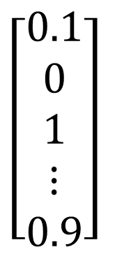

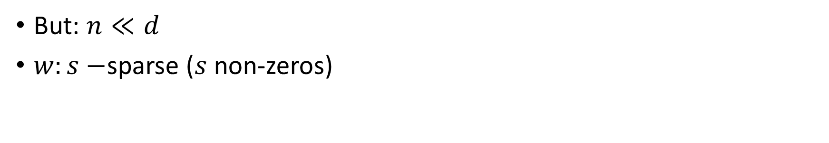
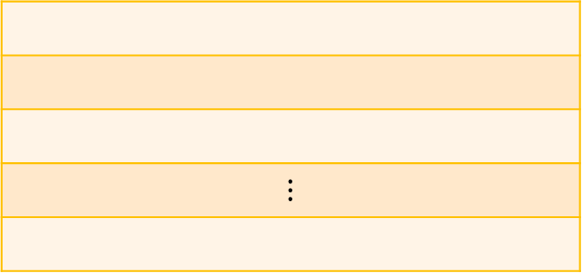


Sparse Linear Regression
$\left[\begin{aligned}0.1 \\ 0 \\ 1 \\ ⋮ \\ 0.9\end{aligned}\right]$
$$⋮$$
d
=
n
$$y$$
=
$$X$$
$$w$$
But: $n≪d$
$w:s−$sparse ($s$ non-zeros)

Slide 23
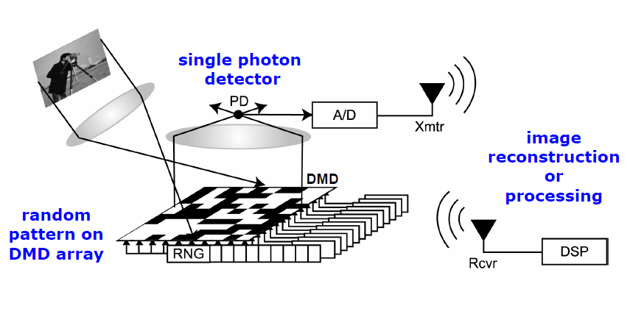
Motivation: Single Pixel Camera
For 1Megapixel image, 1Million measurements would be required
Picture taken from Baranuik et al.

Slide 24
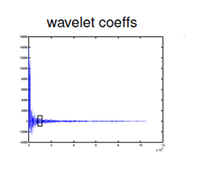
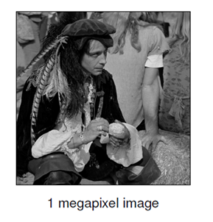
Sparsity
Most images are sparse in wavelet transform space
  Typically around 2.5% coefficients are significant
Picture taken from Baranuik et al.

Slide 25
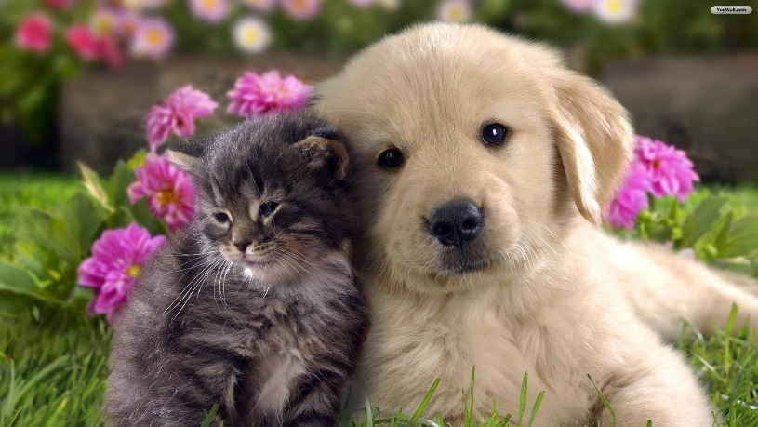
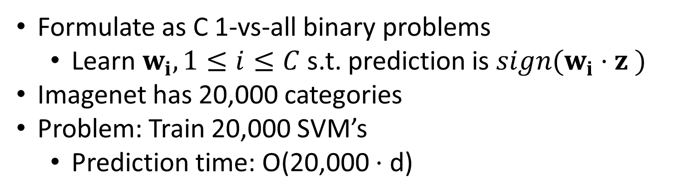
Motivation: Multi-label Classification
Formulate as C 1-vs-all binary problems
  Learn $w_{i}, 1≤i≤C$ s.t. prediction is $sign(w_{i}⋅z )$
Imagenet has 20,000 categories
Problem: Train 20,000 SVM’s
  Prediction time: O(20,000 $⋅$ d)

Slide 26

Sparsity
Typically an image has only $5−10$ objects
Label

Slide 27

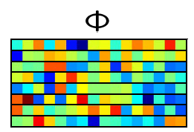



Compressive Sensing of Labels
$$y$$
$$X$$
Label
$$100$$
$$=$$
$$×$$
$$20000$$
Learn $100$ classifiers/regression functions
Use Recovery algorithms to map back to label space
Proposed by Hsu et al and then later pursued by several works

Slide 28
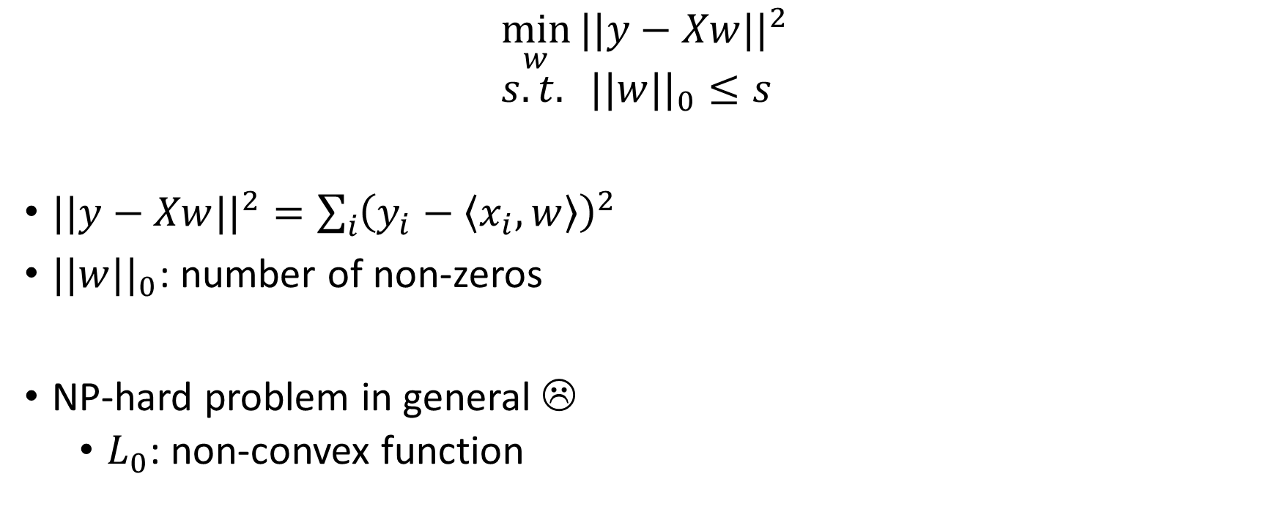
Sparse Linear Regression
$$\min_{w}{||y−Xw||^{2}} \\ s.t. ||w||_{0}≤s$$
$||y−Xw||^{2}=\sum_{i}{{\left(y_{i}−〈x_{i}, w〉\right)}^{2}}$
$||w||_{0}$: number of non-zeros
NP-hard problem in general ☹
  $L_{0}$: non-convex function

Slide 29
Convex Relaxation
$$\min_{w}{||y−Xw||^{2}} \\ s.t. ||w||_{0}≤s$$
Relaxed Problem:
$$\min_{w}{||y−Xw||^{2}} \\ s.t. ||w||_{1} ≤s$$
$||w||_{1}=\sum_{i}{|w_{i}|}$
  Known to promote sparsity
Pros: a) Principled approach, b) Captures correlations between features
Cons: Slow to optimize

Slide 30

Our Approach : Projected Gradient Descent
$$\min_{w}{f\left(w\right)=||y−Xw||^{2}} \\ s.t. ||w||_{0}≤s$$
$w_{t+1}=w_{t}−∂_{w_{t}}f(w_{t})$
$w_{t+1}=P_{s}(w_{t+1})$
[Jain, Tewari, Kar’2014]

Slide 31

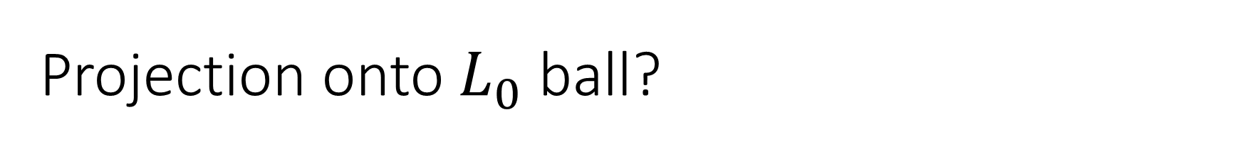
Projection onto $L_{0}$ ball?
$$\min_{x}{||x−z||_{2}^{2}} \\ s.t. ||x||_{0}≤s$$

Slide 32
Important Properties

Slide 33
A Stronger Result?
$$||P_{s}\left(z\right)−z||_{2}^{2}≤\frac{d−s}{d−s^{∗}}||P_{s^{∗}}\left(z\right)−z||_{2}^{2}$$

Slide 34
Our Approach : Projected Gradient Descent
$$\min_{w}{f\left(w\right)=||y−Xw||^{2}} \\ s.t. ||w||_{0}≤s$$
$w_{t+1}=w_{t}−∂_{w_{t}}f(w_{t})$
$w_{t+1}=P_{s}(w_{t+1})$
[Jain, Tewari, Kar’2014]

Slide 35
Convex-projections vs Non-convex Projections
For non-convex sets, we only have:
$$∀Y∈C, ||P_{r}\left(Z\right)−Z||≤||Y−Z||$$
  0-th order condition
But, for projection onto convex set $C$:
$$∀Y∈C, ||Z−P_{C}\left(Z\right)||^{2}≤〈Y−Z, P_{C}\left(Z\right)−Z〉$$
  1-st order condition
0 order condition sufficient for convergence of Proj. Grad. Descent?
  In general, NO ☹
  But, for certain specially structured problems, YES!!!

Slide 36
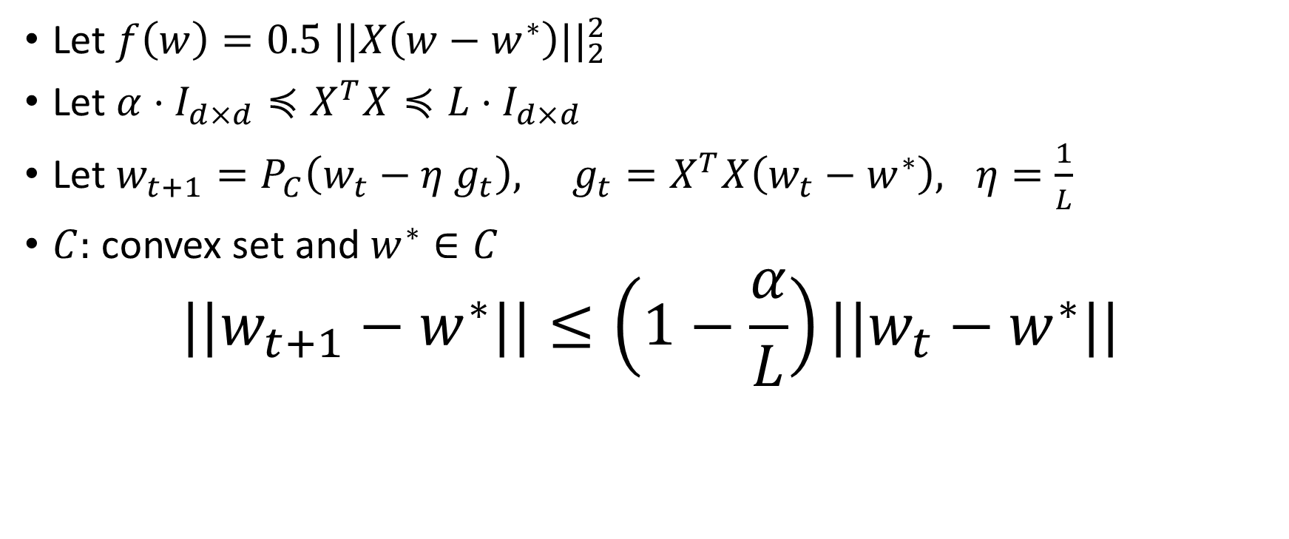
Convex-Projected Gradient Descent Proof?
Let $f\left(w\right)=0.5 ||X\left(w−w^{∗}\right)||_{2}^{2}$
Let $α⋅I_{d×d}≼X^{T}X≼L⋅I_{d×d}$
Let $w_{t+1}=P_{C}\left(w_{t}−η g_{t}\right), g_{t}=X^{T}X\left(w_{t}−w^{∗}\right), η=\frac{1}{L}$
$C:$ convex set and $w^{∗}∈C$
$$||w_{t+1}−w^{∗}||≤\left(1−\frac{α}{L}\right)||w_{t}−w^{∗}||$$

Slide 39




Restricted Isometry Property (RIP)
$X$ satisfies RIP if, for all sparse vectors $Φ$ acts as an Isometry
Formally: For all $s$-sparse $w$
$$(1−δ_{s})||w||^{2}≤||Xw||^{2}≤(1+δ_{s})||w||^{2}$$
$X$
$$w$$
$$Xw$$

Slide 40
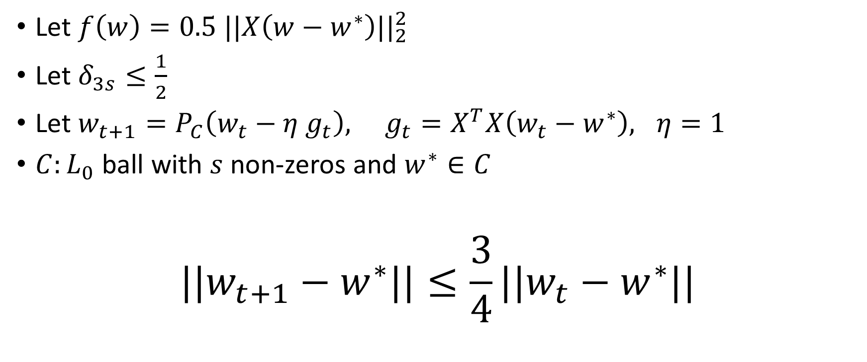
Proof under RIP
Let $f\left(w\right)=0.5 ||X\left(w−w^{∗}\right)||_{2}^{2}$
Let $δ_{3s}≤\frac{1}{2}$
Let $w_{t+1}=P_{C}\left(w_{t}−η g_{t}\right), g_{t}=X^{T}X\left(w_{t}−w^{∗}\right), η=1$
$C:L_{0}$ ball with $s$ non-zeros and $w^{∗}∈C$
$$||w_{t+1}−w^{∗}||≤\frac{3}{4}||w_{t}−w^{∗}||$$
[Blumensath & Davies’09, Garg & Khandekar’09]

Slide 43

Variations
Fully corrective version:
$$u_{t+1}=P_{C}\left(w_{t}−η g_{t}\right) \\ w_{t+1}=\arg{\min_{w}{f(w)}}, s.t. supp\left(w\right)=supp(u)$$
Two stage algorithms:

Slide 45
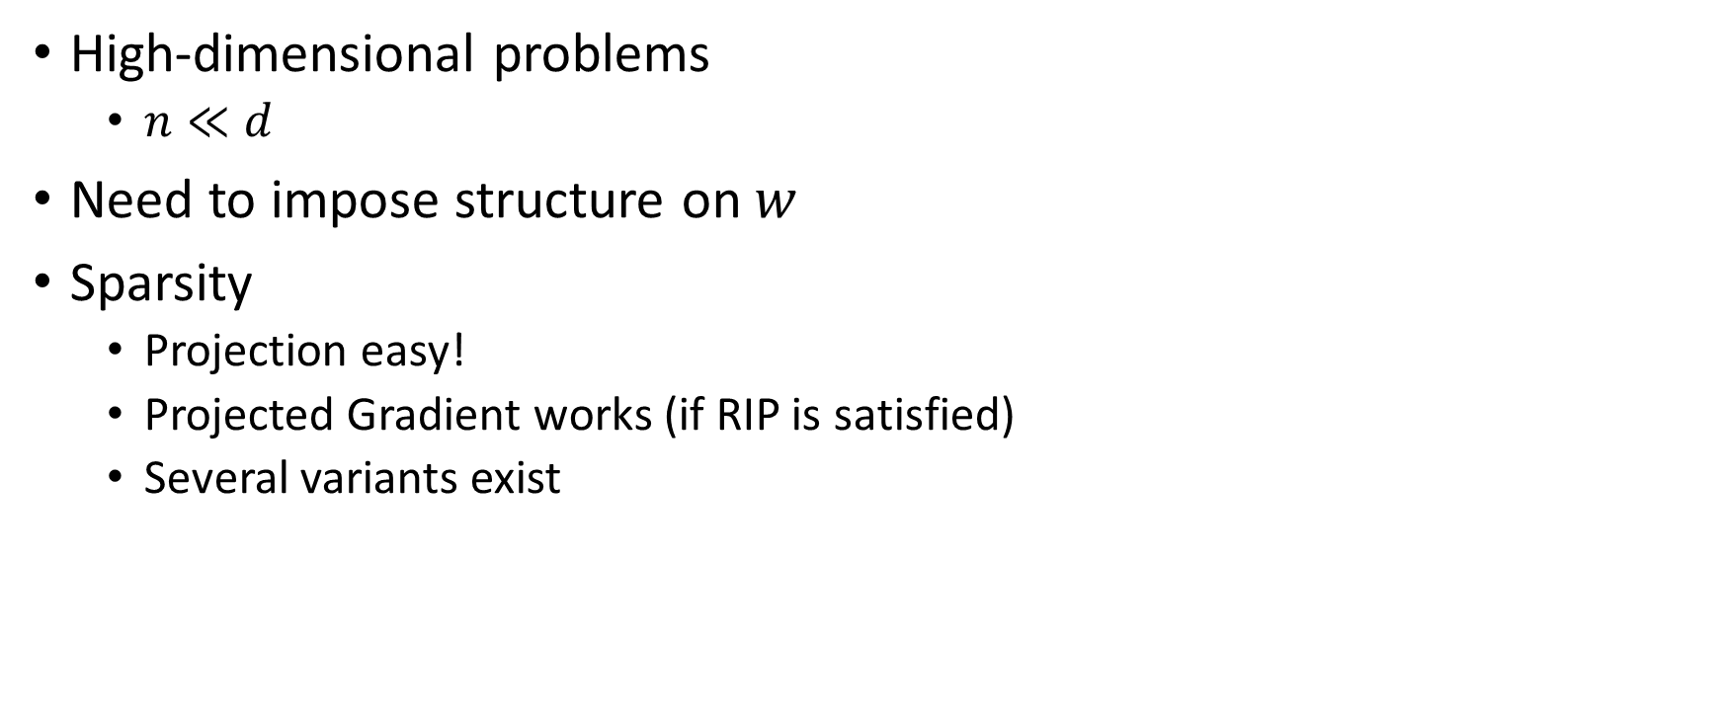
Summary so far…
High-dimensional problems
  $n≪d$
Need to impose structure on $w$
Sparsity
  Projection easy!
  Projected Gradient works (if RIP is satisfied)
  Several variants exist

Slide 46




Which Matrices Satisfy RIP?
$$\left(1−δ_{s}\right)|\left|w||^{2}≤||Xw||^{2}≤\left(1+δ_{s}\right)|\right|w||^{2}, ||w||_{0}≤s$$
Several ensembles of random matrices
  Large enough $m$
For example: $n=O(s\log{\frac{d}{s}})$
  $X_{ij}∼D$
  $D:$ 0-mean distribution
    Bounded fourth moment
$$X$$
$$n=O(s\log{\frac{d}{s}})$$
$$n$$

Slide 47




Popular RIP Ensembles
$$X$$
Most popular examples:
  $X_{ij}∼N(0,1/\sqrt{m})$
  $X_{ij}=+\frac{1}{\sqrt{m}} \left(w.p.\frac{1}{2}\right)and −\frac{1}{\sqrt{m}} (w.p.\frac{1}{2})$
$$n=O(s\log{\frac{d}{s}})$$
$$n$$

Slide 48

Proof of RIP for Gaussian Ensemble
$X∈R^{n×d}$
$X_{ij}∼\frac{1}{\sqrt{n}}N(0,1)$
$n≥\left(\frac{1}{δ_{s}^{2}}\right)s\log{d}$
Then, $X$ satisfies RIP at $s$-sparsity with constant $δ_{s}$

Slide 49
Other structures?
Group sparsity
Tree sparsity
Union of subspaces (polynomially many subspaces)
Projection easy for each one of these problems
Gaussian matrices satisfy RIP (because union of small no. of subspaces)

Slide 50

General Result
Let $f\left(w\right)=.5 ||X\left(w−w^{∗}\right)||_{2}^{2}$
Let $w_{t+1}=P_{C}\left(w_{t}−η g_{t}\right), g_{t}=X^{T}X\left(w_{t}−w^{∗}\right), η=\frac{1}{(1+δ_{3s})}$
$C:$ Any non-convex set and $w^{∗}∈C$
$$||w_{t+1}−w^{∗}||≤\frac{3}{4}||w_{t}−w^{∗}||$$
$$\left(1−δ_{s}\right)|\left|w||^{2}≤||Xw||^{2}≤\left(1+δ_{s}\right)|\right|w||^{2}, w∈C$$

Slide 51

Statistical Guarantees
$$y_{i}=〈x_{i}, w^{∗}〉+η_{i}$$
$x_{i}∼N(0, Σ)$
$η_{i}∼N(0, σ^{2})$
$w^{∗}:s−$sparse
$$|| \hat{w}−w^{∗}||≤\frac{σ⋅κ⋅\sqrt{s\log{d}}}{\sqrt{n}}$$
$κ=λ_{1}(Σ)/λ_{d}(Σ)$
[Jain, Tewari, Kar’2014]

Slide 52

Proof?
$f\left(w\right)=\frac{1}{2}||X\left(w−w^{∗}\right)||^{2}$
$X=[x_{1};x_{2};…;x_{n}]$
$x_{i}∼N\left(0, Σ\right), α⋅I_{d×d}≼Σ≼L⋅I_{d×d}$
$w_{t+1}=P_{s}\left(w_{t}−η g_{t}\right), L=\frac{2}{3L}$
$s={\left(\frac{L}{α}\right)}^{2}s^{∗}$
$$||w_{t+1}−w^{∗}||_{2}^{2}≤\left(1−\frac{α}{10⋅L}\right) ||w_{t}−w^{∗}||_{2}^{2}$$

Slide 53

General Result for Any Function
$f:R^{d}→R$
$f:$ satisfies RSC/RSS, i.e.,
$$α_{s}⋅I_{d×d}≼H\left(w\right)≼L_{s}⋅I_{d×d}, if, ||w||_{0}≤s$$
IHT and several similar algorithm guarantee:
$$f\left(w_{T}\right)≤f\left(w^{∗}\right)+ε$$
After $T=O(\frac{\log\left(\frac{f\left(w^{0}\right)}{ε}\right)}{log⁡(1−\frac{L_{s}}{α_{s}})})$ steps
If $||w^{∗}||≤s^{∗}$ and $s≥10\frac{L_{s}^{2}}{α_{s}^{2}}s^{∗}$
[Jain, Tewari, Kar’2014]

Slide 54


Theory and Practice
$$y_{i}=〈x_{i}, w^{∗}〉+η_{i}$$
$x_{i}∼N(0, Σ)$, $η_{i}∼N(0, σ^{2})$
$w^{∗}:s−$sparse
Number of iterations: $log(\frac{1}{ε})$
$$|| \hat{w}−w^{∗}||≤ε+\frac{σκ\sqrt{s\log{d}}}{\sqrt{n}}$$
$κ=λ_{1}(Σ)/λ_{d}(Σ)$
Convex
Non-Convex
[Jain, Tewari, Kar’2014]

Slide 55

Summary so far…
High-dimensional problems
  $n≪d$
Need to impose structure on $w$
Sparsity
  Projection easy!
  Projected Gradient works (if RIP is satisfied)
  Several variants exist
RIP/RSC style proof works for subgaussian data
Other structures also allowed

Slide 56








Robust Regression
$\left[\begin{aligned}0.1 \\ 0 \\ 1 \\ ⋮ \\ 0.9\end{aligned}\right]$
$$⋮$$
d
n
=
+
n
$$y$$
=
$$X$$
$$w$$
+
$$b$$
$$y=Xw^{∗}+b$$
Typical b:
Deterministic error : $|\left|w−w^{∗}|\right|≤||b||$
Gaussian error : $|\left|w−w^{∗}|\right|≤\frac{||b||}{\sqrt{n}}$

Slide 57

Robust Regression
$||b||_{0}≤β⋅n$
  We want $β$ to be a constant
Entries of $b$ can be unbounded!
  $|{\left|b|\right|}_{2}$ can be arbitrarily large
Still we want: $||w−w^{∗}||=0$

Slide 58

RR Algorithm
$S_{0}=\{1, 2, …, n\}$
For t=0, 1, ….
  $w_{t+1}=\arg{\min{||X_{S_{t}}w−y_{S_{t}}||_{2}^{2}}}$
  $r_{t+1}=y−Xw_{t+1}$
  $S_{t+1}=Top({|r}_{t+1}|, β⋅n)$
Algorithm: was vaguely proposed by Legendre-1805

Slide 59

Result
$y=Xw^{∗}+b$
$||b||_{0}≤β⋅n$
$β≤\frac{1}{100}$
$n≥d\log{d}$
$X_{ij}∼N(0,1)$
$$||b_{S_{t+1}}||_{2}≤\frac{9}{10} ||b_{S_{t}}||_{2}$$

Slide 60
Empirical Results

Slide 61
Empirical Results

Slide 62
Empirical Results

Slide 63

One-bit Compressive Sensing
Compressed Sensing:
$$y=Xw^{∗}$$
  Require to know $y$ exactly
  In practice, finite bit representation, some quantization required
One-bit CS: extreme quantization
$$y=sign(Xw^{∗})$$
  Easily implementable through comparators
Results in two categories:
  Support Recovery [HB12, GNJN13]
  Approximate Recovery [PV12, GNJN13]

Slide 64

Phase-Retrieval
Another extreme:
$y=|Xw^{∗}|$
  Useful in several imaging applications
  A field in itself
Ideas from sparse-vector and low-rank matrix estimation [C12, NJS13]

Slide 65





Dictionary Learning
A
$$×$$
$$≅$$
$r$-dim, k-sparse
vector
$$m$$
Data Point
$$d×r$$
Dictionary

Slide 66







Dictionary Learning
Y
A
X
$$d$$
$$≅$$
$$×$$
$$r$$
$$n$$
$$r$$
Overcomplete dictionaries: $r≫d$
Goal: Given $Y$, compute $A, X$
  Using small number of samples $n$

Slide 67

Existing Results
Generalization error bounds [VMB’11, MPR’12, MG’13, TRS’13]
  But assumes that the optimal solution is reached
  Do not cover exact recovery with finite many samples
Identifiability of $A, X$ [HS’11]
  Require exponentially many samples
Exact recovery [SWW’12]
  Restricted to square dictionary $(d=r)$
  In practice, overcomplete dictionary $(d≪r)$ is more useful

Slide 68

Generating Model
Generate dictionary $A$
  Assume $A$ to be incoherent, i.e., $〈A_{i}, A_{j}〉≤μ/\sqrt{d}$
  $r≫d$
Generate random samples$X=\left[x_{1}, x_{2},…, x_{n}\right]∈R^{d×n}$
  Each $x_{i}$ is $k$-sparse
Generate observations: $Y=AX$

Slide 69

Algorithm
Typically practical algorithm: alternating minimization
  $X_{t+1}=argmin_{X}||Y−A_{t}X||_{F}^{2}$
  $A_{t+1}=argmin_{A}||Y−AX_{t+1}||_{F}^{2}$
Initialize $A_{0}$
  Using clustering+SVD method of [AAN’13] or [AGM’13]

Slide 70

Results [AAJNT’13]
Assumptions:
  $A$ is $μ−$ incoherent ($〈A_{i}, A_{j}〉≤μ/\sqrt{d}, ||A_{i}||=1$)
  $1≤\left|X_{ij}\right|≤100$
  Sparsity: $k≤\frac{d^{\frac{1}{6}}}{μ^{\frac{1}{3}}}$ (better result by AGM’13)
  $n≥O(r^{2}\log{r})$
After $log⁡(\frac{1}{ε})$-steps of AltMin:
$$||A_{T}^{i}−A^{i}||_{2}≤ε$$

Slide 71

Proof Sketch
Initialization step ensures that:
$$||A^{i}−A_{0}^{i}||≤\frac{1}{k^{2}}$$
Lower bound on each element of $X_{ij}$ + above bound:
  $supp(x_{i})$ is recovered exactly
  Robustness of compressive sensing!
$A_{t+1}$ can be expressed exactly as:
  $A_{t+1}=A+Error_{(A_{t}, X_{t})}$
  Use randomness in $supp(X_{t})$

Slide 72




Simulations
Emirically: $n=O(r)$
Known result: $n=O\left(r^{2}\log{r}\right)$

Slide 73
Summary
Consider high-dimensional structured problems
  Sparsity
  Block sparsity
  Tree-based sparsity
  Error sparsity
Iterative hard thresholding style method
  Practical/easy to implement
  Fast convergence
RIP/RSC/subGaussian data: Provable guarantees
http://research.microsoft.com/en-us/people/prajain/

Slide 74



Purushottam Kar
Kush Bhatia
PostDoc
MSR, India
Research Fellow
MSR, India
Ambuj Tewari
Asst. Prof.
Univ of Michigan

Slide 75
Next Lecture
Low-rank Structure
  Matrix Regression
  Matrix Completion
  Robust PCA
Low-rank Tensor Structure
  Tensor completion

