Slide 1
Analysis of observation wells data with annual rainfall data in Karjat block
Vijay Honkalaskar
CTARA, IITBombay

Slide 2
Introduction
GSDA documentation of observation wells data of Karjat block
Analysis of this data against rainfall data
Documentation of present status of Observation Wells
Scope and utility of the data

Slide 3
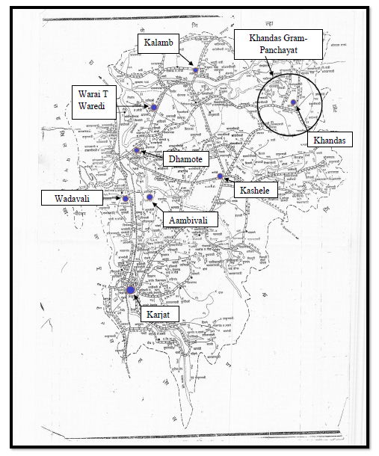
Observation Wells Survey
Work was carried out
as a part of Masters’
Thesis of Vishal
Documentation of
eight observation wells
Measurement of
specifications of Well
Questionnaire survey
in the vicinity of OB well
Figure1: Location of eight observation wells

Slide 4
Observation Wells Survey Outcomes
Almost all wells are being used for domestic water by local residents
People in the vicinity of these wells do not know that it is an observation well
Observation well at Dhamote, could not be located
Only one well at Karjat has a grill cover

Slide 5
Analysis of GSDA data with rainfall data of Karjat Block
Across the years comparison
Input: Aggregate rainfall data, Observation well level data for the same time of different years
Comment: Requires more rigorous analysis that involves developing an infiltration model. Still, few evident discrepancies are listed.
Within the year comparison
Input: Within year rainfall data, Observation well level data for different months within a year
Comment: This is clearer. Water level data can be reasonably compared.

Slide 6
Analysis of GSDA data with rainfall data of Karjat Block: Across the Years
Rainfall data
2003: 2485 mm
2004: 2550 mm
2008: 3638 mm
2009 : 2719 mm
Jan 05
March 09
March 10
Jan 04
Water level has drastically
dropped from
Jan 04 to Jan 05
Water level during March-10
was 5.8 m, which is much
higher than water level
during March-09. There is
decrease in rainfall from 08 to 09.

Slide 7
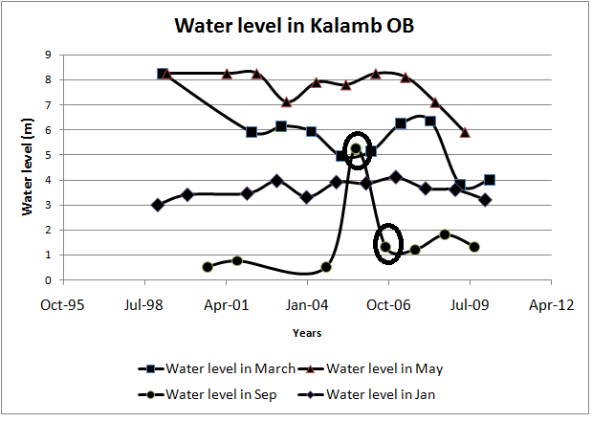
Analysis of GSDA data with rainfall data of Karjat Block: Across the Years
Rain fall
2005: 4774 mm
2006: 4830 mm
Sept 05
Although there is very small increase in average rainfall from 05 to 06, there is drastic increase in water level during October 06
Oct 06

Slide 8
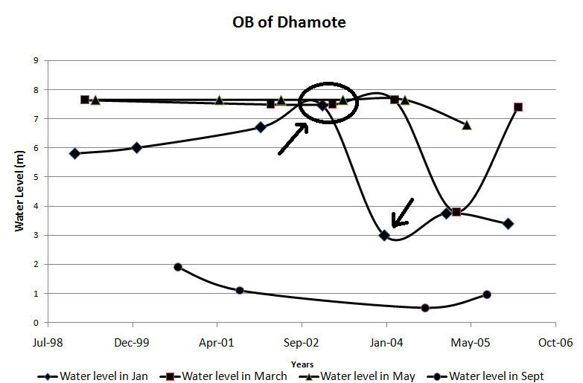
Analysis of GSDA data with rainfall data of Karjat Block: Across the Years
Rainfall
2003: 3140 mm
Jan 03
Jan 04
Although there is an average rainfall of 3140 mm during year 03, there is unexplainable rise in water level during January 04

Slide 9
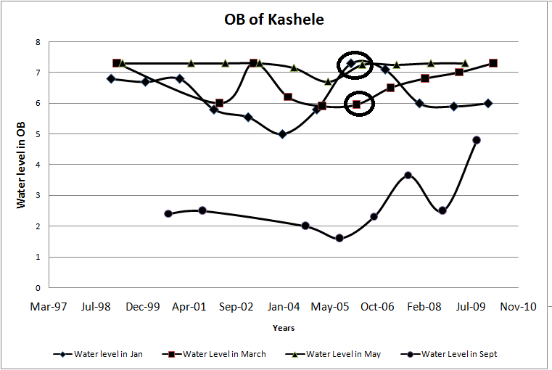
Analysis of GSDA data with rainfall data of Karjat Block: Within the Year
Jan and May 06
Rainfall between Jan 06 to March 06
is just 1.8 mm.
March 06
Although there is quite low rain in
between January 06 and May 06, a
reverse trend in water level is
observed.

Slide 10
Analysis of GSDA data with rainfall data of Karjat Block: Within the Year
Rainfall between Sept 05 to Jan 06
is just 27 mm.
Sept 05
Jan 06
Although there is quite low rain in
between Sept 05 and Jan 06, a
reverse trend in water level is
observed.

Slide 11
Remarks
Reliable groundwater data: an important input to groundwater predictions.
Data mining approaches-composite use of rainfall and OB data -across-years, infiltration models and strengthening geomorphology data -within-year for validation
Other mathematical interpolation and modelling possibilities
Curious: how do you represent a dry-well data point?

