Slide 1
Lecture 20: Hard disk internals
Mythili Vutukuru
IIT Bombay

Slide 2
Hard disk
Interface: a set of 512-byte blocks (sectors), that can be read or written atomically
Internals: one or more platters, connected by a spindle, spinning at ~10K RPM (rotations per minute)
Each platter has a disk head and arm
A platter is divided into multiple tracks, and each track into 512-byte sectors

Slide 3
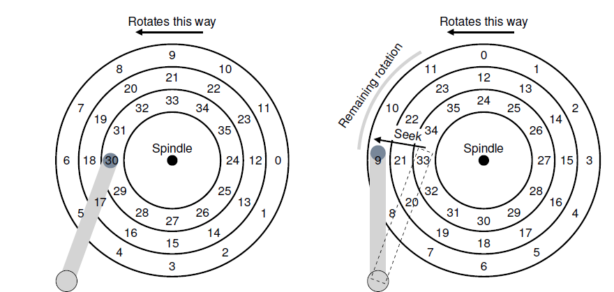
What happens when accessing a sector?
Suppose disk head at 30, need to access 11
Seek to the correct track, wait for disk to rotate

Slide 4
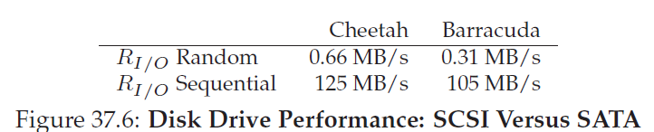
Time taken for I/O operation
Time taken to read/write a block consists of
Seek time to get to the right track (few ms)
Rotational latency for disk to spin to correct sector on the track (few ms)
Transfer time to read sector (few tens microsec)
Given high seek and rotational latency, usually rate of sequential access > rate of random access

Slide 5
Disk Scheduling
Requests to disk are not served in FIFO, they are reordered with other pending requests
Why? In order to read blocks in sequence as far as possible, to minimize seek time and rotational delay
Who does scheduling? OS does not know internal geometry of disk, so scheduling done mostly by disk controller

Slide 6
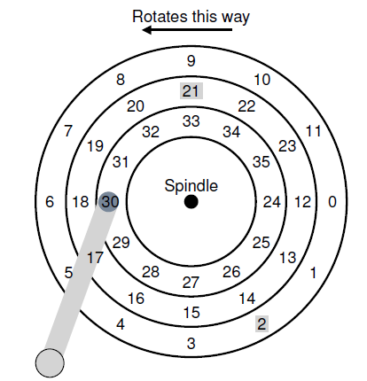
Shortest Seek Time First (SSTF)
Access block that we can seek to fastest
Go to 21 (one track away) before 2 (two tracks away)
Problem: starvation (some requests that are far from current position of head may never get served)

Slide 7
Elevator/SCAN algorithm
Disk head does one sweep over tracks and serves requests that fall on the path
Elevator/SCAN: sweep outer to inner, then inner to outer
C-SCAN: sweep only one direction (say, outer to inner) and circle back, start again
Why? Sweeping back and forth favors middle tracks more
F-SCAN: freeze queue while scanning
Why? Avoid starving far away requests

Slide 8
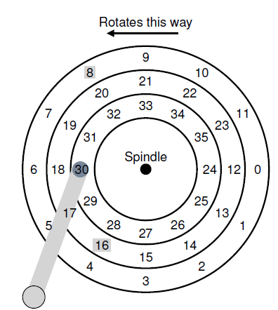
Shortest Positioning Time First (SPTF)
Considers both seek time and rotational latency
Better to serve 8 before 16, even though seek time is higher
Why? 16 incurs a much higher rotational latency

Slide 9
Data storage on disk
Bits stored on disk with some error detection/correction bits
Correct random bit flips
Detect corruption of data
Disk controller or OS can handle some errors (e.g., blacklisting certain sectors)
If errors cannot be masked, user perceives hard disk failures
Technologies such as RAID (Redundant Array of Inexpensive Disks) provide high reliability and performance by replicating across multiple disks.

