Slide 1
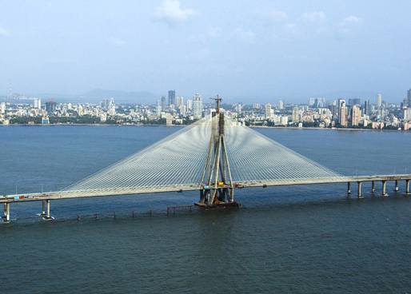
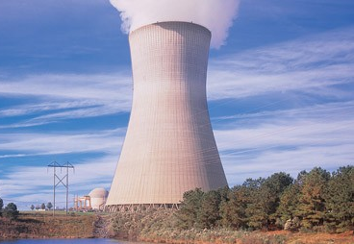
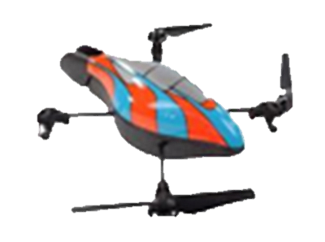
Imaging through Drones
Meghshyam G. Prasad
Supervisors
Sharat Chandran and Michael S. Brown
Image Courtesy: MSRDC(left), Google Image Search(right)

Slide 2
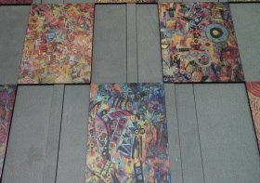
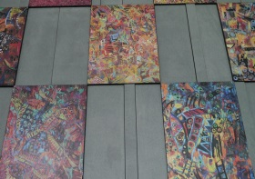
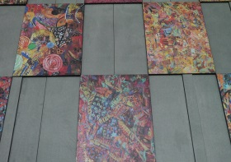
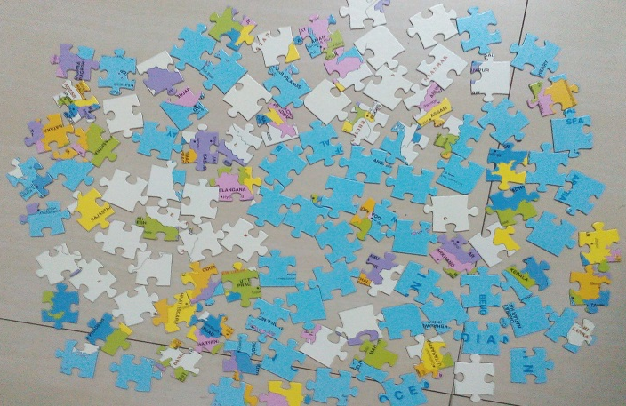
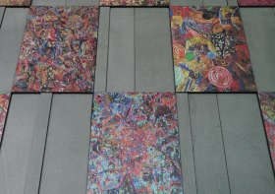
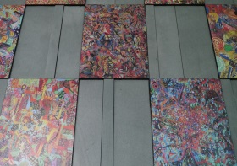
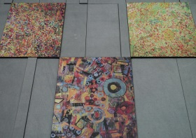
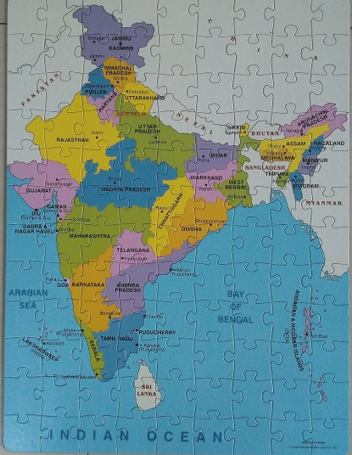
Mosaicing Images Jigsaw Puzzle
One of computer vision’s success is ‘panoramic mosaicing’
We can view mosaicing akin to solving a Jigsaw puzzle

Slide 3
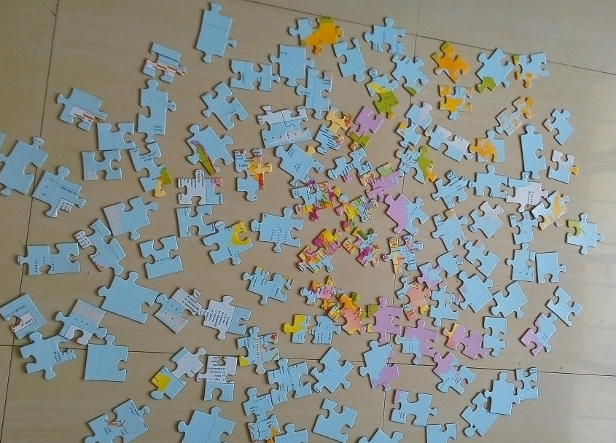
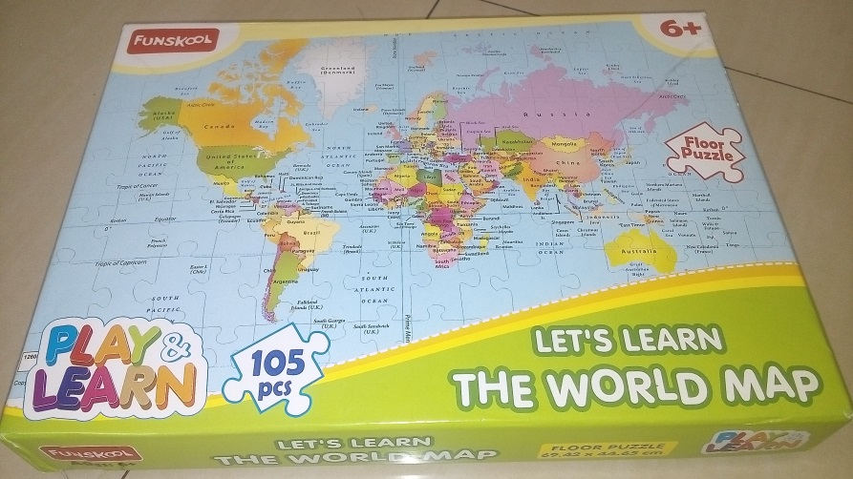
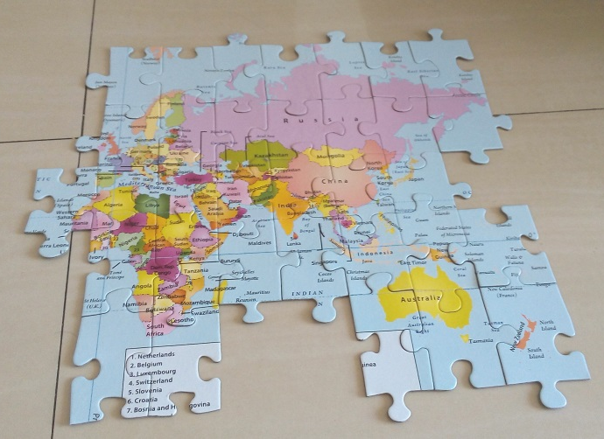
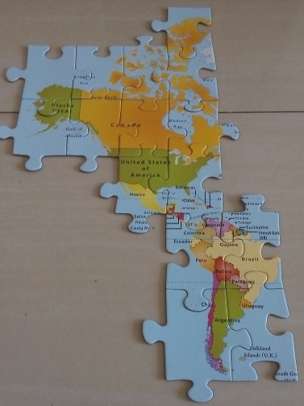
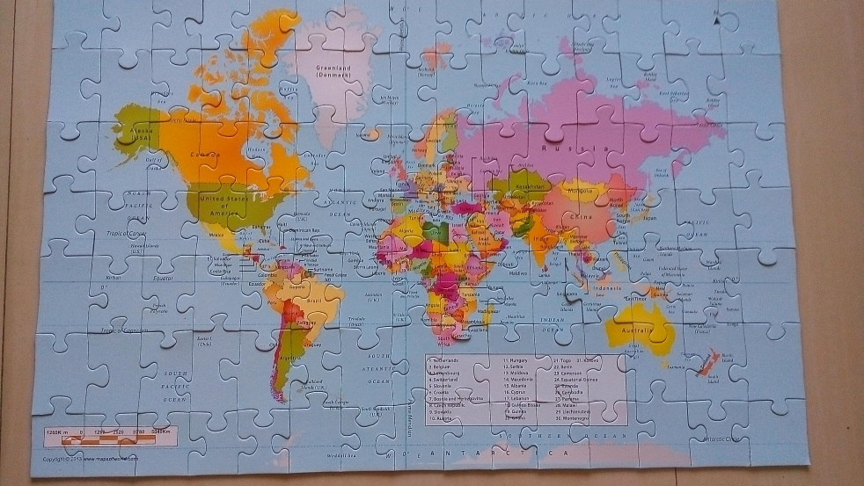
‘Difficult’ Jigsaw Puzzle

Slide 4
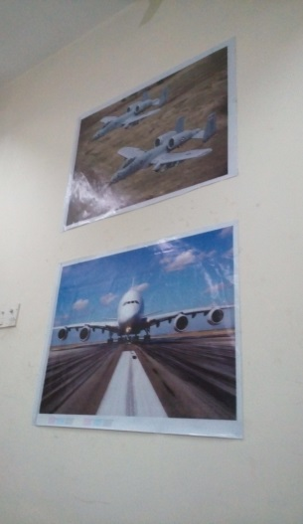
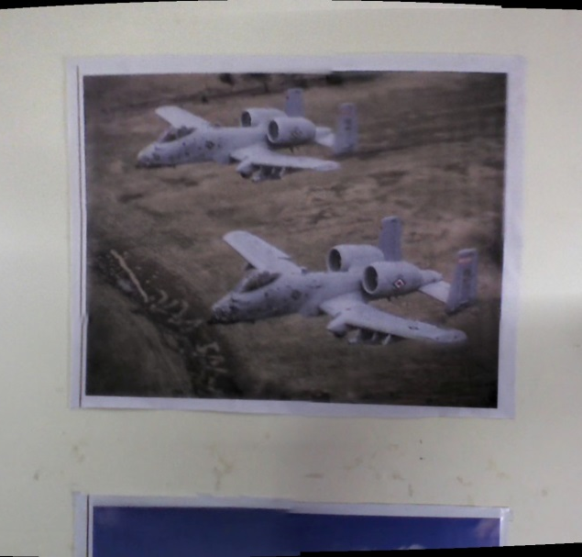
Mosaicing problem solved?
Vacant Spaces: Matching algorithms fail if there are ‘vacant spaces’: little or no overlap (in feature space) between images
Adobe Photoshop’s Output
Input Scene
Approx. 10 ft. height with gap of 2 ft.

Slide 5
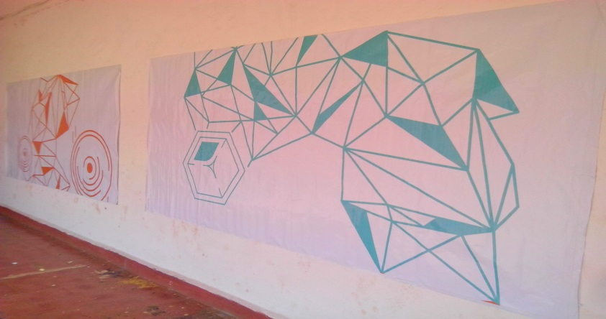
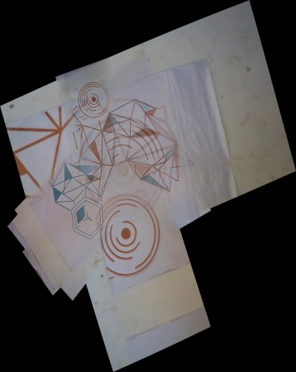
Mosaicing problem resolved?
Repetitive patterns: When scene patterns and texture are repeated (too many similar features), matching algorithm gets confused
Input Scene
Approx. 15 ft. width with gap of 2 ft.
AutoStitch¹ Output
¹AutoStitch. Matthew Brown. http://matthewalunbrown.com/autostitch/autostitch.html

Slide 6
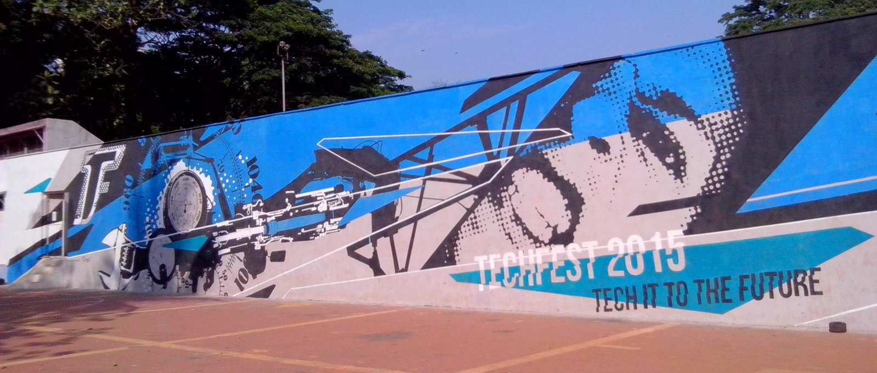
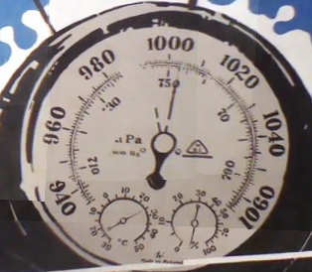
Mosaicing problem solved?
Visualizing large scenes with high quality requires camera movement along two dimensions (too tiring)
Orthographic view of scenes may be infeasible
Too tall
Approach unavailable to people

Slide 7
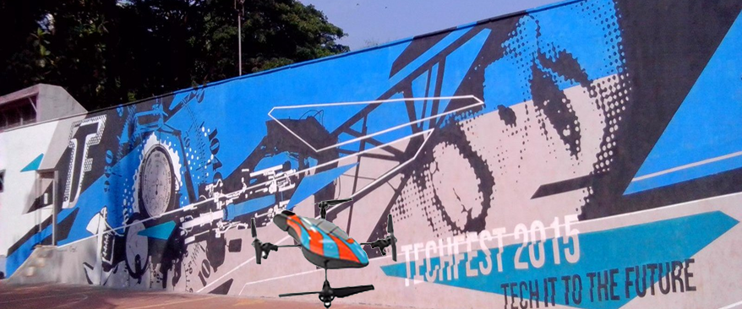
Solution: Inexpensive Quadcopter
However, even a 3 minute video overwhelms any mosaicing program such as Adobe Photoshop (too many images)

Slide 8
Quadcopter benefit: IMU
Inexpensive quadcopters contain an inertial measurement unit (IMU)
After calibration, the IMU gives reasonable information of positions
However,
Pitch and roll may be completely off due to jerky movement of the low cost device
Only IMU cannot be used to scale and reposition input images
GPS may not be present, and cannot be used in indoor environments

Slide 9
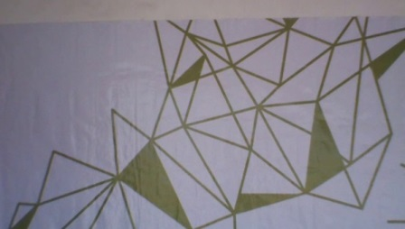
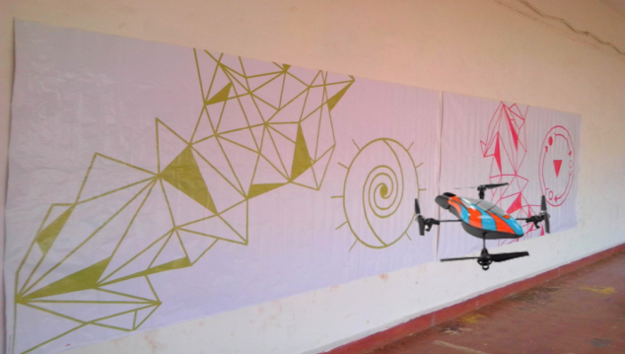
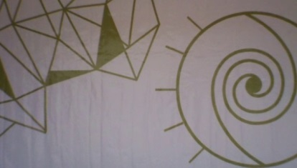
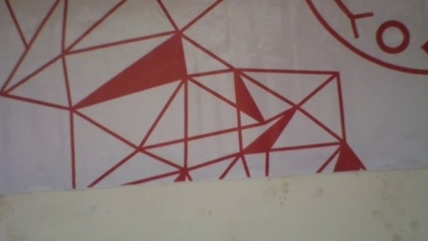
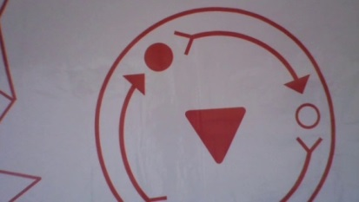
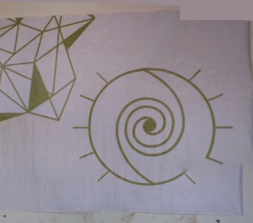
Overall Workflow
Systematic Image Capture
IMU Data
IMU Data
Graph Creation
Discovery of Interesting Images
IMU : Inertial Measurement Unit
IMU Data
Super Panorama
Mini-Panoramas
Notes:
Graph creation will result in disconnected components only if there are vacant spaces in input scene

Slide 10
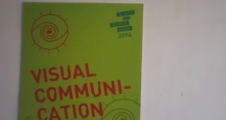
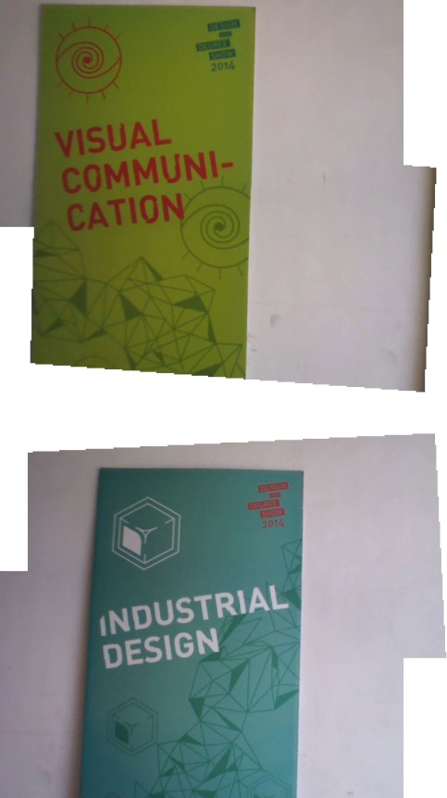
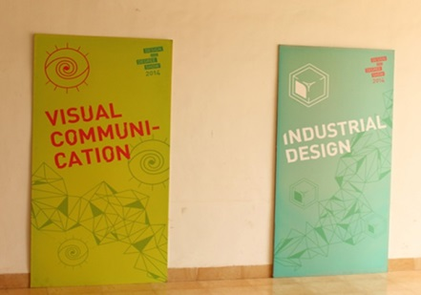
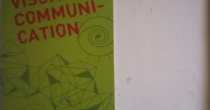
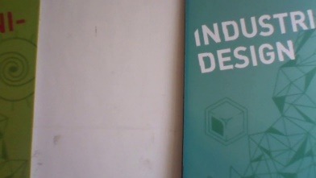
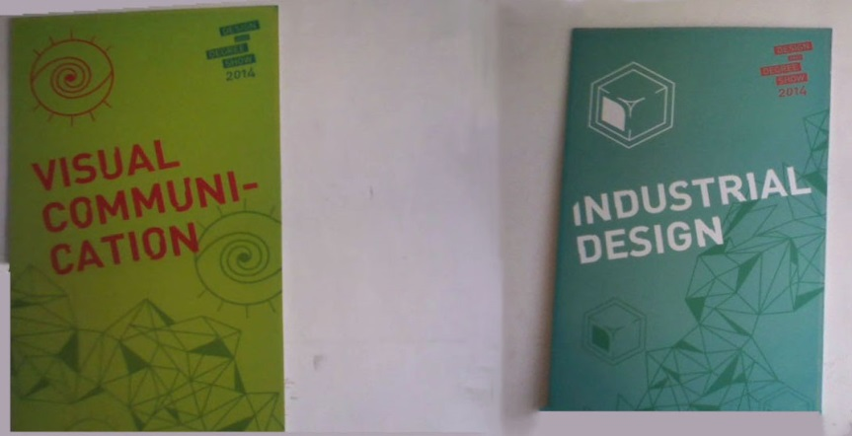
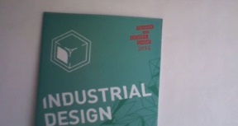
Results: Vacant Spaces
Long Range Photograph
Each display board of approx. 7 ft. height with 3 ft. gap in between
Selected Images
State of the Art Output: Either Top or Bottom
Our Output

Slide 11
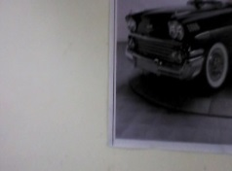
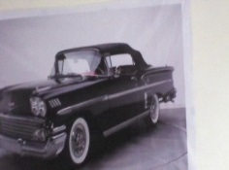
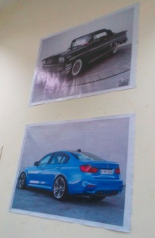
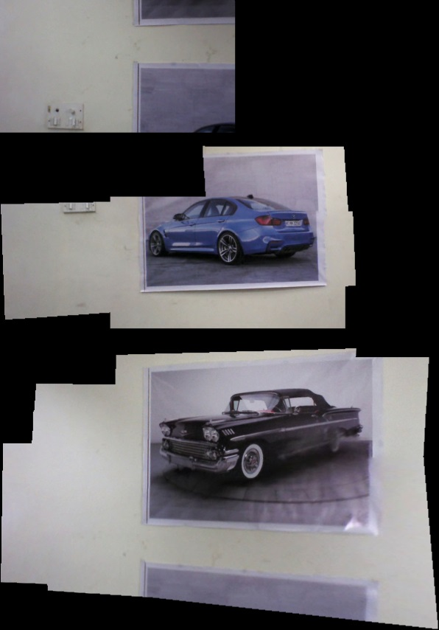
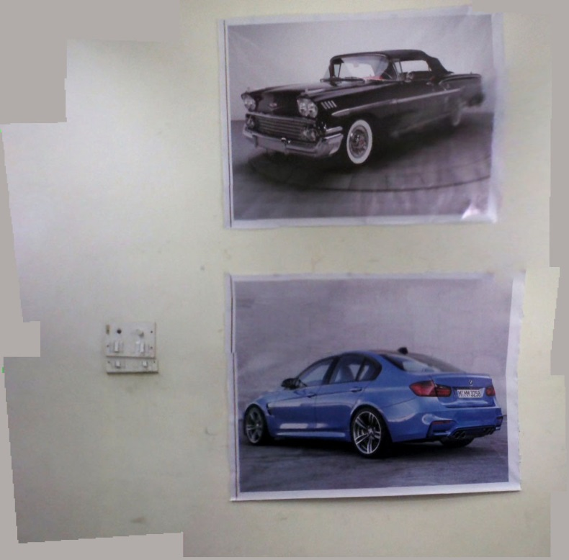
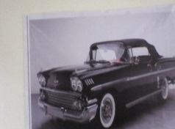
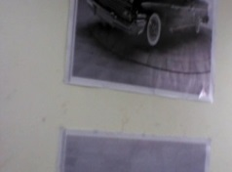
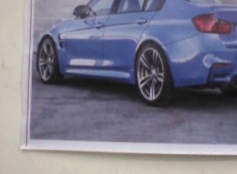
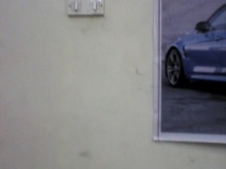
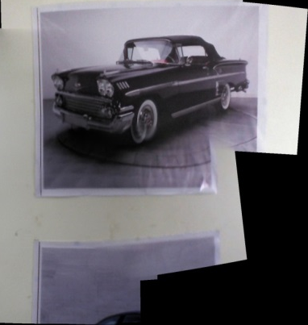
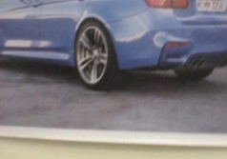
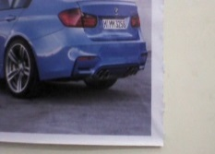
Results: Orthographic View
Long range photograph
Selected Images
AutoStitch
Output
Photoshop
output
Our output
Each poster of approx. 4 ft. height with 2 ft. gap in between

Slide 12
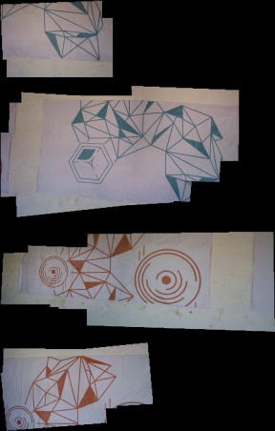
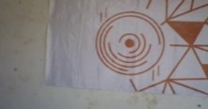
Results: Confusing features
Long Range Photograph
AutoStitch
Photoshop
Selected Images
Our Output
Each poster of approx. 8 ft. width and 5 ft. height with 2 ft. gap in between

Slide 13
Summary
We proposed a new problem of mosaicing large scenes orthographically
Traditional mosaicing methods fail in the presence of
‘vacant spaces’
repetitive patterns in scenes
We solved these problems efficiently using a combination of computer vision techniques, and with IMU data from an inexpensive quadcopter

