Slide 1
Horses for Courses
Translating Imperative Code into SQL
K. Venkatesh Emani
Advisor: S. Sudarshan
IIT Bombay

Slide 2
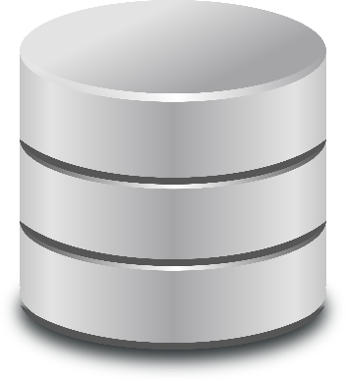
Network round trips
Transfer of unused data
Can we reduce number of queries?
Can we reduce amount of data fetched?
Time taken for one query
APP
What translations do we do?
Selections
Projections
Joins
Aggregations
Exists
Others
All blocks transferred but only two used
DB
Time taken by rewritten query
Only required data is fetched
Time taken for
all queries
Time
Time

Slide 3
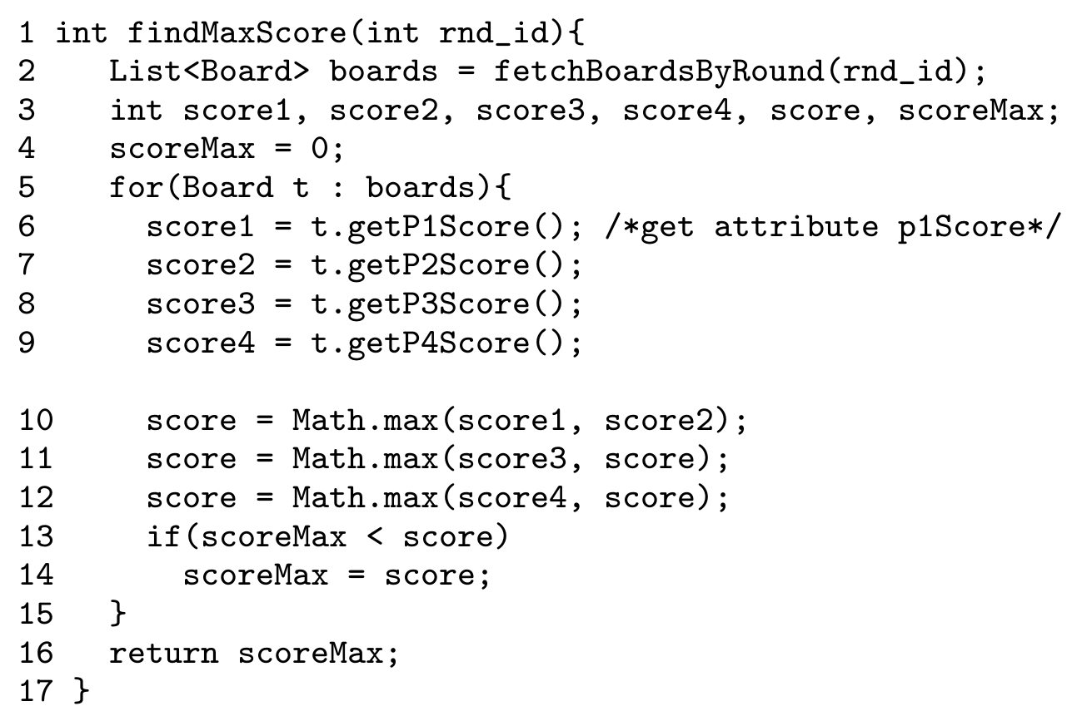
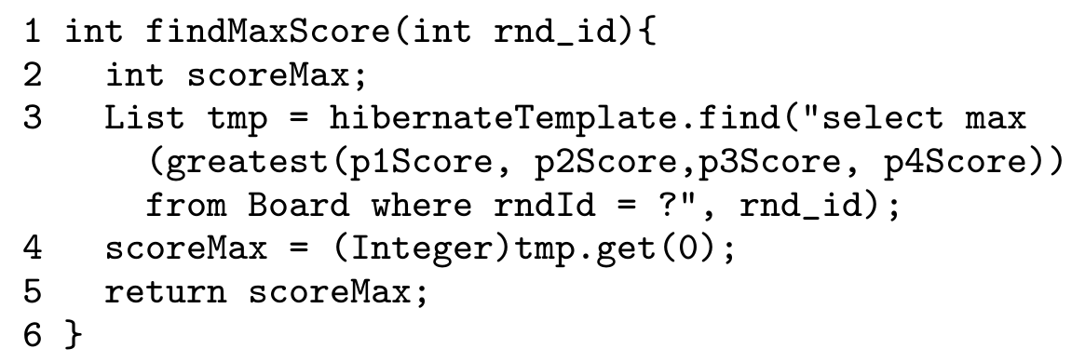
Example
BEFORE
AFTER

Slide 4
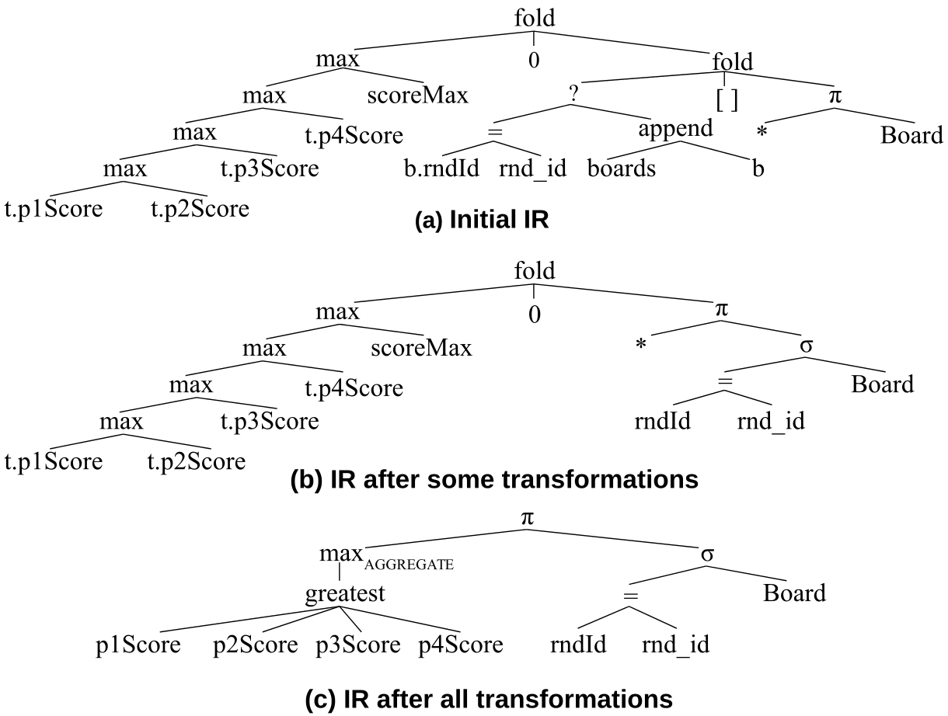
Intermediate Representation
DAG
Relational expressions
Source language expressions
fold for loops

Slide 5
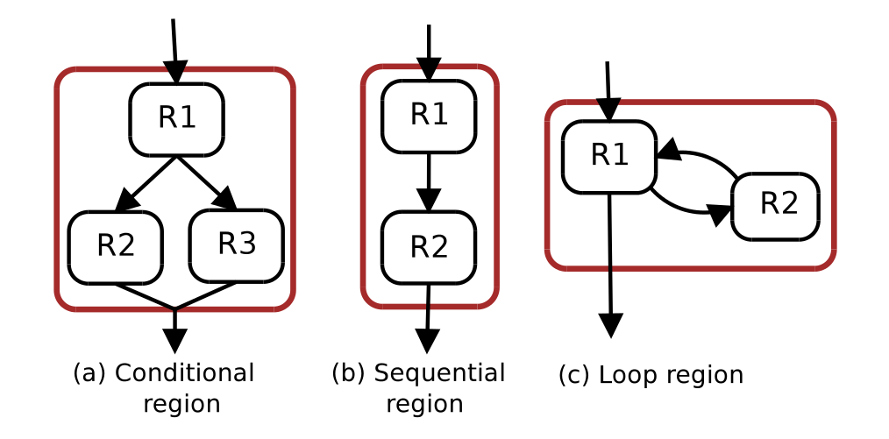
Challenges
Techniques Involved
Program regions
Built from Control Flow Graph
Rule based transformations on algebraic IR
Program rewriting
Dead code removal
Preserving program semantics – real world programs are complex
Rewriting to SQL not always possible
Preconditions on the Data Dependence Graph

Slide 6
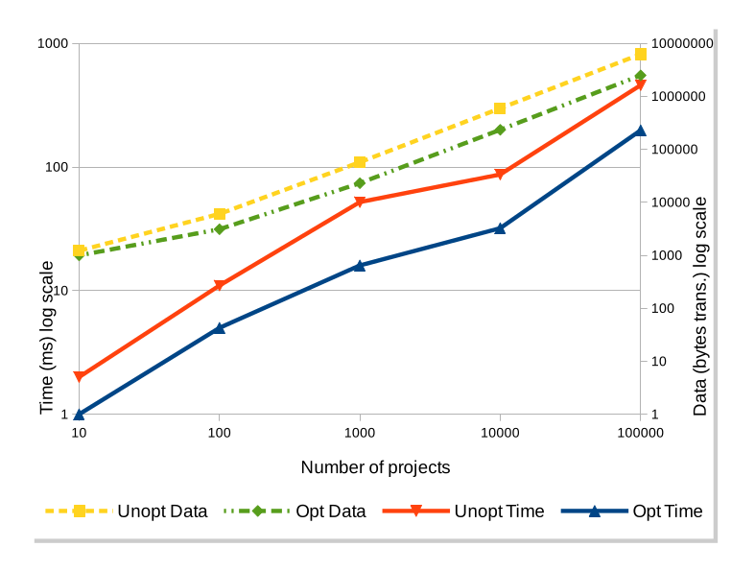
Evaluation
Significant improvements after rewriting – both data and time
> 80% applicability on samples from real world open source application using Hibernate
Comparable to other approaches with similar goals
Resource utilization much lesser

Slide 7
Going forward …
Use these ideas to optimize web services and mobile applications?
A step towards allowing database application developers to express functionality, and let the compiler worry about optimizations

