Slide 1
Process Edification
for Traceability
in Evolving Architectures
Vrinda Yadav IITB-Monash Research Academy, IIT Bombay, India
Rushikesh K. Joshi Department of Computer Science & Engineering, IIT Bombay, India
Sea Ling Faculty of Information Technology, Monash University, Australia

Slide 2
Motivation
Now what if?
The architect leaves the project or the company
Earlier made decisions need to be revisited
Trace the decisions and the changes over time
Multiple modifications made to the processes
Knowledge
Requirements
Architecture
Architect
Evolution

Slide 3
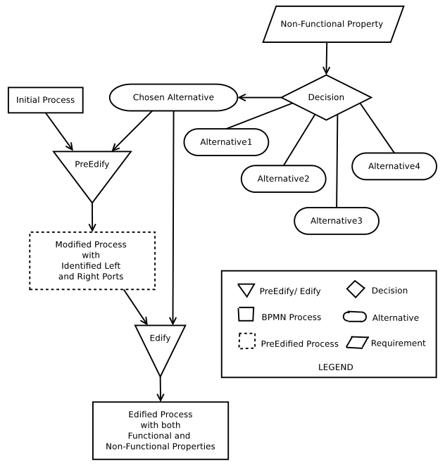
Meta Model of Process Edification

Slide 4
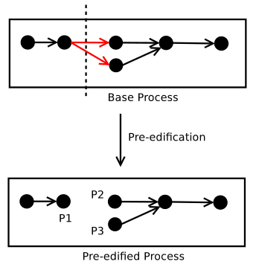
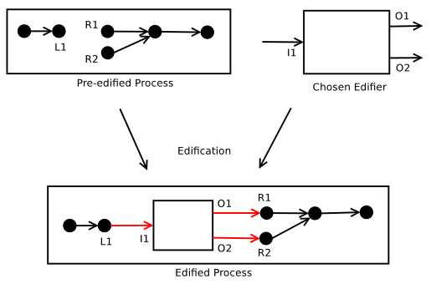
Activities in Process Edification
Edifier Construction
Pre-edification
Edification
O1
I1
O2

