Slide 1
Improving Performance of Network Function Virtualization System (NFV)
Priyanka Naik
Supervisor: Prof. Mythili Vutukuru

Slide 2
What is NFV ???
Conventional Network Appliance Approach
Network Function Virtualization Approach
Virtual Machines
Standard servers, storage and switches

Slide 3
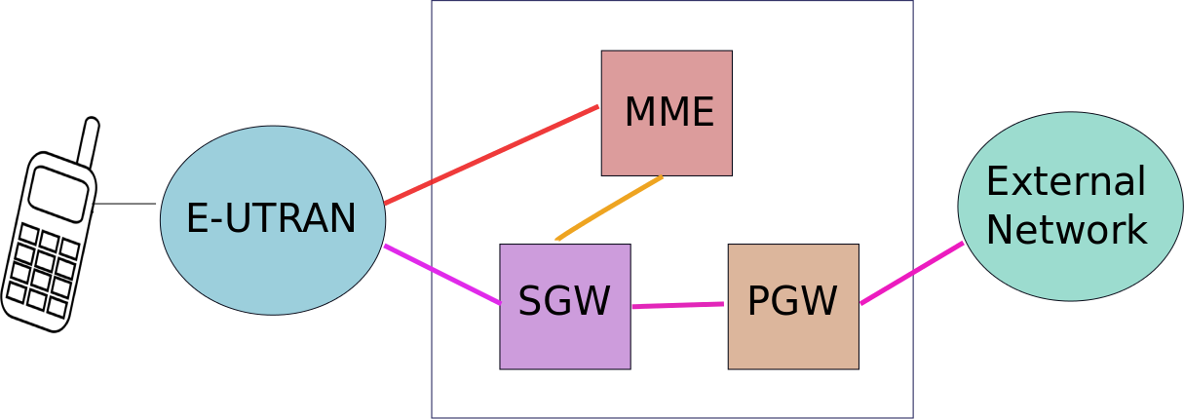
NFV Example
High Cost Hardware Middleboxes
Low Cost Virtual Machines

Slide 4
NFV Deployment
Deployment Components
Application Specific
(ex. EPC Content)
System Specific
Monitor Performance
Manage Scalability

