Slide 1
Human: “You are fast, just like a snail”
----------------------
ALICE: “Thank you for telling me I am fast like a snail”
Assistant.ai: “A good assistant is whatever their boss needs them to be”
Turing Test
An AI agent must be able to imitate humans
“
Sarcasm
A cutting, often ironic remark intended to express contempt or ridicule” – Thefreedictionary.com
All images from wikimedia commons.

Slide 2
Computational Sarcasm
Sprint Thesis Talk by
Aditya Joshi
adityaj@cse.iitb.ac.in
PhD Advisors:
Prof. Pushpak Bhattacharyya, IITB
Prof. Mark J Carman, Monash

Slide 3
The emerging theme
Computational Sarcasm
Understanding sarcasm in humans
Generating sarcasm
Detecting sarcasm
Sarcasm using context incongruity within target text
Sarcasm using incongruity with historical text by the author: (a) Rule-based, (b) Topic model-based
Sarcasm using incongruity with historical text in a conversation
A chatbot module that always responds
sarcastically
An emotion engine
that measures change
in emotions
A sarcasm-enabled
chatbot
Sentiment annotation complexity (eye-tracking)
Sarcasm annotation
complexity (eye-tracking)
Sarcasm in different
cultures
Ongoing
Planned

Slide 4
Sarcasm Generation: A chatbot that responds sarcastically!
Based on ‘SarcasmBot: An open-source sarcasm generation module for chatbots’, WISDOM-KDD 2015, Sydney, August 2015
User Input
What do you think of Greg?
Input
Analyzer
Entities: “Greg: Name”
Tense: Present
Evaluation
Were human evaluators able to identify
which of two responses is from our chatbot?
Generator Selector
Type of question:
Opinion question
I <sentiment-word> <entity>.
<Expression-of-opposite-sentiment>
Sarcasm Generators (8)
I like Greg. The way I love
zero-accountability people.

Slide 5
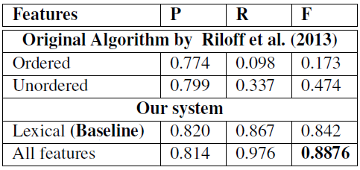
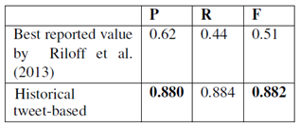
Sarcasm Detection: Using incongruity for a sarcasm classifier
Conclusion
Our work presents approaches to sarcasm generation and detection.
Also see: My poster based on “Drunk-texting Prediction”
Based on ‘Harnessing Context Incongruity for Sarcasm Detection’, ACL–IJCNLP 2015, Beijing, July 2015, and ‘Your sentiment precedes you...’, WASSA – EMNLP 2015, Portugal, 2015.
Being stranded in traffic is the best way to start a week.
Words
Implicit phrases
.
.
Features
# Sentiment Flips
.
I loovved participating in RISC this year.
Lexical polarity
Nicki Minaj! Don’t I looovve her!
Features as given above +
Features
Sentiment agreement with “historical tweets”
Historical tweet: Nicki Minaj is pathetic!

