Slide 1
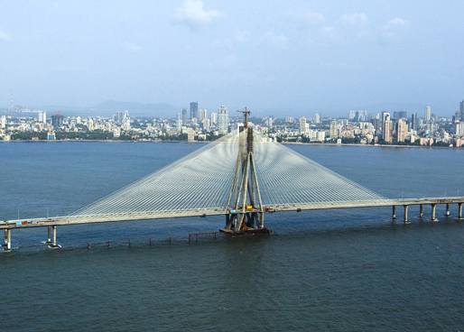
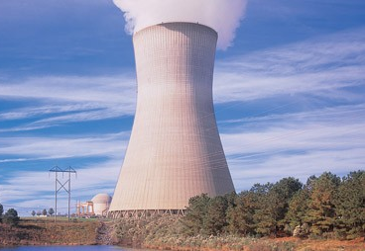
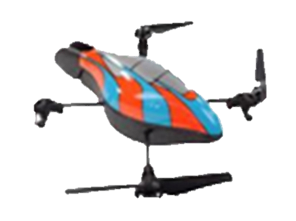
Imaging through Drones
Meghshyam G. Prasad
Supervisors
Sharat Chandran and Michael S. Brown
Image Courtesy: MSRDC(left), Google Image Search(right)

Slide 2
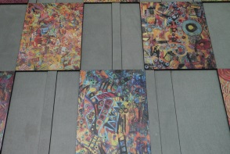
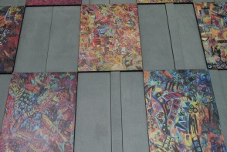
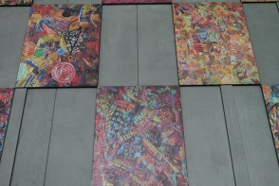
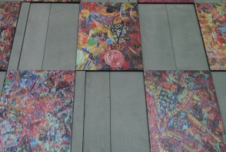
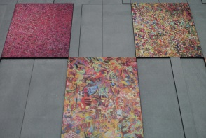
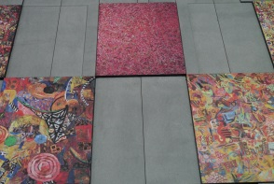
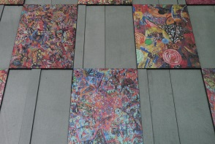
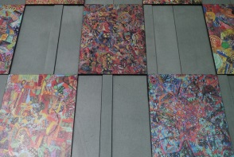
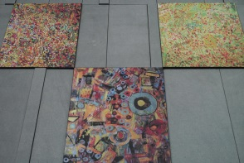
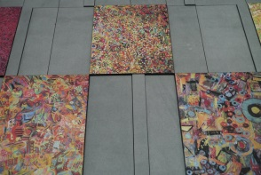
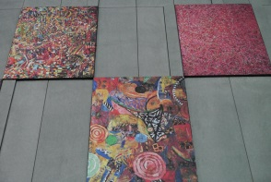
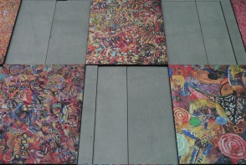
What is Mosaicing?

Slide 3
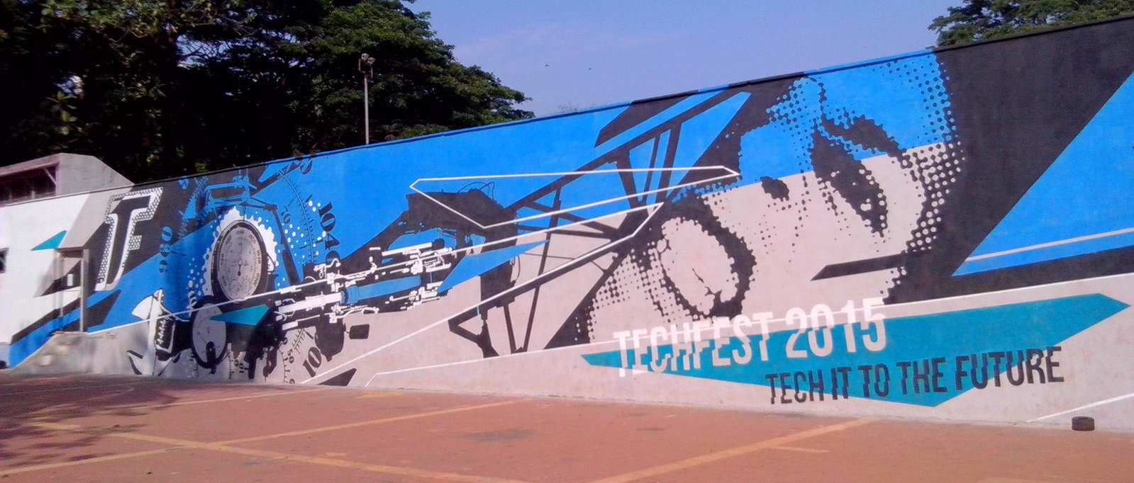
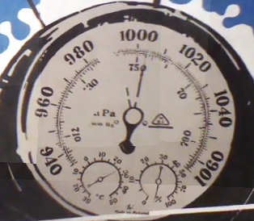
Mosaicing problem solved?
Visualizing large scenes with high quality requires camera movement along two dimensions (too tiring)
Orthographic view of scenes may be infeasible
Too tall
Approach unavailable to people

Slide 4
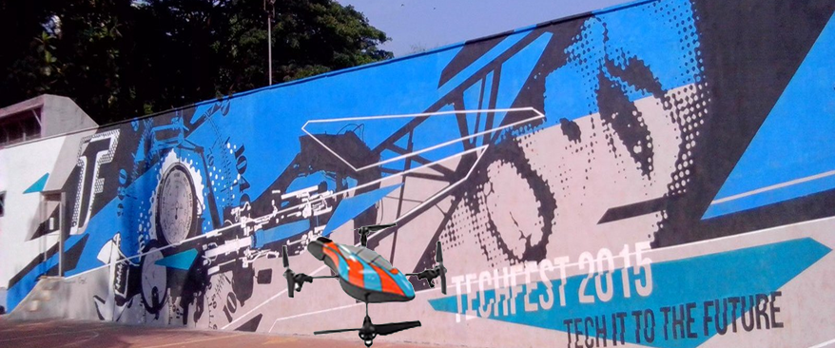
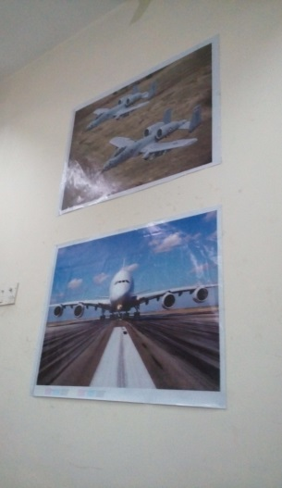
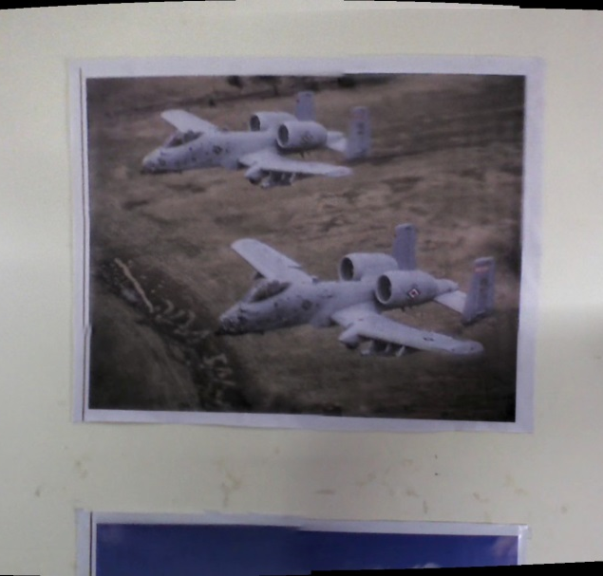
Solution: Inexpensive Quadcopter
We solved these problems using fusion of positional information with computer vision techniques
Adobe Photoshop Output
Input Scene
Approx. 10 ft. height with gap of 2 ft.
However, even a 3 minute video overwhelms any mosaicing program such as Adobe Photoshop (too many images)
Stitching algorithms fail if there are ‘vacant spaces’: little or no overlap between images

