Slide 1
MAP Inference in Markov Models in Computer Vision
Pushmeet Kohli
M Pawan Kumar
ICVGIP 2010

Slide 2
Schedule
9:30-11:00 - Introduction (Pushmeet)
11:00-11:30 - Coffee break
11:30-1:00 - Message Passing (Pawan)
1:00-2:00 – Lunch
2:3:30 - Graph Cuts (Pushmeet)
3:30-4:00 - Coffee break
4:00-5:15 - Advanced Topics (Pawan)
5:15-3:30 - Q&A (Pushmeet and Pawan)

Slide 3
Introduction
Lecture: Pushmeet Kohli

Slide 4
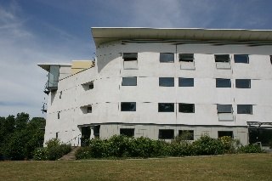
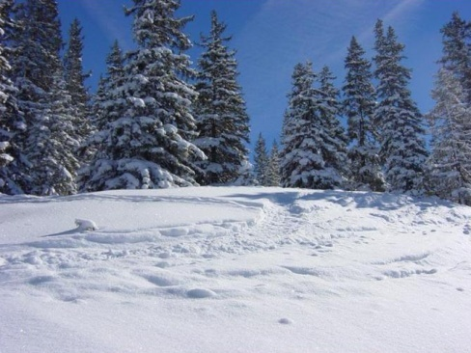

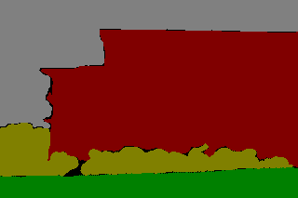
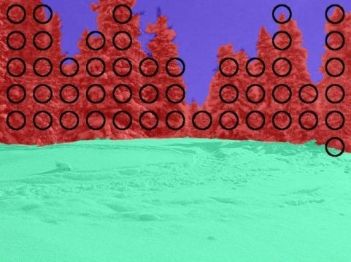
Image Labelling Problems
Infer the values of hidden random variables
Object Segmentation
Pose Estimation
Geometry Estimation
Sky
Building
Orientation
Joint angles
Tree
Grass

Slide 5
Example
Image Segmentation

Slide 6
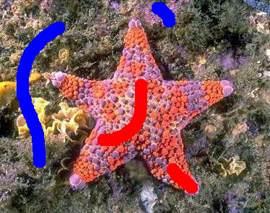
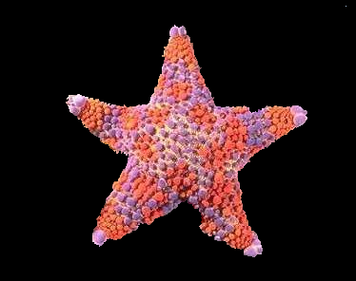
Image Segmentation
( n = number of pixels )
z є (R,G,B)^{n}
x є {0,1}^{n}
Preliminaries
n random variables: x₁,…,x_{n}
Joint Probability: P(x₁,…,x_{n})
Conditional Probability: P(x₁|x₂…,x_{n})
Marginal probability: P(x₁)

Slide 7
Image Segmentation
( n = number of pixels )
z є (R,G,B)^{n}
x є {0,1}^{n}

Slide 8
Image Segmentation
( n = number of pixels )
z є (R,G,B)^{n}
x є {0,1}^{n}
P(x|z) = P(z|x) P(x) / P(z) ~ P(z|x) P(x)
Posterior
Probability
Likelihood
(data-dependent)
Prior
(data- independent)
(MAP Solution) x* = arg max P(x|z) = arg min E(x)
x
x

Slide 9
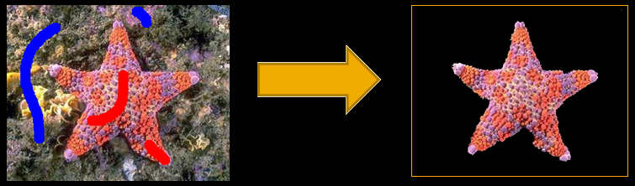
Image Segmentation
Posterior
Likelihood
Prior
P(x|z) = P(z|x) P(x)
∏
P(z_{i}|x_{i})
x_{i}

Slide 10
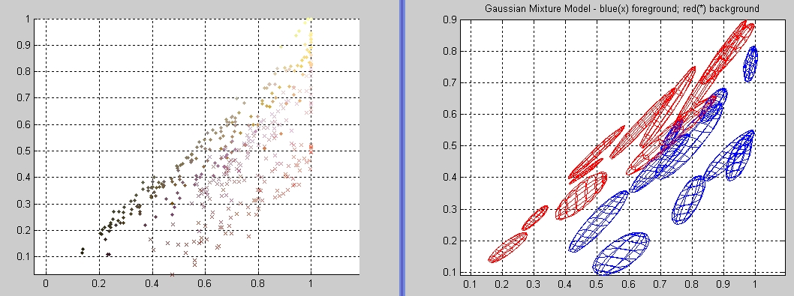
Likelihood
P(x|z) ~ P(z|x) P(x)
P(z|x) = F_{GMM} (z,x)
Green
Green
Red
Red

Slide 11
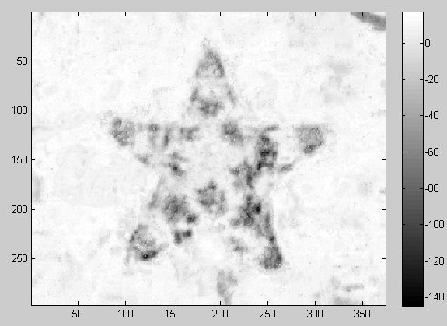
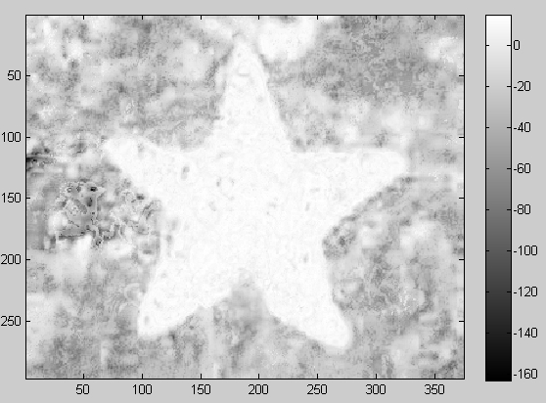

Likelihood
P(x|z) ~ P(z|x) P(x)
Log P(z_{i}|x_{i}=0)
P(z_{i}|x_{i}=1)
MAP Solution
x* = argmax P(z|x)
= argmax P(z_{i}|x_{i})
x
∏
x
x_{i}

Slide 12
Image Segmentation
Posterior
Likelihood
Prior
P(x|z) = P(z|x) P(x)
∏
f(x_{i},x_{j})
Encourages consistency between labelling of adjacent pixels
x_{i},x_{j}

Slide 13
Prior
P(x|z) ~ P(z|x) P(x)
x_{i}
x_{j}
P(x) = ∏ f_{ij} (x_{i},x_{j})
= ∏ exp{-|x_{i}-x_{j}|} “MRF Ising prior”
i,j Є N
i,j Є N

Slide 14
Posterior and Energy Function
P(x|z) =
∏
P(z_{i}|x_{i})
∏
P(x_{i},x_{j})
Posterior Probability
x_{i}
x_{i},x_{j}
-ve log
E(x,z,w) = ∑ θ_{i} (x_{i},z_{i}) + w ∑ θ_{ij} (x_{i},x_{j},z_{i},z_{j})
i
i,j
Energy

Slide 15
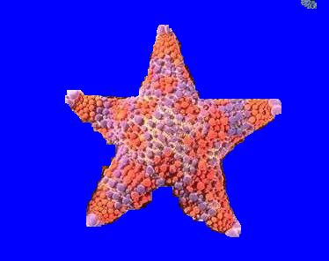
Posterior and Energy Function
E(x,z,w) = ∑ θ_{i} (x_{i},z_{i}) + w ∑ θ_{ij} (x_{i},x_{j})
i
i,j
Image
Likelihood Solution
MRF Solution
(Ising prior)

Slide 16
Conditional Random Fields
P(x|z) =
∏
P(z_{i}|x_{i})
∏
P(x_{i},x_{j},z_{i},z_{j})
x_{i}
x_{i},x_{j}
-ve log
E(x,z,w) = ∑ θ_{i} (x_{i},z_{i}) + w ∑ θ_{ij} (x_{i},x_{j},z_{i},z_{j})
i
i,j
[Boykov and Jolly ‘ 01] [Blake et al. ‘04] [Rother, Kolmogorov and Blake `04]

Slide 17
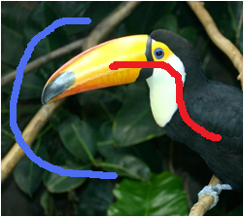
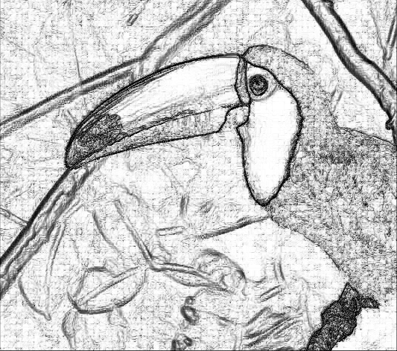
Conditional Random Fields
E(x,z,w) = ∑ θ_{i} (x_{i},z_{i}) + w ∑ θ_{ij} (x_{i},x_{j},z_{i},z_{j})
i
i,j
Cost (θ_{ij})
||z_{i}-z_{j}||₂
Pairwise Cost
[Boykov and Jolly ‘ 01] [Blake et al. ‘04] [Rother, Kolmogorov and Blake `04]

Slide 18
Conditional Random Fields
E(x,z,w) = ∑ θ_{i} (x_{i},z_{i}) + w ∑ θ_{ij} (x_{i},x_{j},z_{i},z_{j})
i
i,j
Pairwise Cost
Global Minimum (x*)
[Boykov and Jolly ‘ 01] [Blake et al. ‘04] [Rother, Kolmogorov and Blake `04]

Slide 19
Some useful concepts
Factors graphs
&
Order of a posterior distribution (or energy function)

Slide 20
Factor Graphs
Write probability distributions as Graphical model:
P(x) ~ exp{-E(x)}
E(x) = θ(x₁,x₂,x₃) + θ(x₂,x₄) + θ(x₃,x₄) + θ(x₃,x₅)
Gibbs distribution
“4 factors”
x₁
x₂
unobserved
variables are in same factor.
x₃
x₄
References:
- Pattern Recognition and Machine Learning [Bishop ‘08, book, chapter 8]
- several lectures at the Machine Learning Summer School 2009 (see video lectures)
x₅
Factor graph

Slide 21
Definition “Order”
x₁
x₂
Definition “Order”:
The arity (number of variables) of the largest factor
x₃
x₄
Factor graph
with order 3
E(X) = θ(x₁,x₂,x₃) θ(x₂,x₄) θ(x₃,x₄) θ(x₃,x₅)
x₅
arity 3
arity 2
Notes:
Make a new slide and explain this better

Slide 22
Examples - Order
4-connected; pairwise MRF
higher(8)-connected; pairwise MRF
Higher-order RF
E(x) = ∑ θ_{ij} (x_{i},x_{j})
E(x) = ∑ θ_{ij} (x_{i},x_{j})
E(x) = ∑ θ_{ij} (x_{i},x_{j})
+θ(x₁,…,x_{n})
i,j Є N₄
i,j Є N₈
i,j Є N₄
Order 2
Order 2
Order n
“Pairwise energy”
“higher-order energy”

Slide 23
Random field models
4-connected; pairwise MRF
higher(8)-connected; pairwise MRF
Higher-order RF
E(x) = ∑ θ_{ij} (x_{i},x_{j})
E(x) = ∑ θ_{ij} (x_{i},x_{j})
E(x) = ∑ θ_{ij} (x_{i},x_{j})
+θ(x₁,…,x_{n})
i,j Є N₄
i,j Є N₈
i,j Є N₄
Order 2
Order 2
Order n
“Pairwise energy”
“higher-order energy”

Slide 24
Random field models
4-connected; pairwise MRF
higher(8)-connected; pairwise MRF
Higher-order RF
E(x) = ∑ θ_{ij} (x_{i},x_{j})
E(x) = ∑ θ_{ij} (x_{i},x_{j})
E(x) = ∑ θ_{ij} (x_{i},x_{j})
+θ(x₁,…,x_{n})
i,j Є N₄
i,j Є N₈
i,j Є N₄
Order 2
Order 2
Order n
“Pairwise energy”
“higher-order energy”

Slide 25




Sparse Higher Order Potentials for Texture Restoration
Training
Image
Pairwise
Energy P(x)
Test Image
Test Image
(60% Noise)
Minimized using
st-mincut or max-product message passing
Result

Slide 26



Sparse Higher Order Potentials for Texture Restoration
Training
Image
Higher Order Structure not Preserved
Pairwise
Energy P(x)
Test Image
Test Image
(60% Noise)
Minimized using
st-mincut or max-product message passing
Result

Slide 27
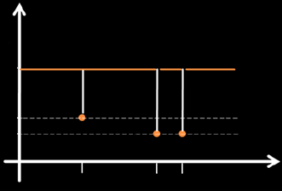
Sparse Higher Order Potentials for Texture Restoration
Minimize:
E(X) = P(X) + ∑ h_{c} (X_{c})
c
Where:
h_{c}: {0,1}^{|c|} → R
Higher Order Function (|c| = 10x10 = 100)
Assigns cost to 2¹⁰⁰ possible labellings!
Exploit function structure to transform it to a Pairwise function
p₁
p₂
p₃

Slide 28
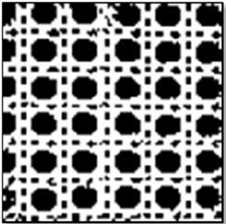
Sparse Higher Order Potentials for Texture Restoration
Learned Patterns
Training
Image
Test Image
Test Image
(60% Noise)
Pairwise Result
Higher-Order
Result
[Joint work with Carsten Rother ]

Slide 29
Examples
Image segmentation
Stereo
Semantic Segmentation

Slide 30
Examples
Image segmentation
Stereo
Semantic Segmentation

Slide 31
Image segmentation
P(x|z) ~ exp{-E(x)}
E(x) = ∑ θ_{i} (x_{i,}z_{i}) + ∑ θ_{ij} (x_{i},x_{j})
i
i,j Є N₄
Observed variable
Unobserved (latent) variable
z_{i}
x_{j}
x_{i}
Factor graph
Notes:
Mention hard constraints

Slide 32
Segmentation: Conditional Random Field
E(x) = ∑ θ_{i} (x_{i,}z_{i}) + ∑ θ_{ij} (x_{i},x_{j},z_{i},z_{j})
i
i,j Є N₄
θ_{ij}
θ_{ij} (x_{i},x_{j},z_{i},z_{j}) = |x_{i}-x_{j}| (-exp{-ß||z_{i}-z_{j}||})
||z_{i}-z_{j}||
z_{j}
z_{j}
z_{i}
z_{i}
Observed variable
x_{j}
x_{j}
Unobserved (latent) variable
x_{i}
x_{j}
Factor graph

Slide 33
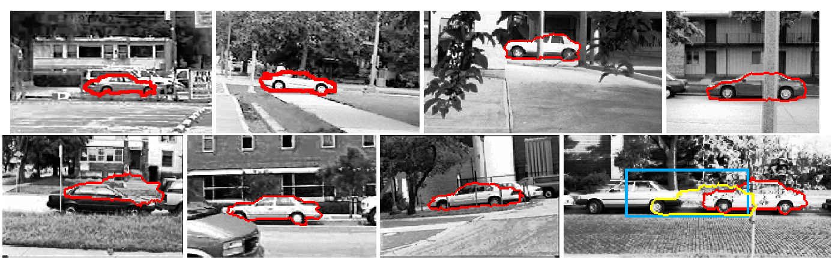
Simultaneous Detection and Segmentation
x – binary image segmentation (x_{i} ∊ {0,1})
ω – non-local parameter (lives in some large set Ω)
E(x,ω) = C(ω) + ∑ θ_{i} (ω, x_{i}) + ∑ θ_{ij} (ω,x_{i},x_{j})
i
i,j
constant
unary potentials
pairwise potentials
ω
Template Position Scale Orientation

Slide 34
Examples
Image segmentation
Stereo
Semantic Segmentation

Slide 35
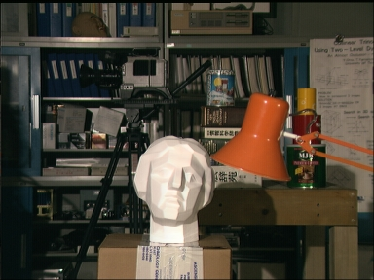
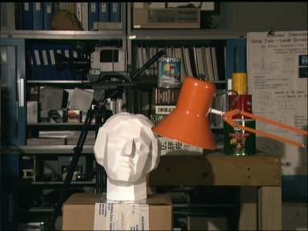

Stereo matching
d=0
d=4
Image – left(a)
Image – right(b)
Ground truth depth
Images rectified
Ignore occlusion for now
Energy:
d_{i}
E(d): {0,…,D-1}^{n} → R
Labels: d (depth/shift)

Slide 36
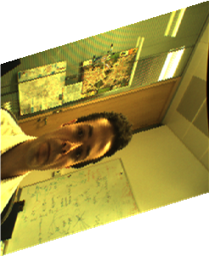
Stereo matching - Energy
Energy:
E(d): {0,…,D-1}^{n} → R
E(d) = ∑ θ_{i} (d_{i}) + ∑ θ_{ij} (d_{i},d_{j})
_{i}
i,j Є N₄
Unary:
θ_{i} (d_{i}) = (l_{j}-r_{i-di})
“SAD; Sum of absolute differences”
(many others possible, NCC,…)
left
_{i}
right
Right Image
i-2
(d_{i}=2)
Left Image
Pairwise:
θ_{ij} (d_{i},d_{j}) = g(|d_{i}-d_{j}|)

Slide 37

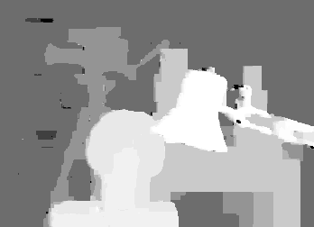
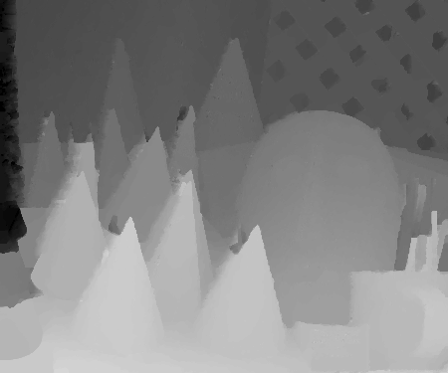
Stereo matching - prior
θ_{ij} (d_{i},d_{j}) = g(|d_{i}-d_{j}|)
cost
|d_{i}-d_{j}|
No truncation
(global min.)
[Olga Veksler PhD thesis, Daniel Cremers et al.]

Slide 38

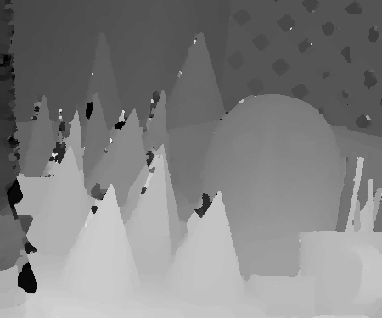
Stereo matching - prior
θ_{ij} (d_{i},d_{j}) = g(|d_{i}-d_{j}|)
cost
|d_{i}-d_{j}|
discontinuity preserving potentials
[Blake&Zisserman’83,’87]
No truncation
(global min.)
with truncation
(NP hard optimization)
[Olga Veksler PhD thesis, Daniel Cremers et al.]

Slide 39
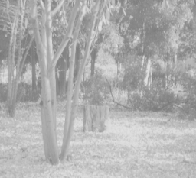
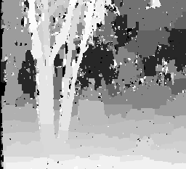
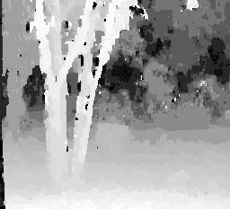
Stereo matching - prior
θ_{ij} (d_{i},d_{j}) = g(|d_{i}-d_{j}|)
cost
Left image
|d_{i}-d_{j}|
Potts model
(Potts model)
Smooth disparities
[Olga Veksler PhD thesis]

Slide 40
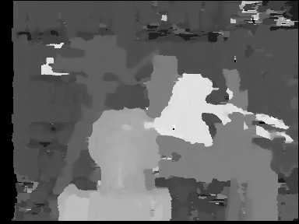
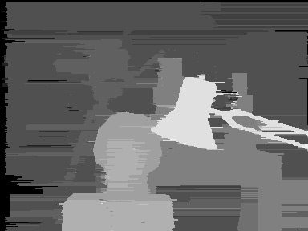
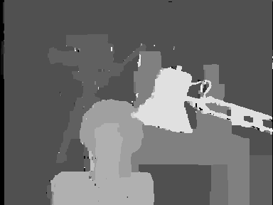
Stereo matching
see http://vision.middlebury.edu/stereo/
No MRF
Pixel independent (WTA)
No horizontal links
Efficient since independent chains
Pairwise MRF
[Boykov et al. ‘01]
Ground truth

Slide 41
Examples
Image segmentation
Stereo
Semantic/Object Segmentation

Slide 42
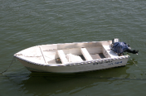

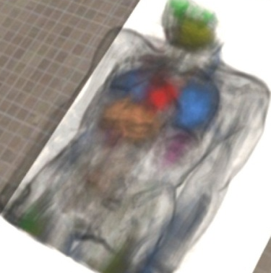
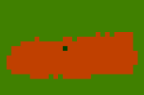

Object Segmentation
Assign a label to each pixel (or Voxel in 3D)
Object Segmentation
Organ Detection
water
tree
boat
chair
road

Slide 43
Different Approaches
(1) No relationships between Pixel s
(2) Pixel Groups, no relationships between groups
(3) Pairwise Relationships between Pixel groups
(4) Pairwise Relationships between Pixel s
(5) Higher order Relationships between Pixels

Slide 44
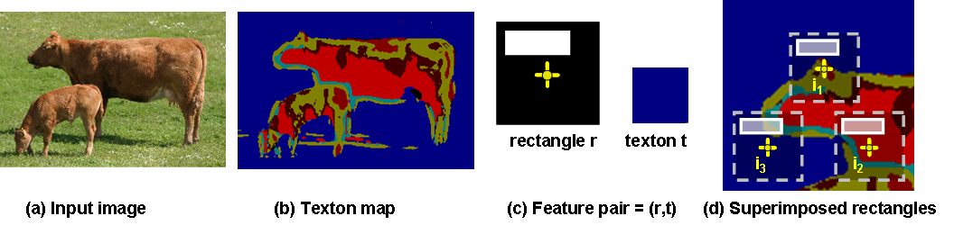
Costs for assigning labels to Pixels
Image Window (W)
Pixel to be classified (P)
Image
Cost for assigning label Cow
P,W
Pixel Classifier
Boosting [Shotton et al, 2006]
Random Decision Forests

Slide 45
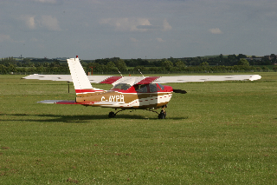

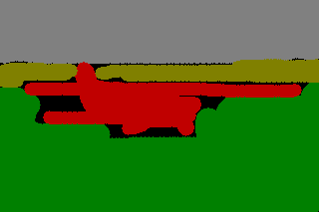
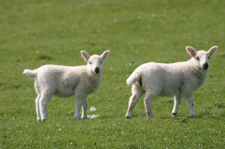
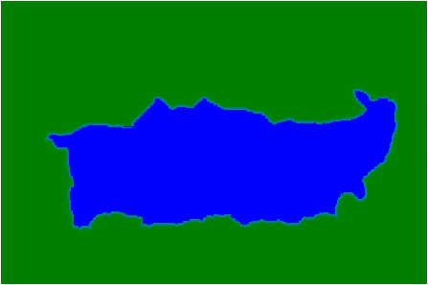
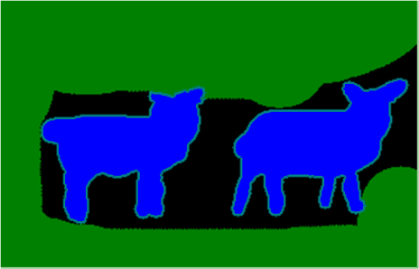
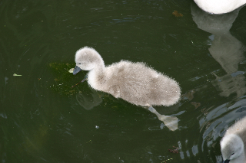


Qualitative Results
Image
(MSRC-21)
Pairwise CRF
Ground Truth

Slide 46
How to minimize the energy functions?

Slide 47
The Problem
E(x) = ∑ f_{i} (x_{i}) + ∑ g_{ij} (x_{i},x_{j}) + ∑ h_{c}(x_{c})
i
ij
c
Unary
Pairwise
Higher Order
x takes discrete values
How to minimize E(x)?

Slide 48
Energy Minimization Problems
NP-Hard
MAXCUT
CSP
Space of Problems

Slide 49
Function Minimization: The Problems
Which functions are exactly solvable?
Approximate solutions of NP-hard problems
Scalability and Efficiency

Slide 50
Function Minimization: The Problems
Which functions are exactly solvable?
Boros Hammer [1965], Kolmogorov Zabih [ECCV 2002, PAMI 2004] , Ishikawa [PAMI 2003], Schlesinger [EMMCVPR 2007], Kohli Kumar Torr [CVPR2007, PAMI 2008] , Ramalingam Kohli Alahari Torr [CVPR 2008] , Kohli Ladicky Torr [CVPR 2008, IJCV 2009] , Zivny Jeavons [CP 2008]
Approximate solutions of NP-hard problems
Schlesinger [1976 ], Kleinberg and Tardos [FOCS 99], Chekuri et al. [2001], Boykov et al. [PAMI 2001], Wainwright et al. [NIPS 2001], Werner [PAMI 2007], Komodakis [PAMI 2005], Lempitsky et al. [ICCV 2007], Kumar et al. [NIPS 2007], Kumar et al. [ICML 2008], Sontag and Jakkola [NIPS 2007], Kohli et al. [ICML 2008], Kohli et al. [CVPR 2008, IJCV 2009], Rother et al. [2009]
Scalability and Efficiency
Kohli Torr [ICCV 2005, PAMI 2007], Juan and Boykov [CVPR 2006], Alahari Kohli Torr [CVPR 2008] , Delong and Boykov [CVPR 2008]

Slide 51
Popular Inference Methods …
Dynamic Programming (DP)
Belief Propagtion (BP)
Tree-Reweighted (TRW), Max-sum Diffusion
Graph Cut (GC)
Branch & Bound
Relaxation methods
Message passing
Combinatorial Algorithms
Convex Optimization
(Linear Programming)

Slide 52
Energy Minimization Problems
NP-Hard
MAXCUT
CSP
Tree Structured
Space of Problems

Slide 53
Energy Minimization Problems
n = Number of Variables
Segmentation Energy
NP-Hard
MAXCUT
CSP
Pair-wise
O(n³)
Submodular
Functions
Tree Structured
O(n⁶)
Space of Problems

Slide 54
Inference
Message Passing & LP relaxation
st-mincut and Pseudo-boolean optimization
Advanced techniques
Speed and Efficiency

Slide 55
Graph Cuts
Lecture: Pushmeet Kohli

Slide 56
Road Map - Inference
Message Passing & LP relaxation
st-mincut and Pseudo-boolean optimization
Advanced technqiues
Speed and Efficiency

Slide 57
Submodular Functions: Definition
Pseudo-boolean function f:{0,1}^{n} → ℝ is submodular if
f(A) + f(B) ≥ f(A˅B) + f(A˄B)
for all A,B ϵ {0,1}^{n}
(OR)
(AND)
Example: n = 2, A = [1,0] , B = [0,1]
f([1,0]) + f([0,1]) ≥ f([1,1]) + f([0,0])
Property : Sum of submodular functions is submodular
Binary Image Segmentation Energy is submodular
E(x) = ∑ c_{i} x_{i} + ∑ d_{ij} |x_{i}-x_{j}|
i
i,j

Slide 58
Submodular Functions
Discrete Analogues of Concave Functions
[Lovasz, ’83]
Widely applied in Operations Research
Applications in Machine Learning
  MAP Inference in Markov Random Fields
  Clustering [Narasimhan , Jojic, & Bilmes, NIPS 2005]
  Structure Learning [Narasimhan & Bilmes, NIPS 2006]
Maximizing the spread of influence through a social network [Kempe, Kleinberg & Tardos, KDD 2003]

Slide 59
Minimizing Submodular Functions
Polynomial time algorithms
  Ellipsoid Algorithm: [Grotschel, Lovasz & Schrijver ‘81]
  First strongly polynomial algorithm: [Iwata et al. ’00] [A. Schrijver ’00]
  Current Best: O(n⁵ Q + n⁶) [Q is function evaluation time] [Orlin ‘07]
Symmetric functions: E(x) = E(1-x)
  Can be minimized in O(n³)
Minimizing Pairwise submodular functions
  Can be transformed to st-mincut/max-flow [Hammer , 1965]
  Very low empirical running time ~ O(n)
E(X) = ∑ f_{i} (x_{i}) + ∑ g_{ij} (x_{i},x_{j})
i
ij

Slide 60
The st-Mincut Problem
Source
2
9
Graph (V, E, C)
  Vertices V = {v₁, v₂ ... v_{n}}
  Edges E = {(v₁, v₂) ....}
  Costs C = {c_{(1, 2)} ....}
2
v₁
v₂
1
5
4
Sink

Slide 61
The st-Mincut Problem
What is a st-cut?
Source
2
9
2
v₁
v₂
1
5
4
Sink

Slide 62
The st-Mincut Problem
What is a st-cut?
An st-cut (S,T) divides the nodes between source and sink.
Source
2
9
What is the cost of a st-cut?
2
Sum of cost of all edges going from S to T
v₁
v₂
1
5
4
Sink
5 + 1 + 9 = 15

Slide 63
The st-Mincut Problem
What is a st-cut?
An st-cut (S,T) divides the nodes between source and sink.
Source
2
9
What is the cost of a st-cut?
2
Sum of cost of all edges going from S to T
v₁
v₂
1
5
4
What is the st-mincut?
Sink
st-cut with the minimum cost
2 + 2 + 4 = 8

Slide 64

So how does this work?
Construct a graph such that:
Any st-cut corresponds to an assignment of x
The cost of the cut is equal to the energy of x : E(x)
S
st-mincut
E(x)
T
Solution
[Hammer, 1965] [Kolmogorov and Zabih, 2002

Slide 65
St-mincut and Energy Minimization
E(x) = ∑ θ_{i} (x_{i}) + ∑ θ_{ij} (x_{i},x_{j})
i
i,j
For all ij
θ_{ij}(0,1) + θ_{ij} (1,0) ≥ θ_{ij} (0,0) + θ_{ij} (1,1)
Equivalent (transformable)
E(x) = ∑ c_{i} x_{i} + ∑ c_{ij} x_{i}(1-x_{j}) c_{ij}≥0
i
i,j

Slide 66
Graph Construction
E(a₁,a₂)
Source (0)
a₁
a₂
Sink (1)

Slide 67
Graph Construction
E(a₁,a₂) = 2a₁
Source (0)
2
a₁
a₂
Sink (1)

Slide 68
Graph Construction
E(a₁,a₂) = 2a₁ + 5ā₁
Source (0)
2
a₁
a₂
5
Sink (1)

Slide 69
Graph Construction
E(a₁,a₂) = 2a₁ + 5ā₁+ 9a₂ + 4ā₂
Source (0)
2
9
a₁
a₂
5
4
Sink (1)

Slide 70
Graph Construction
E(a₁,a₂) = 2a₁ + 5ā₁+ 9a₂ + 4ā₂ + 2a₁ā₂
Source (0)
2
9
a₁
a₂
2
5
4
Sink (1)

Slide 71
Graph Construction
E(a₁,a₂) = 2a₁ + 5ā₁+ 9a₂ + 4ā₂ + 2a₁ā₂ + ā₁a₂
Source (0)
2
9
1
a₁
a₂
2
5
4
Sink (1)

Slide 72
Graph Construction
E(a₁,a₂) = 2a₁ + 5ā₁+ 9a₂ + 4ā₂ + 2a₁ā₂ + ā₁a₂
Source (0)
2
9
1
a₁
a₂
2
5
4
Sink (1)

Slide 73
Graph Construction
E(a₁,a₂) = 2a₁ + 5ā₁+ 9a₂ + 4ā₂ + 2a₁ā₂ + ā₁a₂
Source (0)
2
9
Cost of cut = 11
1
a₁
a₂
a₁ = 1 a₂ = 1
2
E (1,1) = 11
5
4
Sink (1)

Slide 74
Graph Construction
E(a₁,a₂) = 2a₁ + 5ā₁+ 9a₂ + 4ā₂ + 2a₁ā₂ + ā₁a₂
Source (0)
2
9
st-mincut cost = 8
1
a₁
a₂
a₁ = 1 a₂ = 0
2
E (1,0) = 8
5
4
Sink (1)

Slide 75
How to compute the st-mincut?
Solve the dual maximum flow problem
Compute the maximum flow between Source and Sink s.t.
Source
2
9
Edges: Flow < Capacity
Nodes: Flow in = Flow out
1
v₁
v₂
2
5
4
Min-cut\Max-flow Theorem
Sink
In every network, the maximum flow equals the cost of the st-mincut
Assuming non-negative capacity

Slide 76
Maxflow Algorithms
Flow = 0
Augmenting Path Based Algorithms
Source
2
9
1
v₁
v₂
2
5
4
Sink

Slide 77
Maxflow Algorithms
Flow = 0
Augmenting Path Based Algorithms
Source
2
9
Find path from source to sink with positive capacity
1
v₁
v₂
2
5
4
Sink

Slide 78
Maxflow Algorithms
Flow = 0 + 2
Augmenting Path Based Algorithms
Source
2-2
9
Find path from source to sink with positive capacity
Push maximum possible flow through this path
1
v₁
v₂
2
4
5-2
Sink

Slide 79
Maxflow Algorithms
Flow = 2
Augmenting Path Based Algorithms
Source
0
9
Find path from source to sink with positive capacity
Push maximum possible flow through this path
1
v₁
v₂
2
3
4
Sink

Slide 80
Maxflow Algorithms
Flow = 2
Augmenting Path Based Algorithms
Source
0
9
Find path from source to sink with positive capacity
Push maximum possible flow through this path
Repeat until no path can be found
1
v₁
v₂
2
3
4
Sink

Slide 81
Maxflow Algorithms
Flow = 2
Augmenting Path Based Algorithms
Source
0
9
Find path from source to sink with positive capacity
Push maximum possible flow through this path
Repeat until no path can be found
1
v₁
v₂
2
3
4
Sink

Slide 82
Maxflow Algorithms
Flow = 2 + 4
Augmenting Path Based Algorithms
Source
0
5
Find path from source to sink with positive capacity
Push maximum possible flow through this path
Repeat until no path can be found
1
v₁
v₂
2
3
0
Sink

Slide 83
Maxflow Algorithms
Flow = 6
Augmenting Path Based Algorithms
Source
0
5
Find path from source to sink with positive capacity
Push maximum possible flow through this path
Repeat until no path can be found
1
v₁
v₂
2
3
0
Sink

Slide 84
Maxflow Algorithms
Flow = 6
Augmenting Path Based Algorithms
Source
0
5
Find path from source to sink with positive capacity
Push maximum possible flow through this path
Repeat until no path can be found
1
v₁
v₂
2
3
0
Sink

Slide 85
Maxflow Algorithms
Flow = 6 + 2
Augmenting Path Based Algorithms
Source
0
3
Find path from source to sink with positive capacity
Push maximum possible flow through this path
Repeat until no path can be found
1+2
v₁
v₂
2-2
1
0
Sink

Slide 86
Maxflow Algorithms
Flow = 8
Augmenting Path Based Algorithms
Source
0
4
Find path from source to sink with positive capacity
Push maximum possible flow through this path
Repeat until no path can be found
3
v₁
v₂
0
2
0
Sink

Slide 87
Maxflow Algorithms
Flow = 8
Augmenting Path Based Algorithms
Source
0
4
Find path from source to sink with positive capacity
Push maximum possible flow through this path
Repeat until no path can be found
0
v₁
v₂
3
2
0
Sink

Slide 88
Flow and Reparametrization
E(a₁,a₂) = 2a₁ + 5ā₁+ 9a₂ + 4ā₂ + 2a₁ā₂ + ā₁a₂
Source (0)
2
9
1
a₁
a₂
2
5
4
Sink (1)

Slide 89
Flow and Reparametrization
E(a₁,a₂) = 2a₁ + 5ā₁+ 9a₂ + 4ā₂ + 2a₁ā₂ + ā₁a₂
Source (0)
2
9
2a₁ + 5ā₁
1
a₁
a₂
= 2(a₁+ā₁) + 3ā₁
2
= 2 + 3ā₁
5
4
Sink (1)

Slide 90
Flow and Reparametrization
E(a₁,a₂) = 2 + 3ā₁+ 9a₂ + 4ā₂ + 2a₁ā₂ + ā₁a₂
Source (0)
0
9
2a₁ + 5ā₁
1
a₁
a₂
= 2(a₁+ā₁) + 3ā₁
2
= 2 + 3ā₁
3
4
Sink (1)

Slide 91
Flow and Reparametrization
E(a₁,a₂) = 2 + 3ā₁+ 9a₂ + 4ā₂ + 2a₁ā₂ + ā₁a₂
Source (0)
0
9
9a₂ + 4ā₂
1
a₁
a₂
= 4(a₂+ā₂) + 5ā₂
2
= 4 + 5ā₂
3
4
Sink (1)

Slide 92
Flow and Reparametrization
E(a₁,a₂) = 2 + 3ā₁+ 5a₂ + 4 + 2a₁ā₂ + ā₁a₂
Source (0)
0
5
9a₂ + 4ā₂
1
a₁
a₂
= 4(a₂+ā₂) + 5ā₂
2
= 4 + 5ā₂
3
0
Sink (1)

Slide 93
Flow and Reparametrization
E(a₁,a₂) = 6 + 3ā₁+ 5a₂ + 2a₁ā₂ + ā₁a₂
Source (0)
0
5
1
a₁
a₂
2
3
0
Sink (1)

Slide 94
Flow and Reparametrization
E(a₁,a₂) = 6 + 3ā₁+ 5a₂ + 2a₁ā₂ + ā₁a₂
Source (0)
0
5
1
a₁
a₂
2
3
0
Sink (1)

Slide 95
Flow and Reparametrization
E(a₁,a₂) = 6 + 3ā₁+ 5a₂ + 2a₁ā₂ + ā₁a₂
3ā₁+ 5a₂ + 2a₁ā₂
= 2(ā₁+a₂+a₁ā₂) +ā₁+3a₂
Source (0)
= 2(1+ā₁a₂) +ā₁+3a₂
0
5
F1 = ā₁+a₂+a₁ā₂
F2 = 1+ā₁a₂
1
a₁
a₂
2
a₁ | a₂ | F1 | F2
0 | 0 | 1 | 1
0 | 1 | 2 | 2
1 | 0 | 1 | 1
1 | 1 | 1 | 1
3
0
Sink (1)

Slide 96
Flow and Reparametrization
E(a₁,a₂) = 8 + ā₁+ 3a₂ + 3ā₁a₂
3ā₁+ 5a₂ + 2a₁ā₂
= 2(ā₁+a₂+a₁ā₂) +ā₁+3a₂
Source (0)
= 2(1+ā₁a₂) +ā₁+3a₂
0
3
F1 = ā₁+a₂+a₁ā₂
F2 = 1+ā₁a₂
3
a₁
a₂
0
a₁ | a₂ | F1 | F2
0 | 0 | 1 | 1
0 | 1 | 2 | 2
1 | 0 | 1 | 1
1 | 1 | 1 | 1
1
0
Sink (1)

Slide 97
Flow and Reparametrization
E(a₁,a₂) = 8 + ā₁+ 3a₂ + 3ā₁a₂
Source (0)
0
3
3
a₁
a₂
No more augmenting paths possible
0
1
0
Sink (1)

Slide 98
Flow and Reparametrization
E(a₁,a₂) = 8 + ā₁+ 3a₂ + 3ā₁a₂
Residual Graph
(positive coefficients)
Source (0)
Total Flow
0
3
bound on the optimal solution
3
a₁
a₂
0
1
0
Sink (1)
Tight Bound --> Inference of the optimal solution becomes trivial

Slide 99
Flow and Reparametrization
E(a₁,a₂) = 8 + ā₁+ 3a₂ + 3ā₁a₂
Residual Graph
(positive coefficients)
Source (0)
Total Flow
0
3
st-mincut cost = 8
bound on the energy of the optimal solution
3
a₁
a₂
a₁ = 1 a₂ = 0
0
E (1,0) = 8
1
0
Sink (1)
Tight Bound --> Inference of the optimal solution becomes trivial

Slide 100
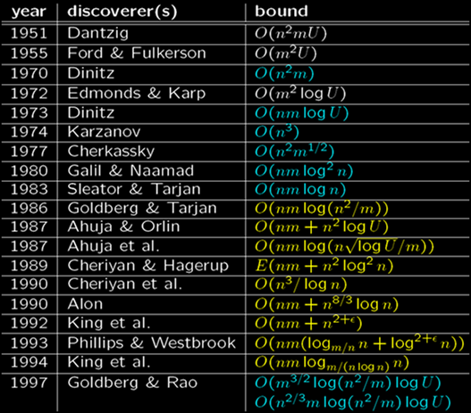
History of Maxflow Algorithms
Augmenting Path and Push-Relabel
n: #nodes
m: #edges
U: maximum edge weight
Algorithms assume non-negative edge weights
[Slide credit: Andrew Goldberg]

Slide 101
History of Maxflow Algorithms
Augmenting Path and Push-Relabel
n: #nodes
m: #edges
U: maximum edge weight
Algorithms assume non-negative edge weights
[Slide credit: Andrew Goldberg]

Slide 102
Augmenting Path based Algorithms
Ford Fulkerson: Choose any augmenting path
Source
1000
1000
1
a₁
a₂
0
1000
1000
Sink

Slide 103
Augmenting Path based Algorithms
Ford Fulkerson: Choose any augmenting path
Source
1000
1000
1
a₁
a₂
0
Good
Augmenting Paths
1000
1000
Sink

Slide 104
Augmenting Path based Algorithms
Ford Fulkerson: Choose any augmenting path
Source
1000
1000
1
a₁
a₂
0
Bad Augmenting Path
1000
1000
Sink

Slide 105
Augmenting Path based Algorithms
Ford Fulkerson: Choose any augmenting path
Source
999
1000
0
a₁
a₂
1
1000
999
Sink

Slide 106
Augmenting Path based Algorithms
n: #nodes
m: #edges
Ford Fulkerson: Choose any augmenting path
Source
999
1000
0
a₁
a₂
1
1000
999
Sink
We will have to perform 2000 augmentations!
Worst case complexity: O (m x Total_Flow)
(Pseudo-polynomial bound: depends on flow)

Slide 107
Augmenting Path based Algorithms
n: #nodes
m: #edges
Dinic: Choose shortest augmenting path
Source
1000
1000
1
a₁
a₂
0
1000
1000
Sink
Worst case Complexity: O (m n²)

Slide 108
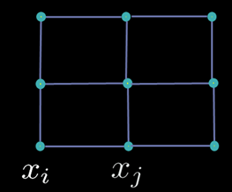
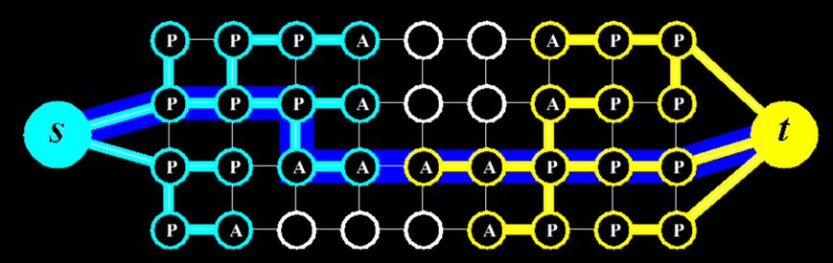
Maxflow in Computer Vision
Specialized algorithms for vision problems
  Grid graphs
  Low connectivity (m ~ O(n))
Dual search tree augmenting path algorithm
[Boykov and Kolmogorov PAMI 2004]
  Finds approximate shortest augmenting paths efficiently
  High worst-case time complexity
  Empirically outperforms other algorithms on vision problems
Efficient code available on the web
http://www.adastral.ucl.ac.uk/~vladkolm/software.html

Slide 109
Code for Image Segmentation
E(x) = ∑ c_{i} x_{i} + ∑ d_{ij} |x_{i}-x_{j}|
E: {0,1}^{n} → R
0 → fg
1 → bg
i
i,j
n = number of pixels
x* = arg min E(x)
x
How to minimize E(x)?
Global Minimum (x*)

Slide 110
How does the code look like?
Graph *g;
For all pixels p
/* Add a node to the graph */
nodeID(p) = g->add_node();
/* Set cost of terminal edges */
set_weights(nodeID(p), fgCost(p), bgCost(p));
end
for all adjacent pixels p,q
add_weights(nodeID(p), nodeID(q), cost(p,q));
end
g->compute_maxflow();
label_p = g->is_connected_to_source(nodeID(p));
// is the label of pixel p (0 or 1)
Source (0)
Sink (1)

Slide 111
How does the code look like?
Graph *g;
For all pixels p
/* Add a node to the graph */
nodeID(p) = g->add_node();
/* Set cost of terminal edges */
set_weights(nodeID(p), fgCost(p), bgCost(p));
end
for all adjacent pixels p,q
add_weights(nodeID(p), nodeID(q), cost(p,q));
end
g->compute_maxflow();
label_p = g->is_connected_to_source(nodeID(p));
// is the label of pixel p (0 or 1)
Source (0)
bgCost(a₁)
bgCost(a₂)
a₁
a₂
fgCost(a₁)
fgCost(a₂)
Sink (1)

Slide 112
How does the code look like?
Graph *g;
For all pixels p
/* Add a node to the graph */
nodeID(p) = g->add_node();
/* Set cost of terminal edges */
set_weights(nodeID(p), fgCost(p), bgCost(p));
end
for all adjacent pixels p,q
add_weights(nodeID(p), nodeID(q), cost(p,q));
end
g->compute_maxflow();
label_p = g->is_connected_to_source(nodeID(p));
// is the label of pixel p (0 or 1)
Source (0)
bgCost(a₁)
bgCost(a₂)
cost(p,q)
a₁
a₂
fgCost(a₁)
fgCost(a₂)
Sink (1)

Slide 113
How does the code look like?
Graph *g;
For all pixels p
/* Add a node to the graph */
nodeID(p) = g->add_node();
/* Set cost of terminal edges */
set_weights(nodeID(p), fgCost(p), bgCost(p));
end
for all adjacent pixels p,q
add_weights(nodeID(p), nodeID(q), cost(p,q));
end
g->compute_maxflow();
label_p = g->is_connected_to_source(nodeID(p));
// is the label of pixel p (0 or 1)
Source (0)
bgCost(a₁)
bgCost(a₂)
cost(p,q)
a₁
a₂
fgCost(a₁)
fgCost(a₂)
Sink (1)
a₁ = bg a₂ = fg

Slide 114
Road Map - Inference
Message Passing & LP relaxation
st-mincut and Pseudo-boolean optimization
Advanced techniques
Speed and Efficiency
Comparison

Slide 115
Graph Cuts for Vision Problems
Mixed (Real-Integer) Problems
Higher Order Energy Functions
Multi-label Problems
  Ordered Labels
    Stereo (depth labels)
  Unordered Labels
    Object segmentation ( ‘car’, `road’, `person’)

Slide 116
Graph Cuts for Vision Problems
Mixed (Real-Integer) Problems
Higher Order Energy Functions
Multi-label Problems
  Ordered Labels
    Stereo (depth labels)
  Unordered Labels
    Object segmentation ( ‘car’, `road’, `person’)

Slide 117
Recap: Mixed Problems
We have seen several of them in the intro ...
x – binary image segmentation (x_{i} ∊ {0,1})
ω – non-local parameter (lives in some large set Ω)
E(x,ω) = C(ω) + ∑ θ_{i} (ω, x_{i}) + ∑ θ_{ij} (ω,x_{i},x_{j})
i
i,j
constant
unary potentials
pairwise potentials
≥ 0
ω
Template Position Scale Orientation

Slide 118
Solving Mixed Problems
x – binary image segmentation (x_{i} ∊ {0,1})
ω – non-local parameter (lives in some large set Ω)
E(x,ω) = C(ω) + ∑ θ_{i} (ω, x_{i}) + ∑ θ_{ij} (ω,x_{i},x_{j})
i
i,j
constant
unary potentials
pairwise potentials
≥ 0
{x*,ω*} = arg min E(x,ω)
x,ω
Standard “graph cut” energy if ω is fixed
[Kohli et al, 06,08] [Lempitsky et al, 08]

Slide 119
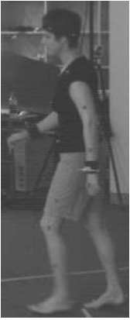
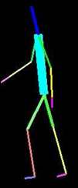
Solving Mixed Problems
Local Method: Gradient Descent over ω
ω * = arg min min E (x,ω)
Submodular
ω
x
ω*
[Kohli et al, 06,08]

Slide 120
Solving Mixed Problems
Local Method: Gradient Descent over ω
ω * = arg min min E (x,ω)
Submodular
ω
x
E (x,ω₁)
Dynamic Graph Cuts
15- 20 time speedup!
Similar Energy Functions
E (x,ω₂)
[Kohli et al, 06,08]

Slide 121

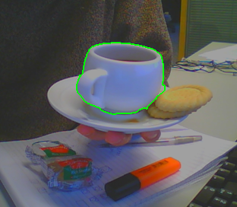
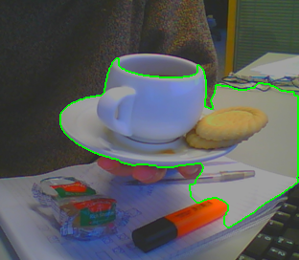

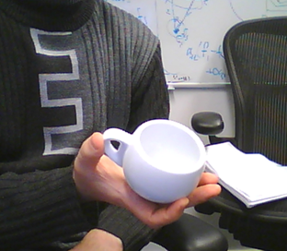
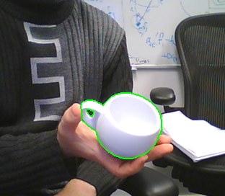
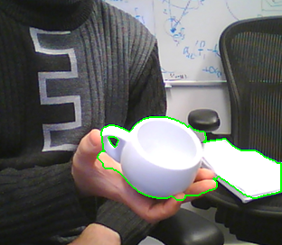
Solving Mixed Problems
Global Method: Branch and Mincut
Produces the global optimal solution
Exhaustively explores all ω in Ω in the worst case
30,000,000 shapes
[Lempitsky et al, 08]

Slide 122
Graph Cuts for Vision Problems
Mixed (Real-Integer) Problems
Higher Order Energy Functions
Multi-label Problems
  Ordered Labels
    Stereo (depth labels)
  Unordered Labels
    Object segmentation ( ‘car’, `road’, `person’)

Slide 123
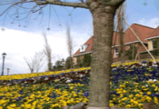
Recap: Higher Order Patch Potentials
Patch Dictionary (Tree)
{
C₁ if x_{i} = 0, i ϵ p
C_{max} otherwise
h(X_{p}) =
p
C_{max} ≥ C₁
  [Kohli et al. ‘07]
E(X) = ∑ c_{i} x_{i} + ∑ d_{ij} |x_{i}-x_{j}| + ∑ h_{p} (X_{p})

Slide 124

Minimizing Higher Order Energy Functions
Exact Transformation
Higher Order Submodular Functions
Pairwise Submodular Function
?
Billionnet and M. Minoux [DAM 1985]
Kolmogorov & Zabih [PAMI 2004]
Freedman & Drineas [CVPR2005]
Kohli Kumar Torr [CVPR2007, PAMI 2008]
Kohli Ladicky Torr [CVPR 2008, IJCV 2009]
Ramalingam Kohli Alahari Torr [CVPR 2008]
Zivny et al. [CP 2008]
st-mincut
S
T

Slide 125
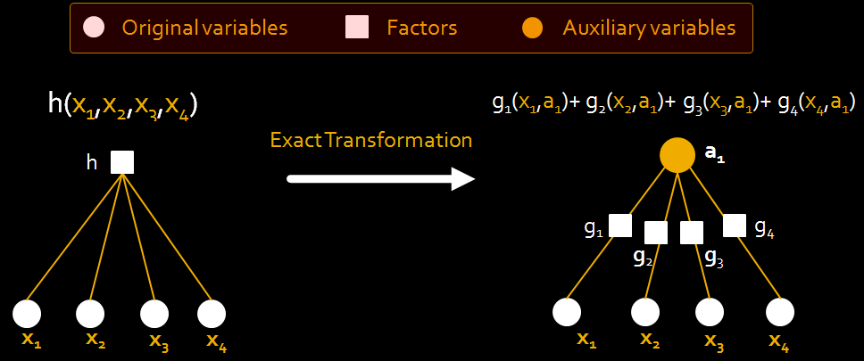
Minimizing Higher Order Energy Functions
Higher Order Function
Pairwise Submodular Function
Identified transformable families of higher order function s.t.
Constant or polynomial number of auxiliary variables (a) added
All pairwise functions (g) are submodular

Slide 126
Minimizing Higher Order Energy Functions
Example:
H (X) = F ( ∑ x_{i} )
concave
H (X)
0
∑ x_{i}
[Kohli et al. ‘08]

Slide 127
Higher order to Quadratic
Simple Example using Auxiliary variables
{
0 if all x_{i} = 0
C₁ otherwise
x ϵ L = {0,1}^{n}
f(x) =
min f(x)
=
min C₁a + C₁ ∑ ā x_{i}
x
x,a ϵ {0,1}
Higher Order Submodular Function
Quadratic Submodular Function
∑x_{i} < 1
a=0 (ā=1)
f(x) = 0
∑x_{i} ≥ 1
a=1 (ā=0)
f(x) = C₁

Slide 128
Higher order to Quadratic
min f(x)
=
min C₁a + C₁ ∑ ā x_{i}
x
x,a ϵ {0,1}
Higher Order Submodular Function
Quadratic Submodular Function
C₁∑x_{i}
C₁
1
2
3
∑x_{i}
[Kohli et al. ‘08]

Slide 129
Higher order to Quadratic
min f(x)
=
min C₁a + C₁ ∑ ā x_{i}
x
x,a ϵ {0,1}
Higher Order Submodular Function
Quadratic Submodular Function
C₁∑x_{i}
a=0
a=1
Lower envelop of concave functions is concave
C₁
1
2
3
∑x_{i}
[Kohli et al. ‘08]

Slide 130
Higher order to Quadratic
min f(x)
=
min f₁ (x)a + f₂(x)ā
x
x,a ϵ {0,1}
Higher Order Submodular Function
Quadratic Submodular Function
f₂(x)
f₁(x)
Lower envelop of concave functions is concave
1
2
3
∑x_{i}
[Kohli et al. ‘08]

Slide 131
Higher order to Quadratic
min f(x)
=
min f₁ (x)a + f₂(x)ā
x
x,a ϵ {0,1}
Higher Order Submodular Function
Quadratic Submodular Function
f₂(x)
a=0
a=1
f₁(x)
Lower envelop of concave functions is concave
1
2
3
∑x_{i}
[Kohli et al. ‘08]

Slide 132
Upper Envelopes
min f(x)
=
min max f₁ (x)a + f₂(x)ā
x
x ϵ {0,1}
a ϵ {0,1}
Higher Order Submodular Function
Quadratic Submodular Function
f₂(x)
a=0
a=1
f₁(x)
Upper envelope of linear functions is convex
1
2
3
Very Hard Problem!!!!
∑x_{i}
[Kohli and Kumar, CVPR 2010]

Slide 133


Why Upper Envelopes?
SILHOUETTE CONSTRAINTS
SIZE/VOLUME PRIORS
[Sinha et al. ‘05, Cremers et al. ’08]
[Woodford et al. 2009]
3D RECONSTRUCTION
BINARY SEGMENTATION
Object
Prior on size
of object
(say n/2)
Rays must
touch silhouette
at least once
Background
[Kohli and Kumar, CVPR 2010]

Slide 134
Graph Cuts for Vision Problems
Mixed (Real-Integer) Problems
Higher Order Energy Functions
Multi-label Problems
  Ordered Labels
    Stereo (depth labels)
  Unordered Labels
    Object segmentation ( ‘car’, `road’, `person’)

Slide 135
Graph Cuts for Multi-Label Problems
Min
E(y) = ∑ f_{i} (y_{i}) + ∑ g_{ij} (y_{i},y_{j})
y
i
i,j
y ϵ Labels L = {l₁, l₂, … , l_{k}}
Exact Transformation to QPBF
Move making algorithms
[Roy and Cox ’98] [Ishikawa ’03] [Schlesinger & Flach ’06]
[Ramalingam, Alahari, Kohli, and Torr ’08]

Slide 136
Multi-label to Pseudo-boolean
So what is the problem?
E_{m} (y₁,y₂, ..., y_{n})
E_{b} (x₁,x₂, ..., x_{m})
y_{i} ϵ L = {l₁, l₂, … , l_{k}}
x_{i} ϵ L = {0,1}
Multi-label Problem
Binary label Problem
such that:
Let Y and X be the set of feasible solutions, then
1. One-One encoding function T:X->Y
2. arg min E_{m}(y) = T(arg min E_{b}(x))

Slide 137

Multi-label to Pseudo-boolean
Popular encoding scheme
[Roy and Cox ’98, Ishikawa ’03, Schlesinger & Flach ’06]
# Nodes = n * k
# Edges = m * k²

Slide 138
Multi-label to Pseudo-boolean
Popular encoding scheme
[Roy and Cox ’98, Ishikawa ’03, Schlesinger & Flach ’06]
Ishikawa’s result:
E(y) = ∑ θ_{i} (y_{i}) + ∑ θ_{ij} (y_{i},y_{j})
i
i,j
y ϵ Labels L = {l₁, l₂, … , l_{k}}
θ_{ij} (y_{i},y_{j}) = g(|y_{i}-y_{j}|)
Convex Function
# Nodes = n * k
# Edges = m * k²
g(|y_{i}-y_{j}|)
|y_{i}-y_{j}|

Slide 139
Multi-label to Pseudo-boolean
Popular encoding scheme
[Roy and Cox ’98, Ishikawa ’03, Schlesinger & Flach ’06]
Schlesinger & Flach ’06:
E(y) = ∑ θ_{i} (y_{i}) + ∑ θ_{ij} (y_{i},y_{j})
i
i,j
y ϵ Labels L = {l₁, l₂, … , l_{k}}
θ_{ij}(l_{i+1},l_{j}) + θ_{ij} (l_{i},l_{j+1}) ≥ θ_{ij} (l_{i},l_{j}) + θ_{ij} (l_{i+1},l_{j+1})
# Nodes = n * k
# Edges = m * k²
l_{j} +1
l_{i} +1
l_{j}
l_{i}

Slide 140

Results – Stereo
Image
MAP Solution
Scanline algorithm
[Roy and Cox, 98]

Slide 141
Disadvantages of Exact Transformations
θ_{ij} (y_{i},y_{j}) = g(|y_{i}-y_{j}|)
Applicability
  Cannot handle truncated costs
  (non-robust)
Computational Cost
  Very high computational cost
  Problem size = |Variables| x |Labels|
  Gray level image denoising (1 Mpixel image)
  (~2.5 x 10⁸ graph nodes)
|y_{i}-y_{j}|
discontinuity preserving potentials
Blake&Zisserman’83,87

Slide 142
Exact Solutions for Multi-label Problems
Other “less known” algorithms
 | Unary Potentials | Pair-wise Potentials | Complexity
Ishikawa Transformation [03] | Arbitrary | Convex and Symmetric | T(nk, mk²)
Schlesinger Transformation [06] | Arbitrary | Submodular | T(nk, mk²)
Hochbaum [01] | Linear | Convex and Symmetric | T(n, m) + n log k
Hochbaum [01] | Convex | Convex and Symmetric | O(mn log n log nk)
T(a,b) = complexity of maxflow with a nodes and b edges

Slide 143
Graph Cuts for Multi-Label Problems
Min
E(y) = ∑ f_{i} (y_{i}) + ∑ g_{ij} (y_{i},y_{j})
y
i
i,j
y ϵ Labels L = {l₁, l₂, … , l_{k}}
Exact Transformation to QPBF
Move making algorithms
[Boykov , Veksler and Zabih 2001] [Woodford, Fitzgibbon, Reid, Torr, 2008]
[Lempitsky, Rother, Blake, 2008] [Veksler, 2008] [Kohli, Ladicky, Torr 2008]

Slide 144
Move Making Algorithms
Energy
Solution Space

Slide 145
Move Making Algorithms
Current Solution
Search Neighbourhood
Optimal Move
Energy
Solution Space

Slide 146
Computing the Optimal Move
Current Solution
Search Neighbourhood
Optimal Move
x^{c}
(t)
Key Property
Move Space
Energy
Solution Space
Bigger move space
Better solutions
Finding the optimal move hard

Slide 147
Move Making Algorithms
Minimizing Pairwise Functions
[Boykov Veksler and Zabih, PAMI 2001]
Series of locally optimal moves
Each move reduces energy
Optimal move by minimizing submodular function
Current Solution
Search Neighbourhood
Move Space (t) : 2^{n}
n
Number of Variables
L
Number of Labels
Space of Solutions (x) : L^{n}
Extend to minimize Higher order Functions
Kohli et al. ‘07, ‘08, ‘09

Slide 148
Binary Moves
x = t x¹ + (1- t) x²
New solution
Current Solution
Second solution
E_{m}(t) = E(t x¹ + (1- t) x²)
Minimize over move variables t
For certain x¹ and x², the move energy is sub-modular QPBF
[Boykov , Veksler and Zabih 2001]

Slide 149
Swap Move
Variables labeled α, β can swap their labels
[Boykov , Veksler and Zabih 2001]
Notes:
Chi square

Slide 150
Swap Move
Variables labeled α, β can swap their labels
Tree
Ground
Swap Sky, House
House
Sky
[Boykov , Veksler and Zabih 2001]

Slide 151
Swap Move
Variables labeled α, β can swap their labels
Move energy is submodular if:
  Unary Potentials: Arbitrary
  Pairwise potentials: Semi-metric
θ_{ij} (l_{a},l_{b}) ≥ 0
θ_{ij} (l_{a},l_{b}) = 0 a = b
Examples: Potts model, Truncated Convex
[Boykov , Veksler and Zabih 2001]
Notes:
Chi square

Slide 152
Expansion Move
Variables take label α or retain current label
[Boykov , Veksler and Zabih 2001]
[Boykov, Veksler, Zabih]

Slide 153
Expansion Move
Variables take label α or retain current label
Tree
Ground
House
Status:
Initialize with Tree
Expand Ground
Expand House
Expand Sky
Sky
[Boykov , Veksler and Zabih 2001]
[Boykov, Veksler, Zabih]

Slide 154
Expansion Move
Variables take label α or retain current label
Move energy is submodular if:
  Unary Potentials: Arbitrary
  Pairwise potentials: Metric
Semi metric
+
Triangle Inequality
θ_{ij} (l_{a},l_{b}) + θ_{ij} (l_{b},l_{c}) ≥ θ_{ij} (l_{a},l_{c})
Examples: Potts model, Truncated linear
Cannot solve truncated quadratic
[Boykov , Veksler and Zabih 2001]
[Boykov, Veksler, Zabih]

Slide 155
Interesting Connections
Expansion and Swap can be derived as a primal dual scheme
Get solution of the dual problem which is a lower bound on the energy of solution
Weak guarantee on the solution
E(x) < 2(d_{max} /d_{min}) E(x*)
θ_{ij} (l_{i},l_{j}) = g(|l_{i}-l_{j}|)
d_{max}
d_{min}
|y_{i}-y_{j}|
[Komodakis et al 05, 07]

Slide 156
General Binary Moves
x = t x¹ + (1-t) x²
New solution
First solution
Second solution
Minimize over move variables t
Move Type | First Solution | Second Solution | Guarantee
Expansion | Old solution | All alpha | Metric
Fusion | Any solution | Any solution | ✗
Move functions can be non-submodular!!

Slide 157





Example: Solving Continuous Problems using Fusion Move
x = t x¹ + (1-t) x²
x¹, x² can be continuous
Optical Flow
Example
Solution from Method 2
x²
Solution from Method 1
F
Final Solution
x¹
x
[Woodford, Fitzgibbon, Reid, Torr, 2008] [Lempitsky, Rother, Blake, 2008]

Slide 158
Range Moves
Move variables can be multi-label
Optimal move found out by using the Ishikawa Transform
Useful for minimizing energies with truncated convex pairwise potentials
x = (t ==1) x¹ + (t==2) x² +… +(t==k) x^{k}
T
θ_{ij} (y_{i},y_{j}) = min(|y_{i}-y_{j}|²,T)
θ_{ij} (y_{i},y_{j})
|y_{i}-y_{j}|
[Kumar and Torr, 2008] [Veksler, 2008]

Slide 159

Range Moves - Results
Noisy Image
Image
Expansion Move
Range Moves
[Veksler, 2008]

Slide 160
Road Map - Inference
Message Passing & LP relaxation
st-mincut and Pseudo-boolean optimization
Advanced technqiues
Speed and Efficiency
Comparison

Slide 161

Why?
3,600,000,000 Pixels
Created from about 800 8 MegaPixel Images
[Kopf et al. (MSR Redmond) SIGGRAPH 2007 ]

Slide 162

[Kopf et al. (MSR Redmond) SIGGRAPH 2007 ]

Slide 163
More Examples
Processing Videos
1 minute video of 1M pixel resolution
  3.6 B pixels
3D reconstruction
[500 x 500 x 500 = .125B voxels]

Slide 164
Image Segmentation in Videos
Segment
First Frame
Can we do better?
Segment
Second Frame
[Kohli & Torr, ICCV05 PAMI07]
Kohli & Torr (ICCV05, PAMI07)

Slide 165

Image Segmentation in Videos
Image
Flow
Segmentation
[Kohli & Torr, ICCV05 PAMI07]
Kohli & Torr (ICCV05, PAMI07)

Slide 166
Dynamic Energy Minimization
Frame 1
E_{A}
minimize
S_{A}
Reuse Computation
differences
between
A and B
E_{B*}
Simpler
fast
Frame 2
E_{B}
minimize
S_{B}
3–100000
time speedup!
Reparametrization
[Kohli & Torr, ICCV05 PAMI07] [Komodakis & Paragios, CVPR07]

Slide 167
Dynamic Energy Minimization
Original Energy
E(a₁,a₂) = 2a₁ + 5ā₁+ 9a₂ + 4ā₂ + 2a₁ā₂ + ā₁a₂
Reparametrized Energy
E(a₁,a₂) = 8 + ā₁+ 3a₂ + 3ā₁a₂
New Energy
E(a₁,a₂) = 2a₁ + 5ā₁+ 9a₂ + 4ā₂ + 7a₁ā₂ + ā₁a₂
New Reparametrized Energy
E(a₁,a₂) = 8 + ā₁+ 3a₂ + 3ā₁a₂ + 5a₁ā₂
[Kohli & Torr, ICCV05 PAMI07] [Komodakis & Paragios, CVPR07]
Kohli & Torr (ICCV05, PAMI07)

Slide 168
Hybrid Algorithms
Original Problem
(Large)
Approximation algorithm
Approximate
Solution
(Slow)
Fast partially optimal algorithm
[ Alahari Kohli & Torr CVPR ‘08]

Slide 169
Hybrid Algorithms
Original Problem
(Large)
Approximation algorithm
Approximate
Solution
(Slow)
Fast partially optimal algorithm
[Kovtun ‘03]
[ Kohli et al. ‘09]
Fast partially optimal algorithm
Reduced Problem
Approximation algorithm
Approximate
Solution
Solved Problem
(Global Optima)
(Fast)
[ Alahari Kohli & Torr CVPR ‘08]

Slide 170



Hybrid Algorithms
3- 100
Times Speed up
Original Problem
(Large)
Tree Reweighted Message Passing
sky
Approximate
Solution
Building
Airplane
(9.89 sec)
Grass
Fast partially optimal algorithm
[Kovtun ‘03]
[ Kohli et al. ‘09]
Fast partially optimal algorithm
Tree Reweighted Message Passing
sky
sky
Reduced Problem
Approximate
Solution
Building
Building
Solved Problem
(Global Optima)
Airplane
Airplane
Total Time
(0.30 sec)
Grass
Grass
[ Alahari Kohli & Torr CVPR ‘08]

Slide 171
Road Map - Inference
Message Passing & LP relaxation
st-mincut and Pseudo-boolean optimization
Advanced technqiues
Speed and Efficiency

Slide 172
End

