Slide 1
Kinectic vision
Looking Deep into Depth
Prof. Partha Pratim Das, ppd@cse.iitkgp.ernet.in & partha.p.das@gmail.com
Department of Computer Science & Engineering
Indian Institute of Technology Kharagpur
18th December 2013
Tutorial: NCVPRIPG 2013

Slide 2
Natural Interaction
Understanding human nature
How we interact with other people
How we interact with environment
How we learn
Interaction methods the user is familiar and comfortable with
Touch
Gesture
Voice
Eye Gaze

Slide 3
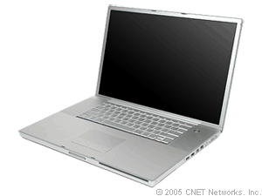
Gesture
Voice
Eye Gaze
Touch

Slide 4
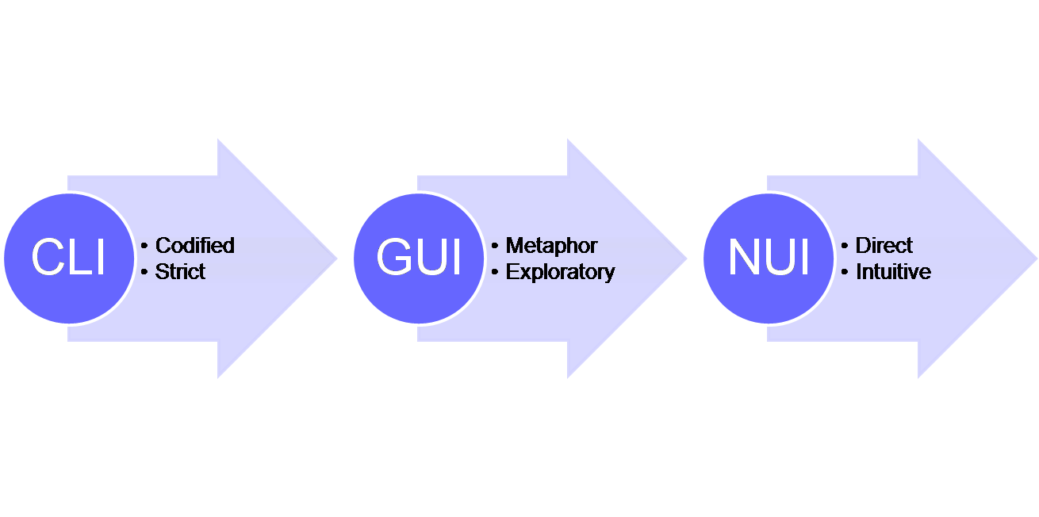
Notes:
http://www.google.co.in/imgres?espv=210&es_sm=93&biw=1366&bih=624&tbm=isch&tbnid=wfnEl7vR6I9XMM:&imgrefurl=http://en.wikipedia.org/wiki/Natural_user_interface&docid=8iCRReaH83F3kM&imgurl=http://upload.wikimedia.org/wikipedia/en/7/7c/CLI-GUI-NUI.png&w=1310&h=652&ei=lt59Uv_fC4SRrAe7n4CQCQ&zoom=1&ved=1t:3588,r:3,s:0,i:92&iact=rc&page=1&tbnh=158&tbnw=318&start=0&ndsp=5&tx=235&ty=72

Slide 5
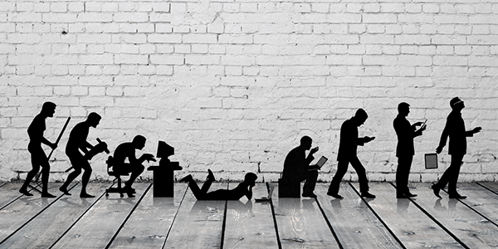
Notes:
http://www.google.co.in/imgres?start=103&espv=210&es_sm=93&biw=1366&bih=624&tbm=isch&tbnid=WLHUUs3mnYzdiM:&imgrefurl=http://www.xtremelabs.com/2013/08/the-future-of-uiux-the-natural-user-interface/&docid=S2ZkYOXSFNHfBM&imgurl=http://www.xtremelabs.com/wp-content/uploads/2013/07/futureUIUX1.jpg&w=600&h=300&ei=y959UubRNJGyrAeZiIGICA&zoom=1&ved=1t:3588,r:3,s:100,i:13&iact=rc&page=7&tbnh=159&tbnw=318&ndsp=20&tx=211&ty=70

Slide 6
Natural User Interface
Revolutionary change in Human-Computer interaction
Interpret natural human communication
Computers communicate more like people
The user interface becomes invisible
or looks and feels so real that it is no longer iconic

Slide 7
Three Layer NUI Model

Slide 8
Layer 1: HCI – Devices and Software Detect and process human behavior

Slide 9
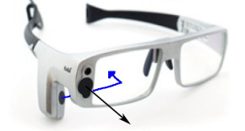
Layer 2: NUI – Middleware and Application Framework Translate human behavior into action

Slide 10
Layer 3: Ambient Computing – Orchestrate billions of devices NUI becomes part of everyday life

Slide 11
Factors for NUI Revolution

Slide 12
Factors for NUI Revolution
Sensor – Detect human behavior
NUI Middleware Libraries – Interprets human behavior
Cloud – Extend NUI across multiple device
Libraries
Cloud
Sensors
Application

Slide 13
Point of Our Interest
Libraries
Sensors
Application

Slide 14
Different Sensors
Touch
Mobile Phones
Tablets and Ultrabooks
Portable Audio Players
Portable Game Consoles
Touch Less
RGB camera
Depth camera – Lidar, CamBoard nano
RGBD camera – Kinect, Asus Xtion pro, Carmine 1.08
Eye tracker – Tobii eye tracker
Voice recognizer – Kinect, Asus Xtion pro, Carmine 1.08

Slide 15
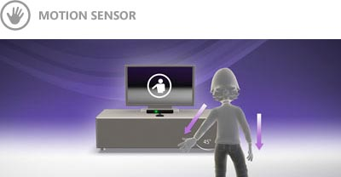
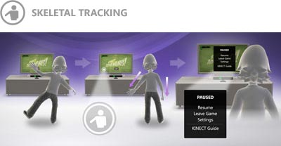
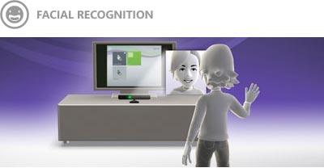
Revolutionary – Kinect

Slide 16
Revolutionary – Kinect
Low Cost

Slide 17
Kinect
The most popular NUI Sensor

Slide 18
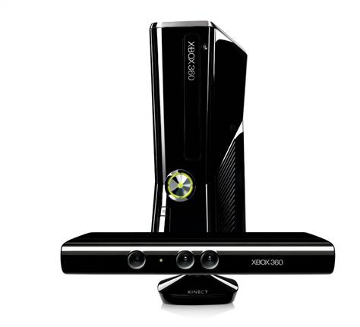
It’s changing the way to play games
Something For Everyone
Full Body Gaming
It’s All About You
Notes:
Full Body Gaming
Controller-free gaming means full body play. Kinect responds to how you move. So if you have to kick, then kick. If you have to jump, then jump. You already know how to play. All you have to do now is to get off the couch.
It’s All About You
Once you wave your hand to activate the sensor, your Kinect will be able to recognize you and access your Avatar. Then you'll be able to jump in and out of different games, and show off and share your moves.
Something For Everyone
Whether you're a gamer or not, anyone can play and have a blast. And with advanced parental controls, Kinect promises a gaming experience that's safe, secure and fun for everyone.

Slide 19
controller FREE gaming
Notes:
Simply step in front of the sensor and Kinect recognizes you and responds to your gestures.

Slide 20
Amazing Games & APPS VIDEOs
Games / Apps
Sports
Dance/Music
Fitness
Family
Action Adventure
Videos
Xbox 360
Fitnect
Humanoid
Magic Mirror

Slide 21
Watch APPS VIDEOs
Xbox 360
http://www.youtube.com/watch?v=_xLTI-b-cZU
Fitnect – Virtual Fitting Room
http://www.openni.org/solutions/fitnect-virtual-fitting-room/
http://www.fitnect.hu/
Controlling a Humanoid Robot with Kinect
http://www.wimp.com/robotkinect/
Magic Mirror in Bathroom
http://www.extremetech.com/computing/94751-the-new-york-times-magic-mirror-will-bring-shopping-to-the-bathroom

Slide 22
What is Kinect?
Low-cost sensor device for providing real-time depth, color and audio data.

Slide 23
How Kinect supports NUI?

Slide 24
Hardware and Software Interaction

Slide 25
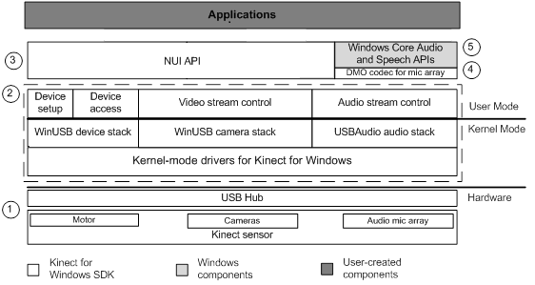
SDK Architecture
Notes:
Kinect hardware - The hardware components, including the Kinect sensor and the USB hub through which the Kinect sensor is connected to the computer.
Kinect drivers - The Windows drivers for the Kinect, which are installed as part of the SDK setup process as described in this document. The Kinect drivers support:
The Kinect microphone array as a kernel-mode audio device that you can access through the standard audio APIs in Windows.
Audio and video streaming controls for streaming audio and video (color, depth, and skeleton).
Device enumeration functions that enable an application to use more than one Kinect
Audio and Video Components Kinect natural user interface for skeleton tracking, audio, and color and depth imaging
DirectX Media Object (DMO) for microphone array beam forming and audio source localization.
Windows 7 standard APIs - The audio, speech, and media APIs in Windows 7, as described in the Windows 7 SDK and the Microsoft Speech SDK. These APIs are also available to desktop applications in Windows 8.

Slide 26
SDK Architecture
Kinect hardware - The hardware components, including the Kinect sensor and the USB hub through which the Kinect sensor is connected to the computer.
Kinect drivers - Windows drivers for the Kinect:
Microphone array as a kernel-mode audio device –std audio APIs in Windows.
Audio and video streaming controls (color, depth, and skeleton).
Device enumeration functions for more than one Kinect
Audio and Video Components Kinect NUI for skeleton tracking, audio, and color and depth imaging
DirectX Media Object (DMO)
microphone array beamforming
audio source localization.
Windows 7 standard APIs - The audio, speech, and media APIs and the Microsoft Speech SDK.
Notes:
Kinect hardware - The hardware components, including the Kinect sensor and the USB hub through which the Kinect sensor is connected to the computer.
Kinect drivers - The Windows drivers for the Kinect, which are installed as part of the SDK setup process as described in this document. The Kinect drivers support:
The Kinect microphone array as a kernel-mode audio device that you can access through the standard audio APIs in Windows.
Audio and video streaming controls for streaming audio and video (color, depth, and skeleton).
Device enumeration functions that enable an application to use more than one Kinect
Audio and Video Components Kinect natural user interface for skeleton tracking, audio, and color and depth imaging
DirectX Media Object (DMO) for microphone array beam forming and audio source localization.
Windows 7 standard APIs - The audio, speech, and media APIs in Windows 7, as described in the Windows 7 SDK and the Microsoft Speech SDK. These APIs are also available to desktop applications in Windows 8.

Slide 27
Hardware

Slide 28
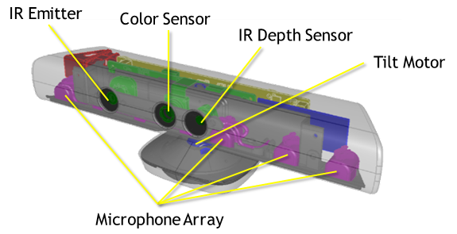
Main components

Slide 29
Main components
RGB camera
Infrared (IR) emitter and an IR depth sensor – estimate depth
Multi-array microphone - four microphones for capturing sound.
3-axis Accelerometer - configured for a 2g range, where g is the acceleration due to gravity. Determines the current orientation of the Kinect.

Slide 30
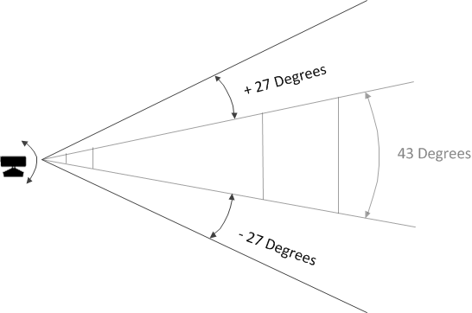
Interaction Space

Slide 31
NUI API

Slide 32
Four data streams
NUI API lets the user programmatically control and access four data streams.
Color Stream
Infrared Stream
Depth Stream
Audio Stream

Slide 33
Stream APPs
Source: Kinect for Windows Developer Toolkit v1.8
http://www.microsoft.com/en-in/download/details.aspx?id=40276
App Examples:
Color Basics - D2D
Infrared Basics - D2D
Depth Basics - D2D / Depth - D3D
Depth with Color - D3D
Kinect Explorer - D2D
Kinect Explorer - WPF

Slide 34
COLOR Stream APPs
Source: Kinect for Windows Developer Toolkit v1.8
http://www.microsoft.com/en-in/download/details.aspx?id=40276
App Examples:
Color Basics - D2D

Slide 35
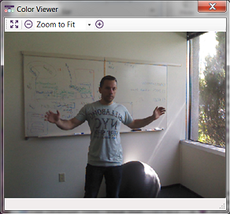
Color stream
Color Format | Resolution
RGB | 640x480 Fps30
 | 1280x960 Fps12
YUV | 640x480 Fps15
Bayer | 640x480 Fps30
 | 1280x960 Fps12
New features of SDK 1.6 onwards:
Low light (or brightly lit).
Use hue, brightness, or contrast to improve visual clarity.
Use gamma to adjust the way the display appears on certain hardware.

Slide 36
INFRARED Stream APPs
Source: Kinect for Windows Developer Toolkit v1.8
http://www.microsoft.com/en-in/download/details.aspx?id=40276
App Examples:
Infrared Basics - D2D

Slide 37
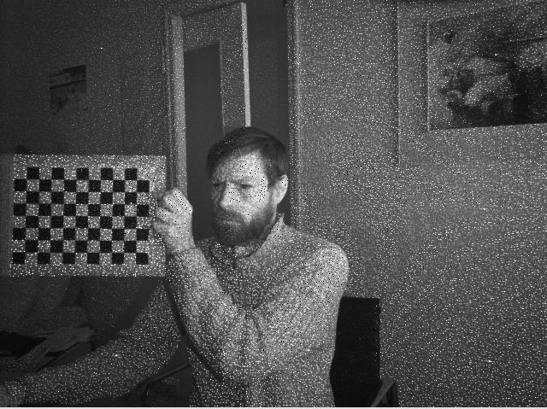
Infrared stream
IR stream is the test pattern observed from both the RGB and IR camera
Resolution 640x480 Fps 30
Notes:
There is only one color image stream available per sensor. The infrared image stream is provided by the color image stream, therefore, it is impossible to have a color image stream and an infrared image stream open at the same time on the same sensor.

Slide 38
DEPTH Stream APPs
Source: Kinect for Windows Developer Toolkit v1.8
http://www.microsoft.com/en-in/download/details.aspx?id=40276
App Examples:
Depth Basics - D2D
Depth - D3D
Depth with Color - D3D

Slide 39
Depth stream
The depth data stream merges two separate types of data:
Depth data, in millimeters.
Player segmentation data
Each player segmentation value is an integer indicating the index of a unique player detected in the scene.
The Kinect runtime processes depth data to identify up to six human figures in a segmentation map.

Slide 40
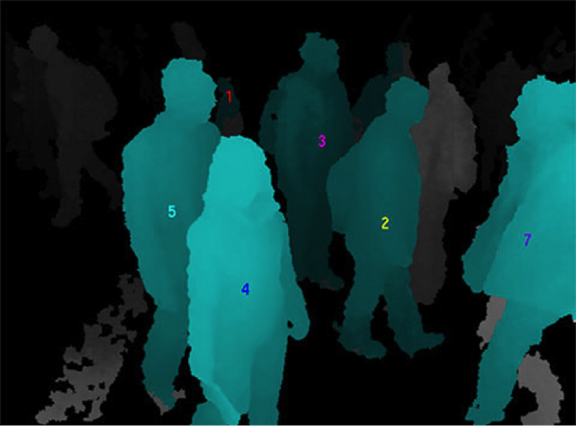
Depth stream

Slide 41
AUDIO Stream APPs
Source: Kinect for Windows Developer Toolkit v1.8
http://www.microsoft.com/en-in/download/details.aspx?id=40276
App Examples:
Kinect Explorer - D2D
Kinect Explorer - WPF

Slide 42
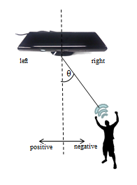
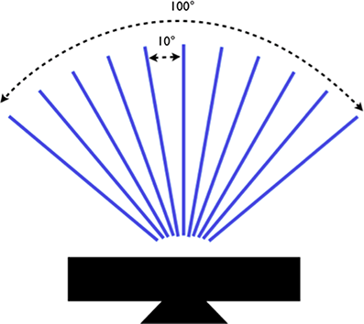
Audio stream
High-quality audio capture
Audio input from + and – 50 degree in front of sensor
The array can be pointed at 10 degree increment with in the range
Identification of the direction of audio sources
Raw voice data access
Notes:
The beamforming functionality supports 11 fixed beams, which range from -0.875 to 0.875 radians (approximately -50 to 50 degrees in 10-degree increments). Applications can use the DMO’s adaptive beamforming option, which automatically selects the optimal beam, or specify a particular beam. The DMO also includes a source localization algorithm, which estimates the source direction.

Slide 43
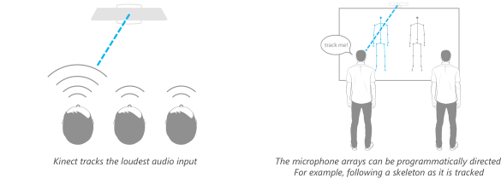
Audio stream

Slide 44
runtime implements
In addition to the hardware capabilities, the Kinect software runtime implements:
Skeleton Tracking
Speech Recognition - Integration with the Microsoft Speech APIs.

Slide 45
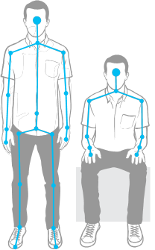
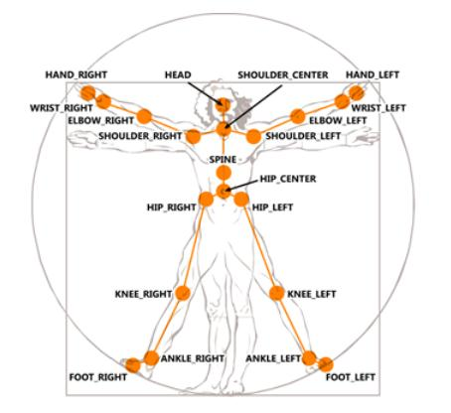
Skeleton tracking

Slide 46
Skeleton tracking APPS
Source: Kinect for Windows Developer Toolkit v1.8
http://www.microsoft.com/en-in/download/details.aspx?id=40276
App Examples:
Skeleton Basics - D2D
Kinect Explorer - D2D
Kinect Explorer - WPF

Slide 47
Skeleton tracking
Tracking Modes (Seated/Default)
Tracking Skeletons in Near Depth Range
Joint Orientation
Joint Filtering
Skeleton Tracking With Multiple Kinect Sensors

Slide 48
Speech Recognition APPS
Source: Kinect for Windows Developer Toolkit v1.8
http://www.microsoft.com/en-in/download/details.aspx?id=40276
App Examples:
Speech Recognition - Integration with the Microsoft Speech APIs.
Speech Basics - D2D
Tic-Tac-Toe - WPF

Slide 49
Speech Recognition
Microphone array is an excellent input device for speech recognition.
Applications can use Microsoft.Speech API for latest acoustical algorithms.
Acoustic models have been created to allow speech recognition in several locales in addition to the default locale of en-US.

Slide 50
Additional libraries & APIs
Face Tracking
Kinect Fusion
Kinect Interaction

Slide 51
Face Tracking Apps
Source: Kinect for Windows Developer Toolkit v1.8
http://www.microsoft.com/en-in/download/details.aspx?id=40276
App Examples:
Face Tracking 3D - WPF
Face Tracking Basics - WPF
Face Tracking Visualization

Slide 52
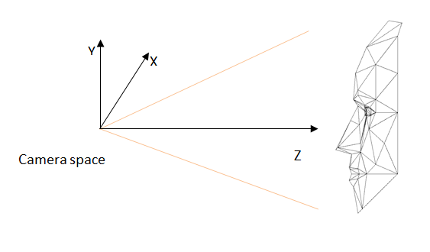
Face tracking
Input Images
The Face Tracking SDK accepts Kinect color and depth images as input. The tracking quality may be affected by the image quality of these input frames
Face Tracking Outputs
Tracking status
2D points
3D head pose
Action Units (Aus)
Notes:
The Face Tracking SDK uses the Kinect coordinate system to output its 3D tracking results. The origin is located at the camera’s optical center (sensor), Z axis is pointing towards a user, Y axis is pointing up. The measurement units are meters for translation and degrees for rotation angles.

Slide 53
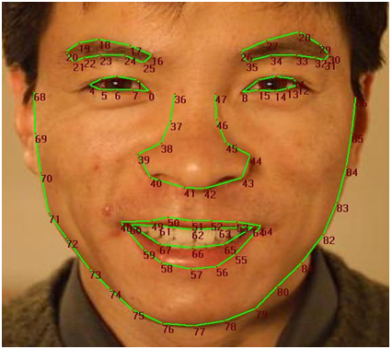
Face tracking
2D points
Notes:
The Face Tracking SDK tracks the 87 2D points indicated in the following image (in addition to 13 points that aren’t shown in Figure 2 - Tracked Points):

Slide 54
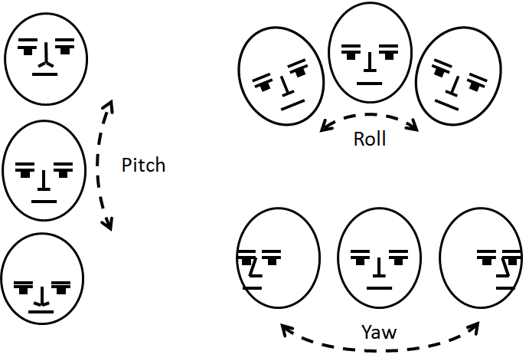
Face tracking
3D head pose
Notes:
The X,Y, and Z position of the user’s head are reported based on a right-handed coordinate system (with the origin at the sensor, Z pointed towards the user and Y pointed UP – this is the same as the Kinect’s skeleton coordinate frame). Translations are in meters.
The user’s head pose is captured by three angles: pitch, roll, and yaw.

Slide 55
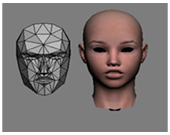
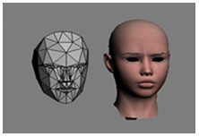
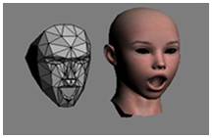
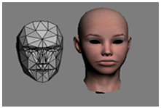
Face tracking
AUs
AU0 – Upper Lip Raiser
AU3 – Brow Lowerer
AU1 – Jaw Lowerer
AU2 – Lip Stretcher
Notes:
The Face Tracking SDK results are also expressed in terms of weights of six AUs and 11 SUs, which are a subset of what is defined in the Candide3 model (http://www.icg.isy.liu.se/candide/). The SUs estimate the particular shape of the user’s head: the neutral position of their mouth, brows, eyes, and so on. The AUs are deltas from the neutral shape that you can use to morph targets on animated avatar models so that the avatar acts as the tracked user does.
The Face Tracking SDK tracks the following AUs. Each AU is expressed as a numeric weight varying between -1 and +1.

Slide 56
Kinect Fusion Apps
Source: Kinect for Windows Developer Toolkit v1.8
http://www.microsoft.com/en-in/download/details.aspx?id=40276
App Examples:
Kinect Fusion Basics - D2D
Kinect Fusion Color Basics - D2D
Kinect Fusion Explorer - D2D

Slide 57
Kinect Fusion
Take depth images from the Kinect camera with lots of missing data
Within a few seconds producing a realistic smooth 3D reconstruction of a static scene by moving the Kinect sensor around.
From this, a point cloud or a 3D mesh can be produced.

Slide 58
Kinect Fusion

Slide 59
Kinect Interaction Apps
Source: Kinect for Windows Developer Toolkit v1.8
http://www.microsoft.com/en-in/download/details.aspx?id=40276
App Examples:
Interaction Gallery - WPF

Slide 60
Kinect Interaction
Kinect Interaction provides:
Identification of up to 2 users and identification and tracking of their primary interaction hand.
Detection services for user's hand location and state.
Grip and grip release detection.
Press and scroll detection.
Information on the control targeted by the user.
Notes:
http://msdn.microsoft.com/en-us/library/dn188673.aspx

Slide 61
Third Party Libraries

Slide 62
Third Party Libraries
Matlab
OpenCV
PCL (Point Cloud Library)
BoofCV Library
ROS

Slide 63
Matlab & OpenCV
Matlab is a high-level language and interactive environment for numerical computation, visualization, and programming.
Open Source Computer Vision (OpenCV) is a library of programming functions for real-time computer vision.
MATLAB and OpenCV functions perform numerical computation and visualization on video and depth data from sensor.
Source:
Maltlab – http://msdn.microsoft.com/en-us/library/dn188693.aspx
OpenCV – http://msdn.microsoft.com/en-us/library/dn188694.aspx
Notes:
Maltlab – http://msdn.microsoft.com/en-us/library/dn188693.aspx
OpenCV - http://msdn.microsoft.com/en-us/library/dn188694.aspx

Slide 64
PCL (Point Cloud Library)
Source: PCL – http://pointclouds.org/documentation/
Notes:
http://pointclouds.org/documentation/
The Point Cloud Library (PCL) is a large scale, open project for point cloud processing.
The PCL framework contains numerous algorithms including filtering, feature estimation, surface reconstruction, registration, model fitting and segmentation. These algorithms can be used, for example, to filter outliers from noisy data, stitch 3D point clouds together, segment relevant parts of a scene, extract keypoints and compute descriptors to recognize objects in the world based on their geometric appearance, and create surfaces from point clouds and visualize them – to name a few.
PCL is cross-platform, and has been successfully compiled and deployed on Linux, MacOS, Windows, and Android.
To simplify development, PCL is split into a series of smaller code libraries, that can be compiled separately

Slide 65
Ros (Robot Operating System)
Provides libraries and tools to help software developers create robot applications.
Provides hardware abstraction, device drivers, libraries, visualizers, message-passing, package management, and more.
Provides additional RGB-D processing capabilities.
Source: ROS – http://wiki.ros.org/openni_camera
Notes:
http://wiki.ros.org/openni_camera

Slide 66
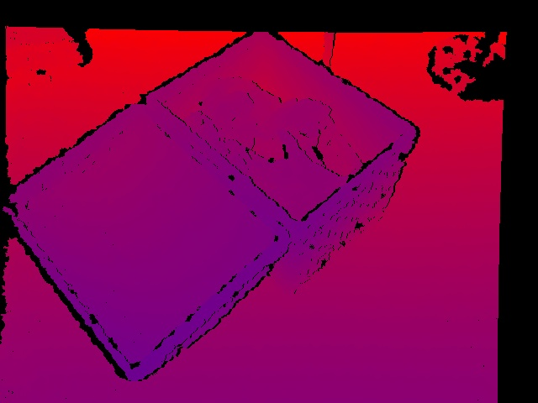
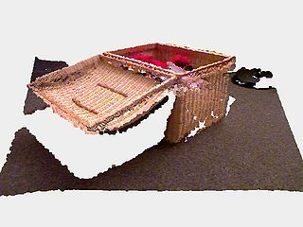
BoofCV
Binary Image processing
Image registration and model fitting
Interest point detection
Camera calibration
Provides RGB-D processing capabilities.
Depth image from Kinect sensor
3D point cloud created from RGB & depth images
Source: BoofCV – http://boofcv.org/index.php?title=Tutorial_Kinect
Notes:
http://boofcv.org/index.php?title=Tutorial_Kinect
http://www.codeproject.com/Articles/293269/BoofCV-Real-Time-Computer-Vision-in-Java

Slide 67
Applications

Slide 68
Kinect Applications
Gesture Recognition
Gait Detection
Activity Recognition

Slide 69
Gesture Recognition
Body Parts | Gestures | Applications | References
Fingers | 9 hand Gestures for number 1to 9 | Sudoku game | Ren et al. 2011
Hand, Fingers | Pointing gestures: pointing at objects or locations of interest | Real-time hand gesture interaction with the robot. Pointing gestures translated into goals for the robot. | Bergh et al. 2011
Arms | Lifting both arms to the front, to the side and upwards | Physical rehabilitation | Chang 2011
Hand | 10 hand Gestures for number 1 to 10 | HCI system. Experimental datasets in-clude hand signed digits gestures but framework can be generalized to recognize a wider range of gestures. | Doliotis 2011

Slide 70
Gesture Recognition
Body Parts | Gestures | Applications | References
Hand and Head | Clap, Call, Greet, Yes, No, Wave, Clasp, Rest | HCI applications. Not build for any specic application | Biswas 2011
Single Hand | Grasp and Drop | Various HCI applications | Tang 2012
Right hand (default), Left hand, Head, Foot or Knee | Push, Hover | View and select recipes for cooking in Kitchen when hands are messy | Panger 2012
Hand, Arms | Right / Left-arm swing, Right / Left-arm push, Right / Left-arm back, Zoom-in/out | Various HCI applications. Not build for any specific application | Lai 2012

Slide 71
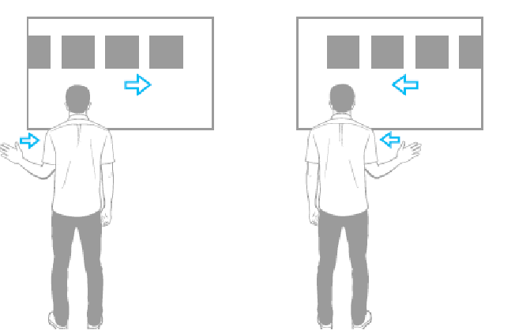
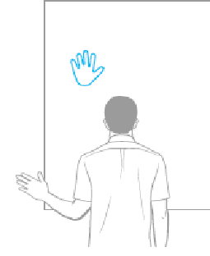
POWERPOINT PRESENTATION CONTROL from hand gesture
Image source : Kinect for Windows Human Interface Guidelines v1.5
Start presentation
End presentation
Left and right swipe
Hand as a
marker
Circling gesture
Push gesture
Image source : Kinect for Windows Human Interface Guidelines v1.5

Slide 72
Gesture path
Right swipe gesture paths

Slide 73
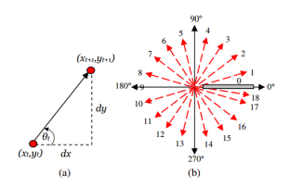
MODELING GESTURES
Consider an example : Take a left swipe path
The sequence of angles will be of the form [180,170,182, … ,170,180,185]
The corresponding quantized feature vector is [9,9,9, … , 9,9,9]
How does it distinguish left swipe from right swipe? Very straightforward!

Slide 74
MACHINE LEARNING
HMM model for right swipe
Returns likelihoods which are then converted to probabilities by normalization, followed by thresholding (empirical) to classify gestures
HMM model for push
HMM model for left swipe
L3
L2
L1
L4
Real time gesture

Slide 75
RESULTS
Here are the results obtained by the implementation
Precision = 97.23 %
Recall = 93.66 %
F-measure = 95.41 %
Accuracy = 95.5 %
 | Correct Gesture | Incorrect gesture
Correctly classified | 281 | 8
Wrongly classified | 19 | 292

Slide 76
Human Gait Recognition Using Depth Camera: A Covariance Based Approach
Source: http://www.serc.iisc.ernet.in/~venky/Papers/Kinect_gait.pdf
Notes:
http://www.serc.iisc.ernet.in/~venky/Papers/Kinect_gait.pdf

Slide 77
Human Gait Recognition Using Depth Camera: A Covariance Based Approach
(a) Fixed Camera (b) Freely moving camera
Recognition Rate – 97%

Slide 78
Team Activity Analysis and Recognition Based on Kinect Depth Map and Optical Imagery Techniques
Source: http://www.tnstate.edu/itmrl/documents/Team%20Activity%20Analysis.pdf
Notes:
http://www.tnstate.edu/itmrl/documents/Team%20Activity%20Analysis.pdf

Slide 79
Windows SDK vis-à-vis OpenNI

Slide 80
Kinect SDK vis-à-vis OpenNI
Library | Capture | Process | Sensor | Platform
OpenNI | Yes | Yes | Primesense Sensors | Windows/ MacOS/ Linux
Kinect for Windows SDK | Yes | Yes | Kinect | Windows and VM
Factors | Kinect SDK | OpenNI
Depth Range | 0.8m – 4.0m | 0.5m – 9m
Skeleton Joints | 20 joints | 15 joints
Too near Too far index | Yes | No

Slide 81
Kinect SDK vis-à-vis OpenNI
Additional libraries and APIs
OpenNI Middleware
Skeleton Tracking
KinectInteraction
Kinect Fusion
Face Tracking
NITE
3D Hand
KSCAN3D
3-D FACE
Source:
NITE – http://www.openni.org/files/nite/
3D Hand – http://www.openni.org/files/3d-hand-tracking-library/
3D face – http://www.openni.org/files/3-d-face-modeling/
KSCAN3D – http://www.openni.org/files/kscan3d-2/
Notes:
NITE - http://www.openni.org/files/nite/
3D Hand - http://www.openni.org/files/3d-hand-tracking-library/
3D face - http://www.openni.org/files/3-d-face-modeling/
KSCAN3D - http://www.openni.org/files/kscan3d-2/

Slide 82
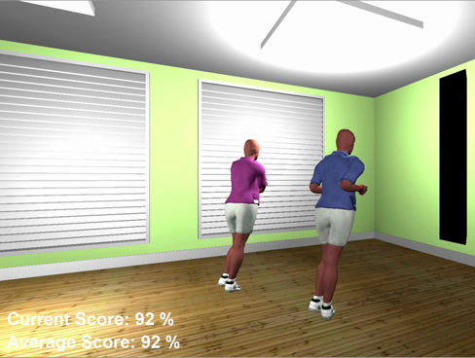
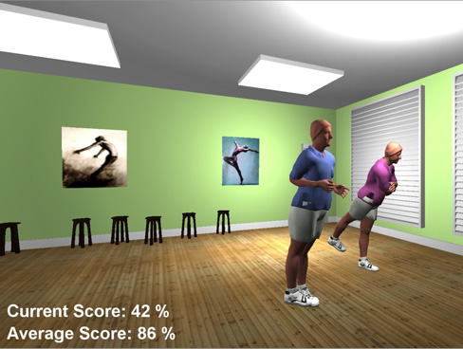
Application in openni
Evaluating a Dancer’s Performance using Kinect-based Skeleton Tracking
Joint Positions
Joint Velocity
3D Flow Error
Source: http://doras.dcu.ie/16574/1/ACMGC_Doras.pdf
Notes:
http://doras.dcu.ie/16574/1/ACMGC_Doras.pdf

Slide 83
Kinect SDK vis-à-vis OpenNI
Kinect SDK
OpenNi
Better skeleton representation
20 joints skeleton
Joints are mobile
Higher frame rate – better for tracking actions involving rapid pose changes
Significantly better skeletal tracking algorithm (by Shotton, 2013). Robust and fast tracking even in complex body poses
Simpler skeleton representation
15 joints skeleton
Fixed basic frame of [shoulder left: shoulder right: hip] triangle and [head:shoulder] vector
Lower frame rate – slower tracking of actions
Weak skeletal tracking.

Slide 84
How does kinect works

Slide 85
Depth Sensing

Slide 86
How pattern looks like?

Slide 87
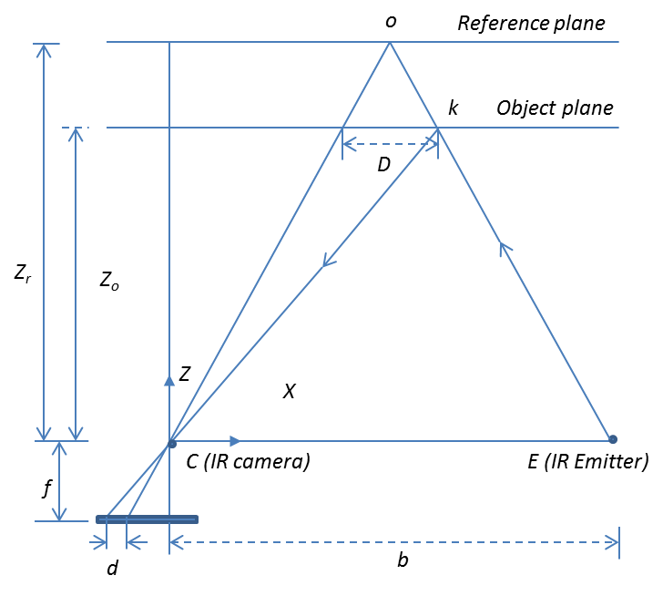
Depth sensing
The IR emitter projects an irregular pattern of IR dots of varying intensities.
The IR camera reconstructs a depth image by recognizing the distortion in this pattern.
Kinect works on stereo matching algorithm. It captures stereo with only one IR camera.

Slide 88
Depth sensing
Project Speckle pattern onto the scene
Infer depth from the deformation of the Speckle pattern

Slide 89
Skeleton Tracking

Slide 90
pose estimation pipeline
capture depth image & remove background
infer body parts
per pixel
cluster pixels to
hypothesize body joint positions
fit model &
track skeleton

Slide 91
Body part Inference
Highly varied training dataset - driving, dancing, kicking, running, navigating menus, etc (500k images)
The pairs of depth and body part images - used for learning the classifier.
Randomized decision trees and forests - used to classify each pixel to a body part based on some depth image feature and threshold
Notes:
Highly varied training dataset allows the classifier to estimate body parts invariant to pose, body shape, clothing, etc. (500k images)
The pairs of depth and body part images are used as fully labelled data for learning the classifier.
Randomized decision trees and forests are used to classify each pixel to a body part based on some depth image feature and threshold

Slide 92
Joint position proposals
Find joint point in each body parts - local mode-finding approach based on mean shift with a weighted Gaussian kernel.
This process considers both the inferred body part probability at the pixel and the world surface area of the pixel.

Slide 93
Results
Input Depth
Inferred body parts
Front view
Side view
Top view
Inferred body joint position
No tracking or smoothing

Slide 94
Using multiple kinects

Slide 95
Pros & Cons of Kinect
PROS
CONS
Multimedia Sensor
Ease of Use
Low Cost
Strong Library Support
2.5D depth data
Limited field of view
43o vert, 57o horz
Limited Range
0.8 – 3.5 m
Uni-Directional View
Depth Shadows
Limited resolution
Missing depth values

Slide 96
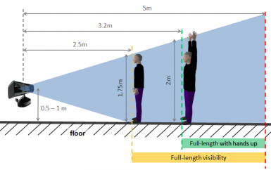
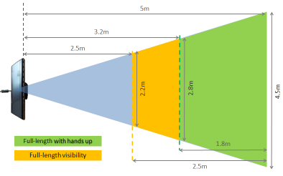
Limited Space for an actor
For a single Kinect, minimum of 10 feet by 10 feet space (3 meters by 3 meters) is needed.
Side View
Top View

Slide 97
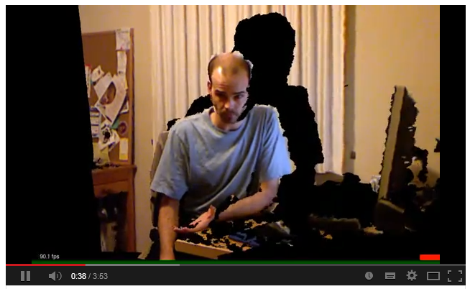
Depth Shadow

Slide 98
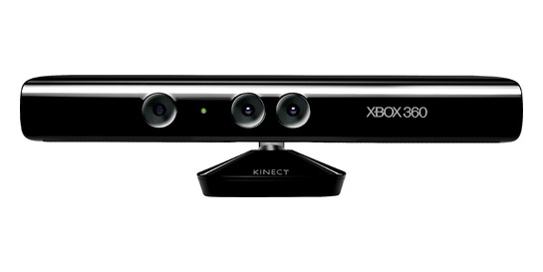
Solution
Use Multiple Kinects

Slide 99
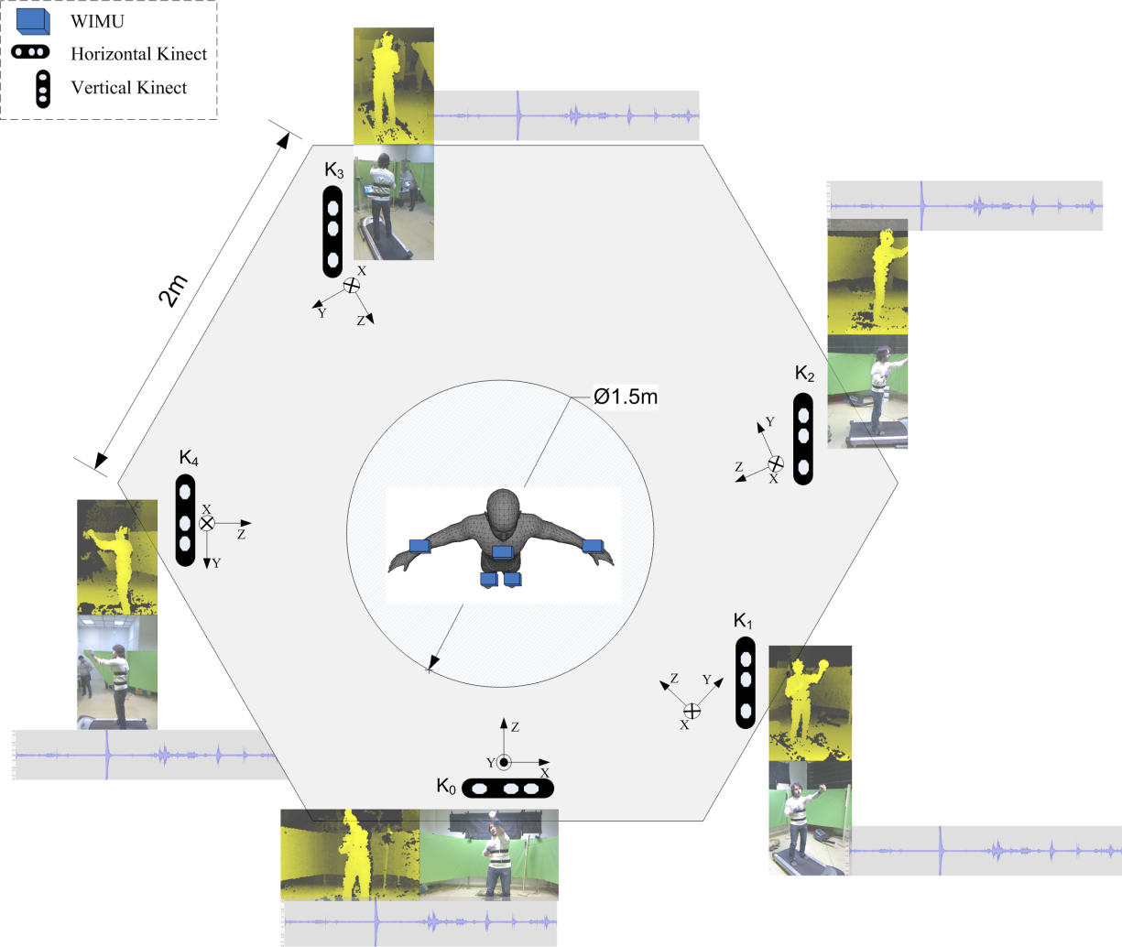
Use of multiple kinect
360⁰ Reconstruction

Slide 100
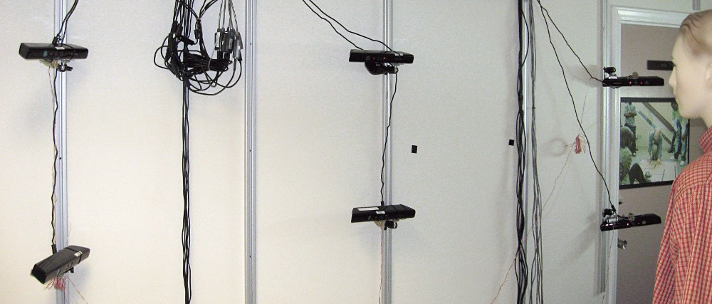
Use of multiple Kinect
Increases field of view
Super Resolution

Slide 101
Drawbacks of Multiple Kinects
IR Interference Noise

Slide 102
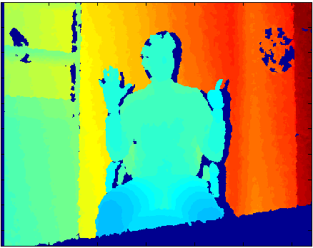
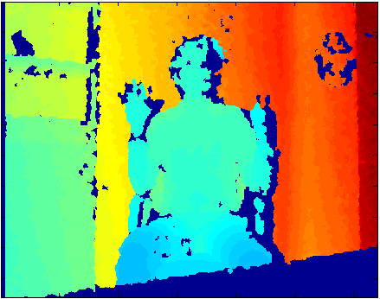
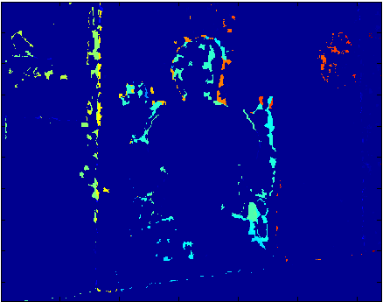
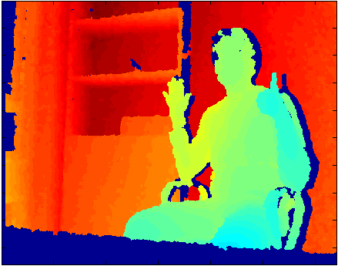
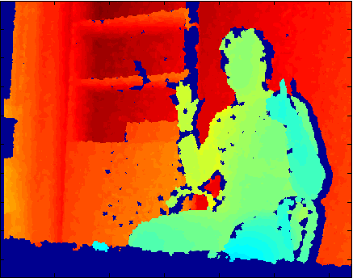
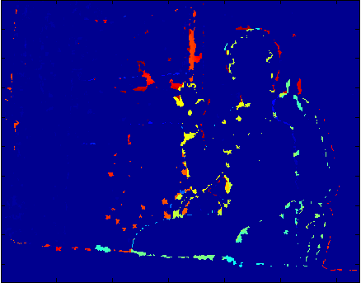
Multiple Kinects interference
Individual capture
Simultaneous capture
Difference

Slide 103
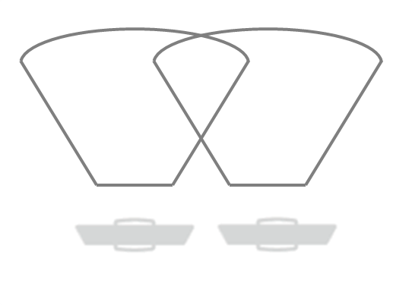
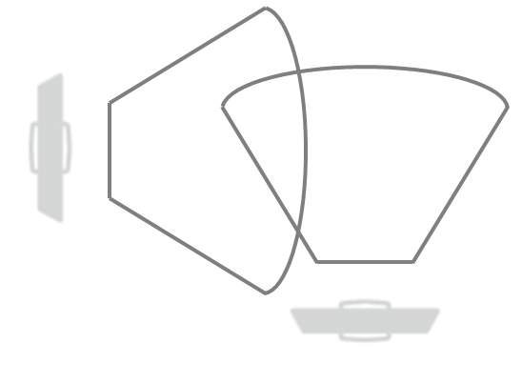
Estimation of Noise
Estimate interference noise in 2 configuration
Parallel
Perpendicular
Parallel
Perpendicular

Slide 104
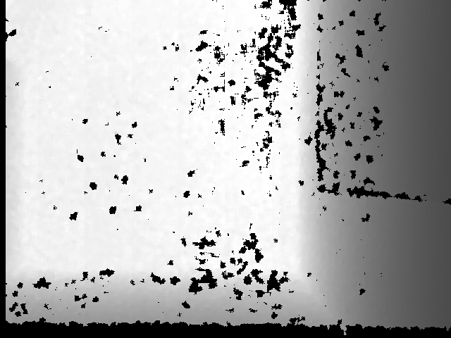
Interference Noise
Single Kinect
Dual Kinects

Slide 105
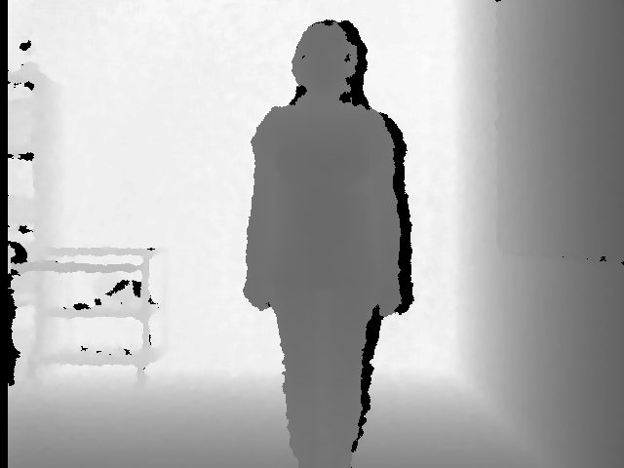
Interference Noise
Perpendicular
Parallel

Slide 106
Estimators
Noise Measure | Angle (⁰) | Scene | Single Kinect | Two Kinects
% ZD Error | 180 | Room | 6.92 | 10.93
 | 180 | Human | 4.01 | 8.25
 | 90 | Human | 4.01 | 7.40
Avg (d_{max} - d_{min}) | 180 | Room | 329 | 639
 | 180 | Human | 206 | 624
 | 90 | Human | 206 | 408
Average Standard Deviation | 180 | Room | 89.15 | 185.71
 | 180 | Human | 58.26 | 168.91
 | 90 | Human | 58.26 | 118.65
% Pixels with d_{min} = 0 & d_{max} > 0 | 180 | Room | 8.08% | 17.52%
 | 180 | Human | 5.32% | 19.84%
 | 90 | Human | 5.32% | 11.87%

Slide 107
Approaches to minimize interference
SDM: Space Division Multiplexing
Circular Placement
Axial and Diagonal Placement
Vertical Placement
TDM: Time Division Multiplexing
Mechanical Shutter (TDM-MS)
Electronic Shutter (TDM-ES)
Software Shutter (TDM-SS)
PDM: Pattern Division Multiplexing
Body-Attached Vibrators
Stand-Mounted Vibrators

Slide 108
SDM – Circular Placement

Slide 109
SDM – Circular Placement

Slide 110
SDM – Circular Placement
Top View
Side View

Slide 111
SDM – Axial and Diagonal Placement

Slide 112
SDM – Axial and Diagonal Placement
Top View
Side View

Slide 113
SDM – Vertical Placement

Slide 114
TDM - Mechanical Shutter (TDM-MS)
Moving Shaft Shutter
Shutter Closed
Shutter Open

Slide 115
TDM - Mechanical Shutter (TDM-MS)
A Revolving Disk Shutter

Slide 116
TDM - Mechanical Shutter (TDM-MS)
4-phase Mechanical Shuttering

Slide 117
TDM - Electronic Shutter (TDM-ES)

Slide 118
TDM - Software Shutter (TDM-SS)
Microsoft's Kinect SDK v1.6 has introduced a new API (KinectSensor.ForceInfraredEmitterOff) to control the IR emitter as a Software Shutter.
This API works for Kinect for Windows only.
Earlier the IR emitter was always active when the camera was active. Using this API the IR emitter can be put o as needed.
This is the most effective TDM scheme. However, no multi-Kinect application has yet been reported with TDM-SS.

Slide 119
PDM – Body-Attached Vibrators

Slide 120
PDM – Stand-Mounted Vibrators

Slide 121
Comparison of Multiplexing Technique
Quality Factor | SDM | TDM | PDM
Accuracy | Excellent | Bad | Very Good
Scalability | Good (no overlaps) | Bad | Excellent
Frame rate | 30 fps | 30/n fps | 30 fps
Ease of Use | Very easy | Cumbersome shutters | Inconvenient vibrators
Cost | Low | High | Moderate
Limitations | Few configurations | Unstable | Blurred RGB
Robustness | Change Geometry | Adjust Set-up | Quite robust

Slide 122
Buying the right kinects

Slide 123
Which Kinect to buy?
Kinect for Xbox 360 –
The gaming console of Xbox. Costs around $100 without the Xbox
http://www.xbox.com/en-IN/Kinect
Kinect Windows SDK is partially supported for this
Kinect for Windows –
This is for Kinect App development. Costs around $250
http://www.microsoft.com/en-us/kinectforwindows/
Kinect Windows SDK is fully supported for this
Good for Gaming
Recommended for Research

Slide 124
References
Ren, Z., Meng, J., and Yuan, J. Depth camera based hand gesture recognition and its applications in human-computer-interaction. In Information, Communications and Signal Processing (ICICS) 2011 8th International Conference on (2011), pp. 1- 5.
Biswas, K. K., and Basu, S. K. Gesture recognition using Microsoft Kinect. In Proceedings of the 5th International Conference on Automation, Robotics and Applications (2011), pp. 100 - 103.
Chang, Y.-J., Chen, S.-F., and Huang, J.-D. A Kinect-based system for physical rehabilitation: A pilot study for young adults with motor disabilities. Research in Developmental Disabilities (2011), 25662570.
Doliotis, P., Stefan, A., McMurrough, C., Eckhard, D., and Athitsos, V. Comparing gesture recognition accuracy using color and depth information. In Proceedings of the 4th International Conference on PErvasive Technologies Related to Assistive Environments, PETRA '11 (2011).

Slide 125
References
Lai, K., Konrad, J., and Ishwar, P. A gesture-driven computer interface using kinect. In Image Analysis and Interpretation (SSIAI), 2012 IEEE Southwest Symposium on (2012), pp. 185 - 188.
Panger, G. Kinect in the kitchen: testing depth camera interactions in practical home environments. In CHI '12 Extended Abstracts on Human Factors in Computing Systems (2012), pp. 1985 - 1990.
Tang, M. Recognizing hand gestures with Microsoft’s Kinect. Department of Electrical Engineering, Stanford University.
Ahmed, N. A system for 360 acquisition and 3D animation reconstruction using multiple RGB-D cameras. Unpublished article. 2012.
URL: http://www.mpiinf.mpg.de/~nahmed/casa2012.pdf.

Slide 126
References
Caon, M., Yue, Y., Tscherrig, J., Mugellini, E., and Khaled, O. A. Contextaware 3D gesture interaction based on multiple Kinects. In Ambient Computing, Applications, Services and Technologies, Proc. AMBIENT First Int'l. Conf. on, pages 7-12, 2011.
Berger, K., Ruhl, K., Albers, M., Schroder, Y., Scholz, A., Kokemuller, J., Guthe, S., and Magnor, M. The capturing of turbulent gas flows using multiple Kinects. In Computer Vision Workshops, IEEE Int'l. Conf. on, pages 1108-1113, 2011a.
Berger, K., Ruhl, K., Brmmer, C., Schroder, Y., Scholz, A., and Magnor, M. Markerless motion capture using multiple color-depth sensors. In Vision, Modeling and Visualization, Proc. 16th Int'l. Workshop on, pages 317-324, 2011b.
Faion, F., Friedberger, S., Zea, A., and Hanebeck, U. D. Intelligent sensor scheduling for multi-Kinect-tracking. In Intelligent Robots and Systems (IROS), IEEE/RSJ Int'l. Conf. on, pages 3993-3999, 2012.

Slide 127
References
Butler, A., Izadi, S., Hilliges, O., Molyneaux, D., Hodges, S., and Kim, D. Shake'n'Sense: Reducing interference for overlapping structured light depth cameras. In Human Factors in Computing Systems, Proc. ACM CHI Conf. on, pages 1933-1936, 2012.
Kainz, B., Hauswiesner, S., Reitmayr, G., Steinberger, M., Grasset, R., Gruber, L., Veas, E., Kalkofen, D., Seichter, H., and Schmalstieg, D. (2012). OmniKinect: Real-time dense volumetric data acquisition and applications. In Virtual reality software and technology, Proc. VRST'12: 18th ACM symposium on, pages 25-32, 2012.
Maimone, A. and Fuchs, H Reducing interference between multiple structured light depth sensors using motion. In Virtual Reality, Proc. IEEE Conf. on, pages 51-54, 2012.
Kramer, J., Burrus, N., Echtler, F., C., D. H., and Parker, M. Hacking the Kinect. Apress, 2012.

Slide 128
References
Zelnik-Manor, L. & Or–El, R. Kinect Depth Map, Seminar in “Advanced Topics in Computer Vision” (048921 –Winter 2013). URL: http://webee.technion.ac.il/~lihi/Teaching/2012_winter_048921/PPT/Roy.pdf
iPiSoft Wiki. User Guide for Dual Depth Sensor Configurations. Last accessed 17-Dec-2013.
URL: http://wiki.ipisoft.com/User_Guide_for_Dual_Depth_Sensor_Configuration
Tong, J., Zhou, J., Liu, L., Pan, Z., and Yan, H. (2012). Scanning 3D full human bodies using Kinects. Visualization and Computer Graphics, IEEE Transactions on, 18:643-650, 2012.
Mallick, T., Das, P.P., Majumdar, A. Study of Interference Noise in Multi-Kinect Set-up, Accepted for presentation at VISAPP 2014: 9th Int’l Jt. Conf. on Computer Vision, Imaging and Computer Graphics Theory and Applications, Lisbon, Portugal, 5-8, Jan, 2014.

Slide 129
References
Huawei/3DLife ACM Multimedia Grand Challenge for 2013. http://mmv.eecs.qmul.ac.uk/mmgc2013/
Schroder, Y., Scholz, A., Berger, K., Ruhl, K., Guthe, S., and Magnor, M. Multiple Kinect studies. Technical Report 09-15, ICG, 2011.

Slide 130
Credits
Tanwi Mallick, TCS Research Scholar, Department of Computer Science and Engineering, IIT, Kharagpur has prepared this presentation.

Slide 131
Thank you

