Slide 1

Framework for Generation and Evaluation of Assessment Instrument
Rekha Ramesh
Research Scholar
(Defence)
Date: 17th October 2017
Faculty Advisors: Prof. Sridhar Iyer & Sasikumar M.
IDP in Educational Technology
Indian Institute of Technology Bombay
Powai, Mumbai, 400 076.

Slide 2
Assessment is a broad term defined as a process for obtaining information that is used for making decisions about students, curricula and educational policy.
(Nitko, A. J, 2001)
As far as students are concerned, assessment is the curriculum. They will learn what they think they will be assessed on, not by what is in the curriculum
(Biggs, 2003)
Notes:
Decisions about students include managing classroom instructions, placing them into different types of educational programs, assigning grades to them, selecting them for educational opportunities and certifying their competence. Decision about curricula and programs include decisions about their effectiveness (summative evaluation) and about ways to improve them (formative evaluation). Decision about educational policy includes decision at school, district or state level

Slide 3
Motivation
1. Assessment is a complex process
2. Design of AI is a major component
7. Even expert teachers need lot of time and effort for creating AI
3. Shortage of experienced
faculty and domain experts
4. Dependency on individual
teachers experience and
expectation
5. University guidelines
concentrate only on
structural information
6. Lack of procedures concerning
the quality of AI
1. Random and unfair AI for students
2. Teachers do not receive adequate feedback

Slide 4
Solution Approach
There are two ways to improve the quality of AI
Evaluating the quality of AI generated by teacher and providing feedback
Automatically generating AI so that the quality is ensured at the time of creation itself.

Slide 5
RQ: How to build a framework for the generation and evaluation of assessment instrument that will improve the quality of AI?
RQ1
Given an AI, how to design a framework for evaluating its quality in terms of its alignment with the LOs of a course?
RQ2
How to design a TTM that will train the teachers to write good assessment questions?
RQ3
RQ3: How to design a framework for automatic generation of AI from a given assessment instrument specification (AIS) from a semantically tagged question repository?

Slide 6
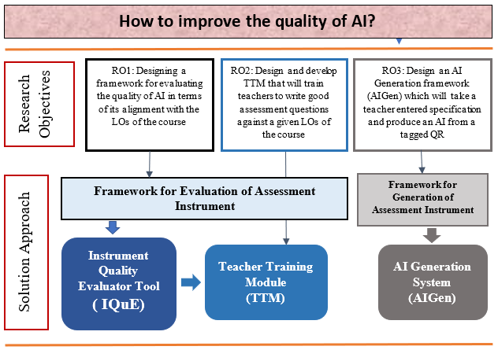
Solution Approach

Slide 7
Scope and Limitations of Thesis
[A] Quality Parameters of AI
The emphasis of framework is on alignment problem
[B] Type of LOs and Questions
LOs and questions must be machine parsable.
There should be some indication of concepts involved
system is capable of handling domains where predominantly text based questions are present.
Certain natural language ambiguities are handled by a manual pre-processing step
[C] Type of Assessments
Restricted only to written assessments in a typical university scenario
[D]Selection of Domain
Data Structures

Slide 8
IQuE Demo

Slide 9
RM/DDR
RC 1
Literature Review and Need Analysis for IQuE, TTM, AIGen
Research Methodology
Design and Development Phase of IQuE
SE of IQuE
RC 2
Development of IQuE
RC 3
Refinement of IQuE
RC 4
Evaluation of IQuE
Design Specs
V₁
V_{F}
Design and Development Phase of TTM
SE of TTM
RC 5
Development of TTM
RC 6
Evaluation of TTM
V_{F}
Design and Development Phase of AIGen
RC 7
Development of AIGen
V_{P}
RC- Research cycle, V_{N} - N^{th} Version, V_{F} – Final version,
V_{P –} Prototype version, SE - Summative evaluation,
FE – Formative Evaluation

Slide 10
Phase 1: Need and context analysis
RM/DDR/Phase 1
Phase No. | Phases | Research Focus | Method of evaluation | Evaluation Instrument | Sample
1 | Need and Context Analysis | Understanding the need for good quality AI | Synthesis of Literature Survey | ----- | Research papers and Assessment Handbooks Experience Reported from University Teachers
 |  | 2. Understanding teacher difficulty in manually generating and evaluating the quality of AI
 |  | Identifying appropriate Knowledge Representation Mechanism
Notes:
12, 13, 14

Slide 11
Key Findings from Literature (1)
RM/DDR/Phase 1
Educational Assessment Theory and Practice
  The assessment needs to be ‘fit-for-purpose’. And it should not prevent learning!
(S. Brown, 2004)
  An assessment framework that provides an overall plan to guide the development of assessment is crucial in determining the contents of AI and blueprint (AIS) is a part of that framework.
(Anderson P. & Morgan, G., 2008)
Quality of AI
  Alignment of AI to LOs of the course is considered as the most important quality measure of a good AI
(Biggs J., 2003) (Nitko A. J., 2001).

Slide 12
Key Findings From Literature (2)
RM/DDR/Phase 1
Difficulty in Manually Ensuring the Quality of AI
  Designing an AI is a complex process and lot of time and effort is needed to manually ensuring the quality of AI.
  wherever possible teachers must make best use of the available technologies to make assessment more efficient
(Brown et al., 1994).
Need for Training
  Teachers have difficulty in framing LOs as well as writing assessment questions against those LOs
(Reddy, P. D. & Mahajan A., 2016).

Slide 13
Key Findings From Literature (3)
RM/DDR/Phase 1
Technology Requirements
  KR mechanism (Ontology)
  (R. Mizoguchi, 2004) (R. Mizoguchi and J. Bourdeau, 2015)
  Information extraction mechanism for LO and questions
  (NLP techniques)
To automate the process of generation of AI
  Language for AI specification (XML)
    (Anderson, P., & Morgan, G., 2008)
      Metadata for question in QR (content or topic, cognitive level, difficulty level and question type)

Slide 14
Phase2:Design and development
RM/DDR/Phase 2
Phase No. | Phases | Research Focus | Method of FE | Evaluation Instrument | Sample
Design and Development of (IQuE) | RC 2: Development of IQuE | Stage1: Creation of Domain Ontology | Qualitative | Rubrics | Domain ontology for DS course created by experts
 |  | Stage2: Generation of LO and AI Annotated Ontology (LIAO) | Quantitative N=1000 | Confusion Matrix | Pairs of an LO and questions from DS courses taken from different universities (Set 1)
 |  | Stage3: Devising the AI Alignment Score
 | RC 3: Refinement of IQuE: | Refinement in stage 1, stage 2 and stage 3 | Quantitative N=1000 | Confusion Matrix | Pairs of an LO and questions from DS courses taken from different universities (Set 1)
b) Design and Development of TTM | RC 5: Development of TTM | Qualitative N=2 | Content Analysis | Users (teachers) comments on the feedback generated by the system
c) Design and Development of (AI Generator) | RC 7: Development of prototype model of AIGen | Accuracy of AIGen | Qualitative N=20 | Rubrics | System generated AIs against a user given specification
 |  | Usefulness and Usability of AIGen | Qualitative N = 5 | SUS survey | User responses to Likert’s scale and open ended questions of survey

Slide 15
Phase 3:Summative Evaluation phase
RM/DDR/Phase 3
Phase No. | Phases | Research Focus | Method of evaluation | Evaluation Instrument | Sample
Summative Evaluation (IQuE) | RC 4: Saturation of IQuE: | Accuracy of IQuE | Quantitative N=1000 | Confusion Matrix | Pairs of an LO and questions from DS courses taken from different universities (Set 2)
 |  | Usefulness and Usability of IQuE | Quantitative N=10 | SUS survey | User responses to Likert’s scale and open ended questions of survey
Summative Evaluation (TTM) | RC 6 Usefulness of TTM | Qualitative N=10 | Content Analysis | Users (teachers) comments on the feedback generated by the system

Slide 16
Design and Development Phase of IQuE
RC 2
Development of IQuE
RC 3
Refinement of IQuE
Saturation of IQuE
FA
SA
Accuracy
content level alignment = 80.1%
cognitive level alignment = 84.2%
Accuracy
content level alignment = 91.2%
cognitive level alignment = 93.23%

Slide 17
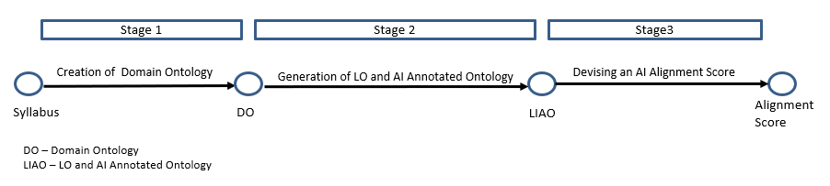
Development Stages of IQuE
Stage 1: Creation of Domain Ontology
Stage 2: Generation of AI and LO annotated ontology
Stage 3: Designing an AI alignment score

Slide 18
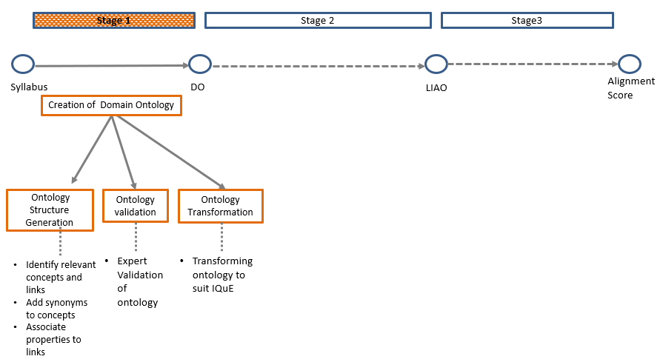
Stage 1: Creation of Domain Ontology
IQuE/Stage 1

Slide 19
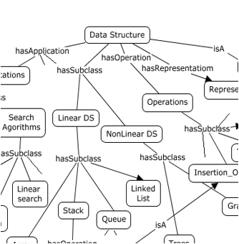
Stage 1: Creation of Domain Ontology
IQuE/Stage 1
Ontology

Slide 20
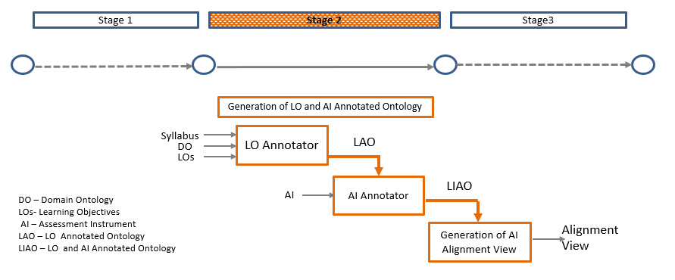
Stage 2: Generation of LO and Instrument Annotated Ontology
IQuE/Stage 2

Slide 21
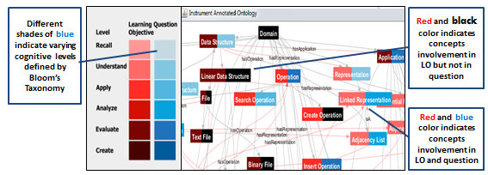
AI Alignment view
IQuE/Stage 2/Alignment veiw
Every node represent the concept in the domain, following information is associated with it such as
Is the concept from the syllabus?
Is it covered by any LO? If yes, what is the cognitive level expected from an assessment question that can be framed on that concept?
Is there any assessment question that is actually asked on it? If yes, what is cognitive level of the asked question?

Slide 22
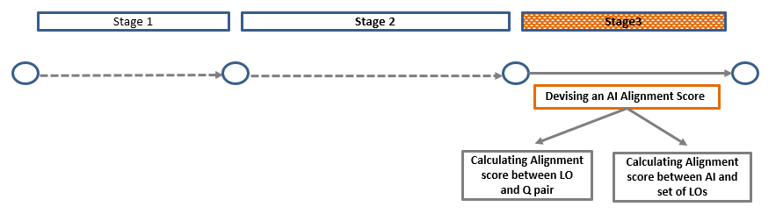
Stage 3: Devising an AI Alignment Score
IQuE/Stage 3/Alignment score
When an AI and a set of LOs are fed to the IQuE system, it calculates the measure of alignment for every question-LO pair and calculates a
  content alignment score
  cognitive level alignment score

Slide 23
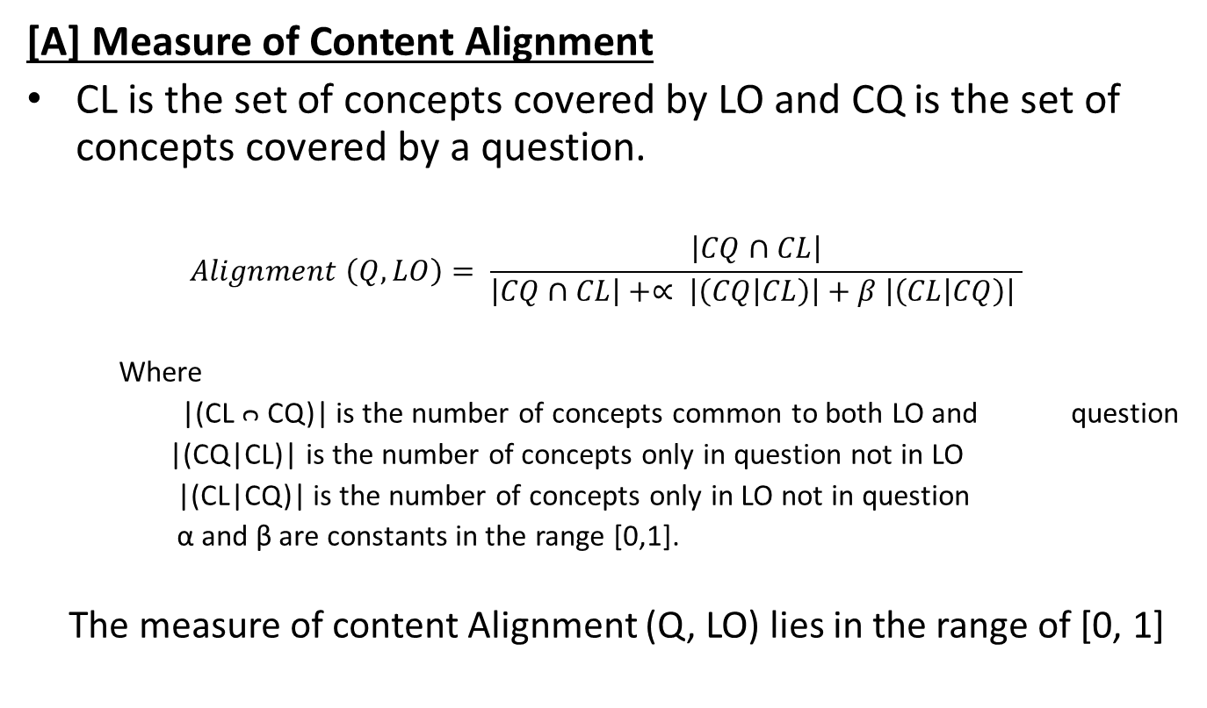
Alignment Score between LO and question
IQuE/Stage 3/Content Alignment
[A] Measure of Content Alignment
CL is the set of concepts covered by LO and CQ is the set of concepts covered by a question.
$$Alignment \left(Q, LO\right)= \frac{\left|CQ∩CL\right|}{\left|CQ∩CL\right|+∝ \left|\left(CQ | CL\right)\right|+β \left|\left(CL | CQ\right)\right| }$$
Where
|(CL ᴒ CQ)| is the number of concepts common to both LO and question
|(CQ|CL)| is the number of concepts only in question not in LO
|(CL|CQ)| is the number of concepts only in LO not in question
α and β are constants in the range [0,1].
The measure of content Alignment (Q, LO) lies in the range of [0, 1]
Expand

Slide 24
Alignment Score between LO and question
IQuE/Stage 3/ Cog-Alignment
[B] Measure of Cognitive Level Alignment
The cognitive levels of LO and questions are matched to get the cognitive alignment matrix.
The measure of cognitive level alignment is based on the difference in the cognitive level of question and LO
  Rule 1: If there is an exact match, then alignment is 100%
  Rule 2: If there is a level difference of +/- 1, then alignment is 50%.
  Rule 3: If there is a level difference of greater than +/- 2 then alignment is 0%.

Slide 25
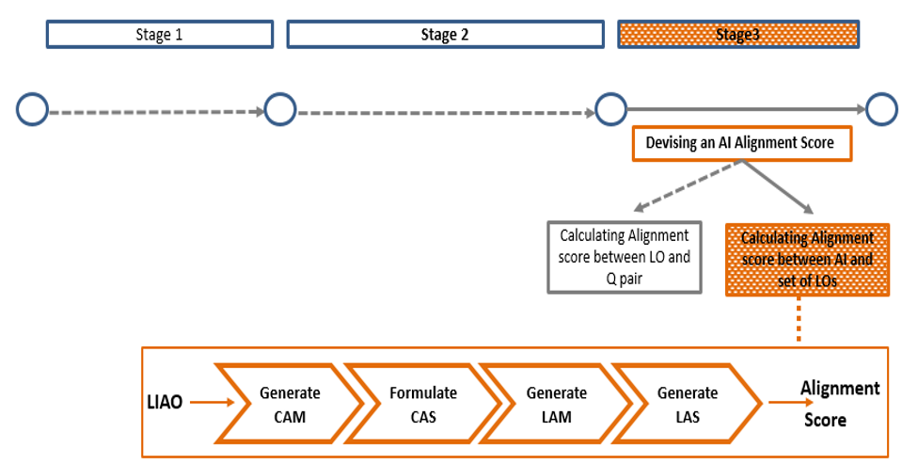
Calculating Alignment Score between Question Set (AI) and LO Set

Slide 26
Calculating Alignment Score between Question Set (AI) and LO Set
IQuE/Stage 3/ CAS
For every question of AI paired with every LO in the set of LOs
  The content alignment score is calculated and put into CAM
  The cognitive alignment score is calculated and put into LAM
The values from CAM and LAM are aggregated to generate a single score called as CAS and LAS
The aggregation takes into consideration
  the maximum contribution of all questions towards each of the LOs
  the contribution of each question towards all the LOs (utility of a question).
DETAILS

Slide 27
Reporting the Quality of AI
IQuE/Stage 3/CA/ Qual-Report
For the example AI, the quality report is
    The content alignment score is 83.14%
    The cognitive level alignment score is 100%
    The Q4 and Q5 are non-utility questions.
    The non-utility questions do not contribute anything to the alignment score neither in terms of content nor in terms of cognitive level to any of the LOs.
    Hence, Q4 and Q5 can be replaced by some other useful questions that will increase the value of CAS.

Slide 28
Performance Evaluation of IQuE
(A) Accuracy of IQuE
IQuE/Testing
Sample: A sample (a pair of LO and a question) of N = 1000 consisting of 100 questions and 10 LOs
  The LOs are mostly adopted from ACM computer science curriculum (Sahami M., et al., 2012)
Domain = Data structures
Experts: A teacher who has
(i) a teaching experience of more than 10 years,
(ii) taught data structures course multiple times
(iii) been a member of curriculum revision committee of university
(iv) designed the AI for the course in university examinations.
The system generated values are compared with expert generated values and a confusion matrix is generated.

Slide 29
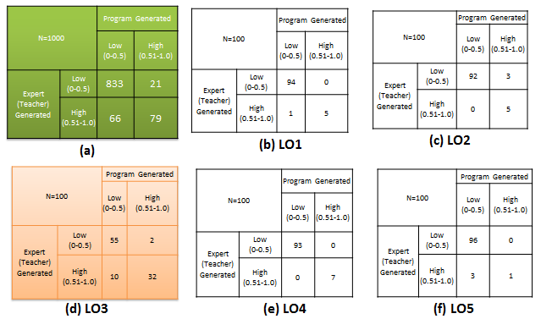
Confusion Matrices : Content Alignment
IQuE/Testing
The overall accuracy is (833+79)/1000 = 91.2%

Slide 30
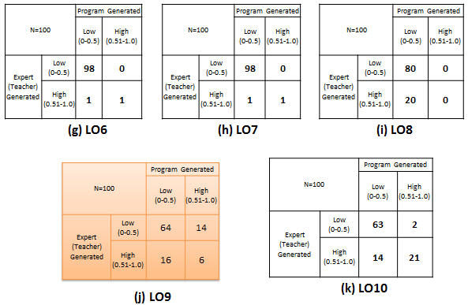
Confusion Matrices : Content Alignment
IQuE/Testing

Slide 31
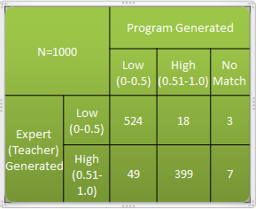
Confusion Matrix: Cognitive Level Alignment
IQuE/Testing
The system generated measure of cognitive level alignment is compared with expert generated values
The accuracy for the cognitive level alignment is (524+399)/990 = 93.23%.
In 1% cases, the system is not able to recognize the cognitive level of the question.

Slide 32
Usability and Usefulness of IQuE
IQuE/Testing
The SUS was administered to N= 20 users
The users were data structure domain experts
  ET researchers(4)
  CS instructors (16)
The average SUS score was found to be 73.4% for ET researchers and 85.53% for non-ET and CS instructors.

Slide 33
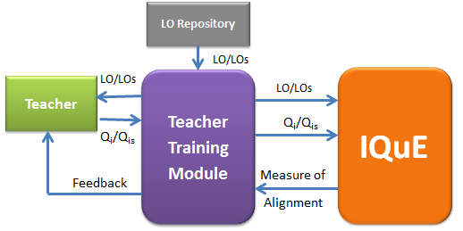
Teacher Training Module
DDR/cycle 5/TTM
To train teachers to write good assessment questions against a given set of LOs which in turn make them better AI designers.
It measures the alignment between the teachers entered question and system given LO and provides a constructive feedback.

Slide 34
  Multiple stages of TTM
DDR/cycle 5/TTM
3 Stages
  Stage 1: One LO one Question
  Stage 2: One LO and Multiple Questions
  Stage 3: Multiple LO and Multiple Questions
Teacher goes through every stage of TTM sequentially.
The level of complexity increases in each stage for the teacher as well as for the system.

Slide 35
TTM Demo

Slide 36
Testing
DDR/cycle 6/TTM/Testing
Sample:
  10 CS instructors
  experience of more than 10 years and also ET experts
  Have taught data structures course multiple times.
Methodology:
  Teachers explored all the three stages of TTM.
  It was compulsory to try atleast minimum required set of LOs in each stage i.e. five in stage 1, two in stage 2 and one in stage 3.
  10 teachers together attempted 59 LOs (stage 1), 21 LOs (stage 2) and 18 LOs (stage 3) respectively.
  For each successful attempt the teacher has to compulsorily write the comments on the feedback provided by the TTM
Analysis
  The logs generated by the system for each user were analyzed including their open-ended explanations.
Notes:
Change

Slide 37
Testing
DDR/cycle 6/TTM/Testing
Notes:
Change

Slide 38
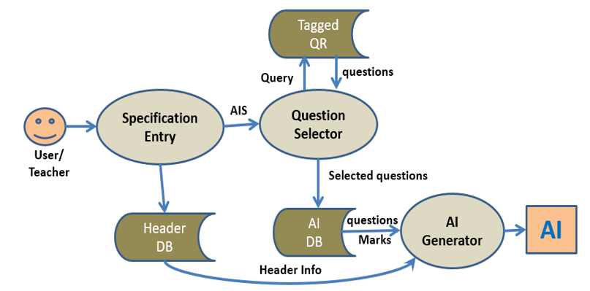
AIGen System
DDR/RC 7/AIGen
A prototype version of the AIGen is designed with restricted version of AIS structure.
AIGen take teachers’ request of assessment in the form of AIS, interprets it, then selects questions from QR meeting those specifications.
The output is generated in xml format and in word document.

Slide 39
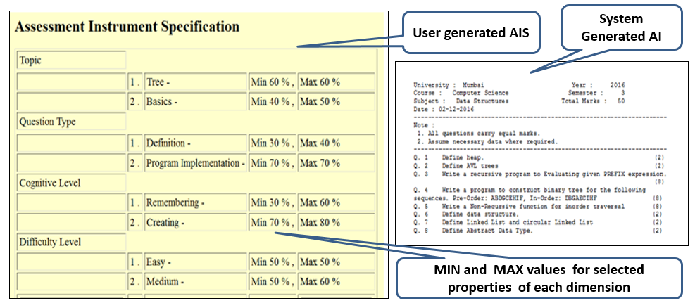
An example AIS and the generated AI

Slide 40
Thesis Contribution
A framework to evaluate the quality of AI
An Instrument Quality Evaluator (IQuE) tool that realizes this framework
Teacher training module that can be used to train teachers to write good assessment questions against given LOs
A language to define assessment instrument specification (AIS) which encompasses its structural as well as behavioral aspect of AI

Slide 41
Thesis Contribution
A framework for the automated generation of AI.
A prototype model of a tool (AIGen) that realizes this framework.
Software tool (QTagger) which suggests metadata for a given question.
Guidelines for building a domain ontology to represent the syllabus.
Formulation of alignment measure of AI in terms of its content and cognitive level
Design of visual representation of alignment

Slide 42
Future work
Extending to Other Domains:
  Extend the system to other courses in engineering curriculum or outside it and investigate the performance on them.
Other Quality measures:
  such as ambiguity in wording of questions, marks distribution, distribution of difficulty levels, etc.
Nature of LOs and questions:
  Removing manual preprocessing step before the LOs and questions are given to IQuE for further processing.
    (i) Automate the process of preprocessing
    (ii) Make the processing algorithm rich so that preprocessing is not required.
Notes:
Change

Slide 43
Future work
Improvement in AIGen:
  Generating AI of good quality
  Providing intelligence to complete the partially filled AIS
  Exploring other search strategies. Currently it is blind exhaustive search
Others (functional aspects of the system):
  Extending the TTM to a mobile platform with IQuE loaded on the server side
  Integrating both IQuE and AIGen systems together as one whole system

Slide 44
Publications
Ramesh, R., Sasikumar, M., & Iyer, S. (2016, July). Integrating the Learning Objectives and Syllabus into a Domain Ontology for Data structures Course. In Proceedings of the 2016 ACM Conference on Innovation and Technology in Computer Science Education (pp. 266-271). ACM.
Rekha R., Sasikumar M. Iyer S. (2016) “A Software Tool to Measure the Alignment of Assessment Instrument with a Set of Learning Objectives of a course”, International Conference on Advanced Learning Technologies (ICALT).
Nalawade, G., & Ramesh, R. (2016, December). Automatic Generation of Question Paper from User Entered Specifications Using a Semantically Tagged Question Repository. In Technology for Education (T4E), 2016 IEEE Eighth International Conference on (pp. 148-151). IEEE.
Ramesh, R., Mishra, S., Sasikumar, M., & Iyer, S. (2014, December). Semi-Automatic Generation of Metadata for Items in a Question Repository. IEEE Sixth International Conference on Technology for Education (T4E), 2014 (pp. 222-228). IEEE
Mishra, S., & Ramesh, R. (2013, December). A Software Solution to Facilitate Moderation, Observation and Analysis in a Focused Group Interview (FGI). InTechnology for Education (T4E), 2013 IEEE Fifth International Conference on(pp. 9-12). IEEE.
Rekha, R., Angadi, A., Pathak, A., Kapur, A., Gosar, H., Ramanathan, M., ... & Sasikumar, M. (2012, January). Ontology driven framework for assessing the syllabus fairness of a question paper. IEEE International Conference In Technology Enhanced Education (ICTEE), 2012 (pp. 1-5). IEEE.
Ramesh, R., Sasikumar, M. (2010). Ontology Based Approach for Finding the Similarity Among Questions in a Distributed Question Bank Scenario. IJCSA, 7(1), 79-93.

Slide 45
Thesis Clarification Table
Sr. No | Issue raised | Clarification/ justification | Revision in the Thesis
Referee II: Dr. Sarat Chandra Babu
1 | (Page 3 Referee Report): Observations related to typos, repeating sentences and words and few minor oversights are indicated. The author should go through these and change accordingly | The researcher agrees to these problems | All corrections and modifications are done accordingly.
2 | (Page 3 & 4) All modules of all figures should be covered in the description | Descriptions of all the modules of the figures are present but they are hidden in the text inside a paragraph and also worded in a different way at some places | The text containing the descriptions are highlighted. The wording of the sentences are made similar to the module names wherever applicable. (Page 4 Fig. 1, Page 25, Fig.3.2)
3 | (Page 3 Referee Report): If first time any abbreviation appears, please expand in bracket even if given in glossary | The researcher agrees to this issue | Corrections are done wherever required and verified throughout the thesis

Slide 46
Thesis Clarification Table
Sr. No | Issue raised | Clarification/ justification | Revision in the Thesis
Referee II: Dr. Sarat Chandra Babu
4 | (Page 3 Referee Report): Since the thesis will be published for wider reading, it is necessary to avoid statements denigrating Indian Universities. In section 5.2, a conclusion has been done without enough evidence. Therefore, in page 44; last para, the text “Even though samples are taken only from Mumbai University, scenario will be similar in many other engineering colleges in India. Hence, poor quality of AIs found in most of the engineering examinations is a serious issue faced by majority of the universities in India” may be deleted | The researcher agrees for removal of the sentence that generalizes the issue of poor quality of AIs found in most of the engineering examinations in India. | Such statements denigrating Indian Universities are removed from thesis. (Page 42, 44, 159)
5 | (Page 3 Referee Report): In chapter 9 all pseudocodes shall be connected to the text above through some sentences. Interconnections are missing here. | The researcher agrees to this issue | All assumptions are now explicitly stated and pseudocodes are connected by its textual descriptions (pages 132, 133, 134, 136 and 137 of chapter 9)

Slide 47
Thesis Clarification Table
Sr. No | Issue raised | Clarification/ justification | Revision in the Thesis
Referee I: Dr. Kinshuk
1 | (Page 1 Referee Report): While the thesis is generally well organized and is correctly formatted, it would be important to check the flow between various chapters. For example, some connecting sentences are needed at the end of various chapters to link them to the next chapter (at the end of chapters 2, 3, 7, 8 and 9) | The researcher agrees to this issue | Connecting statements are added at the end of each chapter.
2 | (Page 2 Referee Report): For the evaluation of AIS, two school teachers took part in the study. Since the research is primarily focused on higher education, with examples from University of Mumbai, please justify how evaluation by school teachers is appropriate in this context. | The researcher has conducted this study in the initial phase of the research work. The purpose was to study the usability and usefulness of AIS. School teachers were preferred as they are more trained and more comfortable with AIS terminologies and models. Later the research work was more focused on evaluation of AI rather than generation of AI. AIGen is only a prototype model as there are lot many improvements to be made. It takes only a subset of the original AIS. This needs to be investigated further and is considered as a future scope for research | This point is further emphasized in section 9.1.5 of chapter 9.

Slide 48
Questions
Q1. Does the author have any thought on implementing mathematics/in other words challenges for implementing mathematics subject?
Ans:
Creating an ontology for mathematics is not that difficult task.
Finding the topic to which the question belongs and mapping it to the domain ontology is extremely difficult.
For some questions traditional methods can be followed. For examples
  Q: State and prove Euler’s theorem for 2 variables.
But some questions (e.g. Solve the equation) has no indication of any concept whether it is from integration, simultaneous equations, difference equation, etc.
In every question, there will be some indication that helps the students in understanding the concepts associated with the questions in order to answer it. The questions can be classified into following categories like
  i) direct explicit indication which explicitly tell which subtopics it belongs.
  ii) Something is known about the question .
  iii) Higher level topic to which the question belong may be known
  iv) There is no indication of the concept at all.
As a future work, we want to collect more samples and tag that part of the question which indicate that it is from a particular topic of a course. Then think about how to make the machine intelligent so that it equally understands.

Slide 49
Q2. Has the assessment created been given to students and if so, are there any interesting findings?
Ans:
Only prototype model of AIGen is built and the system is yet to be fully developed.
To create good assessment instrument meeting the AIS completely, a huge tagged question repository consisting of questions of various types are needed which at present we do not have.

Slide 50
Q3. If the author has any samples from IITs/IISc/NITs’s faculties to understand quality of assessment in general, and experiment with the system, would the result be same. Give your reasons and justify.
Ans:
Yes. The system has been tested with questions from DS course of IITB and the accuracy with respect to content and cognitive level alignment are 86.2% and 73.84% respectively.
The difficulty level of the questions was high but content identification was not that difficult except in few cases.
IQuE had more difficulty in finding the correct cognitive level of the questions as none of the words in some of the questions were matching with the Bloom’s taxonomy keywords.
In addition to Mumbai University, we have considered samples from many other Indian and Foreign universities like ‘University of Florida’, MIT, GATE questions, etc.

Slide 51
Q5. In section 6.1.3.1cb) Measure of Cognitive level – ln the example
LO: Demonstrate and implement different methods of traversing trees.
Q Write a program to implement circular queue using array and perform insert and delete operation
And it is said that “Here, the LO and question are at ‘Apply’ level. Hence, the value is 100”. How does the LO match with the question? LO understand the Tree Traversal and the question is for implementing the circular queue and the author claims 100% alignment—justify the example.
Ans:
Ans. There are 2 components of LO matching with a question i) content level match and ii) cognitive level match. In the above example, there is 100% match of the cognitive levels of LO and question but 0% match at the content level

Slide 52
Q6. Section 7.2.4.4 heading, “Identification of Unwanted Concepts” ---- Is it a good example for illustrating the mentioned heading. Does this para talk about the flaws in the algorithm? Explain
Ans:
Identification of relations (links) is an important part of content identification process. There are certain links such as ‘hasRepresentation’ which are identified by the presence of words such as ‘represent’, ‘representation’, etc. These as English words may have different meanings. This results in the identification of concepts that are not links or concepts from the concerned LO or question. These are unwanted concepts.
This is one of the drawbacks of the algorithm. Disambiguate ‘representation’ as 'hasRepresentation' or any other meaning word need to be done.

Slide 53
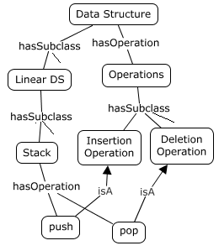

Links in Domain Ontology
IQuE/Stage 1
The links are used to traverse the ontology to locate the neighborhood nodes
Types of links
  hasSubClass
  hasRepresentation
  hasOperation
  hasApplication
  isA
  Includes
All it subclasses can inherit the properties of its super classes and can also override them by providing their own definitions of them.
The links can also have inverses.

Slide 54
Onto-Transformation
IQuE/Stage 1
Guidelines for building a domain ontology to represent the syllabus of any course
Change the root node to the name of domain
List the major topics as level 1 nodes
List the subtopics under each major topic to form level 2 nodes and so on
Group similar nodes under common heads such as Operations, Applications, Representations, etc.
Annotate the node names with synonyms
If the sub nodes are specialized form of the parent node, then Connect the link hasSubclass between them
Choose the link names so as to enable parser identify them from LO or question statement
If nodes representing property are common to all the nodes connected in a subclass hierarchy, then connect the top most node in the hierarchy to that property.
Specific operations pertaining to a node are directly connected to it.
If the subnodes are disjoint and necessary part of the parent node, then connect them to the parent node with an includes link
Define inverse links to facilitate traversing in a reverse direction
Annotate the link names with synonyms
Domain
Ontology
Domain
Ontology ’
Notes:
explanation

Slide 55
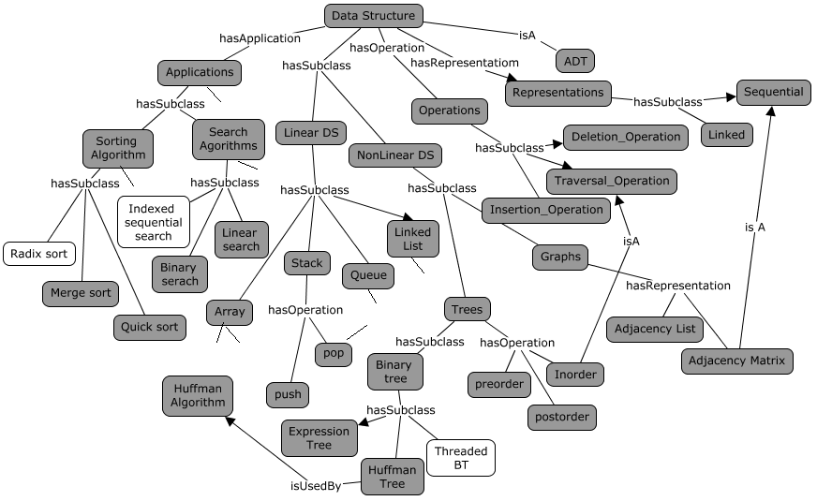
Notion of Syllabus
IQuE/Stage 1
Syllabus is considered as set of keywords which have a corresponding match to nodes of ontology
The contents included in syllabus are shaded in black
RETURN

Slide 56
LO Annotator
IQuE/Stage 2/LO Annotator/step 1 of 4
Step 1: Preprocessing of LO
Remove the punctuations, Lemmatize, Perform POS Tagging
Step2: Extracting Concepts from preprocessed LOs
The words or tokens are matched to the nodes/concepts of domain ontology.

Slide 57
Design of LO Annotator-step 2: Issues and challenges
Challenges and Issues | Proposed Solution
1) Identification of Multi worded concepts | N-Grams algorithm
2) Identification of differently worded concepts | Associating synonyms with the nodes in ontology
3) Finding other related nodes to be mapped in the ontology other than the identified concepts . | Introducing the concept of slot variable to decide whether to traverse the subclass hierarchy and include all the nodes in that.
4) Identification of differently worded links from LO | Links in ontology are associated with synonyms
5) Finding the nodes connected by links if the concept from LO do not have the identified link connected to it | Traverse the superclass hierarchy of concepts to find the connected link
6) Coloring the intermediate nodes between two explicit isolated nodes | Color the only intermediate node between them if there exists.
7) Identification of cognitive level of LO | Matching of tokens or words in LO with keywords associated with Blooms level. If the LO has multiple concepts matching with keywords associated with different levels then it is resolved by considering the highest level among them.

Slide 58
LO Annotator (Step 3)
IQuE/Stage 2/LO Annotator/step 3 of 4
  Extracting Cognitive level from LOs
  A set of keywords associated with every level of Blooms taxonomy are stored into a dictionary
  The tokens are matched to the keywords in the dictionary and accordingly its cognitive level is identified.
  If two tokens match with the keywords of two different Blooms level, then the higher level one is chosen as cognitive level of the complete LO.
Students should be able to-
  Compare and contrast stack and queue data structure (Analyze)
  Explain the working of Expression Tree (Understand)
  Demonstrate and implement various operations on data structures (Apply)
  Define Abstract Data Type (Recall)

Slide 59
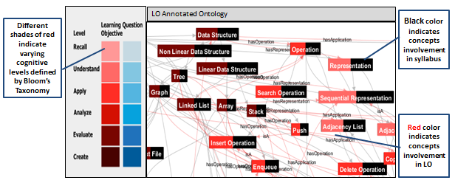
Generating LO Annotated Ontology (step 4)
IQuE/Stage 2/LOAnnotator/step 4 of 4
  LAO provides the visual representation of LOs overlaid on Domain Ontology
  Concepts and Cognitive level extracted from LO are mapped to the nodes of the domain ontology and color coded to generate LAO.
RETURN

Slide 60
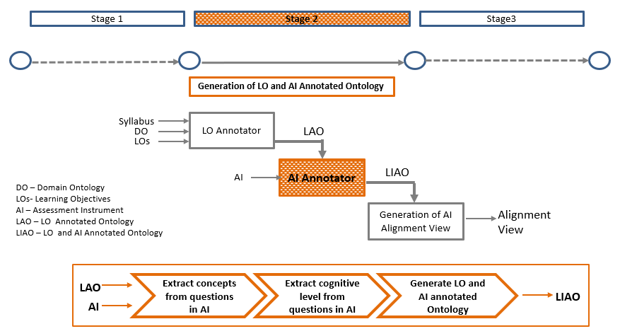
AI Annotator
IQuE/Stage 2/AI Annotator

Slide 61
AI Annotator (Step 1)
IQuE/Stage 2/AI Annotator/step 1of 2
  Extraction of concepts from an question
  Process is same as followed by LO Annotator
  More challenging as Question are more creative
  Q. Imagine you have a web-site which serves files to thousands of users. It cannot service all requests and can only handle only 100 at a time. It adopts a fair policy of serving 100 at a time in order of arrival. Select the most appropriate method to simulate such a system.
  There are no explicit concepts available to map to the ontology.
  Solution:
    using more sophisticated NLP techniques,
    using templates to find semantically close concepts from a question
    manually annotating the question.

Slide 62
AI Annotator (Step 2)
IQuE/Stage 2/AI Annotator/step 2 of 2
  Process is same as followed by LO Annotator
  Apart from the available action words in each level of the Blooms Taxonomy, some domain specific action verbs are added into the dictionary such as
    ‘write a program’ (Apply )
    ‘devise an Algorithm’ (Evaluate)
    ‘show a stepwise execution’ (understand)
  Q. Write a ‘C’ program to form a circular linked list and display the contents in reverse order.
RETURN

Slide 63

Calculating$\left|Q∩L\right|$, $\left|\left(Q | L\right)\right|$ and $\left|\left(L | Q\right)\right|$
IQuE/Stage 3/Content Alignment
CQ[i] is any concept in CQ and CL[j] is any concept in CL. The CQ[i] matches with CL[j] iff—
Case1: CQ[i] ɞ syn (CL[j]). For example,
LO: Students should be able to implement the Huffman coding algorithm using binary tree.
Q: What is Huffman Coding? Apply the Huffman coding algorithm and determine the code for the following characters whose frequencies are given.
Case 2: CQ[i] ɞ syn_expand (CL[j]). For example,
LO: Students should be able to understand the working of various multi-way search tree structures.
Q: Construct a B tree of order 5 for the following data
Notes:
Animate change the background

Slide 64
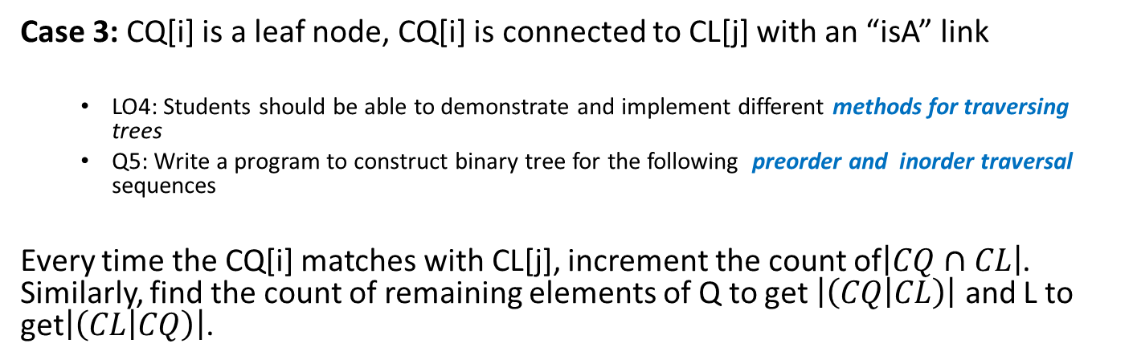
Calculating$\left|Q∩L\right|$, $\left|\left(Q | L\right)\right|$ and $\left|\left(L | Q\right)\right|$
IQuE/Stage 3/Content Alignment
Case 3: CQ[i] is a leaf node, CQ[i] is connected to CL[j] with an “isA” link
LO4: Students should be able to demonstrate and implement different methods for traversing trees
Q5: Write a program to construct binary tree for the following preorder and inorder traversal sequences
Every time the CQ[i] matches with CL[j], increment the count of$\left|CQ∩CL\right|$. Similarly, find the count of remaining elements of Q to get $\left|\left(CQ | CL\right)\right|$ and L to get$\left|\left(CL | CQ\right)\right|$.
Function | Definition
syn (C) | C ᴜ all its synonyms as defined in ontology
expand (C) | C ᴜ all the implicit nodes as identified by the ontology traversal algorithm depending on the conditions present in the LO in which C is present.
syn_expand (C) | expand (C) ᴜ syn (C) for all i ɞ expand (C). It contains the synonym nodes and the nodes that we get after expanding every node from the syn (C).
RETURN

Slide 65
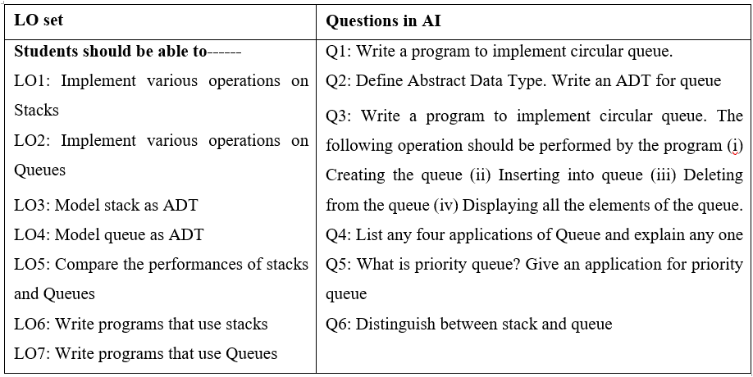
Sample set of LOs and questions

Slide 66
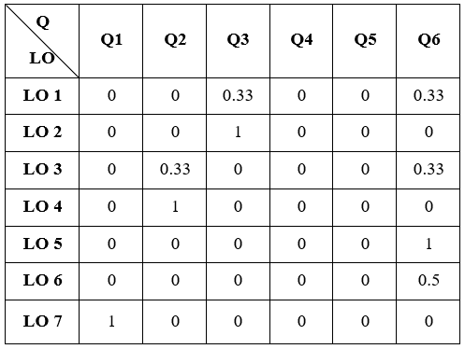
Q-Utility Matrix
IQuE/Stage 3/CAS/step 1 of 2

Slide 67
Step 2: Compute the AI-content Alignment score
IQuE/Stage 3/CAM/step 2 of 2
From the Q-utility matrix,
  For every row, calculate the combined alignment score of all questions together that has a non-zero score..
  The mean of all these values will be the content alignment score for the AI.
For example,
  From the first row the combined aligned score of Q3 and Q6 with respect to LO1 was calculated.
CQ3 ᴜ CQ6 = {queue, operation}
CL₁ = {operation, stack}
Alignment ((CQ3 ᴜ CQ6), CL₁) = (1)/ (1+1+1) = 0.66
For the above Q-utility matrix,
The mean is
(0.66+1+0.66+1+1+0.5+1)/ 7 = 5.16/7 = 0.8314
Hence, the content alignment score of the above AI is 83.14%

Slide 68
Computing utility of questions from CAS
IQuE/Stage 3/CAS/ Q-utility
From the Q-utility Matrix, utility of a question can be calculated by considering the maximum value of each column.
The average utility of all the questions together is the mean of the individual questions utility value.
The average utility of all the questions is (4/6) = 0.66
If any column has all the values as zero, then that question is considered as non-utility questions.

Slide 69
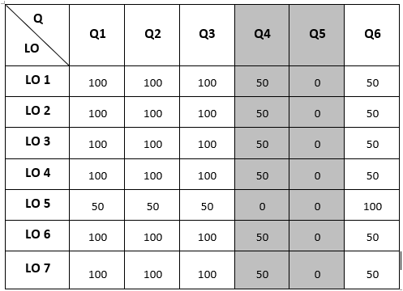
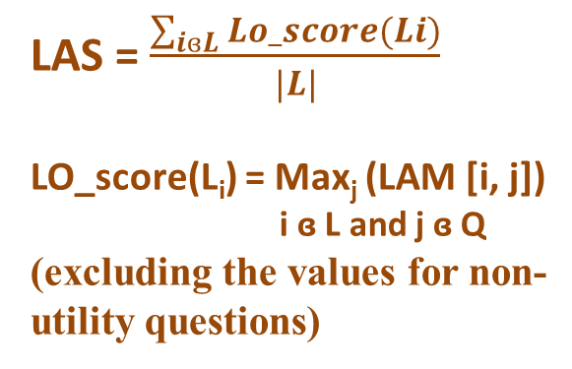
AI-Cognitive Level Alignment Matrix
IQuE/Stage 3/ Cog-Alignment Matrix
LAM [i, j] = cog_alignment (LL_{i}, LQ_{j})
i ɞ L and j ɞ Q where L is set of LOs and Q is set of questions
where LL is cognitive level of LO and LQ is cognitive level of question
LAS = $\frac{\sum_{iɞL}{Lo_score(Li)}}{|L|}$
LO_score(L_{i}) = Max_{j} (LAM [i, j])
i ɞ L and j ɞ Q
(excluding the values for non-utility questions)
RETURN

Slide 70
IQuE
(Instrument Quality Evaluator System)

Slide 71
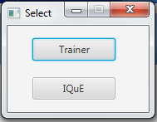

Slide 72
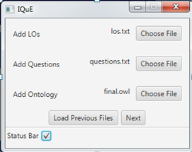

Slide 73
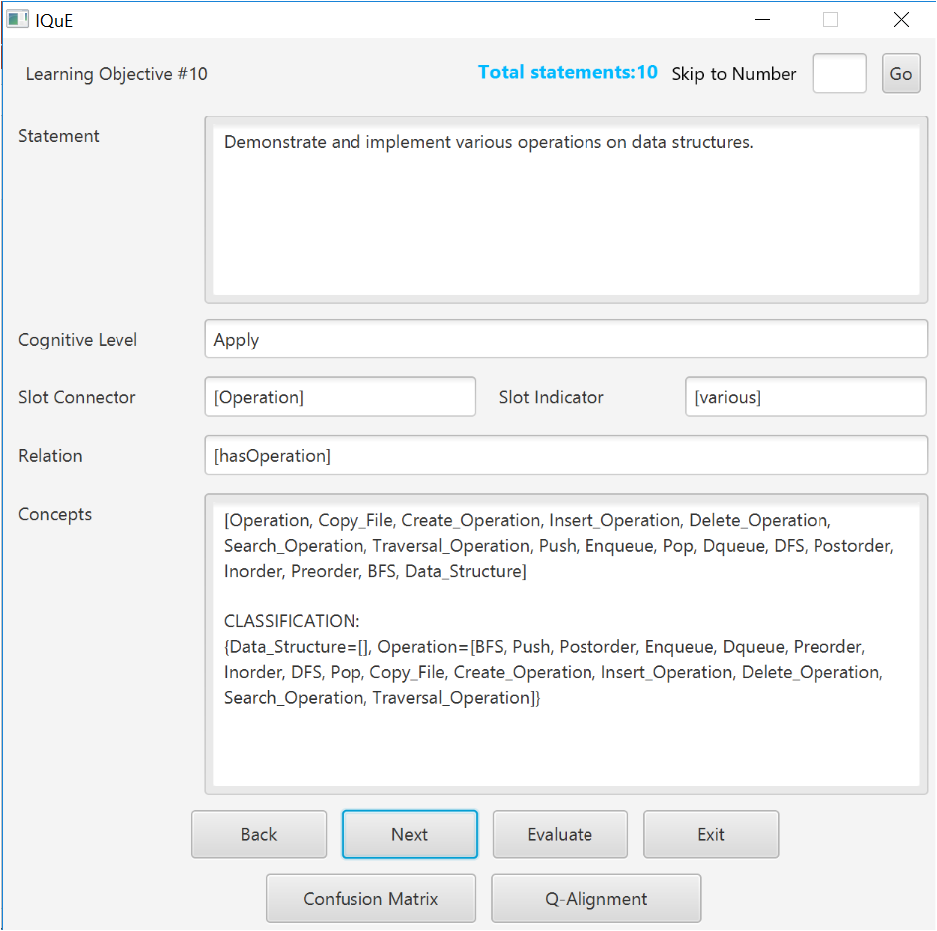

Slide 74


Slide 75
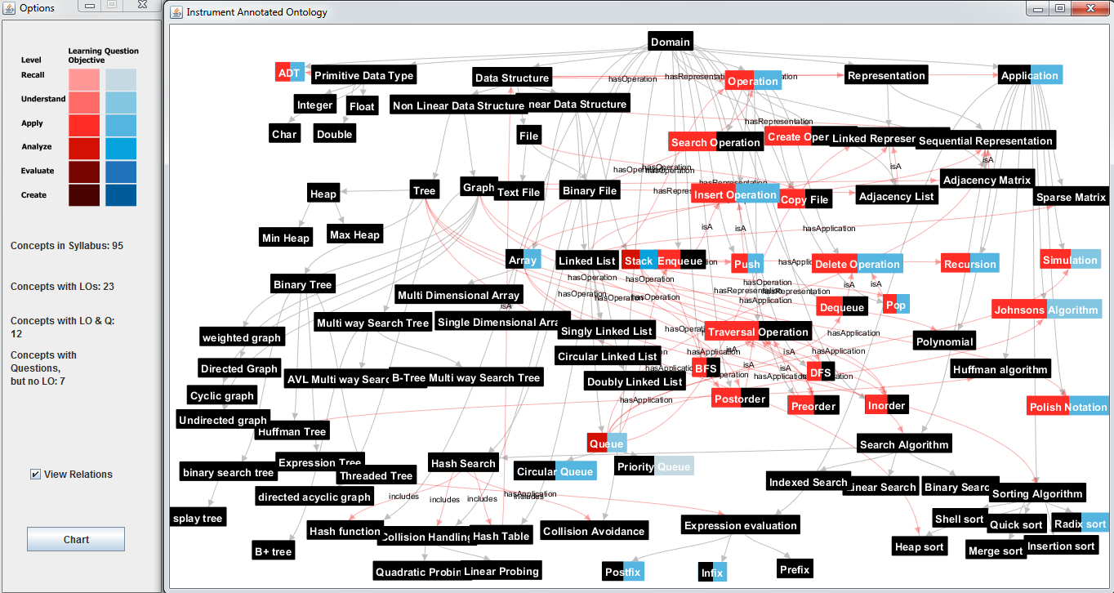

Slide 77
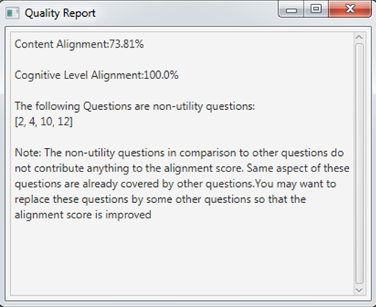

Slide 79
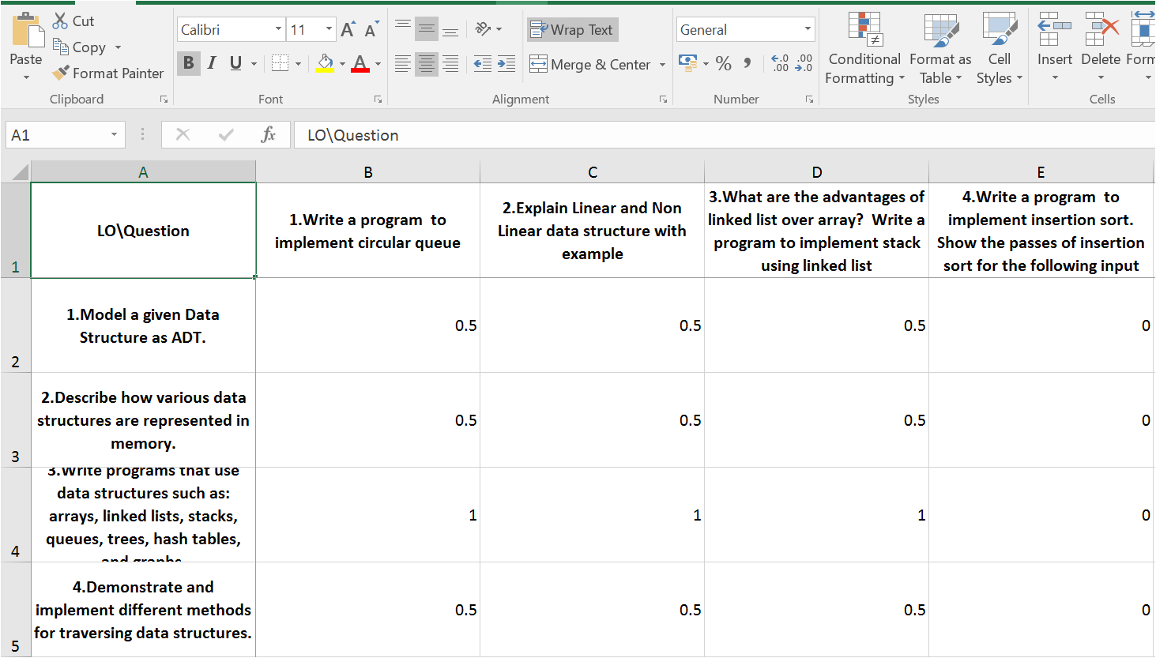
Content Alignment Matrix (CAM)

Slide 80
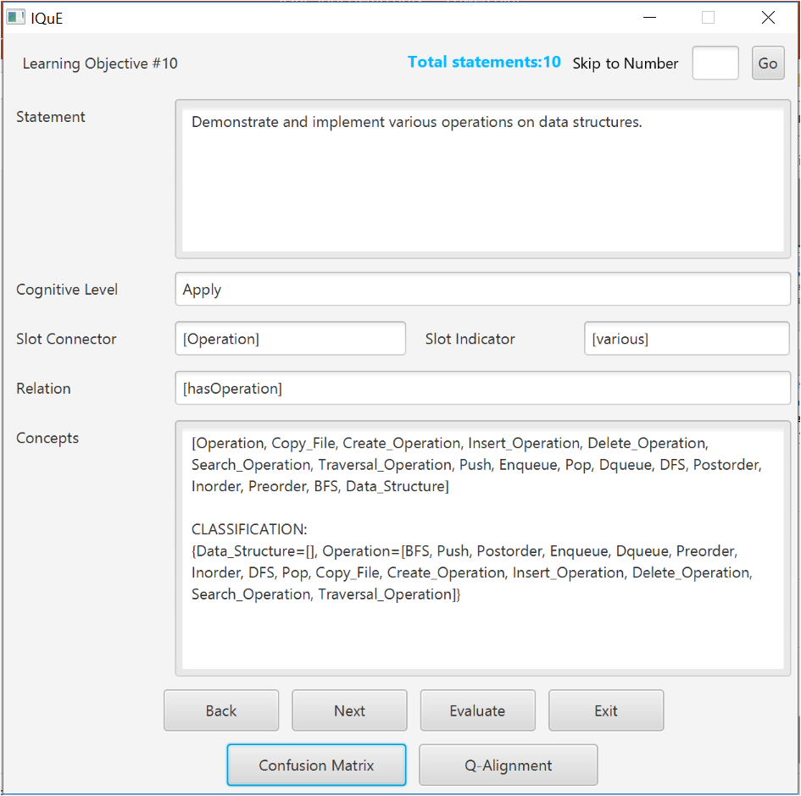

Slide 81
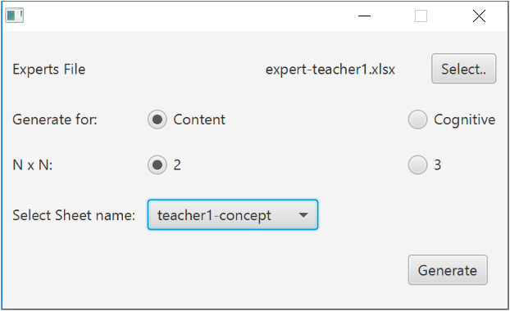

Slide 82
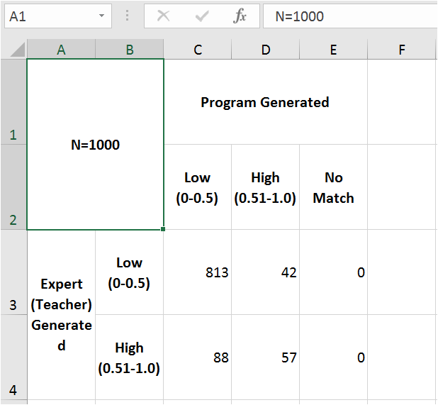
Confusion Matrix: Content

Slide 83
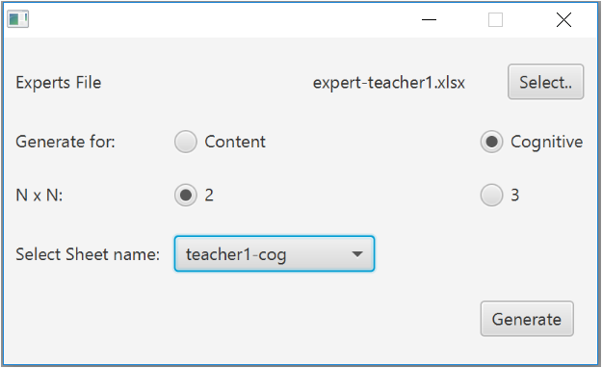

Slide 84
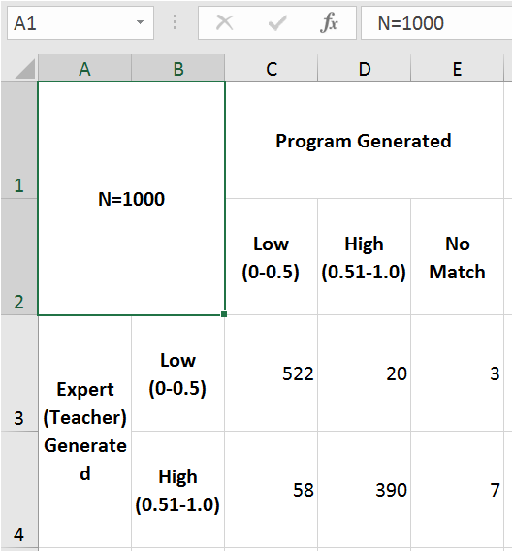
Confusion Matrix: Cognitive Level
RETURN

Slide 85
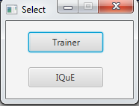

Slide 86
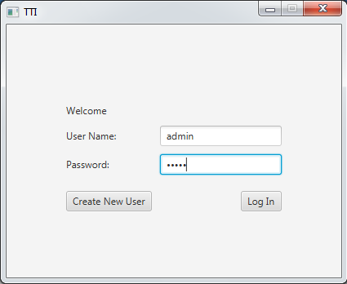

Slide 87
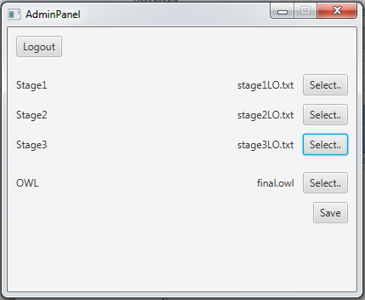

Slide 88
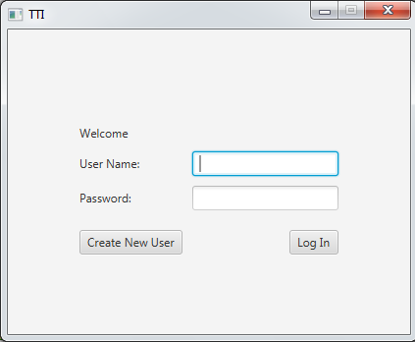

Slide 89
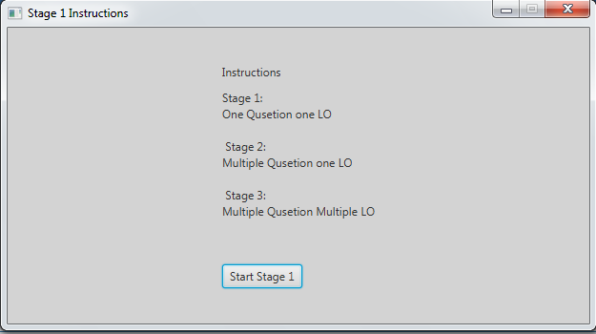

Slide 90
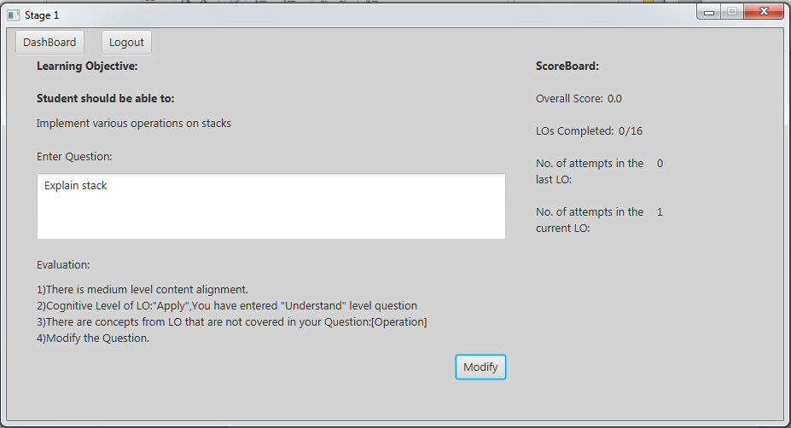

Slide 91
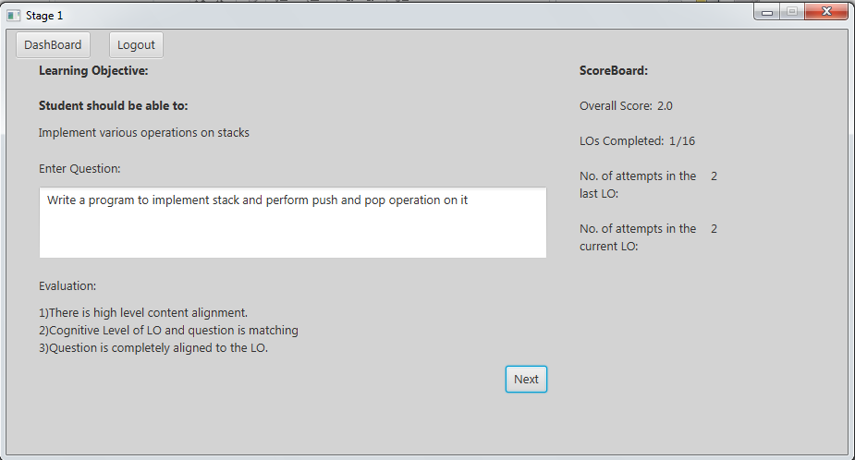

Slide 92
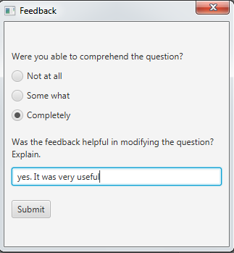

Slide 93
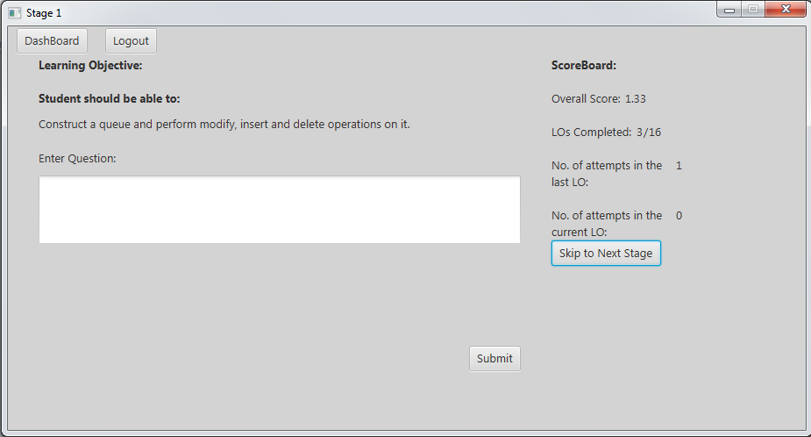

Slide 94
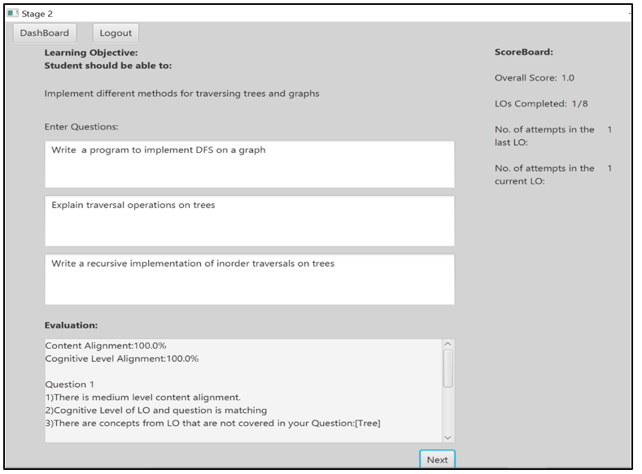

Slide 95
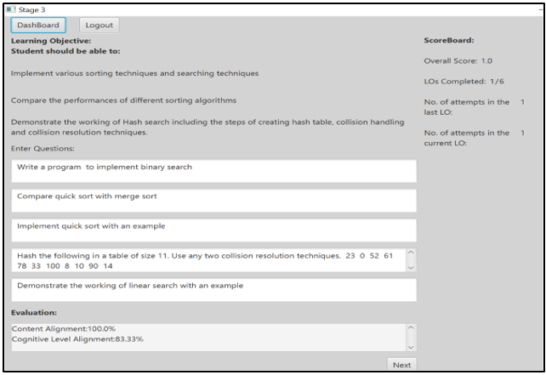

Slide 96
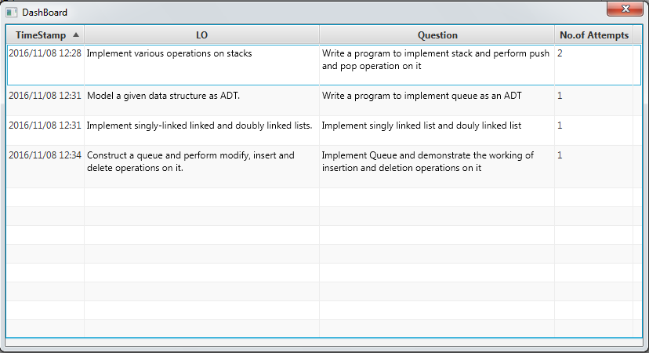
Dashboard
Scoreboard
RETURN

Slide 97
N=1000 |  | Program Generated
 |  | Low (0-0.35) | Medium (0.36-0.7) | High (0.7-1.0)
Expert (Teacher) Generated | Low (0-0.35) | 665 | 137 | 33
 | Medium (0.36-0.7) | 14 | 7 | 0
 | High (0.7-1.0) | 43 | 53 | 48
N=1000 |  | Program Generated
 |  | Low (0-0.35) | Medium (0.36-0.85) | High (0.85-1.0)
Expert (Teacher) Generated | Low (0-0.35) | 665 | 137 | 33
 | Medium (0.36-0.7) | 14 | 7 | 0
 | High (0.7-1.0) | 43 | 53 | 48
Accuracy =72%
Accuracy =72%

Slide 98
N=1000 |  | Program Generated
 |  | Low (0-0.35) | Medium (0.36-0.7) | High (0.7-1.0) | No Match
Expert (Teacher) Generated | Low (0-0.35) | 165 | 14 | 9 | 1
 | Medium (0.36-0.7) | 48 | 295 | 11 | 2
 | High (0.7-1.0) | 16 | 42 | 390 | 7
N=1000 |  | Program Generated
 |  | Low (0-0.35) | Medium (0.36-0.85) | High (0.85-1.0) | No Match
Expert (Teacher) Generated | Low (0-0.35) | 165 | 14 | 9 | 1
 | Medium (0.36-0.7) | 48 | 295 | 11 | 2
 | High (0.7-1.0) | 16 | 42 | 390 | 7
Accuracy =85%
Accuracy =85%

