Slide 1


Visual Analytics of Cohorts in Educational datasets
Rwitajit
Majumdar
Examiners:
Prof. Samit Bhattacharya
Prof. Weiqin Chen
Ph.D. Committee:
Prof. Sridhar Iyer (guide)
Prof. Aniruddha Joshi (co-guide)
Prof. Sahana Murthy
Prof. Girish Dalvi

Slide 2
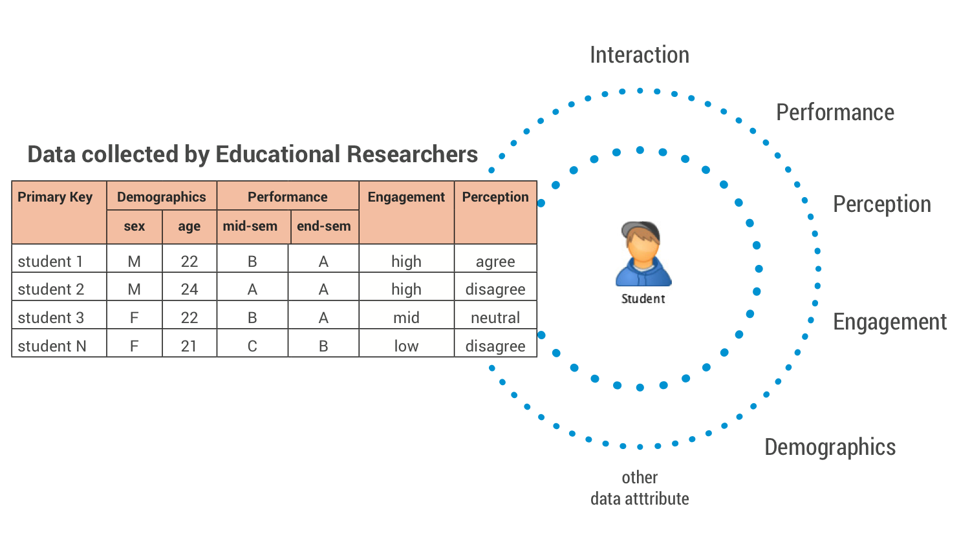
Consider a typical Educational Dataset

Slide 3
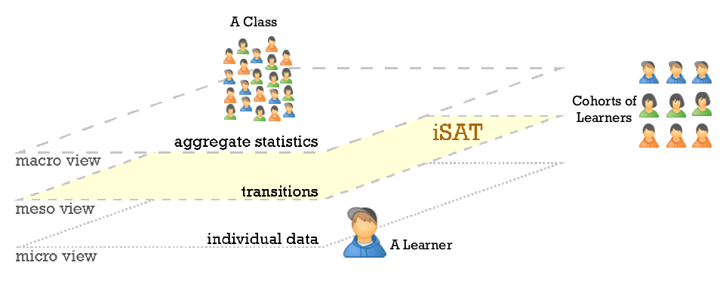
Perspective of analysing data
Macro view
Meso view
Micro view

Slide 4
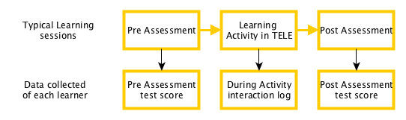
Typical ET research scenario

Slide 5
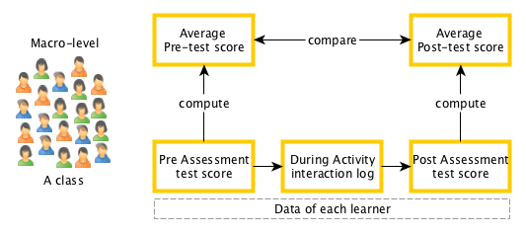
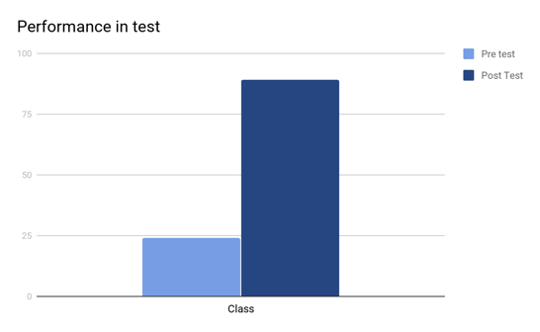
Analysis at Macro level
Utility:
Evaluate effect on performance after learning activity
Limitation:
How many of them remained low achievers across pre and post test?

Slide 6
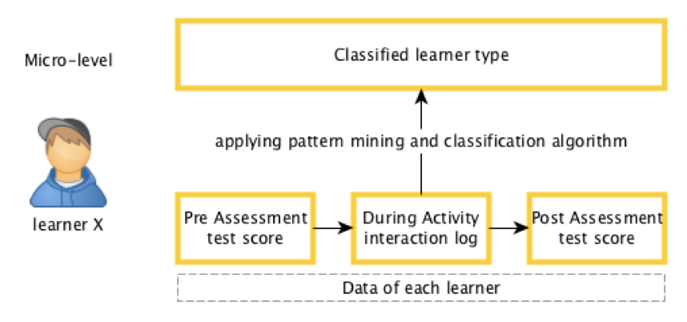
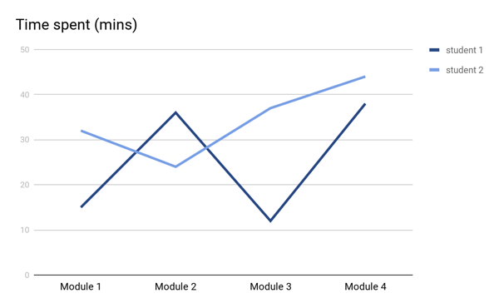
Analysis at Micro level
Utility:
Provide personalised feedback based on learner type
Limitation:
What are the different patterns of engagement that exists in the class?

Slide 7
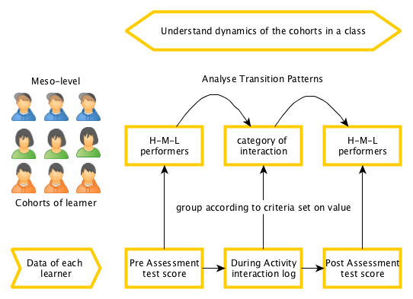
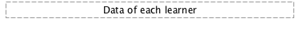
Analysing at Meso level
with Transitions
What proportion of the Low performers
did Desirable interactions,
but still remain Low performer in the post test?
Utility:
Understand dynamics of the class
With respect to the cohorts

Slide 8
Research Objective
To conceptualise a model and tool for
visual analysis of cohorts
in educational datasets.
Cohort - sub groups of students

Slide 9
Contributions
Established the need of Meso-level analytics with visualisation
- based on interviews of stakeholders and literature survey.
Conceptualizing a meso-level analytics as iSAT model
- applied in more than 9 scenarios to establish usefulness and determined utility.
Developed a web-based tool to assist iSAT users
- working solution is tested for usability and usefulness.
Proliferation efforts to enable the community of researchers and instructors to use iSAT model and tool
- reached around 100 educators and researchers; conducted 3 tutorials in international conferences and 1 in house hands-on training workshop.
Instantiated Design and Development Research methodology to conduct a Learning Analytics development research

Slide 10
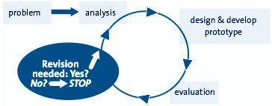
Research Methodology
Adopted
Design and Development Research (DDR) Methodology [1] over
Multiphase mixed methods [2]
Phase
Inquiry question
Phase 1
Need & Context Analysis
Phase 2
Design & Development
Phase 3
Evaluation
Need & Positioning Question
Answer to which helps to understand the need and contextualise the solution
Design Question
Answer to which inform the creation of the solution
Evaluation Question
Answer to which helps to evaluate the output and reflect of it
J. van den Akker, K. Gravemeijer, S. McKenney, & N. Nieveen (Eds.)(2006), Educational design research: Routledge.
Cresswell, J. W. (2003). Research design. Qualitative, quantitative, and mixed methods approaches, 67.

Slide 11
Literature review
Research Objective
To conceptualise a model and tool for visual analysis of cohorts in educational datasets.
Greller, W., & Drachsler, H. (2012).
Dyckhoff, A. L. et.al. (2013)
Park, Yeonjeong, & Il-Hyun Jo., (2015)
Leitner, P., Khalil, M., & Ebner, M. (2017)
Sergis, S., & Sampson, D. G. (2017)
Siemens, (2010)
Gauthier, (2013)
Prieto et al., (2016)
Sergis (2016)
Goldstein PJ (2005)
Who are the stakeholders of educational dataset?
  Learner, teacher, researcher, admin, policy maker
What are the purpose of analysing educational dataset?
  Reporting, Predicting, Differentiation between groups of students, Differentiation between learning offerings, Data consolidation / Correlation, Effects on Performance,etc
What are the strands of analytics of educational dataset?
  Learning Analytics, Teaching Analytics, Academic analytics

Slide 12
Literature review
Research Objective
To conceptualise a model and tool for visual analysis of cohorts in educational datasets.
M.A. Chatti, et.al. (2013)
Aljohani, N. R., & Davis, H. C. (2012).
Wise A, (2014)
Jones, D., Beer, C., & Clark, D. (2013)
Lu, Y et.al. (2017)
Glenn, N. D. (2005).
Daniel Pena et.al. (2001)
Johnson, R. A., & Wichern, D. W. (2014).
Verbert et.al (2013)
Park, Yeonjeong, & Il-Hyun Jo., (2015)
What does the models/frameworks of learning analytics inform?
  Process model, model to link pedagogy and LA, Implementation frameworks for higher ed, implementation framework for wearable, etc
    Lack of any model of analysis with focus on cohort of learners and assists analysis of data with the help of visualisations.
What are the techniques for analysing educational dataset?
  Various statistical and data mining techniques.
    None focus on visual analytics
What are the tools for analysing educational dataset?
  Various dashboards with different purposes for different stakeholders
    Mostly linked to a specific data source and not for independent use.

Slide 13
Scope of research
Research Objective
To conceptualise a model and tool for visual analysis of cohorts in educational datasets.
stakeholders: primarily researchers and teachers. Learners.
purpose: analysing meso-level dynamics of cohorts.
strands of analytics: Learning Analytics
model: to conceptualise a meso-level analysis with visualisation.
technique: analysing transition patterns with visualised data.
tools: web based open access tool.

Slide 14
Positioning solution approach
Research Objective
To conceptualise a model and tool for visual analysis of cohorts in educational datasets.
 |  | Data
 |  | QUALitative | QUANTitative
Analysis | QUANTitative | quantitative content analysis | statistical techniques
 | QUALitative | ethnography, phenomenological methods, grounded theory | visual analysis of quantitative data - creating a graph of quantitative data is an example of qualitatively analyzing quantitative data
For meso-level analysis
Randolph, J. J. (2007). Multidisciplinary methods in educational technology research and development. HAMK Press/Justus Randolph.

Slide 15
focusMeso-level
+
techniqueTracking transitions
+
mediumVisualised data

Slide 16
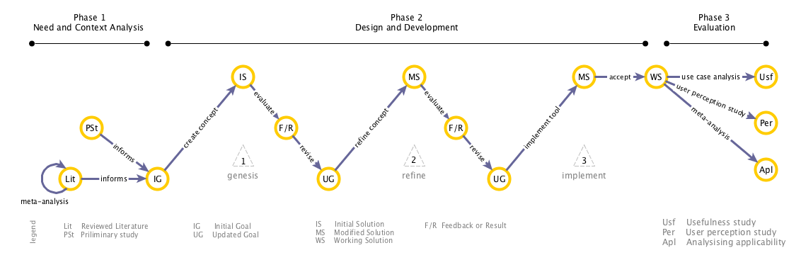
Research path
Notes:
hide

Slide 17
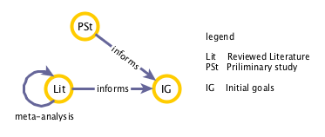
Need & Context Analysis Phase
Meso-level
+
Tracking transitions
+
Visualised data
4 Need and Positioning Questions
What meso-level information is needed and what is its utility?
To what extent existing LA techniques and tools support meso-level analysis?
To what extent existing visualisation is appropriate for analysing transitions?

Slide 18
Need of meso level analysis:
Stakeholders interview
What meso-level information is needed and what is its utility?
Method: Thematic analysis of Semi-structured interview
Sample: 10 interviews
Purposive sampling with following inclusion criteria:
Associated with large-scale educational project which generated educational data.
Individual instructors interested to look at students’ data collected over semesters
Instructors in administrative roles in colleges who required to took part in the college accreditation process.
2 universities
(IIT Bombay &
Mumbai University)
5 teaching domain
(CS, EE, ET, IxDesign, Animation)
3 Modes
(Face-2-face, MOOC, Quality improvement program Workshop)

Slide 19
Need of meso level analysis:
Results
What meso-level information is needed and what is its utility?
To what extent existing LA techniques and tools support meso-level analysis?
To what extent existing visualisation is appropriate for analysing transitions?
Academic performance trends among various sub-groups in the class.
For e.g. Mumbai University (MU) made it mandatory for college accreditation to trace performance of students across time, grouping them in different competency levels.
Tracing how students of certain demographic background respond to instructional interventions and/or feedback in a MOOC.
For e.g. Reporting performance of different cohorts in re-runs of course.
Tracking students’ classroom engagement and behaviors to modify instruction accordingly.
For e.g. instructor wanted to track change in learning behaviours near the examination with the possibility of grouping students based on it.
Tracking extra and co-curricular activities of students
MU colleges need to track their alumni activities in different industries.
Notes:
Track questions

Slide 20
Extent of support from existing LA techniques & tools: Analysing literature
Meso-level
+
Tracking transitions
+
Visualised data
What meso-level information is needed and what is its utility?
To what extent existing LA techniques and tools support meso-level analysis?
To what extent existing visualisation is appropriate for analysing transitions?
Method: We analysed the techniques and tools based on 3 criteria
Provides information at meso-level
Tracks records for analysis / has transition information
supported with visualisation.
Sample:
For techniques - Techniques listed in 2 review papers: 16
For dashboards - Dashboards listed in 3 review papers: 55

Slide 21
Results
Meso-level
+
Tracking transitions
+
Visualised data
What meso-level information is needed and what is its utility?
To what extent existing LA techniques and tools support meso-level analysis?
To what extent existing visualisation is appropriate for analysing transitions?
Techniques | Meso-level | Tracking | Visualisation
Clustering | ✔ | No | possible
Social Net Analysis | No | ✔ | possible
Dashboards
Course Signal | ✔ | No | Metaphor of Traffic lights
Student success system | No | ✔ | Yes
None did
Further details about other items in Table 4.2 (techniques) and Table 4.3 (dashboards) in thesis

Slide 22
Appropriateness of existing visualisation for meso level analysis
What meso-level information is needed and what is its utility?
To what extent existing LA techniques and tools support meso-level analysis?
To what extent existing visualisation is appropriate for analysing transitions?
Method: Analysis of existing visualisation
Sample:
selected a non-exhaustive illustrative list of 7 visualisations which conveyed
the information regarding sub group of data within a larger dataset
Catalogue | Number of viz listed
http://www.datavizcatalogue.com/index.html | 60
http://survey.timeviz.net/ | 115
http://www.visual-literacy.org/periodic_table/periodic_table.html (Lengler & Eppler, 2007) | 100

Slide 23
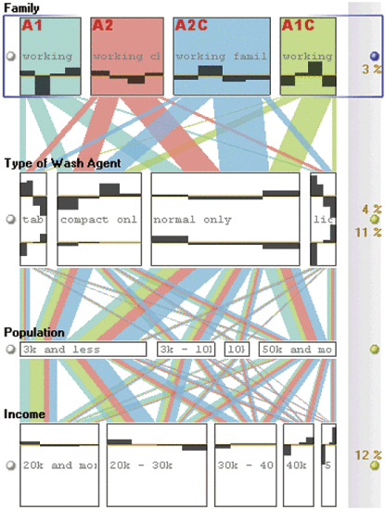
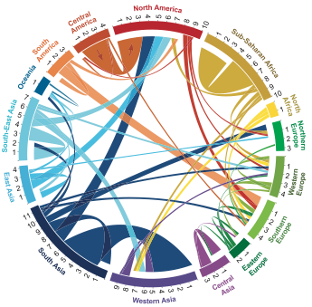
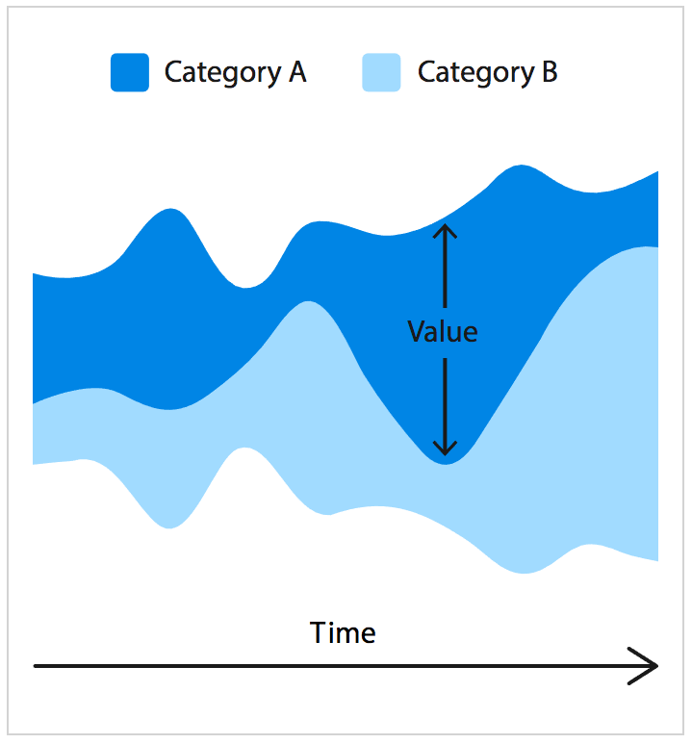
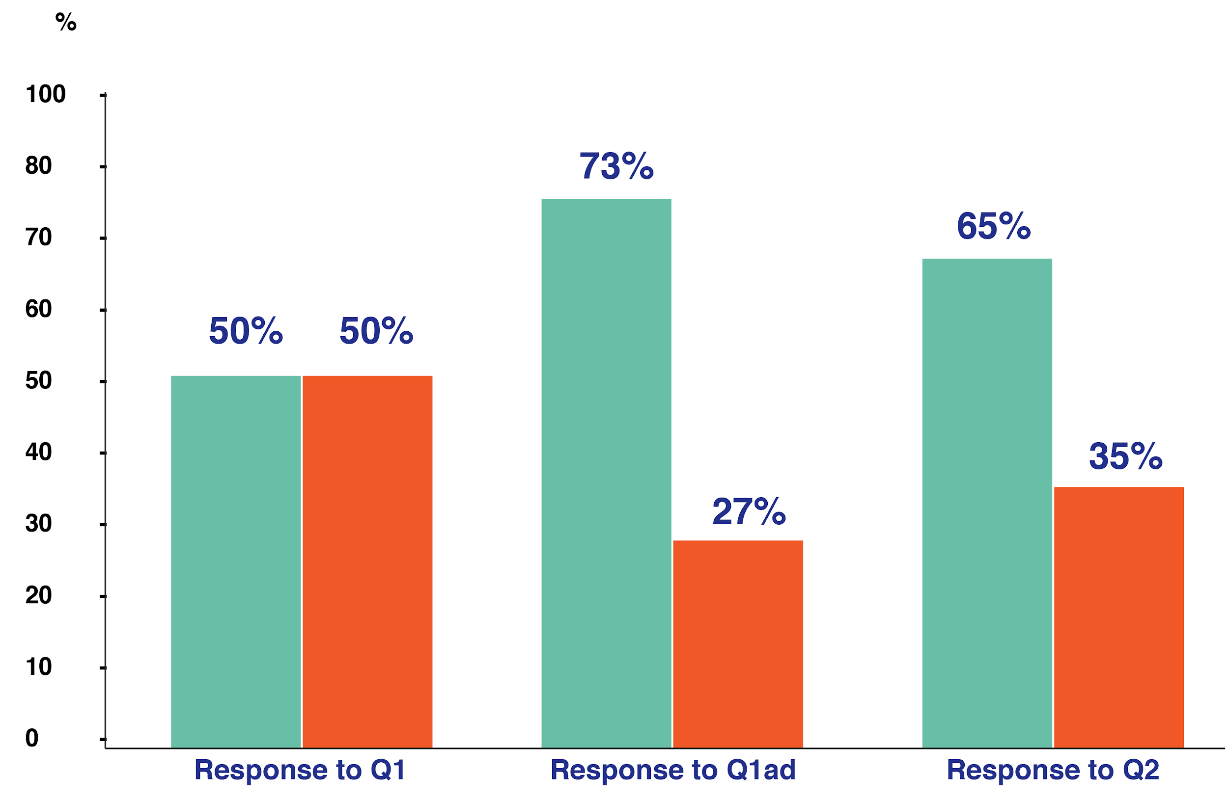
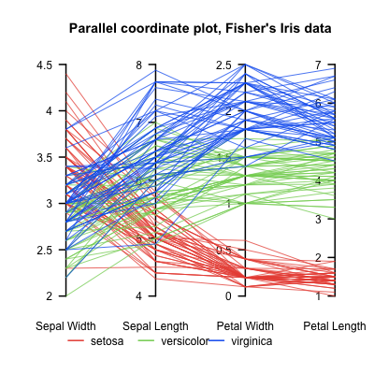
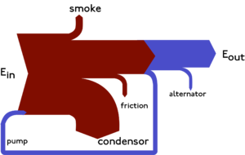
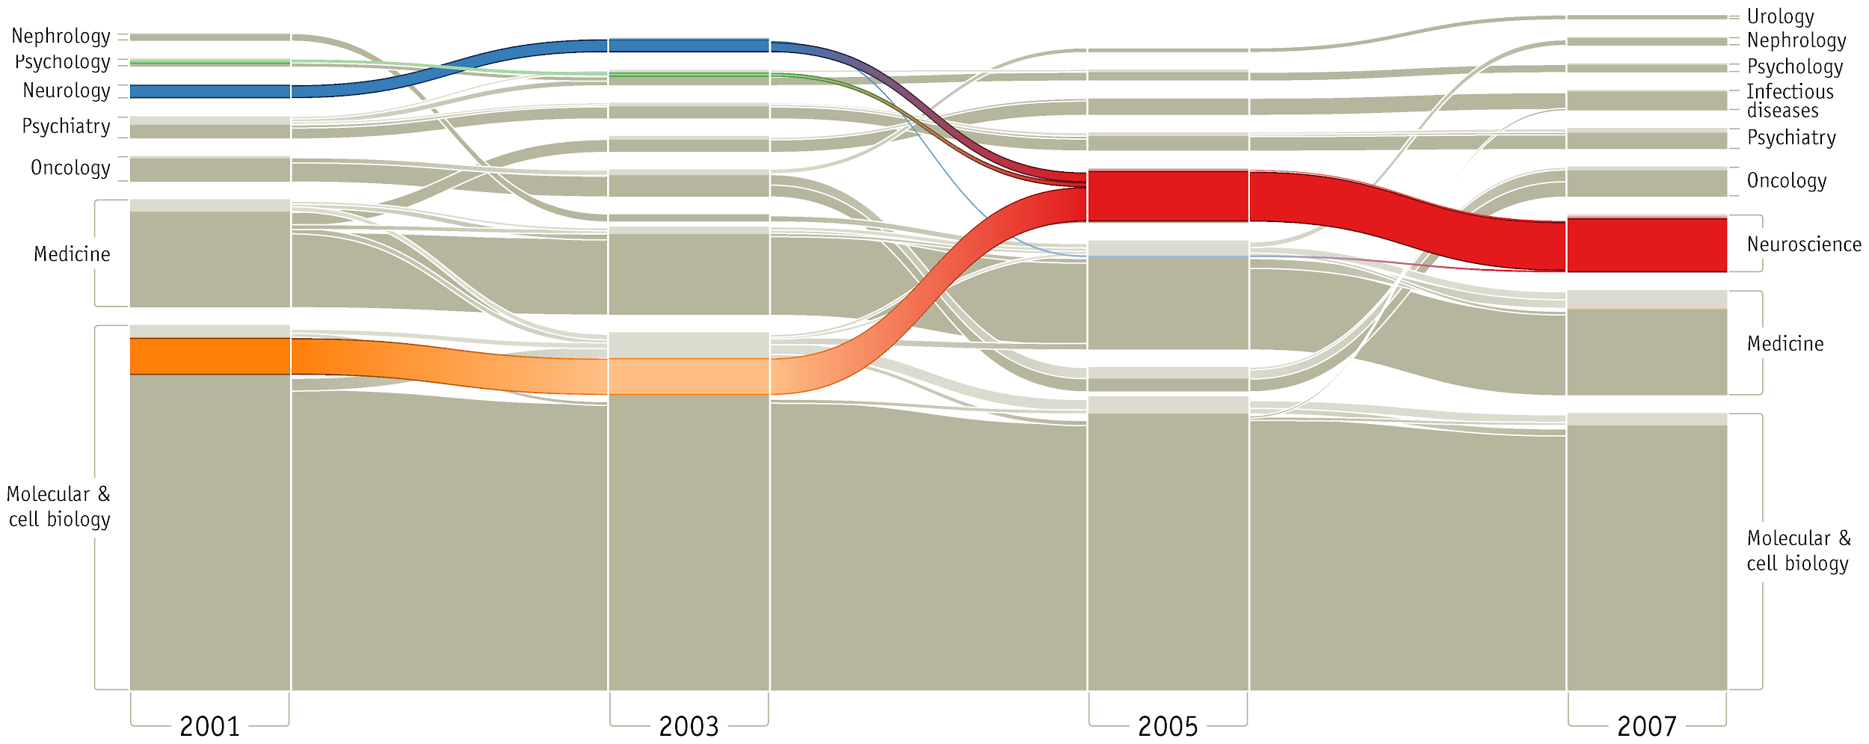
Visualising information of group of records
Accessibility issues
FEATURES | Histogram | Parallel Coordinate | Sankey Diagram | Circular Plot | Steam Graph | Alluvial Diagram | Parallel Set
Relevant Publication | Ioannidis, Y, (2003) gives a historical perspective | Inselberg, (1985;2009) | Riehmann, P. Hanfler, M. & Froehlich B. (2005) | Abel, G. J., & Sander, N. (2014) | Havre, Hetzler & Nowell, (2002) | Rosvall & Bergstrom, (2010) | Kosara, R., Bendix, F., & Hauser, H. (2006).
Shows frequencies | ✔ | no | ✔ | ✔ | ✔ | ✔ | ✔
Handles multiple attributes | ✔ | ✔ | no | no | no | no | ✔
Can represent transitions across multiple attributes | no | ✔ | no | don't know | no | don't know | ✔
Can represent transitions across time | no | ✔ | no | no | ✔ | ✔ | ✔
Interactive tool based on D3JS | ✔ | ✔ | ✔ | ✔ | ✔ | ✔ | ✔

Slide 24
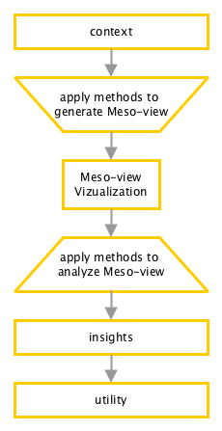
Solution outline
Given any teaching-learning or educational research scenario,
Data + Queries regarding cohorts
Define constructs of the meso-level analysis.
Compute values across the dataset based on those construct
Interactive Visualisation of transitions at meso-level
Specific look-up or compare tasks regarding different constructs of the meso-view
Answers to the posed queries or trends in the dataset of the specific context.
Insights used either as a descriptive model or decisions making aid in the specific context

Slide 25
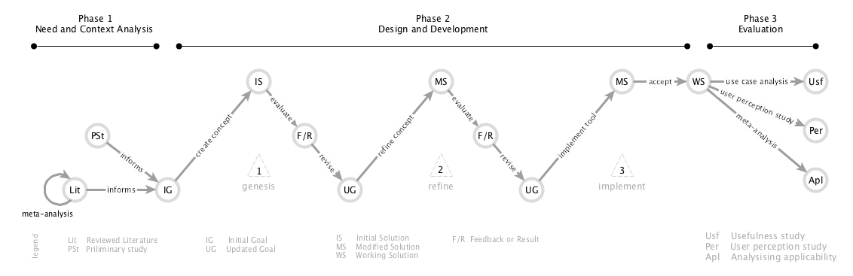
Design and Development Phase

Slide 26
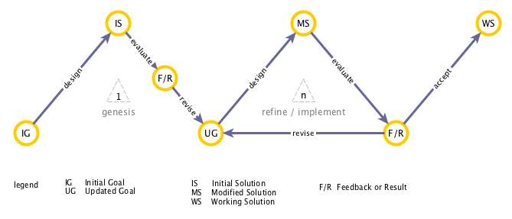
Design & Development Phase
Design Question
DQ1: How can we develop the information artifact based on the goals?
DQ2: How can it be represented visually
Formative Evaluation Question
EQ1 : How useful is the information to analyse the context?
EQ2 : How usable is the model and representation?

Slide 27
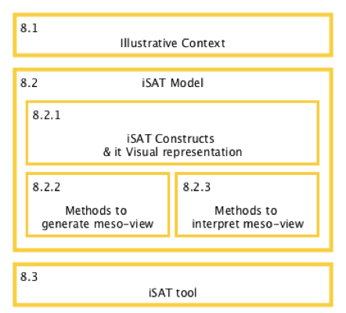
Design and Development cycles
2 cycle for conceptualisation of meso-level analysis model
  Cycle 1 - Genesis
  Cycle 2 - Refinement
1 cycle for implementing the model as web tool
  Cycle 3 - Implement

Slide 28
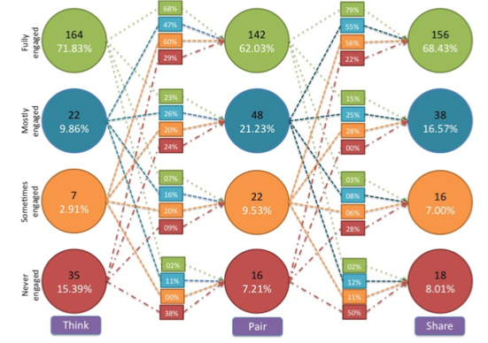
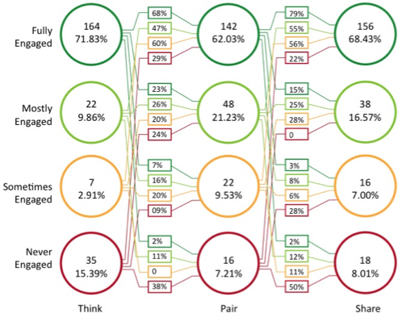
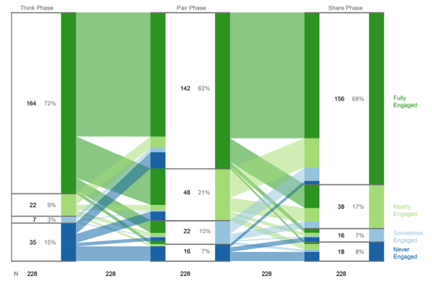
Summary of implementation cycle
 | Genesis cycle | Refinement cycle | Implement cycle
Model | Created model to trace transition across time. | Refined model to trace transitions across time and attributes. | Implemented model with the help of iSAT tool
Construct | State, Phase, Transitions, Transition ratios | State > Strata, Phase, Transitions, Transition ratios | Patterns, Strata, Phase, Transitions, Transition ratios
Method | Developed a method to generate the meso-level information of a dataset. | Semi-automated the method to generate meso-level view by using pivot tables in MS excel. | The iSAT tool generated the meso-level view. Analysis of meso-level view was facilitated with information foraging tasks assisted by interactions with the iSAT tool.
Representation | State Transition Diagram | Stratified Attribute Tracking Diagram | Interactive Stratified Attribute Tracking

Slide 29
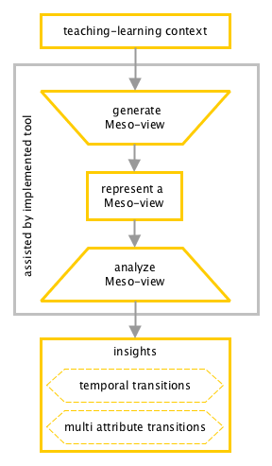
Working solution: iSAT for meso-level analysis.
We developed
a prescriptive model of meso-level analysis
through interactive stratified attribute tracking (iSAT)
Given a dataset of a context
the model prescribes a set of procedure to generate a meso-level view
then prescribes a set of procedure to infer from a meso-level view
A web-based iSAT tool assists users for meso-level analysis.
It helps to:
Parse user dataset and compute cohort transition information,
Create an interactive visualisation of transitions in cohorts,
Facilitate analysis by providing required cohort transitions information on demand.

Slide 30
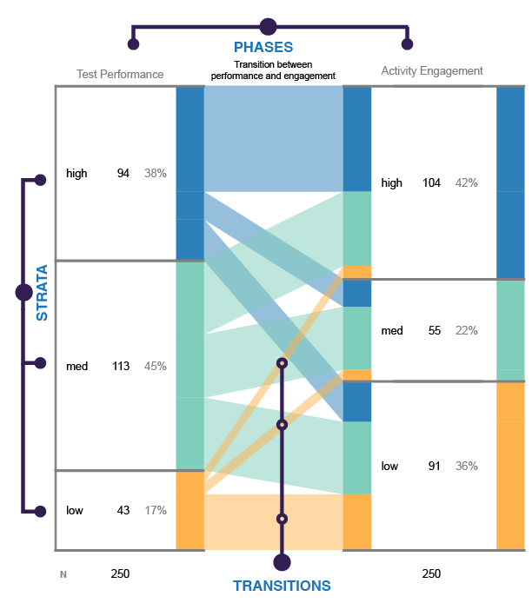
Interactive Stratified Attribute Tracking
(iSAT)
Each attribute in the dataset that can be stratified can be represented as a Phase.
For some data, It is possible to group records according to any criteria set on their attribute values.
Each group of records based on a particular attribute is represented as a Stratum.
A prescriptive model of analysing transitions at meso level with the assistance of interactive visualisation.
proportion of its corresponding strata
Developed a web based tool for visual analysis of cohorts in any datasets.
composition with respect to the strata of the previous phase.
www.et.iitb.ac.in/iSAT
proportion of migrations across Phases.

Slide 31
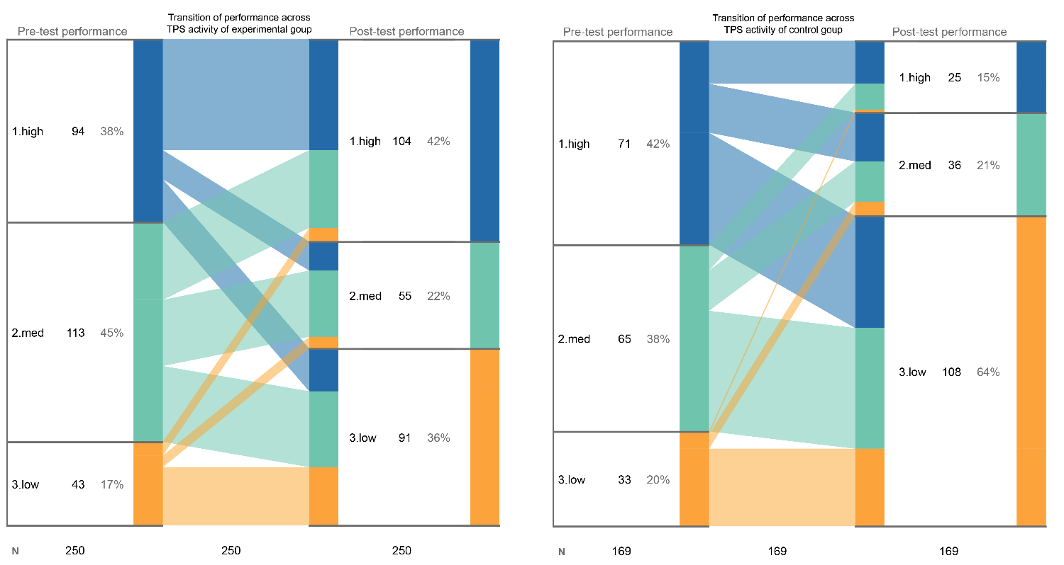
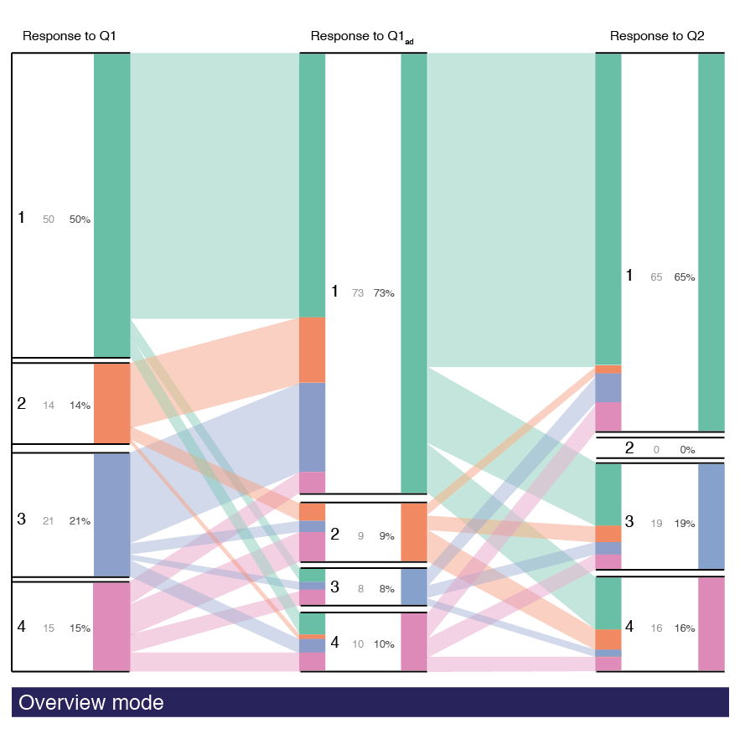
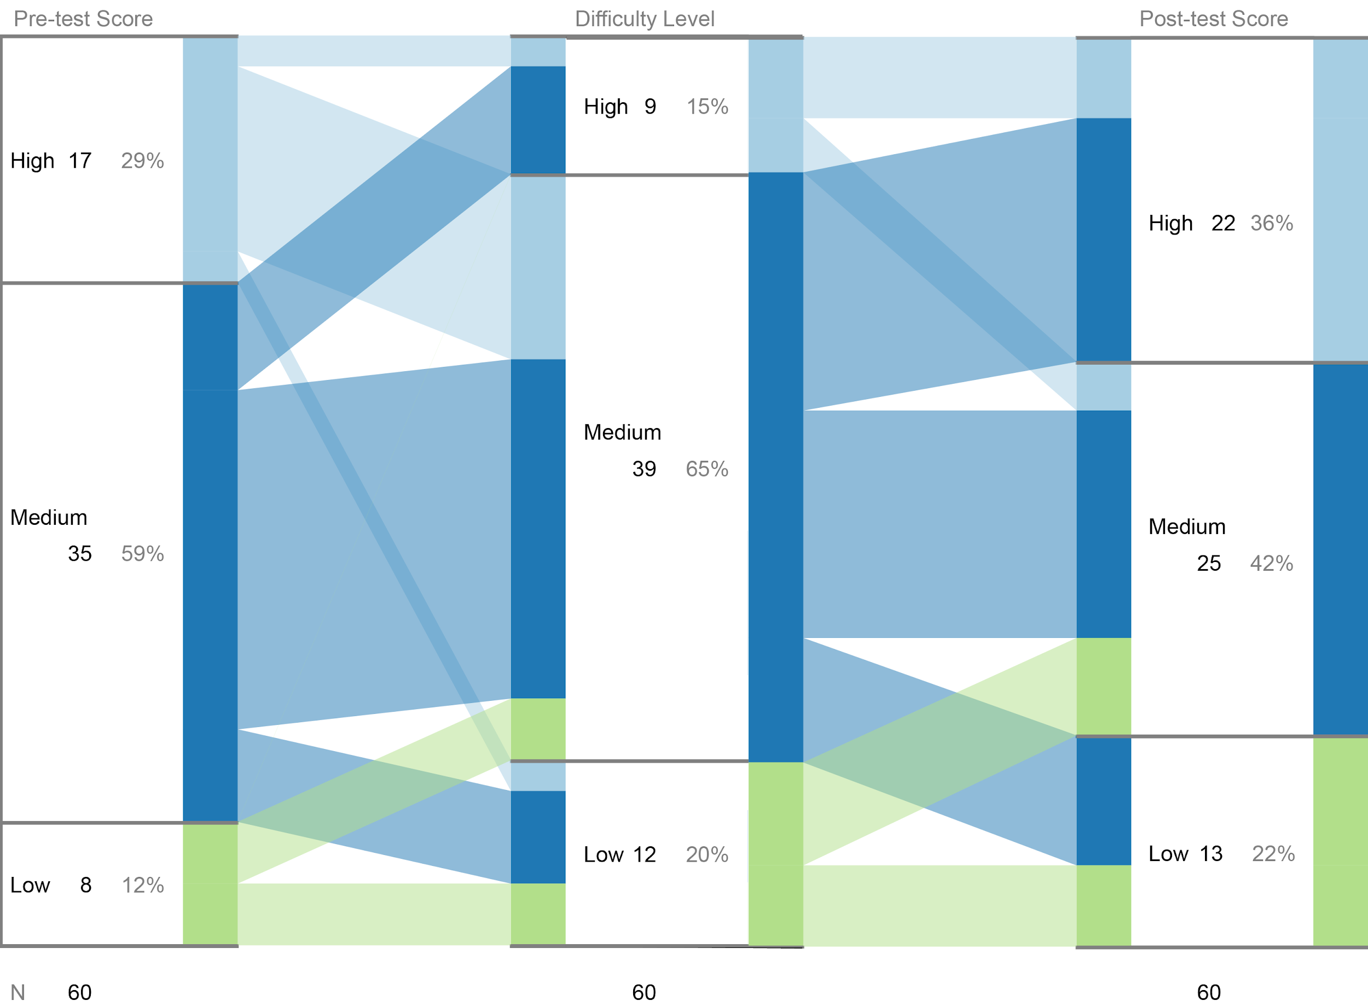
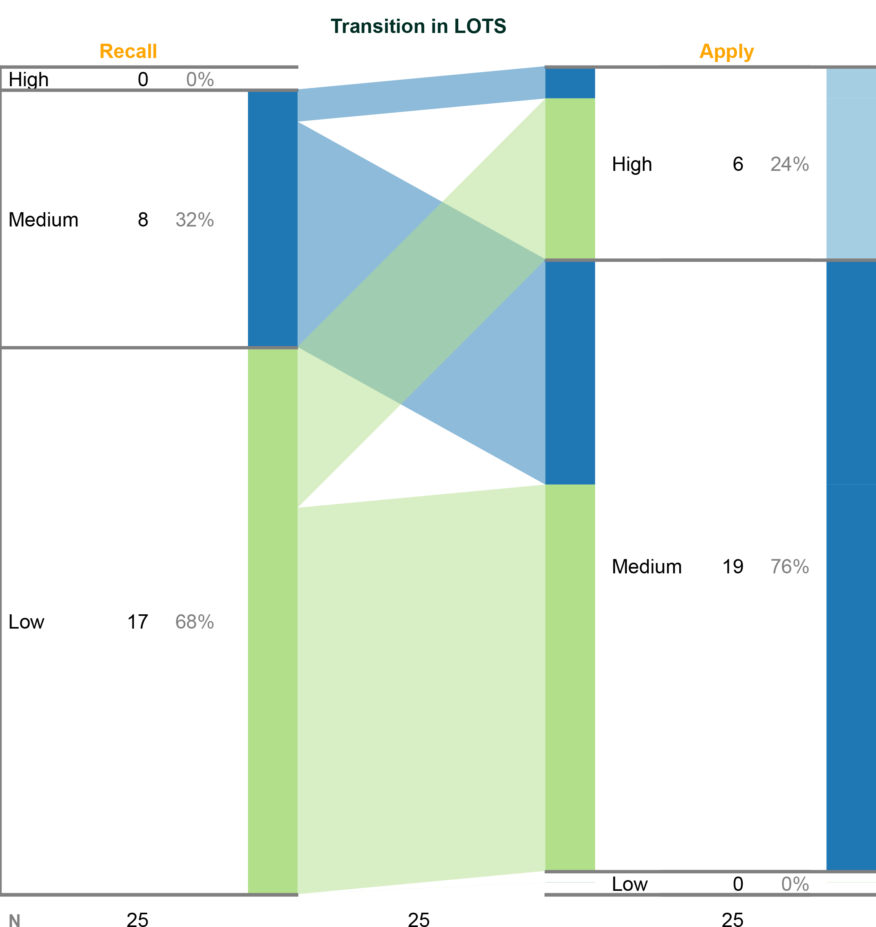
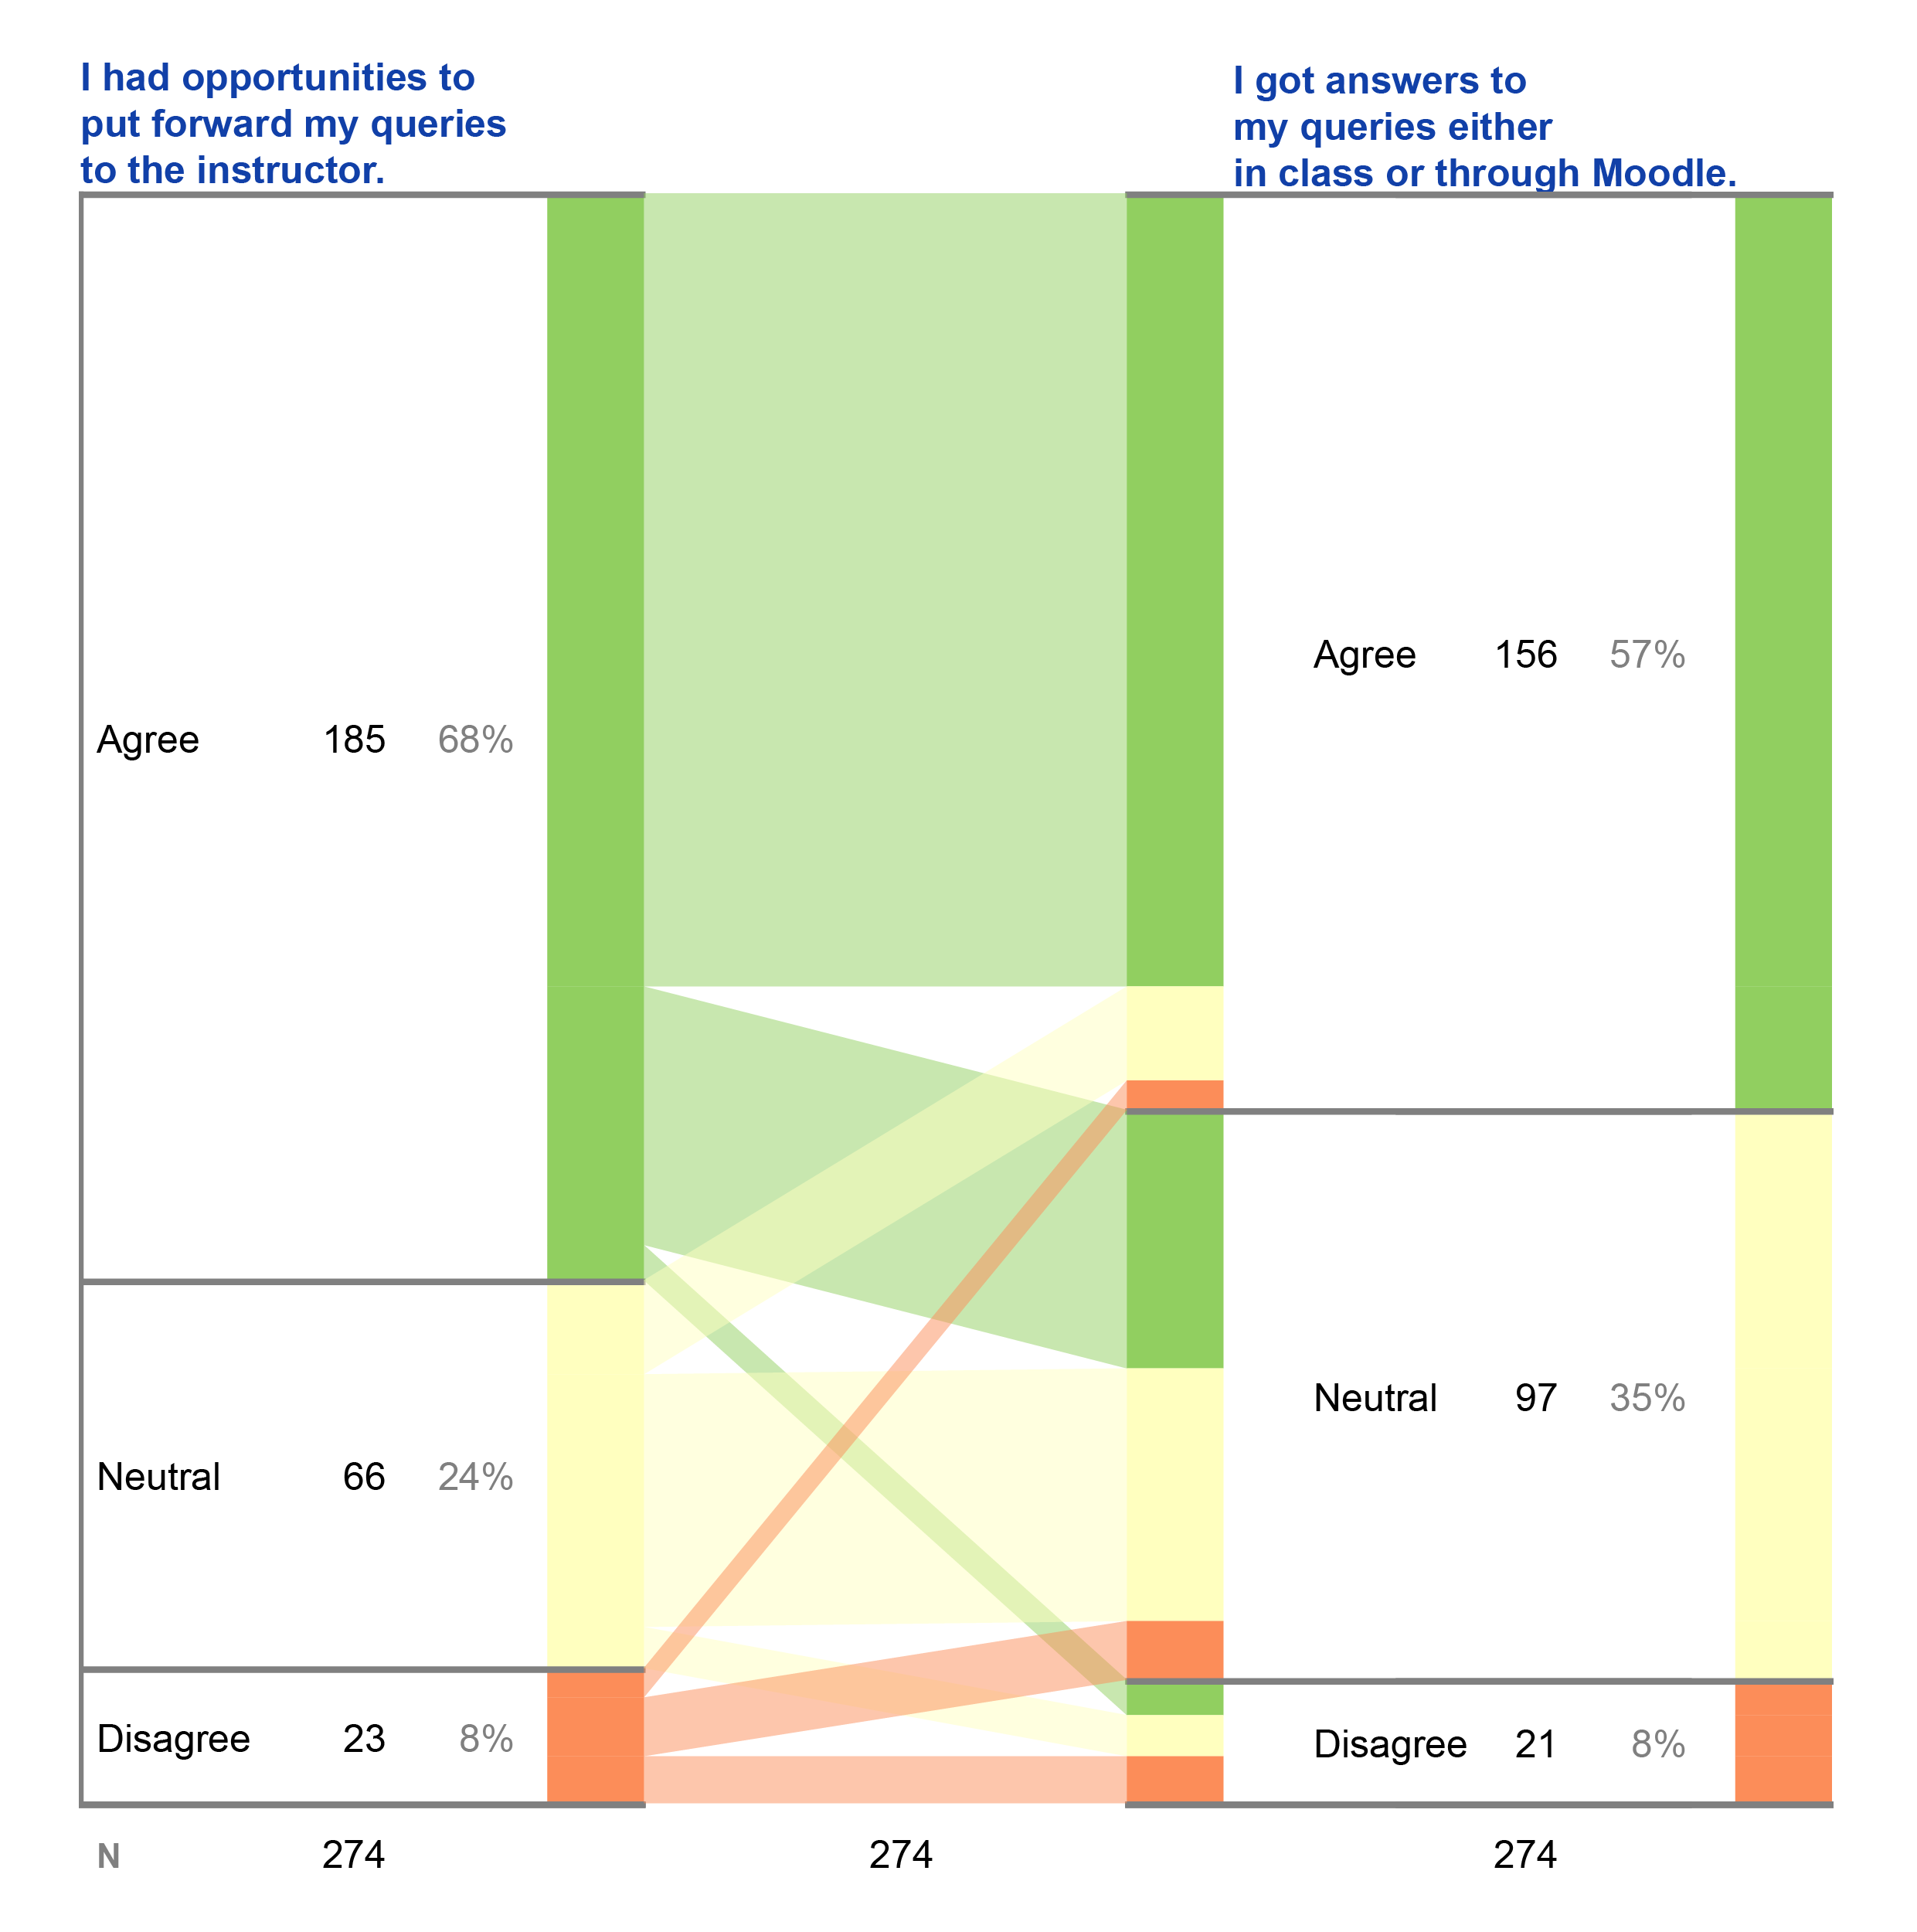
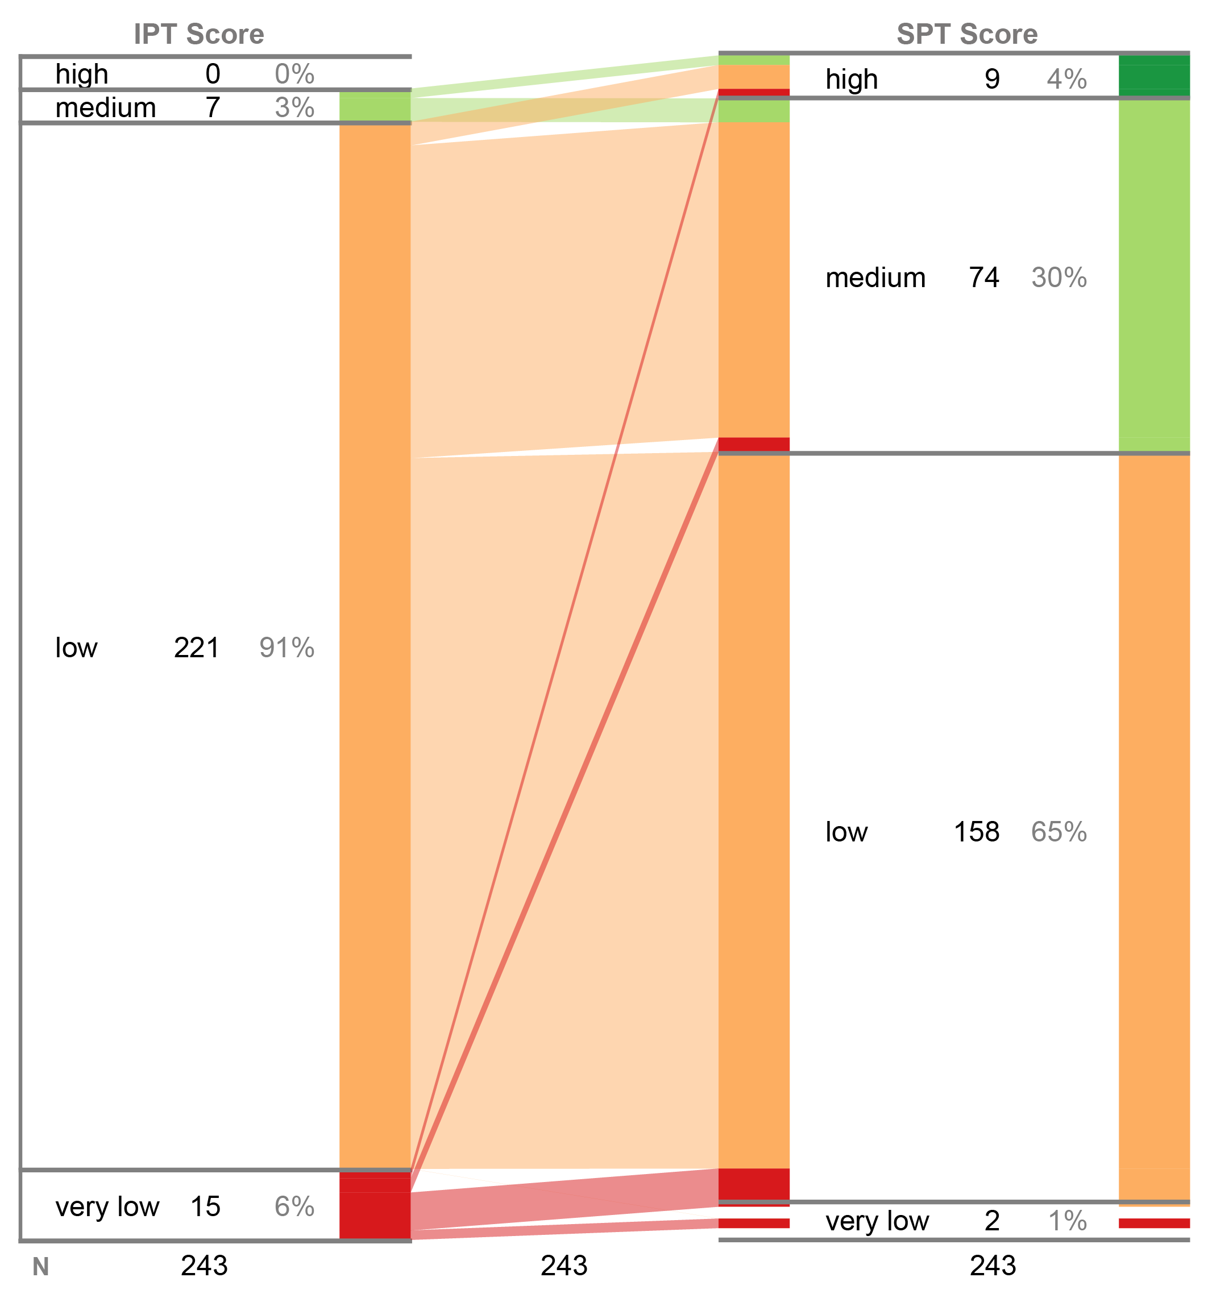
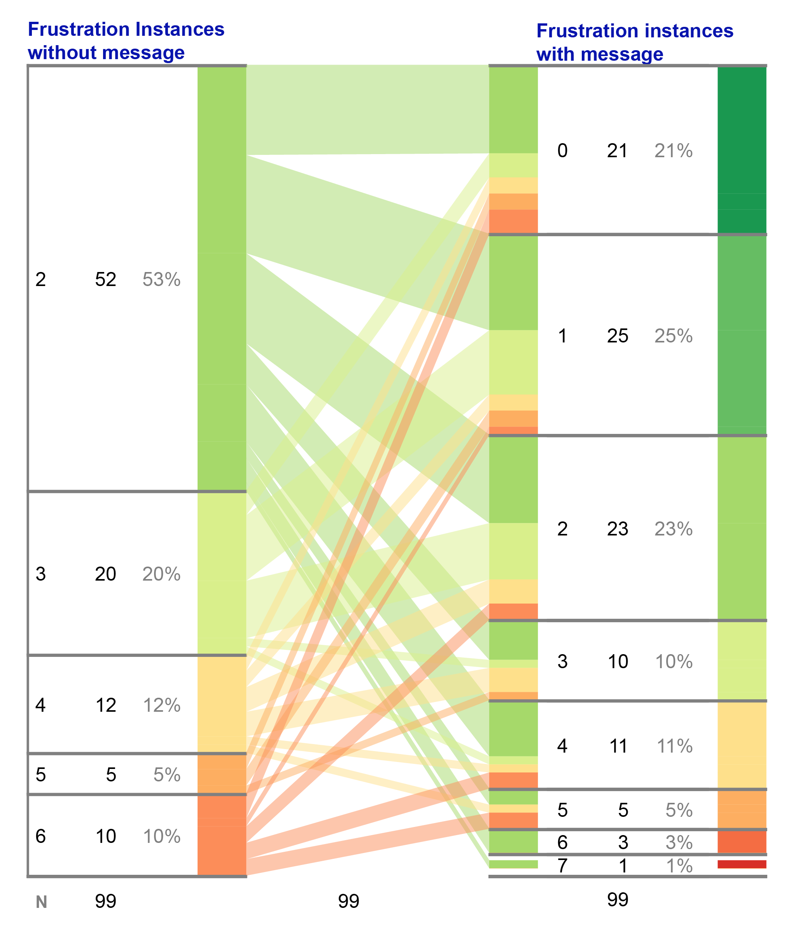
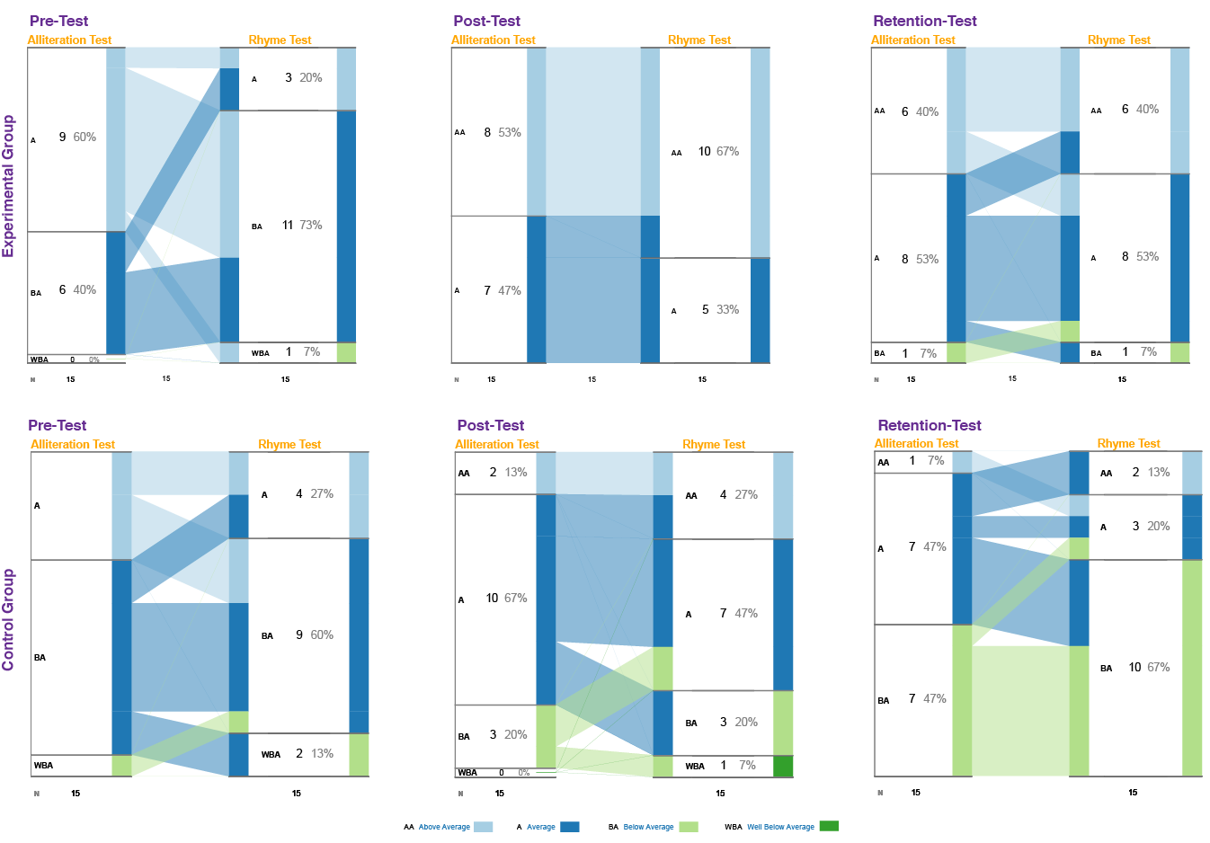
36 iSAT
9 Scenarios - 12 researchers
12 studies - 1809 records
15 RQs
6 conferences - 1 journal - 2 theses

Slide 32
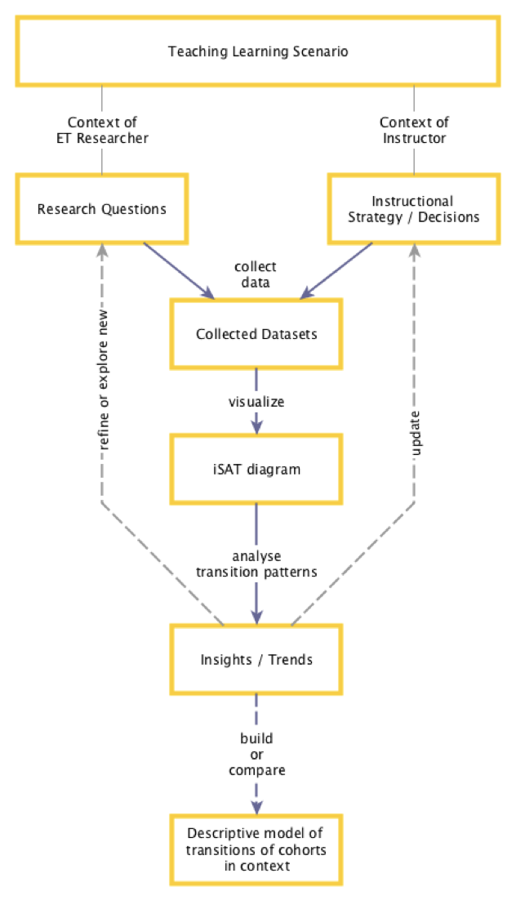
Utility of iSAT
1. Build descriptive model
iSAT helps to define cohorts and understand their temporal dynamics during any teaching-learning session, by stratifying learner attributes and tracing transitions across phases.
2. Compare scenarios based on transitions
iSAT helps to compare interventions by highlighting transitions in performance of different cohorts involved.
3. Refine and explore new research question in ET research context
iSAT assists research decision making by highlighting specific cohorts based on their tracked attribute.
4. Update instructional strategy or decisions in teaching learning context
iSAT assists instructional decision making by highlighting specific cohorts based on their perception or performance pattern.
3
4
1,2

Slide 33

Analysing data from active learning classroom context
Think-Pair-Share
http://www.rde.nsw.edu.au/lxd/files/2015/04/CP-ThinkPairShare-1oczwx0-277x300.gif
Peer Instruction

Slide 34
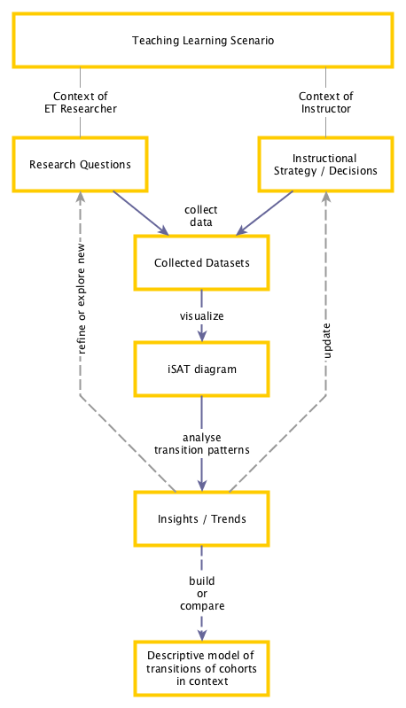
Think-Pair-Share active learning strategy
Tracking Students engagement during active learning sessions in large classroom
http://www.rde.nsw.edu.au/lxd/files/2015/04/CP-ThinkPairShare-1oczwx0-277x300.gif

Slide 35
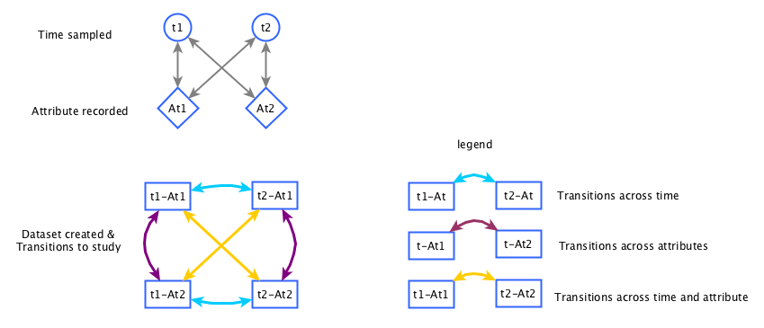
Study 1
Engagement during TPS in large CS 1 class
Breakdown Aggregating the engagement of students loses the variations of the individuals.
Insights Students didnt ‘piggy bag’ during the Pair phase.

Slide 36
Engagement during TPS in large CS 1 class
The different engagement pattern of students were visualized across the phases of the activity.
Researchers could compare proportion of students in each engagement level
in each phase and across them.
The overall pattern of engagement across the observed students in TPS activities could be summarised as a descriptive model

Slide 37
Peer Instruction active learning strategy
Instructional decision making for post activity
Instructors can get the transition of students alternate conceptions by analysing their answer option.
Based on that they can orchestrate the post PI activity.
Q1
Peer instruction
Q1ad
Transfer
Q2

Slide 38
Study 2
Analysing patterns of answering to inform possible instructional decision making.
Breakdown Counting individual proportion of each misconception it is not possible to highlight conceptual change. Live classroom orchestration is difficult
There is not much support for the teacher to make decisions and students to reflect.
Insights The transition patterns of student voting can assist in instructional decisions for post PI activity.

Slide 39
Evaluation Phase

Slide 40
Goals of evaluation
Evaluation aspect | Usefulness of iSAT | User Perception regarding iSAT | Applicability of iSAT
Evaluation Question | What was iSAT used for? How was it useful? | What is the perception of first time users regarding usefulness and usability of iSAT? | In which context, for which type of RQs and for which type of data is iSAT applicable?
Methods / Instruments | Document analysis User interviews | TAM2 survey and SUS User interviews | Literature analysis

Slide 41
Studying Usefulness & Utility of iSAT
Method: 1. Document analysis of published research studies which used iSAT
2. Qualitative analysis of semi-structured interviews of authors / users.
Analysis:
Context of the study
Research question(s) that used iSAT
Research design(s) of the study
Collected data in the study
The reported iSAT diagram(s) for analysing the data
Results highlighted through iSAT diagram(s)
Discussions based on the results
Synthesise the cases to understand utility of the analysis model.

Slide 42
List of studies applying iSAT
Scenario # | Scenario | Study | Reference
1 | Studies related to analysing TPS activities in a large enrollment lecture* | Studying engagement pattern across activity | Kothiyal et.al, 2013
 |  | Comparing learning gains for different interventions | Kothiyal et.al, 2014
2 | Analysing students conceptual change during Peer instruction | Analysing patterns of answering to inform possible decision making | Majumdar & Iyer, 2015; Majumdar & Iyer 2016
3 | Studies to analyse students problem posing exercises (PPE).* | Difference in Novice and Expert learners during PPE | Mishra & Iyer, 2013
 |  | Potential of PPE as Assessment | Mishra & Iyer, 2015
4 | Analysing students engineering design competency of Structuring Open Problem (SOP)* | Relation of prior achievement level vs SOP competencies | Mavinkurve, 2016 (Thesis)
 |  | Effect of intervention on SOP competencies
5 | Analysing trends in thinking skill development over time in a semester long course* | Impact of Project Based Learning on performance at different Bloom’s level | Mistry et.al. 2016
6 | Analysing performances of early learners in a battery of phenological assessments* | Studying relationship in performance across test items and across time | Law et.al. 2016
7 | Analysing transitions of students perceptions in surveys | Probing into effectiveness of implemented framework | Majumdar & Iyer 2013
8 | Assessing learning gains in online workshops* | Studying improvement in each aspect of evaluation | Warriem et.al. 2013
9 | Analysing frustration in an intelligent tutoring system (ITS) | Probing deeper to trace impact of motivational message in ITS | Rajendran, 2014, (Thesis)

Slide 43
Grouping the use cases based on type of transition studied
 |  | Type of transition studied
# of iSAT analysed | # of iSAT Phases | Temporal trends | Multivariate trends
Single group / iSAT | 2 | Analysing students problem posing exercises (scenario 3 - study 2) | Analysing transitions of students perceptions in surveys (scenario 7)
 |  |  | Assessing learning gains in online workshops. (scenario 8)
 | 3 | Analysing engagement during TPS activities in a large enrolment lecture (scenario 1 – study 1) | Analysing students conceptual change during Peer instruction (scenario 2)
Multiple group / iSAT | 2 | Analysing effects on learning during TPS activities in a large enrolment lecture (scenario 1 – study 2) | Analysing trends in thinking skill development over time in a semester long course (scenario 5)
 |  |  | Analysing frustration in an intelligent tutoring system (scenario 9)
 |  |  | Analysing students engineering design competency of Structuring Open Problem (scenario 4 - study 1,2)
 | 2 and 3 | Analysing performances of early learners in a battery of phonological assessments (scenario 6) | Analysing students problem posing exercises (scenario 3 - study 1)

Slide 44
Usefulness of iSAT
Scenarios |  | Context of use
 |  | Face-to-face classroom / Online course |  | ET research studies
iSAT assisted in | descriptive modelling | Understanding student dynamics in project based learning | Studies related to TPS activities in a large enrolment lecture | Analysing frustration in an intelligent tutoring system
 |  |  | Analysing performances of early learners in a battery of phonological assessments
 | decision making | Assessing learning gains in online workshops | Analysing transitions of students perceptions in survey response | Studies to analyse students problem posing exercises
 |  | Analysing students conceptual change during Peer instruction. |  | Analysing students engineering design competency of Structuring Open Problem
 | Primary user | Instructors | Reflective Practitioners / Researchers in classroom | Researchers

Slide 45
Studying perception of first-time user
How useful is iSAT?
How usable is iSAT?
Method - Conducted hands-on workshop
At the end of the sessions usefulness and usability survey regarding iSAT.
Sample - 96 workshop participants across 4 workshops offered.
Instruments - i. usefulness construct from TAM2 survey and interviews
ii. SUS
Analysis - i. Distribution of the TAM2 survey response reflected perception of users.
ii. Distribution of the SUS score was compared to empirical standards.
Notes:
Questions and answer

Slide 46
Implementation of iSAT workshops
4 iSAT workshops
Mentoring Educators in Educational Technology (MEET) 2015 workshop
(Warriem J.M., 2015),
7th IEEE Technology for Education (T4E) 2015 conference
(Majumdar R. & Warriem J.M., 2015b),
4th International Conference on Learning and Teaching in Computing and Engineering (LaTICE) 2016
24th International Conference on Computers in Education (ICCE) 2016
(Majumdar R., Warriem, J.M. & Prasad, P., 2016)
Objectives
Introduce iSAT as a tool for analyzing the data that instructors deal with in their classroom activities. (in MEET 2015)
Introduce iSAT as a visual learning analytics tool to trace educational dataset.
(in T4E 2015, LaTiCE 2016 and ICCE 2016)
Implementation
Illustrative example of meso-level analysis
Hands-on with iSAT tool and worksheet activities
Fill survey /
follow up interviews
~ 1.5 hrs session
~ 4 hrs session

Slide 47
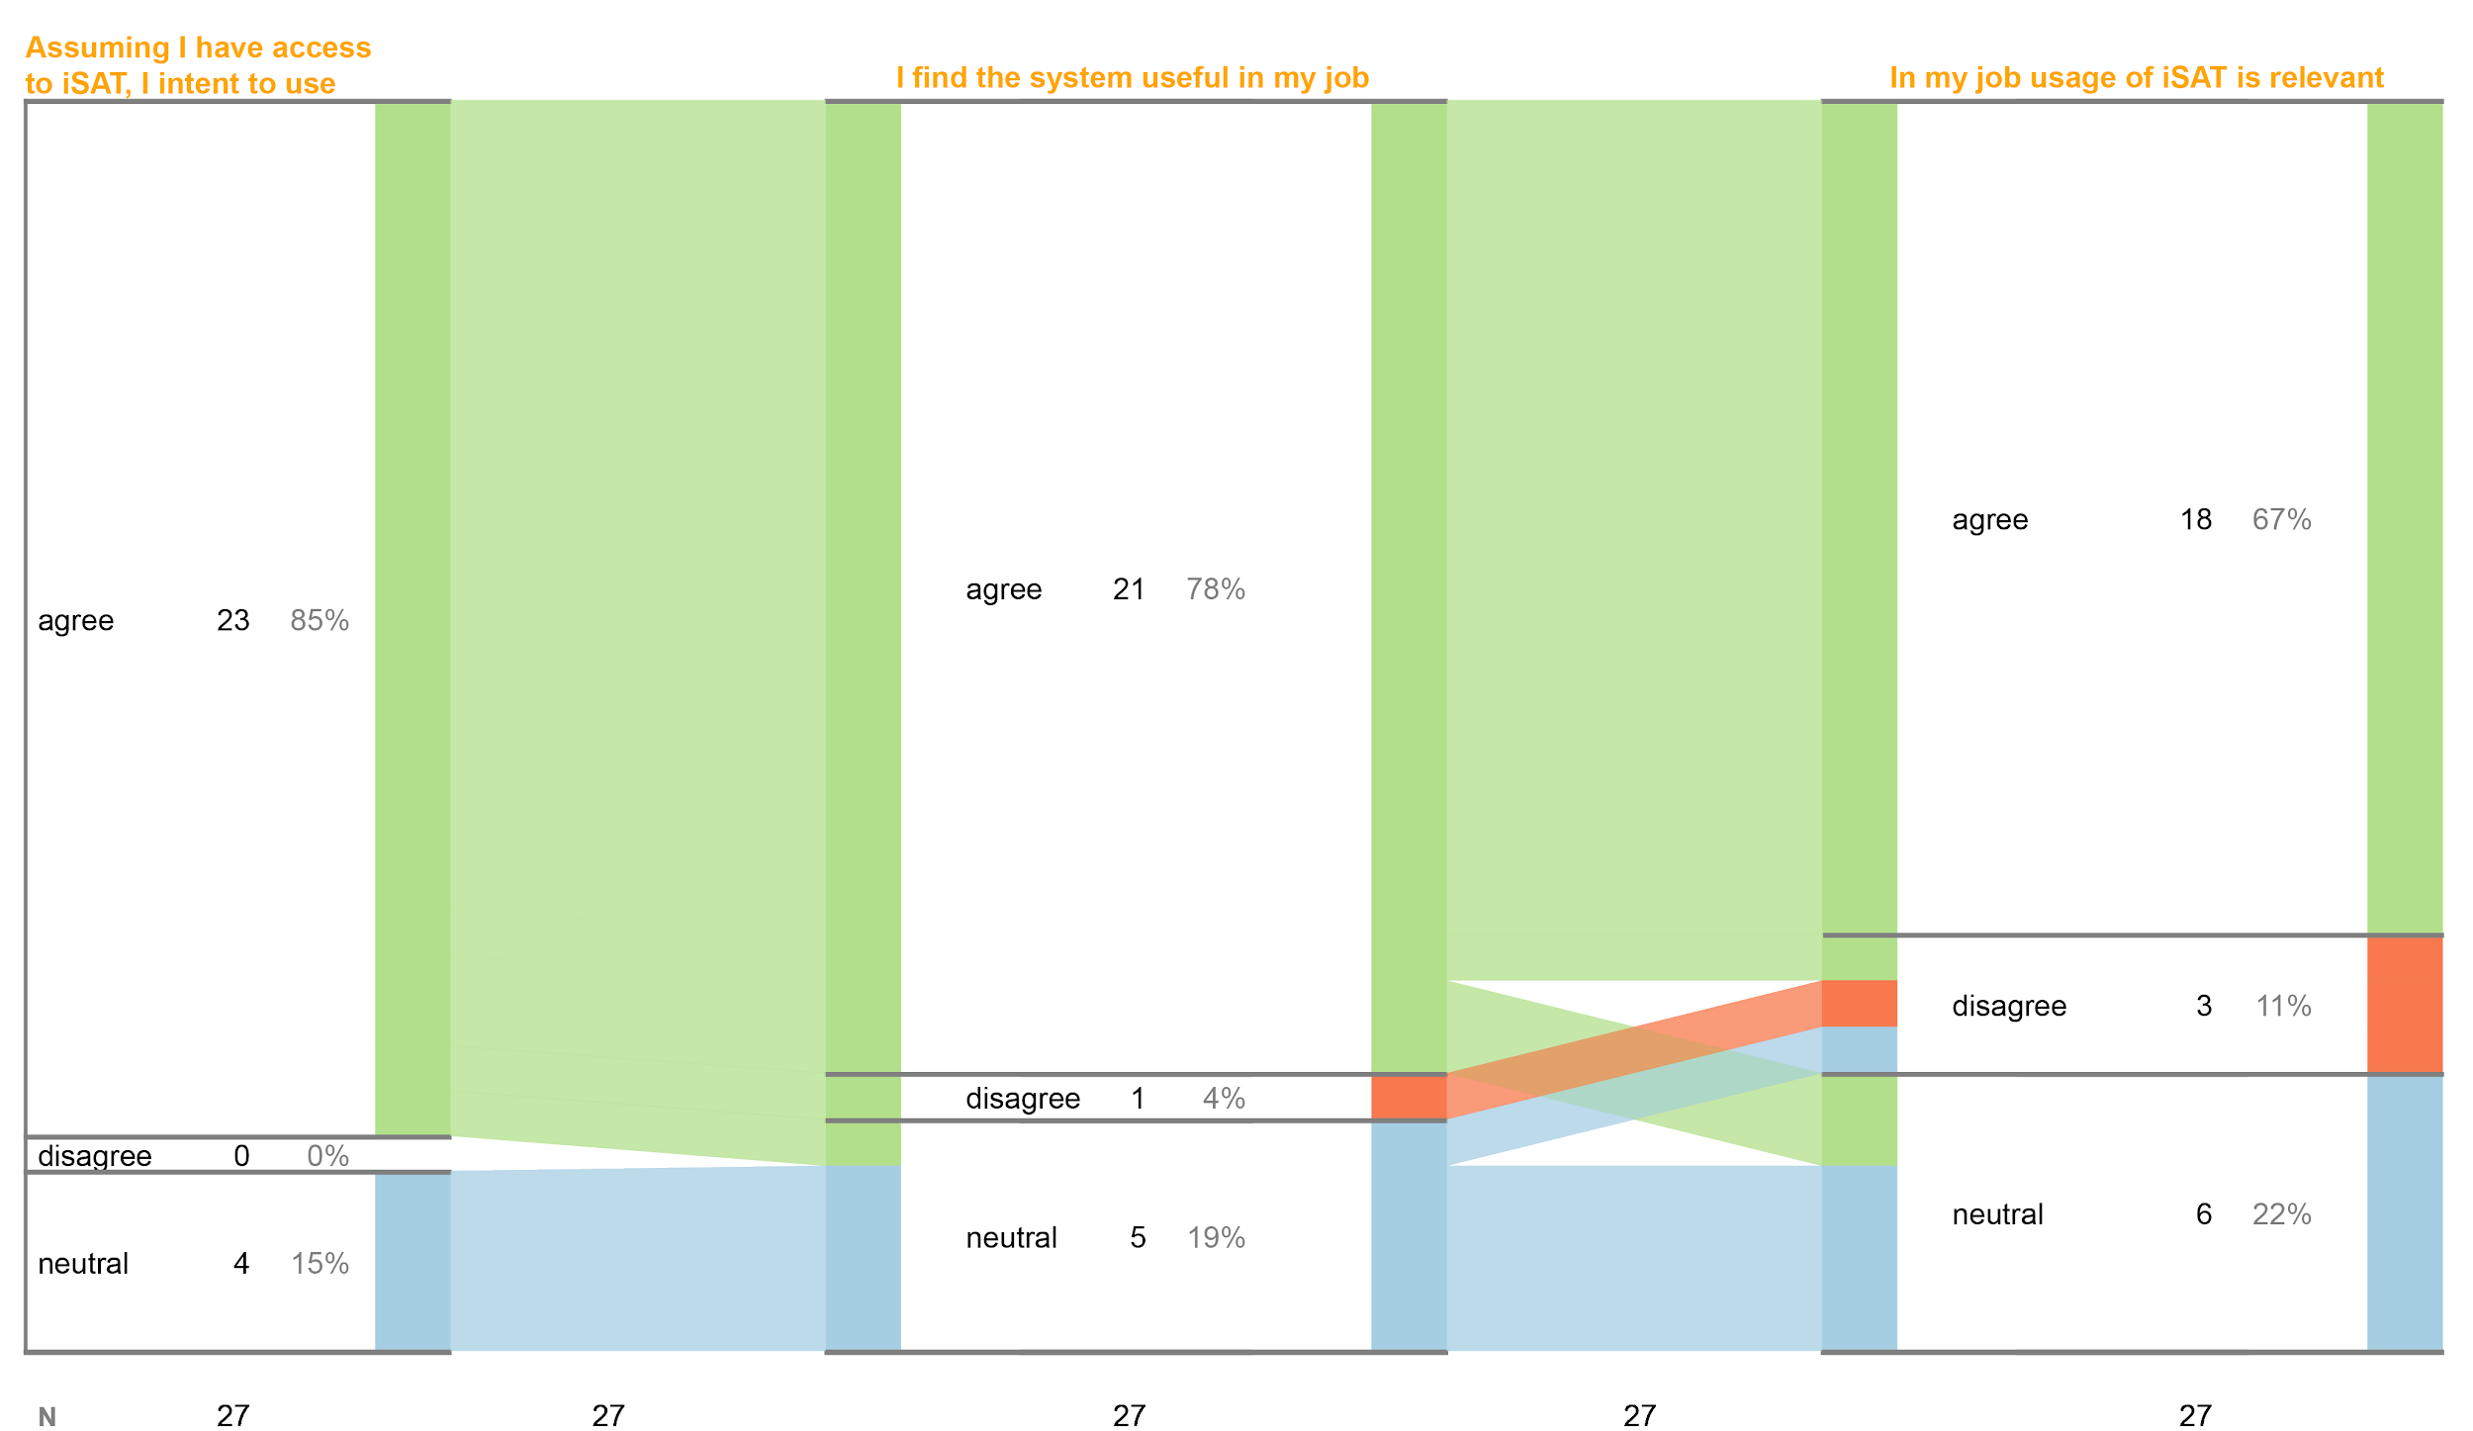
TAM2 usefulness results
How useful is iSAT?
USEFULNESS (n=27) | agree | neutral | disagree
Intent to use | 23 | 4 | 0
Useful for job | 21 | 5 | 1
Relevant for job | 18 | 6 | 3
67% of users perceived that they intended to use iSAT as it was useful and relevant to their job
15% users were neutral across the survey items
NO users disagreed to all the items for iSAT

Slide 48
Analysing interview and email data regarding user perception of usefulness
How useful is iSAT?
Method: Conducted semi-structured interview with interested participants to analyse
The context of the user
The objective of their analysis and
How iSAT may assist to make sense of their context.
Sample: 8 users
2 from educational technology industry,
1 post doc associated with ET related project
1 instructor
1 CSER researcher
1 researcher and physics olympiad organiser
2 reflective practitioner and researcher
Analysis method: Qualitative Analysis

Slide 49
Views from first time users
How useful is iSAT?
iSAT provides overview
  “It is very informative and gives a clear overview of the transitions.”
iSAT reports insights at a cohort level
  “This tool (iSAT) made a way for me to show my data in a proper form.”
Use it in own context to adapt
  “I want to use it with my data”
Simultaneous visualisation assists to verify multiple patterns
  “I can see how many students are selected while applying different criteria”

Slide 50
Views from first time users
How useful is iSAT?
Learnability issues can be tackled by introducing familiar context and data
  “become little bit more familiar. want to try out different dataset on this tool and just to get the feel of the tool.”
Needs ‘how to’ instructions
  “I'm more interested in focusing in the evolution of one cluster but I need to include in the graph the percentage of the cluster that are transitioning to other clusters.”

Slide 51
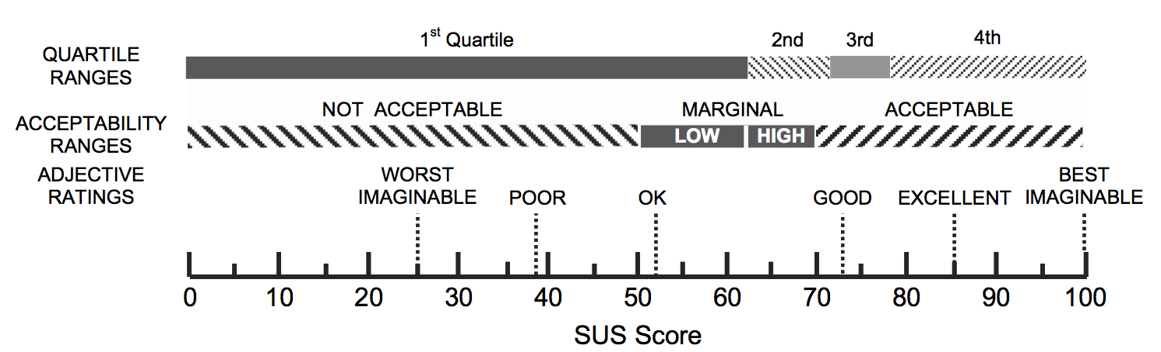
SUS results
How usable is iSAT?
USABILITY | N | SUS Score
 |  | Mean | Std. Dev.
MEET | 14 | 70.71 | 14.85
T4E | 15 | 70.83 | 20.80
ICCE | 6 | 75.41 | 9.00
Overall | 35 | 71.57 | 16.66
SUS score of 71.57 indicates iSAT is an acceptable system
Aaron Bangor , Philip T. Kortum & James T. Miller (2008) An Empirical Evaluation of the System Usability Scale, International Journal of Human-Computer Interaction, 24:6, 574-594, DOI: 10.1080/10447310802205776

Slide 52
Applicability of iSAT in ET research
Research context
  Analyzing learners sub groups
    performance / affective parameters
  in context of online courses / MOOCs, designed teaching-learning classroom interventions, or pseudo-experiments in lab settings
Research question (based on classification by Dillon, 1984)
  Comparisons
  Contingencies
Collected data
  Same attribute collected across time.
  Different attributes collected at the same or across time.
Method:
Analysing literature
Sample:
5 randomly sampled studies from TLT
Analysis:
Investigating the possible transitions to trace in the context of those studies

Slide 53
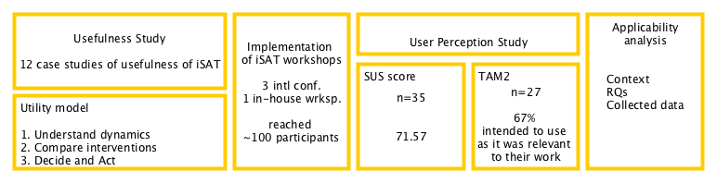
Summary of Evaluation Phase

Slide 54
The context of meso-level analysis was conceptualised by analysing data from preliminary study and literature.
The need of visualisation based tools to assist the process of tracing transition emerged from the analysis.
State Transition Diagram
Developed initial concept of analysing cohorts based on the state they belong to and the transitions they make, similar to markov modeling.
e.g. context: Student engagement across TPS, an active learning session
Stratified Attribute Tracking Diagram
Refined model by including the transitions across attributes, updated method with use of pivot tables.
e.g. context: Students perception across survey items regarding accessibility of muddy point clarification
Interactive Stratified Attribute Tracking
Implemented web-based tool to process and visualize data.
The concepts of patterns were included, information foraging tasks were mapped to the visual interaction task.
e.g. context: Students answering patterns across conceptual questions during PI.
Usefulness is analysed from the research studies that used iSAT. We looked at the RQs the users had and how the information artifact (methods, models, visualisation) helped them to bridge it and give them insights in their context
Utility was synthesised from the use cases.
Applicability was argued from literature and analysed on sampled studies.

Slide 55
Efforts towards proliferation of iSAT
iSAT website www.et.iitb.ac.in/iSAT
iSAT tutorials 3 international conferences and 1 in-house workshop
reached nearly 100 educators and researchers through MEET 2015, T4E 2015, LaTiCE 2016, ICCE 2016
Academic publications 1 Journal
1 conference presentation, 2 conference posters
1 Doctoral Consortium presentation, 1 New member event poster
Effects of proliferation
Usage of the model and tool by workshop participants and reporting insights in peer reviewed conferences.
Opportunity of collaborative research.

Slide 56
Claims
 | Claims | Evidence
1 | iSAT model assists analysis at meso level. | 12 studies applied the iSAT model of analysis and obtained insights regarding the cohorts of learners in their specific context.
2 | Analysing transitions informs researchers and instructors about the dynamics across time and attribute in a teaching-learning scenario. This assists them to build a descriptive model of the context of the data. | 5 reported studies. TPS engagement, Conceptual change in PI, Performance due to PPE, Performance in PBL Studying Phonological performance in kids
3 | iSAT helps to probe deeper in data and answer questions like “Which group benefitted?” | 5 reported studies. TPS learning, Performance due to PPE, Learner fraustration in ITS, SOP competency study Online TPD

Slide 57
Claims
 | Claims | Evidence
4 | iSAT model can be used to compare different interventions | 4 reported studies. TPS learning: TPS vs Interactive lec PPE performance: Advance / novice group, SOP competency - reflection prompt / only TELeDesC Phonological performance - CAI / paper group
5 | iSAT model can be used to take research and instructional decisions based on transition patterns of the data in context | 4 reported studies. Studying PPE as novel assessment Choosing favored mode of student’s doubt clearing Selecting participants for further mentoring Deciding post PI activities
6 | iSAT model can be applicable for analyzing learners sub groups for RQs of type Comparisons and Contingencies with multi-variate data | Analysed 5 research studies from IEEE TLT to find possible transitions that can be analysed

Slide 58
Claims
 | Claims | Evidence
7 | iSAT tool is usable | Average SUS score is 71.57 (n=35)
8 | iSAT model is acceptable by the first time users | 67% of users perceived that they intended to use iSAT as it was useful and relevant to their job 15% users were neutral across the survey items NO users disagreed to all the items for iSAT

Slide 59
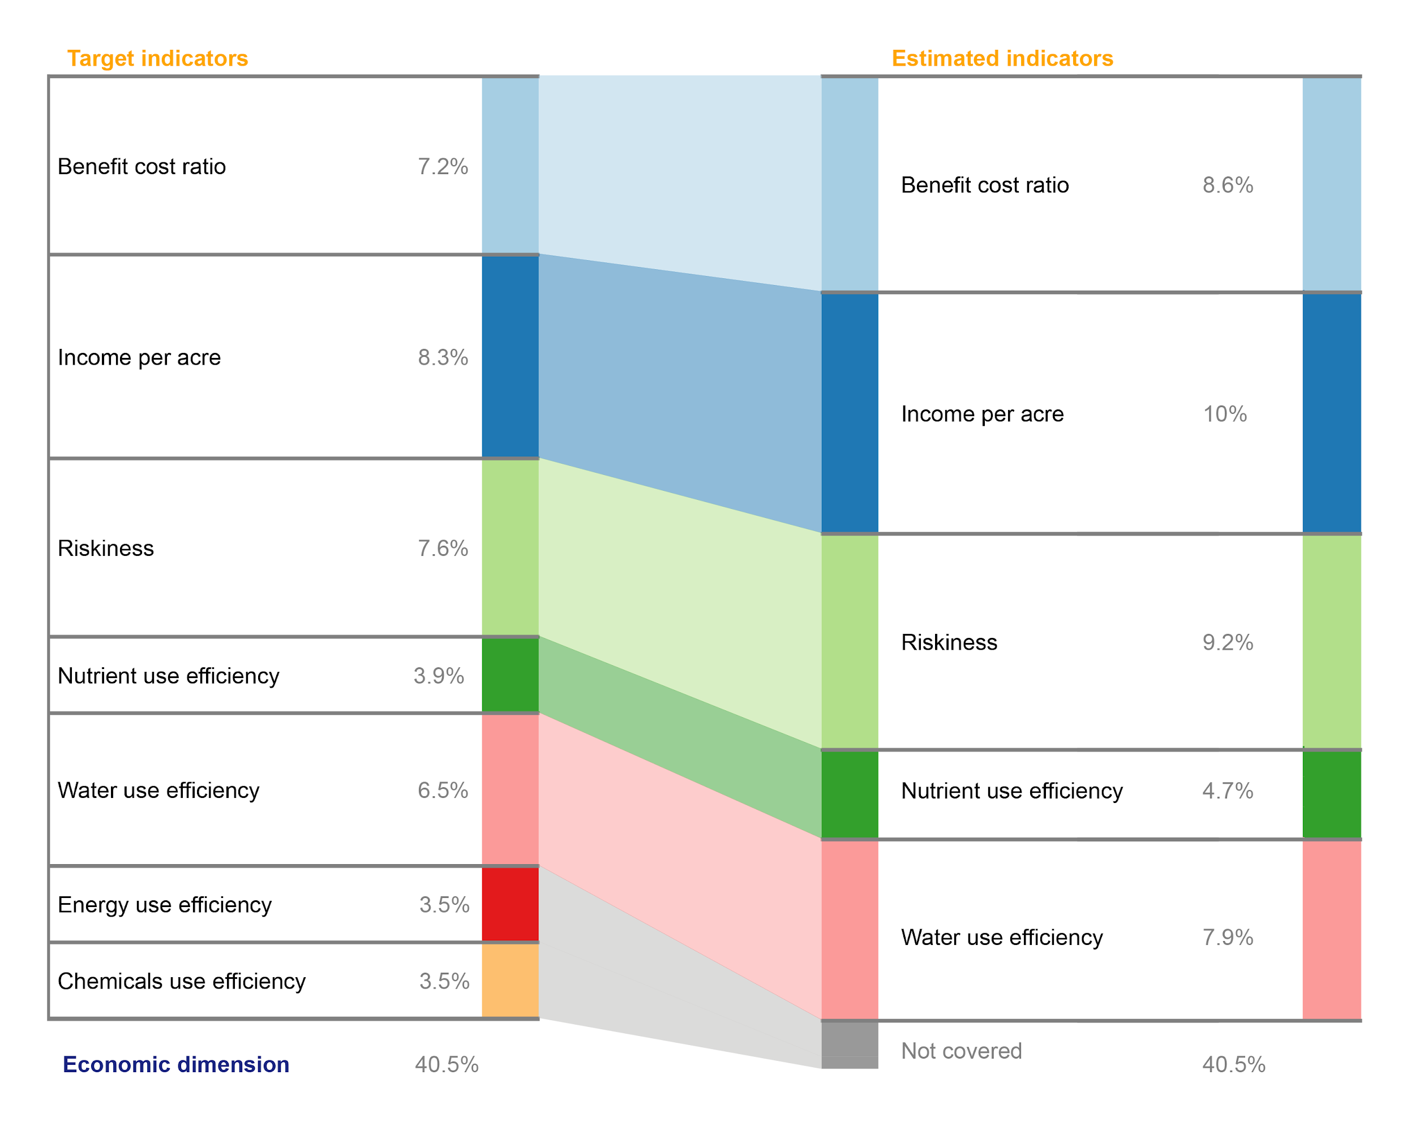
Generalizability Limitations Future
Number of scenarios tested are limited
Patterns are not defined formally from a statistical perspective.
Tool supports analysis for only 3 phases with 7 strata in each phase
Usability evaluation only perception based and not with user tasks
Model
Visualisation
NOW :)
Research
  ET Research
  Diagrams Research
  Interaction Research
Development
  Optimisation of algorithms
  Features in current tool
  Extension of current tool
Evaluation of various farming systems using
Farm Assessment Index (FAI) derived from a set of indicators
Notes:
ET
Expanding in other scenario of analysis
Evaluating effective utilization of iSAT model for different user profiles.
Study to what extent does the users’ experience of analyzing data and iSAT training workshop affects the quality of use of iSAT model and tool.

Slide 60
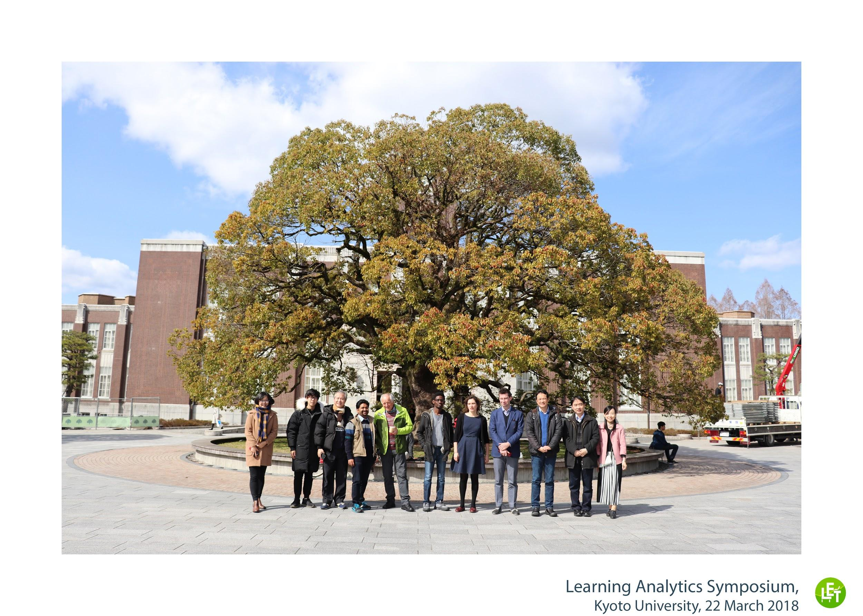

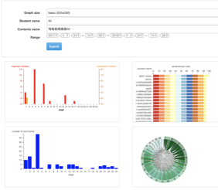
iSAT in Kyoto!
eBook reader with students reading and annotation behavior logger
Learning Analytics dashboard

Slide 61
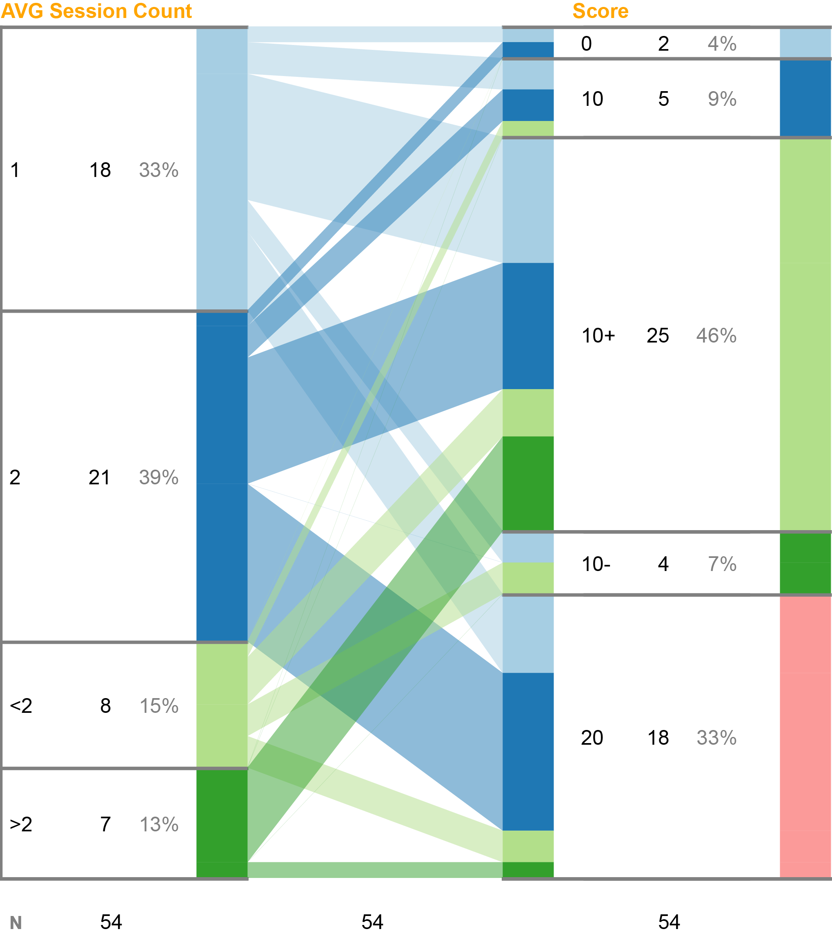
iSAT based actionable analytics
Sessions counts - Assessment score
Dynamics of login count and score >>
Page completion - Page activity
Read only small portion and has highlighted / noted in ebook
Encourage those students to follow up with reading
Page completion - Assessment score
Designing remedial activities if there are high completion rate but low score cohorts

Slide 62
Publications
Thesis Related Journal Publications
Majumdar, R. and Iyer, S. (2016) iSAT: A Visual Learning Analytics Tool for Instructors Research and Practice in Technology Enhanced Learning 11:16. DOI 10.1186/s41039-016-0043-3
Thesis Related Conference Publications
Law, M.C., Majumdar, R. and Hew, K.F. (2016) Tracing Phonological Processing Skill in Early Childhood Through iSAT IEEE Intnl Conf on Technology for Education (T4E), Mumbai, India, Dec 2016.
Majumdar, R. (2016) SAT Diagram: An Interactive Visual Representation for Learning Analytics. Proceedings of the graduate symposium of 9th International Conference on the Theory and Application of Diagrams, Philadelphia, USA, Aug 2016.
Majumdar, R. and Iyer, S. (2015) Beyond Clickers: Tracing Patterns in Students' Response through iSAT. Intnl Conf on Computers in Education (ICCE), Hangzhou, China, Nov 2015.
Majumdar, R., Alse, K., Iyer, S. (2014) Interactive Stratified Attribute Tracking Diagram for Learning Analytics. IEEE Intnl Conf on Technology for Education (T4E), Amritapuri, India, Dec 2014.
Majumdar, R. and Iyer, S. (2014) Using Stratified Attribute Tracking (SAT) Diagrams for Learning Analytics. IEEE Intnl. Conf. on Advanced Learning Technologies (ICALT), Athens, Greece, July 2014.
Kothiyal, A., Majumdar, R., Murthy, S. and Iyer, S. (2013) Effect of think-pair-share in a large CS1 class: 83% sustained engagement. ACM Intl Computing Education Research Workshop (ICER), San Diego, USA, August 2013.

Slide 63
Thank you
Dedicated to: Ma (Dr. Sriya Majumdar) & Mima (Smt. Deepa Ray)
Acknowledgement:
Somu jethu, Ma, Mima, Thamma, Dada for your blessings.
Baba, Mama, Jethu, Jemma, Mami, Phool pisi, Mim di, Rim di, Tuli, Reek, Antu da for being the supportive family
Prof. Sridhar Iyer, Prof. Aniruddha Joshi, Prof. Sahana Murthy, Prof. Girish Dalvi, Prof. Sanjay Chandrashekharan, Prof. A.G. Rao, Prof Kannan Moudgalya,
Prof. N.N. Sharma, for your guidance.
Pallavi and ET office members for working out all the details of sustenance
Ram Karnani, Mehul Sachdeva, Kaka, Prajish, for all the lines of iSAT code.
Aditi, Jk, Bhau, Bhai, yPal, Onuraag, Kaka for being the Lukkhas, Lakshmi, Mrinal mam, Gargi mam, Madhuri mam, Anita mam for all the care. Sameer Sir and family for their interactive moments. ET researchers and family for their intellectual and social support. Andy & Chandra for being there in high times when things dip low. Sai and Baa for being there to connect the dots when it all started… and Aditi for instilling faith while it matured.
To chais, idlis served hot and cocktails on the rocks...

Slide 64
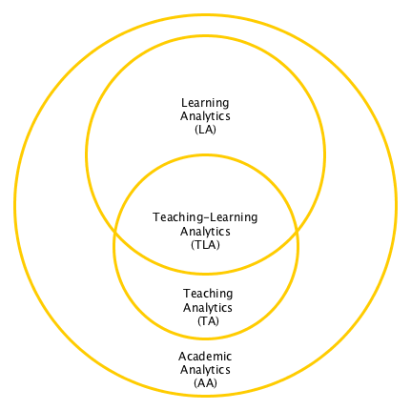
Strands of analysis of educational dataset
Lit review
Learning analytics (LA)¹ - Analysing Learner’s data for understanding how learning happens
Teaching analytics (TA)² - Analysing Teacher’s data for teacher appraisal
Teaching - Learning analytics (TLA)³ - combined analytics to inform instruction design based on teaching-learning data
Academic analytic (AA)⁴ - Analysing data collected in educational context to inform academic policies.
Siemens, 2010
Gauthier, 2013; Prieto et al., 2016
3. Sergis 2016
4. Goldstein PJ (2005)

Slide 65
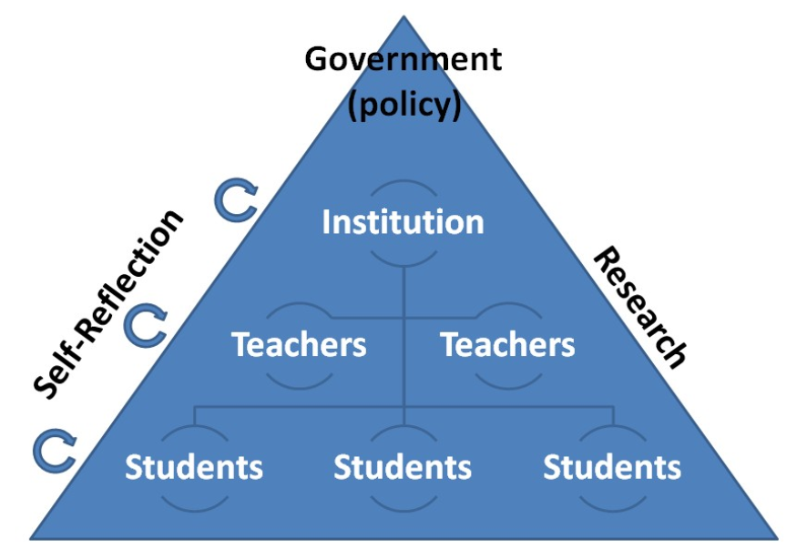
Stakeholders of educational dataset
Greller & Drachsler (2012) talks about Data Subject and Data Clients to classify the stakeholders.
Learners: Students, Online learners, Participants in workshop
Facilitators: Instructors, Teaching assistants, Instructional Designers and Content creators
Researchers
Administrators: Head of the department, Head of the institution
Policy makers: University administrators, Ministry of education
Greller, W., & Drachsler, H. (2012). Translating learning into numbers: A generic framework for learning analytics. Journal of Educational Technology & Society, 15(3), 42.

Slide 66
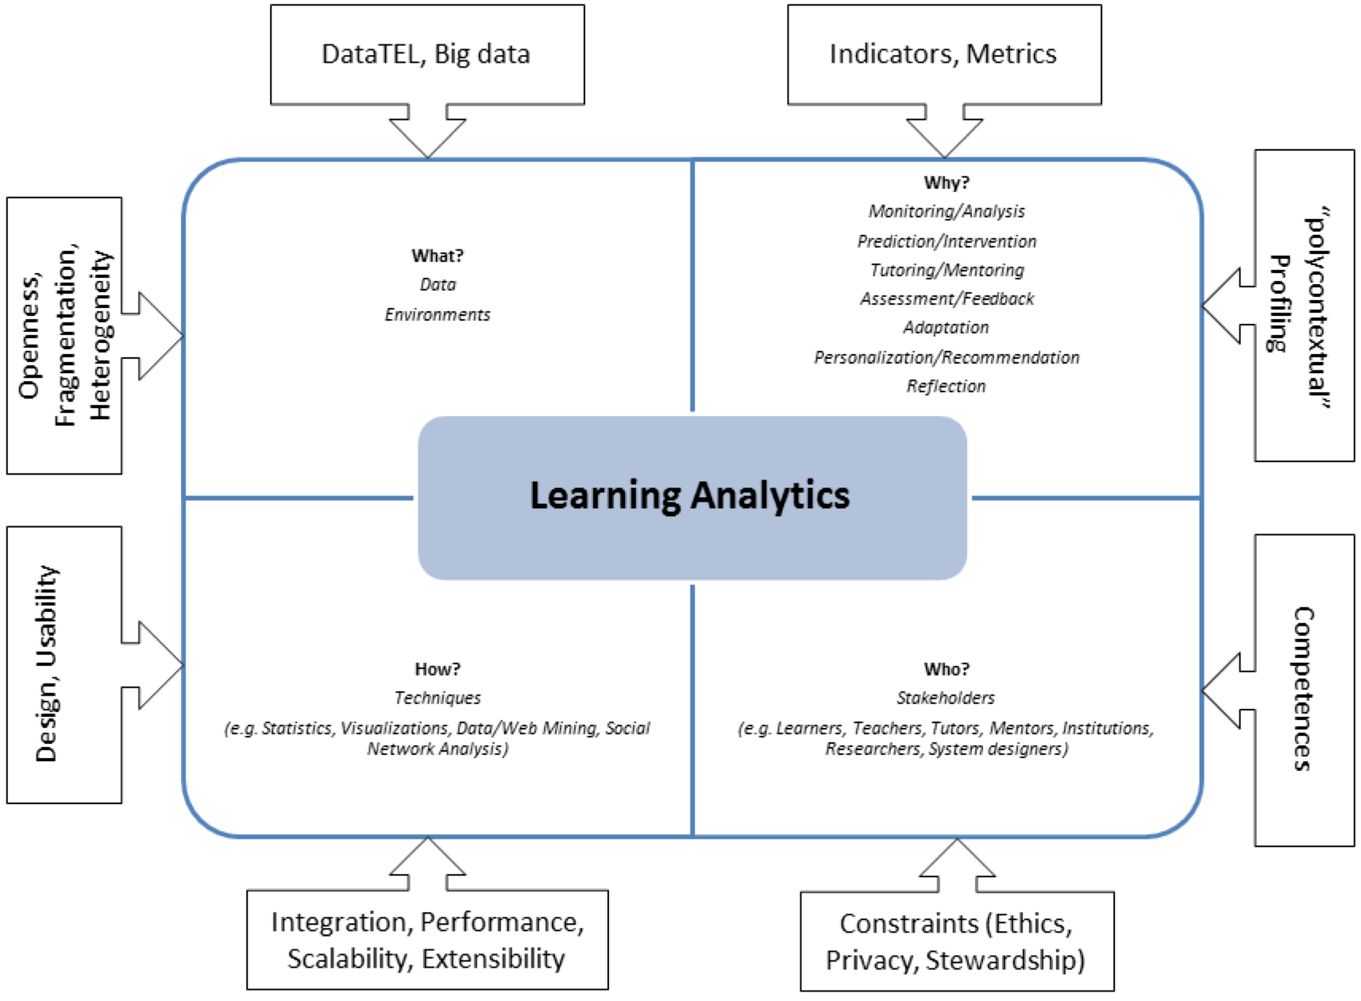
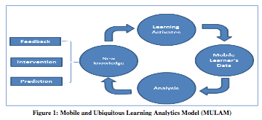



Models / frameworks for learning analytics
Process Model for analysing m-,u- learning environment. Aljohani, N. R., & Davis, H. C. (2012).
Model to refer learning analytics. M.A. Chatti, A.L. Dyckhoff, U. Schroeder, and H. Thüs, (2013)
Model to link pedagogy and learning analytics. Wise A, (2014)
We didn’t find any model of analysis which focuses at the granularity of cohort of learners and assists educators to analyse data with the help of visualisations.
Framework to implement analytics model in higher education.
Jones, D., Beer, C., & Clark, D. (2013)
Framework to implement analytics based on wearable device.
Lu, Y.; Zhang, S.; Zhang, Z.; Xiao, W.; Yu, S.(2017)
Notes:
Remove the pictures

Slide 67
Purpose of analysing educational dataset
Davenport et.al. (2010) | Past | Present | Future
Information | What happened? (reporting) | What is happening now? (alerts) | What will happen? (extrapolation)
Insight | How and Why did it happen? (modeling) | What is the next best action? (recommendation) | What’s the best/worst that can happen? (prediction, optimisation)
Dyckhoff, A. L., Lukarov, V., Muslim, A., Chatti, M. A., & Schroeder, U. 2013; Park, Yeonjeong, and Il-Hyun Jo., 2015;
Leitner, P., Khalil, M., & Ebner, M. 2017; Sergis, S., & Sampson, D. G. 2017 Davenport et.al. 2010

Slide 68
Purpose / Application of Analytics in Education | Reference
Qualitative evaluation Quantitative measures of use / attendance Differentiation between groups of students Differentiation between learning offerings Data consolidation / Correlation Effects on Performance | Dyckhoff, A. L., Lukarov, V., Muslim, A., Chatti, M. A., & Schroeder, U. 2013
to provide feedbacks on students’ learning activities and performance to visualize the evolution of participant relationships within discussion forums to keep track of learners’ interaction in e-learning systems to provide a visualization of learning performance with a comparison whole class group to enable students’ self-reflection and awareness of what and how they are doing to promote reflection and awareness of their activity to improve retention and performance outcomes to help students see how well they are contributing to the group to improve group-work | Park, Yeonjeong, and Il-Hyun Jo., 2015
Predicting student performance and detecting student behaviors Grouping similar materials or students based on their learning and interaction patterns Detection of students with difficulties or irregular learning processes Identifying relationships in learner behavior patterns and diagnosing student difficulties Interpretation of the structure and relations in collaborative activities and interactions with communication tools Reflecting student behavior in terms of its examination traces, consisting of a sequence of course, grade and timestamp Analyzing the contents of forums, chats, web pages and documents Helping instructors to visualize and analyze the ongoing activities of the students and the use of information Identification of relationships among student behaviors and characteristics or contextual variables. Integration of psychometric modelling frameworks into machine-learning models Include possibilities for playful learning to maintain motivation; e.g. integration of achievements, experience points or badges as indicators of success Find hidden insights in data automatically (based on models who are exposed to new data and adapt itself independently) Analysis and interpretation of quantitative data for decision making | Leitner, P., Khalil, M., & Ebner, M. 2017
Evaluation of educational design elements based on educational data Evaluation of overall Educational Design Reflection on delivery of educational design | Sergis, S., & Sampson, D. G. 2017

Slide 69
Educational data analysis techniques
Lit review
Statistics Clustering Classification Regression SNA Association rule mining Text mining | (n=52) 42 (82.7%) 17 (32.7%) 11 (21.2%) 8 (15.4%) 8 (15.4%) 8 (15.4%) 4 (7.7%) | Leitner, P., Khalil, M., & Ebner, M. 2017
Prediction Distillation of data for human judgment Outlier detection Discovery with models Clustering Social network analysis Statistic Machine learning Relationship mining Text mining Gamification Process mining | (n=200) 36 (18%) 33 (17%) 29 (15%) 20 (10%) 18 (9%) 15 (8%) 12 (6%) 11 (6%) 10 (5%) 6 (3%) 6 (3%) 4 (2%) | Sergis, S., & Sampson, D. G. 2017
Existing Statistical methods
Cohort Analysis
Time Series Analysis
Multivariate Analysis
Glenn, N. D. (2005). Cohort analysis (Vol. 5). Sage.
Daniel Pena, George C. Tiao, Ruey S. Tsay, (2001) A course in time series analysis, John Wiley & Sons.
Johnson, R. A., & Wichern, D. W. (2014). Applied multivariate statistical analysis (Vol. 4). Prentice-Hall.

Slide 70
Tools for analysing educational dataset
Lit review
Dashboard | Intended goal | Visualisation used | Ref
LOCO- Analyst | to provide feedbacks on students’ learning activities and performance | Bar graph, pie chart, table matrix, tag cloud | Ali, Hatala, Gašević, & Jovanović, 2012
Student Success System | to identify and treat at-risk students | Risk quadrant, scatterplot, win-lose chart, sociogram | Essa & Ayad, 2012
SNAPP | to visualize the evolution of participant relationships within discussion forums | Sociogram | Bakharia & Dawson, 2011
Student Inspector | to keep track of learners’ interaction in e-learning systems | Bar graph, pie chart | Scheuer & Zinn, 2007
GLASS | to provide a visualization of learning performance with a comparison whole class group | Timeline, bar graph | Leony, et.al. 2012
SAM | to enable students’ self-reflection and awareness of what and how they are doing | Line chart, bar graph, tag cloud | Govaerts, Verbert, Duval, & Pardo, 2012
StepUp! | to promote reflection and awareness of their activity |  | Santos, Verbert, Govaerts, & Duval, 2012
Course Signal | to improve retention and performance outcomes | Signal lights | Arnold, K. E., & Pistilli, M. D. (2012, April)
Narcissus | to help students see how well they are contributing to the group and to improve group-work | Wattle tree | Upton & Kay, 2009

Slide 71

Visualising information of group of records
Lit review
FEATURES | Histogram | Parallel Coordinate | Sankey Diagram | Circular Plot | Steam Graph | Alluvial Diagram | Parallel Set
Relevant Publication | Ioannidis, Y, (2003) gives a historical perspective | Inselberg, (1985;2009) | Riehmann, P. Hanfler, M. & Froehlich B. (2005) | Abel, G. J., & Sander, N. (2014) | Havre, Hetzler & Nowell, (2002) | Rosvall & Bergstrom, (2010) | Kosara, R., Bendix, F., & Hauser, H. (2006).
Limitations | Doesn’t convey transition | Doesn’t convey frequency | Multiple element is not conveyed | Notion of temporal phase doesn’t emerge | Variable

Slide 72


Candidate Methodologies
Multiphase mixed methods.
Design and Development research.
  Suitability of DDR for my work (Details in report)
Cresswell, J. W. (2003). Research design. Qualitative, quantitative, and mixed methods approaches, 67.
J. van den Akker, K. Gravemeijer, S. McKenney, & N. Nieveen (Eds.)(2006), Educational design research: Routledge.

Slide 73
Suitability of our research goal to adopt DDR methodology
The chosen research problem | Developing and analysing a meso level view of the dataset
Is the problem common to stakeholders (design and developers, in original text) | Yes researchers and instructors routinely collect data in their teaching learning scenario and need to analyse them to take decisions or have better understanding of their practices.
Is the problem critical to profession | Yes simplicity of analysis and ease of interpretation with respect to the context is critical.
Does the problem reflect realistic constraints and conditions typically faced by stakeholders (designers, in original text) | Making sense of data gathered in educational context remains a typical and realistic agenda for the stakeholders . For e.g. for a novice researchers mining algorithm becomes difficult to implement and the results difficult to interpret
Does the problem pertain to cutting edge technologies and processes | Yes the research aims to implement Visual Analytics techniques in the domain of Learning Analytics.
Van den Akker et.al, 2006

Slide 74
Need of meso-level info in face-to-face mode of learning
Tracing performance of students for college accreditation according to university norm.
Comparing different course offerings to understand dynamics of the class
  Performance in foundation v/s capstone course
  Performance in prerequisite course and elective taken.
Tracking temporal trends of different sub-groups of students
  performance in related courses across semester,
  On-campus discipline and job profile
Need for
face-to-face mode
online mode / MOOC
academic coordination

Slide 75
Need for
face-to-face mode
online mode / MOOC
academic coordination
Need of meso-level info in MOOC scenario
Learner related data indicating usefulness of content or pedagogical activities, to cater to a high diversity in learning scenario.
Performance or engagement data of learners over a period of time to understand consistency.
Need for meso-level info for academic coordination and analysis
Reporting performance of different cohorts in re-runs of course.
Tracing particular group of students for email reminder
Need for
face-to-face mode
online mode / MOOC
academic coordination

Slide 76
Paradigm to build solution: Design Science
Objective:
To inform the
structure of the solution
Design Science is a paradigm of research with foundation in information system.
We want to build an information artifact based on the data collected in educational context.
Design an Information artifact for analysis.
Develop methods to process and interpret the data,
Design a visual representation of the information for ease of the users to interact and report.
Artifact type | What is it?
Constructs | vocabulary and symbols
Methods | algorithm and practices
Models | abstraction and representations
Instantiations | implemented and prototype system
Von Alan, R. H., March, S. T., Park, J., & Ram, S. (2004). Design science in information systems research. MIS quarterly, 28(1), 75-105.

Slide 77
Data & Information Visualisation
Objective:
To inform the
visualisation design
Frameworks for designing visualisation -
We compared 3 existing frameworks for creating and analysing visualisation and choose the Nested Model of Visualisation design (Munzner, 2009)
Approaches and principles for data viz -
We followed Tufte’s (1983) approach of visualising quantitative data,
and applied principles to choose visual components and its properties.
Munzner, T. A nested model for visualization design and validation. IEEE transactions on visualization and computer graphics, 15(6), 2009

Slide 78
Cycle 1 - Genesis

Slide 79
Initial goal :
Synthesising objectives for design, development and evaluation
In order to conceptualise the meso-level analytics
Design an Information artifact for analysis.
Develop methods to process and interpret the data,
Design a visual representation to interact and report the insights.
This also scoped specific evaluation that could be done
Evaluate the usefulness of the meso-level info in the context of its use.
Evaluate the usability of the methods and representations
Develop a descriptive model for the use of meso-level analysis.
Notes:
Conclusion of need and context analysis phase

Slide 80


Genesis cycle
Goal:
Conceptualise a meso-level view of the data which shall assist users to analyse cohorts based on transitions of their collected attributes, in a given teaching-learning context.
Context:
Studying dynamics of students engagement across Think-Pair-Share, an interactive learning activity.
 | Genesis cycle
Model | Created model to trace transition across time.
Construct | State, Phase, Transitions, Transition ratios
Method | Developed a method to generate the meso-level information of a dataset.
Representation | State Transition Diagram

Slide 81
Walkthrough - TPS engagement study
In class protocol based observation
  12 observations per minute of
  17 types of possible behaviors for
  228 students
3 point of view to analyse - behavior, student, class
Such analysis didn’t provide the transition across time
States and Phase helped to analyse engagement in each phase of activity and then enabled studying transitions across phases and report it.

Slide 82

State Transition Diagram
Phase
State
Transitions & TR

Slide 83
Findings
Sample
4 researchers analyzed the developed model and evaluated generalizability.
Information was useful in the given context to trace engagement pattern across time
Researchers confirmed it can be generalised to define cohorts across attributes.
The notion of state in time can be generalised in attribute.
The information gave only forward transition, other transition information is also required
The method to compute transitions were cumbersome
The representation was cluttered

Slide 84
Summary of genesis cycle
 | Genesis cycle | Refinement cycle | Implement cycle
Model | Created model to trace transition across time. | Refined model to trace transitions across time and attributes. | Implemented model with the help of iSAT tool
Construct | State, Phase, Transitions, Transition ratios | State > Strata, Phase, Transitions, Transition ratios | Patterns, Strata, Phase, Transitions, Transition ratios
Method | Developed a method to generate the meso-level information of a dataset. | Semi-automated the method to generate meso-level view by using pivot tables in MS excel. | The iSAT tool generated the meso-level view. Analysis of meso-level view was facilitated with information foraging tasks assisted by interactions with the iSAT tool.
Representation | State Transition Diagram | Stratified Attribute Tracking Diagram | Interactive Stratified Attribute Tracking

Slide 85
Cycle 2 - Refinement

Slide 86


Refinement cycle
 | Refinement cycle
Model | Refined model to trace transitions across time and attributes.
Construct | State > Strata, Phase, Transitions, Transition ratios
Method | Semi-automated the method to generate meso-level view by using pivot tables in MS excel.
Representation | Stratified Attribute Tracking Diagram
Goal:
Applying relevant theories to refine the meso-level analytics based on the inputs from last iterations.
Context:
Student perception regarding implemented teaching-learning strategy of muddy point clarification

Slide 87


Stratified Attribute Tracking Diagram
Phase
Forward TR
Strata

Slide 88
Findings
Sample
4 previous researchers who applied the developed model and representation to report their finding.
Information was useful to decide which strategy of muddy point clarification to continue.
Researchers confirmed the visual clutter was reduced.
From the reported results there emerged concept of patterns of transitions.
The pivot table method to compute transitions was limited to two phase
There can be further visual mapping of representation to the data visualised.

Slide 89
Summary of implementation cycle
 | Genesis cycle | Refinement cycle | Implement cycle
Model | Created model to trace transition across time. | Refined model to trace transitions across time and attributes.
Construct | State, Phase, Transitions, Transition ratios | State > Strata, Phase, Transitions, Transition ratios
Method | Developed a method to generate the meso-level information of a dataset. | Semi-automated the method to generate meso-level view by using pivot tables in MS excel.
Representation | State Transition Diagram | Stratified Attribute Tracking Diagram

Slide 90
Cycle 3 - Implement

Slide 91

Implement cycle
 | Implement cycle
Model | Implemented model with the help of iSAT tool
Construct | Patterns, Strata, Phase, Transitions, Transition ratios
Method | The iSAT tool generated the meso-level view. Analysis of meso-level view was facilitated with information foraging tasks assisted by interactions with the iSAT tool.
Representation | Interactive Stratified Attribute Tracking
Goal:
Implementing the Meso-level analytics model with an interactive visualisation tool.
Context:
Students response in ConcepTest during Peer Instruction

Slide 92


Interactive Stratified Attribute Tracking Diagram
Phase
Transition
Strata

Slide 93

Information foraging tasks

Slide 94
Information foraging tasks
Methods developed : Information foraging task were defined to assist inferencing based on the visualisation.
Levels of information foraging tasks | Examples | Interaction with the visualisation
Identify characteristics of Phase | What percentage of learners performed low in the post-test? What is the ratio of low performers to high performers for the post-test? | Look up or compare values on the bars representing strata of phase. Click on the particular cohort to get its proportion and transition ratios.
Identify characteristics of Transitions | How many low-scorers in pre-test improved to high-scores in the post-test? Is this statement True: “More than half of the high scorers in pre-test scored high even at the end of post-test”? | Look up or compare values on transitions bars. Click on the specific transition to find the cohort proportion
Identify characteristics of Patterns (group of Transitions) | What is the percentage of learners showing same level of performance in the pre-post tests? Find the ratio of the number of learners whose performance improved to those whose performance deteriorate across pre and post test. | Look up or compare values of patterns. 7 patterns have buttons. For anything else the specific patterns button enables user to find cohort proportion across specific strata
Compare two iSAT Visualisation | Compare and contrast effects of active learning on high achievers by considering another dataset having no active learning intervention | Look up or compare either characteristics of phase, transition or patterns between two iSAT visualisation.

Slide 95

Model of interactive stratified attribute tracking

Slide 96


Example problem from UG physics
Student data that can be gathered from this specific scenario:
Technique used to solve the integral
Accuracy of the response
Category of mistake done
Response time

Slide 97
Levels of Visual Analysis task | What it indicates of cohort dynamics
 | Across categories | Across periods
Identify characteristics of Phase | Trace the most prominent level of performance, Trace if absence of any performance level
Identify characteristics of transitions | Trace proportion of desirable performance transitions across intervention | Trace proportion of transitions across performance levels in consecutive test periods
Identify Patterns in Transitions | Trace Alignment and Returns of performance across phases | Trace proportion of desirable vs undesirable sets of transitions. Analyze performances switches and alignments
Compare two SAT diagrams | Indicate similarities and differences of trends in patterns of two performance transitions having same phases.

Slide 98

Evaluation Phase
Usefulness
Utility
Usability
Applicability

Slide 99
Scenario 1
Studies related to analysing TPS activities in a large enrollment lecture
Study 1: (Kothiyal et.al. 2013)
A field study to investigate the quantity and quality of engagement during TPS in a large CS1 course.
RQ - How much students engagement occurs during the TPS activity?
RQ - How does the amount of engagement change as activity progresses?
Study 2: (Kothiyal et.al. 2014)
A two group experimental study to evaluate effectiveness of TPS for learning.
RQ - Do TPS activities lead to increased conceptual understanding and application of CS1 concepts?

Slide 100
Study 1
Engagement during TPS in large CS 1 class
Breakdown Aggregating the engagement of students looses the variations of the individuals.
Looking at individual students doesnt highlight dynamics of the class
Insights In our case, looking at the transition patterns would help to aggregate meso-level information regarding the sub-groups of engagement.

Slide 101
Study 2
Learning effect of TPS in large CS 1 class
Breakdown
Insights “Who benefitted?” is a regular probing question

Slide 102
Scenario 2
Analysing students conceptual change during Peer instruction
Study 3: (Majumdar & Iyer, 2015; Majumdar & Iyer 2016)
Analysing patterns of answering to inform possible instructional decision making.
How does the learners answering pattern change during the PI activity?

Slide 103
Study 3
Analysing patterns of answering to inform possible instructional decision making.
Breakdown Counting individual proportion of each misconception doesn’t highlight conceptual change.
There is not much support for the teacher to make decisions and students to reflect.
Insights The transition patterns of student voting can assist in instructional decisions for post PI activity.

Slide 104
Scenario 2 | Analysing students conceptual change during Peer instruction
Context | Face to face Classroom
Study 3 | Analysing patterns of answering to inform possible instructional decision making.
Reference | Majumdar R. & Iyer S. (2016) iSAT: a visual learning analytics tool for instructors, Research and Practice in Technology Enhanced Learning, 11(1), 1-22 Majumdar, R., & Iyer, S. (2015). Beyond clickers: tracing patterns in students’ response through iSAT. In Procs. of Intnl. Conf on Computers in Education (ICCE 2015), Hangzhou, China.
Research Questions | How does the learners answering pattern change during the PI activity?
Important of question in that context | To assist decision making of post PI activity instructional strategy
RQ type | Analyse trend
iSAT # | No. 4 - Transition pattern of voted response of students during PI activity
Attribute | Voted answer
Phases & Strata | Q1| Q1-after discussion | Q2 Option A,B,C,D
# of attributes # of Phase # of Strata | 1 Attribute 3 phases 4 strata in each phase
Type of analysis | Temporal + Multivariate
Objective | Analyse answering patterns in PI datasets
Analysis task | Compare 2 transition map
Cohort size (N) | Generated voting response of 100 students
What did iSAT explicate? | Learners chose answer option in each phase. iSAT visualized transitions in learners response across those different voting phases. If the options were linked to each alternate conceptions in that specific topic then iSAT highlights the change in conception for each group of students.
iSAT Analytics affordance used | descriptive modelling
Implications | The trend analysis would give an overview of the alternate conceptions students in a class have. Based on that trend the instructor can take instructional decisions.

Slide 105
Scenario 3
Studies to analyse students problem posing exercises (PPE).
Study 4: (Mishra & Iyer, 2013)
Difference in Novice and Advanced learners during PPE.
RQ - How does PPE affect students learning outcome (as measured by tests) in CS1 course?
RQ - What is the transition pattern from - pretest performance - to - posttest performance of novice and advanced learners, as a result of the PPE activity?
Study 5: (Mishra & Iyer, 2015)
Potential of PPE as Assessment
RQ - How does the quality of question(s) generated by a student relate to the score achieved by him/her in the traditional assessment?

Slide 106

Study 4
Difference in Novice and Advanced learners during PPE.
Breakdown Researchers often reach a dead end when there is no statistical significance at a macro level, but there is sense of improvement.
Insights The transition patterns can get complicated and often researchers club them

Slide 107
Scenario 3 | Studies to analyse students problem posing exercises (PPE).
Context | Experiments in face to face workshop
Study 3 | Difference in Novice and Advanced learners during PPE.
Reference | Mishra S. & Iyer S. (2013) Problem Posing Exercise (PPE): An instructional strategy for learning of complex material in introductory programming courses. In Proceedings of the IEEE 6th International Conference on Technology for Education (T4E, 2013), 151-158.
Research Questions | How does PPE affect students learning outcome (as measured by tests) in CS1 course?
Important of question in that context | The investigation finds out which group of learners are most affected in an active learning intervention
RQ type | Consequence
iSAT # | No. 5 - Transition pattern of students performance between pre and post tests
Attribute | Assessment score
Phases & Strata | Pre-Test score | Post-Test score High, Medium, Low
# of attributes # of Phase # of Strata | 1 Attribute 2 phases 3 strata in each phase
Type of analysis | Temporal
Objective | Exploratory temporal trend analysis
Analysis task | Look up desired pattern of transition - starbursts
Cohort size (N) | Performance of 135 groups
What did iSAT explicate? | Visualised transition patterns between Pre-test and Post-test for the whole group of students. It was evident that students improved or retained their performance level after the question posing exercise.
iSAT Analytics affordance used | Descriptive modelling
Implications | The analysis illustrated the positive effect of question posing to improve performance of majority of the students in each achievement cohort.

Slide 108

Novice learners
Advanced learners

Slide 109
Scenario 3 | Studies to analyse students problem posing exercises (PPE)
Context | Experiments in face to face workshop
Study 4 | Difference in Novice and Advanced learners during PPE.
Reference | Mishra S. & Iyer S. (2013) Problem Posing Exercise (PPE): An instructional strategy for learning of complex material in introductory programming courses. In Proceedings of the IEEE 6th International Conference on Technology for Education (T4E, 2013), 151-158.
Research Questions | - What is the transition pattern from - pretest performance - to - posttest performance of novice and advanced learners, as a result of the PPE activity?
Important of question in that context | The investigation finds out which group of learners are most affected in an active learning intervention
RQ type | Disproportion
iSAT # | No. 6 - Transition pattern of performance for novice group | No. 7 - Transition pattern of performance for advanced group
Attribute | Achievement score Difficulty level
Phases & Strata | Pre-Test score | Rubric score | Post-Test score High, Medium, Low
# of attributes # of Phase # of Strata | 2 Attribute 3 phases 3 strata in each phase
Type of analysis | Multivariate + temporal
Objective | exploratory multivariate trend analysis
Analysis task | Compare 2 transition map
Cohort size (N) | 60 novice learner group | 62 advanced learner group
What did iSAT explicate? | "Visualized proportion of difficulty level of the student generated problems and the transitions of test performances for those students. It helped to assess effectiveness of the PPE based instruction for novice and advanced learners group. Transition patterns show that PPE had more visible effects on novice learning outcome and not on Advanced Learners’. Without any explicit training on PP, Medium level difficulty questions are more posed by both high and medium level pretest performers in both novice and advanced cases. Interestingly advanced learners generate more low level questions than Novices. Higher the difficulty level of generated problem, higher is the posttest score; but it does NOT necessarily imply that: lower difficulty yields lower posttest performance."
iSAT Analytics affordance used | compare - across iSAT

Slide 110
Study 5
Potential of PPE as Assessment
Breakdown Deeper analysis is often required to understand impact
Insights The transition patterns can get complicated and often researchers club them

Slide 111
Scenario 3 | Analysing students conceptual change during Peer instruction
Context | Experiments in face to face workshop
Study 5 | Potential of PPE as Assessment
Reference | Mishra, S., & Iyer, S. (2015). An exploration of problem posing-based activities as an assessment tool and as an instructional strategy. Research and Practice in Technology Enhanced Learning, 10(1), 5.
Research Questions | How does the quality of question(s) generated by a student relate to the score achieved by him/her in the traditional assessment?
Important of question in that context | to test the correlation between two assessment scores for different strata of students
RQ type | relation
iSAT # | No. 8 - Transition pattern of performance for novice group | No. 9 - Transition pattern of performance for advanced group
Attribute | Achievement score Difficulty level
Phases & Strata | Pre-Test score | Rubric score High, Medium, Low
# of attributes # of Phase # of Strata | 2 Attribute 2 phases 3 strata in each phase
Type of analysis | Multivariate + temporal
Objective | exploratory multivariate trend analysis
Analysis task | Compare 2 transition map
Cohort size (N) | 60 novice learner group | 62 advanced learner group
What did iSAT explicate? | Only in the Advanced learner group, higher proportion of high performers generated low difficulty question. The novice learners were more aligned in their performance level and the difficulty of the questions they generated. This shows that the difficulty level can be used to assess the learning of novices, but not advanced learners.
iSAT Analytics affordance used | descriptive modelling

Slide 112
Scenario 4
Analysing students engineering design competency of Structuring Open Problem (SOP)
Study 6: (Mavinkurve M., 2016 Thesis)
Relation of prior achievement level vs SOP competencies.
RQ - What is the relation between students’ prior knowledge level and success in attaining SOP competency?
Study 7: (Mavinkurve M., 2016 Thesis)
Effect of intervention on SOP competencies
RQ - What are the patterns of the students success in the design task after the redesign of the TELE-EDesC?.

Slide 113

Study 6
Relation of prior achievement level vs SOP competencies.
Breakdown Deeper analysis is often required to understand impact
Insights The transition patterns can get complicated and often researchers club them

Slide 114
Scenario 4 | Analysing students engineering design competency of Structuring Open Problem (SOP)
Context | Experiments in face to face workshop
Study 6 | Relation of prior achievement level vs SOP competencies.
Reference | Mavinkurve, M. (2016) Development and assessment of engineering design competencies using technology enhanced learning environment. Thesis
Research Questions | What is the relation between students’ prior knowledge level and success in attaining SOP competency?
Important of question in that context | to test the effect of prior knowledge on attainment of SOP competency for different strata of students
RQ type | 21a. conjunction
iSAT # | No. 10 to No 13 : Transition pattern of prior performance to competencies in SOP 1 to 4
Attribute | Achievement score SOP competency
Phases & Strata | Prior Achievement | SOP competency High, Medium, Low || Successful, Unsuccessful
# of attributes # of Phase # of Strata | 2 Attribute 2 phases 3 strata in prior achievement and 2 in SOP competency
Type of analysis | Multivariate
Objective | exploratory multivariate trend analysis
Analysis task | Look up patterns of transition - compare each of the 4 SOP competencies
Cohort size (N) | 90 students
What did iSAT explicate? | Visualised transitions of cohorts in prior achievement levels to their SOP competency. Separately diagrams were visualized for each of the 4 SOP competencies. "More number of students were categorised as successful students on SOP sub-competencies SOP1, SOP2 and SOP3. But for SOP4 it was found that a large fraction from experimental group students were unsuccessful. This was true of students from all prior achievement levels leading to a conclusion that students’ prior achievement level did not play a role in the attainment of SOP competency
iSAT Analytics affordance used | taking research decision based on comparing descriptive pattern
Implications | This analysis directed the redesign exercise of TELE-EdesC where the researcher focused only on items related to SOP 4.

Slide 115

Study 7
Effect of intervention on SOP competencies
Breakdown Statistical tests of stratfied sample on the same parameter The impact of redeisgn required deeper analysis
Insights The transition patterns can get complicated and often researchers club them

Slide 116
Scenario 4 | Analysing students engineering design competency of Structuring Open Problem (SOP)
Context | Experiments in f2f Classroom
Study 7 | Effect of intervention on SOP competencies
Reference | Mavinkurve, M. (2016) Development and assessment of engineering design competencies using technology enhanced learning environment. Thesis
Research Questions | What are the patterns of the students success in the design task after the redesign of the TELE-EDesC?
Important of RQ in that context | to test the effect of prior knowledge on attainment of SOP competency for different strata of students
RQ type | 33a. consequence
iSAT # | No. 14 to No 17 : Transition pattern of intervention group to competencies in SOP 1 to 4
Attribute | Intervention group SOP competency
Phases & Strata | Group | SOP competency Control, Experimental || Successful, Unsuccessful
# of attributes # of Phase # of Strata | 2 Attribute 2 phases 2 strata in each phase
Type of analysis | Multivariate
Objective | confirmatory multivariate trend analysis
Analysis task | Look up desired pattern of transition - starbursts for each of the 4 SOP competencies
Cohort size (N) | 45 students
What did iSAT explicate? | Visualised transitions of cohorts based on their intervention group to their success in the design task. Separately diagrams were visualized for each of the 4 SOP competencies. Highlighted more number of students were successful from the experimental group who did activities with rubrics than in control group which only got exposure to TELEDesc
iSAT Analytics affordance used | Highlighting descriptive model of transition for establishing effectiveness of intervention

Slide 117
Scenario 5
Analysing trends in thinking skill development over time in a semester long course
Study 8: (Mistry et.al. 2016)
Impact of Project Based Learning on performance at different Bloom’s level
RQ - What is the impact of Project Based Learning on student’s higher order thinking skills and lower order thinking skills?

Slide 118

Study 8
Impact of Project Based Learning on performance at different Bloom’s level
Breakdown Different tests score on different metric of performances. But there are no dashboard which can help users collate that data.
Also for smaller learner set and difference rubric values statistical tests of significance remains difficult.
Insights They visualisation provides an overview of the performance dynamics across the tests.

Slide 119


Slide 120
Scenario 5 | Analysing trends in thinking skill development over time in a semester long course
Context | Reflection of f2f Classroom
Study 8 | Effect of intervention on SOP competencies
Reference | Mistry R., Halkude S. & Awasekar D. (2016) APIT: Evidences of Aligning PjBL with Various Instructional Strategies for Enhancing Knowledge in Automobile Engineering. In Proceedings of the IEEE International Conference on Learning and Teaching in Computing and Engineering (LaTiCE, 2016).
Research Questions | What is the impact of Project Based Learning on student’s higher order thinking skills and lower order thinking skills?
Important of question in that context | to test the effect of prior knowledge on attainment of SOP competency for different strata of students
RQ type | consequence
iSAT # | No 18 - transitions between level in LOTS | No 19 - transitions between level in HOTS | No 20 - transitions between level in LOTS to HOTS
Attribute | Achievement score
Phases & Strata | Higher order thinking skill | Lower order thinking skill High, Medium, Low"
# of attributes # of Phase # of Strata | 2 Attribute 2 phases 2 strata in each phase
Type of analysis | Multivariate
Objective | confirmatory multivariate trend analysis
Analysis task | Look up desired pattern of transition - starbursts for each 3 of thinking skills groups
Cohort size (N) | 25 students
What did iSAT explicate? | Visualized transitions in performance of learners across tasks associated with Lower Order Thinking Skills (LOTS) and Higher Order Thinking Skills (HOTS). 25% students were able to starburst from medium level performance to high level across the LOTs to HOTs activities.
iSAT Analytics affordance used | Descriptive modelling

Slide 121
Scenario 6
Analysing performances of early learners in a battery of phenological assessments
Study 9: (Law et.al. 2016)
Studying relationship in performance across test items and across time
RQ - How does the performance vary across testing period for the two groups of intervention?
RQ - What is the relationship of performance between the Alliteration and Rhyme tests during each testing period?

Slide 122

Study 9
Studying relationship in performance across test items and across time
Breakdown For each test individuals can vary in pefoemance in different ways
Insights More number of people have improved their performance in the experimental group

Slide 123
Study 9
Studying relationship in performance across test items and across time
Breakdown The test performance of learners can vary for different test items across the period of time.
Insights Specific patterns of performance can be used to compare the different groups of interventions.

Slide 124
Scenario 6 | Analysing performances of early learners in a battery of phonological assessments
Context | Experiments in f2f Classroom
Study 9 | Studying relationship in performance across test items and across time
Reference | Law M.C., Majumdar R. and Hew H.F. (2016) “Tracing Phonological Processing Skill in Early Childhood Through iSAT” in Proc IEEE 8th Intnl. Conf. on Technology for Education (T4E), 2-5 Dec. 2016.
Research Questions | How does the performance vary across testing period for the two groups of intervention? | What is the relationship of performance between the Alliteration and Rhyme tests during each testing period?
Important of question in that context | Tracing the temporal change would help to identify proportions of the students with specific patterns across pre, post and retention test. | The analysis would highlight the relationship of performance in the two tests for that particular group of participants.
RQ type | Disproportion | Relation
iSAT # | No 21 - No 24 transitions across different assessments | No 25 - No 30 transitions between Alliteration and Rhyme test
Attribute | Standardized achievement score
Phases & Strata | Pre-Test score | Post-Test score |Retention Test score Well Above Average, Above Average, Average, Below Average, Well Below Average | Alliteration (AT)|Rhyme (RT) Test WAA, AA, A, BA, WBA
# of attributes # of Phase # of Strata | 1 Attribute 3 phases 4 strata in each phase | 1 Attribute 2 phases 4 strata in each phase
Type of analysis | Temporal | Multivariate
Objective | confirmatory temporal trend analysis | confirmatory multivariate trend analysis
Analysis task | Compare 2 transition map
Cohort size (N) | 15 students in Computer assisted Instruction group 15 students in pencil-and-paper training group
What did iSAT explicate? | Traced performance variation across three testing periods for different assessment tests. Computer aided instruction helped to improve posttest performance and maintain it across retention test more than the paper-based instruction. | Helped to analyze performance patterns between the two test categories (AT and RT). For example, in the posttest period, CAI cohort showed similar desired performance levels between AT and RT. Whereas in the paper based instruction group there were performance switches.
iSAT Analytics affordance used | Descriptive modelling
Implications | The trend analysis indicated the effectiveness of the computer aided instruction for phoneme identification by early learners. This helped to conceptualize further possible studies to investigate the relationship with phoneme identification and production in terms of cohort dynamics.

Slide 125
Scenario 7
Analysing transitions of students perceptions in surveys
Study 10: (Majumdar & Iyer 2013)
Probing into effectiveness of implemented framework
RQ - How effective is the LAMP framework?
-For collection of muddy point from the students
-To address the muddy points of the students

Slide 126
Study 10
Studying effectiveness of implemented framework
Breakdown There are variation in response in a survey for each student which is lost while analysing each item independently
Insights Deeper analysis is possible if the records of the specific cohort of interest is filtered.

Slide 127
Scenario 7 | Analysing students conceptual change during Peer instruction
Context | Reflection of f2f Classroom
Study 10 | Studying effectiveness of implemented framework
Reference | Majumdar, R., & Iyer, S. (2013, December). LAMP: A framework for large-scale addressing of muddy points. In Technology for Education (T4E), 2013 IEEE Fifth International Conference on (pp. 127-132).
Research Questions | How effective is the LAMP framework? -For collection of muddy point from the students -To address the muddy points of the students
Important of question in that context | to test the effect of prior knowledge on attainment of SOP competency for different strata of students
RQ type | Conjunction
iSAT # | No. 31: Transition pattern of students perception across survey items
Attribute | Perception scores
Phases & Strata | Question Posed | Answered Received Agree, Neutral, Disagree
# of attributes # of Phase # of Strata | 1 Attribute 2 phases 3 strata in each phase
Type of analysis | Multivariate
Objective | exploratory multivariate trend analysis
Analysis task | Look up transitions from full transition map
Cohort size (N) | 274 students
What did iSAT explicate? | The visualization of the survey response helped to answer both the RQs together and also highlighted the transitions between the two survey items The perception trend indicated the proportion of the group whose preference patterns could be further investigated.
iSAT Analytics affordance used | taking research decision based on comparing descriptive pattern

Slide 128
Scenario 8
Assessing learning gains in online workshops.
Study 11: (Warriem et.al. 2013)
Studying improvement in each aspect of evaluation
RQ - What is the improvement in participants’ ET research methods knowledge as a result of the workshop?

Slide 129
Study 11
Studying improvement in each aspect of evaluation
Breakdown Selecting students based on their perferormance factor increase is difficult
Insights The visualised cohort proportion of the online learners helped to select the batch size for face-to-face interactive workshop

Slide 130
Scenario 8 | Assessing learning gains in online workshops.
Context | Reflection of online Classroom
Study 11 | Studying improvement in each aspect of evaluation
Reference | Warriem J. M., Murthy S. and Iyer S. (2013)Training in-service teachers to do action research in educational technology. in Proc. IEEE 5th Intnl. Conf. on Technology for Education (T4E), pp.192-199, 18-20 Dec. 2013.
Research Questions | What is the improvement in participants’ ET research methods knowledge as a result of the workshop?
Important of question in that context | The analysis would help to get an overview of performance of workshop participants in terms of their achieved rubric score.
RQ type | Consequence
iSAT # | Transitions across rubric score during ideation to study planning stage for different items No 32 - for novelty, No 33 - for positioning, No 34 - for soundness, No 35 - for evidence
Attribute | Achievement score
Phases & Strata | Idea-planning| Study-planning High, Medium, Low, Very low
# of attributes # of Phase # of Strata | 2 Attribute 2 phases 2 strata in each phase
Type of analysis | Multivariate
Objective | exploratory multivariate trend analysis
Analysis task | Look up transitions from full transition map
Cohort size (N) | 242 participants
What did iSAT explicate? | Visualized improvement in mentee’s performance across the online mentorship program. Also helped to identify cohort, which can be trained further in face-to-face mode.
iSAT Analytics affordance used | taking instructional decision based on comparing descriptive pattern
Implications | Based on the descriptive model the researcher could define the criteria for selection for the face to face workshop and further allocate resources for that particular number of participants

Slide 131
Scenario 9
Analysing frustration in an intelligent tutoring system (ITS)
Study 12: (Rajendran R., 2014,Thesis)
Probing deeper to trace impact of motivational message in ITS
RQ - What is the impact of the motivational messages on students’ frustration, learning achievement and time spent to answer the question?

Slide 132
Study 12
Impact of motivational message in ITS
Breakdown Deeper analysis is often required to understand impact
Insights The transition patterns can get complicated and often researchers club them

Slide 133
Scenario 9 | Analysing frustration in an intelligent tutoring system (ITS)
Context | Experiments in ITS environment
Study 12 | Impact of motivational message in ITS
Reference | Rajendran R. (2014) Enriching Student Model in an Intelligent Tutoring System. Thesis
Research Questions | What is the impact of the motivational messages on students’ frustration, learning achievement and time spent to answer the question?
Important of question in that context | The effectiveness of design of the motivational message can be investigated in further details by answering this question. Its effect, can be studied from the perspective of learning achievements and time spent on answer for different cohorts of students
RQ type | consequence
iSAT # | No 36: Transitions of frustration instances before and after showing motivational messages in an ITS session
Attribute | Frustration Instances per session
Phases & Strata | Without motivational message| With motivational message 0-1, 2-3, 4-5, 6 and above
# of attributes # of Phase # of Strata | 1 Attribute 2 phases 4 strata in each phase
Type of analysis | Temporal
Objective | Exploratory multivariate trend analysis
Analysis task | Compare transitions within full transition map
Cohort size (N) | 99 learners from 3 schools
What did iSAT explicate? | Represent trends of frustration instances of learner across activities in an intelligent tutoring system. It highlighted there was a decrease in frustration instances when the activity had motivational messages than one without.
iSAT Analytics affordance used | Descriptive modelling
Implications | The initial analysis of tracing transitions of frustration instances prompted the researcher to zoom into a specific cohorts with respect to their learning achievements and time spent on the session.

Slide 134
Users comments
Ability to zoom in.
Understanding Phonological skill of early learners
  “If I don’t have iSAT all I can do is T-test or ANNOVA. Both are useful but I can’t see any transitions…”
Transitions in performance due on PBL
  iSAT helped to show high-med-low segmentation in each assessment and their migration.
  While using tool helped to organise the data that was gathered.
  For a small group data the tool would be more useful if it shows the associated data of the migrating population.
Physics Olympiad benchmarking exercise
  iSAT helped to visualise proportion of students selected by applying a specific criteria of cut-off.

Slide 135
Utility of iSAT
Utility:
1. iSAT helps to define cohorts and understand their transition dynamics during any teaching-learning session, by stratifying learner attributes and tracing transitions across phases.
Study Context | Attribute Phases & Strata | Cohort size (N) | What did iSAT explicate
Studying engagement during Think-Pair-Share, an active learning sessions in a large undergraduate CS101 class. | Engagement level Think | Pair | Share Fully, Mostly, Sometimes, Never | 228 students | Visualized levels of student engagement across the phases of the activity. It highlighted significant proportion of the cohort were engaged across the phases as observed by their on-task behavior.
Analyzing students’ Problem Posing Exercise (PPE) | Achievement / Difficulty level Pre-Test score | Rubric score | Post-Test score High, Medium, Low | 60 Novice learner group 62 Advanced learner group | Visualized relationship between level of difficulty of the problem posed by students and their test performance. It helped to assess effectiveness of the PPE based instruction for novice and advance learners group and whether PPE can be used for assessment.
Understanding learner dynamics in a semester long Project based Learning activity in Automobile Engineering course | Achievement score Higher order thinking skill | Lower order thinking skill High, Medium, Low | 135 groups | Visualized transitions in performance of learners across tasks associated with Lower Order Thinking Skills (LOTS) and Higher Order Thinking Skills (HOTS).
Tracing learners prior knowledge achievement and success in SOP competency | Achievement score | SOP competency Prior Achievement | SOP competency High, Medium, Low || Successful, Unsuccessful | 25 students | Visualised transitions of cohorts in prior achievement levels to their SOP competency. Separately diagrams were visualized for each of the 4 SOP competencies.

Slide 136
Utility of iSAT
Utility:
2. iSAT helps to compare interventions by highlighting transitions in cognitive performance or affective parameters of different cohorts involved.
Study Context | Attribute,Phases & Strata | Cohort size (N) | What did iSAT explicate
Analyzing early learners’ performance in assessment of phonological processing skills. | Standardized achievement score Pre-Test score | Post-Test score |Retention Test score Well Above Average, Above Average, Average, Below Average, Well Below Average | 15 students in experimental group 15 students in control group | Traced performance variation across three testing periods for different assessment tests. Computer aided instruction helped to improve posttest performance and maintain it across retention test more than the paper-based instruction.
 | Standardized achievement score Alliteration (AT)|Rhyme (RT) Test WAA, AA, A, BA, WBA |  | Helped to analyze performance patterns between the two test categories (AT and RT). For example, in the posttest period, CAI cohort showed similar desired performance levels between AT and RT. Whereas in the paper based instruction group there were performance switches.
Studying effects of active learning module on learning of CS101. | Achievement score Pre-Test score | Post-Test score High, Medium, Low | 250 students in experimental group 169 students in control group | Contrasted achievement levels of the two groups, one who was engaged in TPS activities and other participating in an interactive lecture session. Across Pre-test and Post-test more active learners improved in contrast to just participants in interactive session.
Visualizing frustration instances and motivational message in an ITS (unpublished) | Frustration Instances per session Without motivational message| With motivational message 0-1, 2-3, 4-5, 6 and above | 99 learners from 3 schools | Represent trends of frustration instances of learner across activities in an intelligent tutoring system. It highlighted there was a decrease in frustration instances when the activity had motivational messages than one without.
Tracing success in SOP competency for different intervention | Intervention Group | SOP competency Group | SOP competency Control, Experimental || Successful, Unsuccessful | 23 in experimental group 22 in control group | Visualised transitions of cohorts in prior achievement levels to their SOP competency. Separately diagrams were visualized for each of the 4 SOP competencies.

Slide 137
Utility of iSAT
Utility:
3. iSAT assists instructional or research decision making by highlighting specific cohorts based on their perception or performance pattern.
Study Context | Attribute Phases & Strata | Cohort size (N) | What did iSAT explicate
Evaluating learner perceptions regarding effectiveness of strategies implemented to address their muddy points in CS101 | Perception score Question Posed| Answered Received Agree, Neutral, Disagree | 274 students | Visualized variation of the perception response in a survey. The perception trend assisted to segregate group for further investigate preference patterns.
Tracing changes in students’ response in Peer Instruction voting | Voting question Q1| Q1-after discussion | Q2 Option A,B,C,D | Generated voting response of 100 students | Visualized transitions in learners response across the different answer voting phases
Understanding usefulness of an online teacher-training workshop | Achievement score Idea-planning| Study-planning High, Medium, Low, Very low | 242 participants | Visualized improvement in mentee’s performance across the online mentorship program. Also helped to identify cohort, which can be trained further in face-to-face mode.

Slide 138
Categories of RQ
Category of RQ (Dillon, 1984) | Knowledge in question-answer (considering P and Q as Phases of iSAT) | Possible to visually inspect with iSAT constructs or patterns
Second order: Comparisons Comparative attributes of P and Q
1. Concomitance a. Conjunction | Whether P goes with Q. - whether P and Q are associates | Yes – comparing transitions
b. Disjunction | - whether P and Q are alternative | Yes – switch pattern
2. Equivalence | Whether P is like Q, and wherein | Yes – comparing transitions
3. Difference a. Disproportion | Wherein P and Q differ -whether P is more/less than Q | Yes – comparing transitions
b. Subordination | -whether P is part/whole of Q | Yes – comparing strata
Third order: Contingencies Contingent attributes of P and Q
1. Relation | Whether P relates to Q | Yes – comparing transitions
2. Correlation | Whether P and Q covary | Yes – align pattern
3. Conditionality a. Consequence | Whether or how if P then Q, or if Q then P Whether if P then Q, or what X if P. | Yes – arranging phases
b. Antecedence | Whether if P then Q, or what X then P. | Yes – arranging phases
4. Bi conditionality (causality) | Whether or how if P then Q and if Q then P | No

Slide 139
Cases from TLT paper for applicability analysis
Title | Data collected | Paper reported | Transitions iSAT can visualize
WeFiLab: A web-based WiFi laboratory platform for wireless networking education | Students’ access time, score, place of access, device used, OS, Browser Usability scores | Distribution Average score | Trace transition of access time, logistics and usability score. Trace Aligned patterns of high performance and usability score.
CoScribe: Integrating Paper and Digital Documents for Collaborative Knowledge Work. | Time Likert response | Bar charts Comparative Bar chart of control and experimental group | Trace transitions between Task completion time and their perception of the system
Geolearners: Location-Based Informal Learning with Mobile and Social Technologies | 52 item questionnaire to report Geocaching experience | Tabular information of response categories and qualitative analysis of learning experience | iSAT can trace transitions across level of participation - tech used - level of learning experience
Teaching Boolean Logic through Game Rule Tuning | Pre-post test score | Tabular information of T-test results in pre-post as well as experiment–control group | Trace score across 3 section of the test administered and highlight the difference between control and experimental group
Mood Recognition during Online Self-Assessment Tests | 10 parameters regarding indicated mood, goal set, accuracy. | Modeling students mood | Check transitions of mood across questions

Slide 140
Generalizability
The model of interactive stratified attribute tracking can be applied in educational context which investigates cohorts and study their dynamics across time or their different attributes.
As evidence the applicability analysis showed that The studies in HCI research tracing transitions between different levels of On-task Accuracy and Reaction Time to define cohorts and describe their specific dynamics.
Outside educational dataset, one might apply iSAT model to investigate transition patterns of stratified data across different attributes.
For e.g. In HCI research tracing transitions between different levels of On-task Accuracy and Reaction Time to define cohorts and describe their specific dynamics.
The visualization can be used independent of the model to convey the proportions and transitions of the different groups in a dataset.

Slide 141
Application of iSAT beyond Educational Dataset
Domain:
PhD research in Technology Alternatives in Rural Area
Context:
Evaluation of various farming systems using Farm Assessment Index (FAI) derived from a set of indicators
Role of iSAT visualisation:
1. There are more than 30 indicators used in the study. In some case, a single variable capture a set of (more than one) indicators and, in some cases, a set of variables collectively capture a single indicator. iSAT visualisation helps to present this pattern pictorially for an easier understanding.
2. FAI is an aggregate of all the indicators. Each indicator has its own weightage in the FAI. When an indicator is missing in a case study, the weightage of missing indicator is shared among other indicators. The transition chart helps in representing this redistribution of weightage from the missing indicators to the available indicators.

Slide 142
Limitations
The concept of analysing cohorts with the help of visualization (analysing meso-level view) was applied and tested only in a limited number of educational scenarios.
But the scenarios covered various types of analysis (analysing perception, engagement, performance, etc) in different scenarios (classroom and online) as evidence.
The meso-level view doesn’t test the patterns from a statistical perspective.
The objective was to introduce the concept of visualising and analysing cohorts based on visualising their transitions across different attributes.
Current version of tool supports visualization of 3 phases only.
The visual clutter is often high even for three phases. Hence it was restricted in the current version of the tool.
Involvement of the researcher to assist usage of iSAT
The researcher/creator of iSAT often extended assistance of various degree, from just rendering the image to actually conceptualise possible transitions to study. But the inferences were always drawn by the main researchers involved in the specific context.

Slide 143
Future avenues for research
ET research
Apply iSAT to analyse dynamics of specific teaching-learning scenario.
For e.g. Drop-outs in MOOCs.
Study how meso-level analysis with iSAT model and tool help novice researchers to take different perspective of analysis by investigating transitions.
Study to what extent does the experience and training affect the quality of use of iSAT model and tool for visually analysing cohorts for educators and researchers?
HCI and Diagram research
Compare performance in information foraging tasks from different representations like Table, iSAT diagram or other viz that can convey meso-level information.
Study how interaction affordances in iSAT analysis tool helps to answer queries or formulate new queries regarding the cohorts.
Develop an analytical metric to compare different iSAT diagrams.

Slide 144
Future scope for Tool development
Feature development in current tool
The pre-processing of the data to define criteria to stratify.
Implementing user-defined functions like sorting and filtering option of the strata.
Extension of current tool
API to integrate with existing LMS and MOOC platforms.
Enabling visual data mining by the users and exporting of specific data.
Further optimization of the algorithms of data transformation, graphing and interactions in the web-based tool can be done.

