Slide 1
Active learning: improving student learning and engagement
Sridhar Iyer
IIT Bombay
KJSCE Faculty Conclave, Mumbai
14 July 2018

Slide 2
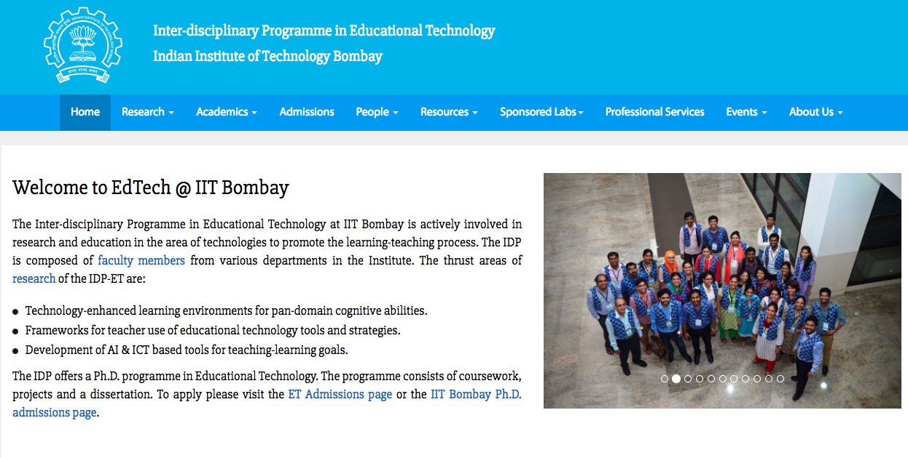

Slide 3
Educational Technology, IIT Bombay
Inter-Disciplinary Program, started 2010
Core faculty, and from departments of CS, engg., science, design, H&SS
25 PhD research Scholars
R&D Focus:
TELoTS: Technology enhanced learning of pan-domain thinking skills
TUET: Teacher use of educational technologies
Outreach, training, CEP
f2f, Large-scale (5000+) Blended programs, MOOCs

Slide 4
What is Educational Technology?
Technology for Education
Creation and use of technologies for various aspects of teaching-learning process
Use of MOODLE as LMS
Creating a Learning Dashboard
Focus is on “Technology”
Technology of Education
Creation and use of Teaching-Learning strategies for student learning and engagement
Use of Peer Discussion
Focus is on “What to do” with/without technology

Slide 5
What is Educational Technology?
Technology for Education
Creation and use of technologies for various aspects of teaching-learning process
Use of MOODLE as LMS
Creating a Learning Dashboard
Focus is on “Technology”
Technology of Education
Creation and use of Teaching-Learning strategies for student learning and engagement
Use of Peer Discussion
Focus is on “What to do” with/without technology

Slide 6
Reflection Spot: Think and Write
Think of one activity that you excel at doing. [~ 1 min]
(Note: Activity could be academics or your hobby)

Slide 7
Reflection Spot: Think and Write
Think of one activity that you excel at doing. [~ 1 min]
(Note: Activity could be academics or your hobby)
Think about why you are so good at this activity [~2 min]
Write down top 3 reasons for your mastery in this activity

Slide 8
Discussion - Excellence
Think of one activity that you feel you excel at doing.
Think about why you are so good at this activity – top 3 reasons
Let me guess - One of your top 3 reasons is likely to be:
Practice or Experience

Slide 9
Discussion - Excellence
Again, think of the activity that you feel you excel at doing.
Do you feel that you could have gained such mastery by listening to lectures on the topic?
Point to keep in mind:
As learners, we develop mastery through practice (doing activities, rather than simply listening to lectures, or watching demos).
So,
As teachers, we must ensure that we provide our students with practice – sufficient and timely opportunities.

Slide 10
Activity: Think-Pair-Share
Scenario 1: An engineering college classroom in 20th Century
Scenario 2: An engineering college classroom in 21st Century

Slide 11
Activity: Think-Pair-Share
Scenario 1: An engineering college classroom in 20th Century
Scenario 2: An engineering college classroom in 21st Century
Think [Time: ~ 1 min]
Write one key difference between two scenarios

Slide 12
Activity: Think-Pair-Share
Scenario 1: An engineering college classroom in 20th Century
Scenario 2: An engineering college classroom in 21st Century
Think [Time: ~ 1 min]
Write one key difference between two scenarios
Pair [Time: ~2 min]
Discuss with your neighbour and together come up with
One difference w.r.t “access to information” that students have
One difference w.r.t “role of teachers”

Slide 13
Activity: Think-Pair-Share
Scenario 1: An engineering college classroom in 20th Century
Scenario 2: An engineering college classroom in 21st Century
SHARE
Student Access of Information
- Participant Response
Role of teachers
- Participant Response

Slide 14
20th Century vs 21st Century Classrooms
In 20th Century
Information was at a premium – No Internet, expensive books, limited access to libraries.
So, students were mostly listeners and note-takers, absorbing information during the lecture, and doing their practice later.
Value for the people who had information, i.e. Teachers

Slide 15
20th Century vs 21st Century Classrooms
In 20th Century
Information was at a premium – No Internet, expensive books, limited access to libraries.
Value for the people who could transmit information, i.e. Teachers
So, students were mostly listeners and note-takers, absorbing information during the lecture, and doing their practice later.
In 21st Century
Information is no longer at premium with internet – lot of accessible materials, devices etc.
Hence, it is not enough for teacher to only transmit information
It is necessary for a teacher to ensure that students are able to assimilate the information, through appropriate practice, during the class itself.

Slide 16
20th Century vs 21st Century Classrooms
In 20th Century
Information was at a premium – No Internet, expensive books, limited access to libraries.
Value for the people who could transmit information, i.e. Teachers
So, students were mostly listeners and note-takers, absorbing information during the lecture, and doing their practice later.
In 21st Century
Information is no longer at premium with internet – lot of accessible materials, devices etc.
Hence, it is not enough for teacher to only transmit information
It is necessary for a teacher to ensure that students are able to assimilate the information, through appropriate practice, during the class itself.
TEACHER-CENTRIC
STUDENT-CENTRIC

Slide 17
How to do learner-centric pedagogy
One way – Active learning techniques.
Students go beyond listening, writing notes, executing prescribed procedures.
Students asked to ‘figure things out’ during class.
Needs attitude shift of teacher:
from content-oriented to learning-oriented.
from “How well am I lecturing?” to “How well are they learning?”

Slide 18
My lectures are plenty interactive!
I often pause to ask students if they understood the material.
I allow students to interrupt whenever they have doubts.
I never hesitate to answer their questions.
I show them demos and videos.
….
VOTE – Are students doing active learning if teacher does above?
Yes
No

Slide 19
Why interactive lectures may not be enough
Students don’t pay utmost attention throughout the lecture.
Students think that they understand because they can follow the lecture.
- They are not confronted with their misconceptions immediately.
Difficult to ensure that all students in the class participate actively.
Students with high motivation / achievement levels drive the pace.
Students with low achievement levels get left behind.
Students may have a barrier to responding directly to the instructor.
Shy students don’t ask questions, or give answer, even if they have one.
Forcing all students to respond tends to be counter-productive.

Slide 20
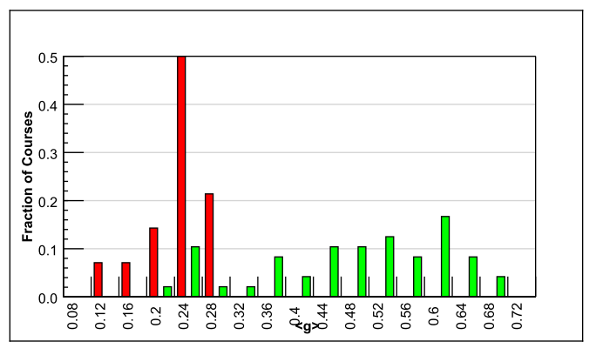
Evidence for active learning – 1
Comparative study of 62 Physics courses (1998)
6542 students
Variety of institutions: high school, college, university
Test of conceptual reasoning – Force Concept Inventory
Pre-post, semester long
Trad lecture (14)
Active learning strategies (48)
Normalized gain
<g> = ^{post-pre} ^{100-pre}
IMPLICATION
Desirable to explicitly incorporate active learning strategies in our teaching-learning.
RESULTS:
Maximum gain from lecture courses was 0.28
- Many instructors had high scores on teaching evaluations
Gain from active-learning courses had a wide range: 0.23-0.7
- AL courses had gains 2-3 times greater than lectures
R. Hake, “Interactive-engagement versus traditional methods: A six-thousand student survey of mechanics test data for introductory physics courses” Am. J. Phys., 66 (1998)

Slide 21
Evidence for active learning – 2
Proc. Natl. Acad. Sc, 111(23), 2014
Meta-analysis of 225 studies (2014)
Exam performance: higher by 0.47 standard deviations in active learning courses– ~ 1/2 letter grade average increase.
Failure rates : 33.8% in traditional classes vs 21.8% in active learning courses
Results hold across STEM disciplines, majors and non-majors, lower- and upper-division courses.
Effect sizes greater for concept inventories than for instructor-written exams.

Slide 22
So, what are active learning strategies?
Requirements:
Students go beyond listening, copying of notes, execution of prescribed procedures.
Instructor designs activities that require students to talk, write, reflect and express their thinking.
Explicitly based on theories of learning.
Evaluated repeatedly through empirical research.
Let us see an example
D. E. Meltzer and R. K. Thornton. "Resource letter ALIP–1: active-learning instruction in physics." Am. J. Phys, 80.6 (2012): 478-496

Slide 23
Vote individually
A large piece of ice is floating in water in a bucket. When it melts what will happen to the water level in the bucket?
It will rise.
It will fall.
It will stay the same

Slide 24
Discuss with your neighbour and converge
A large piece of ice is floating in water in a bucket. When it melts what will happen to the water level in the bucket?
It will rise.
It will fall.
It will stay the same

Slide 25
Have you converged? Then revote.
A large piece of ice is floating in water in a bucket. When it melts what will happen to the water level in the bucket?
It will rise.
It will fall.
It will stay the same

Slide 26
Peer Instruction (PI) technique
Download the PI-activity-constructor resource sheet from:
Download from www.et.iitb.ac.in/TeachingResources.html
Ask Question
(May vote individually)
…Lecture…
Debrief /
Class Discussion
Peer Discussion
Vote
Figure attributed to: Stephanie Chasteen and the Science Education Initiative at the University of Colorado

Slide 27
Balloon Video

Slide 28
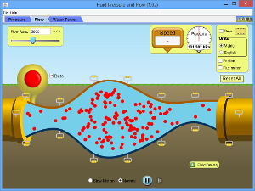
Using visualizations in class
Visualizations such as animations and simulations have been shown to provide many learning benefits, especially in STEM disciplines.
Many teachers report using such visualizations in their class. Most play or demonstrate the animation in class, along with narrative explanation.

Slide 29
Results from research on use of visualizations
Showing demo alone is not effective esp for student learning (Hansen et al 2000)
Potential benefits of visualization is lost if students merely watch (Lindgren & Schwartz)
The way the instructor teaches with the visualization has a profound effect on learning effectiveness (Bratina et.al, 2002)
Active-learning instructional strategy with visualization led to improved outcomes than mere viewing (Laasko et al 2009; Windschitl & Andre 1998, Banerjee, Murthy & Iyer 2015)
How to incorporate structured active learning strategies?

Slide 30
Example of Visualization – Predict technique
Observe Phase
Predict Phase
Check Phase
TEACHER:
Play viz upto the point the stimulus is shown.
PAUSE before result. Don’t show rest of viz yet.
STUDENTS:
Observe first part of viz
TEACHER:
Ask students to make prediction: “What will happen if …”
STUDENTS:
Make prediction – write, vote, discuss w each other
TEACHER:
Shows rest of viz, which has result
STUDENTS:
Check their prediction by watching the result in viz
Will the balloon move?
Yes, to the left
Yes, to the right
No
Show rest of movie
Link to video: http://paer.rutgers.edu/pt3/experiment.php?topicid=13&exptid=121

Slide 31
Features of active learning strategies
Students engage in problem-solving activities during lecture.
Students work collaboratively.
Students are asked to “ﬁgure things out for themselves.”
Students are asked to express their reasoning explicitly.
Qualitative reasoning, conceptual thinking are emphasized.
Speciﬁc student ideas are elicited and addressed.
Students receive rapid feedback on their work.
Ensure (most) students participate
Target misconceptions
from ‘… think they understand’
to ‘… know whether or not understand’

Slide 32
How can an instructor do active learning?
Some strategies:
Peer-Instruction (Eric Mazur, Harvard University, early 1990s)
Think-Pair-Share (Frank Lyman, University of Maryland, early 1980s)
Many others:
(lecture) Team-Pair-Solo, Problem-based learning, Just-in-Time-Teaching, Role-play, Jigsaw, Case-based learning, Peer-review, Productive failure …
(lab) Pair programming
(tutorial) TPS, TPS, PBL, Data-based problem solving

Slide 33
Self-check: Moving from teacher-centric to learner centric strategies
If your strategy begins with:
“I will do …”
“I will show …”
“I will tell…”
Then it is still teacher-centric.
To be learner-centric, the strategy should begin with: “I will make students do …”
Or better still “ Students will do …”

Slide 34
Takeaway
Make students grapple with content during class.
Don’t only clarify doubts:
Provide frequent opportunities for learners to work with the content – Active learning.
Ensure immediate and appropriate feedback to learners – Peer discussion.
Active learning techniques:
Peer Instruction: Don’t keep MCQs for the exam, make students do them during class.
Think-Pair-Share: Don’t just lecture, make students do first.
Visualizations: Don’t just show visualizations, make students predict the outcome.

Slide 35
Thank You
www.et.iitb.ac.in

