Slide 1
Are teachers redundant in this age of MOOCs?
A teacher’s view
Sridhar Iyer
IIT Bombay
Joint work with
Sahana Murthy, Jayakrishnan M, Sameer Sahasrabudhe
This presentation is released under Creative Commons-Attribution 4.0 License. You are free to use, distribute and modify it , including for commercial purposes, provided you acknowledge the source.

Slide 2
What is your MOOC experience?
I have:
Not heard about MOOCs.
Heard of MOOCs, but I don’t believe in them.
Sampled a MOOC.
Been a learner in a MOOC.
Earned a certificate as a learner in a MOOC.
Been a facilitator for my students learning from a MOOC.
Used portions a MOOC in my course.
Created a MOOC.
...

Slide 3
What is a MOOC?
Massive Open Online Courses
Provide access to information anytime, anywhere.
Technology platforms to support scale.
Instructor provides content in the form of videos, slides.
Learners access content and do assessments.
Existing platforms - NPTEL, IITBombayX, edX, Coursera, Futurelearn.

Slide 5
Why should you care?
There is probably a MOOC on the course that you are teaching.
Example: See variety of courses on edX.

Slide 6
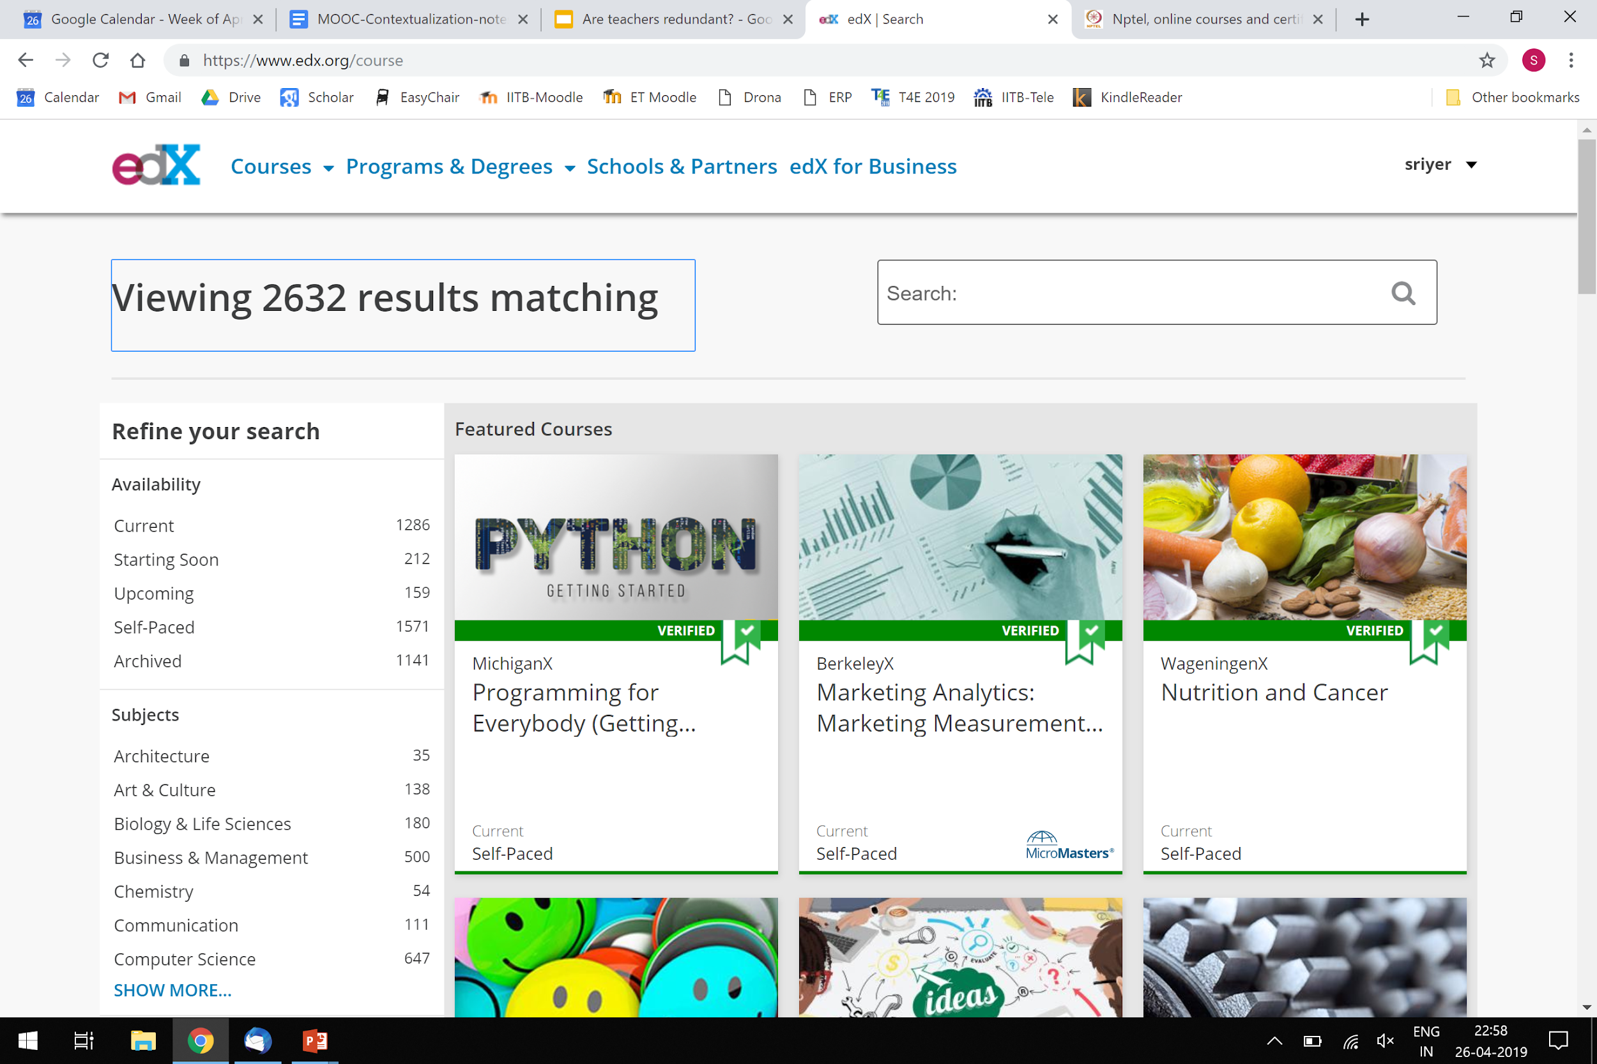

Slide 7
One future possibility
Conventional jobs are reducing.
New (and old) jobs have different demands.
Reskilling/new knowledge needed.
Many universities are introducing Modular courses.
edX MicroMasters
NPTEL Domain Certification

Slide 8
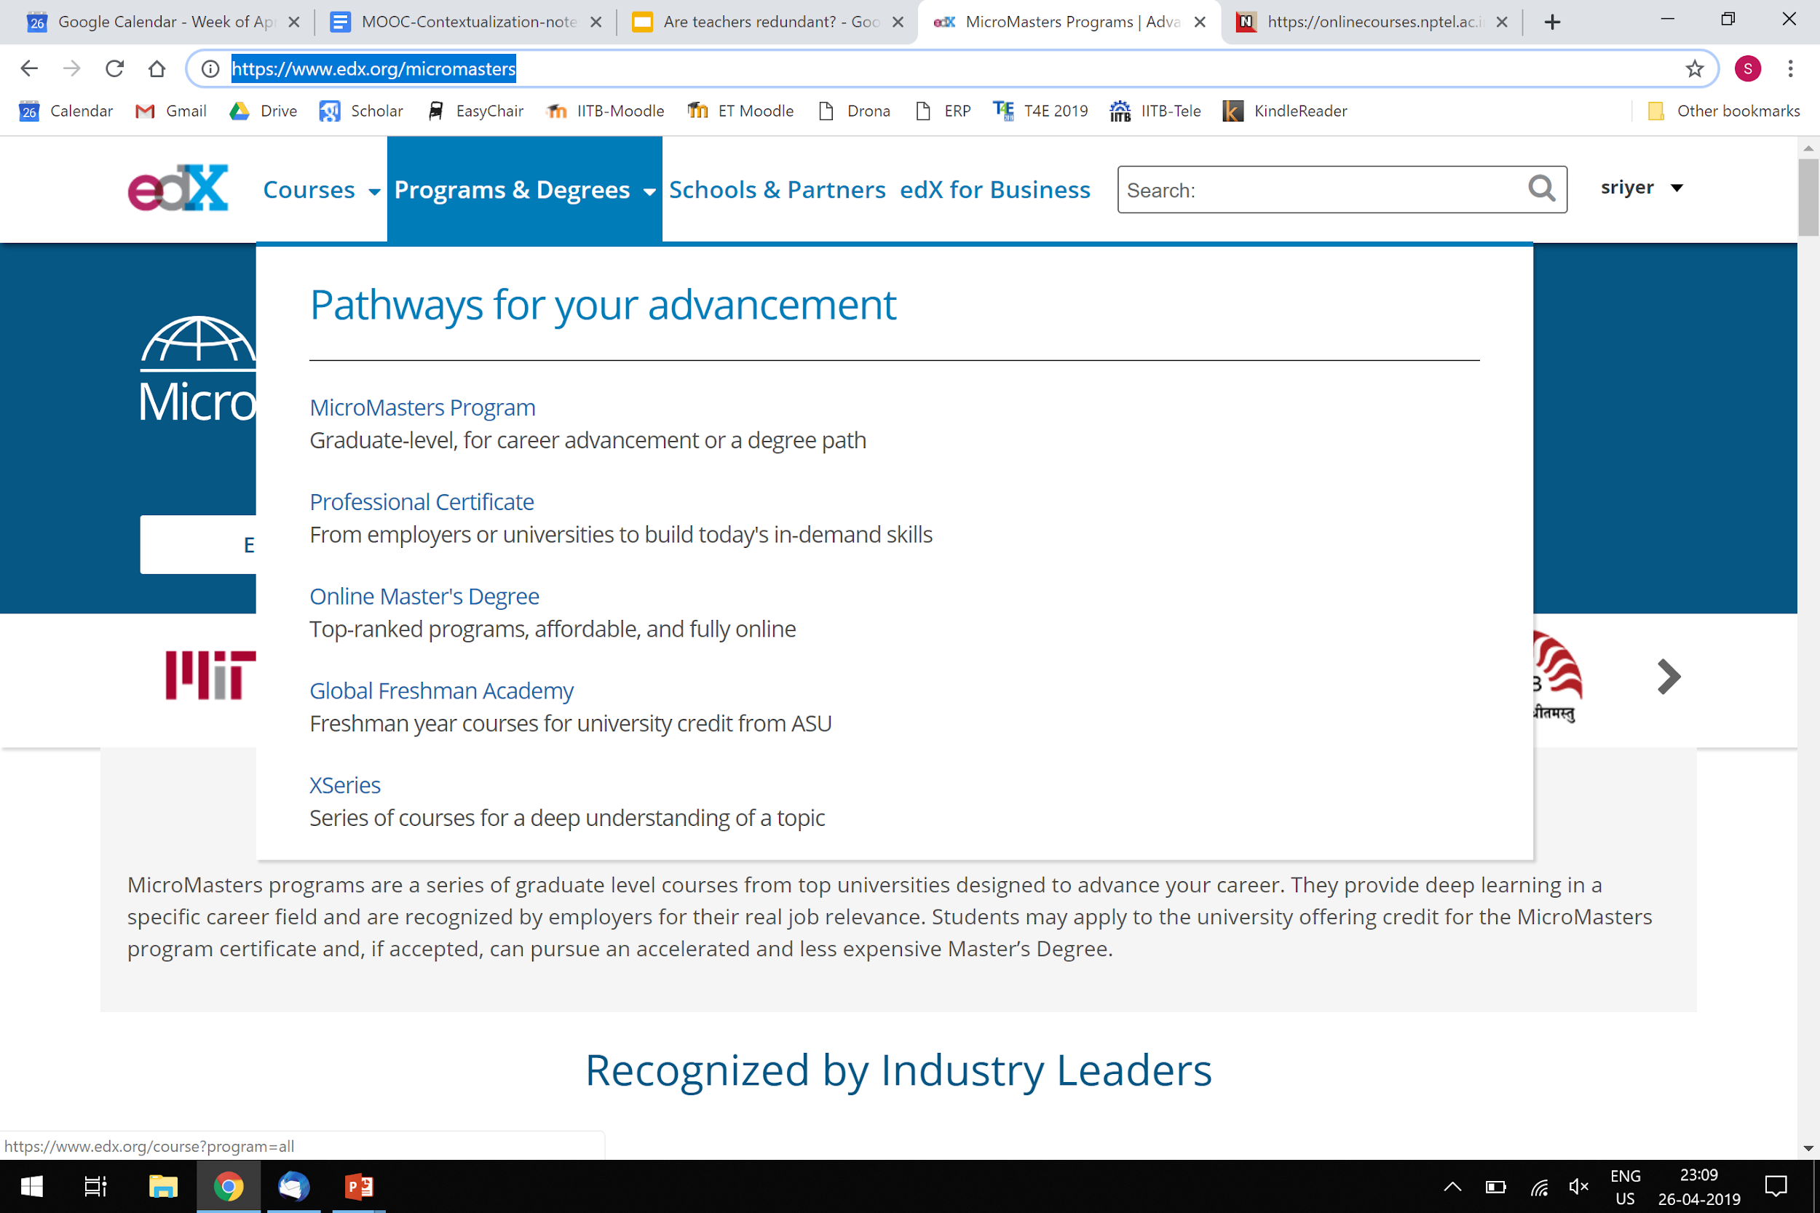

Slide 9
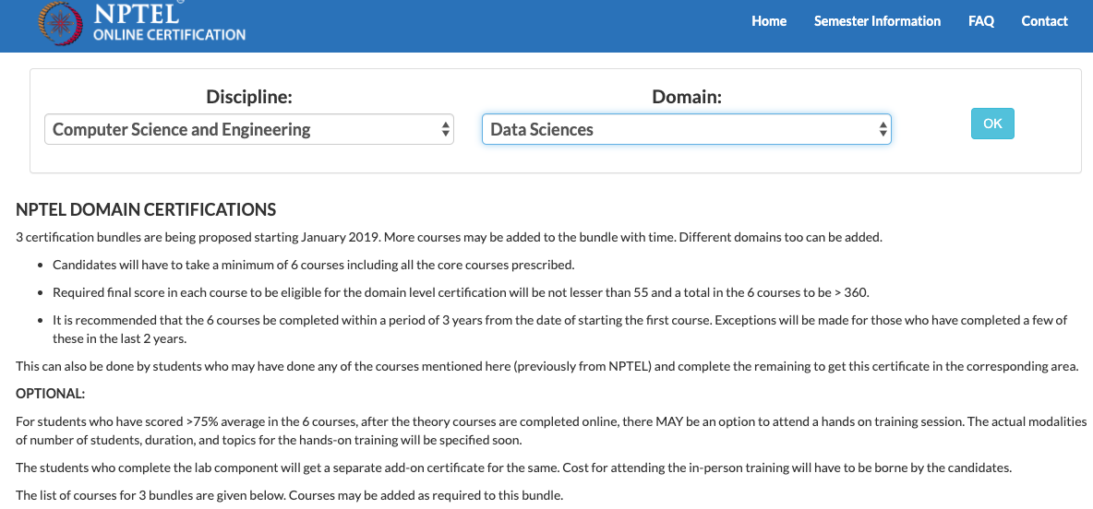
NPTEL Domain Certification in Computer Science

Slide 10
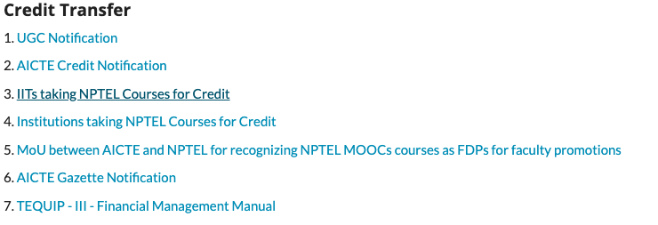
If you think - This happens elsewhere, not in my country
See NPTEL data.
See universities offering credit transfer.

Slide 11
NPTEL Impact
1500+ courses
40K+ hours of video; 330M+ youtube views
Online certification (since 2014)
4.2M+ enrollments; 300K+ exam registration
80% pass percentage; Credit transfer
Overall Statistics available here

Slide 12
If you think - This happens elsewhere, not in my college
See UGC/AICTE notifications.
SWAYAM 2.0 may also have virtual labs, augmented reality, integrated with MOOCs.

Slide 14
Take-away 1
MOOCs are a part of our reality now.
If you are still in options:
Not heard about MOOCs.
Heard of MOOCs, but don’t believe in it.
You are in danger of becoming redundant.
We need to learn to adopt and adapt MOOCs.

Slide 15
What is your teaching style?
I prefer:
Lecturing based on a textbook.
Lecturing with examples.
Lecturing with showing demos and videos.
Asking questions to students, adapting your instruction.
Facilitating active learning.
...

Slide 16
Take-away 2
Don’t stay in 20th century teaching practices.
If you are still in options:
Lecturing based on a textbook.
Lecturing with examples.
Lecturing with showing demos / videos.
You are in danger of becoming redundant.
We need to become 21st century teachers.
How - See my previous talks!

Slide 17
Activity So, how do we stay relevant?
Suppose there is already a MOOC for your course:
Think: What can you do to stay relevant?
Write down 1-2 points.

Slide 18
Activity So, how do we stay relevant?
Suppose there is already a MOOC for your course:
Think: What can you do to stay relevant? Write down 1-2 points.
Pair: Exchange your ideas with your neighbor. Together come up with a plan of how you will implement your ideas while incorporating the MOOC in your course.

Slide 19
Activity So, how do we stay relevant?
Suppose there is already a MOOC for your course:
Think: What can you do to stay relevant? Write down 1-2 points.
Pair: Exchange your ideas with your neighbor. Together come up with a plan of how you will implement your ideas while incorporating the MOOC in your course.
Share: Share answers with entire audience.

Slide 20
Audience responses
Note audience responses here.

Slide 21
Levels of MOOC instructors
Level of usage of MOOC resources | Description | Role of Teacher
Adopt | Show MOOC videos, Repeat MOOC assignment problems, Ask students to post question in discussion forum | Monitoring
Adapt | Help students interpret / assimilate the MOOC, create scaffolding activities, post questions in forums (Contextual support), provide steps to understand assignment solutions. | Bridging
Contextualize | Help students assimilate the MOOC at a deeper level, such as using flipped classroom activities, by creating examples and problems from local syllabus / context. | Mentoring
Complement | Use MOOC resources along with innovative strategies [Pause Video for TPS, Supplementary Project A], contribute to OER. | Innovating
Create | Use MOOC platform to: Create courses, create communities of practice within and outside institution, Community Relevant projects, | Creating

Slide 22
Take-away 3
To stay relevant, be a 21st century teacher.
Teacher is not the deliverer of knowledge, but facilitator of learning.
Learner centricity is the key theme.
Learning happens when students do micro-practice, apply their learning, reflect, collaborate, and so on.
We need to contextualize the learning for our students, in various ways.

Slide 23
Examples
Notes:
Keep all examples here in the master. First give examples from our own work. Then give examples from FDP participants.
Choose examples - types and numbers - as per the context of each talk. Hide the rest.
SI: Examples need not be only in the MOOC context. I have given 3 examples of how I have contextualized learning, from non-MOOC context.
Later: Include examples of MOOC context from my NPTEL course on networks. How did I weave someone else’s video into my course?

Slide 24
My own experiences
I have been a learner in edX courses for many years, while being a teacher in IITBombayX courses.
I have been a learner in an NPTEL course, while being a teacher in another NPTEL course.
I keep learning from my students.
How are new technologies being incorporated?
What are goals and preferences of next generation?

Slide 25
Example - Application first, theory later
Consider the topic of Queues (data structures):
The typical textbook way is to talk about the operations, the code, and then its applications.
Instead, we could pose a problem from local context which requires the student to ‘invent’ the concepts of a Queue data structure, get them to work with their ideas, and then talk about the textbook theory.

Slide 26
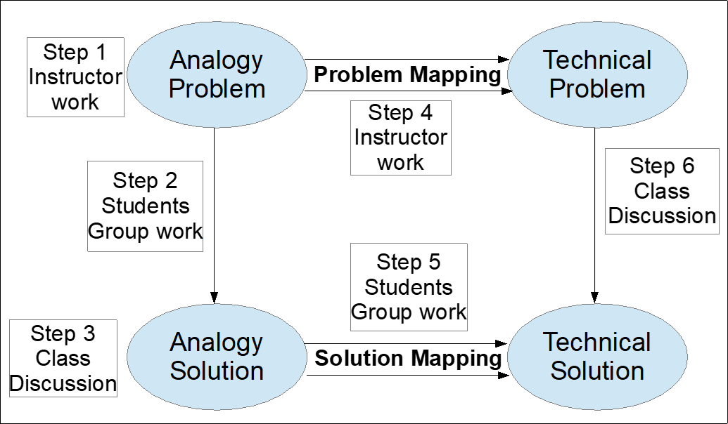
Example - Connect to prior knowledge Analogical problem-solving

Slide 27
Example - Local relevant field problems
Consider Timbaktu-Wireless problem
Rural NGO having one BSNL telephone line
Poles get stolen periodically; No further landlines possible; No cellular coverage due to hills around; No towers permitted on hills due to being reserved forest
Problem: Setup WiFi telephone exchange
Each time there is an incoming phone call, somebody has to run to call the person to the phone; Setup local wifi network and interface it to the BSNL line.
Play 1 minute of the video - 3:45 to 4:45.

Slide 28
Take-away 4
To stay relevant as a teacher:
Upgrade your knowledge continuously
by being a learner in advanced MOOCs, or MOOCs on related topics.
Get to know what students have access to
Utilize their preferences to facilitate their learning.
Contextualize the topic for your students
We need to have the pulse of the next generation and adapt our teaching accordingly.

Slide 29
More Examples

Slide 30
Examples of contextualized use
Prof. Atul Kulkarni - BATU, Lonere (PolyTechnic Students)
Teacher is using existing MOOC material
Creating explicit activity of making student watch videos and post questions

Slide 31
1
Discussions created on the video before the class
Instruction given by the teacher:
Use this forum only to give comment on the video on 8051 microcontroller basic, you can ask question/query related to concept explained in video here,

Slide 32
1
Discussions created on the video before the class
Instruction given by the teacher:
Use this forum only to give comment on the video on 8051 microcontroller basic, you can ask question/query related to concept explained in video here,
2.a

Slide 33
1
Discussions created on the video before the class
Instruction given by the teacher:
Use this forum only to give comment on the video on 8051 microcontroller basic, you can ask question/query related to concept explained in video here,
2.a
2.b

Slide 34
1
Discussions created on the video before the class
Instruction given by the teacher:
Use this forum only to give comment on the video on 8051 microcontroller basic, you can ask question/query related to concept explained in video here,
2.a
3
Clarify doubts and questions raised through in-class discussions
2.b

Slide 35
Examples of innovative use - 1
Prof. Atul Kulkarni - BATU, Lonere (PolyTechnic Students)
Teacher is taking student feedback (survey) on activities
Teacher is providing formative activities to clarify concepts

Slide 36
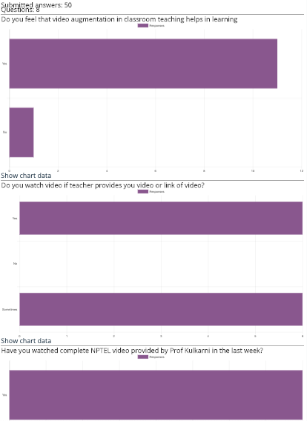
Take feedback on the video and in-class activities
(Formative feedback for the teacher)

Slide 37
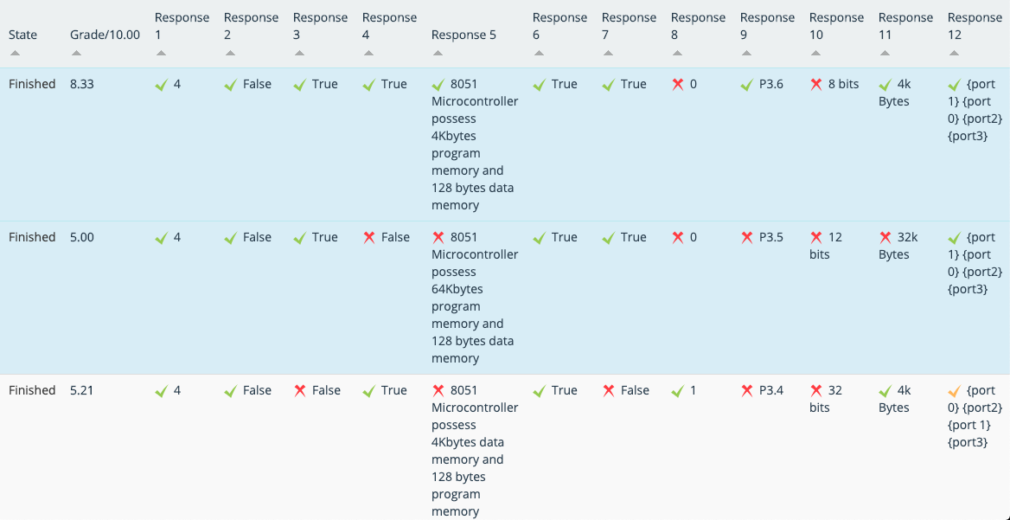
Creating own assignment questions to check knowledge levels of students (formative)

Slide 38
Example of innovative use - 2
Prof. Vijaya Nandhini - GITAM, Hyderabad (1st year UG Engineering students)
Complementary use of the MOOC resources (videos) along with discussions outside classroom
Followed by in-class Peer Instructional strategies to check conceptual understanding and clarifying misconceptions

Slide 39
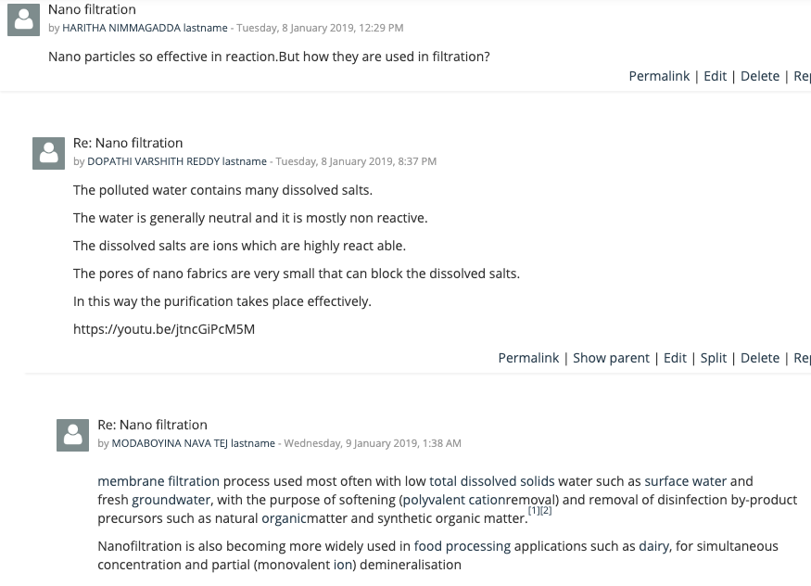
Leverage Peer Learning
Making students ask question and answer peer’s question

Slide 40
Example of Empowered Use
An attendee of FDP series in IITBombayX
MOODLE was a topic in the FDP
Now building a community of practice around MOODLE use with support of colleagues and other FDP attendees

Slide 41
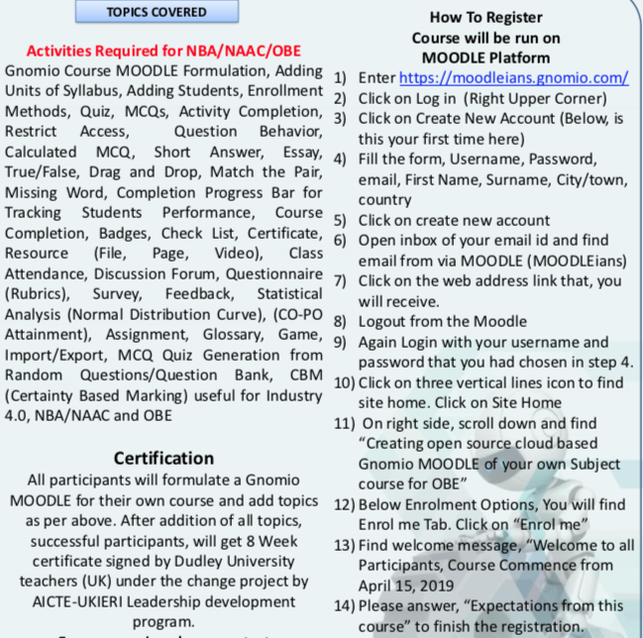
Example of Empowered Use
“Total 545 participants from all over India (Punjab to Tamil Nadu) and (Gujrat to Assam) from various backgrounds …… in capacity of Principals, HODs, Dean's have joined this course”

Slide 42
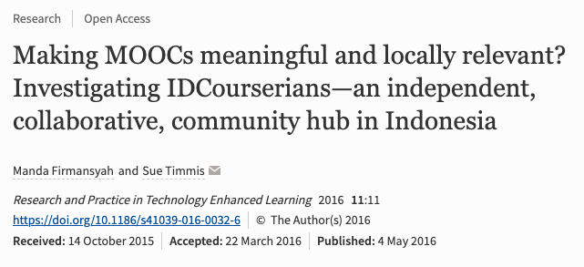
Example of Empowered Use -
Creating study groups and connecting communities - P2PU, Indonesian example

Slide 43
Possibilities for NPTEL Local Chapters
Create Student-Local Chapters and encourage students to use MOOCs at various levels like teachers
Teaching CS to students in schools nearby
NPTEL Alumni speak : Job relevance, How NOC helped

Slide 44
Example of Localization
A faculty from STLIET, Rajkot completed the 3D animation course on IITBombayX
The college announced it as a MOOC (when available on IITBombayX platform). Students get 10 marks for completing a MOOC
The faculty conducts lab sessions using the course material. Translates course content to Gujarati, in real time
Creates simpler activities (as scaffold) for the students so that they are able to solve complex activities prescribed in the course.

Slide 45
Example of contextualization
A faculty from Finolex Academy of Management and Technology, Ratnagiri completed the 3D animation course on IITBombayX.
The college has adapted the online course as the curricular course titled 3D graphics lab.
Lectures/hands on lab sessions are planned using the course content, interspersed with additional activities

Slide 46
Summarizing take-aways
We need to learn to adopt/adapt MOOCs.
We need to become facilitators of learning.
We need to contextualize the learning for our students, in various ways.

Slide 47
Future work - together
Your institute creates a portal for teachers to upload the innovative ways in which they use MOOCs for their students.
IITB will help to share these innovations with others, in various ways - research papers, experience reports, OER repository, so on.

Slide 48
Conclusion -
Teachers are not redundant
In education, the scaling problem is not solved by taking a generalized solution to all, but by:
(i) innovating a large number of varied local solutions and making them available to all, and
(ii) empowering local adaptation and contextualization of these solutions, through technological facilitation and pedagogical training.

Slide 49
Thank you

