Slide 1
Computer Science teaching-learning in schools
Sridhar Iyer
Dept of Computer Science and Engg &
Interdisciplinary Program on Educational Technology
IIT Bombay
NextEducation Workshops
2017
This presentation is released under Creative Commons-Attribution 4.0 License.
You are free to use, distribute and modify it , including for commercial purposes, provided you acknowledge the source.

Slide 2
What do we want our students to learn in CS?
Note audience responses here
Categorize

Slide 3
Why?
Note audience responses here.

Slide 4
Some responses from previous audiences
What:
Computer operations
Use of software and apps
Creation of art and apps
Logical thinking
…
Why:
Computers are ubiquitous
Make students future ready
Useful for life skills
Entrepreuneurship
…

Slide 5
How do we want our students to learn in CS?
Note audience responses here
Categorize

Slide 6
Why?
Note audience responses here

Slide 7
Some responses from previous audiences
How:
Learn by doing
Learn with fun
Learn systematically
…
Why:
Practical subject
Keep students engaged
Useful for life skills
…

Slide 8
Agenda
Part A – Teaching-Learning of Computer applications
Part B – Teaching-Learning of Programming
Part C – The Computer Masti story

Slide 9
Scenario - 1
For teaching the topic of making presentations:
Teacher A shows his students the various features of a presentation software, and then lets them practice it in the computer lab.
Teacher B first gets her students to plan the presentation contents, shows only some key features of the presentation software and lets her students explore the software on their own.

Slide 10
Reflection Spot: Think and decide
Which teacher’s students are likely to create effective presentations? A. Teacher A
B. Teacher B
Why?

Slide 11
Note – 1a
Simply being able to use the features of a presentation software does not lead to creating effective presentations.
Learners need to be able to communicate ideas effectively,
i.e., logically, coherently, precisely, and so on.

Slide 12
Computer fluency, not just computer literacy
Computer literacy: knowledge and ability to use computers and related technologies efficiently.
Computer fluency: robust understanding of what is needed to use computers and related technologies effectively for various purposes.

Slide 13
Why is computer fluency important?
Obvious reason: Software features may change. Learners should be able to adapt to changes in the digital world, and learn to use new technologies on their own.
More important reason: Computers and technology are tools. It is not sufficient to simply know how to ‘operate’ them. It is necessary to learn how to do the corresponding task effectively.
Analogy: Use of carpentry tools vs making of furniture.

Slide 14
Activity: Think – Pair – Share
Suppose you are teaching the topic of email to 5th grade:
Think: What will you teach, and how. [2 minutes]
Pair: Compare your answer with your neighbor, and merge your ideas into a combined answer. [3 minutes]
Share: Discuss answers with entire audience. [5 minutes]

Slide 15
Some responses from previous audiences
Features
Discuss operational aspect of specific email software – login, compose send, etc.
Concepts (How does email work)
Discuss analogy with postal system.
Ask questions to students rather than simply tell.
Concepts (How to communicate)
Discuss similarity and differences with writing letters to family, professional, etc.
Etiquette.

Slide 16
Note – 1b
Learners need to learn how to write letters and email etiquette, not just how to use the ‘compose’ feature of an email service.
Notes:
Optional: Give one example at a higher level of integration

Slide 17
How to teach computer usage skills?
Identify the tasks associated with the given software or tool.
Example: Essay writing is a task associated with a ‘word processor’ tool.
Give sufficient practice for planning and carrying out the tasks.
Example: Ensure that learners can apply the concepts involved in writing an essay, and organizing information, respectively.
Integrate carrying out of the tasks with the technology features.
Example: Get learners to work with the features of formatting and fonts, in the context of writing their essay.
Emphasize best-practices.
Example: How to maintain ‘balance’ between font usage and readability?
Notes:
Example 2: Information organization is associated with ‘creating folders’.

Slide 18
Take-away - 1
Develop computer fluency, not just computer literacy.
Emphasis should be on the concepts required to perform a given task, rather than on the use of specific tool features.

Slide 19
Scenario - 2
There is a debate in the staff room on the teaching of computers.
Some teachers argue that the syllabus should focus on computer operations, software usage and programming.
Other teachers feel that there is more to the subject beyond learning to use various application software and writing of programs.
They turn to you for your opinion.

Slide 20
Reflection Spot: Think and write
What are some broadly useful skills beyond programming that can be developed through the subject of computers?
Come up with one such skill and write it down.

Slide 21
Thinking skills, not just content
Thinking skills: basic methods and processes used for making sense of complex situations, solving problems, and communicating ideas.
Thinking skills that can be developed through the subject of computers: computational thinking, 21st century skills, problem-solving, divergent and convergent thinking, information gathering, analysis and synthesis, and so on.

Slide 22
Why are thinking skills important?
They go beyond content mastery in a specific subject.
Example: Algorithmic thinking is not only key to understanding computers but also can be applied to solving problems in other domains.
They are often transferable from one subject to another.
Example: Learning how to do divergent and convergent thinking through projects such as digital storytelling, is transferable to creating products.
They are part of life skills.
Example: 21st century skills of creativity, critical thinking, collaboration and communication, can be developed through computer-based projects.
Notes:
Discuss ‘why should I care’

Slide 23
Activity – Peer-Instruction
Given: Programming is a suitable topic for students to learn step-wise thinking.
Claim: Students who are good at programming will be able to apply step-wise thinking to real-life situations, such as planning a vacation.
Do you agree?
Yes
No
Pick your option, then discuss with your neighbor, and then re-vote.

Slide 24
Note - 2
Thinking skills need to be explicitly addressed in a curriculum.
Students don’t automatically acquire thinking skills while learning content (subject matter).

Slide 25
How to teach thinking skills?
Identify the thinking skills that are aligned with the given topic.
Example: Project planning, Information synthesis, and representations, are aligned with creating presentations.
Give explicit practice for the thinking skills in familiar scenarios.
Example: Ensure that learners can apply the above thinking skills for planning a vacation, writing a story, conducting a survey, and so on.
Integrate application of the thinking skills with the given topic.
Example: Get learners to apply the thinking skills explicitly, while learning to create presentations using the features of the chosen app.
Emphasize transferability of the thinking skills.
Example: Get learners to reflect on their applying these thinking skills across diverse scenarios.
Notes:
Example 2: Gathering information and synthesis are aligned with Internet Search.

Slide 26
Take-away - 2
Develop thinking process skills, not just content mastery.
Emphasis should be on the thinking skills required to perform a given task, rather than learning to use specific apps.

Slide 27
Scenario - 3
One colleague claims that topics in computers have no connection to topics in other subjects, so it is best to teach computers in isolation.
Another colleague claims that teaching-learning of computers can be integrated with learning other subjects as well as real-world activities. She draws an analogy with teaching-learning of maths.
They ask you for your opinion.

Slide 28
Reflection Spot: Think and write
How can teaching-learning of computers be integrated with topics in other subjects?
Come up with one example and write it down.

Slide 29
Thematic integration, not topics in isolation
Thematic integration: making connections between and among subject area concepts.
Thematic integration leads to increased learning by enabling learners to connect ideas that they encounter across topics. It bridges the gap between abstract knowledge and real-world informal knowledge.

Slide 30
How to do thematic integration?
Use computer activities to strengthen knowledge in other subjects.
Get students to do computer-based projects on topics being learned in other subjects, such as creating a presentation on a topic in Geography.
Integrate knowledge from other subjects with computer curriculum.
Reinforce what they already know in other subjects, such as playing a Maths game for developing computer usage skills.
Make connections to prior knowledge and real-world scenarios.
Introduce ideas conceptually using real-world contexts, and then revisit them more formally, such as step-wise thinking before programming.
Notes:
Discuss ‘why should I care’

Slide 31
How to integrate real-world contexts?
Use familiar real-world scenarios to motivate the need for learning computer skills.
Example: Use a scenario of inventory management in a shop to motivate the need for spreadsheets, and the learning of associated computer skills.
Use future career scenarios to encourage applying computer skills.
Example: Use a scenario of becoming a fashion designer to apply skills of using an image editing software.
Give projects that require students to use multiple skills.
Notes:
Discuss ‘why should I care’

Slide 32
Take-away - 3
Highlight the interconnectedness of knowledge,
not just address a topic in isolation.
Emphasis should be on making connections to prior knowledge in same/other subjects, and real-world contexts, rather than on simply learning computer usage skills.

Slide 33
Scenario - 4
Teacher A says that we should minimize teaching of computers in schools, since it can lead to problems such as repetitive strain injuries and Internet safety issues.
Teacher B says that not exposing students to computers and Internet puts them at a greater disadvantage. She believes that the right way to address the above problems is by inculcating good computer usage practices and following Internet safety guidelines.

Slide 34
Reflection Spot: Think and decide
Which teacher’s students are likely to have poor computer use habits?
Teacher A
Teacher B
Why?

Slide 35
Training in safety, not prohibition
Technology and gadgets are naturally attractive to students.
Prohibition is unlikely to work.
Instead, we should alert them to the pitfalls and inculcate:
Practices to avoid repetitive strain injuries.
Use of Internet safety guidelines.
Sensitivity to others’ rights, such as privacy and intellectual property.

Slide 36
How to do inculcate safe practices?
Ideas are similar to safe practices in other domains:
Increase awareness of the risks and consequences involved.
Example: Discuss ‘what if’ scenarios of computer and internet usage. Get students to articulate the potential pitfalls and safeguards in each scenario.
Create easy to remember guidelines and periodically reinforce them.
Example: SMART is a mnemonic for Internet Safety guidelines from the Computer Masti books.
Provide opportunities for practice in safe environments.
Notes:
Discuss ‘why should I care’

Slide 37
How to inculcate sensitivity?
Increase awareness of what is acceptable and what is not.
Example: While discussing intellectual property rights, get students to articulate the similarity between copying someone else’s answer with ‘copy-paste’ from a website.
Focus on the reasons behind the ‘rules’.
Example: Discuss ‘what if’ scenarios of insensitivity and get students to reflect on how they would feel if they were the target of such behavior.
Provide opportunities for practice in safe environments.
Example: Create a private site on which students can post before they go onto public sites.
Notes:
Discuss ‘why should I care’

Slide 38
Take-away - 4
Discuss risks associated with use of computers and Internet,
not simply ignore them.
Emphasis should be on the reasons behind the practices, rather than on just memorizing the guidelines.

Slide 39
Agenda
Part A – Teaching-Learning of Computer applications
Part B – Teaching-Learning of Programming
Part C – The Computer Masti story

Slide 40
Scenario - 5
You are choosing a textbook for teaching programming in your school.
Book A focuses on the features of the programming language, gives a lot of details to explain the syntax, and has many solved examples of programming exercises.
Book B does not focus so much on the syntax, nor does it have so many solved examples. Instead it focuses on the concepts involved in programming, and their applications through real-life examples.

Slide 41
Reflection Spot: Think and decide
Which book would you prefer for your class?
A. Book A
B. Book B
Why?

Slide 42
Note – 5a
Simply learning the syntax of programming language features does not lead to writing effective programs.
Learners need to be able to plan their program logically, independent of the chosen programming language.

Slide 43
Programming concepts, not just syntax
Syntax: set of rules that defines the combinations of symbols that are considered to be correctly structured. Syntax corresponds to the spelling and grammar of a given programming language.
Concepts: knowledge and ability to do programming for a given goal. Concepts correspond to writing meaningful sentences and paragraphs, to give instructions to accomplish the goal. Some basic concepts are common across most programming languages.

Slide 44
What are some basic programming concepts?
Variables | Memory location to store a value. Associated concepts – data types, data structures.
Assignment | Storing a value in a variable. Associated concepts – operators, expressions.
Sequence | Order in which instructions are executed. Associated concepts – block.
Branching | Choosing among alternative sequences of statements. Associated concepts – condition evaluation.
Iteration | Repeating a sequence of statements. Associated concepts – entry initialization, exit criteria.
Functions | Reusing a sequence of statements. Associated concepts – parameters, user-defined, libraries.
Data Structures | …

Slide 45
Why are concepts more important than syntax?
Obvious reason: Syntax changes from one programming language to another. Learners should be able to adapt to changes in the syntax, and learn to use new languages on their own.
More important reason: Programming concepts form the basis of giving instructions to computers. It is not sufficient to simply know the syntax of such instructions. It is necessary to learn how to use the concepts to plan the sequence instructions (program), independent of the syntax.

Slide 46
Activity: Think – Pair – Share
Suppose the Board asks you to choose the programming language that should be taught in schools.
Think: Which language will you pick, and why. [2 minutes]
Pair: Compare your answer and reasons with your neighbor, and come up with a single answer. [3 minutes]
Share: Discuss answers with entire audience. [5 minutes]

Slide 47
Note – 5b
Learners need to be able to plan their program logically, independent of the chosen programming language.
If the focus is on learning programming concepts before syntax, then the choice of the programming language is not crucial.

Slide 48
How to teach programming concepts?
Introduce concepts in a familiar, real-life scenario or problem.
Choose a problem scenario such that the need for a given programming concept arises naturally. For example, the problem of planning a vacation within a budget naturally involves branching and iteration.
Give sufficient practice for applying the concepts.
Ensure that learners can apply the concepts in various scenarios before going on to programming. For example, get them to create flow-charts for various activities.
Integrate applying the concepts with the language features.
Introduce the syntax of the chosen programming language.
Emphasize the relevant best-practices in programming.

Slide 49
Take-away - 5
Develop programming concepts, not just syntax.
Emphasis should be on the concepts required to perform a given task, rather than the use of specific language features.
This is one way of developing Computational Thinking.

Slide 50
Scenario - 6
For teaching programming, your colleague does the following:
Focuses on explaining concepts before syntax.
Shows the code and working of several example programs.
Gives home assignments to students, to write programs on paper.

Slide 51
Reflection Spot: Think and decide
Do you think her students will be able to write correct* programs?
A. Yes
B. No
*correct – Upon execution, the program produces the expected output for a given input.

Slide 52
Note - 6
Simply reading many programs or writing programs on paper, does not lead to learning to write correct programs.
Learners need to practice tracing programs, i.e., manually carry out the step-by-step execution of a program.

Slide 53
Program tracing, not just reading/writing
Tracing means to simulate the execution of a program, to step through the program line-by-line, showing how the variables change.
Reading means to comprehend the syntax of a program, to get an idea of its purpose (what does it do?) and its working (how does it do?).
Writing means to create a program for a given purpose.

Slide 54
Why is tracing important?
Tracing is a pre-requisite skill for reading complex programs, writing correct programs and debugging (locating and removing errors).
Tracing ensures that learners confront their misconceptions at an early stage of their learning, and also at a detail level.
Tracing can be easily combined with active learning techniques.
Recall: The benefits of active learning. (See my previous talks)

Slide 55
How to do active learning in programming?
Choose a programming concept and a corresponding program.
Example: Concept of iteration and a program to compute factorial N.
Make students solve the problem at a conceptual level.
Example: Make students write their own steps to compute factorial N.
Use an appropriate active learning technique such as Think-Pair-Share.
Do tracing activity, as shown on the next slide.

Slide 56
How to do active learning in programming?
Tracing activity:
Show a part of the program and pause its execution.
Make students predict the values of some variables at the next step.
Continue the program for students to verify their prediction.
Repeat steps 1-3 till the program execution is completed.
Note:
Use appropriate active learning techniques such as peer-instruction for step 2.
If your programming environment does not support pause, then use input statements to simulate a pause, and output statements to examine the values of variables.

Slide 57
How to do tracing: Example from CS 101
Question - Predict the output of the following program:
int a = 1, b = 2, c = 3;
int* p, int* q;
p = &a; q = &b;
c = *p; p = q;
*p = 13;
cout << a << b << c << endl;
cout << *p << *q << endl;
Don’t just ask “What values will be printed?”,
Instead, do an in-class activity, as shown on next few slides …

Slide 58
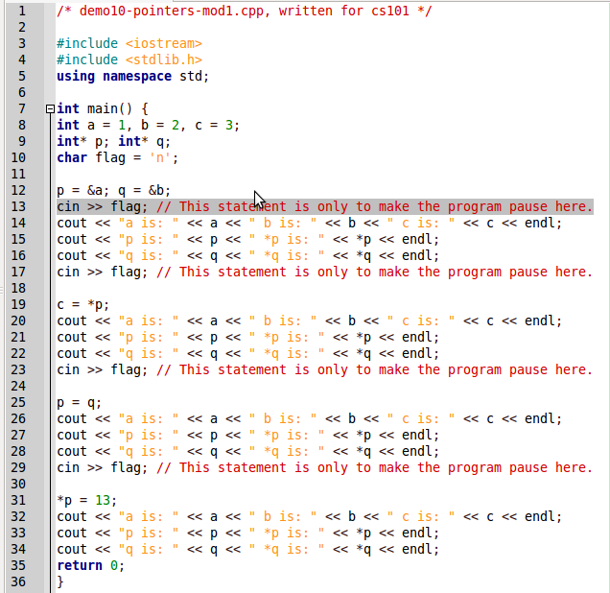
Ask students to predict output 1 (lines 14-16 below)

Slide 62
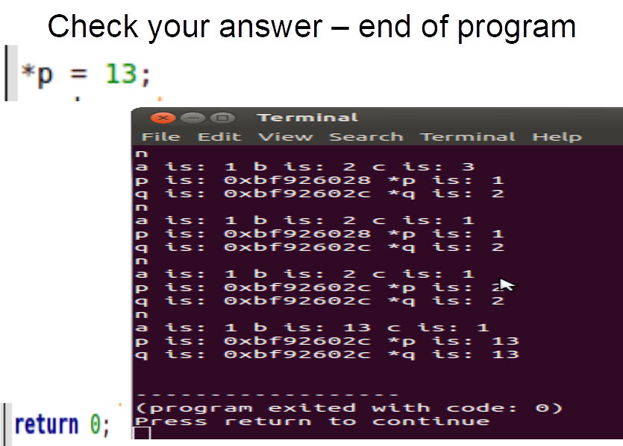

Slide 64
Take-away - 6
Do program tracing, not just program reading or writing.
Emphasis should be on making students predict variables, rather than simply showing the output of a program.

Slide 65
Scenario - 7
While doing hands-on programming using a computer,
Teacher A believes that students will learn better if they straight-away start writing code, and then testing and debugging it.
Teacher B believes that students will learn better if they first spend time in planning their program, and listing test inputs and outputs, before they start writing code.

Slide 66
Reflection Spot: Think and write
Which teacher’s beliefs do you agree with?
A. Teacher A
B. Teacher B
Why?

Slide 67
Note – 7a
Writing the program syntax directly, without prior planning, does not lead to learning to write correct programs.
Learners need to practice stating their program logic, in the form of a flow-chart or pseudo-code, before writing syntax.

Slide 68
Pedagogical strategy: Run-Modify-Write
Writing a new program directly may be daunting for learners.
Running an already discussed program for various inputs, lets them get familiar with the program logic and corresponding output.
Modifying the discussed program for a slightly different purpose, lets them get familiar with writing program logic, as well as the syntax.
Run-Modify-Write is a useful pedagogical strategy for programming.

Slide 69
Activity: Peer-Instruction
Your students are writing a program. The program compiles without syntax errors, and produces output for a given input. Hence they believe that they have completed the program.
Do you agree that your students have completed writing the program?
A. Yes
B. No
Discuss with your peer

Slide 70
Note – 7b
It is not sufficient for learners to get their programs to compile without syntax errors, and test it for a few inputs.
Learners need to practice choosing a range of test inputs, such that various branches in the program are tested.

Slide 71
Why is testing important?
Programming learners are prone to confirmation bias, i.e., a tendency to test for inputs that confirm the belief that their program is correct.
Learners need to test their programs for a variety of inputs, such as extreme values of input variables, and values that test the execution of the different branches in the program.
Hence, teachers should: (i) give a set of test inputs on which learners can test their programs, and (ii) train learners to come up with inputs that can test their programs exhaustively.

Slide 72
Take-away - 7
Make learners state their program logic before writing syntax.
Give run-modify-write programming exercises for learners to get familiar with program logic as well as syntax.
Give a set of test inputs for learners to use while programming.

Slide 73
Scenario - 8
Your colleagues are debating about assessment of programming knowledge of students.
Some say that students should be asked to write programs in an exam. Others say that the exam should be hands-on, in the lab.
Some say that students should be tested on their knowledge of syntax. Others say that programming concepts should be tested, not syntax.
They turn to you for your opinion.

Slide 74
Reflection Spot: Think and write
What is your opinion on how to assess programming knowledge?
Write your opinion and its justification.

Slide 75
Note – 8a
Assessment of programming can be done meaningfully in both exam and lab settings.
It is important to align the assessment with the setting.

Slide 76
Aligning assessment with setting
Both, concepts and syntax, are important.
However, assessing recall of syntax in an exam setting is not useful.
Syntax of a program gets checked in a lab setting during compiling.
So, programming concepts may be assessed in an exam setting.
Both, planning a program and writing a program, are important.
However, assessing writing a program in an exam setting is not ideal.
Writing a program gets checked in a lab setting during execution.
So, planning a program may be assessed in an exam setting.

Slide 77
What to assess in exam settings?
Some aspects of programming that can be meaningfully assessed in exam settings are:
Comprehension of programming concepts. For example, by asking learners to read or trace a given program and predict its output.
Application of programming concepts. For example, by asking learners to write pseudo-code, or draw a flow-chart.
Application of debugging concepts. For example, by asking learners to come up with test inputs, or modify a given program.

Slide 78
What to assess in lab settings?
Some aspects of programming that can be meaningfully assessed in lab settings are:
Application of programming syntax. For example, by asking learners to correct the syntax of a given program and compile it.
Application of programming concepts. For example, by asking learners to write a program for a given goal.
Application of debugging concepts. For example, by asking learners to devise test inputs for a given program, identify logical errors and modify it.

Slide 79
Reflection Spot: Think and decide
A teacher asks students to write a program in a lab setting. Which of the following objectives can be achieved: Student should be able to _________
Read programs.
Trace programs.
Debug programs.
How?

Slide 80
Note – 8b
Align the assessment questions with their settings,
as well as their corresponding learning objectives.

Slide 81
Take-away - 8
Learning objective
Systematic content design
Effective teaching
Instructional strategy
Assessment
Principle: Constructive alignment

Slide 82
Agenda
Part A – Teaching-Learning of Computer applications
Part B – Teaching-Learning of Programming
Part C – The Computer Masti story

Slide 83
21st Century Skills
Prescribed by UNESCO [See wikipedia]
4Cs - critical thinking skills, communication, collaboration and creativity
advocates integration of critical thinking, problem solving and communication into the teaching of core academic subjects
requires teachers to create meaningful and authentic activities and assessment that promote higher order thinking skills.

Slide 84
Computer Masti project (2006-2016):
Curriculum
2006-2013
Explicit focus on thinking process skills
Books
2007-2013
Books for grades 3-8 have chapters on thinking skills
Implementation
2008-2016
Teacher training
Transfer to industry
Scaling

Slide 85
Computer Masti - Beginning
2006-2007: Defining a CS curriculum appropriate from Indian schools.
Why was this required?
Lack of standardized CS curriculum for K-12 in India.
Lack of books that go beyond Computer usage skills.
Lack of innovation in teaching practices.
The third edition of this curriculum, called CMC, was released in 2013.
defines the What, Why and How of teaching CS in K-12 (grade-wise).
66 pages document - available from www.cse.iitb.ac.in/~sri/ssrvm/

Slide 86
CMC - Philosophy
Curriculum
Develop computer fluency, not just computer literacy.
Develop thinking process skills, not just content mastery.
Highlight the interconnectedness of knowledge, not just address a topic/subject in isolation.
Spiral curriculum.
Teaching-Learning
Inquiry-based learning.
Guided-discovery approach.
Learning via real-world context.
Playfulness.

Slide 87
CMC - Emphasis
Explicit emphasis on thinking process skills, and thematic integration.
Builds cognitive abilities for Computational Thinking and 21st century skills.
algorithmic thinking, reasoning, problem solving, information gathering, brainstorming and synthesizing, using multiple representations, and divergent thinking.
Enables students to plan and execute complex projects.
by breaking any given task into a sequence of steps, and then doing the detailed steps required to complete the task.
Builds on what students learn in other subjects.
Leverages computer-based projects to motivate deeper learning in the other subjects.

Slide 88
Key challenge for CMC
Defining a curriculum is not enough,
teachers need books to use in their classrooms/labs.
Solution:
2007-2013: Creation of Computer Masti textbooks for grades 1-8.
Released under Creative Commons.
Available for download from www.cse.iitb.ac.in/~sri/ssrvm/
Google Analytics Statistics [2009 to 2016]: Approx 77,000 page views, 25% returning visitors, from 140 countries.

Slide 89
Computer Masti Books – primary school

Slide 90
Computer Masti Books – secondary school

Slide 91
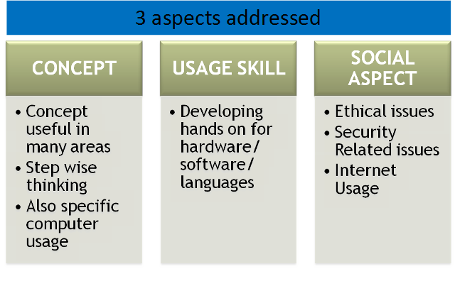
Computer Masti – Aspects

Slide 92
Example – Concept learning not merely skills

Slide 93
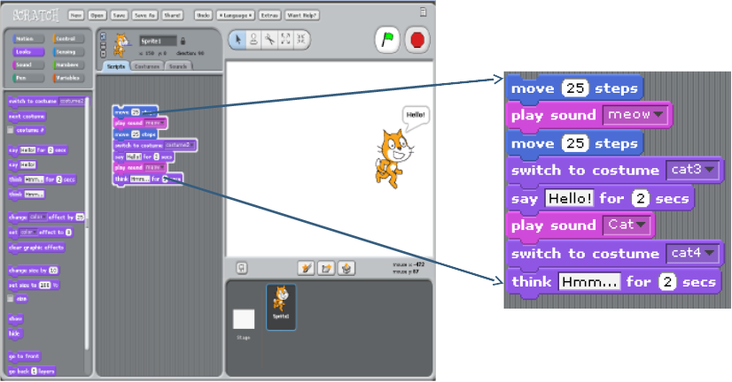
Example - Computational Thinking, Programming, Games

Slide 94
Computer Masti and 21st Century Skills
Critical thinking skills
Chapters explicitly on step-wise thinking, logical reasoning, gathering information, synthesizing information, making mind-maps, handling multiple representations.
Communication
Exercises on planning, creating newsletters, using Internet and Web.
Collaboration
Group activities and projects.
Creativity
Digital story-telling, projects that span multiple topics.

Slide 95
Key challenge for CM textbooks
Writing textbooks is not enough,
teachers need training to use them in their classrooms/labs.
Solution:
2008: Pilot teacher training program at IIT Bombay.
2009: Creation of a company, InOpen for CM implementation in schools.
2015: Reached 200+ schools, 200,000+ students.
2016: InOpen acquired by Next Education.
Scaling up by an order of magnitude.

Slide 96
Key challenge for Implementation
Providing training to use the textbooks is not enough,
policy-makers, teachers and parents need to have buy-in.
Issues:
Moving from separation of theory and lab to an integrated approach.
Moving from focus on content to focus on process.
Aligning assessment with curriculum goals.

Slide 97
Ongoing efforts
Updating content with current technologies.
Digital platforms – interactive eBook, and so on.
Awareness and training workshops.
MOOCs (Massive Open Online Courses) through IITBombayX.
ET 611 – effective use of ICT for school teachers
ET 612 – effective teaching-learning of CS in schools

Slide 98
Thank you
This presentation is released under Creative Commons-Attribution 4.0 License.
You are free to use, distribute and modify it , including for commercial purposes, provided you acknowledge the source.
To Download -
Google - Sridhar Iyer IIT Bombay
Get to my web page
Click on ‘Talks’

Slide 99
Acknowledgements
Creating a brighter tomorrow for today’s students

