Slide 1
Notes:
Goal of the talk: Give an overview of what-why-how of CT, its relevance to India at school and college level, how to inculcate CT in your topic, and resources.
Non-goals: Give a comprehensive view of all aspects and perspectives on CT. Get into details of different aspects.

Slide 2
Educational Technology, IIT Bombay
Inter-Disciplinary Program, started 2010
5 Core faculty
Associate faculty from other departments
2 Post-docs
25 PhD research Scholars; 12 PhDs graduated
Started an M.Tech program in 2019
Includes 2 months internship/field work

Slide 3
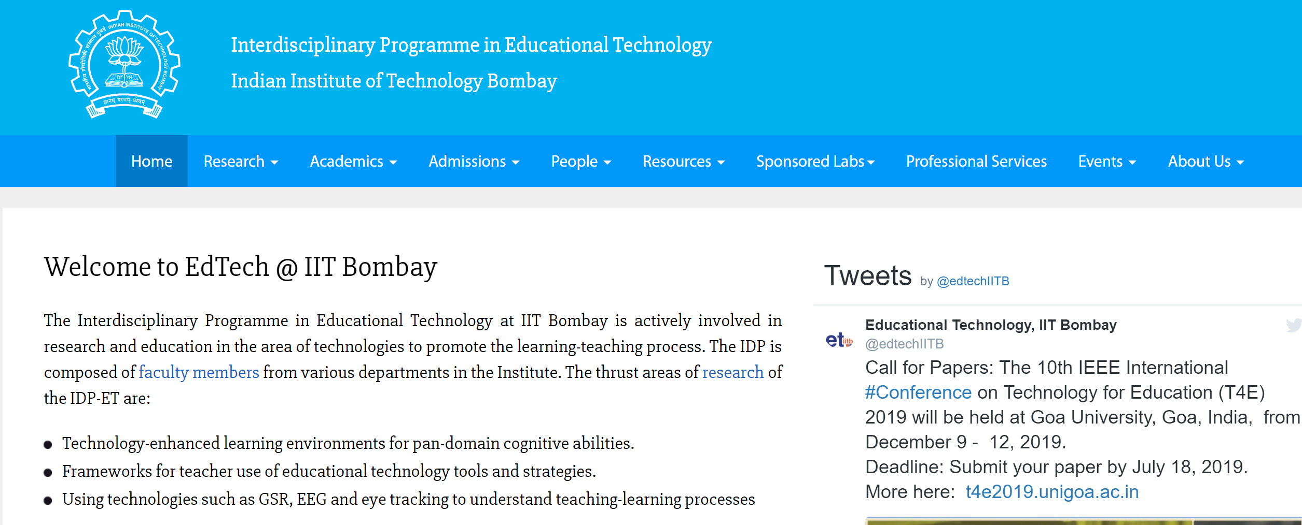
Google - Educational Technology, IIT Bombay

Slide 4
Activity 1 - Play a game
Game goal: Speak English sentences continuously without using the word ‘and’. If you use the word ‘and’, you are out.
Winner: Whoever speaks for the longest duration of time.
A few volunteers to demonstrate the game.

Slide 5
The power of Computational Thinking (CT)
Here is one solution for the game (play audio)
Is this a valid solution?
– We can debate that, BUT the point is:
We typically solve unfamiliar problems in an adhoc manner.
When we apply CT we can solve them systematically and perhaps more simply and efficiently.

Slide 6
What-Why-How of CT

Slide 7
What is CT?
There are many definitions which vary in scope as well as operationalization. The most often cited is:
CT refers to “the thought processes involved in formulating problems and their solutions so that the solutions are represented in a form that can be effectively carried out by an information-processing agent” (Cuny, Snyder, and Wing, 2010).

Slide 8
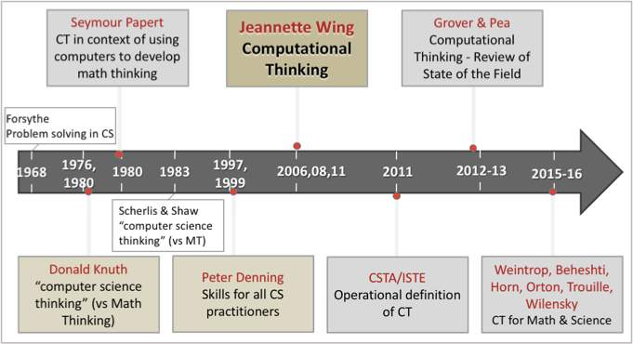
Historical view of CT
See Shuchi Grover’s CACM blog:
https://cacm.acm.org/blogs/blog-cacm/232488-a-tale-of-two-cts-and-a-revised-timeline-for-computational-thinking/fulltext

Slide 9
One reference
Iyer, S. (2019). Teaching-Learning of Computational Thinking in K-12 schools in India.
In S. C. Kong & H. Abelson (Eds.), Computational thinking education (pp. 119-141). Singapore: Springer.
https://link.springer.com/book/10.1007%2F978-981-13-6528-7

Slide 10
Definition of CT for this talk
ISTE and CSTA (2011). Operational Definition of Computational Thinking for K-12 Education. International Society for Technology in Education and Computer Science Teachers Association.
CT is a problem-solving process that includes:
Formulating problems in a way that enables us to use a computer to help solve them.
Automating solutions through algorithmic thinking (a series of ordered steps).
Generalizing and transferring this problem solving process to a wide variety of problems.
Notes:
This is the definition used in the book chapter. It also has:
Logically organizing and analyzing data
Representing data through abstractions such as models and simulations
Identifying, analyzing, and implementing possible solutions with the goal of achieving the most efficient and effective combination of steps and resources

Slide 11
Why bother about teaching-learning of CT?
We need to nurture the next generation to become creative problem-solvers.
CT helps learners to formulate and solve problems in the digital world.
There is a need for integration of CT in K-12 education. (Grover & Pea, 2013; Lye & Koh, 2014)
FOMO – Many countries have already started implementing CTE in a big way.

Slide 12
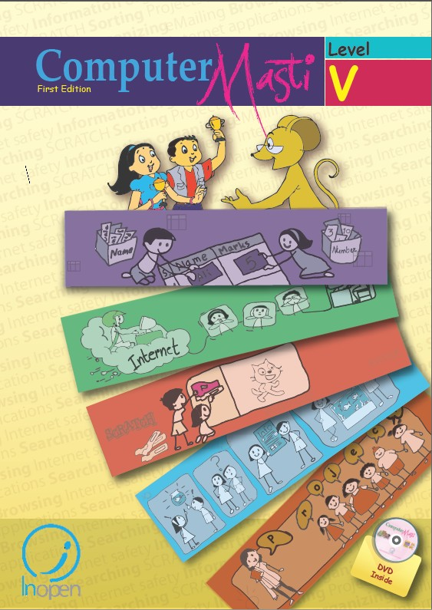
Examples of teaching-learning of CT
Iyer, S. et. al. Computer Masti - A series of computer textbooks for schools, IIT Bombay, 2009-2013.
Used in ~1000 schools in India.
Addresses CT aspects of:
Problem-solving: algorithmic thinking, logical reasoning and decision making.
Logical data handling: gathering, organizing, analyzing and synthesizing information.
Multiple representations of data: represent data, analyze data and convey results.

Slide 13
Example – Step-wise thinking in Grade 3
Notes:
<Main steps – Detailed steps> forms the basis of problem decomposition

Slide 14
Example – Algorithmic thinking, logical reasoning and decision making
Grade 3 | Grade 4 | Grade 5 | Grade 6 | Grade 7 | Grade 8
Break up a non computer-based activity into steps. Identify the main steps or sub-tasks in order to carry out an activity. Identify the sequence of detailed steps required to carry out each sub-task. | Identify goals and constraints of given problem. Apply algorithmic thinking to solve. Write steps to perform given task. | Identify known and unknown information to solve a given problem. Identify problem constraints. Identify solutions that meet the constraints. | Identify and choose between multiple solutions. Identify necessary and sufficient conditions that a solution should satisfy. Apply reasoning, decision making to make choices in performing real life tasks | Systematically divide tasks into sub tasks. Solve increasingly complex problems. Evaluate pros and cons of multiple solutions and decide among the various options State assumptions under which a solution works. | Apply all aspects of thinking skills from previous grades.
Notes:
Spiral and gradually increasing complexity of tasks

Slide 15
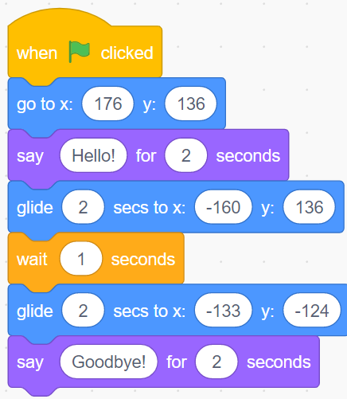
Example – Applying step-wise thinking and programming

Slide 16
Activity 2a – Argue with your neighbour
Computational Thinking is just another buzzword for programming.
Do you agree?
Yes
No
Find a neighbour with an opposite viewpoint and convince them that you are correct.

Slide 17
Activity 2a – Audience responses (live)
CT is same as Programming
Because -
everyone talks about it in the context of programming
Logical approach
Step by step
CT is NOT same as Programming
Because -
Ideas have been explored in other domains as well
Its about thinking not programming, so no limitations
Programming is a subset CT
This is problem solving
More influence by the thinker
Notes:
These are responses from audience at T4E 2019

Slide 18
Activity 2a – Summary
Learning of CT is not the same as learning programming.
CT is a super-set of skills of which programming is one skill.
Some of the other skills are:
Logically organizing and analyzing data.
Representing data through abstractions such as models and simulations.
Identifying, analyzing, and implementing possible solutions with the goal of achieving efficient and effective combination of steps and resources.

Slide 19
CT Framework
Brennan and Resnick (2012)
CT Concepts | CT Practices | CT Perspectives
Computational concepts that learners develop in programming. | The problem solving skills that learners demonstrate repeatedly in the programming process. | Learners’ understanding of themselves and their relationships to others and the technology world by expressing, connecting and questioning during programming.
Loops, Conditionals, Sequences, Parallelism, Data structures, Operators, Event handling, Procedures, Initialization. | Problem formulation, Problem decomposition, Abstracting and Modularizing, Algorithmic thinking, Reusing and remixing, Being iterative and incremental, Testing and debugging. | Computational identity, Programming empowerment, Perspectives of expressing, connecting and questioning.
Notes:
This is in the context of computing. There are variations and other frameworks for CT in CS.
There are no formal frameworks for CT in other disciplines yet.

Slide 20
Activity 2b – Show of hands
Computational Thinking is relevant only for topics studied by Computer Science (CS) students.
Do you agree?
Yes
No
Why do you think so? – Discuss some responses.

Slide 21
Activity 2b – Summary
CT is not just for CS topics or CS students.
It is broader and can be found in several disciplines.
(Hsu, T-C., 2018, has a list of 20 disciplines in which there are CT papers)

Slide 22
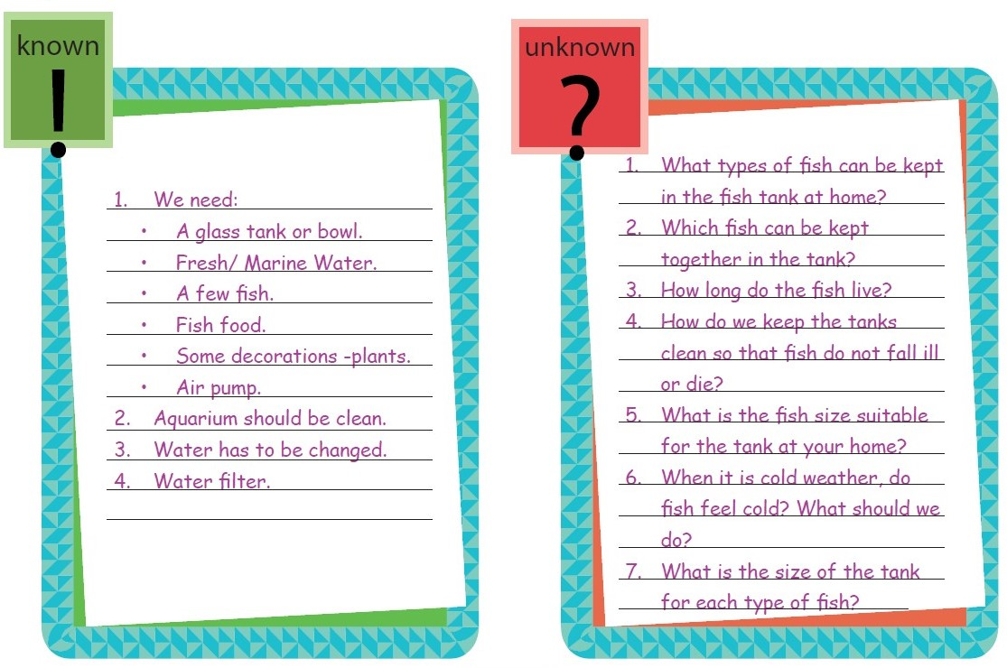
Ex 1 – CT in projects - Setting up a home aquarium – Grade 5
Notes:
Add a lot of diverse examples

Slide 23
Ex 2 – CT in presentations – Grade 6

Slide 24
Ex 3: CT applied in STEM
https://www.c2stem.org/ , Gautam Biswas (Vanderbilt).
Collaborative learning environment.
Domain specific modeling : Physics, Marine biology, Earth Science.
Students learn by building computational models of science processes and then applying the models to problem solving tasks.

Slide 25
Ex 4: CT applied in Hamlet (and Harry Potter)
Hamlet in a new light with computational thinking, Frank Moretti (Stanford).
CT integrated into language arts and social sciences.
“analyzing ‘network diagrams’ or ‘interaction graphs’ where characters are represented as nodes, and two characters are joined by an edge if they have interacted through dialog”.
Of all the characters who speak to both Hamlet and Claudius, only two manage to survive (the “region of death” in the graph).

Slide 26
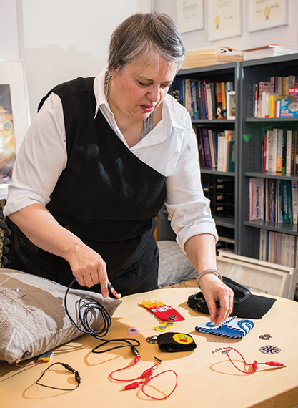
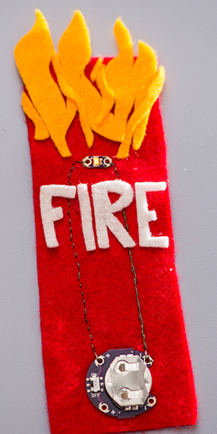
Ex 5: CT applied in e-textiles
Learning by making , Yasmin Kafai (Penn State).
E-textiles combine electronics with fabric and sewing.
“Students devise their own projects, sew with conductive thread, and write computer programs for microprocessors that they attach to their accessories. Some projects incorporate sensors that cause LED lights to activate in response to the moisture of the wearer’s skin”.
‘Exploring Computer Science’ curriculum.
Increasing diversity and inclusiveness.
Bookmark
LeD
Conductive thread
Battery

Slide 27
Activity 3 – Debate
Computational Thinking is just another buzzword for general problem-solving.
Do you agree?
Yes
No
Let’s have a debate between the two camps!
Notes:
CT goes beyond programming, and beyond CS, so is it everything?

Slide 28
Activity 3: The debate is still ongoing!
Minimalistic definition (Guzdial) :
“ The stuff that we have to learn in order to communicate our tasks with a computer. It should be small, and the part that we learn should be generative, useful for new problems and new thinking. Everything else should be eliminated by good user interfaces.
Empirical, operational definition (Weintrop et al)
“… computational practices of actual scientists and engineers who use computing”.
Restricted vs more open definition (Benedetto)
Discusses implications of defining CT in a restricted manner (formal, carried out by computers) vs a wider, more open definition.

Slide 29
Activity 3 – Summary
The debate on “is CT = problem-solving?” has not yet converged.
I don’t have full clarity yet, but I am inclined to take this stance:
CT = Programming concepts + Disciplinary practices
Merge some CT concepts and CT practices from
CT framework
Add some practices of actual scientists and engineers

Slide 30
CT in higher education – Disciplinary practices
Example –Divergent & Convergent Thinking in Design
Software Design is a process which ranges from requirements analysis to conceptual design, detailed design to implementation, and testing to refactoring.
Conceptual design involves:
Expand the problem space by considering multiple perspectives
Systematically reduce the problem into sub-problems
Generate multiple alternative solutions to each sub-problem
Select one solution by evaluating the alternatives based on criteria
Working through these stages systematically is an application of CT.
Teaching-learning of design includes teaching-learning of some CT practices.

Slide 31
Fathom – System for learning expand-reduce skills in design

Slide 32
think&link – System for learning software conceptual design

Slide 33
CT in higher education – Disciplinary practices
Example – Troubleshooting
Troubleshooting (TS) is a process which ranges from the identification of problem symptoms to determining and implementing the action required to fix that problem.
TS involves:
Problem Space Understanding
Hypothesis Generation and Prioritisation
Designing and Running tests
Result Interpretation
Working through these TS stages systematically is an application of CT.
Getting students to do TS activities with explicit reflection can lead to inculcation of CT.

Slide 34
PhyTeR – System for learning network Troubleshooting

Slide 35
VeriSIM – System for learning software design verification

Slide 36
Activity 4 – Create a CT lesson for your topic
Think: Choose a topic in which you are an expert. Identify one CT concept that can be taught through your topic. How?
Pair: Critique your neighbour’s answer. Can you identify one more CT concept in your neighbour’s topic?
Share: Discuss a few answers from the audience.
Notes:
Go beyond Scratch and Arduino based projects

Slide 37
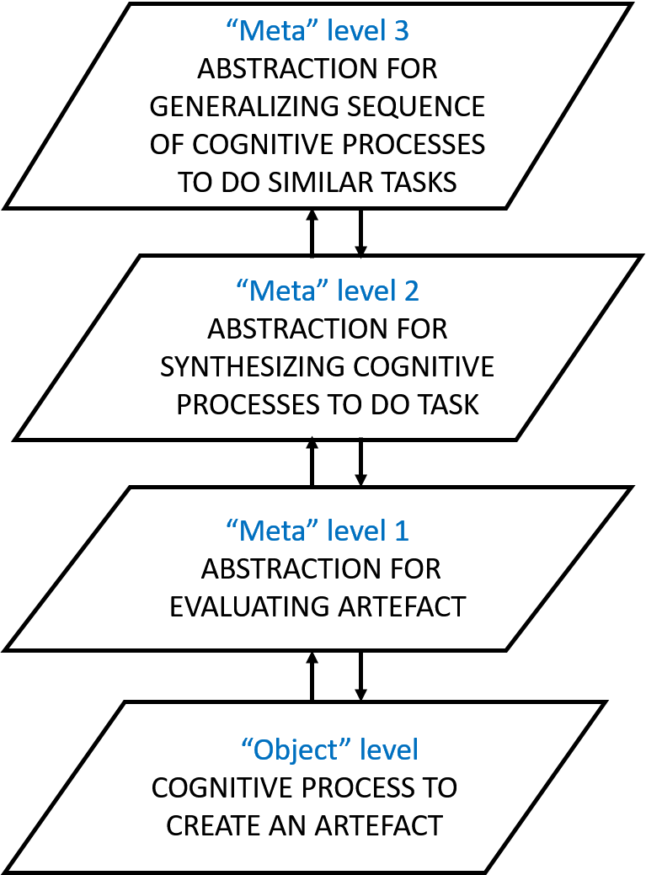
Activity 4 - Guidelines
In order to inculcate CT skills:
Choose a <domain topic, CT skill> pairing such that the CT concept/practice can be mapped clearly in the topic.
Design learning activities that are based in the topic *and* require application of the corresponding CT skill.
Get learners to Do – Evaluate – Synthesize, i.e., reflect on their actions at several levels, until they are able apply the CT skill in a new (similar) topic.

Slide 38
Take-away
CT is not automatically “acquired” while learning content.
Learning CT needs explicit training.
One way to train for CT is through programming concepts and practices, but transfer to a non-programming context is not automatic.
Transfer needs explicit attention and training.
Notes:
Add takeaways on how to do the training and transfer

Slide 39
CT work in India

Slide 40
CT work in India – Ancient - Chandas-sastra
From Prof. K. Ramasubramanian, Dept of HSS, IIT Bombay

Slide 41
Some CT work in India - Today
IIT Bombay - Computer Masti (CS); TELoTS project (Engg practices).
www.et.iitb.ac.in/projects/telots/
ACM India - CS pathshala - Teaching computing without computers.
cspathshala.org
Amrita University – Developing tinkering mindset in school children.
ammachilabs.org/second-foundation/
*This is what I can recall off-hand. Apologies if I have missed listing your work!

Slide 42
Research opportunities in CT
Design and evaluate interventions to develop CT in your students
Create interventions (learning activities) that involve use of CT in various domains.
Show explicit mapping between your design and learners’ development of CT.
Do evaluation to explicitly show that CT has been developed.
Submit a paper to next T4E/COMPUTE conferences
For help with planning your study and writing your paper, see http://www.et.iitb.ac.in/ResearchResources.html

Slide 43
References and Resources
Demystifying computational thinking. Valerie J. Shute, Sun Chen, and Jodi Asbell-Clarke. Educational Research Review 22 (2017): 142-158.
How to learn and how to teach computational thinking: Suggestions based on a review of the literature. Ting-Chia Hsu, Shao-Chen Chang, and Yu-Ting Hung. Computers & Education 126 (2018): 296-310.
Computing Education Research Blog. Mark Guzdial. https://computinged.wordpress.com/
A Tale of two CTs (and a Revised Timeline for Computational Thinking). Shuchi Grover. Blog@CACM. Nov. 5, 2018.
C2STEM: a System for Synergistic Learning of Physics and Computational Thinking. Hutchins, N.M., Biswas, G., Maróti, M. et al. Journal of Science Education and Technology. (2019) doi:10.1007/s10956-019-09804-9
Network theory, plot analysis. Franco Moretti. New Left Review, 68, Mar-Apr 2011.
A crafts-oriented approach to computing in high school: Introducing computational concepts, practices, and perspectives with electronic textiles. Yasmin Kafai. ACM Transactions on Computing Education (TOCE) 14.1 (2014): 1.

Slide 44
Aspects of CT not covered in this talk
Tools
Assessment
Non-formal learning
Policy
In-depth understanding of CT with respect to Mathematical thinking, Design thinking, etc.
…
Notes:
Attempt a comprehensive mention of aspects and perspectives, so that audience is aware of what else is there in CT education and research

Slide 45
Thank you This presentation is available at:
Then, Click on ‘Talks’
This presentation is released under Creative Commons-Attribution 4.0 License. You are free to use, distribute and modify it , including for commercial purposes, provided you acknowledge the source.

