Slide 1

Moving from teacher-centric to student-centric teaching
Sridhar Iyer
Dept of Computer Science and Engg
Sahana Murthy
IDP on Educational Technology
IIT Bombay
Principal’s Workshops
Sponsored by Next Education
2016
This presentation is released under Creative Commons-Attribution 4.0 License.
You are free to use, distribute and modify it, including for commercial purposes, provided you acknowledge the source.

Slide 2
A little bit about you …
I teach
English
Maths
Science
Social Studies
Computers
Pre-primary
Other …

Slide 3
Warm up
Think of one activity that you feel you excel at doing.
Write down your answer. You need not share this with anyone!
Think about why you are so good at this activity.
Write down the top 3 reasons for your mastery in this activity.
Let me guess - One of your top 3 reasons is likely to be:
– Practice. “Experience”

Slide 4
Practice
Again, think of the activity that you feel you excel at doing.
Do you feel that you could have gained such mastery by listening to lectures on the topic?
Point to keep in mind:
As learners, we develop mastery through practice (doing activities, rather than simply listening to lectures, or watching demos).
So,
As teachers, we must ensure that we provide our students with practice – sufficient and timely opportunities.

Slide 5
Workshop Goals
In this workshop you will:
Experience some research-based strategies for improving learning.
Design some effective learning activities for your class.
Share some best-practices from your school.

Slide 6
Debate
Consider two teachers – A and B.
Teacher A gives an excellent lecture in the class, demonstrates solving many problems, and gives appropriate homework to her students.
Teacher B does not lecture continuously nor does she give as much homework. Instead, she makes her students do activities in class, that lets them practice what they have learned immediately, and ensures that they get feedback on their work.
Form two groups.
GROUP A – Write points for when Teacher A’s methods are better.
GROUP B – Write points for when Teacher B’s methods are better.

Slide 7
Debate (Teacher A vs Teacher B)
* Audience responses
Let’s summarize.

Slide 8
A - 20th Century Teacher
Teacher A gives an excellent lecture in the class, demonstrates solving many problems, and gives appropriate homework to her students.
In the 20th century, information was at a premium – No Internet, expensive books, limited access to libraries, and so on.
Hence, those who had access the information and could transmit it effectively were highly valued.
So, students were mostly passive listeners, absorbing information during the lecture, and doing their practice later.
What has changed in the 21st century?

Slide 9
B – 21st Century Teacher
Teacher B does not lecture continuously nor does she give as much homework. Instead, she makes her students do activities in class, that lets them practice what they have learned immediately, and ensures that they get feedback on their work.
In the 21st century, information is no longer at a premium – lot of accessible videos, demos, and so on.
Hence, it is not enough for a teacher to only transmit information effectively.
It is necessary for a teacher to ensure that her students are able to assimilate the information, through appropriate practice, during the lecture itself.
Shift of focus from Teacher-Centric to Learner-Centric pedagogy.

Slide 10
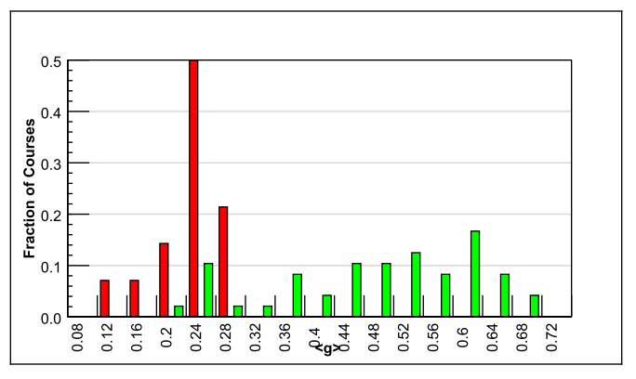
Evidence from research
Comparative study of 62 Physics courses (1998)
6542 students
Variety of institutions: high school, college, university
Semester long physics course
Pre-post test of conceptual reasoning – Force Concept Inventory
Trad lecture (14)
Active learning strategies (48)
Normalized gain
<g> = ^{post-pre} ^{100-pre}
IMPLICATION
Desirable to explicitly incorporate learner-centric activities in our teaching.
RESULTS:
Maximum gain from lecture courses was 0.28
  - Many instructors had high teaching evaluation scores
Gain from learner-centric courses had gains 0.23-0.7, which was 2-3 times greater than lectures
R. Hake, “Interactive-engagement versus traditional methods: A six-thousand student survey of mechanics test data for introductory physics courses” Am. J. Phys., 66 (1998)

Slide 11
How to do learner-centric pedagogy
One way – Active learning techniques.
Students go beyond listening, writing notes, executing prescribed procedures.
Students asked to ‘figure things out’ during class.
Needs attitude shift of teacher:
from content-oriented to learning-oriented.
from “How well am I lecturing?” to “How well are they learning?”

Slide 12
Many teachers say - My lectures are plenty interactive!
I often pause to ask students if they understood the material.
I allow students to interrupt whenever they have doubts.
I never hesitate to answer their questions.
I show them demos and videos.
….
Isn’t this active learning?

Slide 13
Why ‘interactive lectures’ may not be enough
Students don’t pay utmost attention throughout the lecture.
Students think that they understand because they can follow the lecture.
  - They are not confronted with their misconceptions immediately.
Difficult to ensure that all students in the class participate actively.
  Students with high motivation / achievement levels drive the pace.
  Students with low achievement levels get left behind.
Students may have a barrier to responding directly to the instructor.
  Shy students don’t ask questions, or give answer, even if they have one.
  Forcing all students to respond tends to be counter-productive.

Slide 14
So, what are active learning strategies?
Requirements:
Students go beyond listening, copying of notes, execution of prescribed procedures.
Instructor designs activities that require students to talk, write, reflect and express their thinking.
Explicitly based on theories of learning.
Evaluated repeatedly through empirical research.
Let us see an example
D. E. Meltzer and R. K. Thornton. "Resource letter ALIP–1: active-learning instruction in physics." Am. J. Phys, 80.6 (2012): 478-496

Slide 15
Vote individually
A large piece of ice is floating in water in a bucket. When it melts what will happen to the water level in the bucket?
It will rise.
It will fall.
It will stay the same

Slide 16
Discuss with your neighbour and converge
A large piece of ice is floating in water in a bucket. When it melts what will happen to the water level in the bucket?
It will rise.
It will fall.
It will stay the same

Slide 17
Have you converged? Then revote.
A large piece of ice is floating in water in a bucket. When it melts what will happen to the water level in the bucket?
It will rise.
It will fall.
It will stay the same

Slide 18
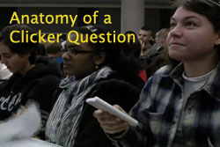
Peer Instruction technique
Peer Instruction is a structured Active Learning strategy
Ask Question
(May vote individually)
…Lecture…
Debrief /
Class Discussion
Peer Discussion
Vote
Figure attributed to: Stephanie Chasteen and the Science Education Initiative at the University of Colorado

Slide 19
Why do active learning techniques work?
What do students do? (in previous example “students”=you)
Talk, argue, listen (sometimes), reason, draw, … ==> engaged with content
Learn from each other, teach each other (teach<=>learn)
Those who don’t know are willing to think, reason, answer
Those who do know are willing to participate (teach? show-off?)
Pre-existing thinking is elicited, confronted, resolved
What are other benefits? To instructor? To class atmosphere
Immediate feedback to instructor
Students realize that even others are struggling
Builds a friendly, yet scientific atmosphere
Improves communication

Slide 20
Activity
Consider the topic that you are currently teaching.
Think: How will you incorporate active learning? List two ways of doing so.
Write down your answer, as specific as you can. [~2 minutes]
Pair: Discuss you answer with your neighbor. Do a self-check of whether your activity is learner centric, (using points on the next slide). [~3 minutes]
Share: Merge answers of the entire group. [~5 minutes]
Info: Think-Pair-Share activity you is an effective active learning strategy.

Slide 21
Self-check:
Moving from teacher-centric to learner centric strategies
Did your strategy begin with:
“I will do …”
“I will show …”
“I will tell…”
Then it is still teacher-centric.
To be learner-centric, the strategy should begin with:
“I will make students do …”
Or better still
“ Students will do …”

Slide 22
Activity: Answers from audience
*

Slide 23
Implementing active learning in your classes – some activities
Ask students to:
Pose problem, ask students to begin the problem solution.
Ask students to complete the last 2 steps in the problem.
Figure out the next step in the derivation.
Devise possible reasons for an observation (shown in a video).
Predict the outcome of an experiment (shown in a video/ animation).
Brainstorm a list of methods to solve a design problem.
Debate pros & cons of various methods.

Slide 24
Summary - Features of active learning strategies
Students engage in problem-solving activities during lecture.
Students work collaboratively.
Students are asked to “ﬁgure things out for themselves.”
Students are asked to express their reasoning explicitly.
Qualitative reasoning, conceptual thinking are emphasized.
Speciﬁc student ideas are elicited and addressed.
Students receive rapid feedback on their work.
Ensure (most) students participate
Target misconceptions
Go from ‘… think they understand’
to ‘… know whether or not they understand’

Slide 25
Tea Break
☺

Slide 26
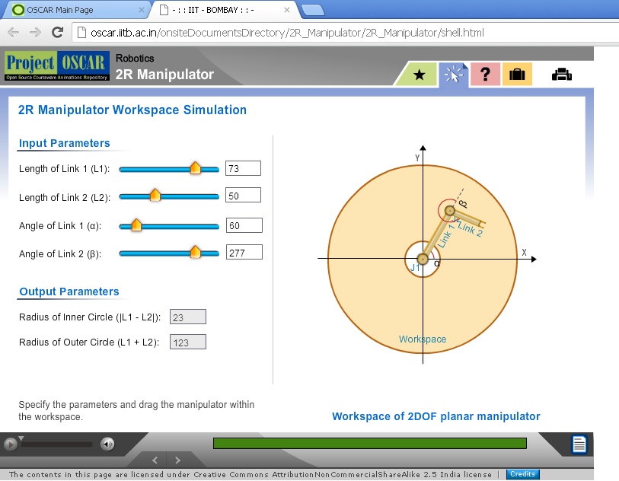
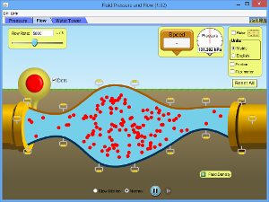
Scenario 2: Using visualizations in class
Visualizations such as animations and simulations have been shown to provide many learning benefits, especially in STEM disciplines.
Many teachers report using such visualizations in their class. Most play or demonstrate the animation in class, along with narrative explanation.

Slide 27
Scenario 2: Using visualizations in class
Visualizations such as animations and simulations have been shown to provide many learning benefits, especially in STEM disciplines.
Many teachers report using such visualizations in their class. Most play or demonstrate the animation in class, along with narrative explanation.
VOTE - Do you think demo & explanations of visualization is effective?
Yes
No
Why or Why not?

Slide 28
What do you mean by “effective”?
Do you think demo & explanations of visualization is effective?
Audience response - Each table say one:
*

Slide 29
What do you mean by effective?
Responses from previous workshop
Engage students
Learning outcomes improves
Students do some sense-making
Motivation improves
Learning of content, facts, concepts
Viz is effective if students are able to see invisible objects
Visualize objects hard to imagine - mirage
Grasp attention of student
Visualization should not lead to misconception

Slide 30
What do you mean by effective - Perspectives
Teacher can cover syllabus faster
Teacher can use more technology
Make invisible elements visible
Trace motion / trajectory
Students will be able to:
Explain the reason underlying phenomenon
Draw multiple representations
Improve motivation, attention…
Instructor centric
Content related
Student centric
Affective
Which of these goals can be achieved by demo of visualizations?

Slide 31
Results from research on use of visualizations
Showing demo alone is not effective esp for student learning (Hansen et al 2000)
Potential benefits of visualization is lost if students merely watch (Lindgren & Schwartz)
The way the instructor teaches with the visualization has a profound effect on learning effectiveness (Bratina et.al, 2002).
Active-learning instructional strategy with visualization led to improved outcomes than mere viewing (Laasko et al 2009; Windschitl & Andre 1998, Banerjee, Murthy & Iyer 2015)
How to incorporate structured active learning strategies?

Slide 32
One way – Use Peer Instruction questions
Peer Instruction is a structured Active Learning strategy (recall ice-bucket Q)
Ask Question
(May vote individually)
…Lecture…
Debrief /
Class Discussion
Peer Discussion
Vote
Figure attributed to: Stephanie Chasteen and the Science Education Initiative at the University of Colorado

Slide 33
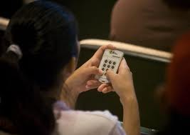
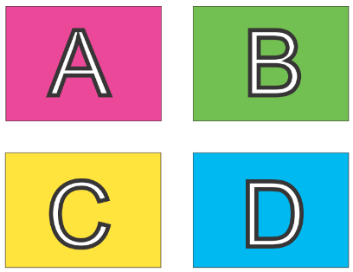
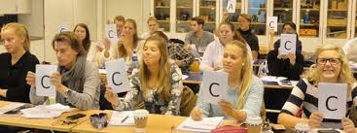

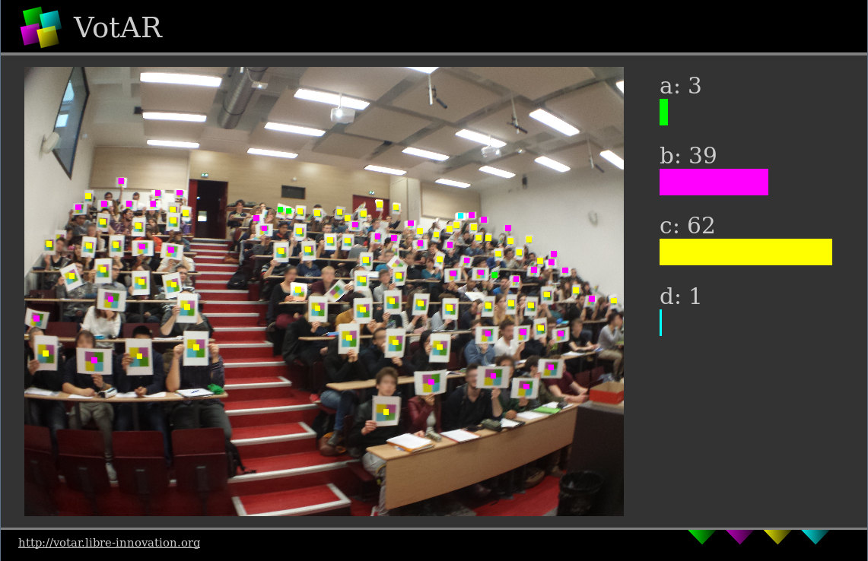
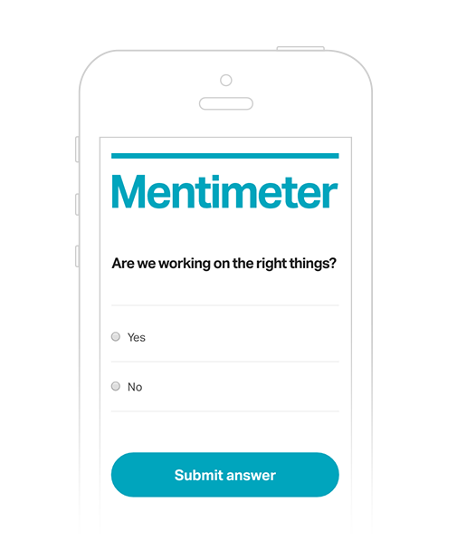



Implementation of Peer-Instruction
www.votar.libre-innovation.org
www.mentimeter.com

Slide 34

Example of PI question with visualization– Predict outcome
Observe Phase
Predict Phase
Check Phase
TEACHER:
Play viz upto the point the stimulus is shown.
PAUSE before result. Don’t show rest of viz yet.
STUDENTS:
Observe first part of viz
TEACHER:
Ask students to make prediction: “What will happen if …”
STUDENTS:
Make prediction – write, vote, discuss w each other
TEACHER:
Shows rest of viz, which has result
STUDENTS:
Check their prediction by watching the result in viz
Will the balloon move?
  Yes, to the left
  Yes, to the right
  No
Show rest of movie
Link to video: http://paer.rutgers.edu/pt3/experiment.php?topicid=13&exptid=121

Slide 35
PI one of the most widely researched* strategies
(* This is good because …)
Extent of research
  300+ research articles
  Physics, biology, chemistry maths, CS, engineering, psychology, medicine …
  Many controlled studies using standardized tests
Courses using peer instruction outperform traditional lecture courses on a common test – data from 10 years implementation Crouch & Mazur, 2001
Students can better answer a question on their own, after peer instruction discussion, (especially difficult questions) – study with 16 pairs of isomorphic questions Smith et al, Science 2009
Student perception : clickers help students show up for class, feel part of class community, make their voice heard, hold them accountable …

Slide 36
Writing your own Peer Instruction questions
There are guidelines for writing peer instruction questions of different types.
Let’s go through some types.
  - We already saw an example of PI question to predict the outcome of an experiment.
Examine if suitable for your class and write a question.

Slide 37
Example:
Peer Instruction question for (difficult) concept
A small mango seed can grow into a big tree in a few years. Where does most of the tree’s mass come from as the tree grows?
Minerals in the soil
Water from rainfall
Gases in the air
Sunlight
Note – this and the next few questions are not meant to test your knowledge! Please wear your ‘Teacher-hat’. Think – why /when is this is useful question?

Slide 38
Example:
Peer Instruction question for (difficult) concept
A small mango seed can grow into a big tree in a few years. Where does most of the tree’s mass come from as the tree grows?
Minerals in the soil
Water from rainfall
Gases in the air
Sunlight
Answer – not from the soil. Because – if so, there should be less soil around a plant (say in a pot) as it grows. Most of the tree is wood, ie carbon, which comes from carbon dioxide during photosynthesis.

Slide 39
Example:
Peer Instruction question for reasoning (science)
What would happen to the seasons if the earth’s orbit around the sun was made a perfect circle (but nothing else changed) ?
There would be no seasons
The seasons would remain pretty much as they are today
North hemisphere would be always Hot, South always cold.
Same seasons in North and South hemisphere at same time

Slide 40
Example:
Peer Instruction question for reasoning (science)
What would happen to the seasons if the earth’s orbit around the sun was made a perfect circle (but nothing else changed) ?
There would be no seasons
The seasons would remain pretty much as they are today
North hemisphere would be always Hot, South always cold.
Same seasons in North and South hemisphere at same time
Seasons are caused by Earth’s axis tilt, not shape of orbit, hence they would still exist, almost same as now.

Slide 41

Example:
Peer Instruction question for reasoning – connecting words to diagrams (English)
Which of the following statements does the picture best represent?
The apple is about to fall from the tree
The apple is falling from the tree
The apple has fallen from the tree
The apples have fallen from the tree

Slide 42
Example:
Peer Instruction question for reasoning – connecting words to diagrams (English)
Which of the following statements does the picture best represent?
The apple is about to fall from the tree
The apple is falling from the tree
The apple has fallen from the tree
The apples have fallen from the tree
Answer – This is question is ambiguous. Either 1 or 3 could be the answer depending on which apple you are looking at. What are ways to refine this question to remove the ambiguity?

Slide 43
What makes a good peer-instruction question?
An effective peer-instruction question:
  Is usually conceptual (avoid long analytic computation)
  Elicits pre-existing thinking, students’ alternate conceptions
  Has believable distractors
  Asks students to predict results of experiment, or algorithm
  Makes students apply ideas in new context
  Relates different representations
  is not ambiguous
  is not leading
  is not ‘trivial’
43

Slide 44
Your turn – write your own question
Work with a partner who teaches the same subject as you.
Choose a topic in your subject that you are teaching this semester.
Write a peer-instruction question of one of the types we have seen:
Predict outcome of an experiment, then show a video for outcome
A difficult concept (not useful to ask PI Qs for simple definitions)
Reasoning
Connecting words to diagrams (good maths questions are possible)
Share a few questions

Slide 45
Audience responses
*

Slide 46
Will you implement Peer Instruction?
Yes definitely, more than once
I will try at least once a week
I would like to but I have concerns
I do not intend to try
Note – Peer Instruction can be used for such opinion questions, followed by discussion.
Let us discuss some of your concerns.

Slide 47
Your Concerns
*

Slide 48
Common Concerns
Too much noise in class!
Activity is too time consuming.
How can I complete the syllabus?

Slide 49
Other structured active learning techniques
Peer-Instruction (Eric Mazur, Harvard University, early 1990s)
Think-Pair-Share (Frank Lyman, University of Maryland, early 1980s)
Many others:
  (lecture) Team-Pair-Solo, Problem-based learning, Just-in-Time-Teaching, Role-play, Jigsaw, Case-based learning, Peer-review, Productive failure …
  (lab) Pair problem solving.
  (tutorial) TPS, TPS, PBL, Data-based problem solving.
See http://www.et.iitb.ac.in/TeachingStrategies.html

Slide 50
Takeaway
Make students grapple with content during class.
Don’t only clarify doubts:
  Provide frequent opportunities for learners to work with the content – Active learning.
  Ensure immediate and appropriate feedback to learners – Peer discussion.
Active learning techniques:
  Peer Instruction: Don’t keep MCQs for the exam, make students do them during class.
  Think-Pair-Share: Don’t just lecture, make students do first.
  Visualizations: Don’t just show visualizations, make students predict the outcome.

Slide 51















Acknowledgements
Creating a brighter tomorrow for today’s students

