Slide 1
TELoTS:
Technology enhanced learning of Thinking Skills
Sridhar Iyer
Indian Institute of Technology Bombay
Joint work with: Faculty and PhD students of Educational Technology @ IIT Bombay
This presentation is released under Creative Commons-Attribution 4.0 License.
You are free to use, distribute and modify it , including for commercial purposes,
provided you acknowledge the source.

Slide 2
Educational Technology, IIT Bombay
Inter-Disciplinary Program, started 2010
5 Core faculty
Associate faculty from departments of Engg., Science, Design, H&SS
25 PhD research Scholars
12 PhDs graduated
Starting an M.Tech program in 2019

Slide 3
What is Educational Technology?
Adaptive and
Personalized
Tutoring Systems
Technology of Education
Creation and use of Teaching-Learning strategies for student learning and engagement
Use of Peer Discussion
Focus is on “What to do” with/without technology
Virtual Reality
Pedagogy & Technology for individual and collaborative learning
Augmented
Makerspace
MOOCs
Games
Learning environments
Eye Tracking
Analytics
Assessment

Slide 4
What do we do?
Research:
TELoTS: Technology enhanced learning of thinking skills
TUET: Teacher use of educational technologies
EDA: Educational data analytics
EmergE: Emerging technologies
Development:
MOOCs: Massive open online courses – IITBombayX
Trained 5000+ college teachers, 5000+ school teachers
Tools: To support teaching-learning process
iQuE, iSAT, CuVIS, …
Consultancy
Outreach
Sponsored Projects
Sponsored Research Labs

Slide 5
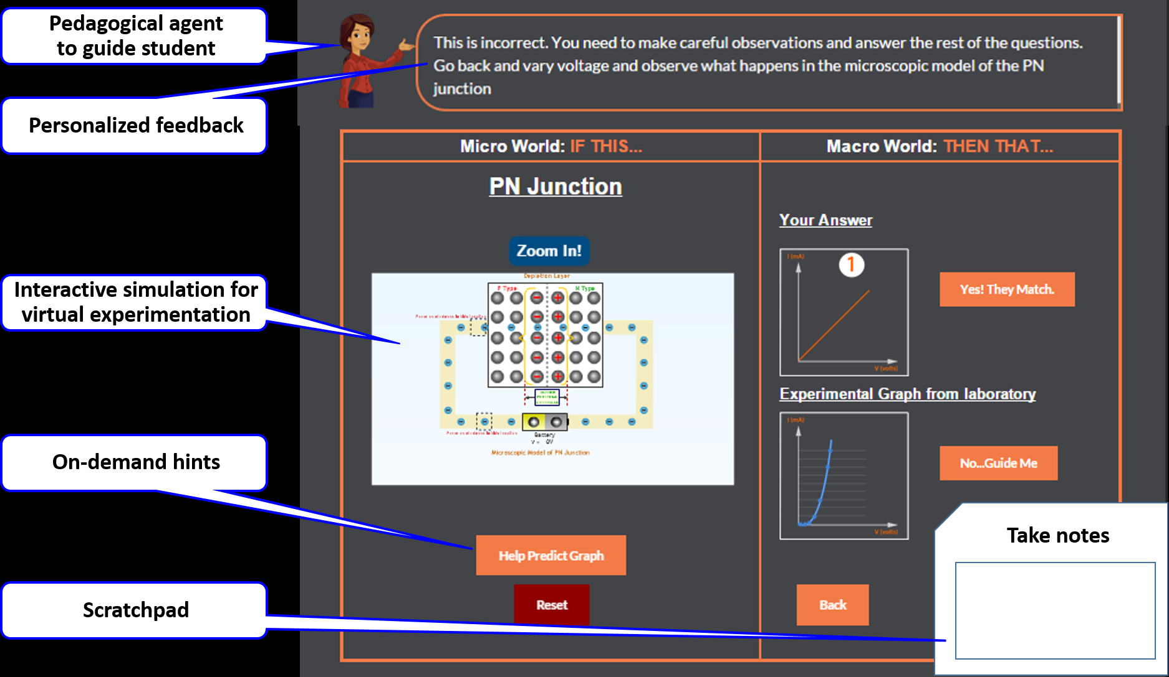
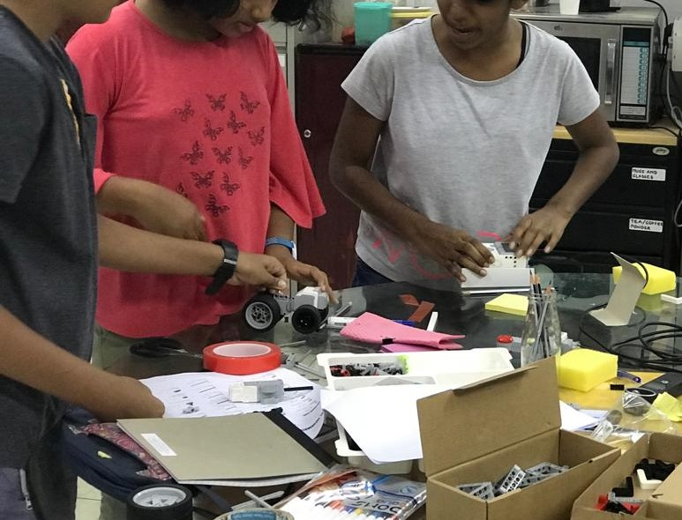
Research Area - TELoTS
Design Thinking, Engg Estimation, Troubleshooting, …
Thinking Skills
Integration with Domain Concepts
Pedagogy and Learning Environments

Slide 6
Opening Activity – Setup
Find a partner – the person sitting next to you.
One of you is A and the other is B.

Slide 7
Activity – Think
A’s Task: Debug an App.
Imagine an app that provides the user with multiple-choice questions on a topic, records answers and gives a score at the end. Suppose the app hangs after a few questions.
B’s Task: Troubleshoot a network.
Imagine you are in office on a WiFi laptop and are unable to reach Google.
Think: How will you approach the problem of debugging / troubleshooting? Write down a few steps that you will take in order to identify the problem in your app / network. [2 minutes]
Task cannot be delegated ☺
Notes:
Ask them to think about process, categorize answers into buckets

Slide 8
Activity – Think-Pair
A’s Task: Debug an App.
B’s Task: Troubleshoot a network.
Think: How will you approach the problem of debugging / troubleshooting? Write down a few steps that you will take in order to identify the problem in your app / network. [2 minutes]
Pair: Discuss with your neighbor and identify some “common steps” that are involved in debugging an app as well as troubleshooting a network. For example, both of you may have had the step “get more information about …” [3 minutes]
Challenge: Come up with an approach that will work for both scenarios.

Slide 9
Activity – Think-Pair-Share
A’s Task: Debug an App.
B’s Task: Troubleshoot a network.
Think: How will you approach the problem of debugging / troubleshooting? Write down a few steps that you will take in order to identify the problem in your app / network.
Pair: Discuss with your neighbor and identify some “common steps” that are involved in debugging an app as well as troubleshooting a network. For example, both of you may have had the step “get more information about …” Challenge: Attempt to draw an approach that will work for both scenarios.
Share: Share your steps / diagram. For example:
Draw the architecture → Imagine the correct functioning of the system → Identify a sub-system that may be causing the problem → Generate a specific hypothesis → Test the hypothesis → Repeat until fixed

Slide 10
Thinking skills
Have broad applicability (pan-domain): for example: Earlier steps of troubleshooting a network may also be valid for troubleshooting a car, given sufficient domain knowledge.
Examples: computational thinking, design thinking, scientific modeling, estimation, data representation & analysis, and so on.
Thinking skills are characterized in a variety of ways:
21st Century skills (Pellegrino & Hilton, 2012),
Trans-disciplinary habits of mind (Mishra, Koehler & Henrikson, 2011),
Science process skills (Padilla, 1990),
Cognitive processes that human beings apply for sense-making and problem-solving (Beyer, 1988).

Slide 11
Activity – Design task
Continue with the same partner as before. One of you is A and the other B.
Imagine a biometric based ATM system. Suppose the goal is to come up with a high level conceptual design for such a system.
Person A’s Task: Novice approach
How do you think a novice (final year B.E/B.Tech) will approach this goal? Write down 2-3 statements of the type ‘Novice will do ….’
Person B’s Task: Expert approach
How do you think an expert (experienced system designer) will approach this goal? Write down 2-3 statements of the type ‘Expert will do ….’

Slide 12
Audience responses – Design task
Novice approach
x
Expert approach
y

Slide 13
Findings from our study (and literature)
Novices
Fixate on one aspect of the functionality
Overlook conflicts in design choices
Expert approach
Comprehensive - consider multiple relevant aspects of the functionalities
Cohesive - have an integrated and consistent design

Slide 14
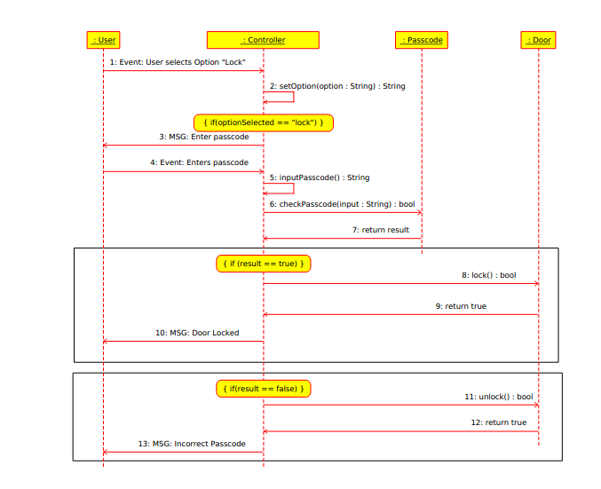
Activity – Analysis task
Imagine a door control system described by the UML diagram shown. The goal is to check whether some property is satisfied by the system:
“When the user chooses the lock option, and enters the correct passcode, the door should lock.”
Predict: What do you think a Novice will do for the above task?

Slide 15
Audience responses – Analysis task
Novice approach
x
Expert approach
y

Slide 16
Findings from our study (and literature)
Novices
Add features rather than check the property
Look for scenarios that confirm the property
Attempt to complete the design
Experts
Focus on checking the given property
Immediately look for scenarios / inputs that may violate the property
Do step-by-step execution to verify the property

Slide 17
Learning of Thinking Skills
Learners do not automatically develop thinking skills while learning content.
It is important to address the teaching and learning of thinking skills explicitly, in addition to content (Redish & Smith, 2008; multiple refs).
Regardless of the education discipline, development of thinking skills has been shown to be crucial for students’ success in the 21st century workplace (NAS, 2014).
Fungibility.

Slide 18
TELoTS @ IIT Bombay
 | 2014 | 2015 | 2016 | 2017 | 2018
TELoTS systems | TELE-DesC: Engg design Blender3D: mental rotation | Mic-O-Map: macro-micro thinking IKnowIT : Ques posing | Geneticus Investigatio: hypothesis testing | MEttLE: Estimation Fathom: div-conv thinking in s/w design | Lakshmi-system: concept. design Prajish system: s/w design eval Idea wavefront: div thinking
PhD theses |  | Structure open problem (electronics) |  | Macro-micro thinking (solid state physics) | Question posing (data structures) Mental rotation (engg graphics)
Theory development |  | TELoTS framework v1 |  |  | TELoTS framework v2
Workshops & conferences | ICCE w/s | ICCE w/s | ICCE w/s ICALT track | ICALT track | ICALT track
18

Slide 19
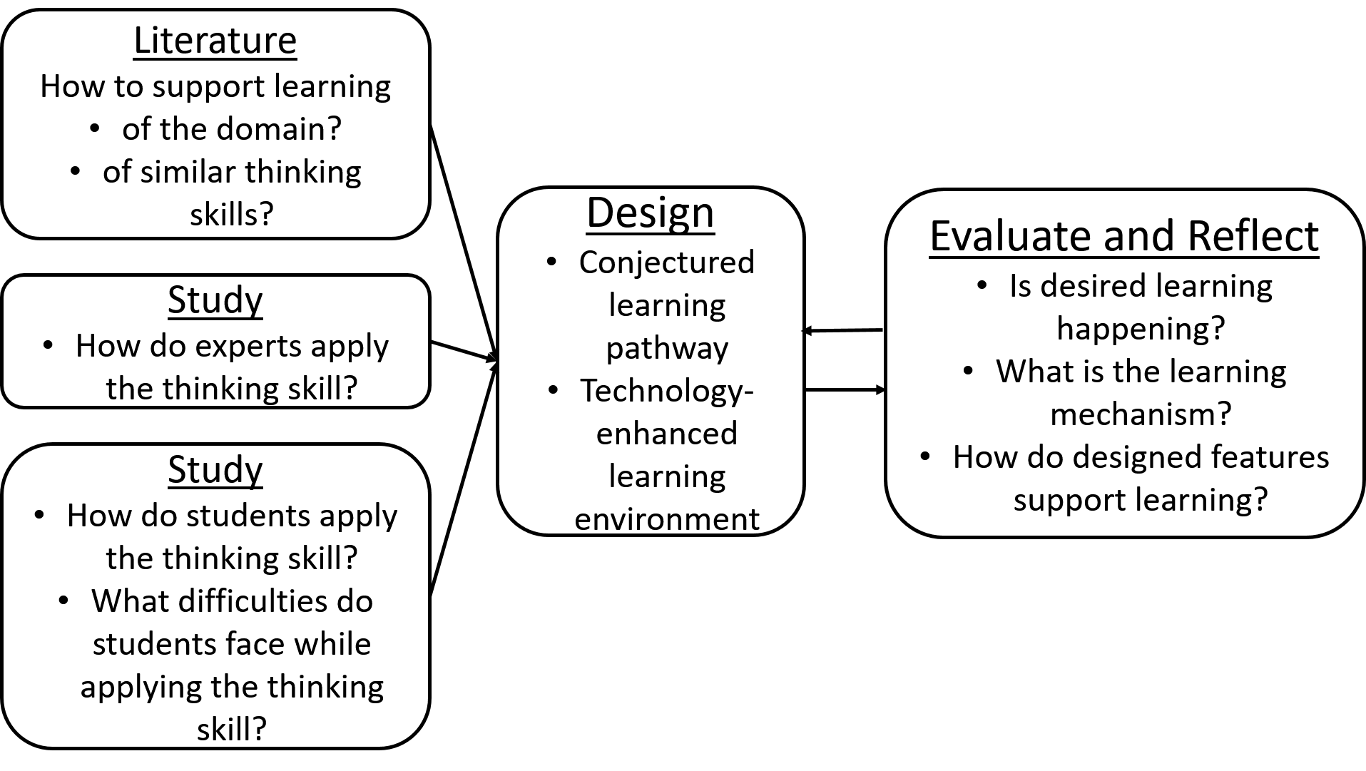
Our Approach

Slide 20
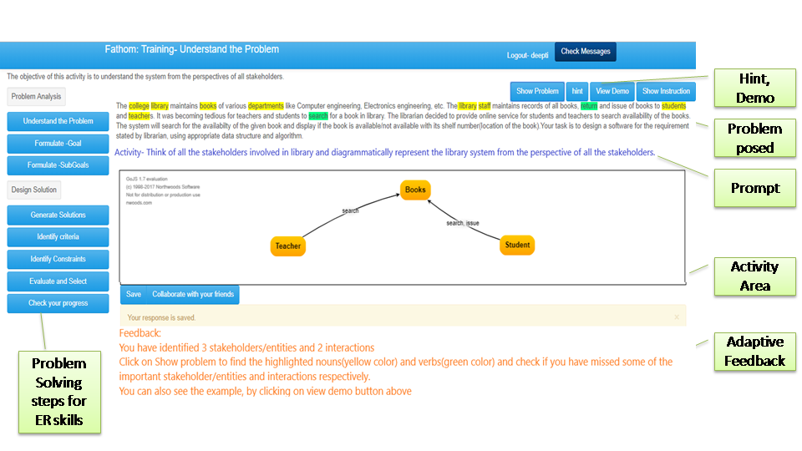
TELoTS system – Expansion-Reduction thinking

Slide 21
TELoTS system – Macro-Micro thinking

Slide 22
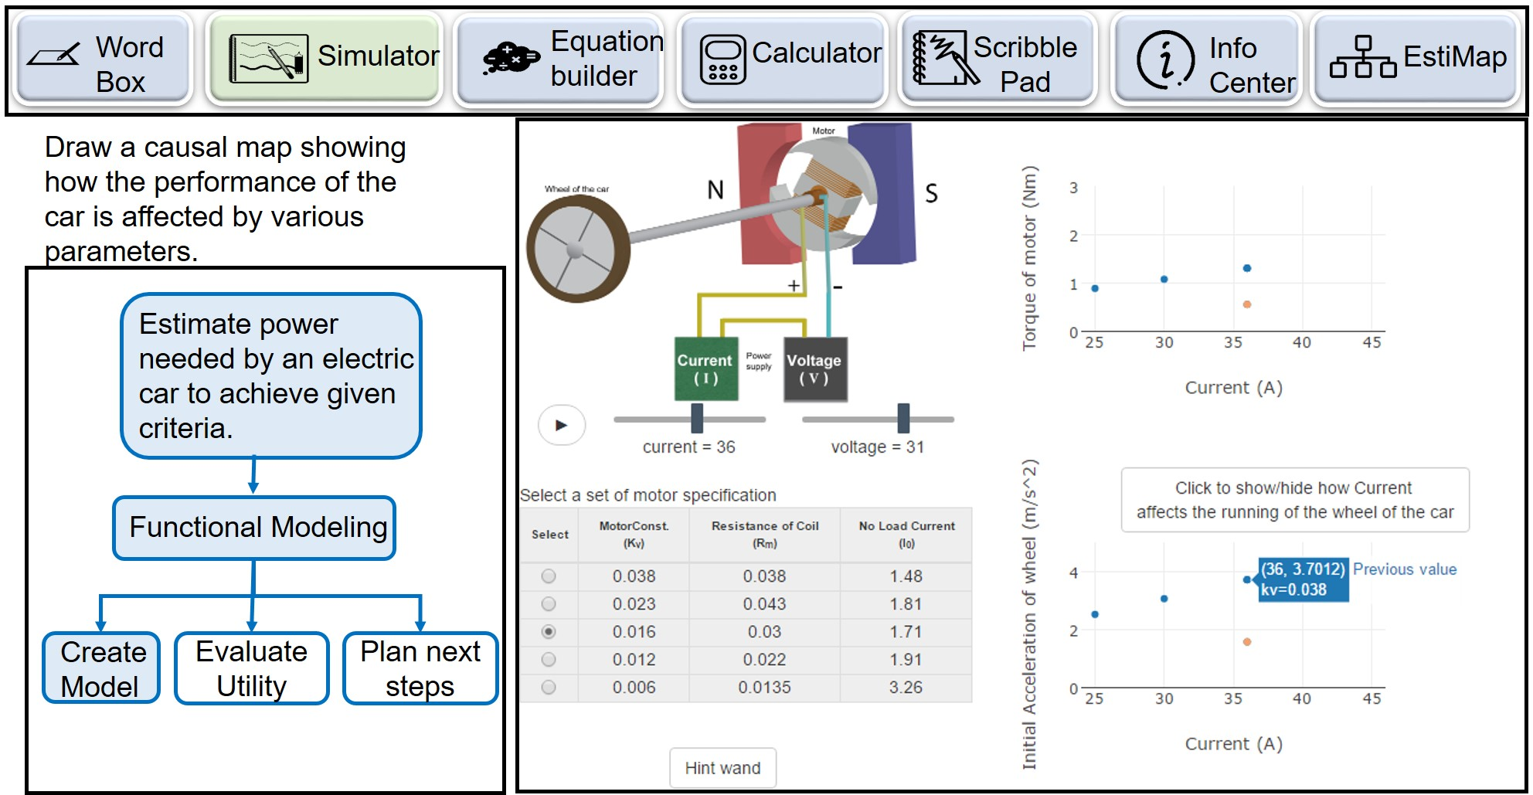
TELoTS system – Engineering Estimation

Slide 23
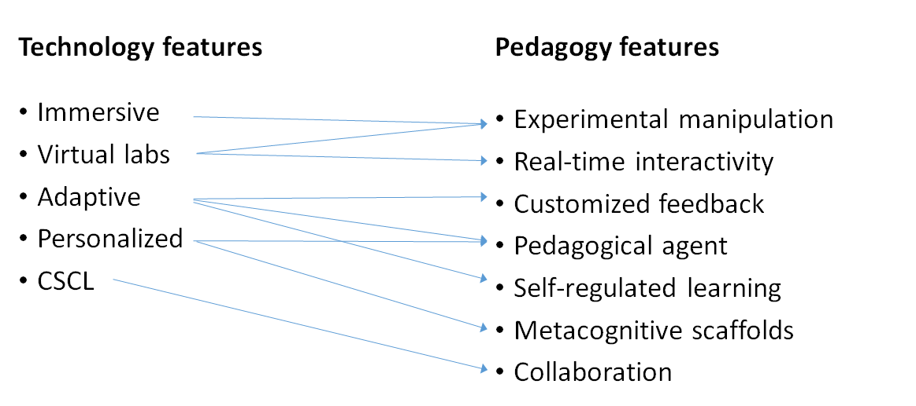
Features of TELoTS systems

Slide 24
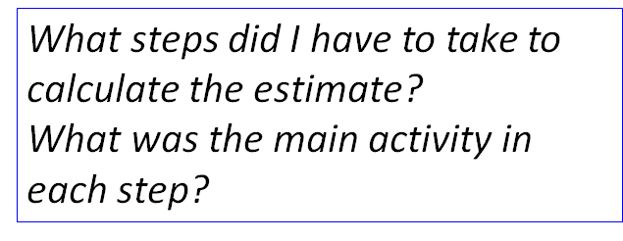
Learning activities in TELoTS systems
24
24

Slide 25
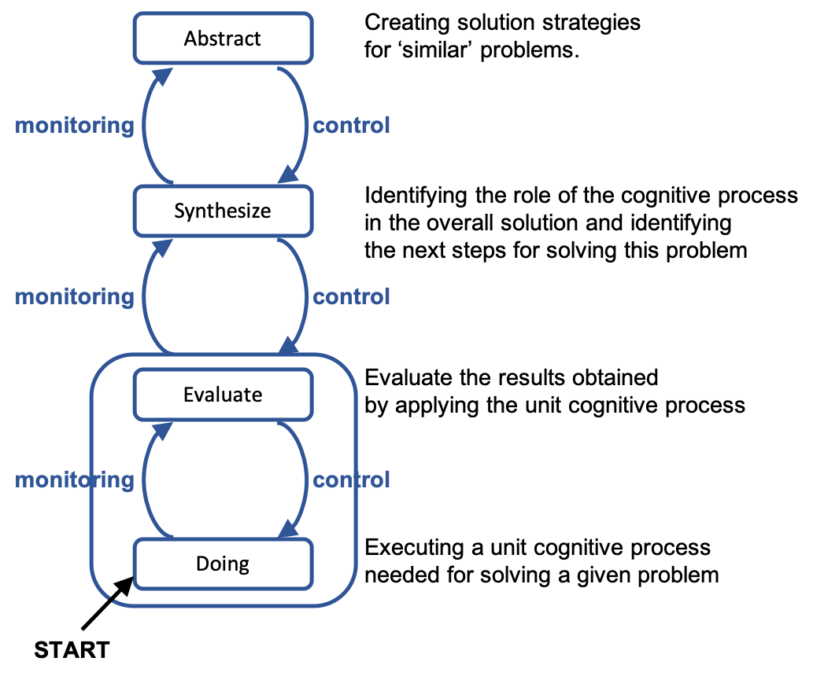
Key contribution – Learning Model
Learning through progressive abstraction
Meta-cognition to take learners from one level of abstraction to the next
Notes:
Put Y-axis arrow

Slide 26
Takeaway
If you want to promote thinking skills:
Use the TELoTS framework to design the learning experience:
Make learners do tasks at progressively higher levels of abstraction – Doing, Evaluation, Synthesis, Abstraction.
Give meta-cognitive tasks to take learners from one level to next.
Provide scaffolds during learning:
Support learners to complete a task.
Provide constructive feedback frequently.
Provide sufficient and diverse practice:
Expand scope of problems from near areas to far areas.
Reduce the scaffolds to make learners independent.

Slide 27
Closing Activity – Contribute your ideas
Think: Identify one thinking skill relevant to your work, that could be pan-domain
What thinking skills do you want entry-level persons in your group to develop?
Which of these are likely to have broad applicability across projects / domains / verticals?
Be as specific as possible. Don’t say ‘Problem-Solving’. Instead describe a scenario of use.
Give examples of applying the thinking skill in multiple scenarios.
Share: Create a list of thinking skills valued in your work-place
[Optional] Write on a piece of paper and give it to me; email telots.iitb@gmail.com
A list of thinking skills that you value is important to us – topics for future PhD students!

Slide 28
Thank You
More info: Google “Educational Technology, IIT Bombay”
www.et.iitb.ac.in
This presentation is released under Creative Commons-Attribution 4.0 License.
You are free to use, distribute and modify it , including for commercial purposes,
provided you acknowledge the source.

