Slide 1
Why should IIT give you a PhD?
Sridhar Iyer
Dept of CSE &
IDP in Educational Technology
Indian Institute of Technology Bombay
Research Scholars Forum event
22 May 2015
This presentation is released under Creative Commons-Attribution 4.0 License.
You are free to use, distribute and modify it , including for commercial purposes,
provided you acknowledge the source.

Slide 2
IIT should give me a PhD because
I have worked hard to improve my knowledge of my area. I am now an expert in my field.
True
False
Vote individually

Slide 3
IIT should give me a PhD because
I have worked hard to improve my knowledge of my area. I am now an expert in my field.
True
False
Vote individually
Justify your answer to your neighbor
Vote again (change your vote if required)

Slide 4
IIT should give me a PhD because
I have worked hard to improve my knowledge of my area. I am now an expert in my field.
True
False
Improving your knowledge and becoming an expert is a necessary condition, but it is not sufficient condition for you to get a PhD.

Slide 5
IIT should give me a PhD because
I have built a new “system” to do X. My system incorporates all the good features of existing systems to do X. It took me years of hard work.
True
False
Vote individually

Slide 6
IIT should give me a PhD because
I have built a new “system” to do X. My system incorporates all the good features of existing systems to do X. It took me years of hard work.
True
False
Vote individually
Justify your answer to your neighbor
Vote again (change your vote if required)

Slide 7
IIT should give me a PhD because
I have built a new “system” to do X. My system incorporates all the good features of existing systems to do X. It took me years of hard work.
True
False
Building a new system to do X is a desirable condition, but it is not sufficient condition for you to get a PhD.

Slide 8
Compilation of obvious or known solutions or
mere development of a system
is NOT a research thesis
To be considered as an acceptable research thesis:
you need to show what is novel in your solution compared to known solutions.
you need to show that your system has resulted in improvement of some relevant metric.

Slide 9
IIT should give me a PhD because
I performed several experiments and collected a lot of data. My analysis has resulted in the following graphs showing that “X is related to Y”.
True
False
Vote individually

Slide 10
IIT should give me a PhD because
I performed several experiments and collected a lot of data. My analysis has resulted in the following graphs showing that “X is related to Y”.
True
False
Vote individually
Justify your answer to your neighbor
Vote again (change your vote if required)

Slide 11
IIT should give me a PhD because
I performed several experiments and collected a lot of data. My analysis has resulted in the following graphs showing that “X is related to Y”.
True
False
Performing experiments may be a necessary condition, but it is not sufficient condition for you to get a PhD.

Slide 12
A report of the experiment you performed
is NOT a research thesis
even though it may contain a good idea.
To be considered as an acceptable research thesis:
you need to show the need for the experiment.
you need to show how the experiment will advance the state of the art (new knowledge, new techniques …)

Slide 13
What is a PhD?

Slide 14
Questions
In Jan 1993 I started on my PhD. I first attempted to find the answers to two questions:
Why is the degree called a PhD?
Why is it awarded independent of a discipline?
IIT Bombay degree will only mention the thesis title.
There was no Web, so I had to search through books in the central library to find some answers.
Do you know these answers?

Slide 15
Answers
Today it is easy to find these answers on the Web.
Definitions from Wikipedia:
entry on "Doctor of Philosophy": "The term "philosophy" does not refer solely to the field of philosophy, but is used in a broader sense in accordance with its original Greek meaning, which is "love of wisdom"."
entry on "Doctorate": "The term doctorate comes from the Latin docere, meaning "to teach"."
Do you know what these definitions imply?

Slide 16
Activity
State whether the following statements are True or False:

Slide 17
Activity
State whether the following statements are True or False:
S1: You are all listening to me simultaneously.

Slide 18
Activity
State whether the following statements are True or False:
S1: You are all listening to me simultaneously.
S2: Buddha and Jesus were contemporaries.

Slide 19
Truth
The statements are True in the conventional sense, BUT we have to keep in mind that the answer DEPENDS on:
granularity of time and granularity of event

Slide 20
Truth
The statements are True in the conventional sense, BUT we have to keep in mind that the answer DEPENDS on:
granularity of time and granularity of event
If you view S1 at a nanosecond level, it may be False.
If you view S2 at a millenium level, it may be True.

Slide 21
Truth
The statements are True in the conventional sense, BUT we have to keep in mind that the answer DEPENDS on:
granularity of time and granularity of event
If you view S1 at a nanosecond level, it may be False.
If you view S2 at a millenium level, it may be True.
=> we are implicitly using commonly accepted definitions of the terms "simultaneously" and "contemporaries".
A PhD is about becoming aware of implicit assumptions and examining such definitions.

Slide 22
Implications - Ph.D
Some other interpretations for "Philosophy", in addition to "love of wisdom" are - delving deep into the subject and –
examining the validity of axioms.
questioning conventional wisdom.
extending the boundary of knowledge.

Slide 23
Implications - Ph.D
Some other interpretations for "Philosophy", in addition to "love of wisdom" are - delving deep into the subject and -
examining the validity of axioms.
questioning conventional wisdom.
extending the boundary of knowledge.
Example: Given a statement "Active learning is good",
the task of a PhD is to investigate the extent of validity and generalizability, i.e.,
make explicit the qualifiers -
Active learning is good for X topic, Y goal, Z audience, W mode, and so on ...
Active learning is not good for X', Y', Z', W', ...

Slide 24
Implications - Ph.D
Some other interpretations for "Philosophy", in addition to "love of wisdom" are - delving deep into the subject and –
examining the validity of axioms.
questioning conventional wisdom.
extending the boundary of knowledge.
Self-study exercise:
Reflect on: What is the axiom that you are investigating?
What is the knowledge whose boundary you are extending?

Slide 25
Implications - Ph.D
You should be able to teach
Basic/Core courses in your discipline
Advanced courses in your specialization
This means that you should have:
Knowledge of the content – what to teach
Knowledge of pedagogy - how to teach

Slide 26
Implications - Ph.D
You should be able to teach
Basic/Core courses in your discipline
Advanced courses in your specialization
Self-study Exercises:
Reflect on whether you can teach courses? How well?
What additional expertise do you need to build in order to do this well?
Ask your IDP-ET colleagues to do a workshop for you on effective teaching-learning strategies!

Slide 27
Implications – Ph.D
The process skills that you acquire in a PhD are transferrable - both for the "Ph." and "D." parts
problem-posing, solution design, estimation, algorithmic thinking, creation & revision of scientific models, data representation & analysis, decision making, …
oral and written scientific communication, teaching-learning skills, …
Example: I did my PhD in program verification, then worked in Networking for 10 years, then moved to ET.

Slide 28
Implications – PhD
The process skills that you acquire in a PhD are transferrable - both for the "Ph." and "D." parts
problem-posing, solution design, estimation, algorithmic thinking, creation & revision of scientific models, data representation & analysis, decision making, …
oral and written scientific communication, teaching-learning skills, …
Hence
most PhD degrees do not mention the department, even though a PhD has domain specific components.
most PhD guides harp on the "PhD process".

Slide 29
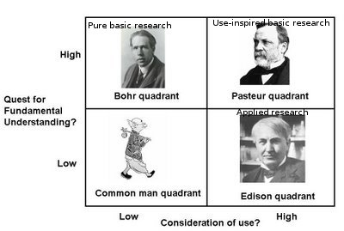
Strive towards: Pasteur’s Quadrant

Slide 30
What is expected of a PhD thesis? by Research Progress Committee (RPC), examiners and scientific community.
Disclaimer: The opinions in this presentation are those of the author(s) and do not necessarily represent those of all faculty in your institute.
Check with your thesis supervisor to confirm what criteria apply to you!

Slide 31
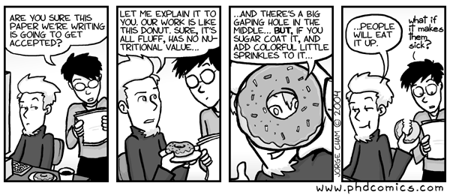
Why does my RPC complain?
RPC / examiners hate fluff and look for value. They are trained to find holes and be suspicious of sugar coating
Go for idlis instead of donuts! ☺

Slide 32
What is the goal of your Annual Progress Seminar (APS)?
Think (individually): What according to you is the goal of an APS?
Write down 1-2 points. [1 minute]

Slide 33
What is the goal of your Annual Progress Seminar (APS)?
Think (individually): What according to you is the goal of an APS?
Write down 1-2 points. [1 minute]
Pair (with your neighbor): Look into your neighbor’s answers. Copy those that you agree with!
Together, try to come up with 1-2 additional points [3 minutes]

Slide 34
What is the goal of your Annual Progress Seminar (APS)?
Think (individually): What according to you is the goal of an APS?
Write down 1-2 points. [1 minute]
Pair (with your neighbor): Look into your neighbor’s answers. Copy those that you agree with!
Together, try to come up with 1-2 additional points [3 minutes]
Share (with everyone): State 1 point from your list.
Identify points that have not been made any earlier group.

Slide 35
Some points from the audience
Progression, direction, correction
getting criticized, getting inputs, getting perspectives
platform for future planning
change the direction, to be on right track
self-evaluation - justify what you have done
documentation of work, learning to presenting your work concisely
ensure that students work; time-bound evaluation
benchmark with other students
assess maturity of thought, assess quality and quantity of work
come up with grant proposals
understand expectations of RPC better
teaching RPC members something new

Slide 36
Goal of your APS
Summative Assessment
determine the degree to which student has met the learning goals
measures performance of the complete year based on report and presentation
Treat your APS as a summative assessment before the APS – this will help you to work carefully to organize and present your research to an independent audience

Slide 37
Goal of your APS
Summative Assessment
determine the degree to which student has met the learning goals
measures performance of the complete year based on report and presentation
Treat your APS as a summative assessment before the APS – this will help you to work carefully to organize and present your research to an independent audience
Formative Assessment
suggestions for solution/ direction/ approach
identify weaknesses, research lacunae, hidden assumptions
helps us to rethink and improve quality of the work
Treat your APS as a formative assessment during and after the APS – this will ensure that you don’t get defensive and listen to the suggestions

Slide 38
Recall: What is not a research thesis?
Compilation of obvious or known solutions or
mere development of a system
is NOT a research thesis
A report of the experiment you performed
is NOT a research thesis
even though it may contain a good idea

Slide 39
So what is a research thesis?
Referees look for | Your thesis must have
Novelty | Analysis of prior work to show that your idea is unique
Positioning | Analysis to show that your work is required, how your work advances the state of the art
Soundness of procedure | Steps to show that you have implemented solution carefully
Evidence to support claim | Data to show that your solution works as claimed
Overall coherence | Consistency between parts of your thesis – treatment should address problem, results should give answer to problem

Slide 40
What exactly is meant by ‘Novelty’?
Dictionary: “The quality of being new, unique, original, innovative, or unusual”.
What has to be novel? → At least one of the below:
Your Problem – Research Question(s).
Your Solution – Strategy to solve a known problem.
Your Domain – Adapt a known solution to your context
Can a non-innovative strategy be developed into a strong research paper?
Yes, provided it is positioned well (See next slide).
Strong to Weak
40

Slide 41
What exactly is meant by ‘Positioning’?
Dictionary: “situation/relation with respect to others”.
How to do positioning? → Do both of the below:
1) Have you shown analysis of related prior work to bring out the gaps?
papers that have addressed a problem similar to yours
papers that have a solution approach similar to yours
2) Does your solution address any of the gaps above?
As the novelty of your problem or solution decreases, the accuracy of your positioning must increase!
41

Slide 42
Explain the relation to other work clearly
Awful | The galumphing problem has attracted much attention [3,8,10,18,26,32,37]
Bad | Smith [36] and Jones [27] worked on galumphing.
Poor | Smith [36] addressed galumphing by blitzing, whereas Jones [27] took a flitzing approach
Good | Smith's blitzing approach to galumphing[36] achieved 60% coverage [39]. Jones [27] achieved 80% by flitzing, but only for pointer-free cases [16].
Better | (Good Above) + We modified the blitzing approach to use the kernel representation of flitzing and achieved 90% coverage while relaxing the restriction so that only cyclic data structures are prohibited.
42
Source: Writing good Software Engineering Research Papers. Mary Shaw. ICSE 2003.

Slide 43
What is ‘Soundness of procedure’?
Dictionary: Following a systematic pattern without any apparent defect in logic
This is domain dependent and the techniques used to ensure soundness differ from one area to another
Some ideas here include:
Systematic implementation, examining boundary cases, careful collection of data, rigorous proofs, …
43

Slide 44
What is ‘Evidence to support claim’?
Dictionary: That which tends to prove or disprove something; grounds for belief.
This is domain dependent and the techniques used to support claims differ from one area to another
Some ideas here include:
Decide what to measure and how to measure - The metrics for evidence should be in sync with the goal of your study.
The analysis that you perform on the metrics data should form the basis of your claims.
44

Slide 45
Questions that examiners ask as they read your thesis
How would they have tackled the problem set out in the abstract and the title?
What questions would they like answers to?
Do the conclusions follow on from the introduction?
How well does the candidate explain what he/she is doing?
Is the bibliography up to date and substantial enough?
Are the results worthwhile?
How much work has actually been done?
What is the intellectual depth and rigour of the thesis?
Is this actually ‘research’—is there an argument?
Source: It’s a PhD, not a Nobel Prize: How experienced examiners assess research theses. G. Mullins and M. Kiley, Studies in Higher Education Volume 27, No. 4, 2002

Slide 46
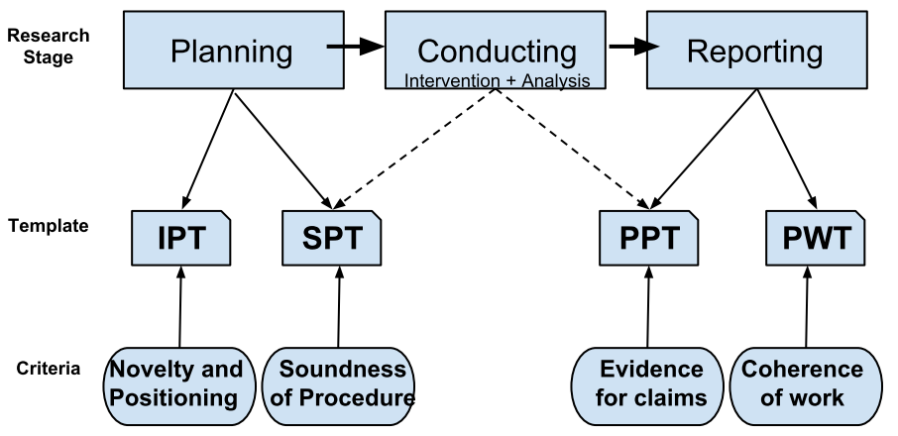
How do I ensure that my research meets the criteria?
Check out the templates created by IDP-Educational Technology, IIT Bombay
Source: Guidelines and Templates for Planning, Conducting and Reporting Educational Technology Research. Sahana Murthy and Sridhar Iyer. T4E 2013.

Slide 47
Research Templates
Download from www.et.iitb.ac.in/resources.html
Idea Proposal Template (IPT) - helps you explore if your idea is suitable for a research study.
Study Planning Template (SPT) - helps you plan the research study around your idea.
Paper Planning Template (PPT) – helps you plan the flow and ideas that will go into your paper.
Paper Writing Template (PWT) – helps you plan the paragraphs that will go into your paper.

Slide 48
Making your PhD an enriching and enjoyable experience
“Nearly everything is really interesting if you go into it deeply enough.” – Richard Feynman

Slide 49
Some gyan
Attend invited talks - including those outside your “area”
This will improve your breadth of knowledge
You may get ideas from a different field to use in your own
Take opportunities to present your work to diverse audiences
This will give you greater clarity on your work
You may get feedback on aspects that you have not thought about
Develop/Maintain a secondary technical skill
Programming, writing, tinkering, …
Develop strong peer relations
They help you survive the lean phases in your PhD
Don’t neglect your extra-curricular activities. ☺

Slide 50
Conclusion: Two points to keep in mind
Being a PhD student at IIT Bombay,
you are contributing to science/knowledge, by your work.
Remember this point whenever you feel depressed about your PhD.
However much you contribute through your work,
it is only drop in the ocean.
Remember this point whenever you feel too great about your expertise. It will help maintain perspective.

