Slide 1

Effective Teaching-Learning in Computer Science
Sridhar Iyer
Dept of CSE &
IDP in Educational Technology
Indian Institute of Technology Bombay
i-SIGCSE workshop on effective teaching in Computer Science
University of Pune, 03 Feb 2015
This presentation is released under Creative Commons-Attribution 4.0 License.
You are free to use, distribute and modify it , including for commercial purposes,
provided you acknowledge the source.

Slide 2
Interdisciplinary programme in Educational Technology
Started April 2010.
Ph.D. program – Research in:
  Technology enhanced learning environments for the development of pan-domain cognitive abilities. Ex: engineering design, system-thinking, problem posing, data visualization, algorithmic thinking, spatial abilities.
  Teacher use of educational technologies and strategies.
Outreach:
  Workshops, Consultancy, Continuing Education Program.
  Pedagogies for effective use of educational technologies.
    Workshops of varying durations - 3 days to 3 weeks.
    Face-to-face as well as distance education modes.
    4000+ teachers attended the workshop in Jan 2015, conducted via the T10KT platform.
  This talk is an overview of some topics from these workshops.

Slide 3
What do we want our students to learn?
Content (of course)
  how does it all fit together, hierarchy of concepts.
Abilities / skills
  complex problem solving, designing experiments, making predictions, how to check solutions.
Attitudes
  where do formulae come from, what is the purpose of engineering, what to do if problem is difficult.

Slide 4
Three aspects of effective pedagogy
Learning Objectives
  What do you want students to be able to do?
  Should be stated in measurable terms.
Assessment
  How do you determine that students have attained the learning objectives?
  Should be aligned with learning objectives.
Instructional Strategies
  How to do student-centric teaching?
  Focus of this talk → scope: classroom environment.

Slide 5
Principles from cognitive science research
Learning is not transfer of information. Learners actively construct their knowledge. (Constructivism)
What people already know affects what they learn (prior knowledge)
Effective learning happens when there is context (situated cognition)
Learning happens effectively as social activity (social learning)
Different students have different mental responses and different approaches to learning (individuality)

Slide 6
All good in theory, but how can a teacher practice these?
One solution:
Use active-learning strategies

Slide 7
What is active-learning?
Approach to teaching and learning whose goal is to engage students with the content via specific activities that get students to talk, write, reflect and express their thinking.
7
Notes:
7

Slide 8
Requirements of active learning strategies
Instructor creates carefully designed activities that require students to talk, write, reflect and express their thinking.
Majority of students go beyond listening, copying of notes, execution of prescribed procedures.
Explicitly based on theories of learning.
Evaluated repeatedly through empirical research.
  Note:
  Many informal strategies may have the goal of engaging students, but to be termed as active learning, they need to meet the above requirements.
Meltzer, David E., and Ronald K. Thornton. "Resource letter ALIP–1: active-learning instruction in physics." American journal of physics 80.6 (2012): 478-496.
8
Notes:
8

Slide 9
Why bother with active learning strategies?
Aren’t the following good enough?
I spend a lot of time preparing lectures.
I deliver my lectures smoothly.
I show them demos and videos.
I often pause to ask students if they understood the material.
I allow students to interrupt with doubts, queries and comments.
I never hesitate to answer their questions.
….
All of the above are necessary, but not sufficient.
Why aren’t these enough?
Let’s examine some empirical results.
9
Notes:
9

Slide 10
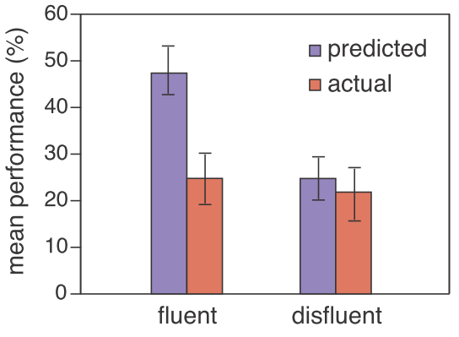
Some evidence for need for active learning
Experiment: 2 video lectures, same content and instructor.
  Fluent mode: speaks fluently, no notes, upright, eye-contact.
  Disfluent: speaks haltingly, often sees notes, “poor” body language.
Measurement: How much learning? Measured by a post-test.
  Predicted: fluent > disfluent
  Finding: fluent = disfluent
Implication:
Improving the fluency of lectures does not necessarily imply better learning. So we need to focus on identifying what does lead to better learning.
10
doi: 10.3758/s13423-013-0442-z
Notes:
10

Slide 11
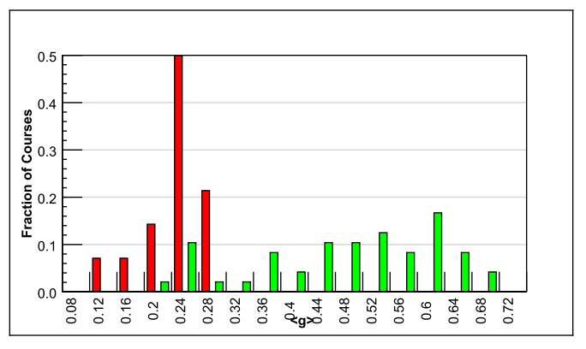
Gains from active learning strategies
6542 students
62 courses - Physics
Variety of institutions: high school, college, university (including Harvard)
Test used – FCI (Force Concept Inventory)
Trad lecture (14)
Active learning strategies (48)
Normalized gain
<g> = ^{post-pre} ^{100-pre}
Maximum gain from lecture courses was 0.28
  Many instructors had high scores on teaching evaluations
Gain from active-learning courses had a wide range: 0.23-0.7
  Active learning courses often had gains 2-3 times greater than lectures
Implication: It is desirable to explicitly incorporate active learning strategies in our teaching-learning process.
R. Hake, “Interactive-engagement versus traditional methods: A six-thousand student survey of mechanics test data for introductory physics courses” Amer. Jour. Phy., 66 (1998)
Notes:
11

Slide 12
Features of active learning strategies
Students engage in problem-solving activities during class time.
Speciﬁc student ideas are elicited and addressed.
Students are asked to “ﬁgure things out for themselves.”
Students are asked to express their reasoning explicitly.
Students work collaboratively.
Students receive rapid feedback on their work.
Qualitative reasoning and conceptual thinking are emphasized.
12
Notes:
12

Slide 13
Activity 1 - Is this teacher doing active-learning?
Teacher lectures. Every once in a while (say, 20 min), she pauses and:
Asks: Do you have any doubts? 3 students raise their hands. Teacher clarifies the doubts and resumes lecture.
Asks: How will you do/prove/solve … ? Some students respond. Teacher comments on the responses and resumes lecture.
Is this teacher doing active-learning?
Vote: 1) Yes 2) No
Turn to your neighbor: Do you have the same answer?
If not, attempt to convince your neighbor that your answer is right.
If yes, turn to another neighbor and discuss.
Vote again: 1) Yes 2) No
13
Notes:
13

Slide 14
Activity 1 - Is this teacher doing active-learning?
Teacher lectures. Every once in a while (say, 20 min), she pauses and:
Asks: Do you have any doubts? 3 students raise their hands. Teacher clarifies the doubts and resumes lecture.
Asks: How will you do/prove/solve … ? Some students respond. Teacher comments on the responses and resumes lecture.
Is this teacher doing active-learning?
Vote: 1) Yes 2) No
Recall active-learning:
Instructor creates carefully designed activities that require students to talk, write, reflect and express their thinking.
Majority of students go beyond listening, copying of notes, execution of prescribed procedures.
14
Notes:
14

Slide 15
Recap: What is active learning?
Approach to teaching and learning whose goal is to engage students with the content via specific activities that get students to talk, write, reflect and express their thinking.
Explicitly based on theories of learning.
Evaluated repeatedly through empirical research.
Why ‘interactive lectures’ are necessary but not sufficient:
  Students don’t pay utmost attention.
  Students think that they know (understand) the topic because they are able to follow the lecture.
  Focus needs to change from “How well am I lecturing?” to
  “How much are they learning?”
15
Notes:
15

Slide 16
Activity 2 – Fostering active-learning in your class
Think (Individually):
Choose a topic that you are about to teach. Come up with one activity that you will implement in class that requires students to talk, write, reflect and express their thinking. (~3 min).
Pair (with your neighbor):
Examine your neighbor’s activity. Does it ensure that majority of students are actively engaged - beyond listening, copying of notes?
If not, what modifications do you suggest? (~5 min).
Share (with everyone):
Your topic and strategy. (~10 min).
16
Notes:
16

Slide 17
Implementing active learning in your classes – some activities
Ask students to:
Pose problem, ask students to begin the problem solution
Ask students to complete the last 2 steps in the problem
Figure out the next step in the derivation
Devise possible reasons for an observation (shown in a video)
Predict the outcome of an program (shown in a video/ animation)
Brainstorm a list of methods to solve a design problem
Debate pros & cons of various methods

Slide 18
Important good practice –
Applicable for all active learning strategies
GET STUDENT BUY-IN.
Create it by explaining why you are doing this.
Better still demonstrate why you are doing this.
Notes:
18

Slide 19
What are some active learning strategies?
Peer-Instruction [Eric Mazur, Harvard University, early 1990s]
Think-Pair-Share [Frank Lyman, University of Maryland, early 1980s]
Team-Pair-Solo [Spencer Kagan, University of California, early 2000s]
Many others:
  Debates, Role-play, Jigsaw, problem-based learning, productive failure.
Activity 1
Activity 2

Slide 20
Peer-Instruction is a classroom active-learning strategy based on specific, well-designed questions, often of the multiple-choice type.
Notes:
20

Slide 21
Dissecting Peer-Instruction method
What do students do? What are the benefits?
Talk, argue, listen (sometimes), reason, draw => Actively engaged
Learn from each other, teach each other (teach<=>learn)
Those who don’t know willing to think, reason, answer
Those who do know also participate
Pre-existing thinking is elicited, confronted, resolved (How many of
you changed your answer?)
What are benefits to instructor? To the class atmosphere?
Immediate feedback to instructor
Students realize that even others are struggling
Builds a friendly, yet scientific atmosphere
Improve communication

Slide 22
More on Peer-Instruction
Overview-level (following slides)
Details (later within this presentation)
Workshop (constructors, videos)

Slide 23

Anatomy of Peer-Instruction method
Ask Question
(May vote individually)
…Lecture…
Debrief /
Class Discussion
Peer Discussion
Vote
Figure attributed to: Stephanie Chasteen and the Science Education Initiative at the University of Colorado
See also: Peer Instruction, A User’s Manual. Eric Mazur.
23
Notes:
23

Slide 24
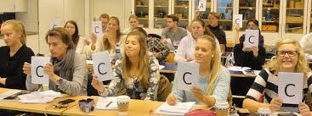
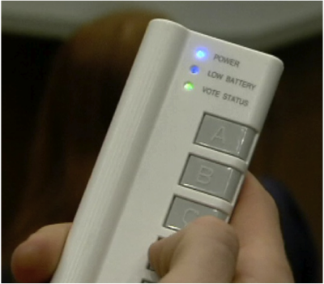

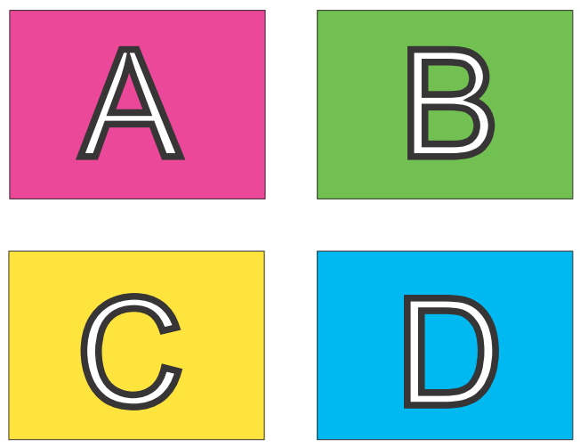
Implementing Peer-Instruction
Clickers
Image from Monash University Peer Instruction in the Humanities Project http://tinyurl.com/kh7uo2o
A4 sheet of paper
Fold it in four
Marker – A, B, C, D
Fingers

Slide 25
Example 1: Counting iterations
Below is the for loop for calculating the factorial of a number. How many times is this set of code executed ?
for (i = 1; i <= N; i ++) {
nFactorial = nFactorial * i;
}
1 time
N times
N -1 times
N + 1 times

Slide 26
Example 2: Predict the outcome of a program
What is the output of the code shown below?
int main() {
int a = 1; b = 2; c = 3;
int *p, *q;
p = &a; q = &b;
c = *p; p = q;
*p = 13;
cout << a << b << c;
}
a=1, b=2, c=3
a= 1, b=13, c=1
a=1, b=2, c=1

Slide 27
What makes a peer-instruction question “good”?
An effective peer-instruction question:
  Is usually conceptual (avoid long analytic computation)
  Elicits pre-existing thinking, students’ alternate conceptions
  Has believable distractors
  Asks students to predict results of experiment, or algorithm
  Makes students apply ideas in new context
  Relates different representations
  is not ambiguous
  is not leading
  is not ‘trivial’
Adapted from Clicker Resource Guide, Science Education Initiative/ CU-Boulder .
27

Slide 28
When to use PI within the learning cycle
BEFORE
Setting up instruction
(beginning of module)
DURING
Developing knowledge
(middle of module)
AFTER
Assessing learning
(end of module)
Questions to:
Motivate
Discover
Provoke thinking
Assess prior knowledge
Questions to:
Check knowledge
Application
Analysis
Evaluation
Synthesis
Elicit misconception
Questions to
Relate to big picture
Demonstrate success
Review or recap
Exit poll
Adapted from From from “iClicker” by Stephanie Chasteen and the Science Education Initiative at the University of Colorado
28
Notes:
An alternate presentation of the Question Cycle by Peter Newbury
28

Slide 29
Challenges you might face
POSSIBLE CHALLENGES | RECOMMENDED STRATEGIES
The class is too quiet. | Be patient – students’ reluctance to discuss improves after 3-4 iterations Do solo vote, allow enough time
The class is too noisy. | That’s ok, this is good noise. Most students are seen to be on task.
Some students just may not participate. | Explain why you are doing this, use challenging & interesting questions, … let them be
The class will get chaotic. How do I get students back? | Use a cue such as a bell
Notes:
29

Slide 30
Plenty of resources
Peer-instruction How-tos, workshop slides, videos, research … Carl Wieman Science Education Institute http://www.cwsei.ubc.ca/resources/clickers.htm
and host of links from within
Instructors in many disciplines have posted peer-instruction questions for their courses – physics, CS, Statistics – use Google (search with varied nomenclature – PI, clickers, PRS)
BUT …
We need to create a library of questions for our courses, report experiences in our context.
Please participate! www.et.iitb.ac.in
Notes:
30

Slide 31
What are some active learning strategies?
Peer-Instruction [Eric Mazur, Harvard University, early 1990s]
Think-Pair-Share [Frank Lyman, University of Maryland, early 1980s]
Team-Pair-Solo [Spencer Kagan, University of California, early 2000s]
Many others:
  Debates, Role-play, Jigsaw, problem-based learning, productive failure.
Activity 1
Activity 2

Slide 32
Think-Pair-Share is a classroom active-learning strategy in which students work on a problem posed by instructor,
  first individually (Think),
  then in pairs (Pair) or groups, and
  finally together with the entire class (Share).
Notes:
32

Slide 33
Dissecting Think-Pair-Share method
What do students do? What are the benefits?
Talk, argue, listen (sometimes), reason, draw => Actively engaged
Learn from each other, teach each other (teach<=>learn)
Those who don’t know and those who do know also participate
Students can tackle large and ill-structured problems
What are benefits to instructor? To the class atmosphere?
Immediate feedback to instructor
Builds a friendly, yet scientific atmosphere
Improves ability to consider multiple points of view
Includes all students in the teaching-learning process

Slide 34
More on Think-Pair-Share
Overview-level (following slides)
Details (later within this presentation)
Workshop (constructors, videos)

Slide 35
TPS: Definition
T (Think): Teacher asks a specific question about the topic. Students "think" about what they know or have learned, and come up with their own individual answer to the question. [Takes 1-3 Minutes].
P (Pair): Teacher asks another question, related to the previous one, that is suitable to deepen the students’ understanding of the topic. Each student is paired with another student. They share their thinking with each other and proceed with the task. [Takes 5-10 Minutes].
S (Share): Students share their thinking (or solution) with the entire class. Teacher moderates the discussion and highlights important points. [Takes 10-20 minutes].

Slide 36
TPS in CS 101: Example 1 (conceptual)
“Consider an unsorted array of N elements”.
Think: Write the pseudo code for sorting the array.
  Students do: Write down answer the given question.
  Instructor does: Encourages students to write, instead of working mentally.
Pair: Discuss your answer with your neighbor, do pros and cons analysis of your algorithms.
  Students do: (i) Identify parts of the answer that they have missed out. (ii) Discuss which answer is better; do pros-cons analysis if there are multiple solutions.
  Instructor does: (i) Walks around the class to get a feel of student solutions. (ii) Gives comments where necessary, to ensure that discussion is on-track.
Share: Participate in discussion of your solution and others.
  Students do: (i) Share their own solution. (ii) Critique other’s solutions.
  Instructor does: Discusses (i) What are all the essential parts in the answer? (ii) Pros-cons of various solutions given by students.
This TPS activity led to a discussion of various sorting algorithms.

Slide 37
Did TPS work in CS101?
We measured student engagement and learning:
  Observed a total of 13 TPS activities across the semester.
  Performed 2-group experiment to measure learning with and without TPS.
Engagement results
  83% of students on average mostly or fully engaged.
  Students self-perception of engagement matches our measurements.
Learning results
  Experimental group (which learned a concept via a TPS-activity) performed significantly better (with a moderate to high effect size) than the control group (which learned the same concept from an interactive lecture).
  Students self-perception of learning due to TPS is high (>70% agreement).
A.Kothiyal, R. Majumdar, S. Murthy and S. Iyer, “Effect of Think-Pair-Share in a large CS1 class: 83% sustained engagement” ACM International Computing Education Research (ICER) Workshop, San Diego, 2013
A. Kothiyal, S. Murthy and S. Iyer, “Think-Pair-Share in a large CS1 class: Does learning really happen?” ACM Innovations and Technology in Computer Science Education (ITiCSE) , Uppsala, 2014

Slide 38
Summary of TPS setup guidelines
Download the TPS-activity-constructor resource sheet from:
  Download from www.et.iitb.ac.in/resources
Three points to keep in mind:
  Ensure that there is a clear ‘deliverable’ for each phase. This drives the action in that phase.
  Ensure that the phases are logically connected. They should use the output of one phase in next.
  Ensure that there is sufficient time for each phase.
  Too little → Frustration; Too much → Boredom.
  Move on when 80% of the class has finished.

Slide 39
Going further

Slide 40
Education research in your classroom
As teachers, we often have good ideas on how to tackle some “problem” in our classroom, such as,
  Active learning for student engagement; Project based learning for connection to real-life.
Usually we stop with ‘trying out’ our idea in our class and getting some informal ‘evidence’, such as,
  My students seem more engaged. I talked a few of them and they agreed.
  I find that they are asking deeper questions, writing better answers.
Your classroom is actually an opportunity for you to:
  Perform action research and generate convincing evidence in a scientific manner, so that your colleagues can appreciate and adopt your ideas.
We have created Guidelines and Templates to help you carry out action research on your own idea, in your own classroom:
  Download from www.et.iitb.ac.in/resources

Slide 41
Conferences
T4E is an IEEE conference on Technology for Education, held in India since 2009. T4E 2016 is in NIT Warangal.
ICCE is an Asia-Pacific conference on Computers in Education. ICCE 2016 will be held in IIT Bombay, in Dec 2016.
LATiCE is an IEEE co-sponsored conference on Learning and Technology in Computing Education. LATiCE 2016 will be held in IIT Bombay, in April 2016.
ITiCSE is an ACM conference on Innovations and Technology in Computer Science Education. ITiCSE 20XX may be held in India!
More info: www.et.iitb.ac.in
41

Slide 42
Peer-Instruction Details

Slide 43
Anatomy of Peer-Instruction method
Ask Question
(May vote individually)
…Lecture…
Debrief /
Class Discussion
Peer Discussion
Vote
Figure attributed to: Stephanie Chasteen and the Science Education Initiative at the University of Colorado
See also: Peer Instruction, A User’s Manual. Eric Mazur.
43
Notes:
43

Slide 44


Implementing Peer-Instruction with clickers

Slide 45
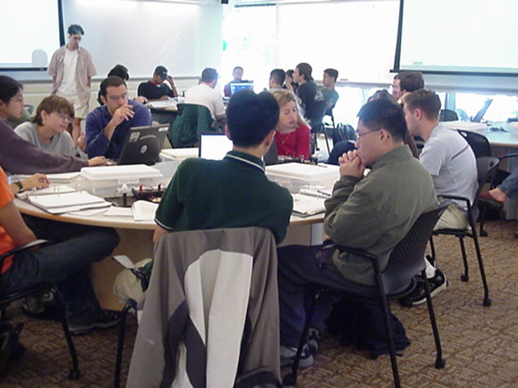
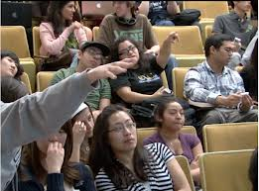
But clickers are not Peer-Instruction
MIT TEAL classroom
From blog.peerinstruction.net

Slide 46


How to implement Peer-Instruction without clickers

Slide 47
How to implement Peer-Instruction in your class
Image from Monash University Peer Instruction in the Humanities Project http://tinyurl.com/kh7uo2o
OR:
A4 sheet of paper
Fold it in four
Marker – A, B, C, D

Slide 48
Why Peer-Instruction
Notes:
48

Slide 49
PI one of the most widely researched* strategies
(* This is good because …)
Extent of research
  300+ research articles
  Physics, biology, chemistry maths, CS, engineering, psychology, medicine & nursing …
  Many controlled studies using standardized tests
Courses using peer instruction outperform traditional lecture courses on a common test
Students can better answer a question on their own, after peer instruction discussion, (especially difficult questions) – study with 16 pairs of isomorphic questions Smith et al, Science 2009
Research on student perception says: clickers help students show up for class, feel part of class community, make their voice heard, hold them accountable …

Slide 50
Writing effective Peer-Instruction questions
Notes:
50

Slide 51
Example 1: Counting iterations
Below is the for loop for calculating the factorial of a number. How many times is this set of code executed ?
for (i = 1; i <= N; i ++) {
nFactorial = nFactorial * i;
}
1 time
N times
N -1 times
N + 1 times

Slide 52
Example 2: Predict the outcome of a program
What is the output of the code shown below?
int main() {
int a = 1; b = 2; c = 3;
int *p, *q;
p = &a; q = &b;
c = *p; p = q;
*p = 13;
cout << a << b << c;
}
a=1, b=2, c=3
a= 1, b=13, c=1
a=1, b=2, c=1

Slide 53
Example 3: What does this code do?
main () {
int vn=9, va[vn];
for (int i = 0; i < vn; i++) va[i] = i * (vn – 1 –i);
for (int i = 0; i < vn; i++) cout << va[i] << “,”;
cout << endl;
}
What does this code do?
Calculates values of array va[]
Prints the values of first vn elements of va
Initializes the array va and prints it
Finds maximum element in the array

Slide 54
Example 4: What will happen if …. ?
Consider the function and main program shown below.
void fun (int& x) { x = 5; }
int main () {
int a = 3;
fun(a);
cout << a << endl;
}
What will happen if we change the function call from
fun (int& x) to fun (int x) ?
No change in the output
Program will not compile
a = 5 will be printed
a = 3 will be printed

Slide 55
Example 5: Debug
int val = 5;
switch (val) {
case 5: cout << “five ”;
break;
case 4: cout << “four ”;
break;
default: cout << “default”;
break;
}
What will happen if we forget to include ‘break’ statement?
Compiler error
It will print only five
It will print five four
It will print five four default

Slide 56
What makes a peer-instruction question “good”?
An effective peer-instruction question:
  Is usually conceptual (avoid long analytic computation)
  Elicits pre-existing thinking, students’ alternate conceptions
  Has believable distractors
  Asks students to predict results of experiment, or algorithm
  Makes students apply ideas in new context
  Relates different representations
  is not ambiguous
  is not leading
  is not ‘trivial’
Adapted from Clicker Resource Guide, Science Education Initiative/ CU-Boulder .
56

Slide 57
What makes a good Peer-Instruction question?
clarity | Students should waste no effort trying to figure out what’s being asked.
context | The topic of the question should be relevant to the class.
connection to learning goals | Does the question make students do the right thing to demonstrate they grasp the concept.
distractors | i) Must be plausible. ii) “Wrong” choices should tell you something about students’ thinking.
difficulty | Check that the question is not too trivial or too hard (note – there exists a theory for this)
stimulates thoughtful discussion | The question should engage students and spark thoughtful discussions. Is there potential for you to be “agile”?
Adapted from “Writing Questions” by Stephanie Chasteen and the Science Education Initiative at the University of Colorado
Notes:
Courtesy of Cynthia Heiner and Peter Newbury
You may then show a series of questions to participants and ask them to consider these aspects: clarity, context, connection, distractors, difficulty, and discussion
57

Slide 58
Activity – write your own question
Choose a topic in an Intro-to-programming course.
Write 3 peer-instruction question in that topic.
Make sure you include the choices too ~ 3 to 5.
Recall – An effective PI question :
  Elicits pre-existing thinking, students’ misconceptions
  Has believable distractors
  Asks students to predict results of a program or algorithm
  Makes students apply ideas in new context
  Relates different representations
Avoid
  Long calculations
  Trivial questions

Slide 59
When to use Peer-instruction questions
Notes:
59

Slide 60
Questions within the learning cycle
BEFORE
Setting up instruction
(beginning of module)
Questions to:
Motivate
Discover
Provoke thinking
Assess prior knowledge
Notes:
An alternate presentation of the Question Cycle by Peter Newbury
60

Slide 61
Questions within the learning cycle
BEFORE
Setting up instruction
(beginning of module)
DURING
Developing knowledge
(middle of module)
Questions to:
Motivate
Discover
Provoke thinking
Assess prior knowledge
Questions to:
Check knowledge
Application
Analysis
Evaluation
Synthesis
Elicit misconception
Notes:
An alternate presentation of the Question Cycle by Peter Newbury
61

Slide 62
Questions within the learning cycle
BEFORE
Setting up instruction
(beginning of module)
DURING
Developing knowledge
(middle of module)
AFTER
Assessing learning
(end of module)
Questions to:
Motivate
Discover
Provoke thinking
Assess prior knowledge
Questions to:
Check knowledge
Application
Analysis
Evaluation
Synthesis
Elicit misconception
Questions to
Relate to big picture
Demonstrate success
Review or recap
Exit poll
Adapted from From from “iClicker” by Stephanie Chasteen and the Science Education Initiative at the University of Colorado
62
Notes:
An alternate presentation of the Question Cycle by Peter Newbury
62

Slide 63
Challenges and Best Practices
Notes:
63

Slide 64
Challenges you might face
POSSIBLE CHALLENGES | RECOMMENDED STRATEGIES
The class is too quiet.
The class is too noisy.
Notes:
64

Slide 65
Challenges you might face
POSSIBLE CHALLENGES | RECOMMENDED STRATEGIES
The class is too quiet. | Be patient – students’ reluctance to discuss improves after 3-4 iterations Do solo vote, allow enough time
The class is too noisy.
Notes:
65

Slide 66
Challenges you might face
POSSIBLE CHALLENGES | RECOMMENDED STRATEGIES
The class is too quiet. | Be patient – students’ reluctance to discuss improves after 3-4 iterations Do solo vote, allow enough time
The class is too noisy. | That’s ok, this is good noise. Most students are seen to be on task.
Notes:
66

Slide 67
Challenges you might face
POSSIBLE CHALLENGES | RECOMMENDED STRATEGIES
The class is too quiet. | Be patient – students’ reluctance to discuss improves after 3-4 iterations Do solo vote, allow enough time
The class is too noisy. | That’s ok, this is good noise. Most students are seen to be on task.
Some students just may not participate. | Explain why you are doing this, use challenging & interesting questions, … let them be
Notes:
67

Slide 68
Challenges you might face
POSSIBLE CHALLENGES | RECOMMENDED STRATEGIES
The class is too quiet. | Be patient – students’ reluctance to discuss improves after 3-4 iterations Do solo vote, allow enough time
The class is too noisy. | That’s ok, this is good noise. Most students are seen to be on task.
Some students just may not participate. | Explain why you are doing this, use challenging & interesting questions, … let them be
The class will get chaotic. How do I get students back? | Use a cue such as a bell
Notes:
68

Slide 69
Best Practices
On Writing Questions
Recommended – questions requiring conceptual reasoning (verbal, logical, diagrammatic)
Avoid – questions involving number crunching (but can use PI to precede a numerical problem, for ex … )
Recommend – Mix it up.
  WHY: different pedagogical goals : bringing out a misconception, predicting an outcome, recall point from last class
  WHAT: different types of questions: survey, representations, reasoning, Y/N
  WHEN: at a variety of points during class (beginning / middle / end)
Avoid - questions that can be answered by memorization (unless that’s your goal, then use sparingly).
Notes:
69

Slide 70
Best Practices
On Facilitating Peer-Instruction
DON’T SKIP ON PEER DISCUSSION (if single vote, only after group talk)
FOCUS ON REASONING NOT ON RIGHT ANSWER.
  Withhold judgment. Do not give ‘rapid rewards’ (nodding in assent)
  Discuss reasons for right and wrong answers
  Ask multiple students to give answers.
TIME. Recommended 2-5 minutes per question.
FREQUENCY. Recommended – a “few” per class, 2-4.
CREDIT. Do not assign heavy credit for right / wrong answers. Some instructors (with clickers) assign a “whiff” of credit for participation.
I like to circulate, listen to student reasoning, give individual attention
Notes:
70

Slide 71
Plenty of resources
Peer-instruction How-tos, workshop slides, videos, research … Carl Wieman Science Education Institute http://www.cwsei.ubc.ca/resources/clickers.htm
and host of links from within
Instructors in many disciplines have posted peer-instruction questions for their courses – physics, CS, Statistics – use Google (search with varied nomenclature – PI, clickers, PRS)
BUT …
We need to create a library of questions for our courses, report experiences in our context.
Please participate! www.et.iitb.ac.in
Notes:
71

Slide 72
Think-Pair-Share Details

Slide 73
Clicker Question
Consider a large class. Ex: CS1 to 450 first year undergraduate students, across various engineering disciplines.
Imagine a 90-minute class in a traditional lecture mode in a large auditorium with fixed seats (Oh yes, we still have many of those).
30 minutes into the class, you take a snapshot of the students.
Predict the percentage of students who may be showing “engaged behavior” (with the content of the lecture).
A. 0-20 % | B. 21-40 % | C. 41-60 % | D. 61-80 % | E. 81-100 %
Do: Voting – Peer-Discussion – Vote again

Slide 74
Think-Pair-Share Activity
Consider the same scenario as in the previous slide - large class, 90-minute traditional lecture, auditorium seating.
Think (Individually):
  Predict the percentage of “engaged” students at various instants of time. Draw a graph of engagement versus time. [~1 Minute]

Slide 75
Think-Pair-Share Activity
Consider the same scenario as in the previous slide - large class, 90-minute traditional lecture, auditorium seating.
Think (Individually):
  Predict the percentage of “engaged” students at various instants of time. Draw a graph of engagement versus time. [~1 Minute]
Pair (with your neighbor):
  Examine each other’s graphs. Converge on a single graph. [~2 Minutes]
  List three techniques that could be used to convert your graph into something that looks like the figure shown. [~3 Minutes]
0.8
% e
t

Slide 76
Think-Pair-Share Activity
Consider the same scenario as in the previous slide - large class, 90-minute traditional lecture, auditorium seating.
Think (Individually):
  Predict the percentage of “engaged” students at various instants of time. Draw a graph of engagement versus time. [~1 Minute]
Pair (with your neighbor):
  Examine each other’s graphs. Converge on a single graph. [~2 Minutes]
  List three techniques that could be used to convert your graph into something that looks like the figure shown. [~3 Minutes]
Share (entire class):
  Create a combined list of techniques. [~3 Minutes]
  Discuss pros and cons of each technique. [~2 Minutes each]
  Identify top three techniques that are likely to “succeed”. [~3 Minutes]
0.8
% e
t

Slide 77
Think-Pair-Share (TPS)
What is TPS? - Illustrated through an activity on an earlier slide.
  Definition follows on a later slide (boring).
Why TPS?
  Well known challenges to teaching-learning in large classes – more easy for students to tune out and get distracted into using their mobiles, talking, or other off-task activities.
  Active learning techniques that engage the entire class are required.
  There is research on various aspects of peer-discussion technique.
  Not so much is known about TPS.
  Later discussion: When to use peer-discussion and when to use TPS.

Slide 78
TPS: Definition
T (Think): Teacher asks a specific question about the topic. Students "think" about what they know or have learned, and come up with their own individual answer to the question. [Takes 1-3 Minutes].
P (Pair): Teacher asks another question, related to the previous one, that is suitable to deepen the students’ understanding of the topic. Each student is paired with another student. They share their thinking with each other and proceed with the task. [Takes 5-10 Minutes].
S (Share): Students share their thinking (or solution) with the entire class. Teacher moderates the discussion and highlights important points. [Takes 10-20 minutes].

Slide 79
TPS: Example
Consider the TPS activity shown below:
Write a program to find the smallest and largest element in a given array
Think: Write the pseudo-code individually. [5 min]
Pair: Write the c++ code with a partner. [10 min]
Share: Compare with demo-array.cpp. [5 min]
Discussion: Why is this a “good” TPS activity?
*
Notes:
*

Slide 80
TPS in CS 101: Example 1 (conceptual)
“Consider an unsorted array of N elements”.
Think: Write the pseudo code for sorting the array.
  Students do: Write down answer the given question.
  Instructor does: Encourages students to write, instead of working mentally.
Pair: Discuss your answer with your neighbor, do pros and cons analysis of your algorithms.
  Students do: (i) Identify parts of the answer that they have missed out. (ii) Discuss which answer is better; do pros-cons analysis if there are multiple solutions.
  Instructor does: (i) Walks around the class to get a feel of student solutions. (ii) Gives comments where necessary, to ensure that discussion is on-track.
Share: Participate in discussion of your solution and others.
  Students do: (i) Share their own solution. (ii) Critique other’s solutions.
  Instructor does: Discusses (i) What are all the essential parts in the answer? (ii) Pros-cons of various solutions given by students.
This TPS activity led to a discussion of various sorting algorithms.

Slide 81
TPS in CS 101: Example 2 (detailing)
Learning outcome
  “Students should be able to write programs for given task (using threads in Scratch)”.
Problem statement
  “Recall the drag-and-drop game demo that we saw in the last class. You and your neighbor have to now create this game. One of you has to write the script (code) for the 'trashcan' object (sprite) while the other writes the script for the 'falling trash' sprite.”
Think (3 minutes)
  Individually, students wrote the pseudo-code for their chosen sprite.
Pair (5 minutes)
  Along with their neighbor, each student wrote the code to interface his/her sprite with its counterpart written by the neighboring student.
Share (8-10 minutes)
  Instructor elicited responses from a few pairs and discussed their solution details. Pairs that had used different approaches from the ones discussed were encouraged to speak. Instructor summarized some solution approaches and their pros and cons.

Slide 82
TPS in CS 101: Example 3 (Multiple solutions)
Suppose you have to write a Taxi Service program. When a driver arrives, his ID is entered in an array driverID (if the array has space). When a customer arrives the earliest waiting driver (if any) in driverID is assigned to the customer.
Think: What struct and variables are required?
Pair: Discuss the pseudo-code for the functions that are required.
Share: Compare with demo18-queue.cpp

Slide 83
Activity - Write a TPS question
Suppose you want to create a TPS activity that should lead students towards:
Write a program to manage the contacts data on a phone.
Group work (in pairs):
What will you specify as the actions to be done in each phase of the TPS activity?
Notes:
*

Slide 84
TPS in CS 101: Example 4 (design)
Write a program to manage your ‘Contacts’ information.
  You need to store the following information about each contact – Name, Phone number, Email id.
  You need to provide functions to – Input, Lookup, Update and Delete – information.
Think: How will you store the information? Write the C++ class declarations for the data structures.
Pair: Discuss with your neighbor’s answer and agree on the class declarations. Together, write the code for the functions.
Share: Participate in discussion of your solutions and others.

Slide 85
Summary of TPS setup guidelines
Download the TPS-activity-constructor resource sheet from:
  Download from www.et.iitb.ac.in/resources
Three points to keep in mind:
  Ensure that there is a clear ‘deliverable’ for each phase. This drives the action in that phase.
  Ensure that the phases are logically connected. They should use the output of one phase in next.
  Ensure that there is sufficient time for each phase.
  Too little → Frustration; Too much → Boredom.
  Move on when 80% of the class has finished.

Slide 86
Experiments with TPS in CS 101
(Details)

Slide 87
Goals
Instructional Goals: standard CS 101 context
  Students should be able to read code, trace code, write code.
  Students should be able to demonstrate conceptual understanding.
  And (since multiple valid solutions may exist), students should be able to analyze the pros and cons of various solutions.
Pedagogical Goals:
  Incorporate active learning techniques a large classroom setting - keep students engaged with the content, with the instructor and with each other - through Writing, Talking, Reflecting.
  Encourage a student to come up with his/her idea of the solution first.
  Get students to work with each other for detailing, so that they do not feel daunted by the task.
Our chosen technique – TPS.
Research Goal: Quantify the engagement & learning due to TPS.

Slide 88
How we implemented TPS
Think:
  The instructor posed a question like predict the output or write the pseudo-code.
  The students worked individually on the task.
  About two minutes.
Pair:
  The instructor gave a task related to the Think phase, such as check your neighbor’s solution, or work with your neighbor to write the detailed code for the given problem.
  The students worked with one of their neighbor’s to complete the task
  Three to five minutes.
Share:
  The instructor facilitated a class-wide discussion related to the tasks in the Think and Pair phases.
  Students participated in the discussion to verify their solution, propose alternate solutions, and discuss ‘what-if’ scenarios.
  Open ended, lasting from three to fifteen minutes depending on the intensity of the discussion.

Slide 89
Did TPS work in CS101? - Overview
We measured student engagement and learning:
  Observed a total of 13 TPS activities across the semester.
  Performed 2-group experiment to measure learning with and without TPS.
Engagement results
  83% of students on average mostly or fully engaged.
  Students self-perception of engagement matches our measurements.
Learning results
  Experimental group (which learned a concept via a TPS-activity) performed significantly better (with a moderate to high effect size) than the control group (which learned the same concept from an interactive lecture).
  Students self-perception of learning due to TPS is high (>70% agreement).
A.Kothiyal, R. Majumdar, S. Murthy and S. Iyer, “Effect of Think-Pair-Share in a large CS1 class: 83% sustained engagement” ACM International Computing Education Research (ICER) Workshop, San Diego, 2013
A. Kothiyal, S. Murthy and S. Iyer, “Think-Pair-Share in a large CS1 class: Does learning really happen?” ACM Innovations and Technology in Computer Science Education (ITiCSE) , Uppsala, 2014

Slide 90
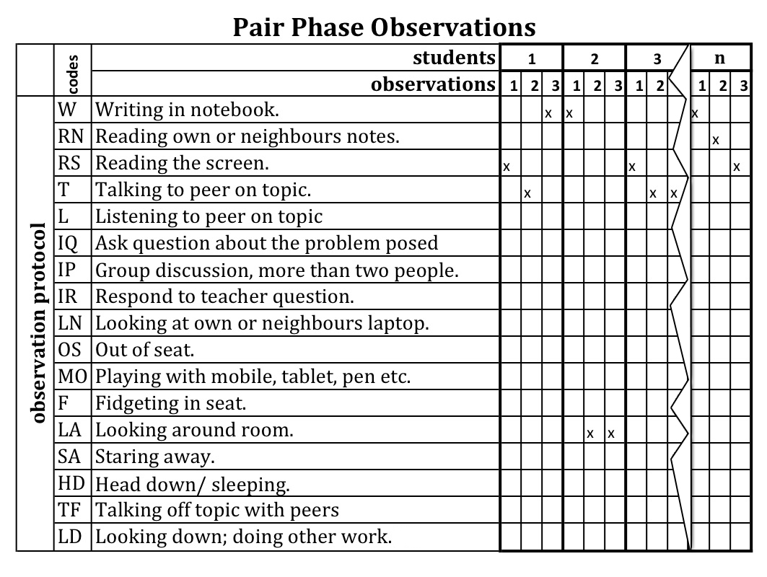
How did we measure engagement? - Observation Protocol

Slide 91
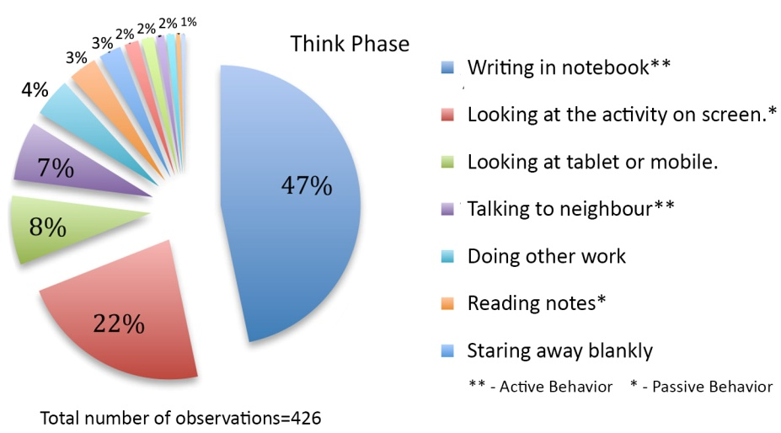
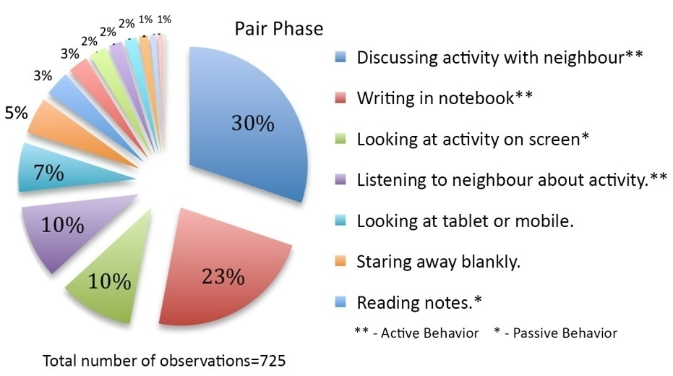
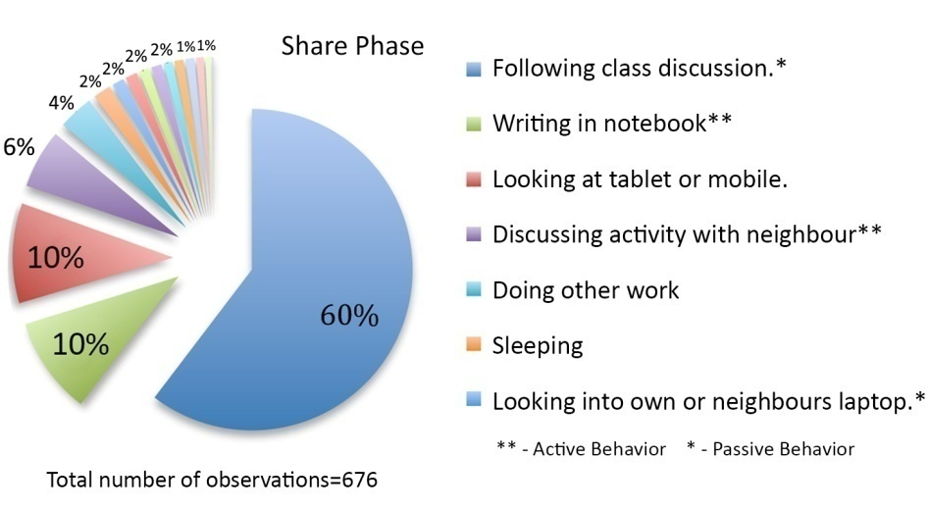
Frequencies of behaviours in each phase

Slide 92
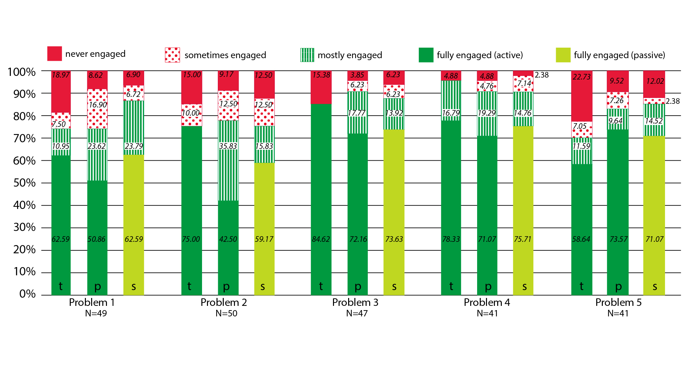
Average classroom engagement levels

Slide 93
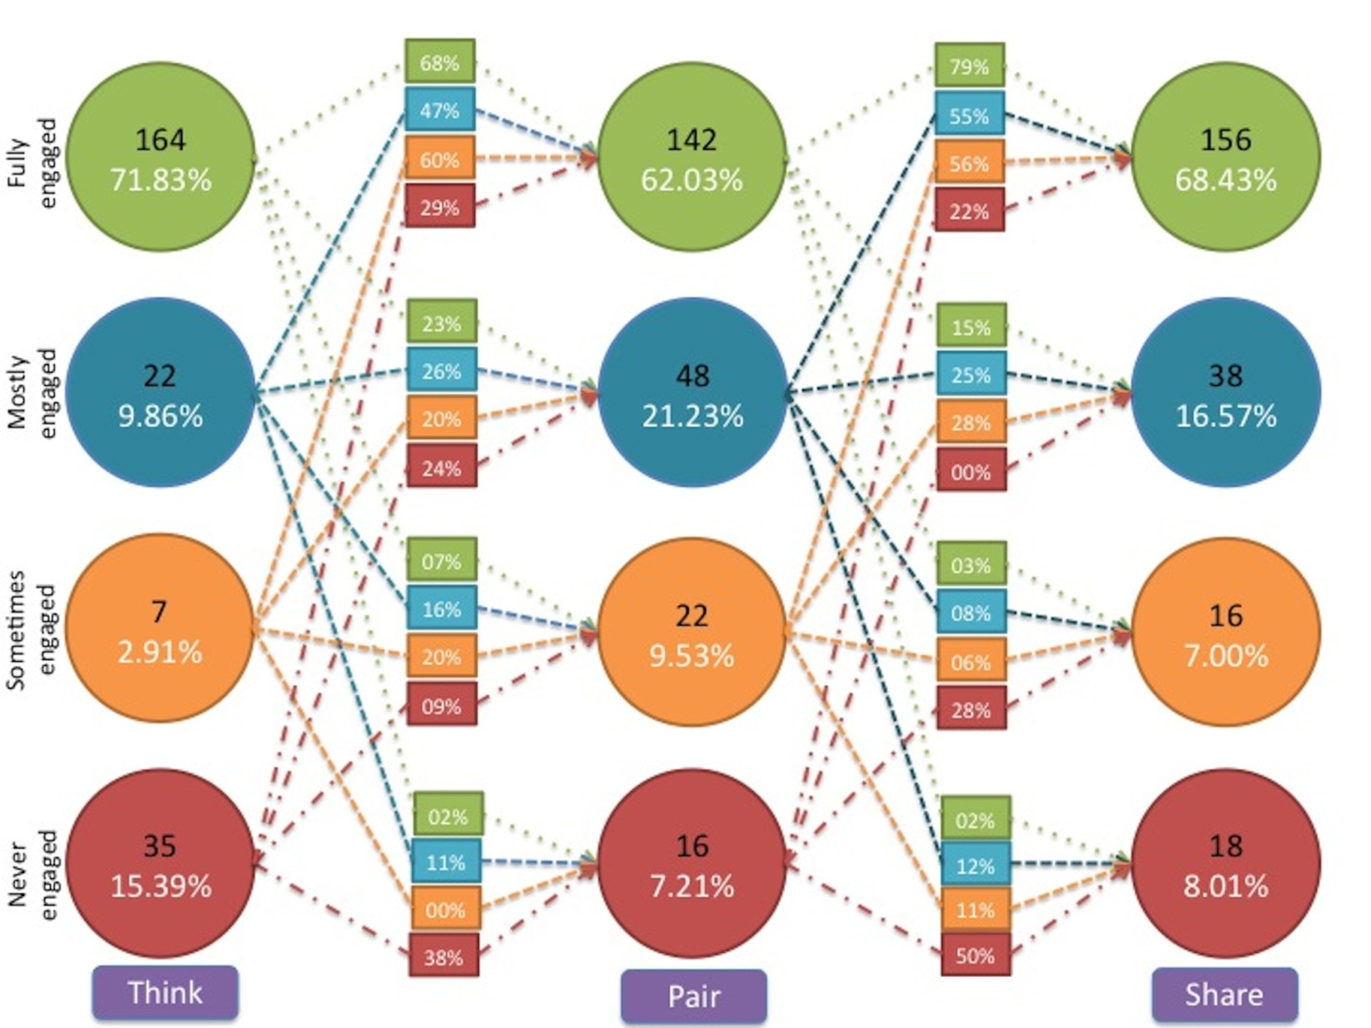
Student behaviour transition model

Slide 94
How did we triangulate? - engagement survey
Measured self-reported student engagement during the TPS activities.
Two questions on a 5 point Likert scale:
  How frequently did you write the solution to the problem given by the instructor during the think phase?
  How frequently did you discuss your solution with your partner during the pair phase?

Slide 95
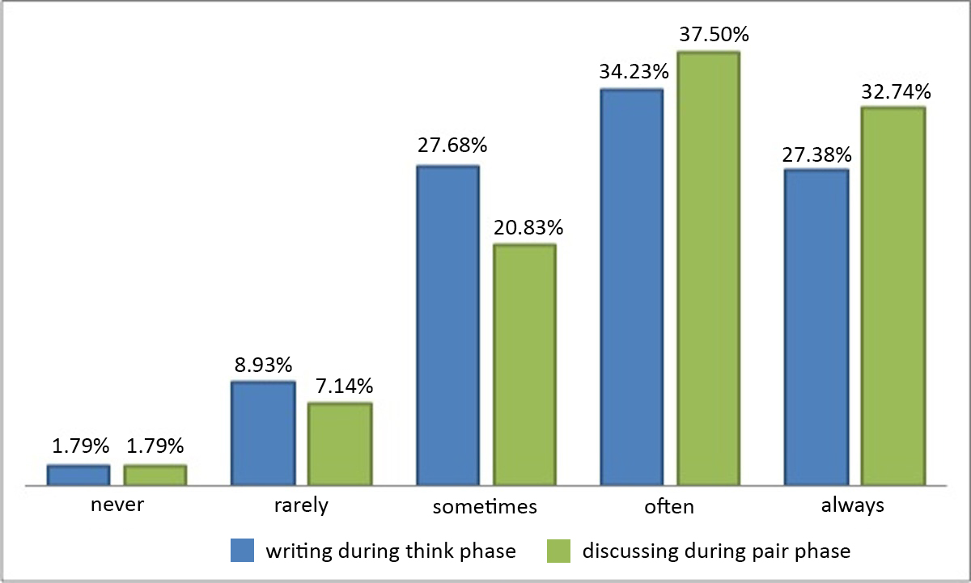
Survey questions - responses

Slide 96
Summary of TPS for engagement
RQ1: What behaviors do students engage in during TPS in a large class?
  Range of behaviors are displayed (see pie charts).
  Predominantly follows expectations of desirable behavior in each phase.
RQ2: How much student engagement occurs during TPS acitivity?
  70% to 95% of students are engaged, averaging out to 83% (see bar charts).
  Observations and self-reported engagement triangulate well.
RQ3: How does the engagement change as the TPS progresses?
  Student who is fully engaged in the think phase is likely remain engaged with probability 0.68 (see state-transition diagram).
  Significant probabilities (0.47, 0.6) that students from lower engagement states in think phase will move to higher engagement states in pair phase.

Slide 97
TPS and learning
Two-group, quasi-experimental study:
  One section was the experimental group (263 students), which received a TPS treatment, and the other was control group (184 students), which received a regular interactive lecture. Same instructor for both groups.
Topic: CPU execution sequence of multiple threads.
  Concept is new to both novices and advanced learners, so their prior knowledge does not play a role.
TPS Treatment:
  Think: Write one possible interleaved execution sequence.
  Pair: Check your neighbors’ solution. If it is the same as yours, come up with a second possible interleaved execution sequence.
  Share: Identify differences in your solution with one given by the Instructor.
Post-test:
  Problem on thread interleaving, similar to the one discussed. Included as the last part of Quiz1 – in the class following the above activity.
A. Kothiyal, S. Murthy and S. Iyer, “Think-Pair-Share in a large CS1 class: Does learning really happen?” ACM Innovations and Technology in Computer Science Education (ITiCSE) , Uppsala, 2014

Slide 98
TPS and learning: Research Questions
RQ1: Do TPS activities lead to increased conceptual understanding and application of CS1 concepts?
  Answered through: 2 group quasi-experimental study.
RQ2: What are the students’ perceptions of learning with TPS?
  Answered through: Focus group interviews.
RQ3: What are the instructor’s perceptions of teaching with TPS?
  Answered through: Instructor class logs.

Slide 99
RQ1: Learning outcome measurement
Two-group, pre-post quasi-experimental study.
Sample – Course had 2 sections and same instructor for both.
  One section was the experimental group (263 students), which received a TPS treatment, and the other was control group (184 students), which received a regular interactive lecture.
  Equivalence established on the basis of a pre-test of 5 questions on the pre-requisites. Mann Whitney U test showed no significant difference.
Treatment: Topic - CPU execution sequence of multiple threads.
  Concept is new to both novices and advanced learners, so their prior knowledge does not play a role.
  Instructor first explained the concept of multiple threads and thread synchronization via an interactive lecture. Next the instructor presented a problem on interleaving of threads.
  Control group: instructor explained the solution as a worked example
  Experimental group: problem was presented as a TPS activity

Slide 100
RQ1: Problem given during treatment
Thread A When Run flag clicked, Say “Thread A start”; Repeat 2 times ● Move 10 steps; Say “Thread A done” | Thread B When Run flag clicked Say “Thread B start”; Turn 90 degrees; Broadcast “event”; Say “Thread B done”; | Thread C When I receive “event”, Glide to (0,0).
Assume that: (i) 'When' and 'Say' statements result in 2 assembly instructions, (ii) Loop initialization, increment and condition check, each results in 1 assembly instruction, and (iii) all other statements result in 3 assembly instructions. Also assume that: (a) all assembly instructions are atomic and take the same amount of time, (b) CPU time-slice is sufficient for 3 assembly instructions. What are the possible interleaved execution sequences?”
TPS Treatment:
  Think: Write one possible interleaved execution sequence.
  Pair: Check your neighbors’ solution. If it is the same as yours, come up with a second possible interleaved execution sequence.
  Share: Identify differences in your solution with one given by the Instructor.

Slide 101
RQ1: Post-test results
Post-test was one question on thread interleaving similar to the problem discussed during treatment.
It was included as the last part of the quiz that students took in the class following the above problem-solving activity.
The post-test question was graded out of a maximum score of 4.
250 students in the experimental group and 169 students in the control group took the post test.
Used Mann-Whitney U-test to compare means of the two groups.
Cohen’s effect size (d = .67) suggests a moderate to high significance
Post-test scores
Experimental Mean (SD) | Control Mean (SD) | p-value | Difference
1.91 (1.65) | 0.88 (1.38) | 0.00 | Significant at p<0.05

Slide 102
RQ1: Stratified Analysis (Expt group)
61% of high achievers in pre-test continued to be high in post-test.
Significant percentage of medium (37%) and low achievers (30%) move into a higher achievement category.

Slide 103
RQ1: Stratified Analysis (Control group)
Only 21% of high achievers in pre-test continued to be high achievers in post-test. 79% of high achievers moved into low or medium achievement.

Slide 104
RQ1: Confirmation
Experimental study was conducted in one topic.
For all other topics, both groups were taught using interactive lectures interspersed with TPS.
No significant difference between the groups when both learnt via the same method. This result continued to hold for all exam problems throughout the semester.
These results indicate that it was the introduction of the TPS activity which caused the significant difference between the post test scores of the two groups.

Slide 105
RQ2: Student perceptions of TPS
Likert Scale – 336 responses received.
4 focus group interviews of 30 minutes duration, with 8-10 students in each group. Audio recorded, transcribed and analyzed using the content analysis technique.
Likert scale survey | Agree (%) | Neutral (%) | Disagree (%)
Thinking about the problem and writing the solution during the think phase helped me learn CS1 concepts. | 72 | 21 | 7
Discussing my solution with my partner during the pair phase helped me learn CS1 concepts. | 67 | 24 | 9
Listening to other students' solutions and discussion during the share phase helped me learn CS1 concepts. | 73 | 21 | 6
I would not have learned as much from the lecture if there had been no think-pair-share activities. | 58 | 29 | 13

Slide 106
RQ2: Confirmation
“The think and pair parts were equally important. Unless we think on our own, we won’t get to know at what level we are. When we were made to think on certain questions we realize that these are some places we get stuck. We discuss those things with our partner, we realize that he overcame this problem in a certain manner and then we may come up with better solutions. So that’s a way of learning.”
“In a class of 240 you can come with 4 or 5 different solutions. […] In that half an hour [of TPS] we are able to learn five methods of solving a problem and pros and cons of each method. That’s more that you can learn in an hour.”

Slide 107
RQ3: Instructor perceptions
Instructor maintained detailed logs of the class.
External observer, who attended all classes, maintained notes of classroom observations.
TPS is useful to address the challenges of students tuning out, getting distracted or going off-task.
  When specific deliverables were given in each stage of the activities, students were on-task.
  There is increased participation by everyone, not just the vocal students. Since everyone has worked on the problems, everyone has something to contribute and so gets involved.
TPS works even in large classes.
  The Share phase can become a bottleneck, but many solutions turn out to be similar and so only the first instance of each type of solution needed to be discussed.

Slide 108
Snippets from cs 101 course evaluation
“Think-Pair-Share activity proved useful in clearing the doubts and building confidence in the course.”
“The think-pair exercises were nice. They stimulated our thinking process.”
“He came up with very innovative exercises such as Think-Pair-Share which further improved our understanding of the course.”
“Think, Pair, Share was a good idea, but sometimes it was more than needed. Anyhow, overall it was good.”
“Used Think Pair Share very effectively. This involved everyone. However, pace was often slow.”
“His methods were innovative but I couldn`t connect to.”

Slide 109
Summary of findings
Engagement:
  70% to 95% of students are engaged, averaging out to 83%
  Observations triangulate well with self-reported engagement.
  Student who is fully engaged in the think phase is likely remain engaged with probability 0.68 (see state-transition diagram).
  Significant probabilities (0.47, 0.6) that students from lower engagement states in think phase will move to higher engagement states in pair phase.
Learning:
  Group which learned a concept via a TPS-activity performed significantly better (with a moderate to high effect size) than the group which learned the same concept from an interactive lecture.
  Significant majority of students approved of a TPS-based classroom environment, and felt that they would not have been able to learn CS1 as well had they not performed the TPS activities.

Slide 110
Summary of TPS setup guidelines
Download the TPS-activity-constructor resource sheet from:
  Download from www.et.iitb.ac.in/resources
Three points to keep in mind:
  Ensure that there is a clear ‘deliverable’ for each phase. This drives the action in that phase.
  Ensure that the phases are logically connected. They should use the output of one phase in next.
  Ensure that there is sufficient time for each phase.
  Too little → Frustration; Too much → Boredom.
  Move on when 80% of the class has finished.

