Slide 1
Creating your Elevator Pitch Communication Skills (HS 791)
Sridhar Iyer
IIT Bombay
(Dept of CSE and IDP in Educational Technology)
This presentation is released under Creative Commons-Attribution 4.0 License.
You are free to use, distribute and modify it , including for commercial purposes,
provided you acknowledge the source.

Slide 2
Scenario
Consider that you are at a job interview. The interviewer says: “Tell me about yourself”. You have one minute to make a good impression.
What do you say?
Write down some points for your answer in your notebook.
[2 minutes]

Slide 3
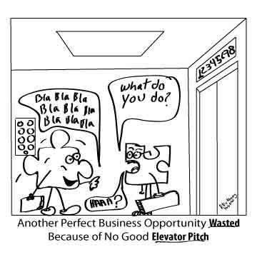
Elevator Pitch
An elevator pitch is a short summary used to quickly and simply define a person, profession, product, service, organization or event, and its value proposition.
It should be possible to deliver the pitch in the time span of an elevator ride, or approximately thirty seconds to two minutes
Source: en.wikipedia.org/wiki/Elevator_pitch

Slide 4
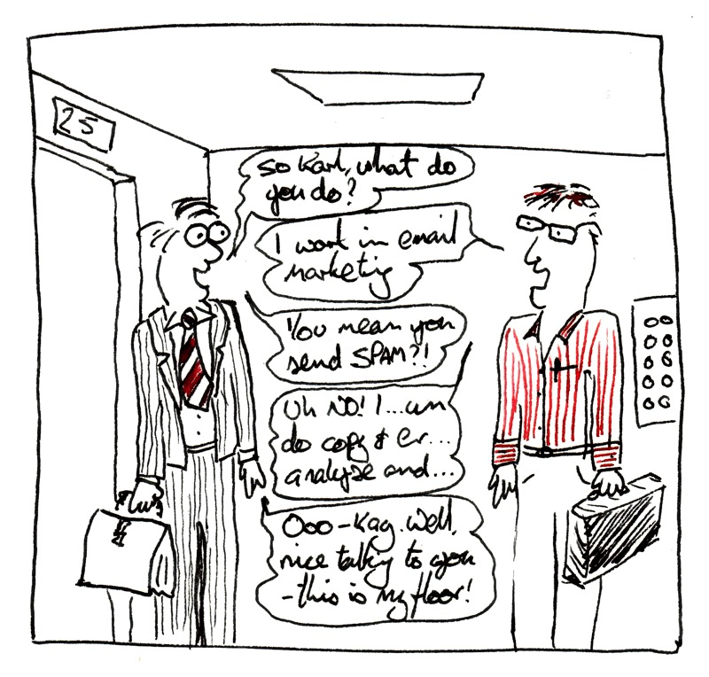
Why should you care?
Important for:
Job interviews
Talking about your research
Conference meetings
You get only one chance to make a first impression.
Being able to sum up unique aspects of yourself, your service or product in a way that excites others, is a fundamental skill.

Slide 5
Why prepare an elevator pitch?
Many interviews start with a question like “Tell me about yourself."
The interviewer doesn't want to know about your childhood.
The interviewer wants to know your background, achievements, future goals, and determine if you are a good fit for XYZ company.
If you learn how to address this open-ended question smoothly and effectively, your interview will start off on a great note.

Slide 6
Example
Hi, my name is Samantha Atcheson, and I am a senior Environmental Sciences major. I am looking for a position that will allow me to use my research and analysis skills. Over the past few years, I’ve been strengthening these skills through my work with a local watershed council on conservation strategies to support water quality and habitats. Eventually, I’d like develop education programs on water conservation awareness. I read that your organization is involved in water quality projects. Can you tell me how someone with my experience may fit into your organization?
Source: career.uoregon.edu/blog/students/2010/04/elevator-speech-30-seconds-interview

Slide 7
Activity – Peer Discussion [3 Minutes]
Why is this a weak pitch: I have spent the last three years in market research. I want to move to a larger platform. I graduated from XYZ university.
Why is this a strong pitch: I have three years of market research experience with expertise in research design, construction of analytical models and data analysis. I developed a new tool using Facebook that was adopted by my last company. I am looking for bigger challenges. I graduated from XYZ university as a marketing major.

Slide 8
Some points that came up in class
Weak – casual tone, only facts but no details
Strong – enthusiastic tone, facts + specific details
has personal emotions
how can he/she use the skills
has defined achievement
expertise is given explicitly
why he/she wants to join the company
shows acquainted with technology

Slide 9
Features of a good elevator pitch
Explain what you do, or what you can offer
Communicate your USP (Unique Selling Proposition)
What should the listener do after hearing you?
Tips:
Should be ~200 words. You should be able say it in ~1 minute.
Cut out any information that doesn't absolutely need to be in.
Practice saying it aloud.
Source: careerservices.wvu.edu/students/build-it/interviewing/developing-your-elevator-speech

Slide 10
Activity [15 Minutes]: Create your elevator pitch
Suppose you are going for a job interview.
Think (Individually) - Create your one minute elevator pitch. Write this down. Make sure you state your target audience.
Pair (with your neighbour) - Examine your neighbor’s pitch for strong features. Help to identify missing features. Eliminate redundant or unnecessary phrases.
Share (with the class) – Mention a point that you liked in your neighbour’s pitch (and why).

Slide 11
Use of Technology
Elevator pitch need not be only a written statement
It can be a prezi, video, code demo, whatever ...
Example: Search for “2 Minute Thesis” on http://phdcomics.com/comics/archive_list.php
Show - T4E 2012 teaser video – Minute 6:30 and 7:45
Show - T4E 2013 teaser video – Minute 10:15 and 18.10

Slide 12
How-to: Technology
Many tools exist for creating short videos, screencast and animations
Some of these tools are: Camstudio, Camstatia Studio, Jing, Screen-o-matic, RecordMyDesktop, and Unity game engine
The websites for these tools have easy-to-follow tutorials for their usage. Simply follow the instructions and create your screencast/ animation

Slide 13
Assignment
1. Read the following for what to include in your pitch:
http://www.wikihow.com/Develop-Your-Personal-Elevator-Pitch
http://www.mindtools.com/pages/article/elevator-pitch.htm
http://www.prepary.com/how-to-create-an-elevator-pitch/
2. Choose one of the following tools and create your pitch:
http://www.techsmith.com/jing.html
http://process.spoken-tutorial.org/index.php/Main_Page#Technology
3. Upload your elevator pitch on your website:
Submit a link to your pitch as the assignment.
Participate in the IITB Elevator Pitch Competition.

Slide 14
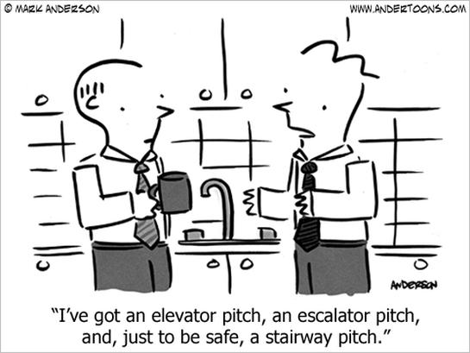
Conclusion
Your elevator pitch is not a static statement
Refine it over time:
As you do more projects
Find better ways to express your contributions
Pitch to different audiences
Load your pitch onto your phone and you are good to go!

