Slide 1
Welcome to this Webinar
The talk will begin in a few minutes
Please Mute your mics and Turn Off your video
Use the chat window to ask questions during the talk

Slide 3
Notes
This set of slides is the Master copy
Use it for a half-day workshop
It has too much details for a one-hour talk
Modify the talk depending on the audience

Slide 4
Acknowledgements
Co-instructor of the course iitb-teachonline - Prof. Sahana Murthy
TAs of iitb-teachonline – Ashutosh Raina and Lucian Ngeze
Co-creators of LCM model – Sahana Murthy, Sameer Sahasrabudhe, Jayakrishnan M.
Post-docs on LCM – Gargi Banerjee, Veenita Shah, Mrinal Patwardhan
Tutorials on Tools – Yogendra Pal, Kameswari Chebrolu, P Sunthar, Bhaskaran Raman, Kannan Moudgalya, Santosh Noronha
TA support for upcoming Moodle course – ET PhD students!

Slide 5
Educational Technology, IIT Bombay
Inter-Disciplinary Program, started 2010
5 Core faculty
Associate faculty from other departments
2 Post-docs
25 PhD research Scholars; 12 PhDs graduated
Started an M.Tech program in 2019
(ET is distinct from CDEEP, which provides lecture recording services)

Slide 6
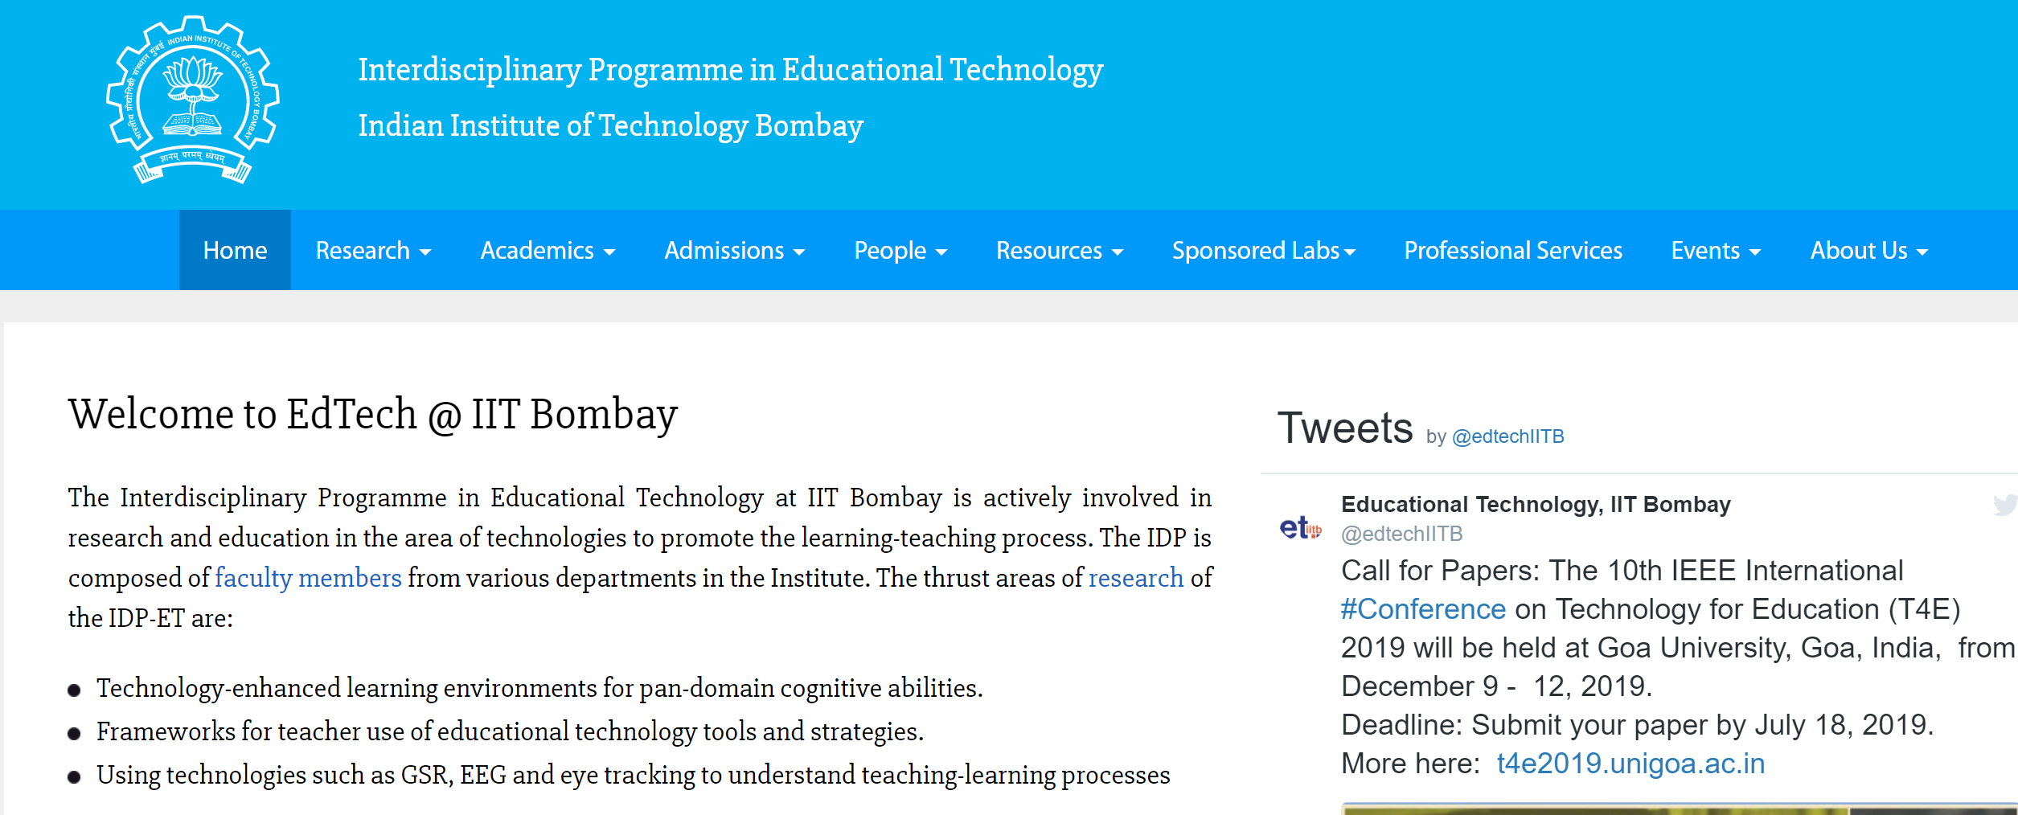
Google - Educational Technology, IIT Bombay

Slide 7
What we do in Educational Technology?
Adaptive and
Personalized
Tutoring Systems
Virtual Reality
Pedagogy & Technology for individual and collaborative learning
Augmented
Makerspace
MOOCs
Games
Learning environments
Eye Tracking
Analytics
Assessment

Slide 8
What do we do? – At a glance
Research:
TELoTS: Technology enhanced learning of thinking skills
TUET: Teacher use of educational technologies
EDA: Educational data analytics
EmergE: Emerging technologies
Development:
MOOCs: Massive open online courses – IITBombayX
Trained 5000+ college teachers, 5000+ school teachers
Handbooks: Resources for ET researchers and teachers
RMET, LOBE, …
Tools: To support teaching-learning process
iQuE, iSAT, CuVIS, …
Consultancy
Outreach
Sponsored Projects
Sponsored Research Labs

Slide 9
Online instruction

Slide 10
Before you begin a Webinar / Live interaction
1) Appoint a moderator: for this session - Prof. Sahana Murthy
To keep track of questions being posted on the chat
To alert the speaker if any question/comment needs immediate response
To ‘pass the Mic around’ during any interaction phase
2) Remind participants of the communication protocol:
Please keep your Mic Muted and Video Off
Speak only when the moderator says it’s your turn
3) Share presentation material beforehand (if possible)

Slide 11
A note about this talk
I set out to make a one hour talk
IT ran away from me and became a three hour tutorial ☺
I couldn’t bring myself to delete any slides
They have so much useful information, I feel ☺
So I have just ‘hidden’ them for this presentation
Please download the ppt file and see the hidden slides for details of any point that interest you

Slide 12
Activity 1 – Each one say one
Consider your idea of online instruction, whatever it may be. Which aspect of face-to-face classes will you miss the most if you have to move to online instruction?
Take a minute to think about your answer.
Post your response in the chat window.

Slide 13
Is your response similar to any in this list?
Making eye contact
Using gestures
Walking around
Seeing students’ faces
Adapting in real-time
Writing on the board
Step-by-step derivation
Interaction
Doing Q & A
Possible occasionally [Video call]
Limited gestures [Video]
Not advisable
Adapting possible [Feedback]
Not always in real-time [Analytics]
Use a tablet [Ex: Wacom]
Possible [Ex: Khan Academy]
Possible, and essential [Forum]
Possible [Forum, VC]
Moving
Online
Notes:
If your response is not in this list, we can discuss it during Q & A.
@Moderator: Note new responses in order to expand this slide.

Slide 14
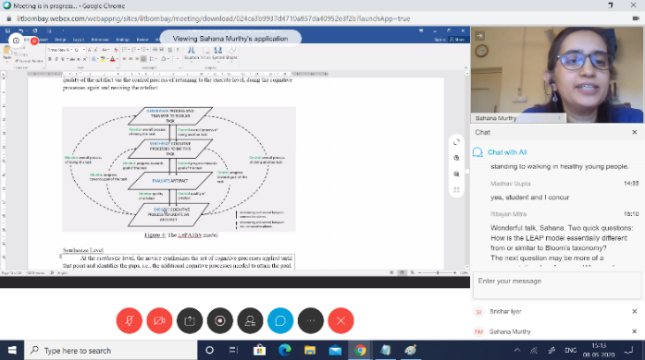
Face-to-Face vs Online classes
Course Materials
60%
70%
40%
30%
Notes:
Online typically involves flipping the classroom.
Make the material available to students; Let them go through it as per their convenience; Do a live interaction

Slide 15
Why bother to change our way of lectures?
What if we do:
Go to a virtual classroom (e.g. Zoom meeting)
Do a live lecture with students who are able to attend
Use the meeting software itself to record the lecture
Make the recording available to students who were not able to attend
Use Moodle to upload resources, give assignments, have discussions and conduct quizzes
Notes:
Seems easy - learn to use the meeting software and to record one’s writing, if required.

Slide 16
Problems with virtual classrooms
Consider from students’ point of view
Access issues
No smart phone
Shared device
Lack of flexibility in schedule
Power, Network
2) Hour-long lecture, and over a screen – engagement?
Notes:
The connectivity, access and affordability for internet varies widely in our country.
Do not assume that students have the same access as you do, or that it is uniform for all students.
Conduct a survey for your class/institute and get to know your local context/reality.

Slide 17
Problems with recorded virtual classrooms
Uploading recordings of live sessions may be useful
Not sufficient because
Glitches in recordings (voice break, frozen frame) – lose student attention
Many students study for the test - even short lectures (~10 min) are not watched fully by most; high variability in student motivation
Network bandwidth issues – connectivity, mobile data plan
Lecture alone not enough – need activities for deeper engagement
Notes:
There is a lot of data and studies to support the above points.
Highly motivated students will find ways to attend virtual classroom, persevere through glitches in recordings.
What percentage of your class falls in this category?

Slide 18
Emergency remote teaching
Giving a lecture in a virtual classroom + Uploading its recording, is a form of emergency remote teaching (ERT)
Primary objective of ERT - provide temporary access to instruction and instructional material in a manner that is quick to set up and reasonably easy to access, during an emergency
Typically, ERT attempts to mimic the actions in a face-to-face class
ERT is likely to be ineffective for student engagement and learning
This mode should be used sparingly (< 20% of the course)
Notes:
Use of remote teaching to deliver instruction that would otherwise be done face-to-face, is not wrong.
ERT is likely to be ineffective for student engagement and learning.

Slide 19
Online instruction
The goal is to exploit the power of the online medium and utilize it to promote effective student learning
Notes:
Attempting to mimic classroom actions in the online medium is not the goal.

Slide 20
Online instruction involves
Making course materials available for asynchronous access
Giving immediate practice activities and timely feedback to students
Conducting synchronous meetings to address queries and do tutorials
Providing a forum for learners to discuss the content with each other and the instructor
Course Materials

Slide 21
Activity 2 – Self-select your level
How comfortable are you with having to do online instruction? Choose the option that best describes you. No need to disclose your choice.
I am comfortable. Ex: I already use Moodle lessons or create flipped class videos or have discussion on Piazza
I think I can manage with some training. Ex: I use Moodle for conducting quizzes. I am comfortable with learning new software
I am daunted by having to move online. Ex: I use only the most basic features in Moodle

Slide 22
What do the options indicate?
Read the conceptual parts of iitb-teachonline course. Take your own decisions about which tools to use.
Go through the course in some detail, both the concepts and the technology tools. Note the recommendations. Do what works for you.
Don’t Panic. Go through the conceptual parts. Your TAs, CDEEP staff and other colleagues are there to help you with the technology parts.
If you chose option 1
(I am comfortable)
If you chose option 2
(I think I can manage)
If you chose option 3
(I am daunted)
Moving
Online

Slide 23
Activity 3 – Identify your concerns
Which aspects of online instruction do you feel daunted by, if any?
Choose all options that apply to you. No need to disclose your choices.
Making videos
Time required to prepare for each class
Using the online platform (like Moodle features)
Interacting with students synchronously (like Zoom meetings)
Doing online assessments
Having to use technologies in general
Uncertainty of technology support from institute

Slide 24
Addressing each concern
Making videos
Time required to prepare for each class
Using the online platform
Interacting with students synchronously
Doing online assessments
Having to use technology in general
Uncertainty of technology support from institute
Plenty of Do-it-Yourself tools
Curate content from open educational resources
Local tutorials by colleagues
Get familiar with features of meeting software
Simple tools exist, and colleagues with expertise
There is no option now!
Several committees are working on it ☺
Moving
Online

Slide 25
Pause here – for feedback to speaker
In a face to face class, I would pause here and say “Is this making sense?”. Then look around the class to get feedback
In this Webinar: Let me ask the same question now,
“Is this talk making sense, so far?”
Please type Yes or No in the chat window
Use the chat window to ask questions during the talk

Slide 26
Concepts overview
LeD
LbD
LxI
Six principles
One slide on each
Notes:
Principles are not sacrosanct. They are recommendations for effective student learning.
Some terminology will be introduced. Please refer www.lcm-model.org for details.

Slide 27
Principle #1
Curate before you create
Notes:
There is a lot of good content already available. Don’t re-invent, instead re-purpose.

Slide 28
For applying principle #1 – Use OER repositories
What: Find Open Edu Resources for your topic
Why: Content creation is time-consuming and effort intensive; There is a lot of good content already available
How:
Use your own previous recordings (if any)
Use a colleague’s, in your department
Use a colleague’s, in another institute (NPTEL)
Find other OER repositories
Create activities for students to assimilate and apply the content
Notes:
Curation is also a creative activity
Check institute policy regarding percentage of a course that can be covered using curated materials

Slide 29
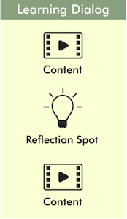
Principle #2
Keep videos short,
and insert reflection spots
Notes:
Don’t do long lectures. Instead chunk them into multiple LeD.

Slide 30
For applying principle #2 – Create Learning Dialog (LeD)
What: Create short videos with pause points
Why: Even short videos are not watched fully
How:
Split your face-to-face lecture into a few chunks (sections within the lecture)
Insert a Reflection Spot into each chunk
Create you LeD

Slide 31
LeD Constructor
What is it: Template and scaffolds to create your LeD
Download from this link
Identify LeD title
Choose your topic
Identify the breakpoints
Give title for LeD
Create LeD outline
Create flow of LeD content
Identify reflection spot position and broad idea for activity
Write LeD script
Create script for content to be recorded before reflection spot
Create activity for Reflection spot; Typically, one or two RS per LeD.
Create script for content after reflection spot
Refine and rehearse
Refine LeD script/slides
Rehearse

Slide 32
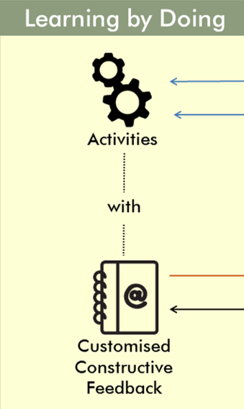
Principle #3
Give practice opportunity,
immediately and frequently,
and give feedback
MCQs, short answer
Objective/Subjective
Notes:
Split your homework into a few chunks, corresponding to your LeDs.

Slide 33
For applying principle #3 – Design Learning by Doing (LbD)
What: Give questions immediately after LeD
Why: Immediate practice and feedback
How:
Split your homework or assignments into a few chunks, corresponding to your LeDs
Plan feedback to be given for the questions
Create you LbD
MCQs, short answer
Objective/Subjective

Slide 34
LbD Constructor
What is it: Template and scaffolds to create your LbD
Download from this link
Identify concepts for LbDs at various cognitive levels
Choose the LeD for which you want to create LbDs
Identify the concept(s) in the LeD for which you want the students to
attain at recall-understand level
do practice at apply level
Create LbDs at Recall-Understand level for concept attainment
Write 2-3 recall-understand level questions for concept attainment
Decide pedagogical & technological format for each question
Design constructive, customized feedback for each question
Create LbDs at Apply level for practice
Write 2-3 Apply level questions for practice.
Decide pedagogical & technological format for each question
Design constructive, customized feedback for each question
Create LbDs at higher cognitive levels for knowledge integration
Choose concepts from multiple LeDs that need to be integrated
Create an activity that requires complex analysis or synthesis
Design feedback
Decide the format for implementing activity & feedback

Slide 35
Principle #4
Provide diverse resources to cater to different students,
and incentivize the access to resources
Notes:
Give an explanation

Slide 36
For applying principle #4 – Provide LxT
What: Provide additional resources to cater to diversity in students
Why: Address prerequisites, advanced material, language
How:
Find OER resources
Incentivize learners with a Quiz
Create you LxT
Notes:
Each Trajectory itself may have diverse types of resources for the same goal
Assimilation Quiz is a recall level question to check if students have accessed a particular resource

Slide 37
LxT Constructor
What is it: Template and scaffolds to create your LxT
Download from this link
Identify Trajectories
List all possible categories
Identify modules/LeDs for LxTs
Prioritize the categories
Identify Resources
Search for resources
Check copyright
Finalize resources
Create Tasks
For each Trajectory create a task that they should do with the resource
Create Assimilation Quiz
Identify an information that learner should see in the resource
Create a question that checks whether the student saw the information

Slide 38
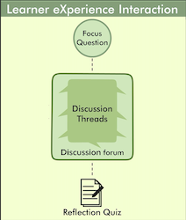
Principle #5
Leverage peer-learning,
to bring in diverse perspectives and solutions,
discover additional resources,
and avoid isolation issues
Notes:
Give an example here

Slide 39
For applying principle #5 – Create LxI
What: Sharing knowledge and perspectives; Utilize discussion forums effectively
Why: Several benefits of peer-learning
How:
Foster meaningful discussions
Write focus question
Incentivize learners to participate
Give a Quiz based on the discussion
Create you LxI

Slide 40
LxI Constructor
What is it: Template and scaffolds to create your LxI
Download from this link
Choose a topic for the LxI
Go through the topic/s of the LeD/s for the module
Decide on a topic which
allows multiple viewpoints which are valuable for discussion
Allows learner to draw upon his/her experiences
Write the focus question
Create a question/activity for your students focusing on the chosen topic
Question/activity should elicits multiple, diverse viewpoints
Provide detailed instructions for
Writing the answer
Reading and commenting on others’ posts
Create the reflection quiz
Write 1-2 questions such that the answers require
reading the responses in the discussion
reflecting on the responses
Expressing about what they learned from others’ posts
Incentivise

Slide 41
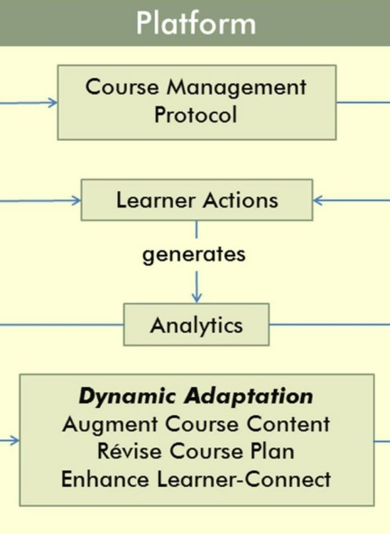
Principle #6
Respond to student actions, in a timely and appropriate manner
Notes:
See how they are doing in the course, what they are saying in the discussion forums.
Adapt instruction, Recognize participation.

Slide 42
For applying principle #6 – Do Orchestration
What: Respond to learner actions as the course progresses
Why: Maintain connect; Keep course on track
How:
Do live interactions once in a while
Communicate frequently using email
Respond to discussion forum posts
Use analytics provided by the platform
Notes:
Write some examples here

Slide 43
The LCM model – operationalizes the principles
www.lcm-model.org
Clarification
Discussions
Lectures
Focus question for discussion + Peer interaction + Reflection Quiz
Learner Experience Interaction
Content + Reflection Spot
Learning Dialogs
LxI
LeD
Orchestration
Additional readings
Self-study material
LxT
LbD
Homeworks
Assignments
Practice problems
Learning Extension
Trajectories
Activities + Customized Feedback
Resources + Assimilation Quiz
Learning
by Doing

Slide 44
Activity 5 – Map your course to LCM
1) Choose the type of your course:
My course has more of:
Lectures and Tutorials (Practice)
Readings and Class discussions
Combination of both of the above
2) Map your course to LCM elements:
– LeD, LbD, LxT, LxI

Slide 45
Mapping for your course
My course has more of:
Lectures and Tutorials (Practice) – Do more LeD and LbD
Readings and Class discussions – Do more LxT and LxI
Combination of both of the above – Do a combination

Slide 46
Transitioning to online - Conceptual summary
Your face-to-face course:
Lectures and Notes
Homeworks, Assignments
Additional Readings
Interesting Debates, Discussions
Proctored Exams
Your corresponding online course:
LeD – chunk each lecture into sections and include reflection spot in each chunk
LbD - chunk each homework into sections corresponding to each LeD and include immediately
LxT – close the loop for additional readings with an Assimilation Quiz
LxI - Give focus questions for discussions and close the loop with Reflection Quiz
Depends on technology and policy
Notes:
Ungraded Assessments can be done using LbD – Give practice questions with self-evaluation rubrics
Graded Assessments can be done using LbD – Give points for each question
Graded Assessments can be done using LxT and LxI – Give points for Assimilation Quiz and Reflection Quiz

Slide 47
Pause here – for feedback to speaker
Let me ask a question now,
“Is this talk making sense, so far?”
Please type Yes or No in the chat window
Use the chat window to ask questions during the talk

Slide 48
Technologies overview

Slide 49
Hardware resources
Capturing lectures
Camera/ webcam
Headphone/ Earbuds
Tablet / Paper
Recorder/ Mobile phones
Editing lecture videos
Laptop/ Desktop
Uploading videos
Server space
Internet (bandwidth)
Institutional Resources
Studios (Recording)
CDEEP (ones used for f2f class)
Smaller studios (offline recording)
Platform (LMS)
Peak load calculations
Server size, Internet bandwidth
Meetings (Live interaction online)
Internet bandwidth, Software licenses

Slide 50
Software resources
Purposes and corresponding technologies
Creating Content
Video creation – Examples: OBS, Screen recorder, Zoom
Activity creation - Examples: Moodle, Mentimeter, Padlet
Delivering Content
Platform – Examples: BodhiTree, IITBombayX, Moodle
Video hosting – Examples: YouTube, Drive, KPoint
Live interaction – Examples – Zoom, Meet, BigBlueButton, WebEx
For details of technologies visit the course page - iitb-teachonline
Notes:
Talk about criteria for choosing technology

Slide 51
What to compare in technology tools?
Video creation – Ease of use, Time taken to render, Size of file, …
Activity creation – Ease of creation, giving feedback, Ease of doing, …
Platform – Ease of use for faculty and students, Support for LCM-based content creation and delivery, Grading and assessments, Analytics, …
Video hosting –Availability (anytime-anywhere), Security, Privacy, …
Live interaction – Scaling, Sharing, Breakout rooms, …
…
Availability of tech-support (within your institute and elsewhere) is an important criteria for comparison, in addition to features.
For comparison of technologies visit the course page - iitb-teachonline
Notes:
Recommendations of specific technologies are not within the scope of this talk. See course page.

Slide 52
Pause here – for feedback to speaker
Let me ask a question now,
“Is this talk making sense, so far?”
Please type Yes or No in the chat window
Use the chat window to ask questions during the talk

Slide 53
Website walk-through
Preparing content
Delivering content
Interacting with students
Making decisions

Slide 54
Activity 4 – Demo
Switch from WebEx window to your browser
Go to https://sites.google.com/view/iitb-teachonline/
Follow along with my commentary to browse the course
Switch back to WebEx window after the demo

Slide 55
Pause here – for feedback to speaker
Let me ask a question now,
“Is this talk making sense, so far?”
Please type Yes or No in the chat window
Use the chat window to ask questions during the talk

Slide 56
Options for your course
Technology choices
Pedagogical strategies
Pros-cons of choices

Slide 57
A good option
Use BodhiTree. It has in-built support to create content as per LCM model
+
Have one live interaction per week (using Zoom or any tool you prefer)
Advantages: Exploits the power of online instruction. Has analytics and exam features
Disadv: Not yet integrated with LDAP login; some learning involved if you are used to Moodle
Alternative platform: Use IITBombayX.
Advantages: Several large scale courses have been held; Support staff available
Disadv: Learning curve to figure out how to implement LCM model in the platform

Slide 58
A good option
Use BodhiTree. It has in-built support to create content as per LCM model
Pedagogical strategy:
Create multiple LeDs for flipped classroom content correspond to a lecture
Create corresponding LbDs for immediate practice
Create LxIs for peer-learning
Create LxTs for addressing diversity
Orchestrate through BodhiTree
Have one live interaction per week, for discussing the flipped classroom content
Advantages: Exploits the power of online instruction. Has analytics and exam features
Disadv: Not integrated with LDAP; some learning involved if you are already used to moodle
Alternatives: IITBombayX, Moodle, provided the features for implementing LCM are used

Slide 59
An acceptable option
Use Moodle + YouTube + Zoom
Pedagogical strategy:
Record your lectures (using OBS or Zoom or CDEEP)
Upload lectures on YouTube or Google Drive and Post the link in Moodle
Create activities, assignments and quizzes in Moodle
Have one live interaction per week (using Zoom or any tool you prefer)
Advantages: Sufficient tech-support available; Low additional investment for Institute
Disadv: Partially utilizes the power of online instruction; Moodle expertise play a major role

Slide 60
An acceptable option
Use Moodle + YouTube + Zoom
Pedagogical strategy:
Record your lectures (using OBS or Zoom or CDEEP)
Do chunking at the level of Lecture #N, sub-topic T.
Include reflection spots in a few chunks
Upload lectures on YouTube/Drive and Post the link in Moodle
Create LbDs – Provide some practice questions (Moodle Quiz) after every chunk
Create LxTs – Provide links to additional resources and a Moodle Quiz to go with it
Live interaction - Do Zoom meeting once a week, for doubts and discussions
Advantages: Sufficient tech-support available; Low additional investment for Institute
Disadv: Partially utilizes the power of online instruction; Moodle expertise play a major role

Slide 61
An emergency option
Use Zoom + YouTube + Moodle
(emergency remote teaching)
Pedagogical strategy:
Do lectures in a virtual classroom (using Zoom or any tool), and record the live sessions
Upload the recording on YouTube/ Google Drive and Post the link in Moodle
Use Moodle features that you are familiar with, to give assignments and quizzes
Advantages: Easy to implement
Disadv: Not learner-centric
Recommendation: Include Activity slides in the live session,
as demonstrated in this talk

Slide 62
Combination of options
Identify the content that you feel you *must* do yourself 50%
Create this content as close to LCM model as you can
Identify the content that is amenable to curation 30%
Find OER resources and give activities
Identify the content that could be left to live session 20%
Do live interaction and upload video
*The percentages are only indicative. They vary depending on institute policy

Slide 63
Pause here – for feedback to speaker
Let me ask a question now,
“Is this talk making sense, so far?”
Please type Yes or No in the chat window
Use the chat window to ask questions during the talk

Slide 64
Time management
Content creation for online instruction takes at least 4X times as compared to the corresponding face-to-face class
Hence:
Curate resources
Give activities to assimilate the content
Get TAs to help with technology
Consult colleagues who have used the technology

Slide 65
Take-away
There is no single correct way of conducting online courses, just as in face-to-face teaching
It is not necessary for all faculty to have the same approach
Be aware of the trade-offs and take considered decisions, not to mimic face-to-face teaching as a default
It is sufficient if you start wherever you are comfortable and go up the levels gradually

Slide 66
Topics not covered in this talk
How to incorporate Virtual Labs
What to do about physical labs
How to conduct remote exams
What to do about proctoring
What about learning analytics
How to use analytics meaningfully
…

Slide 67
What next?
We create a 2 weeks course on Moodle Take you through the modules of iitb-teachonline course
Provide help and feedback for you to create LCM elements
First run of the course – June 1 to June 15, 2020
Will have one live interaction per week
Sign up for getting the synchronous feel of a course, and interesting discussions with other IITB colleagues

Slide 68
Recording of this Webinar
This webinar is being recorded at the request of colleagues who are unable to join. This will be put up on an internal site.
An anonymized version of this webinar, not including any Q&A discussions, will also be put up on the site for review.
If no one has any objection or privacy concerns, the anonymized version will be put up on the course website - iitb-teachonline

Slide 69
Stop here – over to Moderator
Please enter your questions into the chat window
Speak as directed by the moderator
Please type your feedback / criticism for this talk, also in the chat window (or send to me by email –
sri@iitb.ac.in)
Thank You

Slide 70
Download Link This presentation is available at:
Then, Click on ‘Talks’
This presentation is released under Creative Commons-Attribution 4.0 License. You are free to use, distribute and modify it , including for commercial purposes, provided you acknowledge the source.

