Slide 1
epiSTEME 2015
Panel on Large Scale Field Implementations of Educational Technology Projects
17 December 2015
Some NMEICT Initiatives at IIT Bombay
Sridhar Iyer
IIT Bombay
Dept of Computer Science &
IDP on Educational Technology
This presentation is released under Creative Commons-Attribution 4.0 License.
You are free to use, distribute and modify it, including for commercial purposes, provided you acknowledge source.

Slide 2
Preamble: Goals & Metrics of TEL
As ET researchers, we typically focus on interventions, create prototypes, and do pilot implementations on small scale.
What do we usually measure? – Learning, Engagement, …
For larger scale projects, we need more / other metrics.
TEL (Technology Enhanced Learning) metrics:
Effectiveness: learning, perceived usefulness.
Attractiveness: engagement, fun.
Efficiency: ease of access for teachers/students, scaling to numbers.
Accessibility: inclusiveness, handling diversity.
The main role of the technology is one or more of the above.
Keep these in mind as we discuss the following projects.

Slide 3
National Mission on Education Through ICT (NMEICT)
Policy: Government of India is committed to supporting education through effective use of ICT.
www.sakshat.ac.in
Launched in 2009.
100+ projects, 20+ institutions, Rs 6000crore (~1 billion USD)
All content under Open Education Resources
Technology developed under FOSS
Research in Technology for Education
Support for conferences – T4E 2012-16, ICCE 2016.

Slide 4
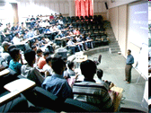
NMEICT Project – T10KT
Teach 10000 Teachers (T10KT) features
310 remote centers
2-4 week long teacher training workshops in Engg
22 workshops – total of 125,000 teachers trained
Blended mode – Live lectures and interactions, with remote / online labs and assignments
http://www.it.iitb.ac.in/nmeict/

Slide 5
T10KT: Some details
Workshops on content
Programming, Computer networks, Thermodynamics, …
Workshops on teaching and research
Educational Technology for Engineering Teachers (ET4ET)
Research Methods in Educational Technology (RMET)
Technical Communication
MOOC
Courses through IITBx - www.iitbombayx.in
3 courses, 50 colleges, 35,000 students, so far
Course on Educational Technology starts Jan 7th, 2016.

Slide 6
T10KT: Some learnings
Findings:
Possible to do large scale professional development, with sound pedagogy, using technology for scaling.
Intention to use from ET4ET, Action research from RMET.
Focus on pedagogy is more important than technology.
We know this intuitively but we also showed it from data.
Immersivity and pertinency are key drivers.
Authentic activities and immersion close to real context is crucial.
Early shift of ownership is crucial for sustainability.
Research work
PhD thesis on model for sustainability and scale.
PhD thesis on analysis of T10KT participants.

Slide 7
NMEICT – Computer tools literacy
www. spoken-tutorial.org
10 min self-learning video tutorials
300+ tutorials developed
22 Indian Languages
~900K students trained in 4 years
www.fossee.in
Specific workshops in open-source tools such as Scilab, Python

Slide 8
Spoken-Tutorials: some details
SELF Workshops (Spoken Tutorial based Education and Learning through Free FOSS study) on:
Basic IT skills – Use of Libre Office suite, Browsers, …
Programming – C++, Java, Python, …
Employability – Blender, InkSpace, …
From July 2011 till date:
~2000 institutions participating
~22000 trainings conducted
~995000 students trained
Community participation for organizing trainings and creating contents

Slide 9
Spoken-Tutorials: Some learnings
Findings:
Feedback of 25,000 participants:
using 5 point Likert Scale (from very bad to very good).
80% of the participants rate the quality of instructional content as “good” or “very good”.
75% rate the overall quality of SELF workshops to be “good” or “very good”.
60% rate the topics of study as “useful” or “very useful”.
Research work:
PhD thesis on effectiveness of teaching-learning of programming through Spoken Tutorials.
Post-doc opportunities also available.

Slide 10
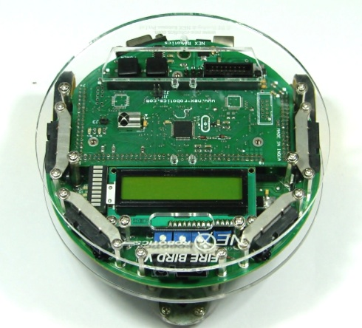
e-Yantra
e-Yantra Robotics Competition (eYRC)
Goal :
Practical orientation Innovative BE Projects
Seeding labs: Robotic kits given to colleges
Mentor students
Students
e-Yantra Robotic Teacher Competition
(eYRTC)
e-Yantra Lab Setup Initiative (eLSI)
Teachers
e-Yantra
eco-system
Colleges
Goal :
Train in theory + hands-on project
Provide methodology for Project Based Learning (PBL)
Goal :
Create infrastructure
Align course +project outcomes with practicals
Empower teachers
Provide innovation platform
eYRC-2012(Pilot) | 4,384
eYRC-2013 | 6,300
eYRC-2014 (ongoing) | 12,428

Slide 11
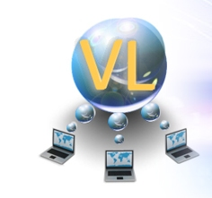
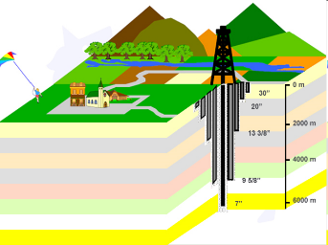
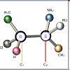
NMEICT Projects
Content generation for higher education
http://oscar.iitb.ac.in
http://www.vlab.co.in
Virtual Labs
500 animations, simulations
Instructional Design workshops

Slide 12
OSCAR: Some details
Interactive animations and simulations for topics:
150 at School level for science and maths.
300 at College level for engineering and science.
Workshops
12 workshops, 600 people trained.
4 workshops on Instructional Design, 8 on Blender skills.
Process
Several models tried for scaling.
Domain-owner model successful.
Downloads
52,000 downloads from 100 countries over 8 years.

Slide 13
OSCAR: Some learnings
Findings:
Difficult but important to create well-designed visualizations.
Example - Attention to aspects of ID, VC, UI, are crucial for usability.
For adoption, sustained teacher training is required.
Example - Workshop at T4E 2015.
Research work:
PhD thesis on incorporating design principles in creating educational visualizations.
PhD thesis on determining the right level of interactivity for a given topic and learning objective.
PhD thesis on training instructors to select and use visualizations in their classrooms.

Slide 14
Other IITB Projects
Content and outreach for CS in schools - Computer Masti
~400 schools in Academic year 2015-2016
500,000 students; 4000 teachers trained since 2009
70,000 views (downloads?) from across 140 countries
http://www.cse.iitb.ac.in/~sri/ssrvm

Slide 15
Computer Masti: Some details
Focus on Thinking process skills:
Step-wise thinking, Logical reasoning, Gathering information, Brainstorming, Mind-mapping, …
Thematic integration:
Connection to real-world scenarios, Application of knowledge from other subjects, Application of CM learning to other subjects.
Spiral curriculum:
Topics are revisited in successive years at greater depth.
Guided-discovery based teaching-learning.

Slide 16
Computer Masti: Some learnings
It is not enough to write a “good” curriculum, we need to write textbooks.
It is not enough to write “good” textbooks, we need to do teacher training.
It is not enough to do teacher training once a year, we need to do periodic visits to schools.
It is not enough to support the implementation, we need to do measurements.
Schools don’t always buy / use / pay for quality!

Slide 17
Reflections: Sustainability at scale
Content creation, such as OSCAR, Vlabs:
Difficult to scale and sustain without continuous influx of funds.
Going beyond download counts requires systematic outreach.
Outreach, such as T10KT, Spoken-Tutorials:
Scale to large numbers; order of magnitude more funding.
Sustainability depends on continued funding, trainers, teams, …
Self-sustaining, such as Computer Masti:
Needs investors willing to take the risk to create a company.
Survival depends on business model – customers, market.
The main competition to high-quality products in education sector is, non-use – Sridhar Rajagopalan, MD, Educational Initiatives

Slide 18
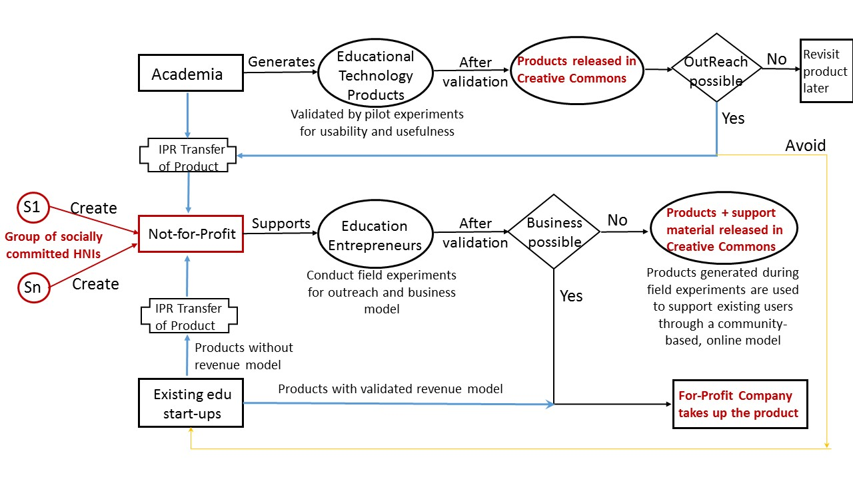
Recommendations Proposed IITB Model for outreach

Slide 19
Upcoming Conferences at IITB
LaTiCE 2016 – March 28th - April 2nd, 2016.
Learning and Technology in Computing and Education.
ICCE 2016 – November 28th – December 2nd, 2016
International Conference on Computers and Education.
T4E 2016 – December 2nd – December 5th, 2016
IEEE International Conference on Technology for Education
ICALT 2018 – IEEE Conference on Advanced Learning Technologies
We have put in a lot of effort to get these conferences to India, so that large number of teachers and researchers can attend.
Don’t Miss Them.

Slide 20
Visit Us
Openings:
Faculty - Short & long-term visits
Students – PhD / Post-doc in ET
Contact information:
Sridhar Iyer sri@iitb.ac.in

Slide 21
Educational Technology Research @ IIT B
Technology Enabled Learning of Thinking Skills
Process skills of pan-domain applicability
Engineering Design, Modeling, Estimation
Data visualization, Representational competence
Computational thinking, Problem posing
Systems thinking, …
Teacher Professional Development
Workshop models, Instruction design, …

Slide 22
Research – sample Ph.D. theses
Development and assessment of engineering design competencies
Spatial skills such as mental rotation of 3D objects
Graph interpretation and data visualization skills
Scientific abilities such as macro-micro thinking (Physics)
Systems thinking (Biology), problem-posing (Computer Science), debugging and trouble-shooting (Computer Science).
Framework for scaffolding programming to Hindi-medium learners
Interactivity enhancing factors for Visualizations in engineering
Development of guidelines to design and evaluate Virtual Labs
Collaborative approach for programming using Spoken Tutorials
Teacher integration of technology in classroom
Framework for customized visualization selection and integration
Automated generation and evaluation of assessment instrument
Constructing customized textbooks from lecture transcripts
TEL of
Thinking Skills
Frameworks for content and skill development
Teacher use of ET
Automation of ET systems

