Slide 1

Think-Pair-Share: An active learning strategy
Experiences from CS 101 + “How-To” for your course
Sridhar Iyer
Dept of CSE &
IDP in Educational Technology
Indian Institute of Technology Bombay
Based on joint work with:
Sahana Murthy, Aditi Kothiyal, and Rwitajit Majumdar
This presentation is released under Creative Commons-Attribution 4.0 License.
You are free to use, distribute and modify it , including for commercial purposes,
provided you acknowledge the source.

Slide 2
What is active learning?
Approach to teaching and learning whose goal is to engage students with the content via specific activities that get students to talk, write, reflect and express their thinking.
  There are several instructional strategies that can come under active learning.
  Many informal strategies may have the same goal, but to be termed as active learning, they need to meet the following requirements.
Requirements of active learning strategies:
Instructor creates carefully designed activities that require students to talk, write, reflect and express their thinking.
Students go beyond listening, copying of notes, execution of prescribed procedures.
Explicitly based on theories of learning.
Evaluated repeatedly through empirical research.
2
Notes:
2

Slide 3
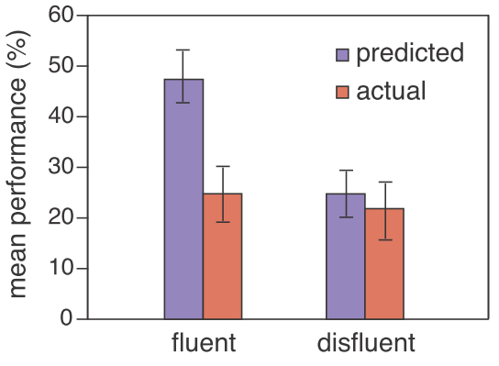
Some evidence for need for active learning
Experiment: 2 video lectures, same content and instructor.
  Fluent mode: speaks fluently, no notes, upright, eye-contact.
  Disfluent: speaks haltingly, often sees notes, “poor” body language.
Measurement: How much learning? Measured by a post-test.
  Predicted: fluent > disfluent
  Finding: fluent = disfluent
Implication:
Improving the fluency of lectures does not necessarily imply better learning. So we need to focus on identifying what does lead to better learning.
3
doi: 10.3758/s13423-013-0442-z
Notes:
3

Slide 4
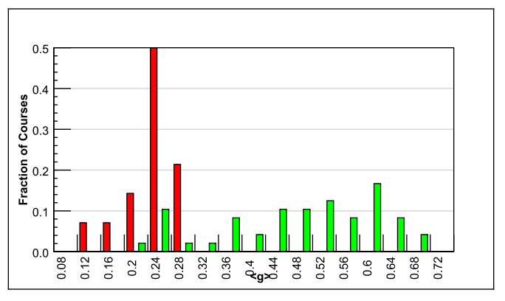
Gains from active learning strategies
6542 students
62 courses - Physics
Variety of institutions: high school, college, university (including Harvard)
Test used – FCI (Force Concept Inventory)
Trad lecture (14)
Active learning strategies (48)
Normalized gain
<g> = ^{post-pre} ^{100-pre}
Maximum gain from lecture courses was 0.28
  Many instructors had high scores on teaching evaluations
Gain from active-learning courses had a wide range: 0.23-0.7
  Active learning courses often had gains 2-3 times greater than lectures
Implication: It is desirable to explicitly incorporate active learning strategies in our teaching-learning process.
R. Hake, “Interactive-engagement versus traditional methods: A six-thousand student survey of mechanics test data for introductory physics courses” Amer. Jour. Phy., 66 (1998)
Notes:
4

Slide 5
Features of active learning strategies
Students engage in problem-solving activities during class time.
Speciﬁc student ideas are elicited and addressed.
Students are asked to “ﬁgure things out for themselves.”
Students are asked to express their reasoning explicitly.
Students work collaboratively.
Students receive rapid feedback on their work.
Qualitative reasoning and conceptual thinking are emphasized.
5
Notes:
5

Slide 6
What are some active learning strategies?
Think-Pair-Share [Frank Lyman, University of Maryland, early 1980s]
Peer-Instruction [Eric Mazur, Harvard University, early 1990s]
Team-Pair-Solo [Spencer Kagan, University of California, early 2000s]
Many others:
  Debates, Role-play, Jigsaw, problem-based learning, productive failure.

Slide 7
Think-Pair-Share: Activity - 1
Consider a large class. Example: CS 101; 450 first year UG students, across various engineering disciplines.
Imagine a 90-minute class in a large auditorium with fixed seats.
Think (Individually):
  Predict the percentage of students who may be showing “engaged” behavior (with the content of the lecture), at various instants of time.
  Draw a graph of engagement versus time. [~1 Minute]
Percentage of
students engaged
% e
Pause here: Do this task before moving on
t (Time instant of lecture)

Slide 8
Think-Pair-Share: Activity - 1
Consider a large class. Example: CS 101; 450 first year UG students, across various engineering disciplines.
Imagine a 90-minute class in a large auditorium with fixed seats.
Think (Individually):
  Predict the percentage of students who may be showing “engaged” behavior (with the content of the lecture), at various instants of time.
  Draw a graph of engagement versus time. [~1 Minute]
Pair (with your neighbor):
  Examine each other’s graphs. [~1 Minute]
  Together, come up with two techniques that could be used to convert your graph into something that looks like the figure shown. [~3 Minutes]
0.8
% e
Pause here: Do this task before moving on
t

Slide 9
Think-Pair-Share: Activity - 1
Consider a large class. Example: CS 101; 450 first year UG students, across various engineering disciplines.
Imagine a 90-minute class in a large auditorium with fixed seats.
Think (Individually):
  Predict the percentage of students who may be showing “engaged” behavior (with the content of the lecture), at various instants of time.
  Draw a graph of engagement versus time. [~1 Minute]
Pair (with your neighbor):
  Examine each other’s graphs. [~1 Minute]
  Together, come up with three techniques that could be used to convert your graph into something that looks like the figure shown. [~3 Minutes]
Share (entire class):
  Create a combined list of techniques. [~2 Minutes]
  Discuss pros and cons of each technique. [~2 Minutes each]
  Identify top three techniques that are likely to “succeed”. [~3 Minutes]
Points that came up in Share phase are noted in file tps-notings-idp-Dec2013.txt
0.8
% e
t

Slide 10
Think-Pair-Share (TPS)
What is TPS? - Illustrated through activities on earlier slides.
  Definition follows on the next slide.
Why use TPS?
  Well known challenges to teaching-learning in large classes – more easy for students to tune out and get distracted into using their mobiles, talking, or other off-task activities.
  Active learning techniques that engage the entire class are required.
  TPS is a relatively easy way to achieve the benefits of small group cooperative learning in a large class.
  Formative assessment (rapid feedback that can be acted upon) is possible.

Slide 11
TPS: Definition
Collaborative, active learning strategy, in which students work on a problem posed by instructor,
  first individually (Think), then in pairs (Pair) or groups, and
  finally together with the entire class (Share).
T (Think): Teacher asks a specific question about the topic. Students "think" about what they know or have learned, and come up with their own individual answer to the question. [Takes 1-3 Minutes].
P (Pair): Teacher asks another question, related to the previous one, that is suitable to deepen the students’ understanding of the topic. Each student is paired with another student. They share their thinking with each other and proceed with the task. [Takes 5-10 Minutes].
S (Share): Students share their thinking (or solution) with the entire class. Teacher moderates the discussion and highlights important points. [Takes 10-20 minutes].

Slide 12
TPS: Benefits
Why does TPS work?
  Students are actively engaged.
  Students learn from each other (social process, teach=>learn).
  Students can tackle large and ill-structured problems, and develop the ability to consider multiple points of views.
Other benefits:
  Makes class interactive.
  Students realize that even others are struggling.
  Builds a friendly, yet academic atmosphere.
  Includes all the students in the teaching-learning process.

Slide 13
Think-Pair-Share: Activity – 2
Consider an instructor who says: “My lectures are interactive. I show visualizations and demos. I ask questions to students, and encourage them to ask questions. My class proceeds based on these questions and answers.”
  Think (Individually): Write down 2-3 reasons for why this may not be an effective strategy. [~1 Minute]
Points mentioned by audience are noted in file tps-notings-idp-Dec2013.txt
Pause here: Do this task before moving on

Slide 14
Think-Pair-Share: Activity – 2 (Skip)
Consider an instructor who says: “My lectures are interactive. I show visualizations and demos. I ask questions to students, and encourage them to ask questions. My class proceeds based on these questions and answers.”
Think (Individually): Write down 3-4 reasons for why this may not be an effective strategy. [~1 Minute]
Pair (with your neighbor): Select one reason from your list, and come up with a way in which you can rectify it. [~2 Minutes]

Slide 15
Think-Pair-Share: Activity – 2 (Skip)
One of your colleagues says: “I don’t just lecture. My classes are interactive. I show visualizations and demos. Students can ask questions in my class. I also ask questions to students. The class proceeds based on these questions and answers.”
Think (Individually): Write down 3-4 reasons for why this may not be an effective strategy. [~1 Minute]
Pair (with your neighbor): Select one reason from your list, and come up with a way in which you can rectify it. [~2 Minutes]
Share: [~5 Minutes]
  Create a combined list of reasons and corresponding strategies.
  Discuss strategies that can cater to multiple reasons.

Slide 16
Why ‘interactive lectures’ are not enough
Some reasons:
Students dont pay utmost attention.
Students think that they know (understand) the topic because they are able to follow the lecture.
  They are not confronted with their misconceptions immediately.
It is difficult to ensure that all students in the class participate actively.
  Students with high motivation and achievement levels drive the pace.
  Students with low achievement levels get left behind.
Students have a barrier to responding directly to the instructor.
  Shy students dont ask questions, or give answer, even if they have one.
  Tactics that force all students to respond tend to be counter-productive.

Slide 17
TPS in CS 101

Slide 18
Goals
Instructional Goals: standard CS 101 context
  Students should be able to read code, trace code, write code.
  Students should be able to demonstrate conceptual understanding.
  And (since multiple valid solutions may exist), students should be able to analyze the pros and cons of various solutions.
Pedagogical Goals:
  Incorporate active learning techniques a large classroom setting - keep students engaged with the content, with the instructor and with each other - through Writing, Talking, Reflecting.
  Encourage a student to come up with his/her idea of the solution first.
  Get students to work with each other for detailing, so that they do not feel daunted by the task.
Our chosen technique – TPS.
Research Goal: Quantify the engagement & learning due to TPS.

Slide 19
How we implemented TPS
Think:
  The instructor posed a question like predict the output or write the pseudo-code.
  The students worked individually on the task.
  About two minutes.
Pair:
  The instructor gave a task related to the Think phase, such as check your neighbor’s solution, or work with your neighbor to write the detailed code for the given problem.
  The students worked with one of their neighbor’s to complete the task
  Three to five minutes.
Share:
  The instructor facilitated a class-wide discussion related to the tasks in the Think and Pair phases.
  Students participated in the discussion to verify their solution, propose alternate solutions, and discuss ‘what-if’ scenarios.
  Open ended, lasting from three to fifteen minutes depending on the intensity of the discussion.

Slide 20
TPS in CS 101: Example 1 (conceptual)
“Consider an unsorted array of N elements”.
Think: Write the pseudo code for sorting the array.
  Students do: Write down answer the given question.
  Instructor does: Encourages students to write, instead of working mentally.
Pair: Discuss your answer with your neighbor, do pros and cons analysis of your algorithms.
  Students do: (i) Identify parts of the answer that they have missed out. (ii) Discuss which answer is better; do pros-cons analysis if there are multiple solutions.
  Instructor does: (i) Walks around the class to get a feel of student solutions. (ii) Gives comments where necessary, to ensure that discussion is on-track.
Share: Participate in discussion of your solution and others.
  Students do: (i) Share their own solution. (ii) Critique other’s solutions.
  Instructor does: Discusses (i) What are all the essential parts in the answer? (ii) Pros-cons of various solutions given by students.
This TPS activity led to a discussion of various sorting algorithms.

Slide 21
TPS in CS 101: Example 2 (detailing)
Learning outcome
  “Students should be able to write programs for given task (using threads in Scratch)”.
Problem statement
  “Recall the drag-and-drop game demo that we saw in the last class. You and your neighbor have to now create this game. One of you has to write the script (code) for the 'trashcan' object (sprite) while the other writes the script for the 'falling trash' sprite.”
Think (3 minutes)
  Individually, students wrote the pseudo-code for their chosen sprite.
Pair (5 minutes)
  Along with their neighbor, each student wrote the code to interface his/her sprite with its counterpart written by the neighboring student.
Share (8-10 minutes)
  Instructor elicited responses from a few pairs and discussed their solution details. Pairs that had used different approaches from the ones discussed were encouraged to speak. Instructor summarized some solution approaches and their pros and cons.

Slide 22
TPS in CS 101: Example 3 (design)
Write a program to manage your ‘Contacts’ information.
  You need to store the following information about each contact – Name, Phone number, Email id.
  You need to provide functions to – Input, Lookup, Update and Delete – information.
Think: How will you store the information? Write the C++ class declarations for the data structures.
Pair: Discuss with your neighbor’s answer and agree on the class declarations. Together, write the code for the functions.
Share: Participate in discussion of your solutions and others.

Slide 23
Did it work?
We measured student engagement and learning:
  Observed a total of 13 TPS activities across the semester.
  Used data from 8 activities to create, validate and establish the reliability of our observation protocol (example given on a later slide).
  Reporting findings and inferences from the remaining 5 TPS activities.
  One 2-group experiment to measure learning with and without TPS (not yet published).
Quantified student engagement levels
  83% of students on average mostly or fully engaged.
  Predominant behaviors displayed were
    writing the solution to the problem (Think),
    discussing with neighbour or writing (Pair),
    and following the class discussion (Share).
  Students self-perception of engagement matches our measurements.
A. Kothiyal, R. Majumdar, S. Murthy and S. Iyer, “Effect of Think-Pair-Share in a large CS1 class: 83% sustained engagement” ACM International Computing Education Research (ICER) Workshop, San Diego, 2013

Slide 24
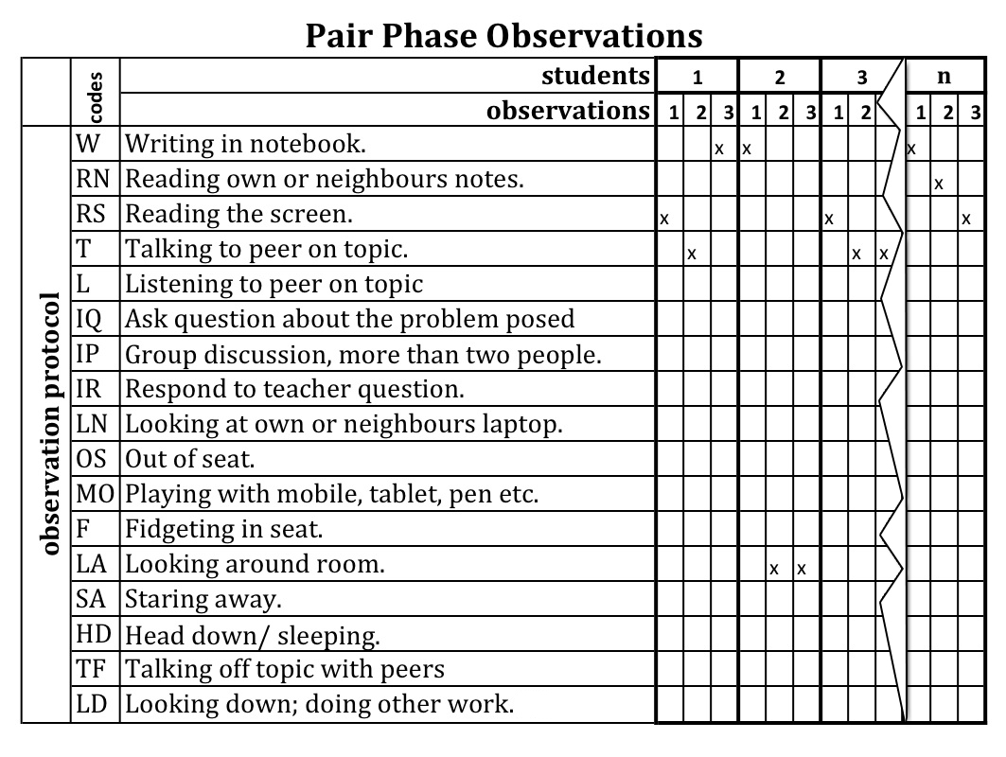
How did we measure? - Observation Protocol

Slide 25
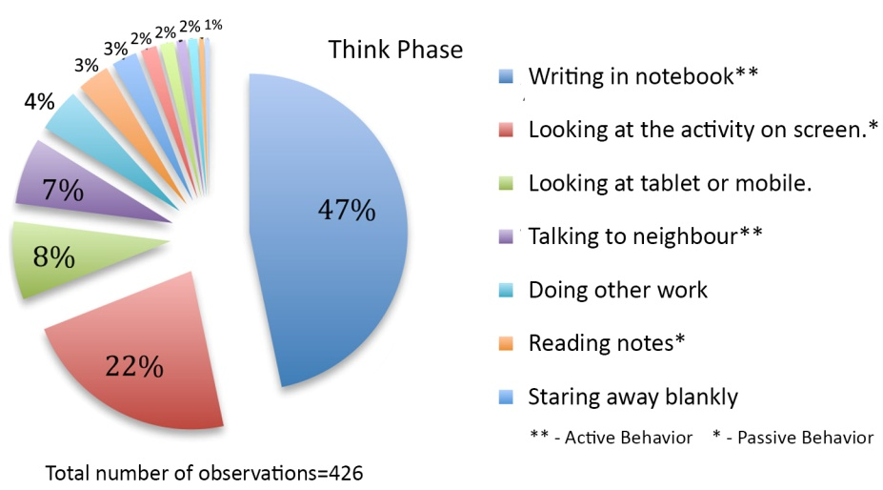
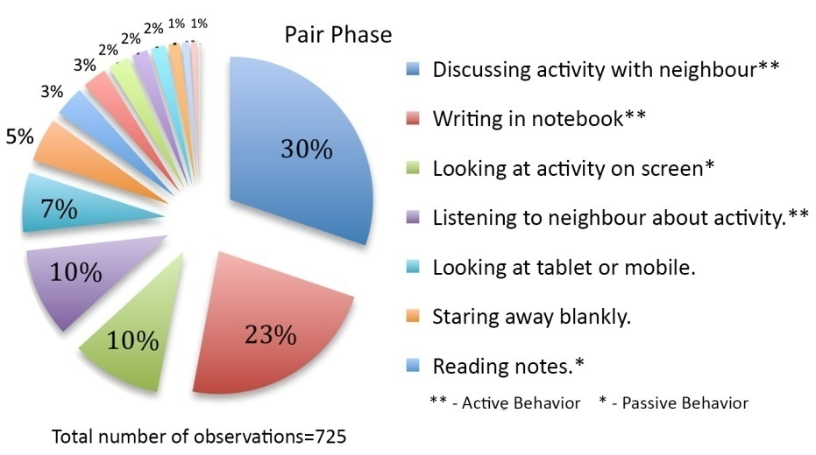
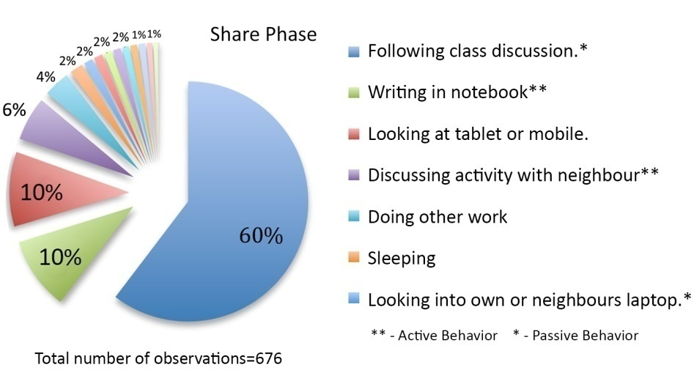
Frequencies of behaviors in each phase

Slide 26
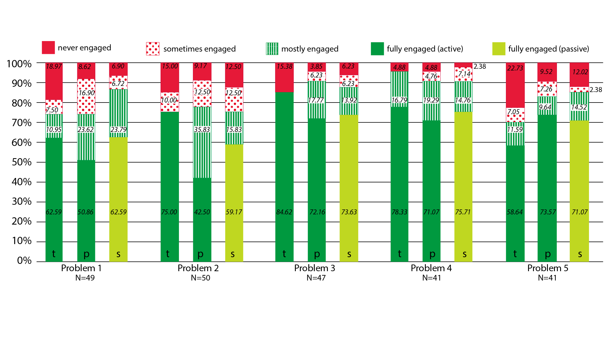
Average classroom engagement levels

Slide 27
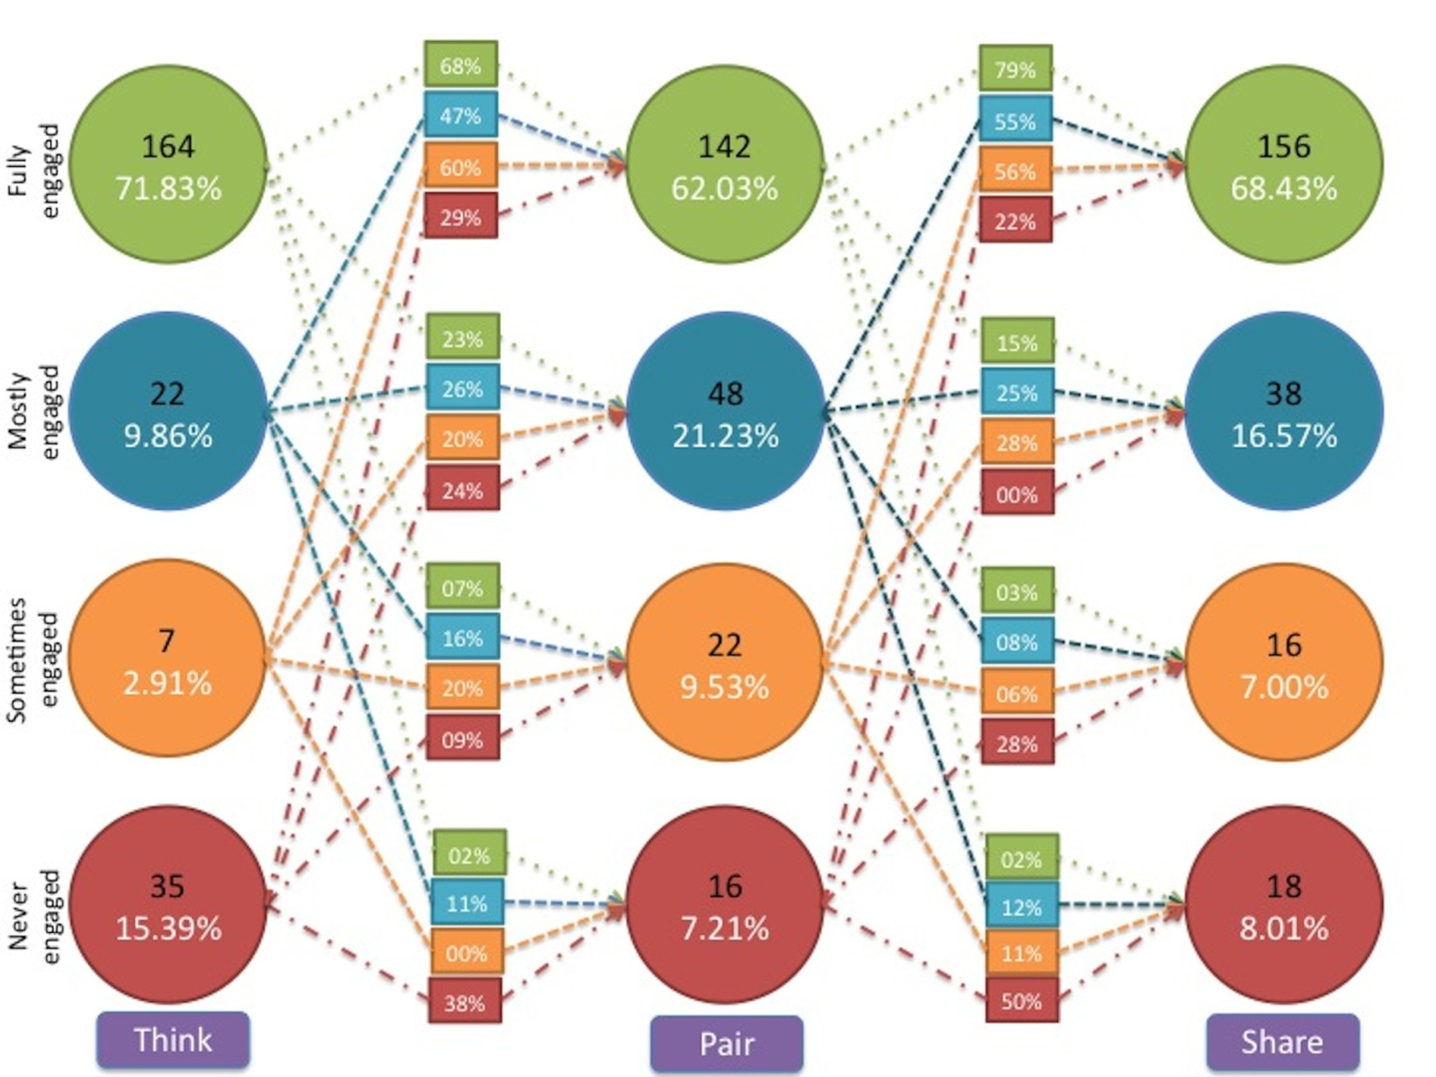
Student behavior transition model

Slide 28
How did we triangulate? - Engagement survey
Measured self-reported student engagement during the TPS activities.
Two questions on a 5 point Likert scale:
  How frequently did you write the solution to the problem given by the instructor during the think phase?
  How frequently did you discuss your solution with your partner during the pair phase?

Slide 29
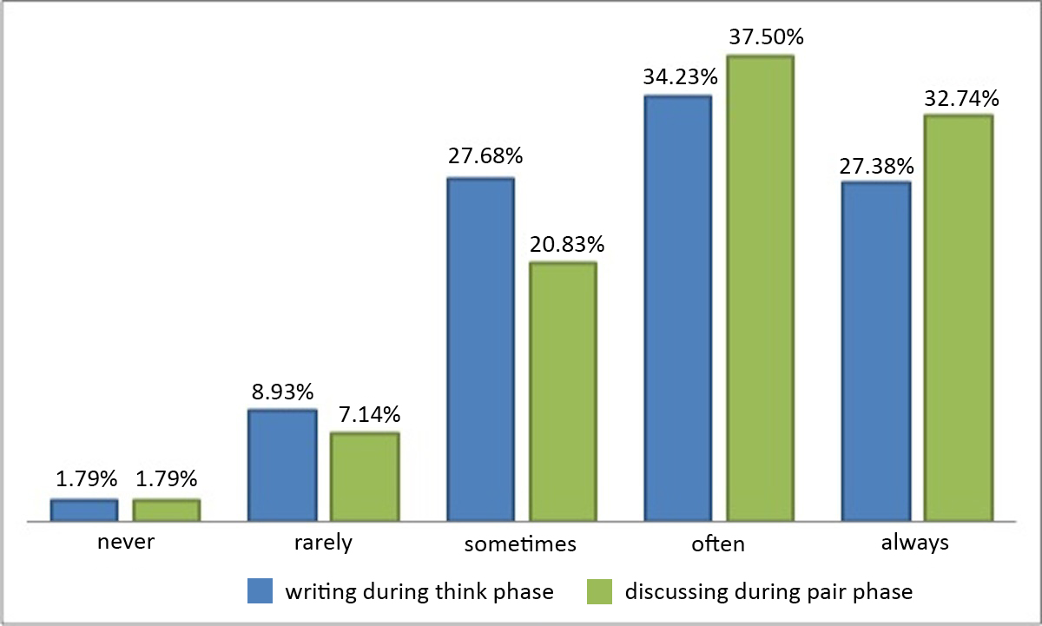
Survey questions - responses

Slide 30
TPS and learning
Two-group, quasi-experimental study:
  One section was the experimental group (263 students), which received a TPS treatment, and the other was control group (184 students), which received a regular interactive lecture. Same instructor for both groups.
  In the interest of fairness, we restricted the study to one lecture only.
Topic: CPU execution sequence of multiple threads.
  Concept is new to both novices and advanced learners, so their prior knowledge does not play a role.
TPS Treatment:
  Think: Write one possible interleaved execution sequence.
  Pair: Check your neighbors’ solution. If it is the same as yours, come up with a second possible interleaved execution sequence.
  Share: Identify differences in your solution with one given by the Instructor.
Post-test:
  Problem on thread interleaving, similar to the one discussed. Included as the last part of Quiz1 – in the class following the above activity.

Slide 31
Results: TPS and learning
Post-test scores
Experimental Mean (SD) | Control Mean (SD) | p-value | Difference
1.91 (1.65) | 0.88 (1.38) | 0.00 | Significant at p<0.05
Perception of learning
Likert scale survey | Agree (%) | Neutral (%) | Disagree (%)
Thinking about the problem and writing the solution during the think phase helped me learn CS1 concepts. | 72 | 21 | 7
Discussing my solution with my partner during the pair phase helped me learn CS1 concepts. | 67 | 24 | 9
Listening to other students' solutions and discussion during the share phase helped me learn CS1 concepts. | 73 | 21 | 6
I would not have learned as much from the lecture if there had been no think-pair-share activities. | 58 | 29 | 13

Slide 32
Confirmation: focus group interviews
“The think and pair parts were equally important. Unless we think on our own, we won’t get to know at what level we are. When we were made to think on certain questions we realize that these are some places we get stuck. We discuss those things with our partner, we realize that he overcame this problem in a certain manner and then we may come up with better solutions. So that’s a way of learning.”
“In a class of 240 you can come with 4 or 5 different solutions. […] In that half an hour [of TPS] we are able to learn five methods of solving a problem and pros and cons of each method. That’s more that you can learn in an hour.”

Slide 33
Snippets from cs 101 course evaluation
“Think-Pair-Share activity proved useful in clearing the doubts and building confidence in the course.”
“The think-pair exercises were nice. They stimulated our thinking process.”
“He came up with very innovative exercises such as Think-Pair-Share which further improved our understanding of the course.”
“Think, Pair, Share was a good idea, but sometimes it was more than needed. Anyhow, overall it was good.”
“Used Think Pair Share very effectively. This involved everyone. However, pace was often slow.”
“His methods were innovative but I couldn`t connect to.”

Slide 34
Summary of findings
Engagement:
  70% to 95% of students are engaged, averaging out to 83%
  Observations triangulate well with self-reported engagement.
  Student who is fully engaged in the think phase is likely remain engaged with probability 0.68 (see state-transition diagram).
  Significant probabilities (0.47, 0.6) that students from lower engagement states in think phase will move to higher engagement states in pair phase.
Learning:
  Group which learned a concept via a TPS-activity performed significantly better (with a moderate to high effect size) than the group which learned the same concept from an interactive lecture.
  Students approved of a TPS-based classroom environment, and felt that they would not have been able to learn CS1 as well had they not performed the TPS activities.

Slide 35
TPS in your class

Slide 36
Resource sheet
Look at the TPS-activity-constructor resource sheet handout given.
  Download from www.et.iitb.ac.in/resources
Think (Individually): Do Part 1 of the handout.
  Write questions for one TPS activity in your course . [~3 Minutes]
Pair (with your neighbor): Do Part 2 of the handout.
  Get feedback on your TPS activity. [~2 Minutes]
Share: Get more ideas by listening to TPS activities of others.
Pause here: Do this task before moving on

Slide 37
Summary of TPS setup guidelines
Three points to keep in mind:
  Ensure that there is a clear ‘deliverable’ for each phase. This drives the action in that phase.
  Ensure that the phases are logically connected. They should use the output of one phase in next.
  Ensure that there is sufficient time for each phase.
  Too little → Frustration; Too much → Boredom.
  Move on when 80% of the class has finished.

Slide 38
Announcements
Slides, TPS resource sheet and video will be up on:
  IDP-ET website: www.et.iitb.ac.in/resources
Contribute an appendix of TPS activities for your course, based on the TPS activities that worked in your class.
  This will be useful to other instructors who plan to implement TPS. If interested, send mail to convener.et@iitb.ac.in
My contact information:
  Sridhar Iyer, Dept of CSE, IIT Bombay, Powai, Mumbai 400076.
  sri@iitb.ac.in
  www.cse.iitb.ac.in/~sri

